Slide 1
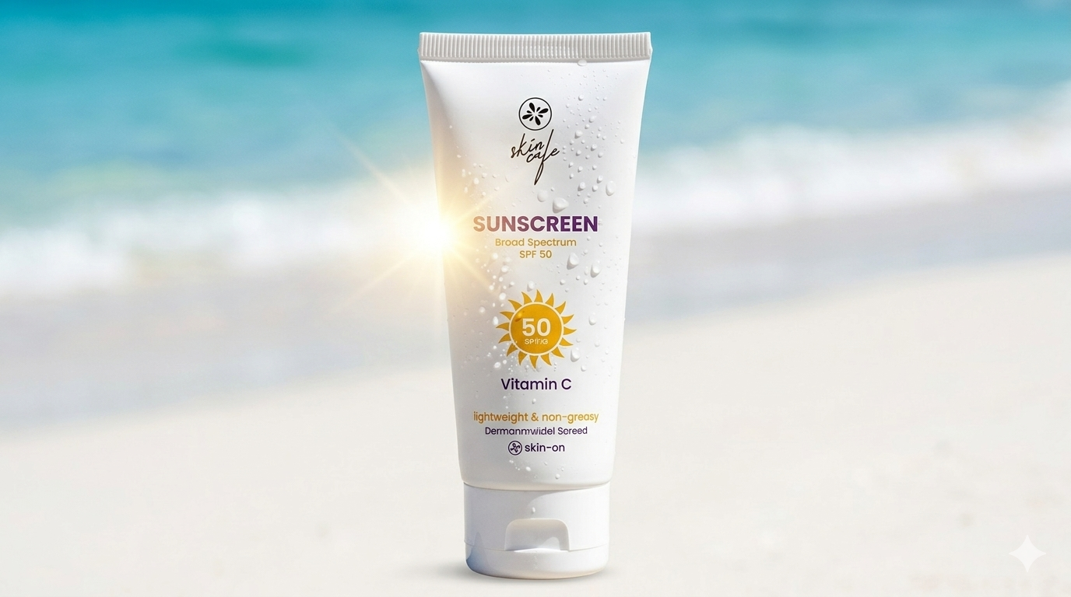


Skin Cafe Sunscreen Marketing Strategy
A Trust-Driven Marketing Strategy to Make
Sunscreen a Daily Habit

Slide 2


Situation Analysis
Where we are
Where we want to be
Trust gap toward local skincare brands
Market dominated by foreign skincare brand
Low male participation in skincare
Low awareness about UV protection
Strong trust toward local skincare brands
Skin Cafe positioned as a trusted alternative to foreign brands
Higher male engagement in sunscreen usage
Increased awareness about daily UV protection and sunscreen benefits
ANALYSIS
PLANNING
EXECUTION
EVALUATION

Slide 3


Consumer Analysis
Target Consumers
Buying Behavior
Age Group: 18–30
Urban & semi-urban youth
Social media-driven consumers
Students and young professionals
Trust influencer and peer reviews before purchase
Compare local brands with foreign alternatives
Highly price-sensitive but quality-conscious
ANALYSIS
PLANNING
EXECUTION
EVALUATION

Slide 4


Trust Barrier and Market Challenges
Trust Barriers
Strong perception that foreign brands are safer
and more effective
Fear of counterfeit and low-quality skincare products
Limited trust in locally manufactured cosmetics
Lack of scientific skincare awareness among consumers
Market Challenges
Highly competitive skincare market
Consumers highly sensitive to price
Sunscreen still not part of daily routine
Difficulty differentiating local brands from competitors
ANALYSIS
PLANNING
EXECUTION
EVALUATION

Slide 5
রোদ থাকুক বাইরে, সুরক্ষা থাকুক ত্বকে
Strategic approach for trust building,
Core campaign idea and creativity
ANALYSIS
PLANNING
EXECUTION
EVALUATION

Slide 6
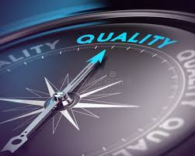




Trust Building Strategy
Get Doctor to Say it works
Prove of quality
Show lab certificate
Telling where the ingredients come from
Breaking the Myths
Using Real Reviews
ANALYSIS
PLANNING
EXECUTION
EVALUATION

Slide 7
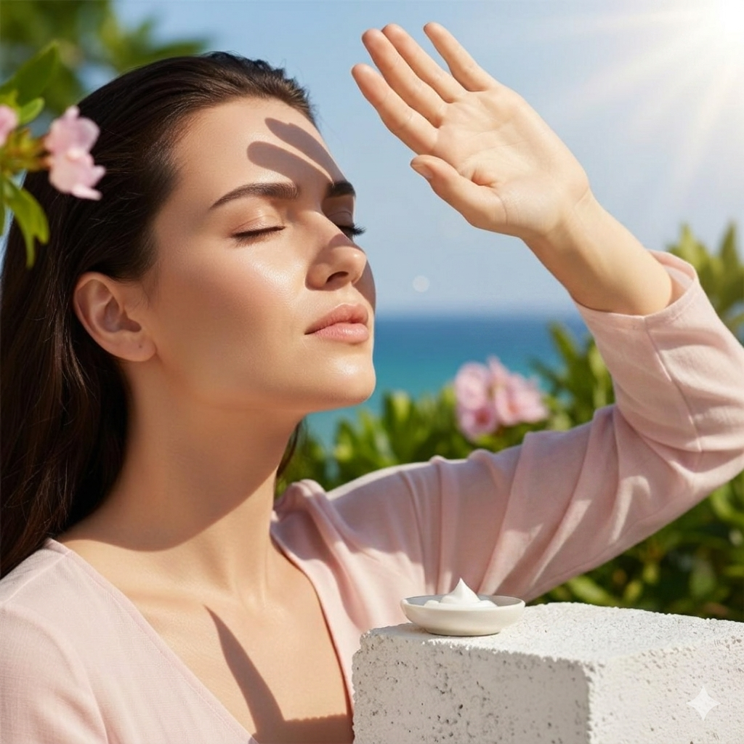
Campaign Strategy
Tag Line
রোদ থাকুক বাইরে,
সুরক্ষা থাকুক ত্বকে
ANALYSIS
PLANNING
EXECUTION
EVALUATION

Slide 8
Campaign Strategy
Advertise through influencer
Social media
In Campus Stalls
Visible posters and leaflets
in high-traffic areas
ANALYSIS
PLANNING
EXECUTION
EVALUATION

Slide 9
Channel Strategy
Online Integration
Offline Integration
Sajgoj, Aroggo, Renowed FB Page
Super Shop, Harlen Store
ANALYSIS
PLANNING
EXECUTION
EVALUATION

Slide 10
Quarter | Strategic Theme | Product | Price | Place | Promotion
Q1 (Jan–Mar) | The Winter-to-Spring Transition | Finalize batch production. • Run shelf-life & leakage stability audits on tubes. Prepare travel/mini-size sample tubes. | • Anchor standard retail pricing (e.g., ৳650–৳700 range). Lock in wholesale margins for beauty retailers. | Partner with skincare e-commerce platforms (Daraz, The Mall BD, etc.). Pitch to physical pharmacy & beauty counters. | The "Clouds Don't Block UV" Campaign: Educate on indoor/winter UV damage. Send PR seeding boxes to micro-influencers for honest formulation reviews.
ANALYSIS
PLANNING
EXECUTION
EVALUATION

Slide 11
Financial Budget Allocation (sector)
ANALYSIS
PLANNING
EXECUTION
EVALUATION

Slide 12
Challenges & Feasibility
Dominance of Foreign Competitors
Competitive pricing & localized positioning
Low Trust in Local Brands
Science-backed communication & real consumer reviews
Limited UV Protection Awareness
Educational content & awareness campaigns
Low Male Sunscreen Usage
Gender-inclusive campaigns & influencer engagement
ANALYSIS
PLANNING
EXECUTION
EVALUATION

Slide 13
Thank You

