Slide 1
Closure
A closure is an anonymous function that can capture variables from
the environment where it is created.
The beauty of clouse is: Normal functions cannot automatically
use variables outside themselves. Closures can.

Slide 2
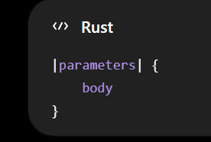
Closure syntax
let square = |x: i32| -> i32 {
x * x
};

Slide 3
Closures Can Be One Line
let double = |x| x * 2;
println!("{}", double(10));

Slide 4
An ideal example of a closure
fn main() {
let bonus = 10;
let add_bonus = |x| x + bonus;
println!("{}", add_bonus(5));
}

