Slide 1

Workshop on Computer Vision Fundamentals
Reeshoon Sayera

Slide 2
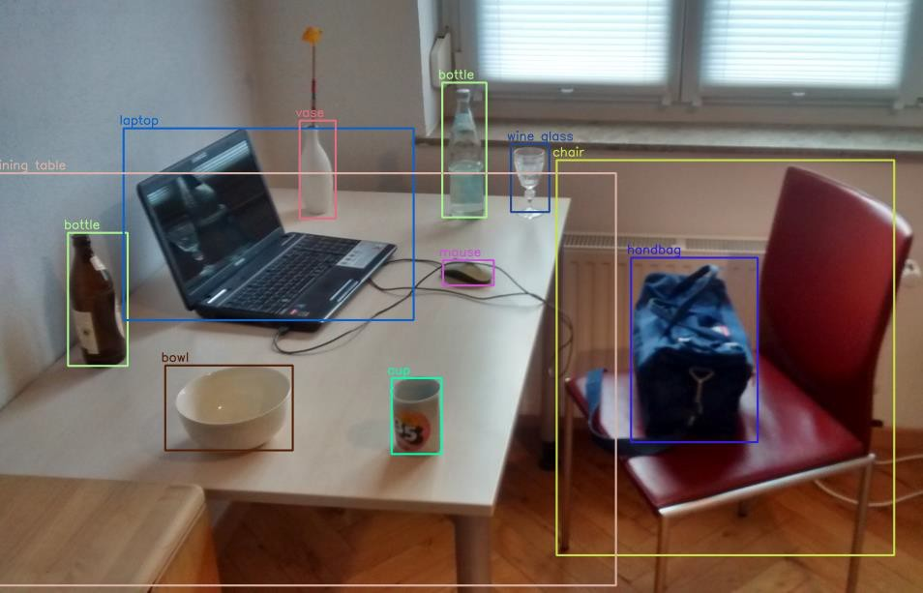
What is Computer Vision
Ability of Computers
  To understand visual data
    For example: images, videos
  Automate tasks
    Which human visual system can perform

Slide 3
Visual Perception
How do we know that the objects that we see are for real?
Can people “see” without being aware of what they see?
Why do objects appear colored?

Slide 4
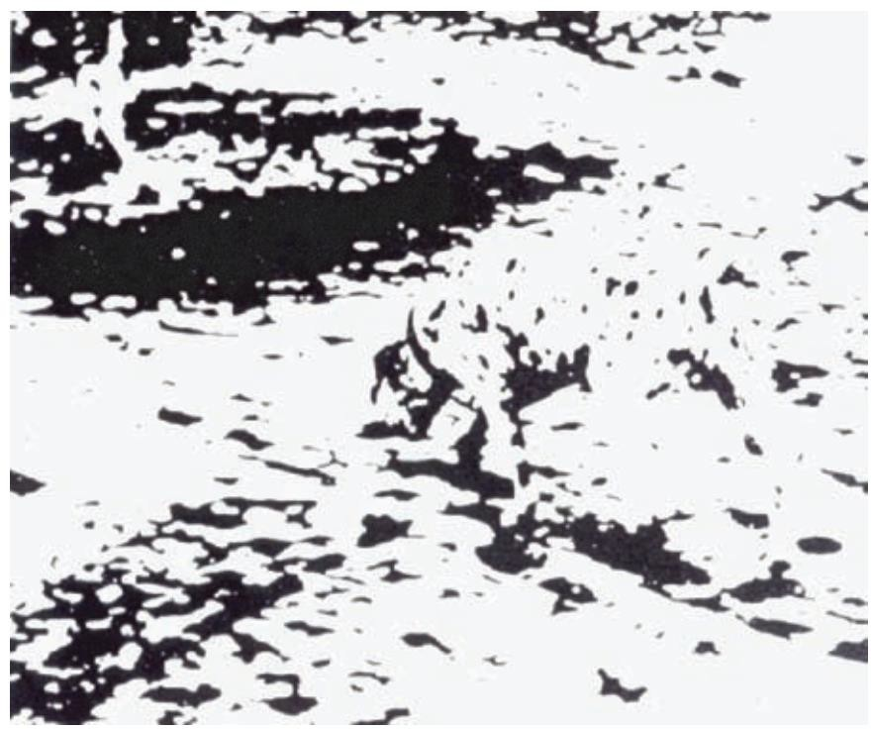
What can you see in this picture?

Slide 5
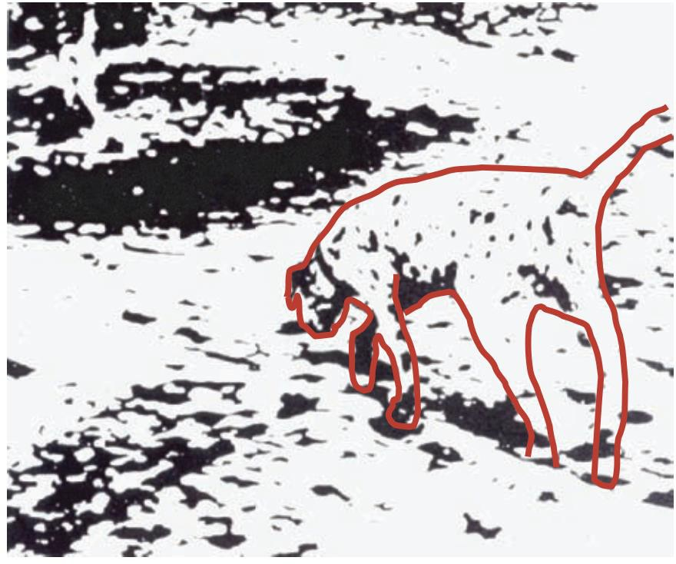
Now what can you see in this picture?

Slide 6
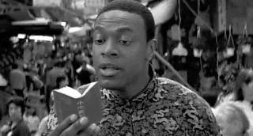

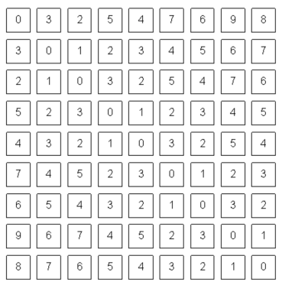
Goal of Computer Vision
To bridge the gap between
  image pixels and “meaning” (semantic)!
What we see!
What computer sees!

Slide 7
Motivation
Why learn computer vision?

Slide 8
Because
Find it interesting!
Out of curiosity!
Good job market!

Slide 9
Recent advancement
Used to be done mostly in academics
Now
  Google
  Facebook
  Apple
  IBM
  Microsoft
  …

Slide 10



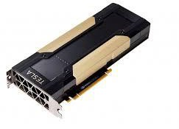
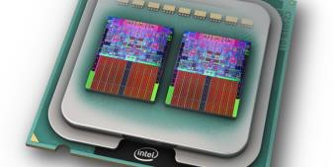
What changed?
Emergence of deep learning
Advancement in hardware
Availability of large-scale data
  ImageNet
  OpenImages
  YFCC100M
  Youtube-8M
  Kinetics
  AVA
  …

Slide 11
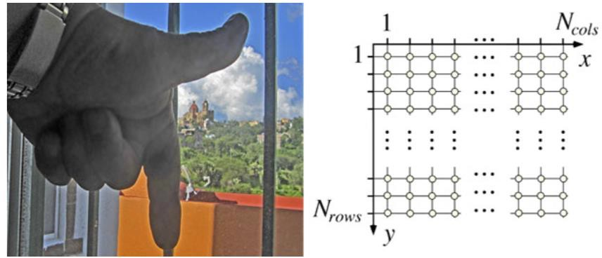
What is a digital image?
Definition: A digital image is defined by integrating and sampling
continuous (analog) data in a spatial domain [Klette, 2014].

Slide 12
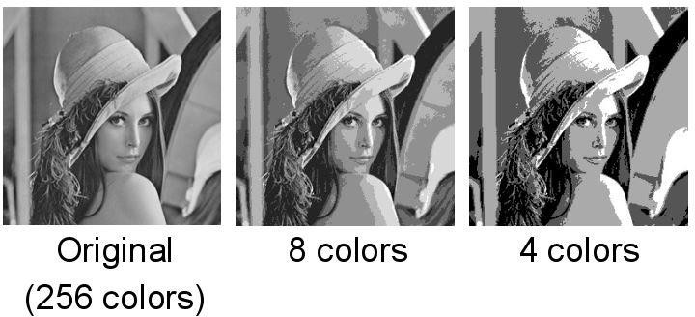


Image Types: (Gray)Scalar and Binary
A scalar image has integer values
a=8
a=3
a=2
a: level (bit)
Ex. If 8 bit (a=8)
  image spans from 0 to 255
  0 black and 255 white
Ex. If 1 bit (a=1)
  it is binary image
  0 and 1 only

Slide 13
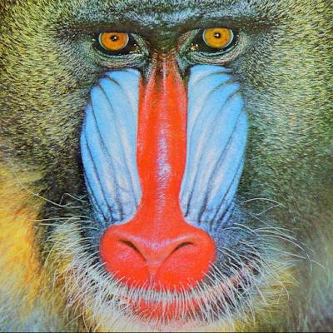
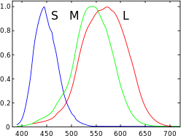
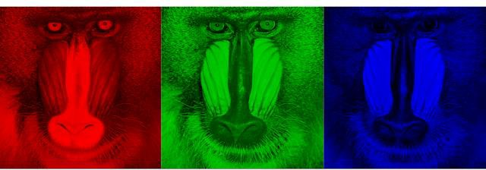
Image Type: RGB (red, green, blue)
Image has three channels (bands)
Each channel spans a-bit values.
Human Cone-cells (normalized) responsivity spectra
Some people might have 4 cone-types!
Some might have just 2!

Slide 14
Evolution of Computer Vision

Slide 15
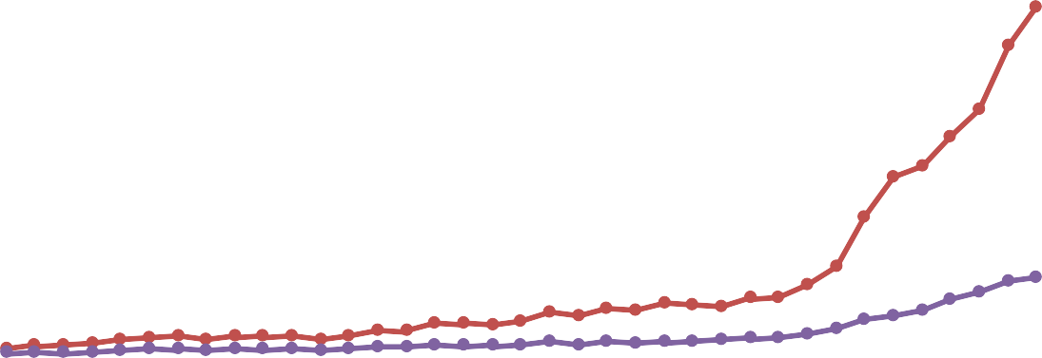







2012 to Present: Deep Learning Explosion
14000
12000
10000
8000
6000
4000
2000
0
Submitted Papers Accepted Papers
Publications at top Computer Vision conference
1959
Hubel & Wiesel
1963
Roberts
1970s
David Marr
1979
Gen. Cylinders
1986
Canny
1997
Norm. Cuts
1999
SIFT
2001
V&J
2004 , 2007
Caltech101;
PASCAL
2009
ImageNet
AI Winter
1958
Perceptron
1969
Minsky & Papert
1980
Neocognitron
1985
Backprop
1998
LeNet
2006
Deep Learning
2012
AlexNet

Slide 16

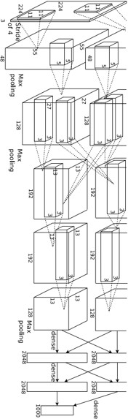

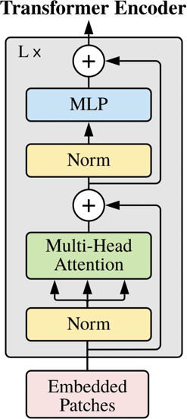
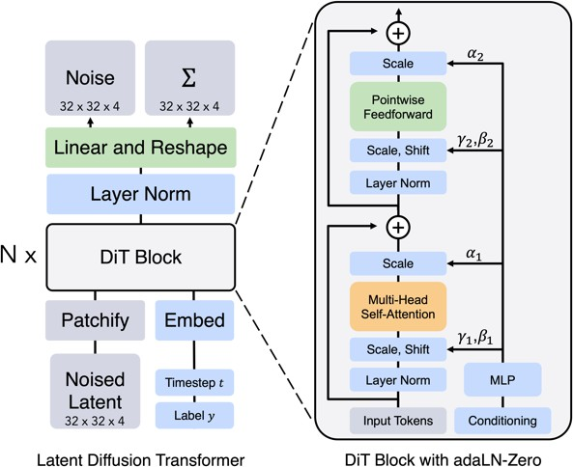














2012 to Present: Deep Learning is Everywhere
Year 2012
AlexNet
Year 2015
ResNet
Year 2021
Vision Transformer (ViT)
Year 2023
Diffusion Transformer (DiT)
[Peebles ICCV 2023]
[Dosovitskiy ICLR 2021]
[Krizhevsky NIPS 2012]
Figure copyright Alex Krizhevsky, Ilya Sutskever, and Geoffre y Hinton, 2012. Reprod uced with permission.
[He ICCV 2015]
March 31, 2026

Slide 17


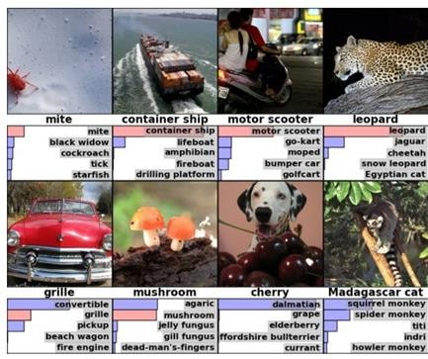

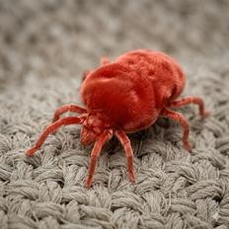
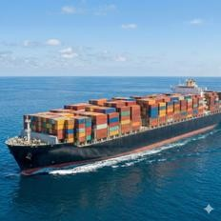
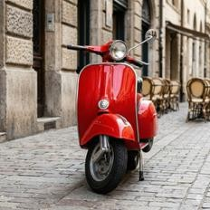
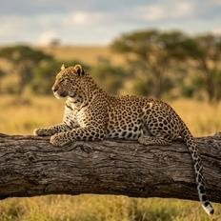
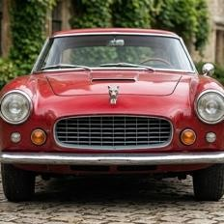
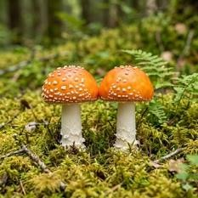
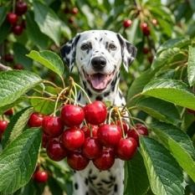
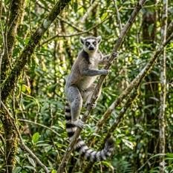
2012 to Present: Deep Learning is Everywhere
Image Classification (circa 2012)
Image Generation (2026)
All photos were generated with Imagen 4
Slide inspiration: Justin Johnson
March 31, 2026
Figures copyright Alex Krizhevsky, Ilya Sutskever, and Geoffre y Hinton, 2012. Re produce d with permission.
Figures copyright Alex Krizhevsky, Ilya Sutskever, and Geoffre y H inton, 2012. Re produce d with permission.

Slide 18
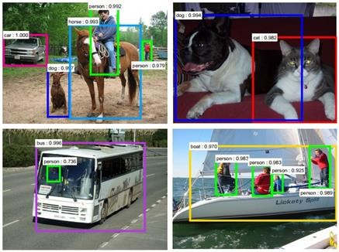
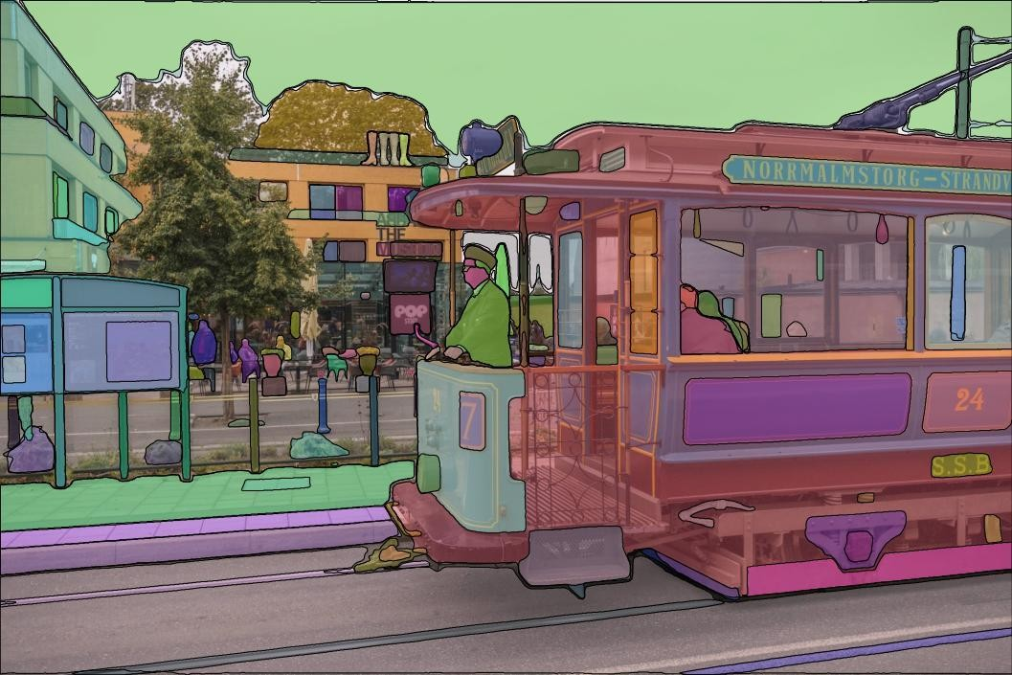
2012 to Present: Deep Learning is Everywhere
Object Detection Image Segmentation
Slide inspiration: Justin Johnson
Faster R-CNN
Ren, He, Girshick, and Sun, NeurIPS 2016
Segment Anything
Kirillov et al, ICCV 2023
March 31, 2026

Slide 19
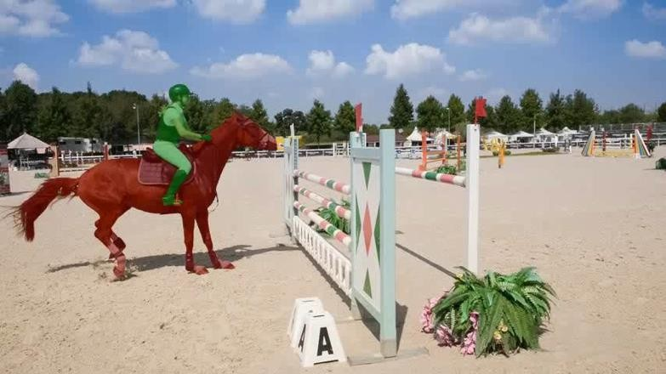
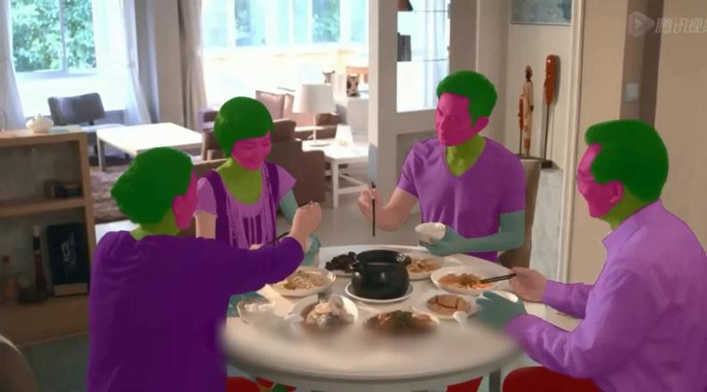
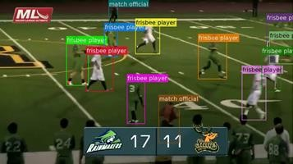
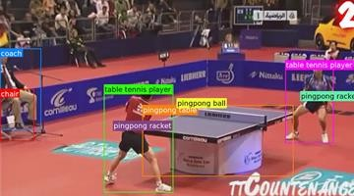
2012 to Present: Deep Learning is Everywhere
Video Understanding and Activity Recognition
A. Gupta, J. W, J. Deng & L. Fei-Fei, NeurIPS, 2023, Z Luo, Z. Durante, L. Li, W, Xie, R. Liu, E. Jin, Z. Huang, L. Y. Li, J. Wu, J. C. Niebles, E. Adeli, & L. Fei-Fei, NeurIPS, 2022

Slide 20
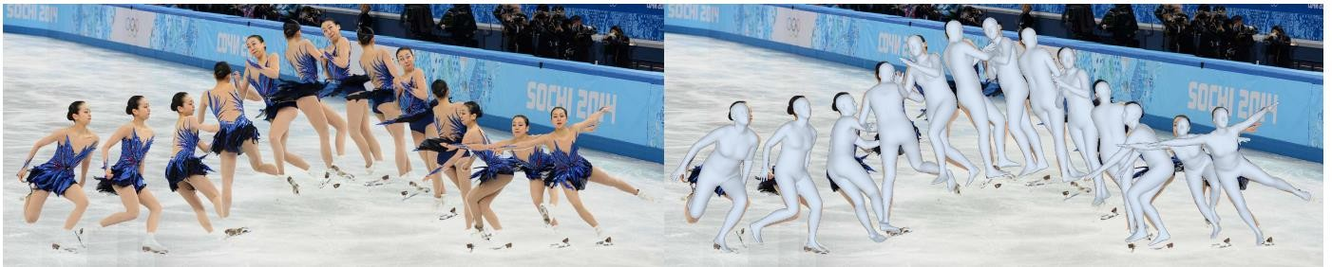
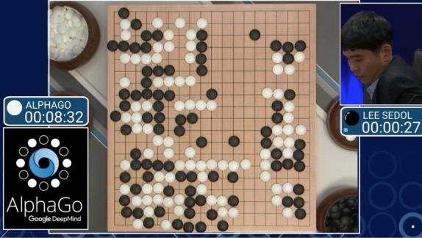
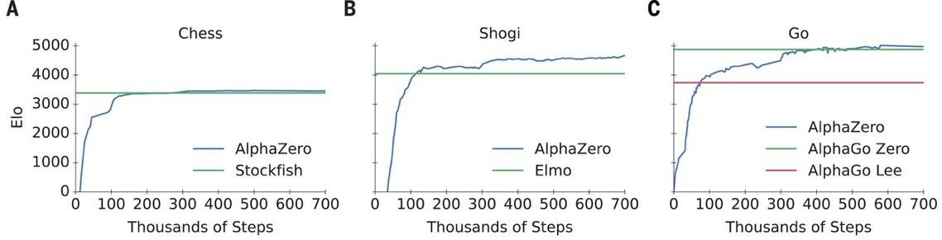
2012 to Present: Deep Learning is Everywhere
Human Mesh Reconstruction (Goel et al, 2023)
Game Playing (AlphaGo/AlphaZero, Silver et al, 2016 & 2017)
Source: https://www.b bc.com/news/technology-35785875
Source: https://arxiv.org/pdf/1712.01815

Slide 21
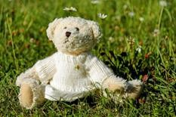
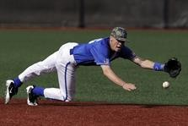

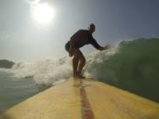


2012 to Present: Deep Learning is Everywhere
Early Image Captioning
Vinyals et al, 2015
Karpathy and Fei-Fei, 2015
A white teddy bear
sitting in the grass
A man in a baseball
uniform throwing a ball
A woman is holding a cat in her hand
All images are CC0 Pu blic domain:
http s://pixab ay.co m/en /lu ggage-antique-cat-1643 010/
http s://pixab ay.co m/en /ted dy-plush-bear s-cute-ted dy-bear-1623 436/ http s://pixab ay.co m/en /su rf-wave-su mmer-sp ort-litoral-1668 716/ http s://pixab ay.co m/en /woman-female-mod el-po rtrait-adu lt-9839 67/ http s://pixab ay.co m/en /han dstan d-lake-medi tatio n-4960 08/
http s://pixab ay.co m/en /bas eball-playe r-sh ortstop-in field-1045 263/
A man riding a wave
on top of a surfboard
A cat sitting on a
suitcase on the floor
A woman standing on a
beach holding a surfboard
Cap tion s ge nerated by Ju stin Jo hnson using Neur altalk2

Slide 22
2012 to Present: Deep Learning is Everywhere
Gemini 3 (2026):
The image features a charming, cream-colored teddy bear
sitting peacefully in a sunlit grassy field.
Modern Image Captioning – can be much more detailed!
Key Details:
The Bear: It has soft, fluffy fur and is wearing a hand-knitted white sweater or dress. Its expression is neutral yet sweet, with dark eyes and a stitched brown nose.
The Setting: The bear is positioned in lush green grass
dotted with small white daisies. One particular daisy appears to be "growing" or resting right on top of the bear's head, giving it a whimsical look.
Lighting: The scene is bright and warm, suggesting a clear, sunny day. The sunlight creates soft shadows and highlights the texture of both the bear's fur and the knitted yarn of its outfit.
The overall mood is serene, nostalgic, and gentle.
A white teddy bear
sitting in the grass
A man in a baseball A woman is holding
uniform throwing a ball a cat in her hand
A cat sitting on a A woman standing on a
suitcase on the floor beach holding a surfboard
Slide inspiration: Justin Johnson
All images are CC0 Pu blic domain:
http s://pixab ay.co m/en /lu ggage-antique-cat-1643 010/
http s://pixab ay.co m/en /ted dy-plush-bear s-cute-ted dy-bear-1623 436/ http s://pixab ay.co m/en /su rf-wave-su mmer-sp ort-litoral-1668 716/ http s://pixab ay.co m/en /woman-female-mod el-po rtrait-adu lt-9839 67/ http s://pixab ay.co m/en /han dstan d-lake-medi tatio n-4960 08/
http s://pixab ay.co m/en /bas eball-playe r-sh ortstop-in field-1045 263/
A man riding a wave
on top of a surfboard
Cap tion s ge nerated by Ju stin Jo hnson using Neur altalk2
March 31, 2026

Slide 23
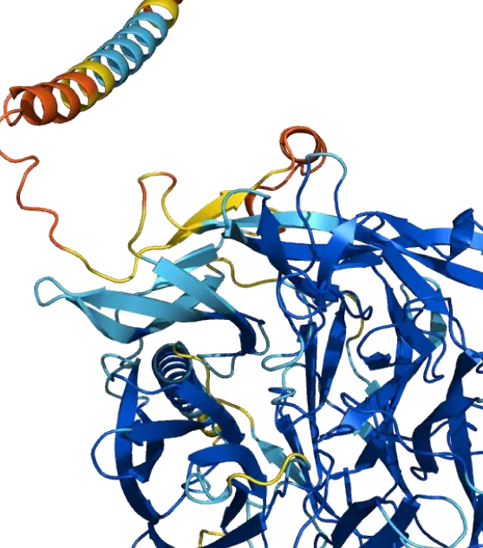
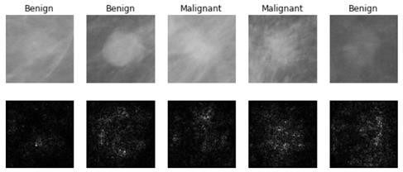

2012 to Present: Deep Learning is Everywhere
Medical Imaging
Levy et al, 2016 Figu re r epro duced with p ermission
Slide inspiration: Justin Johnson
Galaxy Classification
Protein Folding
(Jumper et al 2021)
This image is from the AlphaFold P rotein St ructure Database
(alp hafold .eb i.ac.uk) by De epMi nd Technologie s Limited and EMBL-EBI,
li ce nsed un der CC-BY 4.0.
Dieleman et al, 2014
Fro m left to right : pu blic domain b y NASA, usage per mitted by
ESA/Hub ble, pu blic domain b y NASA, and pu blic domain.
March 31, 2026

Slide 24
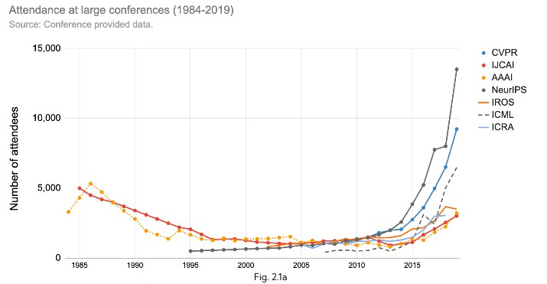
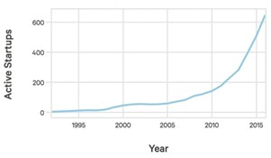
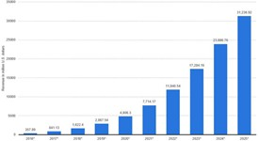
AI’s Explosive Growth & Impact
Number of attendance
At AI conferences
Startups Developing AI
Systems
Enterprise Application AI
Revenue
Source: The Gradient
Source: Crunchbase, VentureSource, Sand Hill Econometrics
Source: Statista
March 31, 2026

Slide 25
Convolutional Neural Networks

Slide 26
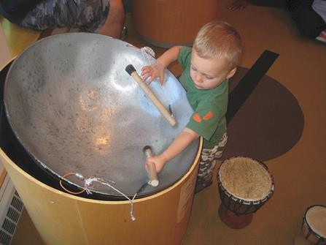
The Image Classification Challenge: 1,000 object classes
1,431,167 images
Output: Scale T-shirt
Steel drum Drumstick Mud turtle
Deng et al, 2009
Russakovsky et al. IJCV 2015
1959
Hubel & Wiesel
1963
Roberts
1970s
David Marr
1979
Gen. Cylinders
1986
Canny
1997
Norm. Cuts
1999
SIFT
2001
V&J
2004 , 2007
Caltech101;
PASCAL
2009
ImageNet
AI Winter
1958
Perceptron
1969
Minsky & Papert
1980
Neocognitron
1985
Backprop
1998
LeNet
2006
Deep Learning
Fei-Fei Li & Adeli & Durante & Johnson & Xiang
CS231n: Lecture 1 -
52
March 31, 2026

Slide 27
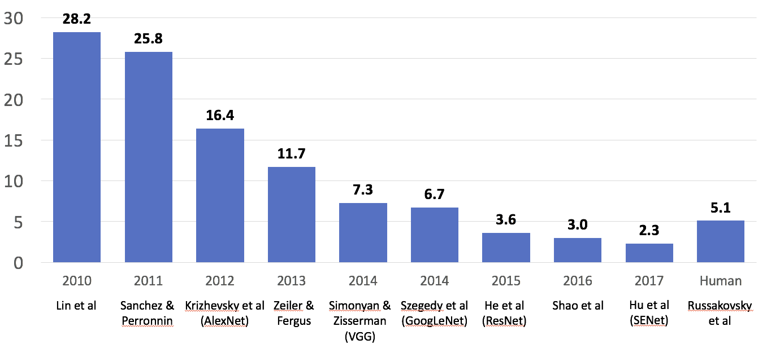
1959
Hubel & Wiesel
1963
Roberts
1970s
David Marr
1979
Gen. Cylinders
1986
Canny
1997
Norm. Cuts
1999
SIFT
2001
V&J
2004 , 2007
Caltech101;
PASCAL
2009
ImageNet
AI Winter
1958
Perceptron
1969
Minsky & Papert
1980
Neocognitron
1985
Backprop
1998
LeNet
2006
Deep Learning
Fei-Fei Li & Adeli & Durante & Johnson & Xiang
CS231n: Lecture 1 -
53
March 31, 2026

Slide 28
AlexNet, 2012
1959
Hubel & Wiesel
1963
Roberts
1970s
David Marr
1979
Gen. Cylinders
1986
Canny
1997
Norm. Cuts
1999
SIFT
2001
V&J
2004 , 2007
Caltech101;
PASCAL
2009
ImageNet
AI Winter
1958
Perceptron
1969
Minsky & Papert
1980
Neocognitron
1985
Backprop
1998
LeNet
2006
Deep Learning
2012
AlexNet
Fei-Fei Li & Adeli & Durante & Johnson & Xiang
CS231n: Lecture 1 -
54
March 31, 2026

Slide 29
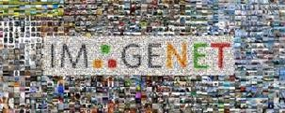
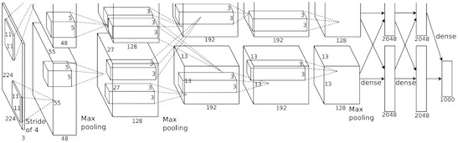
A bit of history:
ImageNet Classification with Deep Convolutional Neural Networks [Krizhevsky, Sutskever, Hinton, 2012]
Figure copyright Alex Krizhevsky, Ilya Sutskever, and Geoffrey Hinton, 2012. Reproduced with permission.
“AlexNet”
Lecture 5 -

Slide 30

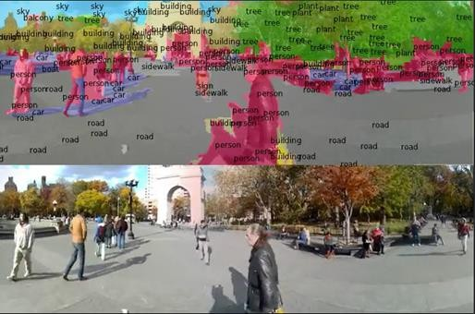
~2012 – 2020: ConvNets dominate all vision tasks
Detection Segmentation
Figures copyright Shaoqing Ren, Kaiming He, Ross Girschick, Jian Sun, 2015. Reproduced with permission.
[Faster R-CNN: Ren, He, Girshick, Sun 2015]
Lecture 5 -
Figures copyright Clement Farabet, 2012. Reproduced with permission.
[Farabet et al., 2012]

Slide 31






~2012 – 2020: ConvNets dominate all vision tasks
Image Captioning
A white teddy bear sitting in
the grass
A man in a baseball
uniform throwing a ball
A woman is holding a cat in her hand
All ima ges are CC0 Public domain:
https://pixabay. com/en/luggage-antique-cat-1643 010/
https://pixabay. com/en/teddy-plush-bears-cute-teddy-bear-1623 436/
https://pixabay. com/en/surf-wave-summer-sport-litoral-1668 716/
https://pixabay. com/en/woman-fe male-model-portrait-adult-9839 67/
https://pixabay. com/en/handstand-lake-meditation-4960 08/
https://pixabay. com/en/baseball-player-shortstop-infield-1045 263/
Captions gene rated by Justin Johnson using Ne uraltalk2
A man riding a wave on top
of a surfboard
A cat sitting on a suitcase
on the floor
A woman standing on a beach
holding a surfboard
[Vinyals et al., 2015]
[Karpathy and Fei-Fei, 2015]
Lecture 5 -

Slide 32
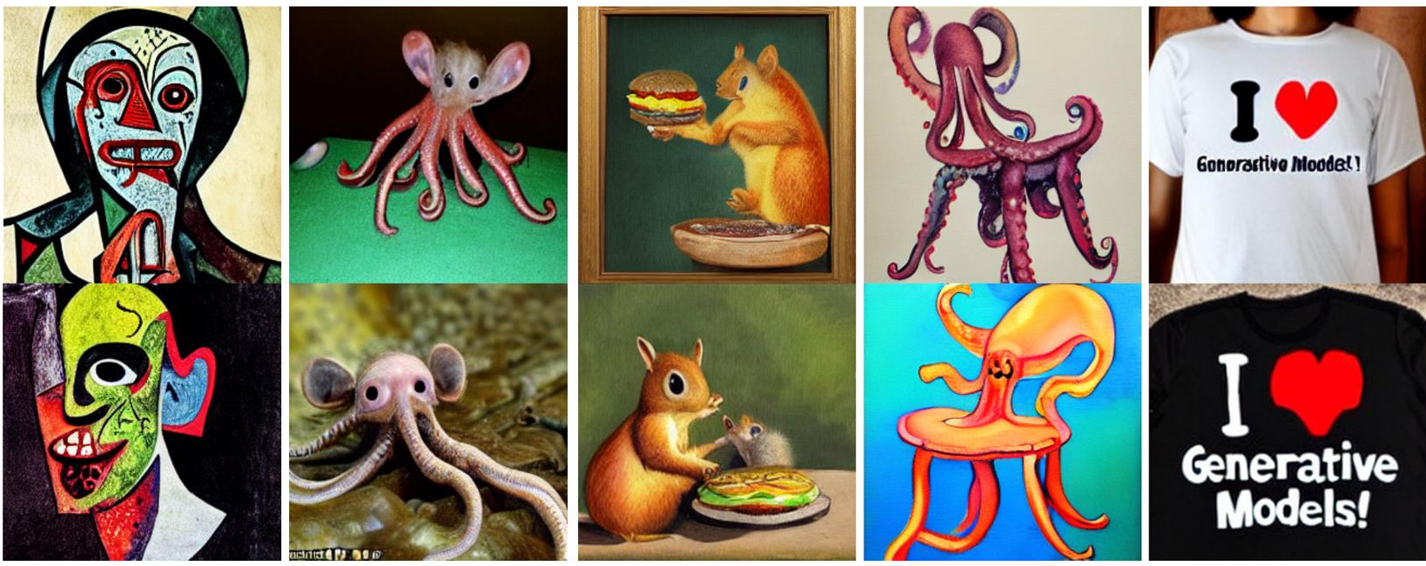
~2012 – 2020: ConvNets dominate all vision tasks
Text-to-Image Generation
Rombach et al, “High-Resolution Image Synthesis with Latent Diffusion Models”, CVPR 2022
A watercolor painting of a chair that looks like an octopus
A shirt with the inscription: “I love generative models!”
A zombie in the style of Picasso
An image of a half mouse half octopus
A painting of a squirrel eating a burger

Slide 33
Our Computer Vision Task for Today:
Image Classification

Slide 34
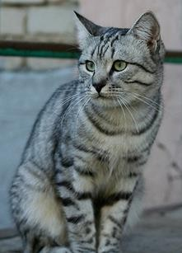
Image Classification: A core task in Computer Vision
(assume given a set of possible labels)
{dog, cat, truck, plane, ...}
cat
This image by Nik ita is
licensed unde r CC-BY 2.0
Lecture 2 -
34

Slide 35
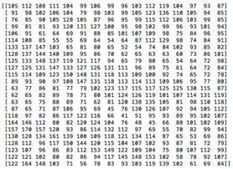
The Problem: Semantic Gap
What the computer sees
An image is a tensor of integers between [0, 255]:
This image by Nik ita is
e.g. 800 x 600 x 3
(3 channels RGB)
licensed unde r CC-BY 2.0
Lecture 2 -
35

Slide 36


Challenges: Viewpoint variation
All pixels change when the camera moves!
This image by Nik ita is licensed unde r CC-BY 2.0
Lecture 2 -
36

Slide 37




Challenges: Illumination
This image is CC0 1. 0 public domain
This ima ge is CC0 1. 0 public domain
This image is CC0 1. 0 public domain
This image is CC0 1. 0 public domain
Lecture 2 -
37

Slide 38


Challenges: Background Clutter
This image is CC0 1. 0 public domain
This ima ge is CC0 1. 0 public domain
Lecture 2 -
38

Slide 39



Challenges: Occlusion
This image is CC0 1. 0 public domain
This image is CC0 1. 0 public domain
This image by jonsson is license d
under CC-BY 2.0
Lecture 2 -
39

Slide 40




Challenges: Deformation
This ima ge by Umberto Salvagnin is licensed unde r CC-BY 2.0
This image by Umberto S alvagnin is
licensed unde r CC-BY 2.0
This image by sare bear is
licensed unde r CC-BY 2.0
This image by Tom Thai is license d under CC-BY 2.0
Lecture 2 -
40

Slide 41

Challenges: Intraclass variation
This image is CC0 1. 0 public domain
Lecture 2 -
41

Slide 42


Challenges: Context
Image source: https://www.linkedin.com/posts/ralph-aboujaoude-diaz-40838313_technology-artificialintelligence-computervision-activity-6912446088364875776-h-Iq?utm_source=linkedin_share&utm_medium=member_desktop_web
Lecture 2 -
42

Slide 43

An image classifier
Unlike e.g. sorting a list of numbers,
no obvious way to hard-code the algorithm for recognizing a cat, or other classes.
Lecture 2 -
43

Slide 44


Attempts have been made
Find edges
Find corners
?
John Canny, “A Computational Approach to Edge D etection”, IEEE TPAM I 1986
Lecture 2 -
44

Slide 45



Machine Learning: Data-Driven Approach
Collect a dataset of images and labels
Use Machine Learning algorithms to train a classifier
Evaluate the classifier on new images
Example training set
Lecture 2 -
45

Slide 46
Linear Classifier
Lecture 2 -

Slide 47

Parametric Approach
Image
10 numbers giving class scores
f(x,W)
Array of 32x32x3 numbers (3072 numbers total)
W
parameters or weights
Lecture 2 -

Slide 48
f(x,W) = W x
Parametric Approach: Linear Classifier
Image
10 numbers giving class scores
f(x,W)
Array of 32x32x3 numbers (3072 numbers total)
W
parameters or weights
Lecture 2 -

Slide 49
Parametric Approach: Linear Classifier
3072x1
f(x,W) = W x
Image
10x1 10x3072
f(x,W)
10 numbers giving class scores
Array of 32x32x3 numbers (3072 numbers total)
W
parameters or weights
Lecture 2 -

Slide 50
Parametric Approach: Linear Classifier
3072x1
f(x,W) = W x + b
10x1
Image
10x1 10x3072
f(x,W)
10 numbers giving class scores
Array of 32x32x3 numbers (3072 numbers total)
W
parameters or weights
Lecture 2 -

Slide 51

Example with an image with 4 pixels, and 3 classes (cat/dog/ship)
Flatten tensors into a vector
56
231
24
2
56 | 231
24 | 2
Input image
Lecture 2 -

Slide 52
Example with an image with 4 pixels, and 3 classes (cat/dog/ship) Algebraic Viewpoint
Flatten tensors into a vector
56
231
24
2
0.2 | -0.5 | 0.1 | 2.0
1.5 | 1.3 | 2.1 | 0.0
0 | 0.25 | 0.2 | -0.3
1.1
-96.8
437.9
61.95
56 | 231
24 | 2
Cat score
+
3.2
=
Dog score
-1.2
Ship score
Input image
W
b
Lecture 2 -

Slide 53


Interpreting a Linear Classifier
Lecture 2 -

Slide 54

Interpreting a Linear Classifier: Visual Viewpoint
Lecture 2 -

Slide 55






Interpreting a Linear Classifier:
Geometric Viewpoint
f(x,W) = Wx + b
Array of 32x32x3 numbers (3072 numbers total)
Cat ima ge by Nik ita is license d under CC-BY 2.0
Lecture 2 -
Plot created using Wolfram Cloud

Slide 56


[Krizhevsky et al. 2012]
Linear layers
[He et al. 2015]
Lecture 2 -

Slide 57

Recap: Fully Connected Layer
32x32x3 image -> stretch to 3072 x 1
input
activation
1
1
10 x 3072
weights
3072
10
Lecture 5 -

Slide 58
Fully Connected Layer
32x32x3 image -> stretch to 3072 x 1
input
activation
1
1
10 x 3072
weights
3072
10
1 number:
the result of taking a dot product between a row of W and the input (a 3072-dimensional dot product)
Lecture 5 -

Slide 59
Convolution
32x32x3 image -> preserve spatial structure
32
height
32
depth
width
3
Lecture 5 -

Slide 60
Image Filtering
Image filtering: compute function of local neighborhood at each position
  • Enhance images
  • Denoise, resize, increase contrast, etc.
  • Extract information from images
  • Texture, edges, distinctive points, etc.
  • Detect patterns
  • Template matching

Slide 61

Image Filtering
Modify pixels based on some function of neighborhood

Slide 62

Image Filtering
Output is linear combination of the neighborhood pixels

Slide 63
Convolution: Spatial Dimensions
Convolution is a filtering operation
  expresses the amount of overlap of one function as it is shifted over another function
7
Input: 7x7
Filter: 3x3
7
Lecture 5 -

Slide 64
Convolution: Spatial Dimensions
Input: 7x7
Filter: 3x3
7
7
Lecture 5 -

Slide 65
Convolution: Spatial Dimensions
Input: 7x7
Filter: 3x3
7
7
Lecture 5 -

Slide 66
Convolution: Spatial Dimensions
Input: 7x7
Filter: 3x3
7
7
Lecture 5 -

Slide 67
Convolution: Spatial Dimensions
Input: 7x7 Filter: 3x3 Output: 5x5
7
7
Lecture 5 -

Slide 68
Convolution: Spatial Dimensions
Input: 7x7 Filter: 3x3 Output: 5x5
7
In general Input: W Filter: K
Output: W – K + 1
7
Lecture 5 -

Slide 69
Convolution: Spatial Dimensions
Input: 7x7 Filter: 3x3 Output: 5x5
Problem: Feature maps shrink with each layer!
7
In general Input: W Filter: K
Output: W – K + 1
7
Lecture 5 -

Slide 70
Convolution: Spatial Dimensions
0 | 0 | 0 | 0 | 0 | 0 | 0 | 0 | 0
0 |  |  |  |  |  |  |  | 0
0 |  |  |  |  |  |  |  | 0
0 |  |  |  |  |  |  |  | 0
0 |  |  |  |  |  |  |  | 0
0 |  |  |  |  |  |  |  | 0
0 |  |  |  |  |  |  |  | 0
0 |  |  |  |  |  |  |  | 0
0 | 0 | 0 | 0 | 0 | 0 | 0 | 0 | 0
Input: 7x7 Filter: 3x3 Output: 5x5
Problem: Feature maps shrink with each layer!
Solution: Add padding around the input before sliding the filter
In general Input: W Filter: K
Padding: P
Output: W – K + 1 + 2P
Lecture 5 -

Slide 71
Convolution Layer
32x32x3 image
5x5x3 filter
32
Convolve the filter with the image
i.e. “slide over the image spatially, computing dot products”
32
3
Lecture 5 -

Slide 72
Convolution Layer
Filters always extend the full depth of the input volume
32x32x3 image
5x5x3 filter
32
Convolve the filter with the image
i.e. “slide over the image spatially, computing dot products”
32
3
Lecture 5 -

Slide 73

Convolution Layer
32x32x3 image 5x5x3 filter
32
1 number:
the result of taking a dot product between the filter and a small 5x5x3 chunk of the image
(i.e. 5*5*3 = 75-dimensional dot product + bias)
32
3
Lecture 5 -

Slide 74
Convolution Layer
32
32
3
Lecture 5 -

Slide 75
Convolution Layer
32
32
3
Lecture 5 -

Slide 76
Convolution Layer
32
32
3
Lecture 5 -

Slide 77
Convolution Layer
32
32
3
Lecture 5 -

Slide 78
Convolution Layer
activation map
32x32x3 image 5x5x3 filter
32
28
convolve (slide) over all spatial locations
32
28
3
1
Lecture 5 -

Slide 79
consider a second, green filter
Convolution Layer
32x32x3 image 5x5x3 filter
activation maps
32
28
convolve (slide) over all spatial locations
32
28
3
1
Lecture 5 -

Slide 80
Convolution Layer
6 activation maps,
each 1x28x28
3x32x32 image
Consider 6 filters, each 3x5x5
Convolution Layer
32
32
6x3x5x5
filters
Stack activations to get a
6x28x28 output image!
Lecture 5 -

Slide 81
A ConvNet is a neural network with Conv layers
32
28
CONV
e.g. 6 5x5x3 filters
32
28
3
6
Lecture 5 -

Slide 82
A ConvNet is a neural network with Conv layers
32
28
24
….
CONV
CONV
CONV
e.g. 6 5x5x3 filters
e.g. 10 5x5x6 filters
32
28
24
3
6
10
Lecture 5 -

Slide 83
A ConvNet is a neural network with Conv layers with activation functions!
32 28
24
….
CONV ReLU
e.g. 6 5x5x3 filters
CONV ReLU
e.g. 10 5x5x6 filters
CONV ReLU
32
28
24
3
6
10
Lecture 5 -

Slide 84



Components of CNNs
Convolution Layers Pooling Layers
Fully-Connected Layers
x
h
s
Activation Functions
Goal: Introduce non-linearities to our model!
Lecture 6 -

Slide 85

Pooling Layers: Another way to downsample
64 x 224 x 224
Single depth slice
1 | 1 | 2 | 4
5 | 6 | 7 | 8
3 | 2 | 1 | 0
1 | 2 | 3 | 4
x
Max pooling with 2x2 kernel size and stride 2
6 | 8
3 | 4
Gives invariance to small spatial shifts. No learnable parameters.
y
Lecture 5 -

Slide 86
Recap: Pooling Layer
Single depth slice
6 | 8
3 | 4
1 | 1 | 2 | 4
5 | 6 | 7 | 8
3 | 2 | 1 | 0
1 | 2 | 3 | 4
Max
Pooling
x
pool with 2x2 filters and stride 2
3.25 | 5.25
2 | 2
Average Pooling
y
Lecture 6 -

Slide 87




Convolution and Pooling: Translation Equivariance
H x W x C H’ x W’ x C’
Conv or Pool
Conv(Translate(X))
= Translate(Conv(X))
Translate
Translate
Conv or Pool
Intuition: Features of images don’t depend on their location in the image
Lecture 5 -

Slide 88


Summary: Convolutional Networks
Fully-Connected Layer Activation Function
x
h
s
Convolution Layer
Pooling Layer
Lecture 5 -

Slide 89


What do Conv filters learn?
32
28
Linear classifier: One template per class
Conv
ReLU
28
32
3
Lecture 5 -

Slide 90

What do Conv filters learn?
First-layer conv filters: local image templates (Often learns oriented edges, opposing colors)
32
28
Conv
ReLU
28
32
3
AlexNet: 64 filters, each 3x11x11
Lecture 5 -

Slide 91

What do Conv filters learn?
Deeper conv layers: Harder to visualize
Tend to learn larger structures e.g. eyes, letters
32
Conv
ReLU
28
32
3
6th layer conv layer from an ImageNet model
Visualization from [Springenberg et al, ICLR 2015]
Lecture 5 -

Slide 92

General CNN Architecture

Slide 93

Visualizing CNN

Slide 94
CNN Architectures
Softmax
FC 1000
FC 4096
FC 4096
Pool
3x3 conv, 512
3x3 conv, 512
3x3 conv, 512
3x3 conv, 512
Pool
3x3 conv, 512
3x3 conv, 512
3x3 conv, 512
3x3 conv, 512
Pool
3x3 conv, 256
3x3 conv, 256
Pool
3x3 conv, 128
3x3 conv, 128
Pool
3x3 conv, 64
3x3 conv, 64
Input
Softmax
FC 1000
Softmax
FC 1000
FC 4096
FC 4096
Pool
3x3 conv, 512
3x3 conv, 512
3x3 conv, 512
Pool
3x3 conv, 512
3x3 conv, 512
3x3 conv, 512
Pool
3x3 conv, 256
3x3 conv, 256
Pool
3x3 conv, 128
3x3 conv, 128
Pool
3x3 conv, 64
3x3 conv, 64
Input
Pool
3x3 conv, 512
3x3 conv, 512
3x3 conv, 512
3x3 conv, 512
3x3 conv, 512
3x3 conv, 512, /2
..
.
3x3 conv, 128
3x3 conv, 128
3x3 conv, 128
3x3 conv, 128
3x3 conv, 128
3x3 conv, 128, / 2
Softmax
FC 1000
FC 4096
FC 4096
3x3 conv, 64
3x3 conv, 64
3x3 conv, 64
3x3 conv, 64
3x3 conv, 64
3x3 conv, 64
Pool
3x3 conv, 256
3x3 conv, 384
Pool
3x3 conv, 384
Pool
Pool
7x7 conv, 64, / 2
5x5 conv, 256
Input
11x11 conv, 96
Input
Lecture 6 -
AlexNet
VGG16
VGG19
Res-Net

Slide 95


Learning Phases
Labels
Training
Images
Image
Features
Training
Trained
classifier
Testing
Image not in training s
Image Features
Apply classifier
Prediction
et

Slide 96
Training Steps
Define network
• Loss function
• Initialize network parameters
• Get training data
  Prepare batches
• Feedforward one batch
  • Compute loss
  • Backpropagate gradients
  • Update network parameters
  • Repeat

Slide 97

Hands on Experience: CIFAR10
50,000 training images
each image is 32x32x3
10,000 test images.
Lecture 2 -

Slide 98

2021 - Present: Transformers have taken over
2017: Transformers
for language tasks
Vaswani et al, “Attention is all you need”, NeurIPS 2017
Lecture 5 -

Slide 99

2021 - Present: Transformers have taken over
2017: Transformers
for language tasks
2021: Transformers
for vision tasks
Dosovitskiy et al, “An Image is Worth 16x16 Words: Transformers for Image Recognition at Scale”, ICLR 2021
Vaswani et al, “Attention is all you need”, NeurIPS 2017

Slide 100
Despite the successes, computer vision still has a long way to go
March 31, 2026

Slide 101
Visual Intelligence entails
Understanding
Reasoning
Generation
Data is critical for Deep Learning algorithms

Slide 102



Computer Vision Can Cause Harm
Harmful Stereotypes Affect people’s lives
Source: https://www.washingtonpost.com/technology/2019/10/22/ai-hiring-face-scanning-algorithm-increasingly-de cides-whether-you-de serve-job/
https://www.hire vue.com/platform/online-video-interviewing-software
Example Cred it: Timnit Geb ru

Slide 103




Computer Vision Can Save Lives
Hospital
Daily Living Spaces
Intensive Care Unit
Operating Rooms
Patient Rooms
Administrative Space
Senior Care
Chronic Disease Management
Mental Health
Homes
Recognizing Activities from Contactless Sensors using Ambient Intelligence Computer Vision Technology
March 31, 2026

Slide 104

Computer Vision Can Save Lives
March 31, 2026

Slide 105




Slide 106



x8
R. Zhang, S. Lee, M. Hwang, A. Hiranaka, C. Wang, W, Ai, J. J. Tan, S. Gupta, Y. Hao, G. Levine, R. Gao, A. Norcia, L. Fei-Fei, J. Wu, CoRL, 2023

Slide 107





World Modeling
R Wu, B. Mildenhall, P. Henzler, K. Park, R. Gao, D. Watson, P. Srinivasan, D. Verbin, J. T. Barron, B. Pool, A. Holynski. arXiv, 2023; CVPR, 2024

Slide 108


And there is a lot we don’t know how to do
Slide inspiration: Andrej Karpathy
https://fedand fit.com/wp-
content/ uploads/2020/06/summer-activities-
for-kids_ optimiz ed-scaled.jp eg
This image is
copyright-free United
State s government
work
March 31, 2026

Slide 109
Thank You

