Slide 1

Service Level Standardization

Slide 2
Agenda
Opportunities with Process Standardization
Scope by Tiers
Deliverables and Suggested Timeline by Tiers
Q&A

Slide 3
Standardization benefits everyone
Opportunities
Approach
Benefits
(To Client) Added transparency on identifying metrics and tracking implementation schedule to the client
(To National Team) Resource availability and requirement based on complexity
Define different level of timeline and resource requirements based on complexity
Set a clear scope on metrics based on complexity and value to the client
(To Client) Clearer view on timeline and actionable insights
(To National Team) Better manage clients’ expectations
(To Analytics Team) Better quality analysis and tracking as well as error prevention

Slide 4
Tiers
and Scopes

Slide 5
Metrics Scope by the Tier
Bronze
Silver
Gold
Impression
Clicks
CTR
Visits
Pageview
Unique Visitor
Average Visit Duration (sec)
Exit Clicks
Scroll Depth
Video Plays
Video Playback Depth
Micro Interaction***
Micro Interaction Engagement Rate
Detailed Exit Clicks
VDP Widget Click Out
SRP Widget Click Out
Other Custom Metrics
a
a
a
Basic Metrics
Requires GA implementation
Media & Interactions
a
a
Detailed Interactions
a
*** Micro Interaction includes content navigation (e.g. In case of Acura CPO how users arrived at the article page through homepage or hamburger menu)
Notes:
If client requests other metrics that we never tracked before, we’ll consider this as “other custom metrics” and to be included under “Gold” tier
Based on the discussion with an account manager, we came to understand that VDP and SRP widget click outs are valuable piece of information, however, because it is valuable to the client and requires more effort for implementation, we suggest that we could present this as gold tier service when presenting to the client

Slide 6
Action Item Lead Time by the Tier - Guideline
Time is subject to factors such as requirement complexity, number of tracking, available resource, and other development
Bronze
Silver
Gold
Days until first report
27 ~ 41 days
31 ~42 days
35 ~ 50 days
Action Item
Responsibility
Days
Analytics Sign-off Sheet (Approved mocks required)
Interaction Sheet
JIRA Ticket Set Up for GA Tag (GTM development takes place after JIRA ticket)
Web Development & GA Tags
Branded Content
1~3 day
Analytics - Dev
2~5 days
Analytics - Dev
2~5 days
3~6 days
Analytics - Dev
1 sprint (2 weeks)
Testing (Testing occurs after developers)
Initial Data Check
7. Weekly Report Dashboard for Silver & Gold Static report for Bronze
Post Campaign Analysis Slides
Investigation (Troubleshoot / Ad hoc Analysis) Time depends on complexity and shows response
Analytics - Dev
3~6 days
4~7 days
5~8 days
Analytics
3~5 days
6~8 days
8~11 days
Analytics
2~3 days
Analytics
10~13 days
10~13 days
5~8 days
3~6 days
3~6 days
2~5 days
Analytics
time for initial acknowledgement and preliminary assessment
Notes:
Excluding development time, we’d expect 14 business days for Bronze from sign-off to first report, 17 business days for silver, and 21 days for gold
The biggest benefit for Gold is faster turnaround time for investigation and in-depth analysis as well as allowing clients to brief on lessons through key learnings (PCA)
******Depending on the complexity of micro-interactions and other requirements, follow up testing may be required after campaign release
Depending on how many we allow for microinteractions, number of days for testing can vary greatly

Slide 7
Thank you
Questions?
Notes:
Analytics team is okay as long as impelementation team is not working on 2 tracking implementation at the same time
Scroll Depth – if client has GA knowledge , scroll tracking template – data clensing is what distinguish this to Silver
Bronze – remove interaction sheet? But for consistency we’ll keep it there
Dev team confirmed that web development and GA Tag implementation should be completed in 2 weeks time provided mocks won’t change in between initial request and development
SRP VDP testing 2 more days for Bronze and Silver for Testing (item 4)
Sales team wants SRP/VDP click outs but because these are valuable and unique asset only from Trader, we encourage you to pitch it to Gold

Slide 8
Appendix

Slide 9
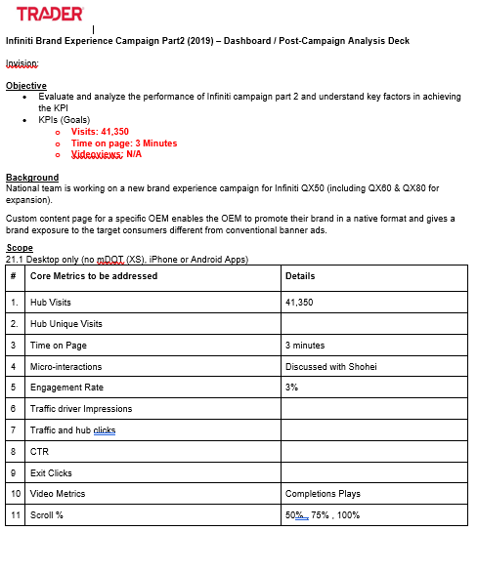
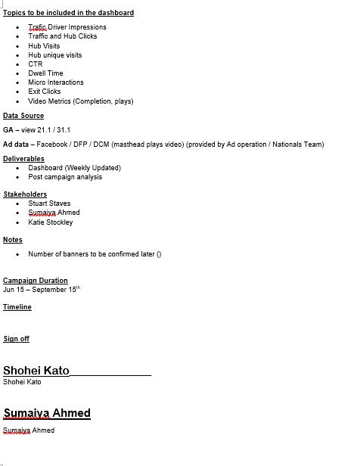
Sample Deliverable – Sign Off Sheet
Sign-Off sheet indicates the commitment from the analytics team for the project
Notes:
Outlines objective, background, scope, deliverables, data sources (desktop only or mobile as well), internal stakeholders

Slide 10
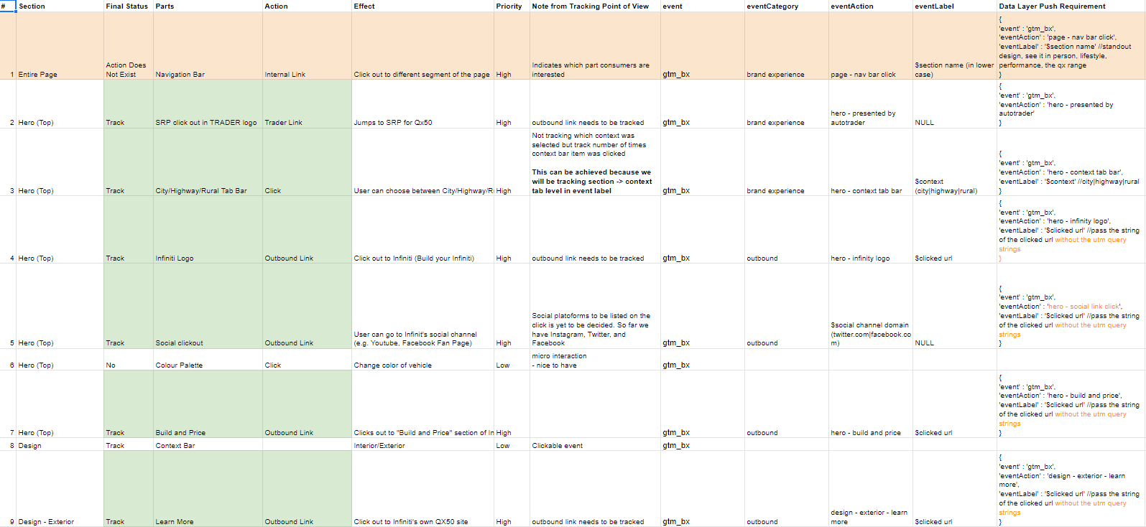
Sample Deliverable – Interaction Sheet
Notes:
Interaction Sheet
https://docs.google.com/spreadsheets/d/1rg-frFRodPAeKMFJWKw84Emr3KBAA-mF-G1_gWvLVhM/edit?usp=sharing
Provides list of interactions and corresponding GA tracking and parameters for implementation
QA status is also included in the sheet

Slide 11
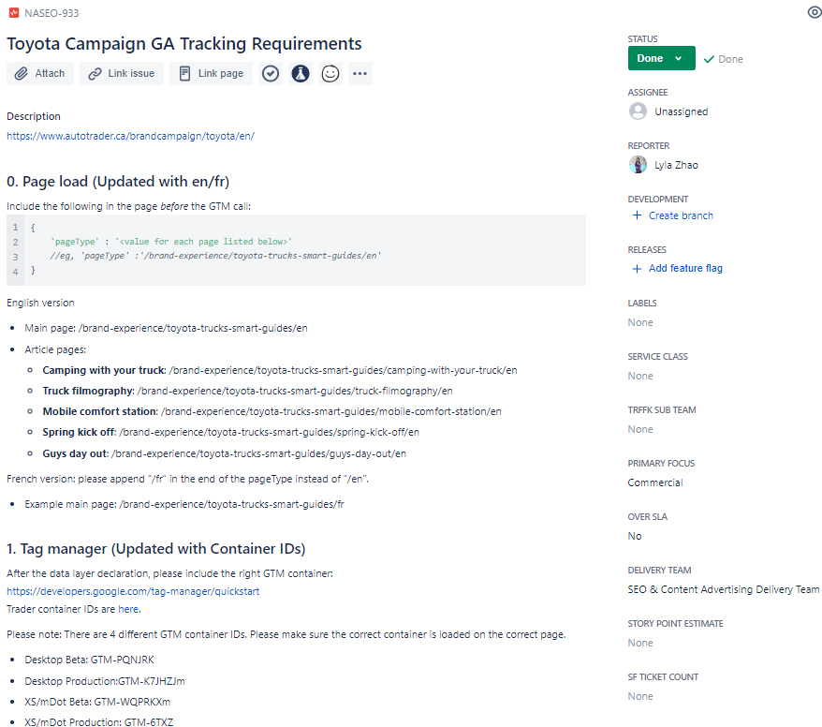
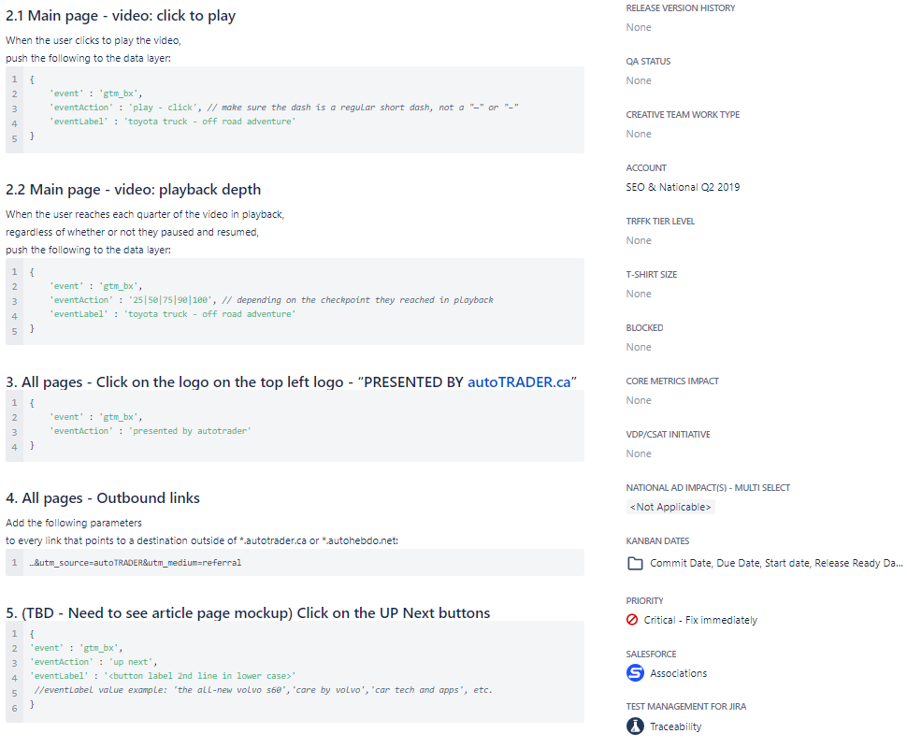
Sample Deliverable – JIRA Ticket Set up
Notes:
Interaction Sheet
https://docs.google.com/spreadsheets/d/1rg-frFRodPAeKMFJWKw84Emr3KBAA-mF-G1_gWvLVhM/edit?usp=sharing

Slide 12
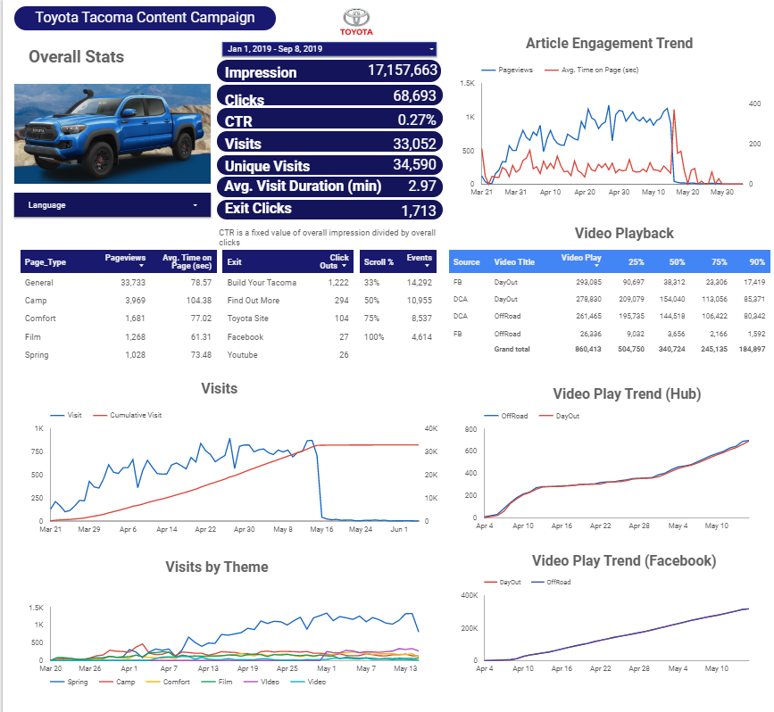
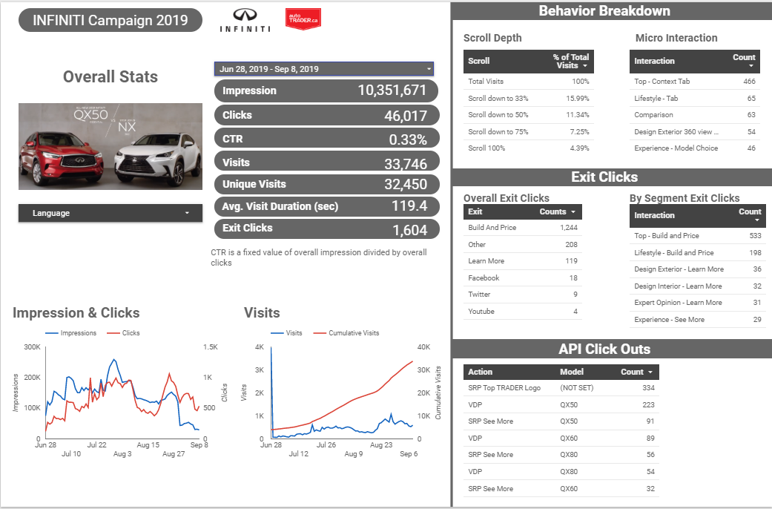
Sample Deliverable – Dashboard
Gold
Silver
Notes:
Interaction Sheet
https://docs.google.com/spreadsheets/d/1rg-frFRodPAeKMFJWKw84Emr3KBAA-mF-G1_gWvLVhM/edit?usp=sharing

Slide 13

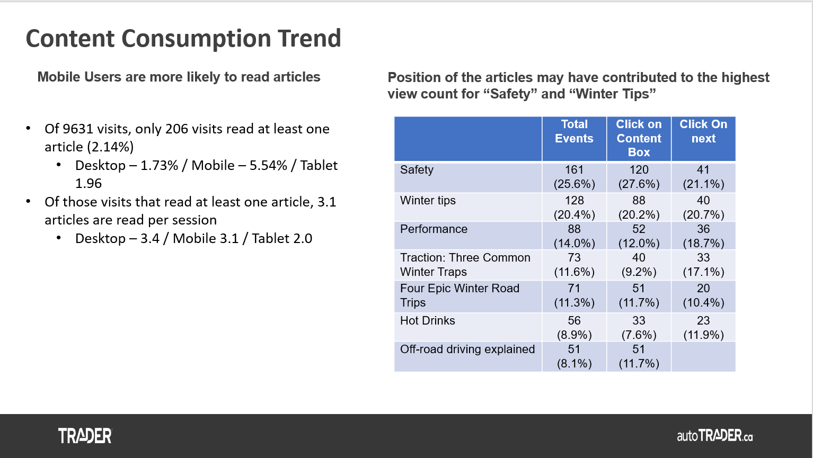
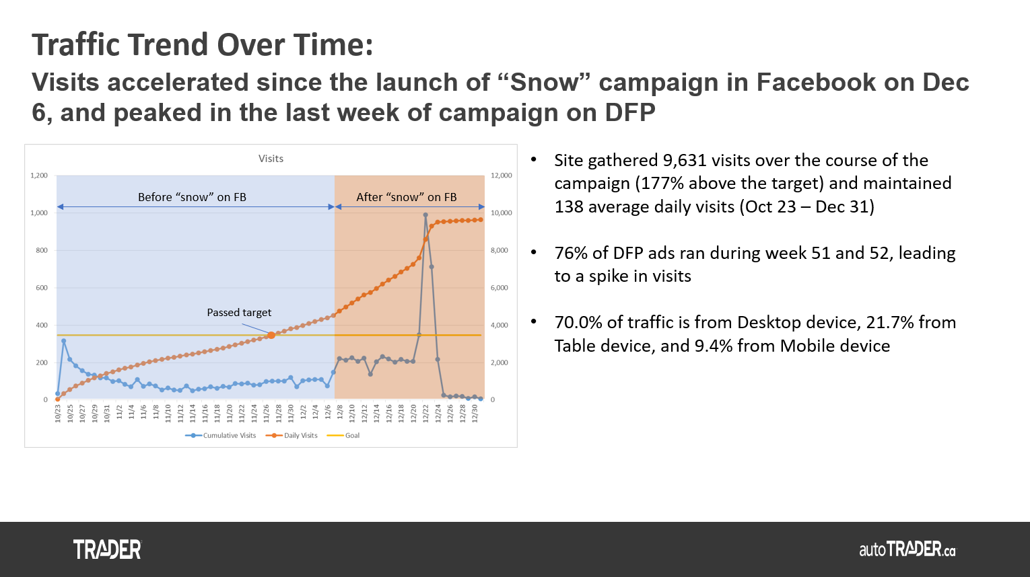
Sample Deliverable - Post Campaign Analysis
Notes:
Interaction Sheet
https://docs.google.com/spreadsheets/d/1rg-frFRodPAeKMFJWKw84Emr3KBAA-mF-G1_gWvLVhM/edit?usp=sharing

Slide 14


