Slide 1
Microarchitecture
Notes:
Morgan Kaufmann Publishers
Chapter 4 — The Processor

Slide 2
Introduction
§4.1 Introduction
CPU performance factors
  Instruction count
    Determined by ISA and compiler
  CPI and Cycle time
    Determined by CPU hardware
Simple subset, shows most aspects
  Memory reference: lw, sw
  Arithmetic/logical: add, sub, and, or, slt
  Control transfer: beq
These 8 instructions capture the essence of the data path and control path design. This shall be similar to the choice of instructions for your project.
Chapter 4 — The Processor — <number>
Notes:
Morgan Kaufmann Publishers
Chapter 4 — The Processor

Slide 3
The 8 Representative Instructions
add rd, rs, rt R[rd]=R[rs]+R[rt]
and rd, rs, rt R[rd]=R[rs]&R[rt]
sub rd, rs, rt R[rd]=R[rs]-R[rt]
or rd, rs, rt R[rd]=R[rs] I R[rt]
slt rd, rs, st set on less than
if R[rs]<R[rt], R[rd]=1
lw rt, immediate(rs) load word, addr=R[rs]+imm
R[rt]=Mem[addr]
sw rt, immediate(rs) store word, addr=R[rs]+imm
Mem[addr]=R[rt]
beq rs, rt, label branch to label if R[rs]=R[rt]
Chapter 4 — The Processor — <number>

Slide 4
MIPS Instruction Format
R-type: opcode rs rt rd shamt funct
source source dest shift amt function
6-bit 5-bit 5-bit 5-bit 5-bit 6-bit
add 000000 100000
and 000000 100100
sub 000000 100010
or 000000 100101
slt 000000 101010
I-type: opcode rs rt constant
6-bit 5-bit 5-bit 16-bit
lw 100011
sw 101011
beq 000100
Chapter 4 — The Processor — <number>

Slide 5
Instruction Execution
PC → instruction memory, fetch instruction
Register numbers → register file, read registers
Depending on instruction class
  Use ALU to calculate
    Arithmetic result
    Memory address for load/store
    Branch target address
  Access data memory for load/store
  PC ← target address or PC + 4
ALU serves multiple purposes.
(see slide #3)
Chapter 4 — The Processor — <number>
Notes:
Morgan Kaufmann Publishers
Chapter 4 — The Processor

Slide 6
Steps for microarchitecture design
Step 1: instruction set (ISA)
--use 8 representative instructions
Step 2: build data path
--use logic components
--connect logic components
Step 3: build control path
--create truth table (from opcode
and other fields of ISA)
Chapter 4 — The Processor — <number>

Slide 7
Combinational Elements
AND-gate
  Y = A & B
Adder
  Y = A + B
A
+
Y
B
A
Y
B
Arithmetic/Logic Unit
  Y = F(A, B)
Multiplexer
  Y = S ? I1 : I0
A
I0
M
u
x
Y
Y
ALU
I1
B
S
F
Chapter 4 — The Processor — <number>
Notes:
Morgan Kaufmann Publishers
Chapter 4 — The Processor

Slide 8
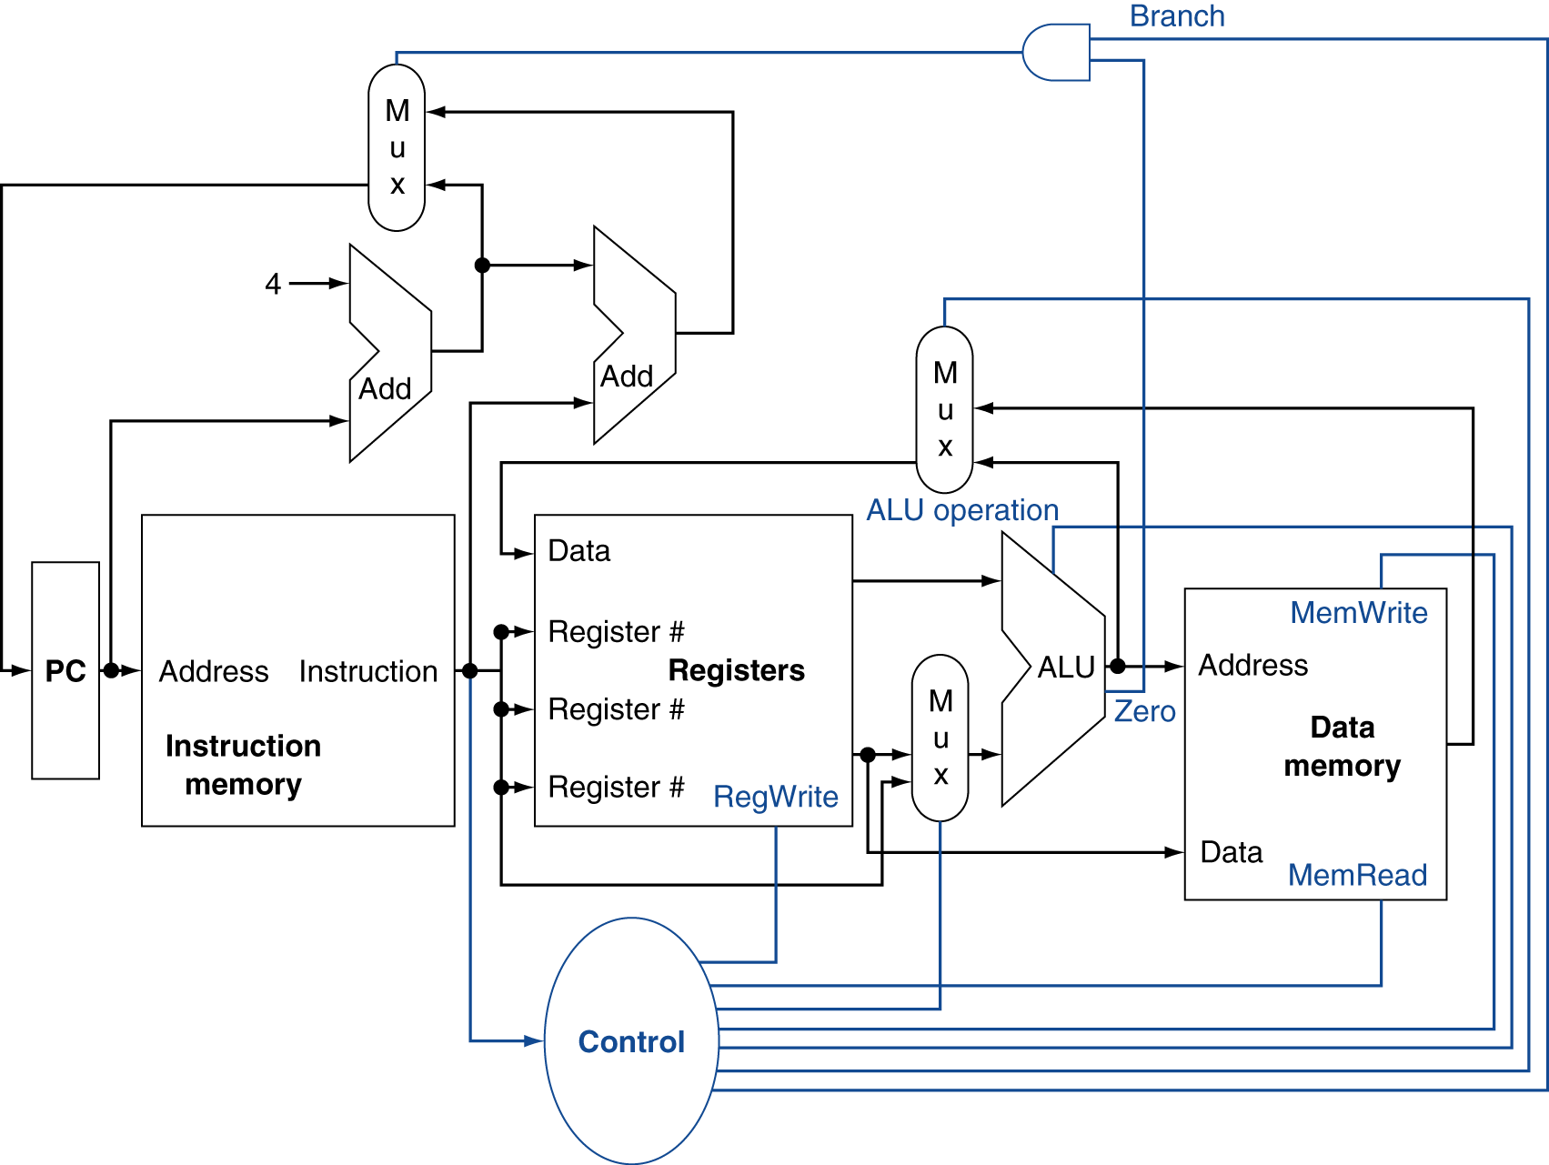
A datapath/control template
Chapter 4 — The Processor — <number>
Notes:
Morgan Kaufmann Publishers
Chapter 4 — The Processor

Slide 9
How To Design Datapath
Chapter 4 — The Processor — <number>

Slide 10
Building a Datapath
Datapath
  Elements that process data and addresses
  in the CPU
    Registers, ALUs, mux’s, memories, …
We will build a datapath incrementally
  Refining the overview design
§4.3 Building a Datapath
Chapter 4 — The Processor — <number>
Notes:
Morgan Kaufmann Publishers
Chapter 4 — The Processor

Slide 11
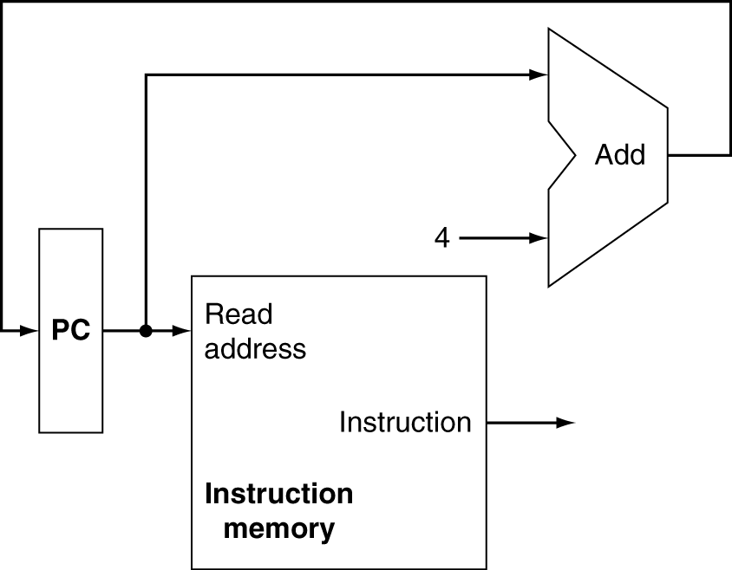
Instruction Fetch
Increment by 4 for next instruction
32-bit register
Chapter 4 — The Processor — <number>
Notes:
Morgan Kaufmann Publishers
Chapter 4 — The Processor

Slide 12
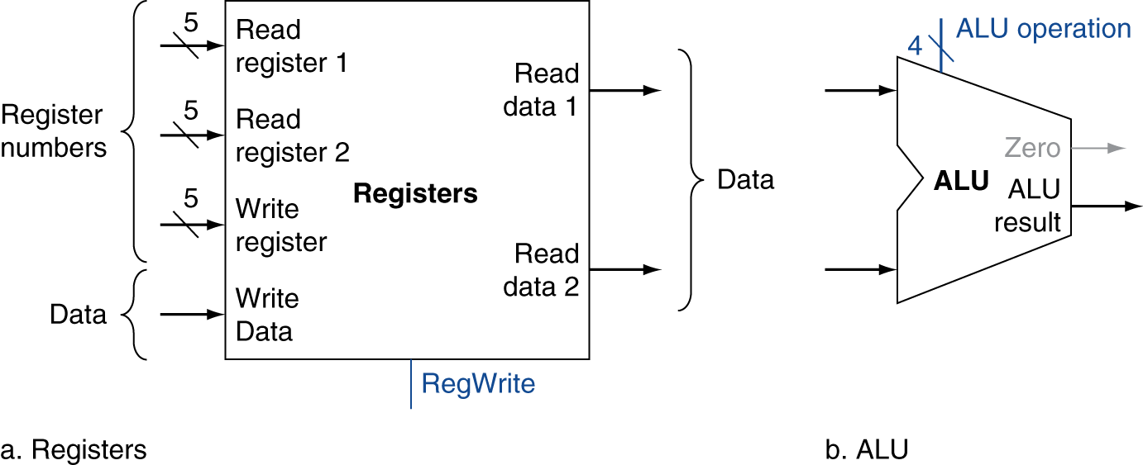
R-Operand Instructions
Read two register operands
Perform arithmetic/logical operation
Write register result
Chapter 4 — The Processor — <number>
Notes:
Morgan Kaufmann Publishers
Chapter 4 — The Processor

Slide 13
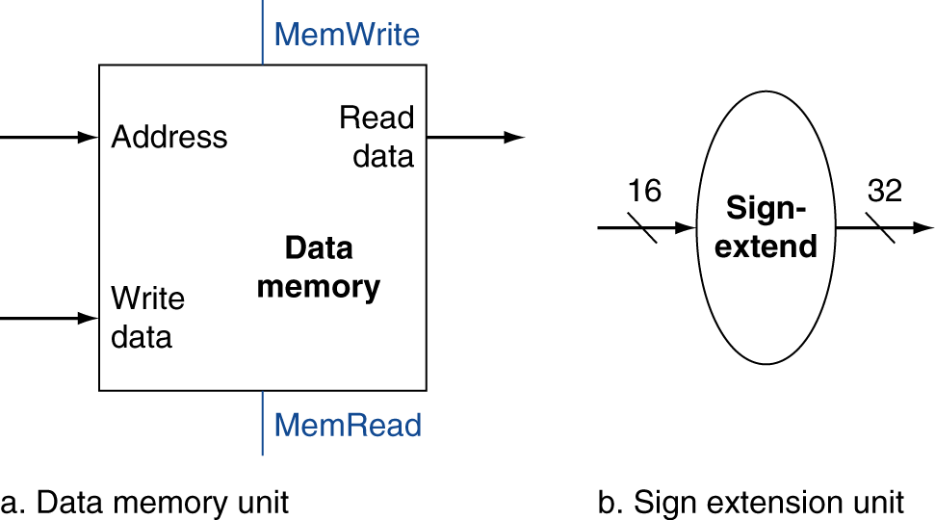
Load/Store Instructions
Read register operands
Calculate address using 16-bit offset
  Use ALU, but sign-extend offset
Load: Read memory and update register
Store: Write register value to memory
Chapter 4 — The Processor — <number>
Notes:
Morgan Kaufmann Publishers
Chapter 4 — The Processor

Slide 14
Branch Instructions
Read register operands
Compare operands
  Use ALU, subtract and check Zero output
Calculate target address
  Sign-extend displacement
  Shift left 2 places (word displacement)
  Add to PC + 4
    Already calculated by instruction fetch
Chapter 4 — The Processor — <number>
Notes:
Morgan Kaufmann Publishers
Chapter 4 — The Processor

Slide 15
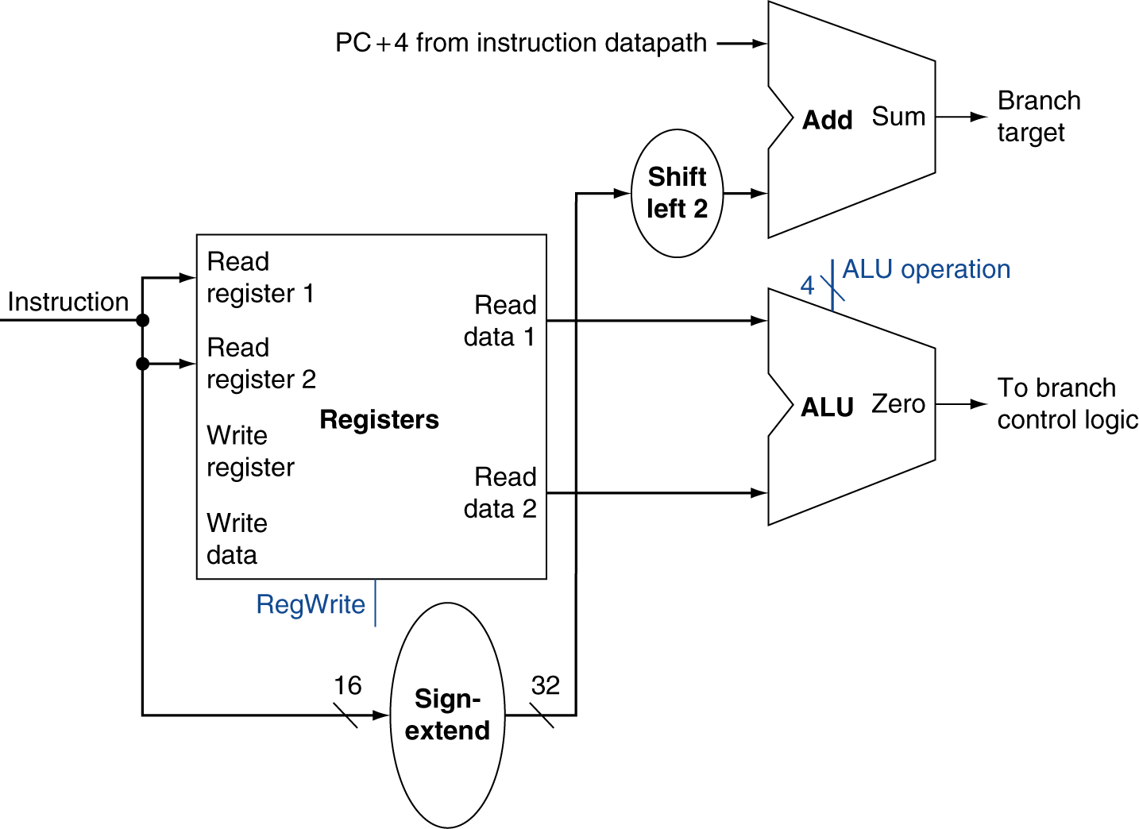
Branch Instructions
Just
re-routes wires
Sign-bit wire replicated
Chapter 4 — The Processor — <number>
Notes:
Morgan Kaufmann Publishers
Chapter 4 — The Processor

Slide 16
Composing the Elements
First-cut data path does an instruction in one clock cycle
  Each datapath element can only do one function at a time
  Hence, we need separate instruction and data memories
Use multiplexers where alternate data sources are used for different instructions
Chapter 4 — The Processor — <number>
Notes:
Morgan Kaufmann Publishers
Chapter 4 — The Processor

Slide 17
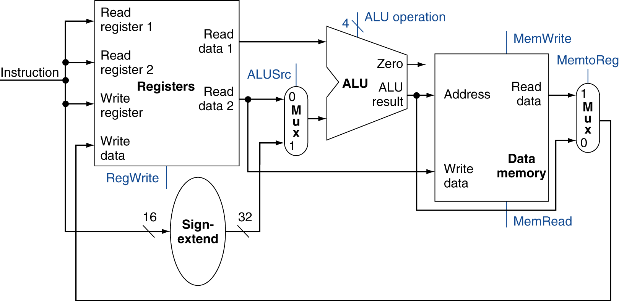
Load/Store Datapath
lw rt, imm(rs) addr=imm + Reg[rs] (use ALU to calculate addr)
sw rt, imm(rs) addr=imm + Reg[rs] (use ALU to calculate addr)
load: Reg[rt] ← Memory[addr]
store: Reg[rt] → Memory[addr]
Chapter 4 — The Processor — <number>
Notes:
Morgan Kaufmann Publishers
Chapter 4 — The Processor

Slide 18
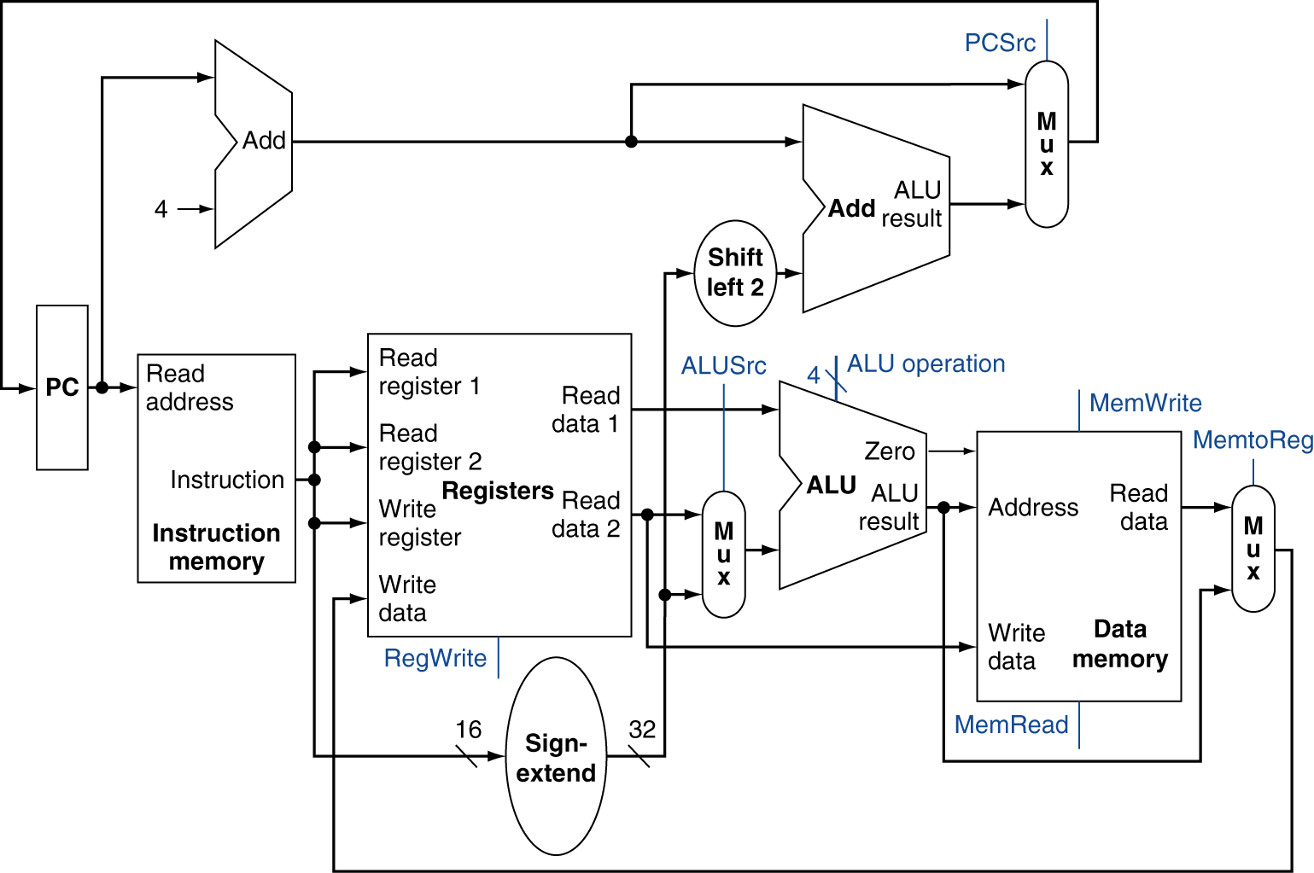
Full Datapath
Chapter 4 — The Processor — <number>
Notes:
Morgan Kaufmann Publishers
Chapter 4 — The Processor

Slide 19
How To Design Control
Chapter 4 — The Processor — <number>

Slide 20
ALU Control
ALU used for
  Load/Store: F = add
  Branch: F = subtract
  R-operand type: F depends on funct field
§4.4 A Simple Implementation Scheme
ALU control | Function
0000 | AND
0001 | OR
0010 | add
0110 | subtract
0111 | set-on-less-than
1100 | NOR
Chapter 4 — The Processor — <number>
Notes:
Morgan Kaufmann Publishers
Chapter 4 — The Processor

Slide 21
ALU Control
Assume 2-bit ALUOp derived from opcode
  Combinational logic derives ALU control
opcode | ALUOp | Operation | funct | ALU function | ALU control
lw | 100011 | load word | XXXXXX | add | 0010
sw | 101011 | store word | XXXXXX | add | 0010
beq | 000100 | branch equal | XXXXXX | subtract | 0110
R-type | 000000 | add | 100000 | add | 0010
 |  | subtract | 100010 | subtract | 0110
 |  | AND | 100100 | AND | 0000
 |  | OR | 100101 | OR | 0001
 |  | set-on-less-than | 101010 | set-on-less-than | 0111
Create a TRUTH TABLE for “ALU control”
using inputs = ALUop (6 bits) + funct (6 bits)
Chapter 4 — The Processor — <number>
Notes:
Morgan Kaufmann Publishers
Chapter 4 — The Processor

Slide 22
The Main Control Unit
Control signals derived from instruction
R-type
0
rs
rt
rd
shamt
funct
31:26
25:21
20:16
10:6
5:0
Load/
Store
35 or 43
rs
rt
address
31:26
25:21
20:16
15:0
Branch
4
rs
rt
address
31:26
25:21
20:16
15:0
opcode
always read
read, except for load
write for R-type and load
sign-extend and add
Chapter 4 — The Processor — <number>
Notes:
Morgan Kaufmann Publishers
Chapter 4 — The Processor

Slide 23
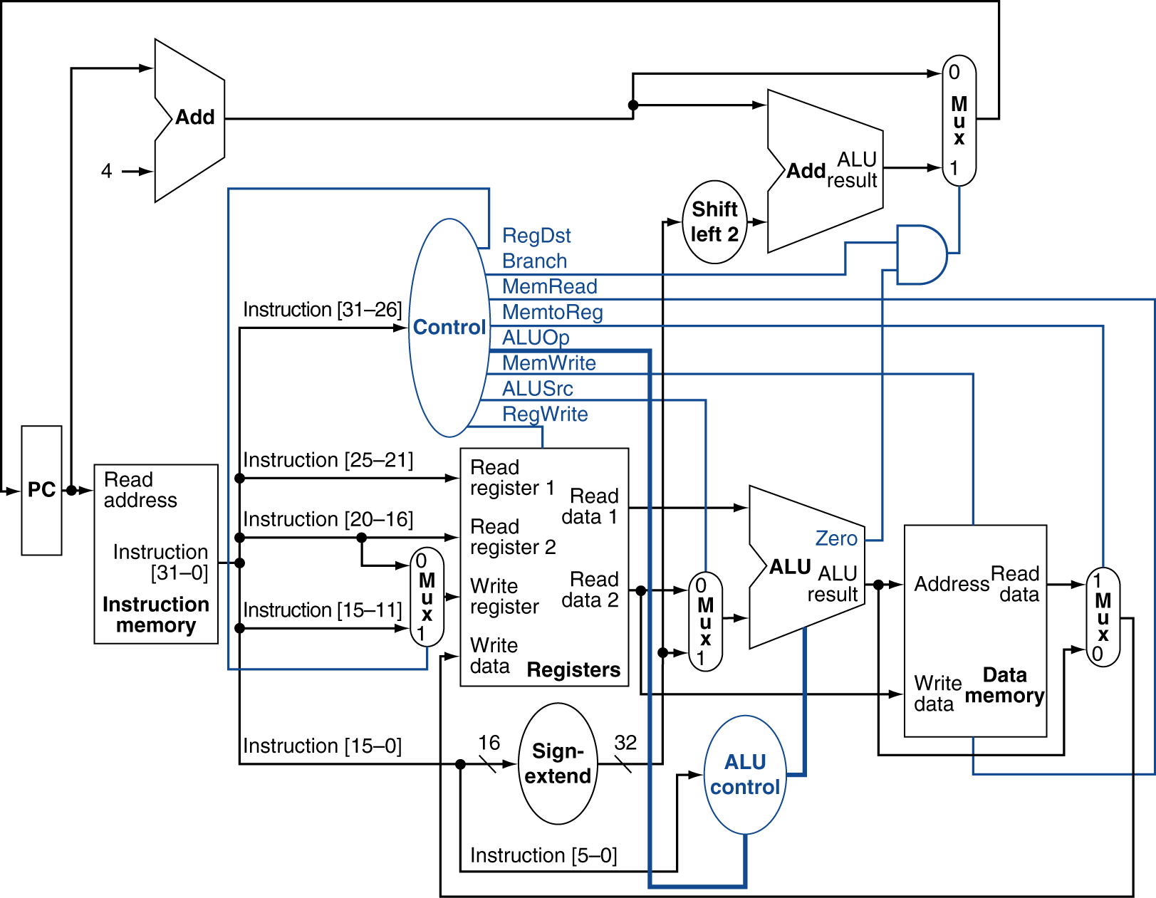
Datapath With Control
Chapter 4 — The Processor — <number>
Notes:
Morgan Kaufmann Publishers
Chapter 4 — The Processor

Slide 24
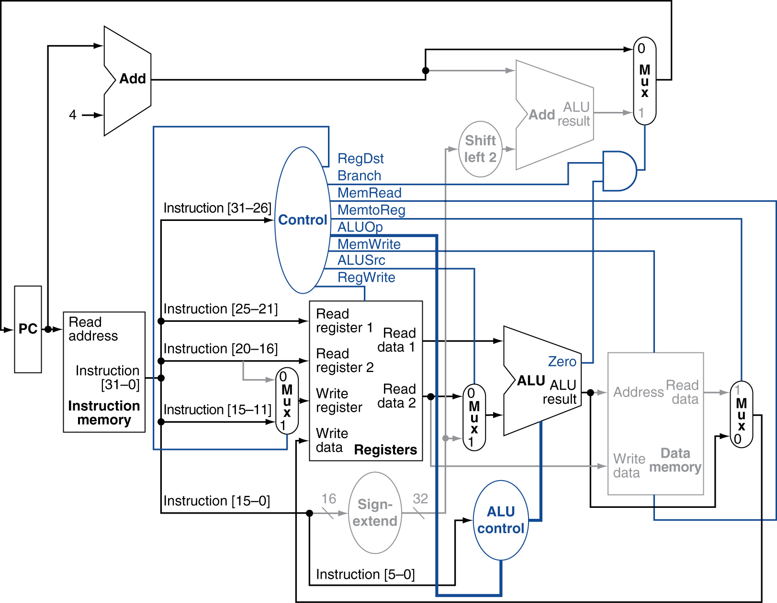
R-Type Instruction
Chapter 4 — The Processor — <number>
Notes:
Morgan Kaufmann Publishers
Chapter 4 — The Processor

Slide 25
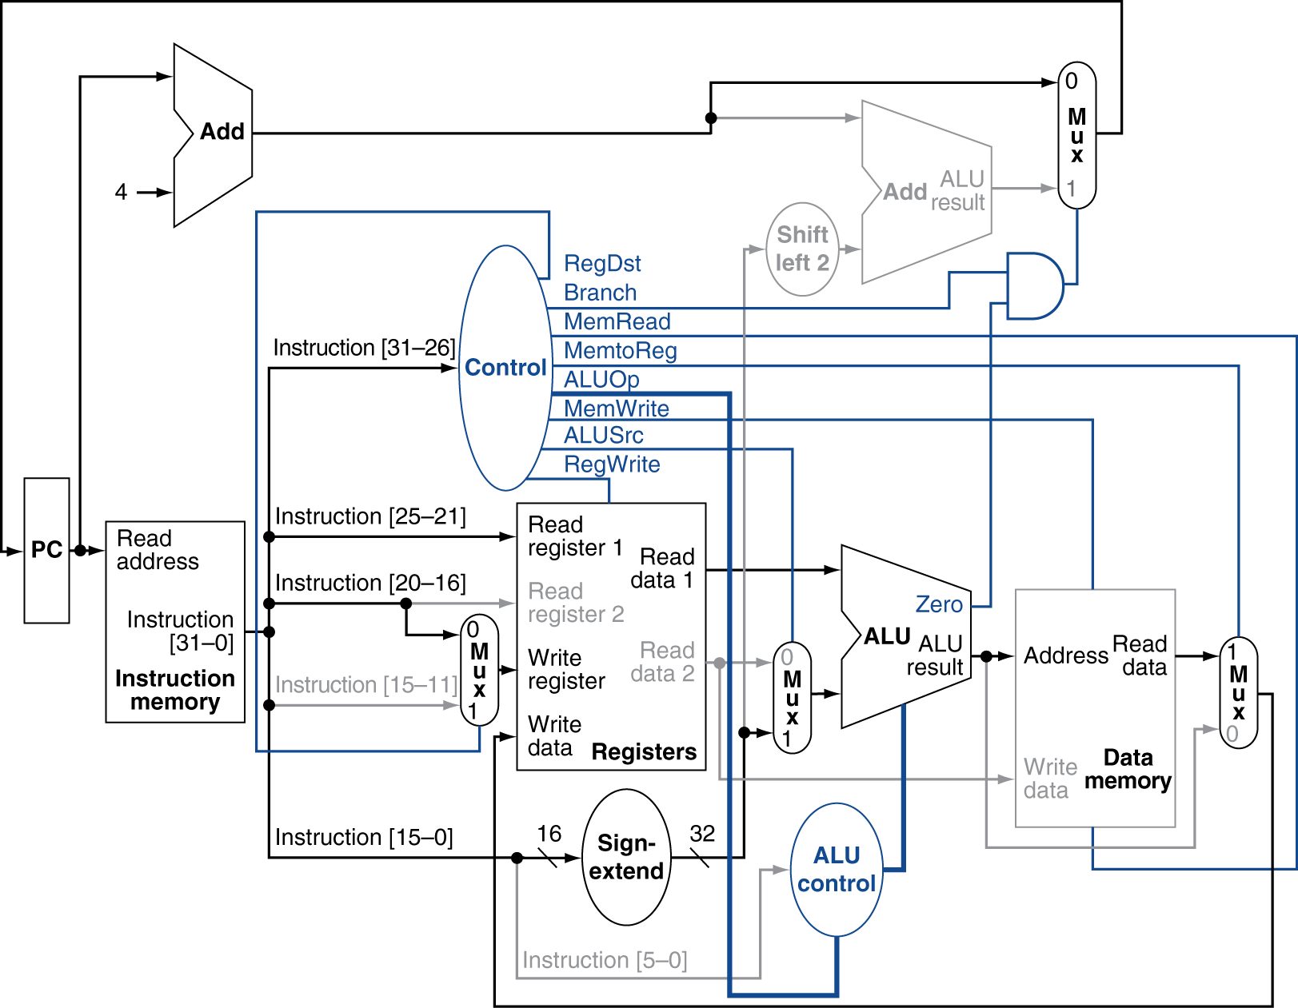
Load Instruction
Chapter 4 — The Processor — <number>
Notes:
Morgan Kaufmann Publishers
Chapter 4 — The Processor

Slide 26
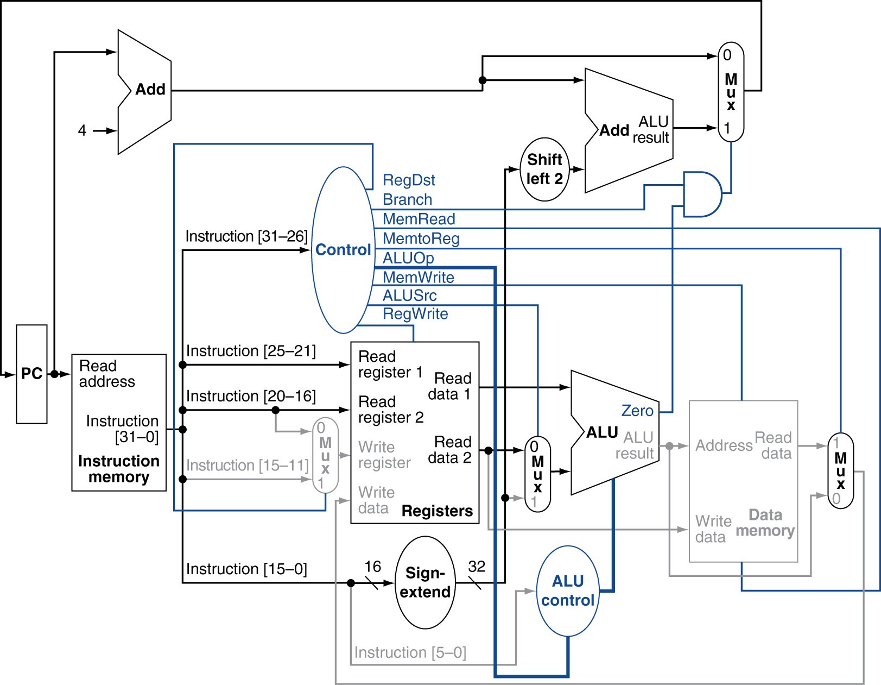
Branch-on-Equal Instruction
Chapter 4 — The Processor — <number>
Notes:
Morgan Kaufmann Publishers
Chapter 4 — The Processor

Slide 27
Performance Issues
Longest delay determines clock period
  Critical path: load instruction
  Instruction memory → register file → ALU → data memory → register file
Not feasible to vary period for different instructions
Violates design principle
  Making the common case fast
We will improve performance by pipelining
Chapter 4 — The Processor — <number>
Notes:
Morgan Kaufmann Publishers
Chapter 4 — The Processor

Slide 28
Summary of Microarchitecture Design
Systematic process
--ISA
--datapath
--control
Need to further consider performance
--pipeline is “universal standard”
--cache is “universal standard”
Chapter 4 — The Processor — <number>

Slide 29
Reference diagram for Homework 5.1 and 5.2
Regmux
ALUmux
Chapter 4 — The Processor — <number>
Notes:
Morgan Kaufmann Publishers
Chapter 4 — The Processor

Slide 30
Homework #5
5.1 Use slide 6 as a reference to answer the questions.
The instruction ADD Rd, Rs, Rt does Reg [Rd] ⬅ Reg [Rs] + Reg [Rt]
Fill in the values of the control signals generated for this instruction.
RegWrite =
MemRead =
MemWrite =
ALUoperation =
ALUmux =
Regmux =
Branch =
Note: the meaning of each control signal is given below.
RegWrite: 1=yes, there is a register write in this cycle, 0= no
MemRead: 1=yes, there is Data Memory Read in this cycle, 0= no
MemWrite: 1=yes, there is a data memory write in this cycle, 0=no
ALUoperation: fill in the opcode (i.e. ADD)
ALUmux: select one from ( register or I-memory)
Regmux: select what to write back to register file, (output of ALU or data memory)
Branch: 1=this instruction causes “Jump”, 0= no
Chapter 4 — The Processor — <number>

Slide 31
Homework #5
5.2 Under this ADD Rd, Rs, Rt instruction, which blocks perform useful function.
Select from the blocks below.
I-memory (Instruction memory)
Registers (register file)
ALU
Data memory
add (Branch adder)
5.3 If this ADD Rd, Rs, Rt is the only instruction to be supported by the processor,
what is the clock cycle time (in ps)? Use the latency of each block below.
I-memory = 200 ps
registers = 90 ps
ALUmux = 20 ps
Regmux = 20 ps
ALU = 90 ps
Data-memory = 250 ps
5.4. What is the clock rate in G Hz (giga Hertz) in 4.3?
Chapter 4 — The Processor — <number>

Slide 32
Reference diagram for Homework 5.3
Increment by 4 for next instruction
32-bit register
Chapter 4 — The Processor — <number>
Notes:
Morgan Kaufmann Publishers
Chapter 4 — The Processor

Slide 33
Homework #5
5.5 If the only instruction we need to do in a processor is fetch
consecutive instruction, what would the cycle time be?
Use the reference diagram in the previous slide.
Use the latency value below:
I-memory = 200 ps
Add = 70 ps
Chapter 4 — The Processor — <number>

