Slide 1
Email Spam Filter
Discovery Challenge http://www.ecmlpkdd2006.org/challenge.html
A competition deals with personalized spam filtering and generalization across related learning tasks.
Renjie Weng
rweng@stevens.edu
CS 559 Machine Learning, 2013Fall

Slide 2
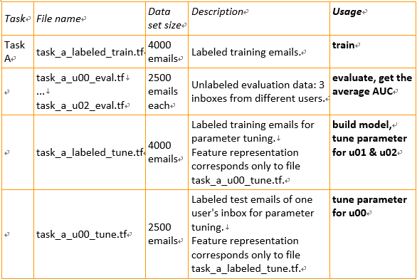
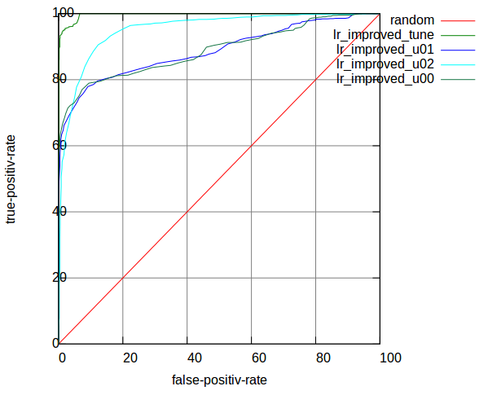
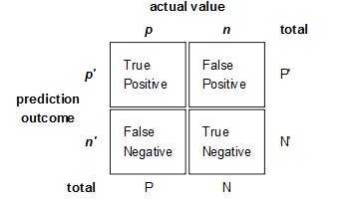
Data Set
The evaluation criterion is the AUC value. The AUC value is the area under the ROC curve (Receiver Operating Characteristic curve)
ROC (Receiver Operating Characteristic)
X axis -- Specificity -- False Positive rate = FP / [FP + TN]
Y axis -- Sensitivity -- True Positive rate = TP / [TP + FN]
Give an example, the first line in task_a_labeled_train.tf starts like following, 1 9:3 94:1 109:1 163:1

Slide 3
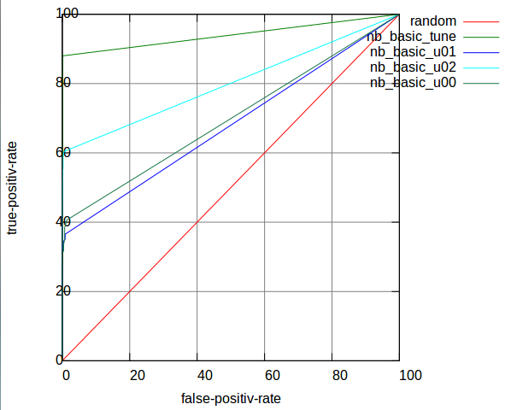


Naïve Bayes
“
A PLAN FOR SPAM http://www.paulgraham.com/spam.html
Training:
For each word, calculate the probability of a mail to be Spam when it contains this word :
 | tune | u01 | u02 | u00_tune | u00
AUC | 0.998056 | 0.899351 | 0.951194 | 0.992355 | 0.869827
u00_tuned |  |  |  | 0.996812 | 0.894598
P(S|W) = $\frac{P\left(W | S\right)∗P\left(S\right)}{P\left(W | S\right)∗P\left(S\right)+ P\left(W | H\right)∗P\left(H\right)}$
, where P(W|S) is the static likelihood of a word exists in all Spam, which I call learned from training data. Same as P(W|H) .
Evaluating:
To evaluate a new mail, I can calculate the Combining Probabilities which shows the probability of a mail to be Spam or Healthy.
In my classifier, I pick the most interesting some words (Graham used 15) from a e-mail with highest P(S|W) to calculate the probability

Slide 4
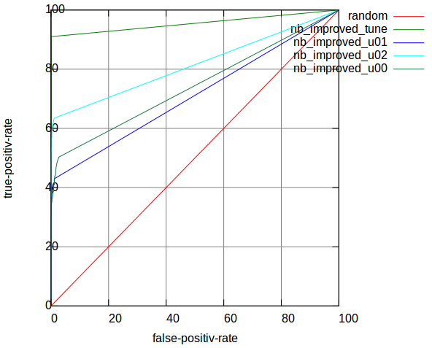
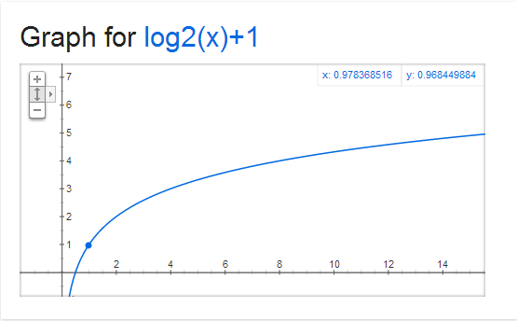
Improve Naïve Bayes
 | tune | u01 | u02 | u00_tune | u00
AUC | 0.998196 | 0.912002 | 0.952196 | 0.991569 | 0.874134
u00_tuned |  |  |  | 0.991257 | 0.901313
Frequency & Anti-Spoof
e.g. in train_data, -1 9:84 35:324 67:2 74:18 92:6 132:3
The useful frequency should distinguish the low value, but should not be too big when the value is high.
I hope the frequency can be transformed to something like this figure.
I lost the parameters here, actually I can get 1% higher AUC.
Improve
 | tune | u01 | u02 | u00_tune | u00
AUC | 0.998056 | 0.899351 | 0.951194 | 0.992355 | 0.869827
u00_tuned |  |  |  | 0.996812 | 0.894598
However, there is another problem pointed out by Graham, “such an algorithm would be easy for spammers to spoof: just add a big chunk of random text to counterbalance the spam terms.”

Slide 5
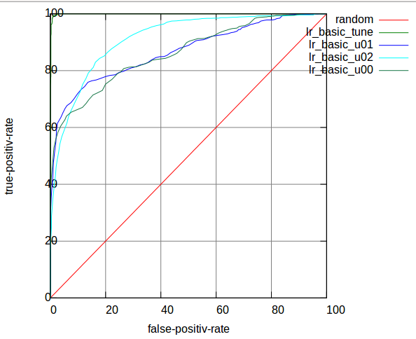
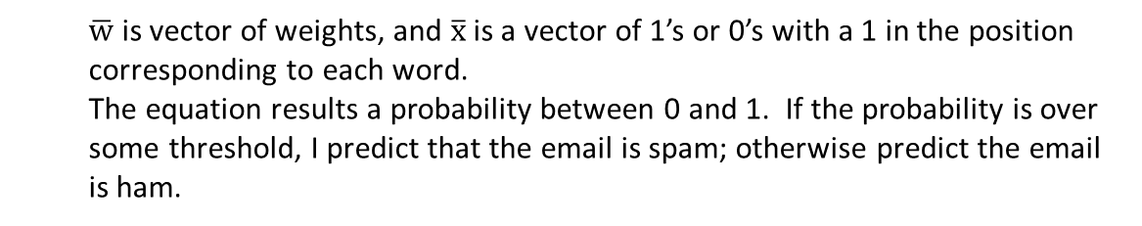
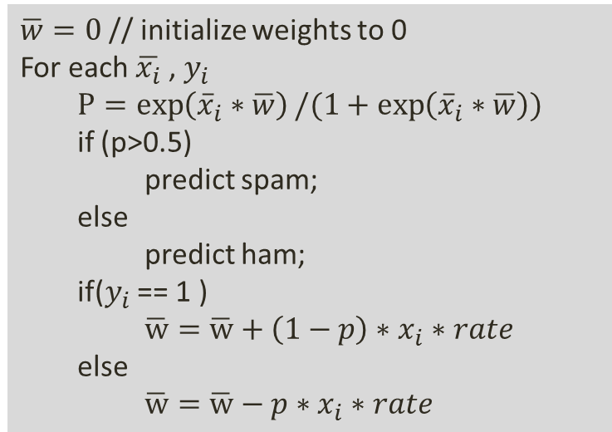
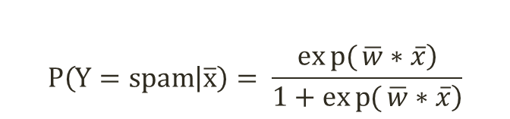
Logistic Regression
“
Online Discriminative Spam Filter Training ,
by Joshua Goodman & Wen-tau Yih @ CEAS 2006
$$P\left(Y=spam | \overline{x}\right)= \frac{\left.exp{(}\overline{w}∗\overline{x}\right)}{\left.1+exp{(}\overline{w}∗\overline{x}\right)}$$
 | tune | u01 | u02 | u00_tune | u00
AUC | 0.999212 | 0.867380 | 0.912238 | 0.999411 | 0.848224
u00_tuned |  |  |  | 0.999588 | 0.862130
$\overline{w}$ is vector of weights, and $\overline{x}$ is a vector of 1’s or 0’s with a 1 in the position corresponding to each word.
The equation results a probability between 0 and 1. If the probability is over some threshold, I predict that the email is spam; otherwise predict the email is ham.
Training
Algorithm:
$\overline{w}=0$// initialize weights to 0
For each $\overline{x_{i}}$, $y_{i}$
$$P=\exp\left({\overline{x}}_{i}∗\overline{w}\right)/(1+\exp\left({\overline{x}}_{i}∗\overline{w}\right))$$
if (p>0.5)
predict spam;
else
predict ham;
if($y_{i}$ == 1 )
$\overline{w}=\overline{w}+\left(1−p\right)∗x_{i}∗rate$
else
$\overline{w}=\overline{w}−p∗x_{i}∗rate$

Slide 6
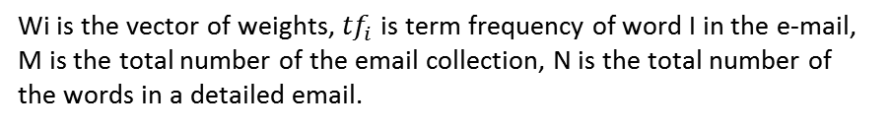
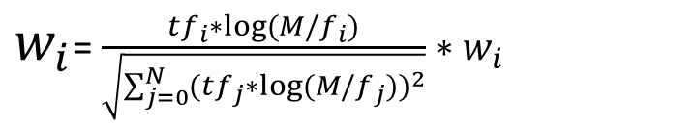
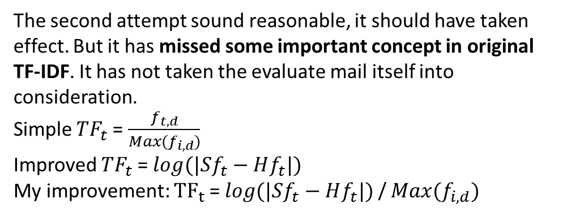
Logistic Regression with TF-IDF
 | tune | u01 | u02 | u00_tune | u00
AUC | 0.999371 | 0.887771 | 0.952392 | 0.999475 | 0.881424
u00_tuned |  |  |  | 0.999606 | 0.888191
TF-IDF can evaluate how important the word is in spam.
First attempt:
$w_{i}$= $\frac{{tf}_{i}∗log(M/f_{i})}{\sqrt{\sum_{j=0}^{N}{{{(tf}_{j}∗log(M/f_{j}))}^{2}}}}∗w_{i}$
Improve
 | tune | u01 | u02 | u00_tune | u00
AUC | 0.999212 | 0.867380 | 0.912238 | 0.999411 | 0.848224
u00_tuned |  |  |  | 0.999588 | 0.862130
Wi is the vector of weights, ${tf}_{i}$ is term frequency of word I in the e-mail, M is the total number of the email collection, N is the total number of the words in a detailed email.
Second attempt:
$$W_{i}={TF}_{i}∗{IDF}_{i}=log(|Sf_{i}−Hf_{i}|)∗(|\log\left(S/n_{i}\right)−log(H/n_{j})|)$$
My improvement:
The second attempt sound reasonable, it should have taken effect. But it has missed some important concept in original TF-IDF. It has not taken the evaluate mail itself into consideration.
Simple ${TF}_{t}$= $\frac{f_{t,d}}{Max(f_{i,d})}$
Improved ${TF}_{t}$ = $log(|Sf_{t}−Hf_{t}|)$
My improvement: ${TF}_{t}$ = $log(|Sf_{t}−Hf_{t}|)$ / $Max(f_{i,d})$

Slide 7
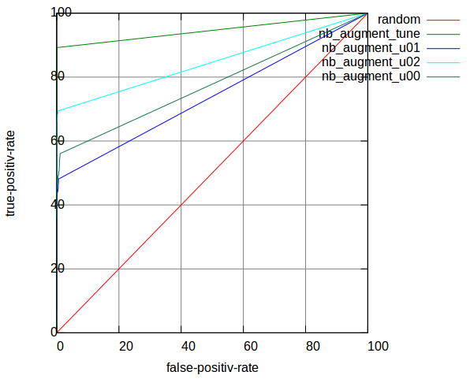
Shall we stop?
Bayesian Filter Self-Learning
 | tune | u01 | u02 | u00_tune | u00
AUC | 0.997701 | 0.927123 | 0.980120 | 0.989169 | 0.889985
u00_tuned |  |  |  | 0.992031 | 0.958331
No.
Observe: Why AUC on tune_data could be so high? Why u02 has higher AUC than u01, and u00 has lowest AUC but has an individual tuning data?
-- I can learn from myself
-- More data, more good.
-- Avoid cheating
-- Improvement
I set a learning boundary when evaluating mails. I believe those mails which have probabilities > 0.99 or < 0.01 are predicted correctly. Then I can treat those mails as labeled to augment my training data.
Another advantage is that these extra training data has more similarities on features to the evaluating data.
Logistic Regression Filter Self-Learning
 | tune | u01 | u02 | u00_tune | u00
AUC | 0.999315 | 0.899148 | 0.960306
u00_tuned |  |  |  | 0.999421 | 0.892779

Slide 8
Shall we stop now?
It depends.
Since the self-learned data has more similarities to those evaluation data, I want to increasing their weight while evaluation. I can import an enlargement coefficient on the self-learning rate. I got this idea from LR learning rate.
But this enlargement is obviously not the bigger the better. When I learned from predicted probability, I have also unavoidably learned some bad classified mails. That’s not good for this kind of mistakes to be enlarged.
Enlarged x3
 | tune | u01 | u02 | u00_tune | u00
AUC | 0.997126 | 0.936075 | 0.985456
u00_tuned |  |  |  | 0.990459 | 0.976759
Enlarged x20
 | tune | u01 | u02 | u00_tune | u00
AUC | 0.994268 | 0.953053 | 0.987347
u00_tuned |  |  |  | 0.979197 | 0.988825

Slide 9
Conclusion
-- LR
Weights will trend to a balanced point, converge faster
Need limited train data compared to Bayes
Not improved by self-learning
More true-positive-rate , more false-positive-rate
-- Bayes
More data more precise
Good performance when self-learning
Less false-positive-rate, less true-positive-rate
“Spam filtering is not just classification, because false positives are so much worse than false negatives that you should treat them as a different kind of error. And the source of error is not just random variation, but a live human spammer working actively to defeat your filter.”
-- Paul Graham

Slide 10
My Results
Bayesian Filter
Logistic Regression Filter
 | u00 | u01 | u02 | Average AUC
AUC | 0.901313 | 0.912002 | 0.952196 | 0.921837
 | u00 | u01 | u02 | Average AUC
AUC | 0.888191 | 0.887771 | 0.952392 | 0.909551
Bayesian Filter With Self-Learning
Enlarge*3 for Bayesian Filter With Self-Learning
 | u00 | u01 | u02 | Average AUC
AUC | 0.958331 | 0.927123 | 0.980120 | 0.955191
 | u00 | u01 | u02 | Average AUC
AUC | 0.976759 | 0.936075 | 0.985456 | 0.966097
I felt quite exciting when compared to Ranking in Discovery Challenge 2006:
Rank Task A | Average AUC | Team
1 | 0.950667 | Khurram Nazir Junejo, Mirza Muhammad Yousaf, Asim Karim Lahore University of Management Sciences, Pakistan
1 | 0.949094 | Bernhard Pfahringer University of Waikato, New Zealand
1 | 0.948666 | Kushagra Gupta, Vikrant Chaudhary, Nikhil Marwah, Chirag Taneja Inductis India Pvt Ltd
2 | 0.936457 | Nikolaos Trogkanis, National Technical University of Athens, Greece Georgios Paliouras, National Center of Scientific Research "Demokritos", Greece
3 | 0.927839 | Chao Xu, Yiming Zhou Beihang University, Beijing, China

