Slide 1
CM44 TB
Kazuki UENO
Satoshi MIHARA

Slide 2
New TB structure
Team leaders
More frequent discussion among team leaders with PM & TC
Close communication in each team
Include more people in active sub-projects
Other activities
Integration in the detector solenoid
CDC & CTH in cradle
Area (electronics) layout

Slide 3
Executive
Board
Project Manager:
S. Mihara (KEK)
Spokesperson:
M. Aoki (KEK)
Collaboration Board Chair:
Y. Uchida (Imperial)
Collaboration Board
Technical Coordinator (TB Secretary):
K. Ueno (Osaka)
Financial Board Chair:
C. Carloganu (LPC)
Technical
Board
Infrastructure Team:
Y. Fukao (KEK)
Solenoid magnet Team
M. Yoshida (KEK)
Physics Detector Team
K. Ueno (Osaka)
DAQ & Online Team
K. Oishi (KEK)
Data Analysis Team
Y. Zhang (IHEP)
Beam Detector Team
J. Tojo (Kyushu)
Proton beam-line:
Y. Fukao (KEK)
CS, MTS, BTS:
M. Iio (KEK)
CDC:
A. Sato (Osaka)
DAQ-Trigger:
M. Lee (SKKU)
Physics and SW:
Y. Uchida (Imperial)
Y. Zhang (IHEP)
Muon monitor:
Y. Fukao (KEK)
J. Tang (SYSU)
Proton target:
S. Makimura (KEK)
Detector Solenoid:
K. Sasaki (KEK)
M. Yoshida (KEK)
CTH:
Y. Fujii (Monash)
DAQ-Slow Control:
K. Oishi (KEK)
Offline Computing:
Y. Igarashi (KEK)
Proton monitor:
P. Sarin
(IIT-Bombay)
Muon beam-line:
C. Wu (IHEP)
Y. Fukao (KEK)
Cryogenics:
T. Okamura (KEK)
Cosmic-ray veto:
D. Chokheli (GTU)
DAQ-readout:
Y. Igarashi (KEK)
Data Management:
K. Hayasaka (Niigata)
Straw Chambers:
H. Nishiguchi (KEK)
Safety:
S. Mihara (KEK)
Muon target:
A. Jansen (TUD)
Rad Hard:
K. Ueno (Osaka)
ECAL:
J. Tojo (Kyushu)
Radiation Shield:
Y. Uchiyama (KEK)
X-ray calibration:
A. Jansen(TUD)
Sub-project
Coordinators

Slide 4
Executive
Board
Project Manager:
S. Mihara (KEK)
Spokesperson:
M. Aoki (KEK)
Collaboration Board Chair:
Y. Uchida (Imperial)
Collaboration Board
Technical Coordinator (TB Secretary):
K. Ueno (Osaka)
Financial Board Chair:
C. Carloganu (LPC)
Technical
Board
Infrastructure Team:
Y. Fukao (KEK)
Solenoid magnet Team
M. Yoshida (KEK)
Physics Detector Team
K. Ueno (Osaka)
DAQ & Online Team
K. Oishi (KEK)
Data Analysis Team
Y. Zhang (IHEP)
Beam Detector Team
J. Tojo (Kyushu)
Proton beam-line:
Y. Fukao (KEK)
CS, MTS, BTS:
M. Iio (KEK)
CDC:
Sato (Osaka)
R. Nagai (Osaka)
DAQ-Trigger:
M. Lee (SKKU)
C. Yamada (Osaka)
Physics and SW:
Y. Uchida (Imperial)
Y. Zhang (IHEP)
Muon monitor:
Y. Fukao (KEK)
J. Tang (SYSU)
Proton target:
S. Makimura (KEK)
Detector Solenoid:
K. Sasaki (KEK)
M. Yoshida (KEK)
CTH:
Y. Fujii (Imperial)
A. Miles (Monash)
DAQ-Slow Control:
K. Oishi (KEK)
Offline Computing:
Y. Igarashi (KEK)
Proton monitor:
P. Sarin
(IIT-Bombay)
Muon beam-line:
C. Wu (IHEP)
Y. Fukao (KEK)
Cryogenics:
T. Okamura (KEK)
Cosmic-ray veto:
D. Chokheli (GTU)
C. Carloganu (LPC)
DAQ-readout:
Y. Igarashi (KEK)
Data Management:
K. Hayasaka (Niigata)
Straw Chambers:
H. Nishiguchi (KEK)
Safety:
S. Mihara (KEK)
Muon target:
A. Jansen (TUD)
Rad Hard:
K. Ueno (Osaka)
ECAL:
J. Tojo (Kyushu)
Radiation Shield:
Y. Uchiyama (KEK)
X-ray calibration:
A. Jansen(TUD)
Sub-project
Coordinators

Slide 5
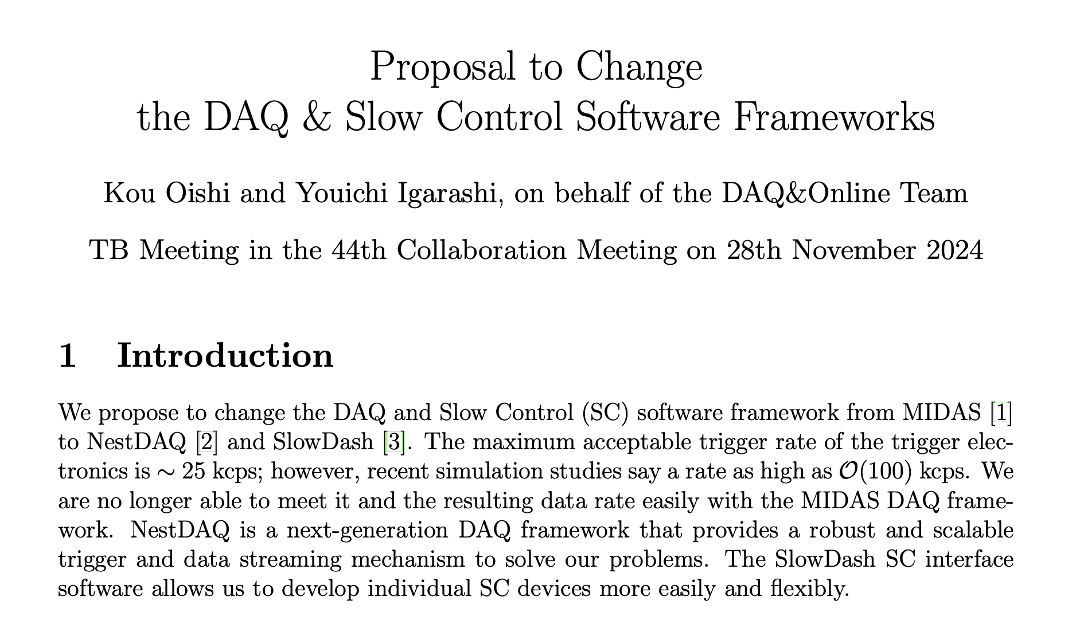
Design Change
DAQ & Slow control framework

