Slide 1

AURORA — Redefining Modern Digital Commerce
A premium, minimalist e‑commerce platform for curated lifestyle essentials. Fast, resilient, and beautifully simple — designed for shoppers who value craft, performance, and effortless discovery.

Slide 2


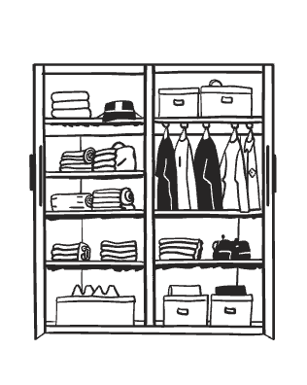
Vision & Design Language
Glassmorphism-first
Seamless Dark /
Light Modes
Minimalist UI / UX
Outfit-inspired typography, deliberate whitespace, and prioritized CTAs make browsing calm, fast, and conversion-focused.
Frosted panels, subtle shadows, and layered translucency create a tactile, high-end feel that foregrounds product photography.
Native CSS variables power instantaneous theme switching with consistent color tokens for contrast, accessibility, and brand cohesion.

Slide 3

Frontend Architecture — Performance & Maintainability
React (Vite)
React Router (SPA)
Lucide Iconography
Blazing-fast builds, HMR, and lightweight bundles for a snappy shopper experience.
Fluid navigation and route-based code splitting to minimize initial load and preserve client state.
Consistent, accessible icon set optimized for vector crispness across densities.
React Context API
Global state for Cart & Theme with local persistence and selective re-renders to reduce overhead.

Slide 4

Complex Frontend Features — Filtering & Sorting
Robust Filtering Engine
Multi-faceted, client-side + server-assisted filters: dynamic categories, size arrays per product, color/metadata tags, and numeric price-range sliders with debounce and async refinement.
Real-time Sorting Logic
Deterministic sorts: relevance, newest, price asc/desc, and composite scores (popularity + margin). Stable sorting preserves user context.

Slide 5
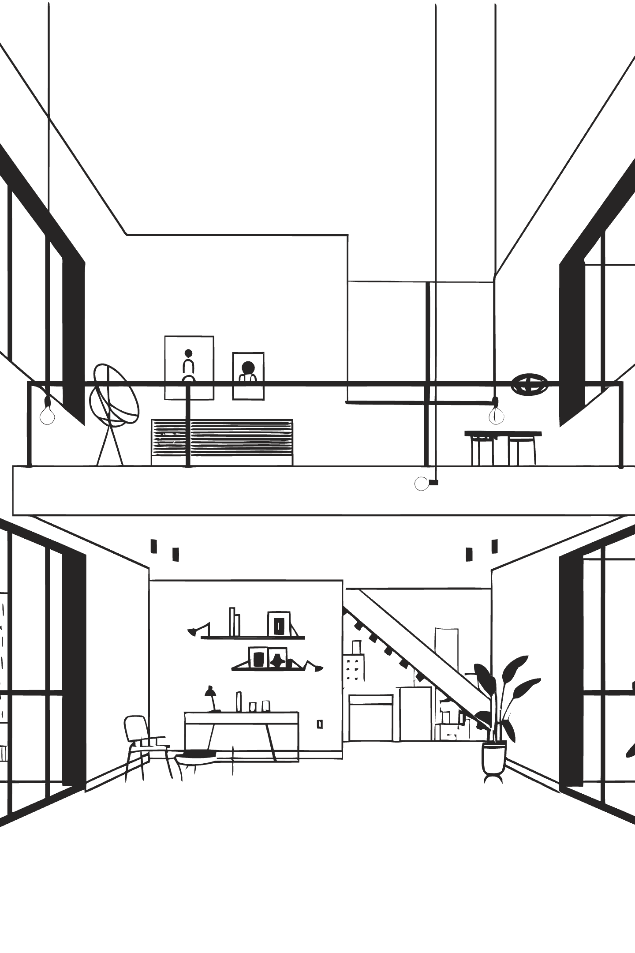
Backend Infrastructure — Scalable MVC
Node.js + Express implementing an enterprise-ready MVC pattern. Separation of concerns across Routes, Controllers, and Models ensures testability, maintainability, and straightforward horizontal scaling.
Routes
Controllers
Models
Thin adapters for authentication, product catalog, cart, checkout, and webhooks.
Business logic, validation, and orchestration with clear unit boundaries.
Data access encapsulated via Mongoose with schema-driven validation and hooks.

Slide 6

Database Strategy — Resilient & Schema-driven
MongoDB Atlas
Managed cloud database with global clusters, automated backups, and performance insights.
Mongoose Schemas
Explicit schemas for products, inventory, users, and orders — enabling validation, indexing, and population patterns.
Graceful Fallback
Edge caching + client-side IndexedDB fallback keeps browsing and cart interactions functional during transient connectivity loss.

Slide 7





Product Catalog & Metadata
Apparel
Footwear
Electronics
Bags
12 SKUs with size arrays (XS–XL), fit metadata, fabric tags, and color variants.
6 SKUs with numeric sizing, width options, and stock split per warehouse.
4 SKUs with technical metadata, warranties, and serial-level tracking.
5 SKUs with dimensions, materials, and compartment metadata.
Accessories
5 SKUs with versatile attributes and cross-sell metadata (bundle suggestions).
Total: 32+ curated products. Every item includes dynamic metadata to support filtering, personalization, and merchandising rules.

Slide 8
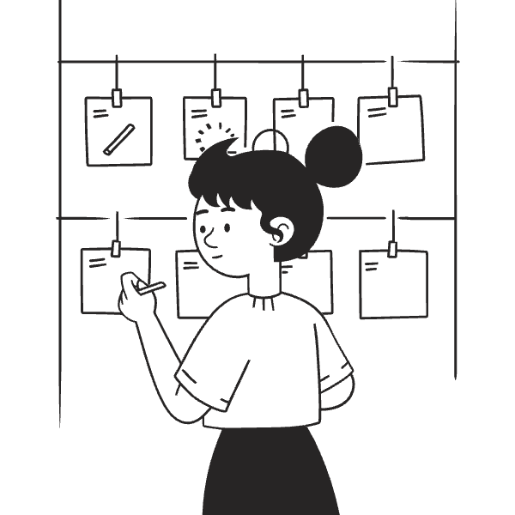
Checkout & Contact Integrations
Checkout Workflow
Server-validated cart, shipping calculation, tax estimation, guest + account flows, and webhooks for order lifecycle events.
Contact Us
Functional contact integration with validated forms, rate-limited endpoints, and email/webhook forwarding for CRM ingestion.

Slide 9

Success Story & Roadmap
1
Launched MVP
Catalog browsing, cart, and offline resilience — validated with early users.
2
Optimization
Performance tuning (bundle splitting, image delivery), accessibility audit, and A/B tests for merchandising.
3
Next: Payments
Integrate Stripe API for live payments, SCA support, subscriptions, and disputes handling.
4
Scale & Internationalize
Multi-region DB, localized catalogs, currency support, and SOC-compliant ops for enterprise clients.

Slide 10


Key Takeaways & Next Steps
Design: Glassmorphism + Outfit typography for a distinctive, premium experience.
Frontend: React + Vite, Context for Cart/Theme, deterministic filtering & sorting.
Backend: Node/Express MVC with Mongoose and MongoDB Atlas for scale and resiliency.
Product: 32+ SKUs across 5 categories with rich metadata to power discovery.
Roadmap: Stripe integration, internationalization, and enterprise readiness.
Ready to demo a working flow? Proposal: 4-week sprint to integrate Stripe payments, add analytics, and run a high-conversion UX pass.

