Slide 1
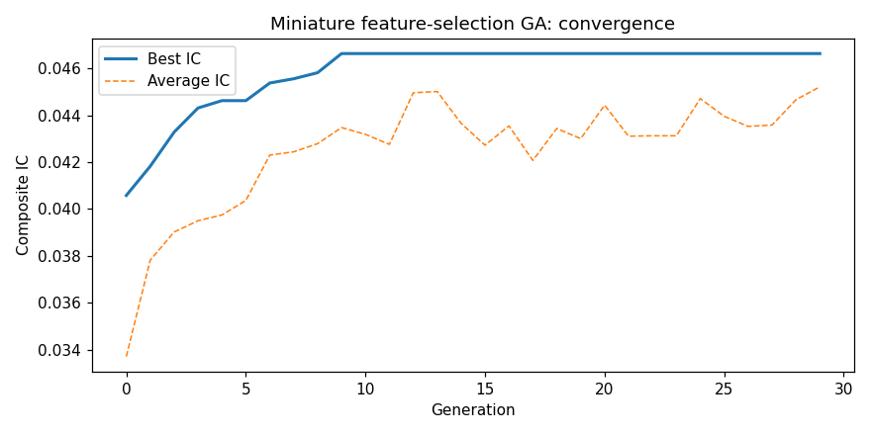
FIGURE 11.1
Convergence of the miniature feature-selection GA. The best composite IC climbs from about 0.041 to 0.047 within roughly nine generations and then plateaus, while the average population IC rises more gradually and noisily, illustrating t...
Editable source: ga_mini_toy.py | PNG file: fig_19_1_mini_ga.png (matplotlib plot - edit the script/code and rerun to change the data)

Slide 2
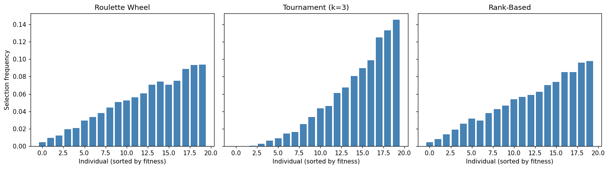
FIGURE 11.2
Selection frequency for 20 individuals (sorted by increasing fitness) under three selection operators. Roulette wheel selection is proportional to absolute fitness, tournament selection concentrates more sharply on the fittest individual...
Editable source: Chapter_11_Draft.md, section 11.3.7 code | PNG file: fig_19_2_selection.png (matplotlib plot - edit the script/code and rerun to change the data)

Slide 3
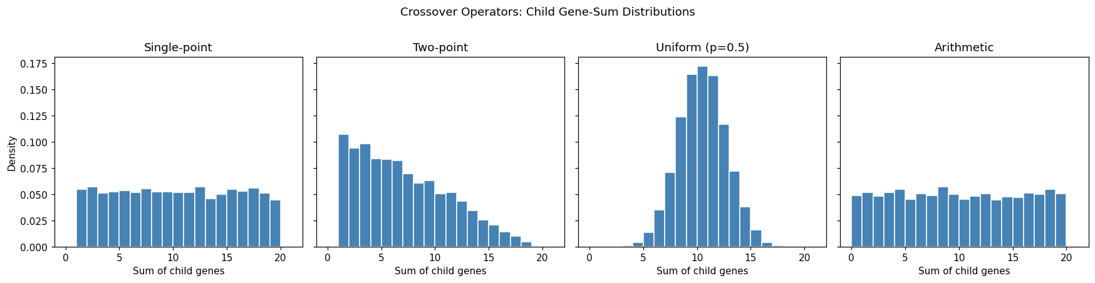
FIGURE 11.3
Distribution of gene sums for children of an all-zeros parent and an all-ones parent. Single-point crossover produces a uniform distribution. Two-point crossover peaks at the extremes (when the swapped segment is short) and in the middle...
Editable source: Chapter_11_Draft.md, section 11.3.8 code | PNG file: fig_19_3_crossover.png (matplotlib plot - edit the script/code and rerun to change the data)

Slide 4
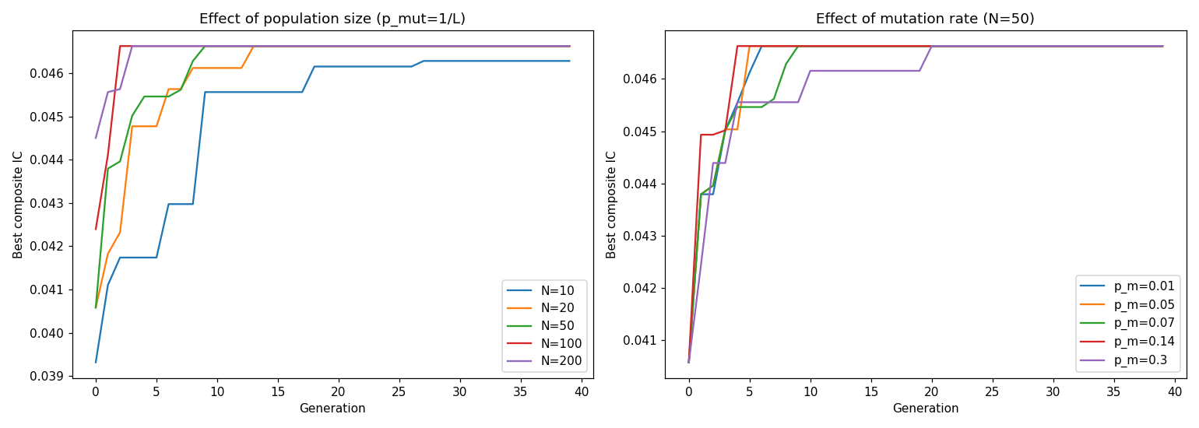
FIGURE 11.4
**Left:** Larger populations converge faster to the optimal composite IC (about 0.047) thanks to greater initial diversity, with $N = 100$ and $N = 200$ almost indistinguishable, showing diminishing returns beyond $N \approx 100$. **Righ...
Editable source: ga_mini_toy.py | PNG file: fig_19_4_param_sensitivity.png (matplotlib plot - edit the script/code and rerun to change the data)

Slide 5
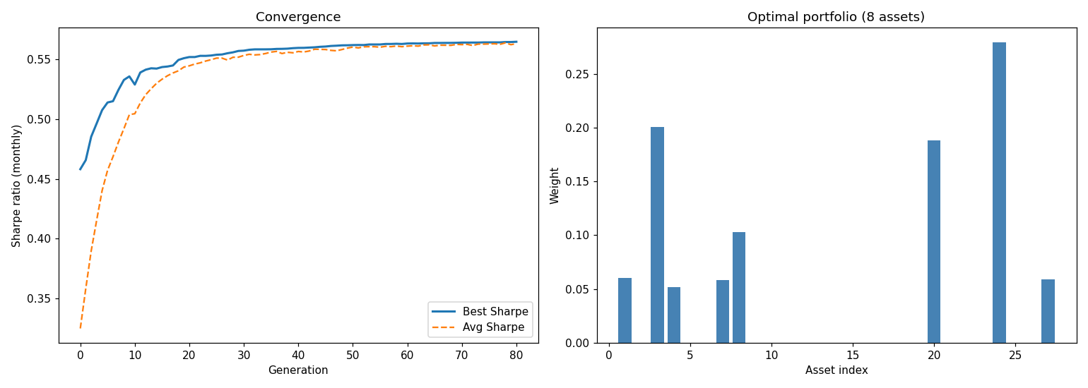
FIGURE 11.5
**Left:** GA convergence for cardinality-constrained portfolio optimisation on 30 real US equities (2015 to 2019). The best monthly Sharpe ratio stabilises well before the 80th generation. **Right:** The optimal portfolio weights, concen...
Editable source: ga_book_demos.py (demo_portfolio) | PNG file: fig_19_5_portfolio.png (matplotlib plot - edit the script/code and rerun to change the data)

Slide 6
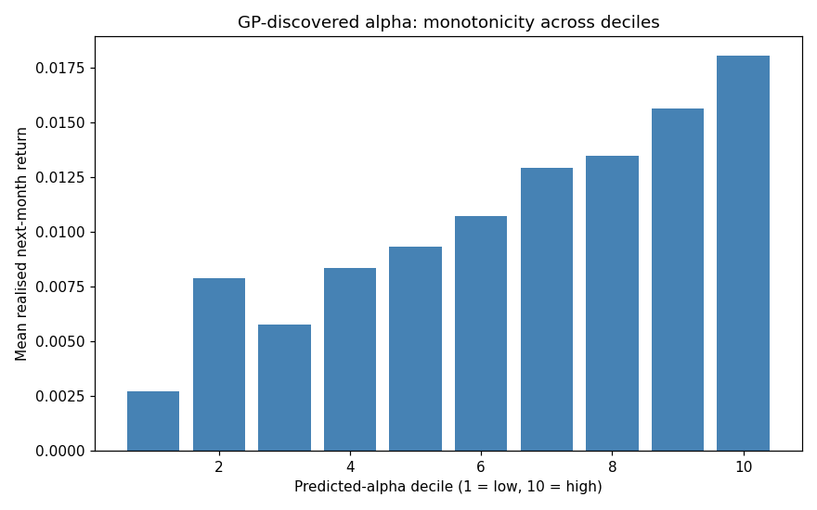
FIGURE 11.6
Mean realised next-month return across deciles of the GP-discovered alpha, computed over the full 2015 to 2019 cross-section (in-sample). The relationship is close to monotone: stocks in the top decile of the evolved formula outperform t...
Editable source: ga_book_demos.py (demo_gp) | PNG file: fig_19_6_gp_alpha.png (matplotlib plot - edit the script/code and rerun to change the data)

Slide 7
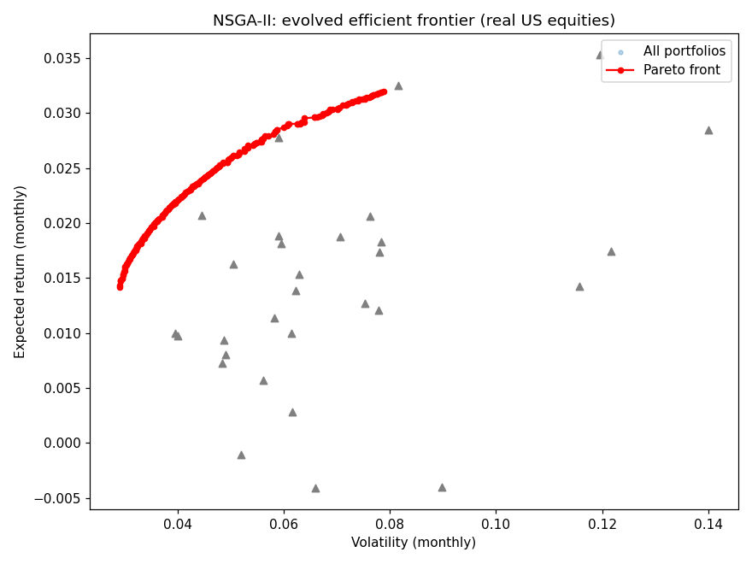
FIGURE 11.7
The NSGA-II-evolved Pareto front (red) for 30 real US equities (2015 to 2019), with monthly return and volatility on the axes. Grey triangles represent individual assets. The Pareto front dominates all individual assets: diversified port...
Editable source: ga_book_demos.py (demo_nsga2) | PNG file: fig_19_7_nsga2.png (matplotlib plot - edit the script/code and rerun to change the data)

Slide 8
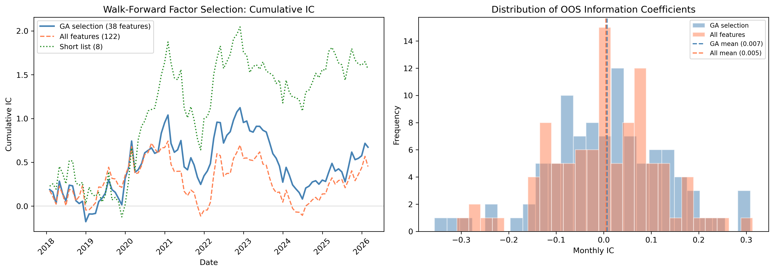
FIGURE 11.8
**Left:** Cumulative out-of-sample IC over the walk-forward period (January 2018 to February 2026). The GA-selected model (blue, solid) consistently outpaces the all-features baseline (coral, dashed). The curated short list (green, dotte...
Editable source: ga_real_data_plots_v3.py | PNG file: fig_19_8_cumulative_ic.png (matplotlib plot - edit the script/code and rerun to change the data)

Slide 9
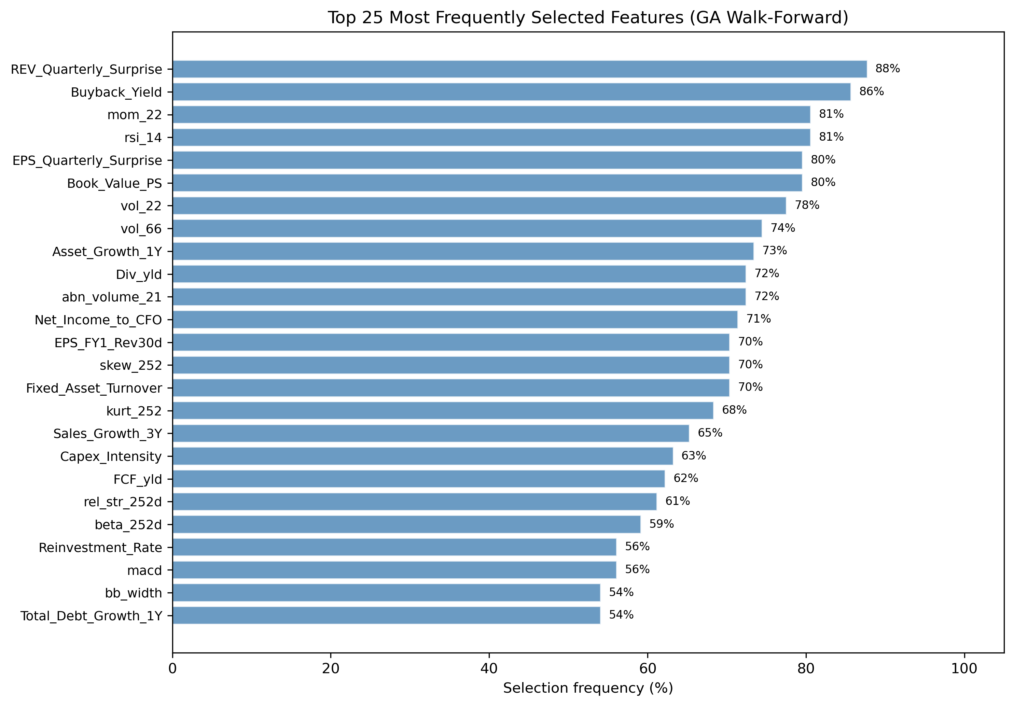
FIGURE 11.9
Selection frequency of the 25 most frequently chosen features across 98 walk-forward windows. Earnings surprise (`REV_Quarterly_Surprise`, 88%), buyback yield (`Buyback_Yield`, 86%), and short-term momentum (`mom_22`, 81%) are selected m...
Editable source: ga_real_data_plots_v3.py | PNG file: fig_19_9_feature_frequency.png (matplotlib plot - edit the script/code and rerun to change the data)

Slide 10
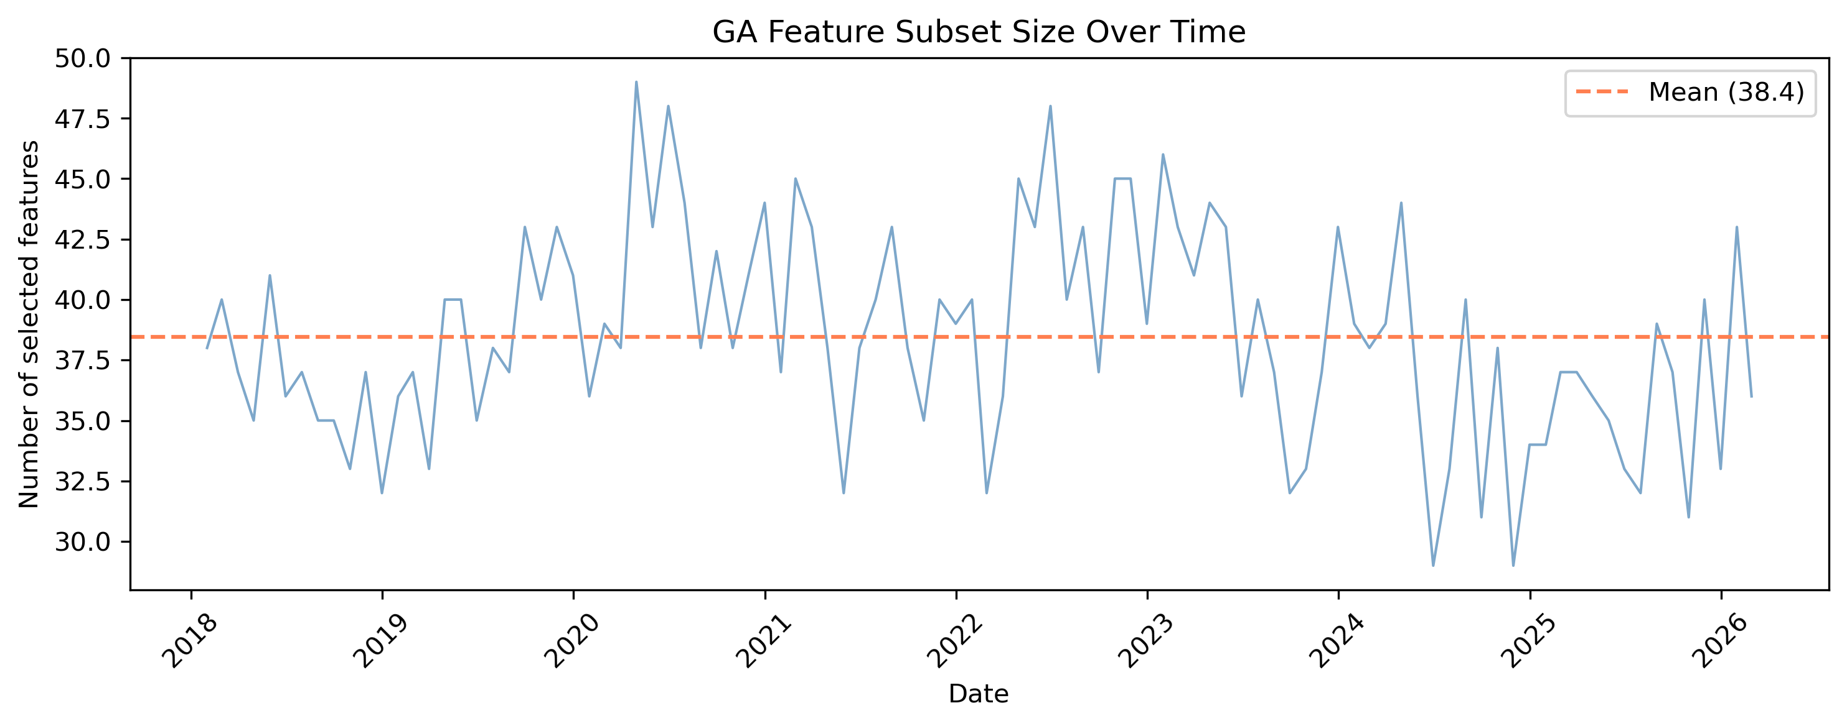
FIGURE 11.10
Number of features selected by the GA at each walk-forward window. The mean is approximately 38 features (dashed line), with moderate variation across time. The cardinality penalty keeps subsets below 50 features in most windows.
Editable source: ga_real_data_plots_v3.py | PNG file: fig_19_10_n_selected.png (matplotlib plot - edit the script/code and rerun to change the data)

Slide 11
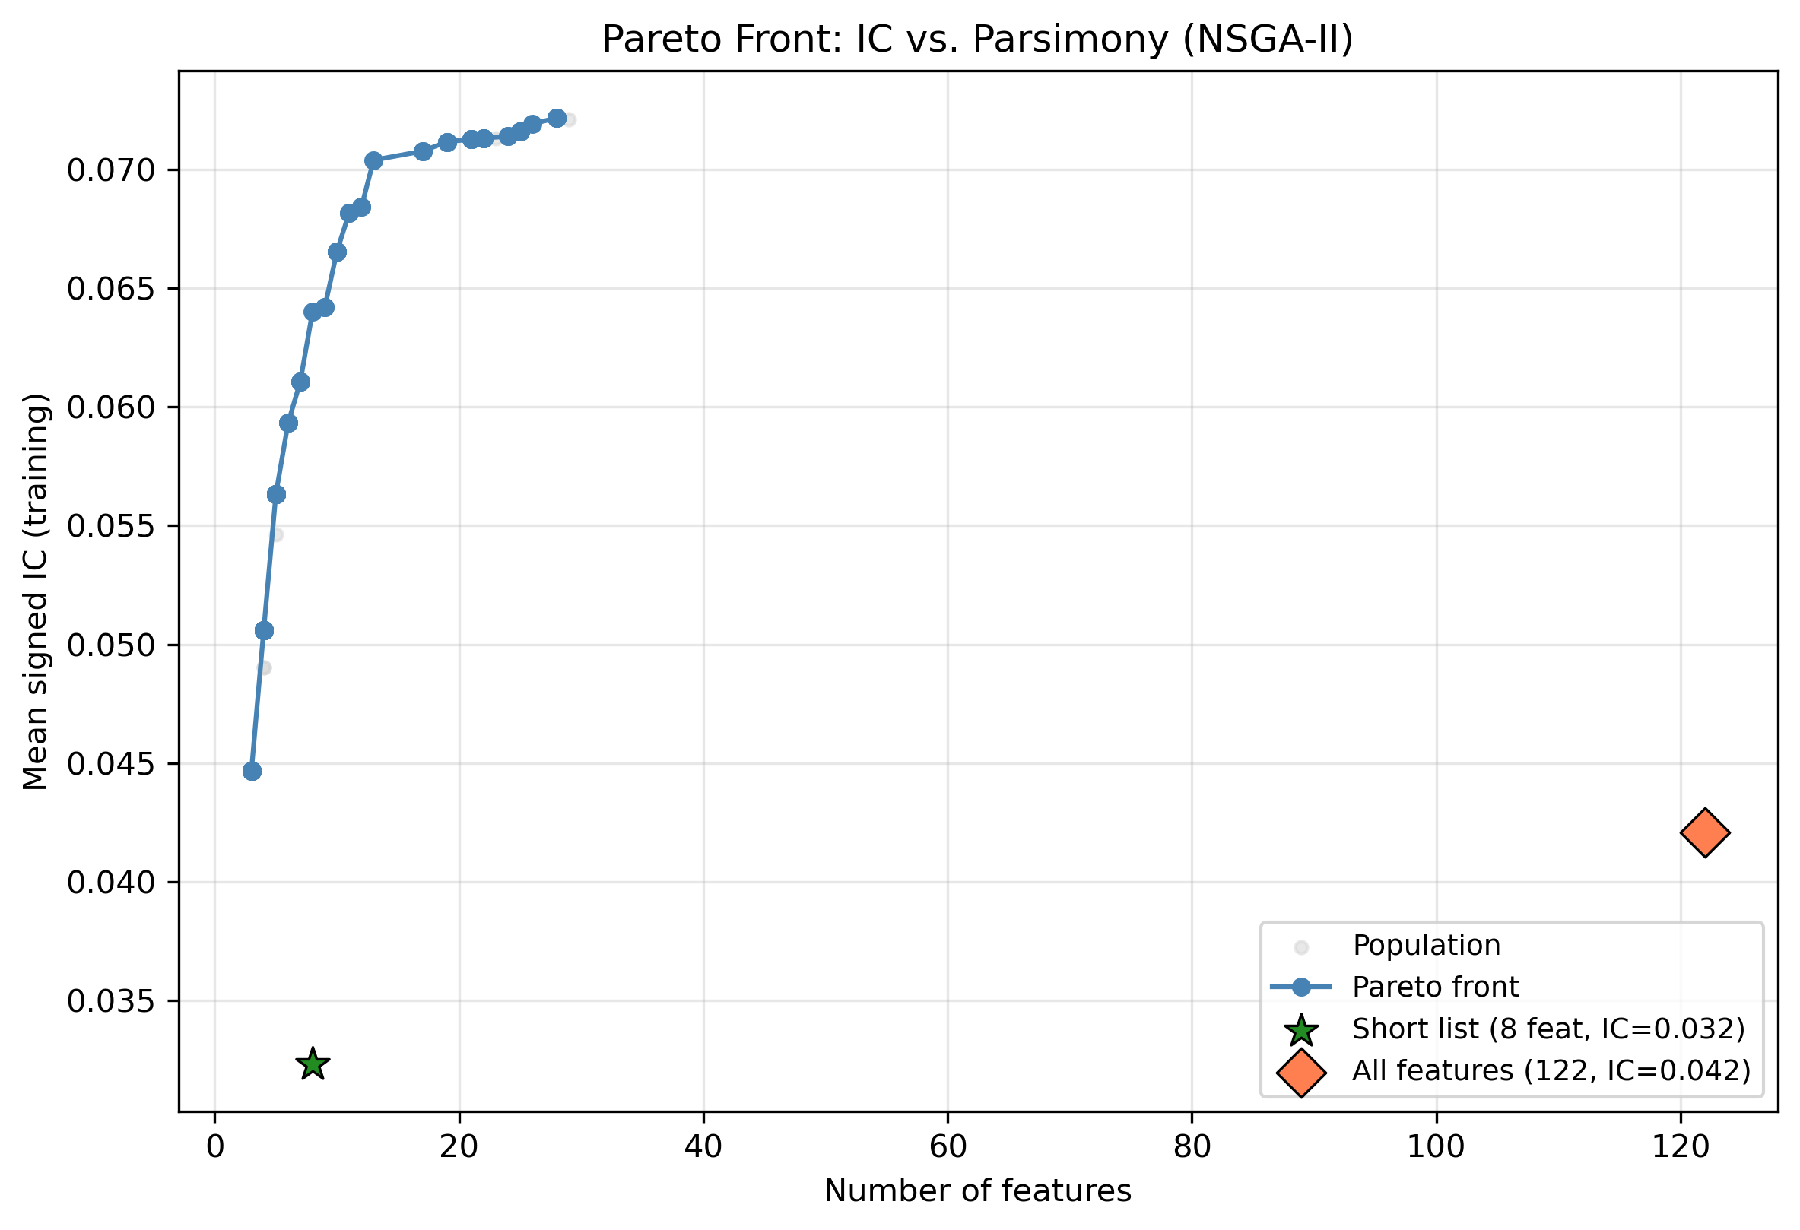
FIGURE 11.11
Pareto front of the bi-objective feature selection problem (IC vs. number of features). The blue connected line shows the Pareto-optimal trade-off. The green star marks the curated short list (8 features, IC = 0.032) and the coral diamon...
Editable source: ga_multiobjective_fs.py | PNG file: fig_19_11_pareto_front.png (matplotlib plot - edit the script/code and rerun to change the data)

Slide 12
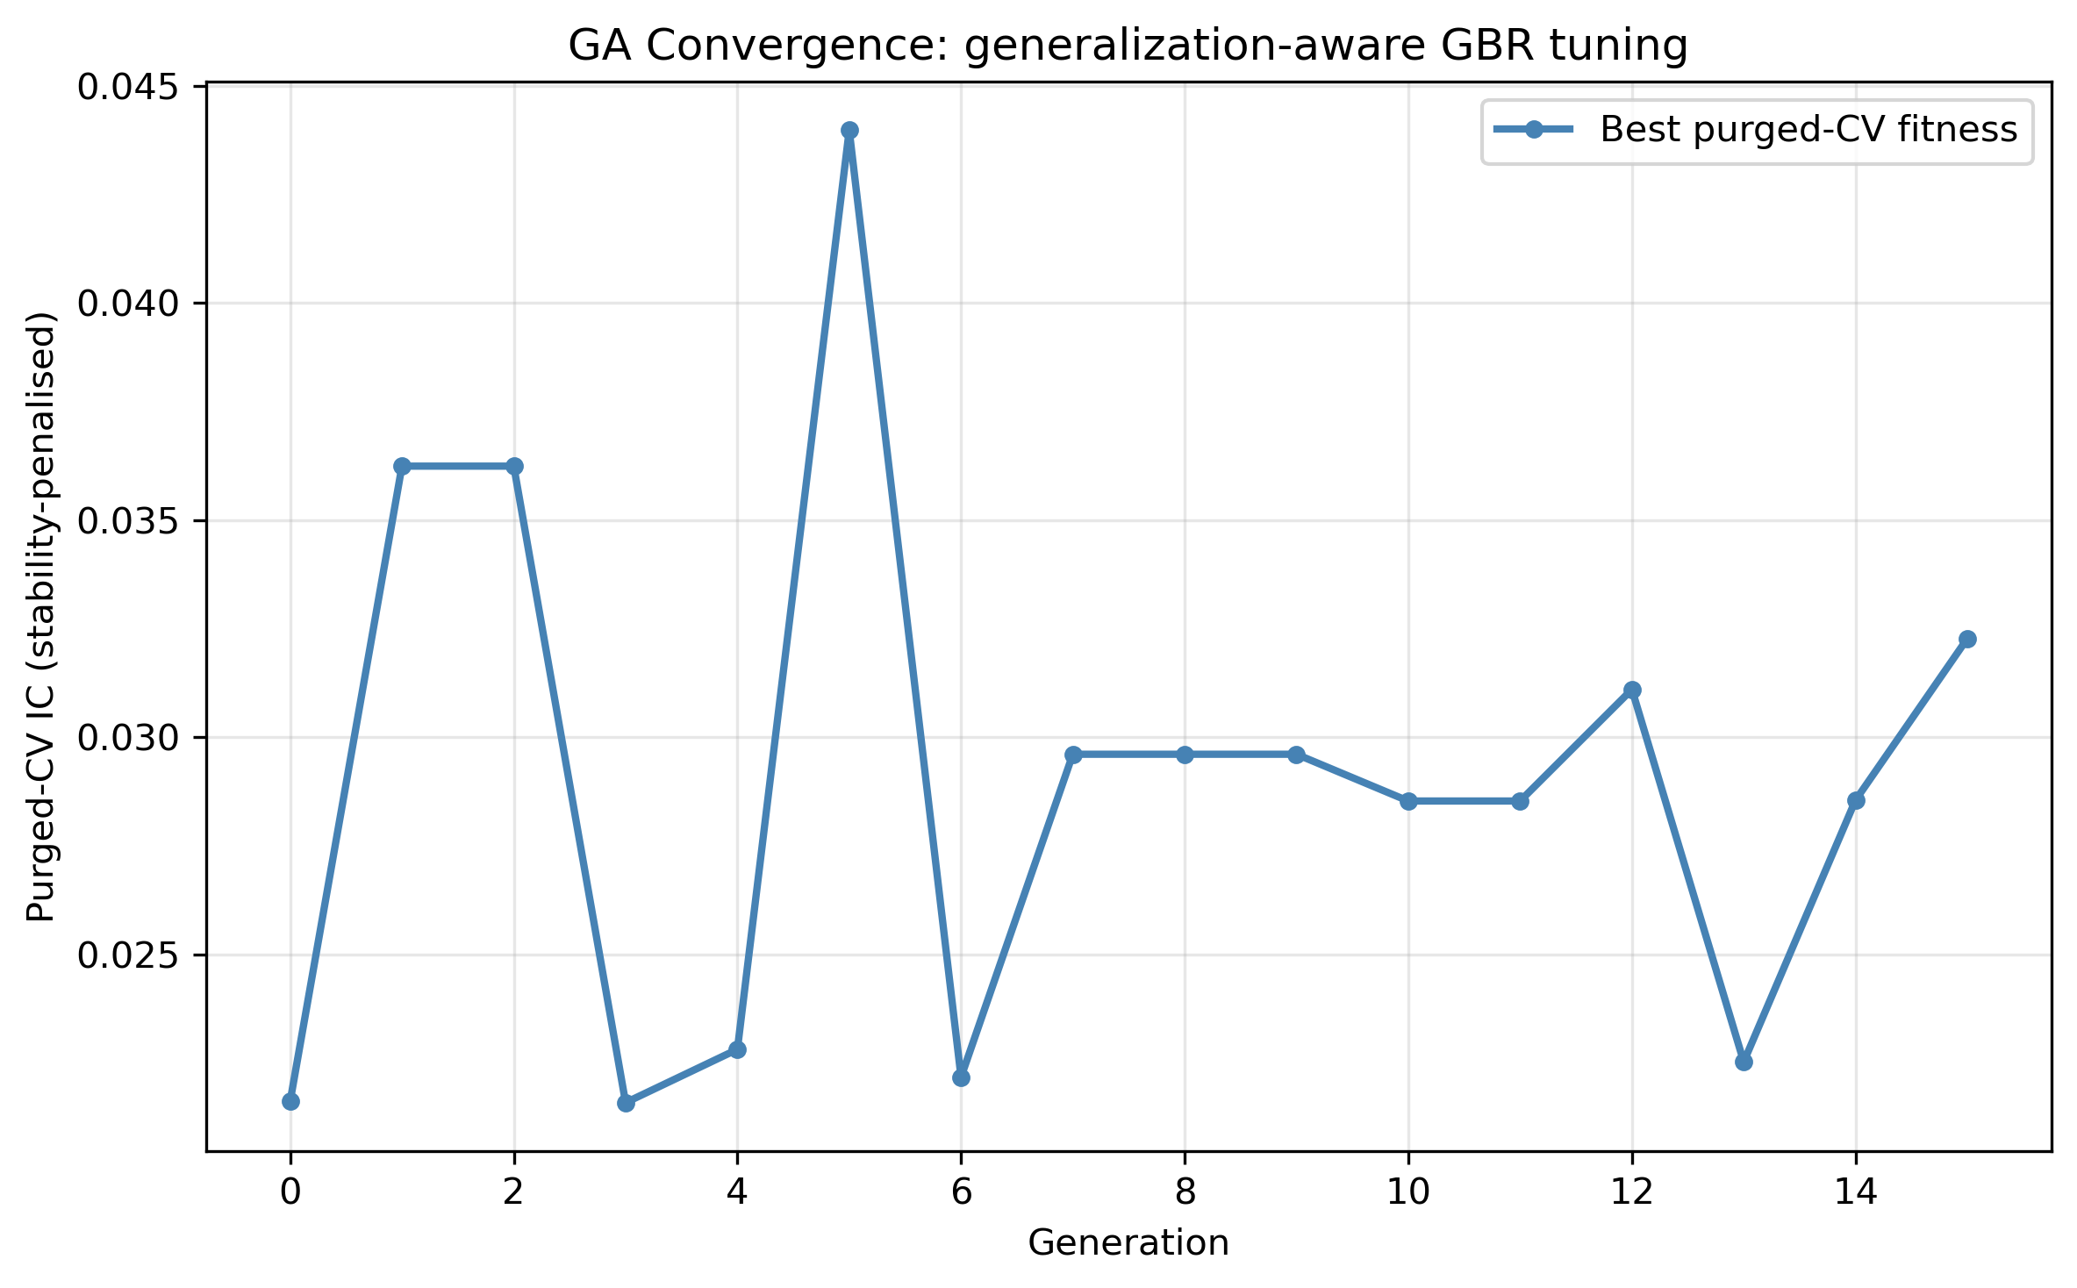
FIGURE 11.12
GA convergence for generalisation-aware gradient boosting tuning. The best recency-validated fitness (blue) improves over the first several generations and then plateaus. Because the search space and the fitness both favour regularisatio...
Editable source: ga_xgb_tuning.py | PNG file: fig_19_12_convergence.png (matplotlib plot - edit the script/code and rerun to change the data)

Slide 13
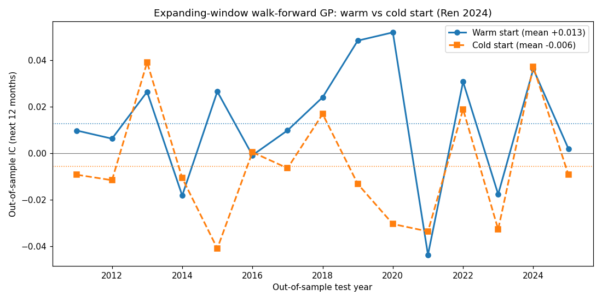
FIGURE 11.13
Out-of-sample IC in each of fifteen yearly test periods (2011 to 2025) for warm-start (solid) versus cold-start (dashed) GP alpha mining, under an expanding training window. Dotted lines mark the means. The warm-started GP is positive in...
Editable source: ga_repro_walkforward.py | PNG file: fig_19_13_walkforward.png (matplotlib plot - edit the script/code and rerun to change the data)

Slide 14
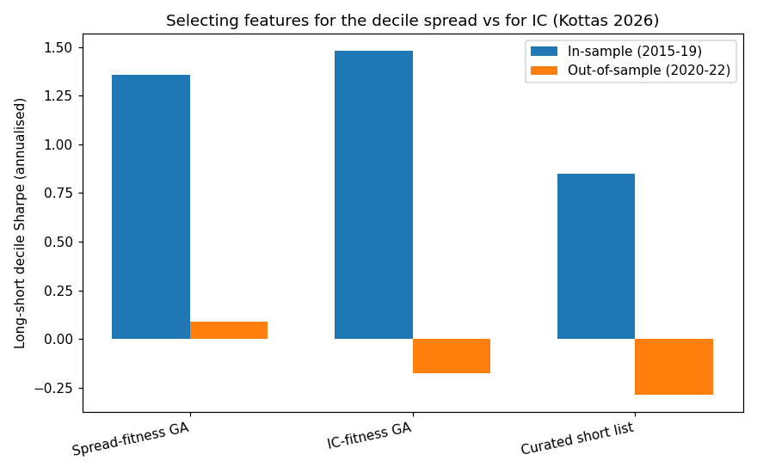
FIGURE 11.14
Annualised long-short decile Sharpe ratio, in-sample (2015 to 2019, blue) and out-of-sample (2020 to 2022, orange), for features chosen to maximise the decile spread, features chosen to maximise IC, and the curated short list. Only the s...
Editable source: ga_reproductions.py (repro2) | PNG file: fig_19_14_decile.png (matplotlib plot - edit the script/code and rerun to change the data)

Slide 15
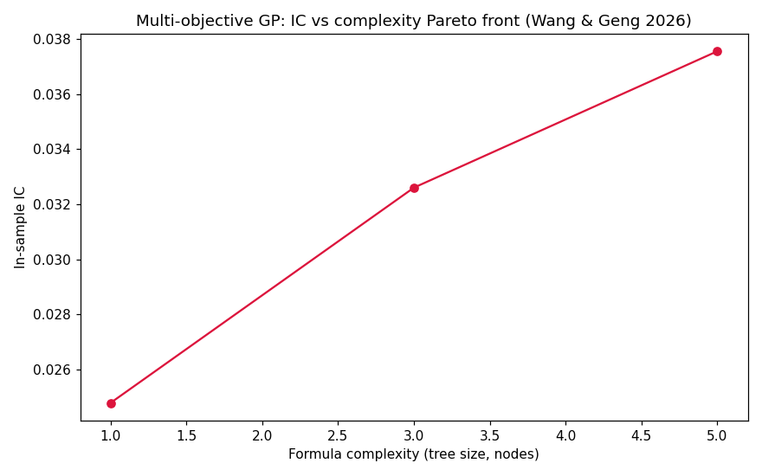
FIGURE 11.15
In-sample IC versus formula complexity (tree size in nodes) along the NSGA-II Pareto front. A single value factor (`PB`) achieves IC 0.025; combining it with momentum lifts this to 0.033, and a three-term expression reaches 0.038, after ...
Editable source: ga_reproductions.py (repro3) | PNG file: fig_19_15_pareto.png (matplotlib plot - edit the script/code and rerun to change the data)

