Slide 1
Chapter 11 & 12:
File System Interface and Implementation
Modified by Dr. Neerja Mhaskar for CS 3SH3

Slide 2
File-Systems
Provides efficient and convenient access to disk by allowing data to be stored, located and retrieved easily.
Each file system has its own logic and data structures that reside on secondary storage (disks)
File system examples
  UFS (Unix file system) - UNIX
  Ext3/Ext4 (extended file system) - LINUX
  FAT, NTFS etc. – Windows

Slide 3

File System Layers

Slide 4
File
Logical storage unit in a file system is called a file
A file is a sequence of bits, bytes, lines, or a more complex data item.
Typically file contents are broken down into logical blocks.
Disk I/O transfers performed in blocks (usually 512 bytes or more), which are stored on one or more sectors.
File systems I/O performed in group of blocks called clusters.
  Ensures that I/O has more sequential-access and fewer random-access characteristics, thereby increasing efficiency

Slide 5
File Cont…
A file is associated with the following:
File attributes – Name, Identifier (e.g. inode number), text etc.
File operations – Create, write, read, delete, truncate, repositioning within a file.
File type – Executable (.bin, .exe), text file (.txt, .doc)

Slide 6

File Control Block
Every file has a file control block (FCB) that contains all the information about the file (e.g.: ownership, permissions, and location of the file contents.)
FCB in Unix/Linux systems is called an inode.
A typical file-control block

Slide 7
File structure
Different files types have different file structures.
  These file structures are used by Operating systems and programs to work with them.
  All operating systems must support the executable file structure to load and run programs.
Supporting different file structure can increase the size of the OS making it hard to manage and work with.
  Therefore, Unix treats all files as sequence of bytes

Slide 8
File Access Methods
File access methods
  Sequential Access: Information in the file is processed in order, one record after the other.
    Most common
    Editors and compilers are accessed sequentially.
  Direct access: Information in the file is accessed directly and in no particular order.
    Databases – data accessed directly.

Slide 9
Disk Structure – Partitions and Volumes
Disks can be broken up into multiple partitions, slices, or mini-disks,
  Each partition is called a logical disk which can have its own filesystem.
Multiple physical disks can be combined into one volume, i.e. a larger virtual disk,
  This volume can have its own filesystem spanning the physical disks.
Each volume containing file system also tracks that file system’s info in device directory or volume table of contents

Slide 10

A Typical File-system Organization

Slide 11
Directories
Directories – enable segregating files into groups and managing them as groups.
The directory contains information about the files, including attributes, location, and ownership.
Unix treats directories and files as same entities
Operations that are to be performed on a directory:
  Operations regarding a file: Create, delete rename, search.
  Traverse the file system and list directory contents.
Various schemes for defining logical structure of a directory exist.
  Single-level, two-level, tree-structure, Acyclic-Graph Directories and General Graph directories.

Slide 12
Protection
Files must be kept safe for reliability ( against accidental damage ), and protection ( against deliberate malicious access. )
Protection is achieved by controlling access to a file.
A file can be accessed in various ways:
  Read, Write, Execute, Append, Delete and List
Access control lists (ACL)
Is a protection mechanism in which each file/directory has a list of users and the type of access permitted for each user.
Main issue with ACL is the length.
  Solution: Condense the list by classifying users.

Slide 13
Protection Cont…
Many systems recognize three classifications of users in connection with each file:
  Owner – creator of the file
  Group. A set of users sharing the file and need similar access
  Universe. All other users in the system.
The most common recent approach is to combine ACLs with the above classification to achieve fine grain access control.

Slide 14
Access Lists and Groups in Linux
UNIX uses a set of 9 access control bits, in three groups of three
Three classes of users on Unix / Linux: Owner, Group, and Others.
Mode of access: R (read), W (write), and X (execute)
Each class of user is given RWX permission using bits (0 = deny access and 1 to grant access).
File/Directory permissions set using chmod command.
Example: Suppose we want to set the below permissions on a file named test. txt: RWX
a) owner access 7 ⇒ 1 1 1
b) group access 6 ⇒ 1 1 0 c) public access 1 ⇒ 0 0 1
The command in UNIX is => chmod 761 test.txt

Slide 15
Question
What access rights does the below command specify on the file test.txt?
chmod 550 test.txt

Slide 16
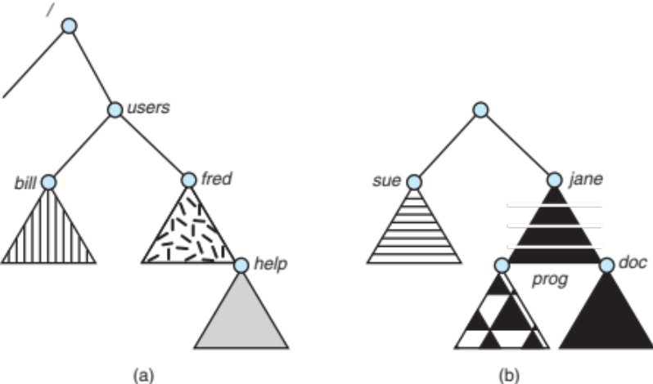
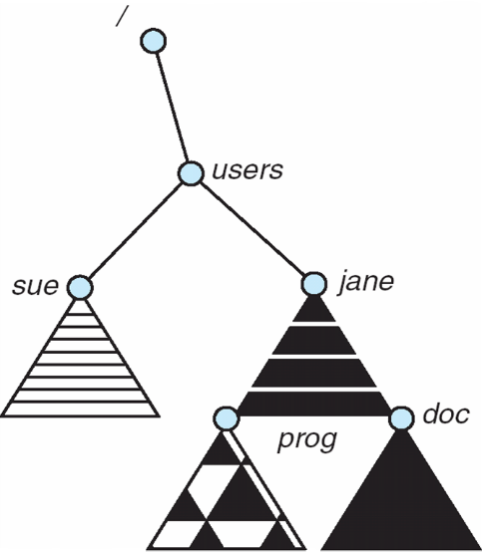
File System Mounting
Before your computer can use any kind of storage device (such as a hard drive, CD-ROM, or network share), it must be made accessible through the computer's file system.
This process is called mounting.
An unmounted file system (i.e., Fig. (b)) is mounted at a mount point - the location within the file structure where the file system is to be attached.

Slide 17
File-System Implementation
Several on-disk and in-memory data structures are used to implement a file system
On Disk Structures
Boot control block (boot block in Unix) is per volume
  contains information needed by the system to boot OS from that volume. Needed only if volume contains OS, and is usually first block of volume.
Volume control block (superblock in UNIX) is per volume
  Contains volume (or partition) details (e.g.: Total # of blocks, # of free blocks, block size, free block pointers or array etc.)
Directory structure is per file system
  Used to organizes the files. In Unix file system, it contains file names and associated inode numbers.

Slide 18
File-System Implementation
Directory structure is per file system
  Used to organizes the files.
    In Unix file system, it contains file names and associated inode numbers.
In-Memory File System Structures
In-memory structures are used for both file-system management and performance improvement via caching.
Mount table - contains information about each mounted volume
In-memory directory-structure cache - holds the directory information of recently accessed directories.

Slide 19
File-System Implementation
System-wide open-file table contains a copy of the FCB of each open file, as well as tracks the number of processes that have the file open.
Per-process open-file table contains a pointer to the appropriate entry (for the file) in the system-wide open-file table and some other fields.
Buffers hold file-system blocks when they are being read from disk or written to disk.
Open system call
open(filename) – system call returns a pointer to the appropriate entry (matching the filename) in the per-process file-system table.
  All file operations use this pointer
  UNIX refer to it as a file descriptor (an integer value).

Slide 20

Creating a new file
An application program calls the logical file system to create a file.
The logical file system knows the format of the directory structures.
To create a new file, it allocates a new FCB.
The system then reads the appropriate directory into memory.
  Update it with the new file name and FCB identifier, and writes it back to the disk

Slide 21
Opening a file
The open() call passes a file name to the logical file system.
The file system first searches the system-wide open-file table to check if the file is already in use by another process.
  YES => create per-process open-file table entry
  NO => Search directory structure for the given file name. Once the file is found, its FCB is copied into a system-wide open-file table in memory.
    System-wide open-file table stores the FCB, and also keeps tracks of the number of processes that have the file open.
    Update per-process open-file table to store and return the pointer to the entry in the system-wide open-file table and some other fields (current location, access mode).

Slide 22
Opening a file Cont…
Closing the file
When a process closes the file, the per-process table entry is removed
The system-wide entry’s open count is decremented.

Slide 23
Virtual File Systems
Modern operating systems must concurrently support multiple types of file systems.
A Virtual File System (VFS) allows easy and uniform access to different types of file systems on the system.
Any command related to a file/directory under any logical file system is first presented to this VFS, which translates it to an appropriate command in the corresponding logical file system.
A VFS also provides a mechanism for uniquely representing a file throughout a network.

Slide 24

Virtual File Systems (Cont.)

Slide 25
Allocation Methods - Contiguous
An allocation method refers to how disk blocks are allocated for files.
Three allocation methods are in practice:
  Contiguous allocation
  Linked Allocation
  Indexed Allocation

Slide 26
Contiguous Allocation
Each file occupies set of contiguous blocks
Simple – only starting location (block #) and length (number of blocks) are required in the directory entry
Problems are:
  knowing file size,
  finding contiguous space for file,
  external fragmentation.

Slide 27

Contiguous Allocation

Slide 28
Extent-Based Systems
Many newer file systems (i.e., Veritas File System) use a modified contiguous allocation scheme
Extent-based file systems allocate disk blocks in extents
An extent is a contiguous block of disks
  Extents are allocated for file allocation
  A file consists of one or more extents

Slide 29

Allocation Methods - Linked
Each file is a linked list of disk blocks, and blocks may be scattered anywhere on the disk
Each block contains pointer to next block
File ends at nil pointer

Slide 30
Allocation Methods – Linked Cont…
No external fragmentation
Space wasted in storing pointers
  Alleviate this problem by clustering blocks into groups
  However, this increases internal fragmentation
Reliability can be a problem (if pointer is lost or damaged)
  Use doubly linked lists – however this increases overhead
Locating a block can take many I/Os
Random access is slow as you need to traverse all the previous blocks.

Slide 31
Variation of Linked allocation – FAT
FAT (File Allocation Table) variation of Linked Allocation
  Beginning of volume has this table, indexed by block number
  Directory entry contains the block# of the first block of the file
  The table entry indexed by that block# contains the block# of the next block in the file
  Chain continues until it reaches the last block
    Its table entry has a special end-of-file value
  An unused block is indicated by a table value of 0
FAT table must be cached.

Slide 32

File-Allocation Table

Slide 33
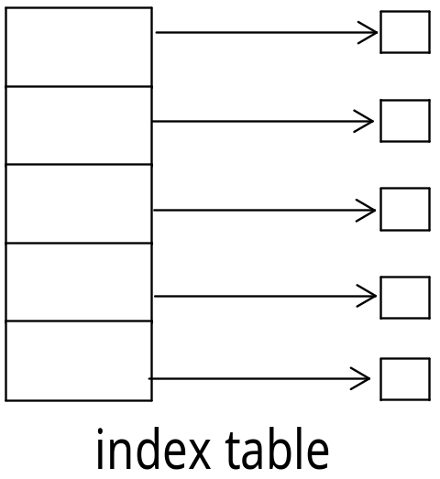
Allocation Methods – Indexed Allocation
Each file has its own index block(s) of pointers to its data blocks
i^{th} entry in the index block points to the i^{th} block of the file
Directory contains the address of the index block
Similar to paging!
Logical view

Slide 34

Example of Indexed Allocation

Slide 35
Indexed Allocation (Cont.)
Supports Random Access, but overhead of index block
No external fragmentation
Number of entries in the index block depends on the size of the block and size of the pointer holding block addresses.
  If block size = 512 bytes and pointer size = 4 bytes:
    Total number of entries in the index block = 512/4 = 128
  If the index table requires just 1 block, what is the file size in this case?

Slide 36
Indexed Allocation Cont…
What happens if file is large such that the index block runs out of space to hold data block addresses?
Various scheme to deal with this:
Linked Scheme
  Link together several index blocks.
  The last entry of an index block either holds the address of the next index block (for large file) or is NULL (for small file)
Multilevel Scheme - Multilevel index
Combined Scheme - Uses direct blocks (addresses of the data blocks) and indirect blocks (addresses of the index blocks).

Slide 37
Indexed Allocation Cont…
Multilevel Scheme - Multilevel index
  Two level - First-level index block points to a set of second-level index blocks, which in turn point to the file blocks.
  This approach could be continued to a third, fourth or n-th level, depending on the desired maximum file size.
Example: Consider a Two-level index scheme. Given block size = 4KB and pointer size = 4 bytes. What is the maximum file size in the system?
No. of pointers in one block = 4* 2¹⁰/4 = 2¹²/2² = 2¹⁰
First level index block points to 2¹⁰ second level index blocks.
Each second level index blocks point to 2¹⁰ data blocks
The maximum file size in the system = 2¹⁰ * 2^{10 *} 2¹² = 2³² = 4GB

Slide 38
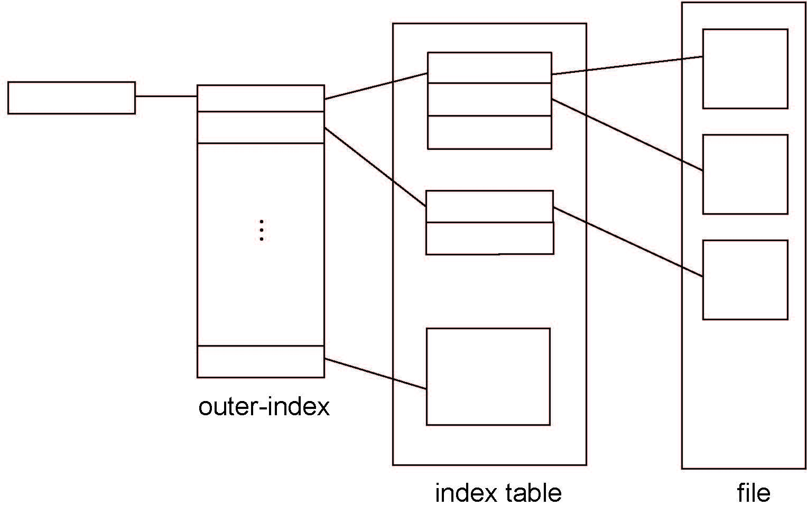
Indexed Allocation – Multi-Level Scheme

Slide 39

Combined Scheme: UNIX UFS

Slide 40
Performance
Contiguous great for sequential and random for relatively small files. However, suffers from external fragmentation.
Linked good for sequential access for large files, but inefficient for random access
Indexed allocation is more complex, but is good for both sequential and random access, for large files.

Slide 41
Free-Space Management
File system maintains free-space list to track available blocks/clusters
Many implementations of free-space lists exists
  Bit vector
  Linked List
  Grouping
  Counting

Slide 42
Free space list Implementation - Bit vector
Bit vector or bit map (n blocks)
Simple and easy to find first free block or n consecutive blocks
Need to be kept in memory for efficiency.
Also, to be written to disk occasionally – Why?
0
1
2
n-1
…
1 ⇒ block[i] free
0 ⇒ block[i] occupied
bit[i] =

Slide 43
Bit vector example
Inefficient as it requires lot of space.
  Example:
block size = 4KB = 2¹² bytes
disk size = 2⁴⁰ bytes (1 terabyte)
no of blocks = n = 2⁴⁰/2¹² = 2²⁸
32 MB needed to store the bit map!

Slide 44

Free space list Implementation - Linked List
Linked list - keep track of all free blocks.
Generally the system just adds and removes single blocks from the beginning of the list.
Traversing the list and/or finding a contiguous block of a given size are not easy sometimes.

Slide 45
Free space list Implementation Cont…
Grouping
  Modify linked list to store address of next n-1 free blocks in first free block, plus a pointer to next block that contains free-block-pointers.
Counting
  Because space is frequently contiguously used and freed, with contiguous-allocation allocation, extents, or clustering
  Keep address of first free block and the number of free contiguous blocks that follow the first block.
  Each entry in the free-space list then consists of a disk address and a count.

Slide 46
End of Chapter 11 & 12

