Slide 1
Chapter 13: I/O Systems
Modified by Dr. Neerja Mhaskar for CS 3SH3

Slide 2
Overview
Management of I/O devices forms a major component of operating system design and operation.
Designing the I/O subsystem is challenging as
  I/O devices vary greatly, and new types of devices are frequently made
To meet this challenge, the kernel of an operating system is structured to use device-driver modules.
  Device drivers - are modules that can be plugged into an OS to handle a device or category of similar devices.
A device controller is in charge of a of one or more devices.
Device drivers communicate with device controllers for I/O requests for a device (See slides on I/O structure in Chapter 1).

Slide 3
Polling and Interrupts
The host and a device controllers communicate with each other to process an I/O request.
This involves the host checking if the device is available to accept an I/O request or provide data for an I/O request.
Polling or Busy waiting occurs if host is constantly checking to see if device is available.
  Polling is efficient if device is fast.
  Polling inefficient if host rarely finds device ready for service. In which case the device uses interrupts to notify the host.
See Chapter 1 lecture notes for details on interrupts.

Slide 4
Direct Memory Access (DMA)
See Chapter 1 slides on DMA

Slide 5
Application I/O Interface
User application access a wide variety of different devices.
The detailed differences in I/O devices are abstracted away by identifying a few general kinds.
Applications are presented with a common interface (standardized set of functions) for each general kind.
Devices are broadly grouped by the OS into the following categories:
  Block Devices (e.g. hard disks)
  Character Devices (e.g. keyboard)
  Network Devices
  Clocks and Timers

Slide 6
Kernel I/O Subsystem
Kernels provide many services related to I/O
Scheduling - determine a good order of I/O requests for execution.
Buffering - store original data in memory while transferring between devices
  To cope with device speed mismatch
  To cope with device transfer size mismatch
  Double buffering – two buffers to store data, to increase efficiency and throughput.
    This double buffering decouples the producer of data from the consumer, thus relaxing timing requirements between them.

Slide 7
Kernel I/O Subsystem Cont…
Caching - faster device holding always a copy of data
Spooling and Device reservation are facilities provided by the kernel I/O subsystem to deal with concurrent device access
Spooling – A spool is a buffer that holds output for a device that cannot accept interleaved data streams
    E.g.: Printer
Device reservation – The kernel provides exclusive access to a device
  System calls for allocation and de-allocation
  However, the programmers need to watch out for deadlock

Slide 8
Kernel I/O Subsystem Cont…
Error Handling
  Operating systems can often compensate effectively for transient failures. For example, retry a read or write.
  System error logs hold problem reports
Protection
  All I/O instructions defined to be privileged
  I/O must be performed via system calls

Slide 9
I/O Requests to Hardware Operations (Optional)
Consider reading a file from disk for a process:
  Determine device holding file
  Translate name to device representation
  Physically read data from disk into buffer
  Make data available to requesting process
  Return control to process

Slide 10
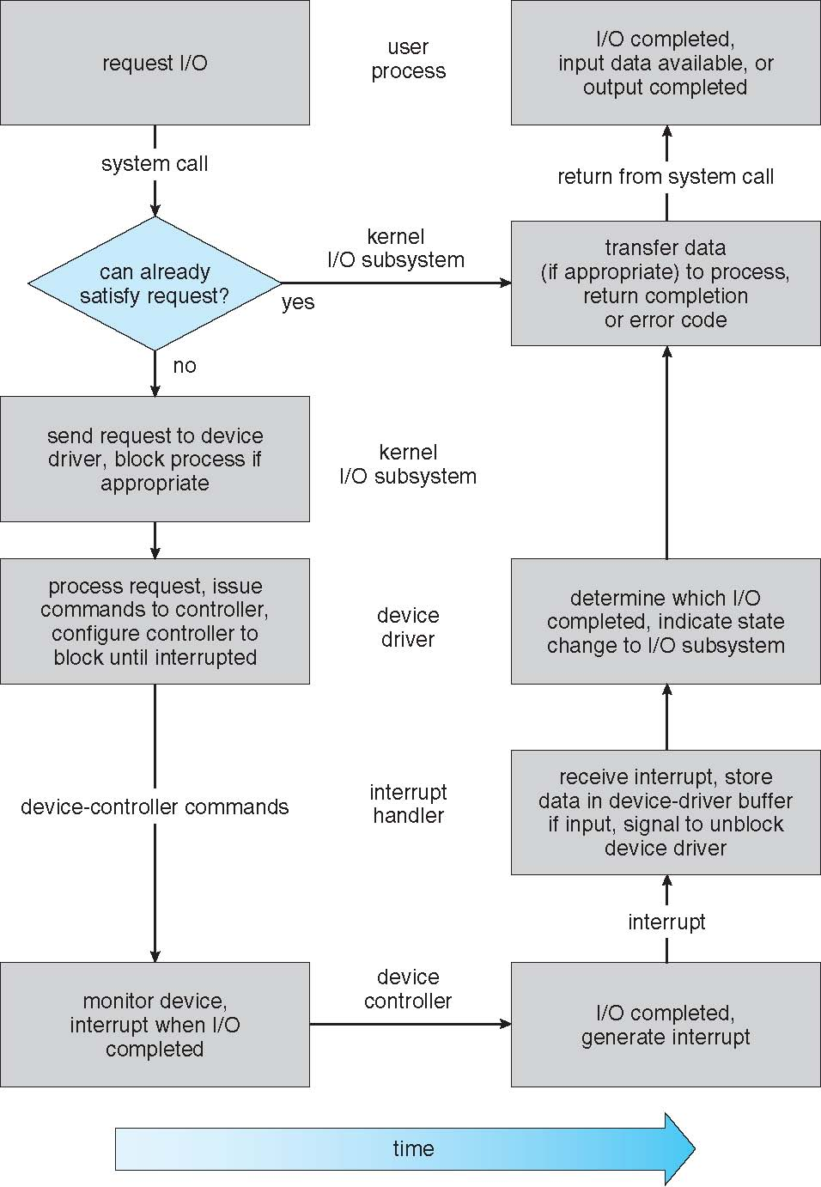
Life Cycle of An I/O Request (Optional)

Slide 11
End of Chapter 13

