Slide 1
Chapter 2: Operating-System Structures
Modified by Dr. Neerja Mhaskar for CS 3SH3

Slide 2
Operating System Services – for user
Operating systems provide an environment for execution of programs and services to programs and users.
Operating-system services for the user:
  User interface - e.g. CLI, GUI, etc.
  Program execution
  I/O operations
  File-system manipulation
  Communications
  Error detection

Slide 3
Operating System Services – for system
Operating-system services for the system:
  Resource allocation
  Accounting
  Protection and Security

Slide 4

A View of Operating System Services

Slide 5
Command Line Interpreter (CLI)
CLI allows direct command entry.
Windows and Unix treat CLI as a separate program; that is, CLI is not part of the kernel.
In Unix/Linux they are called shells.
Primary job is to fetch a command from user and execute it.
Sometimes the CLI itself contains the code to execute the command.
Sometimes just names of programs (used by Unix)
  Adding new features doesn’t require shell modification.

Slide 6
Shells in Unix and Linux
Multiple shells are available (you can write your own shell program!)
$ echo $0 OR $ echo “$SHELL” – will give you the current shell
Shells interface with the operating system to access its services.
Shells do not have the code to execute the request.
Eg: rm file.text → Shell searches for file rm → load rm in memory → executes it with file.txt as parameter
Shell has no idea how ‘rm’ command is implemented and the system call used to process the request.

Slide 7
System Calls
Provide an interface to OS services
Are routines mostly written in a high-level language (C or C++). However, lower level task written in assembly.
Accessed by programs via a high-level Application Programming Interface (API) rather than direct system call use.

Slide 8
API
An API specifies a set of interfaces (functions) available to the programmer.
These interfaces can be implemented as single or multiple system calls.
Why use an API?
  Portability.
  System calls detailed and difficult to work with.
Three most common APIs are:
  Win32 API for Windows
  POSIX API for POSIX-based systems (including UNIX, Linux, and Mac OS X)
  Java API for the Java virtual machine (JVM)

Slide 9

How System Calls are used?
System call sequence to copy the contents of one file to another file
1000s of system calls executed per second!
Note: Programmers don’t see this level of detail.

Slide 10
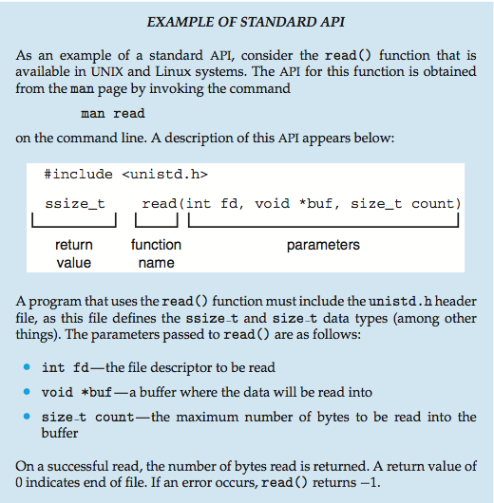
Example of Standard API

Slide 11
System Call Implementation
The API makes the appropriate system calls through the system call interface.
System call interface: serves as a link to system calls made available by the Operating System.
  Each system call has a number that uniquely identifies it
  Maintains a table indexed according to these numbers
The caller need know nothing about how the system call is implemented
  Just needs to obey API and understand what OS will do as a result after the system call is invoked.
  Most details of OS interface hidden from programmer by API

Slide 12

API – System Call – OS Relationship

Slide 13
System Call Parameter Passing
Often, more information is required than simply identity of desired system call.
  Exact type and amount of information vary according to OS and call.
Three general methods used to pass parameters to the OS
  Simplest: pass the parameters in registers
    In some cases, may be more parameters than registers

Slide 14
System Call Parameter Passing
Parameters stored in a block, or table, in memory, and address of block is passed as a parameter in a register
  This approach taken by Linux and Solaris
Parameters placed, or pushed, onto the stack by the program and popped off the stack by the operating system
Block and stack methods do not limit the number or length of parameters being passed

Slide 15

Parameter Passing via Table

Slide 16
Types of System Calls
Process control
  For managing processes: e.g. create, terminate, load, execute process.
File management
  create, delete, open, close, read, write file etc.
Device management
  request/release device, read, write, reposition, logically attach or detach devices etc.
Information maintenance: e.g. Get/set time or date, get/set system data, get/set process, file, or device attributes
Communications: e.g. create, delete communication connection, attach and detach remote devices etc.
Protection: e.g. Control access to resources, get and set permissions, allow and deny user access etc.

Slide 17

Examples of Windows and Unix System Calls

Slide 18

Standard C Library Example
C program invoking printf() library call, which calls write() system call

Slide 19
System Programs
Provide a convenient environment for program development and execution
  Some of them are simply user interfaces to system calls; others are considerably more complex
They are also called system utilities
Constantly running system-program processes are known as services, subsystems, daemons
System Programs can be divided into these categories:
  File management
  Status information
  File modification
  Programming-language support
  Program loading and execution
  Communications

Slide 20
Operating System Structure
General-purpose OS is very large program
Various ways to structure an OS
  Simple structure (Monolithic) – MS-DOS
  More complex -- UNIX
  Layered – an abstraction
  Microkernel –Mach
  Modules

Slide 21

Simple Structure -- MS-DOS
MS-DOS – written to provide the most functionality in the least space
  Not divided into modules
  Although MS-DOS has some structure, its interfaces and levels of functionality are not well separated.
  Application programs can access I/O devices!

Slide 22
Non Simple Structure -- Original UNIX OS
The original UNIX operating system had limited structuring.
Like MS-DOS limited by hardware functionality.
The UNIX OS consists of two separable parts:
  Systems programs
  The kernel
    Consists of everything below the system-call interface and above the physical hardware
    Provides the file system, CPU scheduling, memory management, and other operating-system functions;
    A large number of functions for one level

Slide 23
Layered Approach
The operating system is divided into a number of layers (levels), each built on top of lower layers. The bottom layer (layer 0), is the hardware; the highest (layer N) is the user interface.
With modularity, layers are selected such that each uses functions (operations) and services of only lower-level layers
Disadvantages:
  Delineating the layers is tricky.
  Slow as any user request needs to go through all the layers with correct function calls and parameters.

Slide 24

Layered Approach Contd…
.

Slide 25
Microkernel System Structure
As Unix expanded the kernel became large and difficult to manage.
Microkernel – This approach structures the OS by
  Removing all the nonessential components from the kernel and
  Implementing them as user or system-level programs.
Microkernels provide minimal process and memory management.
Mach is an example of microkernel
  Mac OS X kernel (Darwin) partly based on Mach
Communication takes place between user modules using message passing.

Slide 26
Microkernel – contd…
Advantages:
  Easier to extend a microkernel
  Easier to port the operating system to new architectures
  More reliable and secure
Disadvantages:
  Performance overhead of user space to kernel space communication (Windows NT, first release had a layered microkernel approach.)

Slide 27

Microkernel System Structure

Slide 28
Modules
Many modern operating systems implement loadable kernel modules (so far the best methodology for OS design)
  Kernel has set of core components
  Links in additional services via modules (either at boot time or run time.)
  Each core component is separate
  Each talks to the others over known interfaces
  Each is loadable as needed within the kernel

Slide 29
Modules Contd…
Similar to layers (each kernel section has protected and defined interfaces) and the microkernel approach (as the kernel is small) but with more flexibility as modules do not need to invoke message passing to communicate.
Modules are common in modern implementations of Unix/Linux, Solaris etc., and Windows
Linux supports loadable kernel modules, primarily for supporting device drivers and file system.

Slide 30

Solaris Modular Approach

Slide 31
Hybrid Systems
Most modern operating systems are actually not one pure model
  Hybrid combines multiple approaches to address performance, security, usability needs
  Linux and Solaris kernels are:
    Monolithic for efficient performance.
    Modular - dynamic loading of functionality

Slide 32
End of Chapter 2

