Slide 1
Chapter 4: Threads

Slide 2
Threads
Multi-threaded applications have multiple threads within a single process.
Thread is a basic unit of CPU utilization. Each thread consists of
  Thread ID,
  Program Counter,
  Stack, and Set of registers
However, they share code, data, and files.
Process creation is heavy-weight while thread creation is light-weight.

Slide 3
Multi-threading examples
Editing word document
  One thread can interpret the key strokes.
  Second thread display images.
  Third thread checks spelling and grammar.
  Fourth thread does periodic automatic backups of the file being edited.
Most operating system kernels are multi-threaded.
  Many threads operate in the kernel process, where each thread performs a specific task.
    Managing devices
    Managing memory
    Interrupt handling, etc.

Slide 4

Single and Multithreaded Processes

Slide 5
Advantages
Responsiveness – may allow continued execution if part of process is blocked, especially important for user interfaces
Resource Sharing – threads share resources by default. There resource sharing is easier between threads than processes
Economy – cheaper than process creation, thread switching lower overhead than context switching
Scalability – process can take advantage of multiprocessor architectures
Can simplify code, increase efficiency
Threads enable concurrent programming and, on multiple processor systems, true parallelism.

Slide 6
Parallelism and Concurrency
Parallelism implies a system can perform more than one task simultaneously
Concurrency supports more than one task making progress
  Single processor / core, scheduler provides concurrency

Slide 7


Concurrency vs. Parallelism
Concurrent execution on single-core system:
Parallelism on a multi-core system:
It is possible to have concurrency without parallelism.

Slide 8
Multicore Programming
Multicore or multiprocessor systems puts pressure on programmers, challenges include:
  Dividing activities: Identifying tasks in the application that can be performed concurrently.
  Balance: Evaluate if the tasks coded to run concurrently provide same or more value than the overhead of thread creation.
  Data splitting: Preventing threads from interfering with each other.
  Data dependency: Tasks need to be synchronized if data is shared.
  Testing and debugging: Challenging as the race conditions become difficult to identify.

Slide 9
Multicore Programming (Cont.)
Types of parallelism
  Data parallelism – distributes subsets of the same data across multiple cores, same operation on each
    Example: Adding numbers 1 to N, where N is large. The set is divided into number of cores and the same computation is performed on each set.
  Task parallelism – distributing threads across cores, each thread performing unique operation. (Windows word document example)

Slide 10

Amdahl’s Law
Identifies performance gains from adding additional cores to an application that has both serial and parallel components
S is serial portion
N processing cores
If an application is 75% parallel (25% serial), moving from 1 to 2 cores results in speedup of 1.6 times
As N → ∞, speedup approaches 1 / S.
According to the law, adding more # of processes after a certain number has no effect on speedup!
Some suggest formula does not account for hardware performance, therefore ceases to apply N → ∞

Slide 11
User Threads and Kernel Threads
User level threads - management done by user-level threads library in user space. These threads are put by programmers into there programs.
Three primary thread libraries:
  POSIX Pthreads
  Windows threads
  Java threads
Kernel level threads – managed by the Kernel in kernel space.
Virtually all general purpose operating systems have thread support:
  E.g., Windows , Solaris, Linux, Tru64 UNIX, Mac OS X

Slide 12
Multithreading Models
A relationship must exist between user threads and kernel threads.
This is achieved using one of the below three ways.
  Many-to-One
  One-to-One
  Many-to-Many

Slide 13

Many-to-One
Many user-level threads mapped to single kernel thread
Thread management is handled by the thread library in user space, which is very efficient.
One thread blocking causes all threads to block
Multiple threads may not run in parallel on multicore system because only one may be in kernel at a time
Few systems currently use this model
Examples OS (implemented this in past):
  Solaris Green Threads
  GNU Portable Threads

Slide 14

One-to-One
Each user-level thread maps to kernel thread
Creating a user-level thread creates a kernel thread
More concurrency than many-to-one
This model has max. overhead.
Number of threads per process sometimes restricted due to overhead
Examples: Windows, Solaris 9 and later

Slide 15

Many-to-Many Model
Allows many user level threads to be mapped to an equal or smaller number of kernel threads.
Users have no restrictions on the number of threads created.
Blocking kernel system calls do not block the entire process.
Processes can be split across multiple processors.
Individual processes may be allocated variable numbers of kernel threads, depending on the number of CPUs present and other factors.
Examples: Solaris prior to version 9

Slide 16

Two-level Model
Similar to many to many model, except that it allows a user thread to be bound to kernel thread as well
Examples
  IRIX
  HP-UX
  Tru64 UNIX
  Solaris 8 and earlier

Slide 17
Linux Processes and Threads
Linux treats processes and threads the same.
Linux refers to them as tasks rather than threads
Thread creation is done through clone() system call
clone()allows a child task to share the address space of the parent task (process)
However, rather than copying all data structures, the new task points to the data structures of the parent task, depending on the set of flags passed to clone()

Slide 18
Thread Libraries
Thread library provides programmer with API for creating and managing threads
Two primary ways of implementing
  Library entirely in user space: Involves API functions implemented solely within user space, with no kernel support
  Kernel-level library supported by the OS: Involves system calls, and requires a kernel with thread library support.

Slide 19
Thread Libraries Cont.
There are three main thread libraries in use today:
POSIX Pthreads - may be provided as either a user or kernel library, as an extension to the POSIX standard.
Win32 threads - provided as a kernel-level library on Windows systems.
Java threads - Since Java generally runs on a Java Virtual Machine, the implementation of threads is based upon whatever OS and hardware the JVM is running on, i.e. either Pthreads or Win32 threads depending on the system.

Slide 20
Pthreads
May be provided either as user-level or kernel-level
Pthreads, is a POSIX standard (IEEE 1003.1c) API for thread creation and synchronization
  Specification, not implementation
API specifies behavior of the thread library, implementation is up to development of the library
Common in UNIX operating systems (Solaris, Linux, Mac OS X)
On Linux, pthread library implements the 1:1 model
Function names start with “pthread_”

Slide 21

Pthreads Example

Slide 22
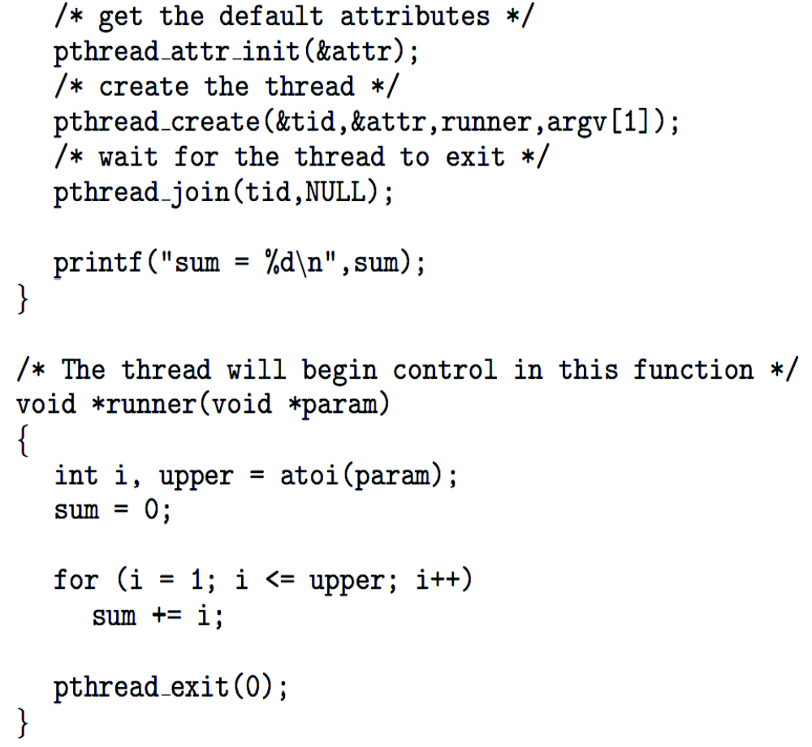
Pthreads Example (Cont.)

Slide 23
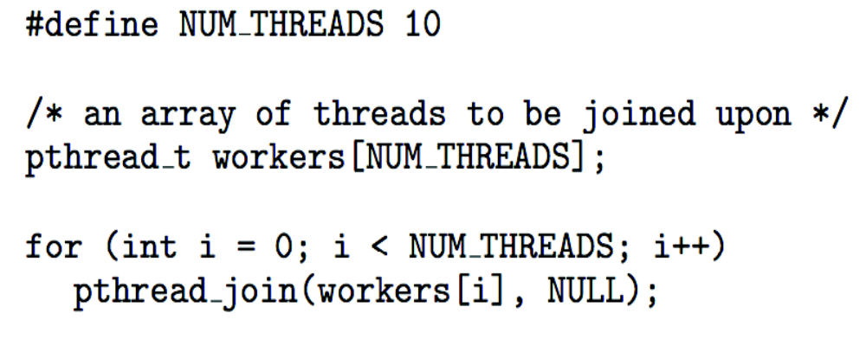
Pthreads Code for Joining 10 Threads

Slide 24
Question
int main()
{
pid_t pid;
pid = fork();
if (pid == 0) { /* child process */
fork();
thread create( . . .);
}
fork();
return 0;
}
How many unique processes are created?
How many unique threads are created?
Draw the process and thread tree.

Slide 25
Process and thread tree for question in slide 4.24
P₁
P₆
P₂
P₅
T₂
P₃
T₁
P₄

Slide 26
Implicit Threading
In Implicit Threading, creation and management of threads done by compilers and run-time libraries rather than programmers
Three methods explored
  Thread Pools
  OpenMP
  Grand Central Dispatch

Slide 27
Threading Issues
Semantics of fork() and exec() system calls
Signal handling
Thread cancellation of target thread
  Asynchronous or deferred
Thread-local storage
Scheduler Activations

Slide 28
End of Chapter 4

