Slide 1
Chapter 8: Main Memory – Part I
Modified by Dr. Neerja Mhaskar for CS 3SH3

Slide 2
Memory Management
Why do we need memory management in OS?
  To provide a convenient abstraction of memory for programming
  To allocate scarce memory resources among competing processes to maximize performance with minimal overhead
Mechanisms
  Virtual and physical addressing
  Techniques: partitioning, segmentation, paging
  Page table management, TLBs, Virtual Memory tricks
Policies
  Page replacement algorithms

Slide 3

Background
Main memory is simply an array of bytes.
Main memory, Cache and registers are only storage CPU can access directly
Program must be brought (from disk) into main memory for execution

Slide 4
Memory protection - Multi-programming environment
In a multi-programming environment, many processes are in main memory each having its own memory space.
Protection of processes’ memory is required to ensure correct operation
Protection of processes’ memory space is provided by hardware (base and limit registers).
  base registers (smallest legal physical memory address), and
  limit registers (specifies size of the range).

Slide 5

Protection using Base and Limit Registers

Slide 6

Hardware Address Protection with Base and Limit registers
CPU hardware compares every address generated in user mode with the registers
Lets it access the memory address only if its with in the legal range
Base and limit register values loaded only by the operating system

Slide 7
Address Binding
Address binding of instructions and data to memory addresses can happen at three different stages
  Compile time: If memory location known a priori, absolute code can be generated.
  Load time: Must generate relocatable code if memory location is not known at compile time
  Execution time: Binding delayed until run time if the process can be moved during its execution from one memory segment to another
    Need hardware support for address maps.
    Most general purpose OS use this method.

Slide 8
Logical vs. Physical Address Space
Logical address – addresses generated by the CPU
  Also referred to as virtual address
Physical address – address seen by the memory unit
Logical address space is the set of all logical addresses generated by a program
Physical address space is the set of all physical addresses assigned to the program
Logical and physical address space is the same in compile and load time address-binding schemes
Logical and physical address space differs in execution-time address-binding scheme

Slide 9
Memory-Management Unit (MMU)
MMU - hardware device that at run time maps/translates virtual address to physical address
This mapping based on schemes implemented
  contiguous memory allocation, segmentation and paging.
Simplest mapping scheme
  generalization of the base register scheme
  Base register in this scheme is called relocation register
  Relocation register’s value is added to every address generated by a user process’ memory address request.

Slide 10

Dynamic relocation using a relocation register

Slide 11
Memory-Management Unit (MMU) Cont…
We now have two different types of addresses: logical addresses (in the range 0 to max), and
Physical addresses (in the range R + 0 to R + max for a base value R).
The user program generates only logical addresses and thinks that the process runs in locations 0 to max.
However, these logical addresses must be mapped to physical addresses before they are used.

Slide 12
Swapping
Swapping: Moving a process temporarily out of memory to a backing store, and then bring it back into memory for continued execution
  Swapping enables total physical memory space of processes can exceed physical memory
Backing store - fast disk space
  large enough to accommodate copies of all memory images for all users;
  provides direct access to these memory images
Main issues with standard swapping is the time taken to switch data related to a process is high
Not common in modern OS.
Modified versions of swapping used in conjunction with Virtual memory techniques

Slide 13
Contiguous Memory Allocation
Main memory must support both OS and user processes
Main memory usually divided into two partitions:
  Operating system held in low memory with interrupt vector
  User processes held in high memory
Contiguous Memory Allocation Scheme (obsolete):
  Each process contained in single contiguous section of memory.
  Memory protection in this scheme is achieved through the use of Relocation and limit registers.

Slide 14
Contiguous Allocation - Partitioning
Contiguous memory allocation can be achieved in two ways:
  Fixed partitioning
  Variable or dynamic partitioning
Fixed partitioning: Main memory is divided into a number of static partitions (possibly of different sizes) at system generation time.
A process may be loaded into a partition of equal or greater size.
Maximum number of active processes is fixed.
Simple to implement
Suffers from internal fragmentation
Internal Fragmentation – allocated memory may be slightly larger than requested memory; this size difference in memory is internal to a partition, but not being used

Slide 15
Fixed partitioning example
OS = 8M | 6MB | 10MB | 10MB | 8MB
OS = 8M | 6MB | P₁=8.2MB | 1.8MB | 10MB | 8MB
OS = 8M | 6MB | P₁=8.2MB | 1.8MB | 10MB | P₂ = 6.1MB | 1.9 MB
OS = 8M | 6MB | P₁=8.2MB | 1.8MB | P₃ = 9 MB | 1 MB | P₂ = 6.1MB | 1.9 MB
OS = 8M | P₄ = 5MB | 1 MB | P₁=8.2MB | 1.8MB | P₃ = 9 MB | 1 MB | P₂ = 6.1MB | 1.9 MB
Maximum number of possible active processes = ?
Can process P₅ = 3MB be brought into main memory?

Slide 16
Contiguous Allocation - Partitioning
Variable or dynamic partitioning: Partitions are created dynamically, so that each process is loaded into a partition of exactly the same size as that process.
  No internal fragmentation, but suffers from external fragmentation.
External Fragmentation – total memory space exists to satisfy a request, but it is not contiguous
External fragmentation problem can solved by compaction.
Compaction - Shuffle memory contents to place all free memory together in one large block.

Slide 17
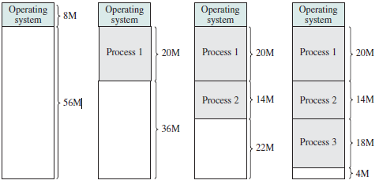
Dynamic partitioning example
Memory = 64M

Slide 18
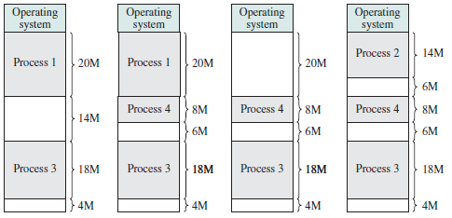
Dynamic partitioning example Cont…
Can process P₅ = 10 MB be brought into main memory?
Can process P₆ = 17M be brought into main memory?

Slide 19
Dynamic Storage-Allocation Problem
How to satisfy a request of size n from a list of free holes?
First-fit: Allocate the first hole that is big enough
Best-fit: Allocate the smallest hole that is big enough
Worst-fit: Allocate the largest hole; must also search entire list
First-fit and best-fit better than worst-fit in terms of speed and storage utilization.

Slide 20
Segmentation
Segmentation - partitions logical address space of a program into segments (related data units).
For example, module, procedure, stack, data, file, etc.
Each segment instead of the entire program is loaded into memory
As a result, programs can reside in non-contiguous memory locations.
Segmentation suffers from external fragmentation and the need for compaction.

Slide 21

Programmer’s View of a Program

Slide 22
Segmentation Architecture
Logical address generated by the CPU, consists of a two tuple:
<segment-number, offset>,
We now must map two-dimensional user-defined addresses into one-dimensional physical memory addresses.
  Achieved through hardware support.
Segment table – Indexed by segment number, and consists of base–limit register pairs.
  base – contains the starting physical address where the a segment resides in memory
  limit – specifies the length of the segment
Multiple base/limit pairs, one per segment (segment table)

Slide 23
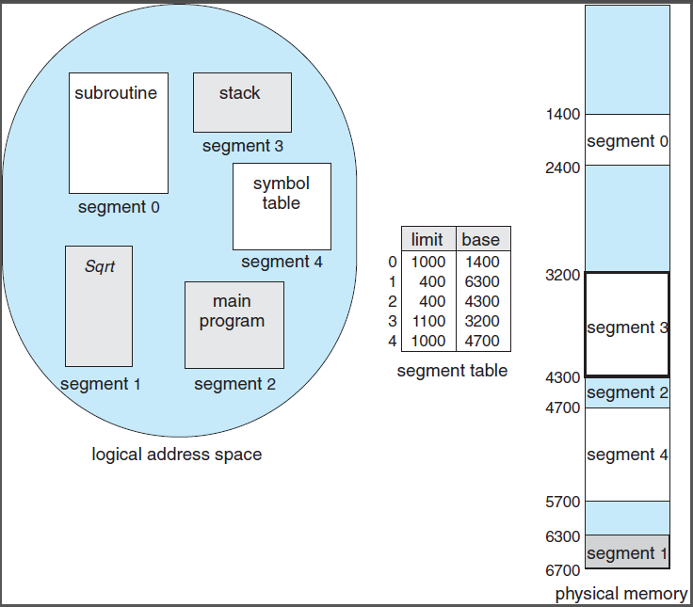
Logical View of Segmentation
CPU generates <2, 53>, that is CPU is referencing byte 53 of Segment 2.
This is mapped on the location 4300 + 53 = 4353 of physical memory.

Slide 24

Segmentation Hardware

Slide 25
Paging
Paging - divides logical address space of a program into fixed blocks called pages and physical address space into fixed-sized blocks called frames.
  Frame size = page size.
  Avoids external fragmentation, but suffers from internal fragmentation.
  Paging is used in most OS ranging from PC, mainframes to smart phones.

Slide 26
Address Translation Scheme
Address generated by CPU (virtual address) consists of two parts:
  Page number (p) – used as an index into a page table which contains the frame numbers of the pages loaded in physical memory.
  Page offset (d) – The frame number is combined with the page offset to define the physical memory address.
  The page offset ranges from 0 to page size -1
The page size (like the frame size) is defined by the hardware.

Slide 27

Paging Hardware

Slide 28

Paging Model of Logical and Physical Memory

Slide 29

Address Translation Scheme
Page Size is usually a power of 2 (512 bytes to 1GB), as it makes address translation particularly easy
For given logical address space size = 2^{m}, page size = 2^{n} and physical address space = 2^{r} the logical address looks like
Number of bits to represent logical address = m
Number of bits to represent physical address = r
Number of bits to represent offset = n
Number of pages = 2^{m-n}
Number of bits to represent a page number = m-n
Number of frames = 2^{r-n}
Number of bits to represent a frame number = r-n

Slide 30

Paging and Address Translation Example
Logical address space = 2⁴
Page size = 2² = 4 bytes
Memory size = 2⁵ = 32 bytes
Total # of pages = 2⁽⁴⁻²⁾ ⁼2²
Total # of frames = 2⁵ – 2² ⁼ 2³
Logical address 3 (d) is in page 0,
and page 0 resides in the 5th frame
Logical address 3 maps to physical address = (5*4 + 3) =20 + 3 = 23.

Slide 31
End of Chapter 8 – Part I

