Slide 1
Chapter 9: Virtual Memory – Part II
Modified by Dr. Neerja Mhaskar for CS 3SH3

Slide 2
Second-chance algorithm
It is essentially a FIFO, except that the reference bit is used to give pages a second chance at staying in the page table.
How second-chance algorithm works
A reference bit is associated with each page
When a new page is brought into memory, the reference bit = 0
When a page is referenced, it is left in memory and the reference bit = 1

Slide 3
Second-chance (Clock) algorithm
When a page must be replaced, the page table is scanned in FIFO manner:
  If reference bit = 0 -> replace the page
  If reference bit = 1 then:
    set reference bit 0, leave page in memory (give it a second chance.)
    replace next page, subject to same rules
The order in which bits set to 0 is not known
  It is possible to select a victim page that was not least recently used.
Additional bits can be used to record order.

Slide 4
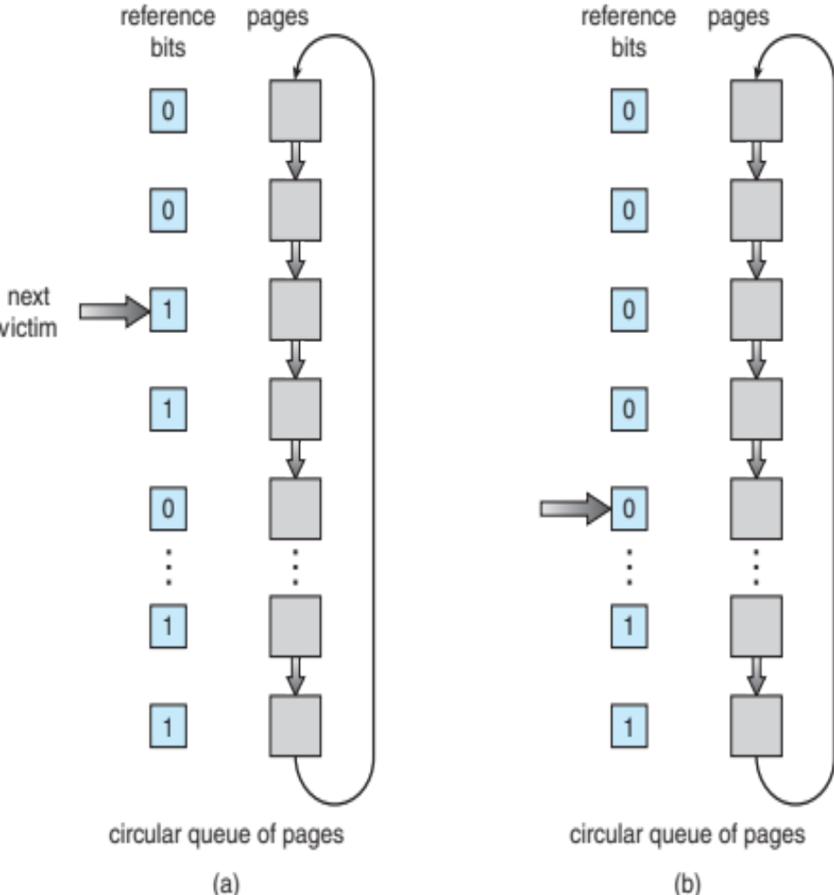
Second-Chance (Clock) Algorithm – Implementation
What happens if all bits are set to 1

Slide 5
Second-Chance (Clock) Algorithm – Implementation
A circular queue is maintained
A pointer indicates which page is to be replaced next. Initially pointer points to the first frame
When a new page is brought into memory, its reference bit = 0
When a page must be replaced the pointer advances until it finds a page with reference bit = 0
As it advances, it clears the reference bits (sets to 0)
Once a victim page is found, it is replaced with the new page, and the pointer points to the next position.
Note that , when a page is found the pointer does not move.

Slide 6
Second-Chance (clock) Algorithm Example
Reference string: 7,0,1,2,0,3,0,4,2,3,0 and Number of frames = 3
The arrow represents the pointer
Each cell contains the pair <page number, reference bit value>
7 0 1 2 0 H 3
0 H 4 2 3 0 H
Total Page Faults = 8 (note that H = page hit)
7,0
7,0
0,0
7,0
0,0
1,0
2,0
0,0
1,0
2,0
0,1
1,0
2,0
0,0
3,0
2,0
0,1
3,0
4,0
0,1
3,0
4,0
0,0
2,0
3,0
0,0
2,0
3,0
0,1
2,0

Slide 7
Page-Buffering Algorithms
Page buffering algorithms used in conjunction with page replacement algorithms to improve performance.
Maintain a fixed minimum number of free frames (called free-frame pool) at all times. When page fault occurs
    Select a victim frame (as before).
    Read the new page into a free frame in the free frame pool, before moving the victim page out. Results in the process causing the page fault restarted faster.
    When convenient, evict victim page and add its frame to the free-frame pool.
Note that the frame numbers in the pool can vary.

Slide 8
Demand paging - Allocation of Frames
Demand paging involves many I/O operations
  Since I/O operations are expensive, a system implementing demand paging to improve performance must have a
    Page replacement algorithm, and
    Frame allocation algorithm.
Various strategies/algorithms available to allocate frames to processes
  Equal allocation
  Proportional allocation
  Local and global allocation
Each process needs minimum number of frames to execute.
  This is defined by the computer architecture.

Slide 9
Equal and Proportional Allocation of Frames
Equal allocation: Allocate free frames equally among processes (after allocating frames for the OS)
  Keep the leftover frames in free frame buffer pool
  E.g. If there are 100 frames (after allocating frames for the OS) and 5 processes, give each process 20 frames
Proportional allocation: Allocate frames to each process according to its size
  Dynamic as degree of multiprogramming, process sizes change
  Priority Allocation: Use a proportional allocation scheme using priorities rather than size

Slide 10
Global vs. Local Allocation
Global replacement – process selects a replacement frame from the set of all frames; one process can take a frame from another
  Process execution time can vary greatly
  However, greater throughput => more common
Local replacement – each process selects from only its own set of allocated frames
  More consistent per-process performance
  However memory is under utilized

Slide 11
Thrashing
Thrashing – is a situation in which the system is busy swapping pages of a process in and out, instead of executing its instructions on the CPU.
Thrashing results in very low CPU utilization => slow system or a system that has come to a halt.
How does Thrashing occur in a system?
If a process does not have the number of frames it needs to support pages in active use, it will
  page fault to get the desired page in memory
    As a result it will replace a page in an existing frame
  But quickly needs to replace a page again from a frame to bring in the replaced page!

Slide 12
Thrashing Cont…
As the thrashing processes wait for the pages to be swapped in and out, CPU utilization drops sharply.
As CPU utilization plummets, OS thinking that it needs to increase the degree of multiprogramming.
Another process added to the system, thus worsening the problem!

Slide 13
How to Prevent Thrashing? Cont…
To prevent thrashing, we must provide a process with as many frames as it needs for all its active pages.
How do we know how many frames it “needs”?
Working-set Model
Page Fault Frequency

Slide 14
Working-Set Model
Working-set Model: Based on locality model
  Locality model – states that as a process executes, it moves from locality to locality.
  A locality is a set of pages that are actively used together
A program is generally composed of several different localities, which may overlap.
To avoid thrashing enough frames should be allocated to accommodate the size of the current locality

Slide 15
Working-Set Model
The working set model uses a parameter Δ for each process.
Δ - defines the working-set window.
  working-set = set of recently accessed pages.
    If a page is in active use, it will be in the working set.
    If it is no longer being used, it will drop from the working set Δ time units after its last reference.
Accuracy of Working set depends on selection of Δ
  if Δ too small will not encompass entire locality
  if Δ too large will encompass several localities
  if Δ = ∞ ⇒ will encompass entire program

Slide 16

Working-Set Model
For example, given the sequence of memory references shown in Figure below
If Δ = 10 memory references
  Working set (WS) at time t₁ is {1, 2, 5, 6, 7}.
  By time t₂, the working set has changed to {3, 4}.

Slide 17
Working-Set Model
WSS_{i} (working set size of Process P_{i}) =
total number of pages referenced in the most recent Δ (varies in time)
m is the total number of available frames
D = Σ WSS_{i} ≡ total demand frames
if D > m ⇒ Thrashing. Therefore, we need to suspend or swap out one of the processes.

Slide 18
Page Fault Frequency
Thrashing has a high page fault rate.
Page Fault Frequency - Establish “acceptable” page-fault frequency (PFF) rate and use local replacement policy
  Page fault rate high => process needs more frames.
  Page-fault rate is too low => process may have too many frames
  Establish upper and lower bounds on the desired page-fault rate
    Page fault rate > upper limit – allocate more frames to the process
    Page-fault rate < lower limit - remove a frame from process

Slide 19
Memory-Mapped Files
Memory-mapped file allows file I/O to be treated as routine memory access by mapping a disk block to a page in memory
A file is initially read using demand paging
  A page-sized portion of the file is read from the file system into a frame in memory
  Subsequent reads/writes to/from the file are treated as ordinary memory accesses
Simplifies and speeds file access by driving file I/O through memory rather than read() and write() system calls
Also allows several processes to map the same file allowing the pages in memory to be shared
Data written back to disk periodically and/or at file close() time
Some Oses (e.g Solaris) uses memory mapped files for standard I/O.

Slide 20

Memory Mapped Files

Slide 21
Memory mapped file in Linux
To use mmap()system call in C on Linux you need to include the following header file:
#include <sys/mman.h>
Below header files needed for store file descriptor returned from the open() system call.
#include <fcntl.h>
#include <stdlib.h>
  Example: int mmapfile_fd = open(argv[1], O_RDONLY);
To memory map a file use the mmap() system call. Example:
mmapfptr = mmap(0, MEMORY_SIZE, PROT_READ, MAP_PRIVATE, mmapfile_fd, 0);
To unmap the memory mapped file use the munmap()system call. Example:
munmap(mmapfptr, MEMORY_SIZE);

Slide 22
Copy-on-Write
Consider the fork() system call to create a new child process.
  It creates a copy of the parent’s address space for the child.
  As most fork() calls are followed by exec() system, the above steps is unnecessary.
Copy-on-Write (COW) allows both parent and child processes to initially share the same pages in memory
  If either process modifies a shared page, only then is the page copied
COW allows more efficient process creation as only modified pages are copied.

Slide 23
Allocating Kernel Memory
So far, we have discussed about process’ memory.
Kernel memory is allocated from a free-memory pool as:
  Certain hardware devices interact directly with physical memory, and may require memory in contiguous pages.
  Memory needed for kernel data structures is of varying sizes (some smaller than half a pages).
    Kernel must ensure that minimum memory is wasted due to fragmentation.
Two strategies adopted for managing free memory that is assigned to kernel processes:
  Buddy System
  Slab Allocation

Slide 24
Buddy System
Allocates memory from fixed-size segment consisting of physically-contiguous pages
Memory allocated using power-of-2 allocator
  Satisfies requests in units sized as power of 2
  Request rounded up to next highest power of 2
  When smaller allocation needed than is available, current chunk split into two buddies of next-lower power of 2
    Continue until appropriate sized chunk available
Advantage – quickly coalesce unused chunks into larger chunk (note that only buddies can be coalesced)
Disadvantage – internal fragmentation

Slide 25
Buddy System Example
For example, assume 256KB chunk available, kernel makes the following requests
  request 21KB,
  request 60 KB, and
  request 120KB
Rounding the request of 21KB to the closest power of 2 > 21, we get segment of size 32KB. Therefore, request 21KB is satisfied by memory segment C_{L} (see the tree in next slide).
Other requests (60KB and 120KB) are satisfied in a similar way.
If request 60KB and 120KB are released, we cannot coalesce, these segments as they were not buddies – that is they did not result from the same partition.
However, if request 21KB is released later, then all the segments can coalesce to form the original 256KB segment.

Slide 26

Buddy System Example Cont…
120 KB
60 KB
21 KB

Slide 27
Slab Allocation
Slab Allocator uses caches to store kernel objects.
Cache consists of one or more slabs.
  Slab is one or more physically contiguous pages
  Single cache for each unique kernel data structure (e.g.: separate cache for program descriptors, semaphores, file objects etc.)
  Each cache filled with objects – instantiations of the data structure

Slide 28

Slab Allocation

Slide 29
Slab Allocation
When cache is created, it is filled with objects marked as free
When structures stored, objects marked as used
If a slab is full of used objects, next a free object is allocated from a partial slab if available.
If no empty slabs, new slab allocated from contiguous physical pages and assigned to a cache.
  memory for the object is allocated from this slab.
Benefits include
  no fragmentation,
  fast memory request satisfaction (as no allocation and deallocation of memory)
Slab started in Solaris, and now used by various Operating Systems (e.g. Linux)

Slide 30
End of Chapter 9 – Part II

