Slide 1
Web Development Final Project School Management System
summer 2025
Olga Sakara
Contact: osakara@ukr.net

Slide 2

Thank you, teachers! Thanks a lot for FullCalendar – it's awesome! Thank you, React Hook Form team!

Slide 3



Did you remember? The ideas!
Administrator
Students
Calendar
Teachers

Slide 4
What i used
JavaScript
TypeScript
React
Forms
FullCalendar
API integration
JSON
GitHub
(except ChatGPT and magic)

Slide 5
Functionality
Data fetching from external API
useEffect for side effects
Multiple pages using React Router
Component structure
Props management
Form handling using React Hook Form

Slide 6
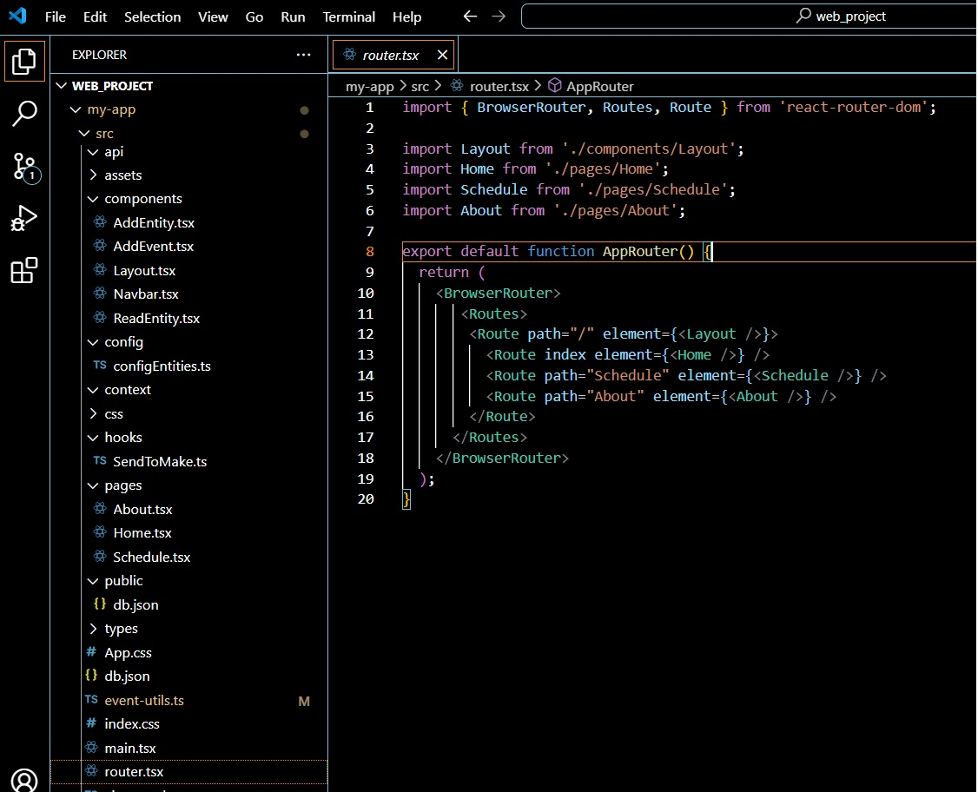
Structure
src/
├── components/
# Shared components
├── hooks/
# Custom hooks
├── pages/
# Pages (Home, Schedule, About)
├── config/
# Form configuration
├── router.tsx
# Route configuration
└── main.tsx
# Application entry point

Slide 7
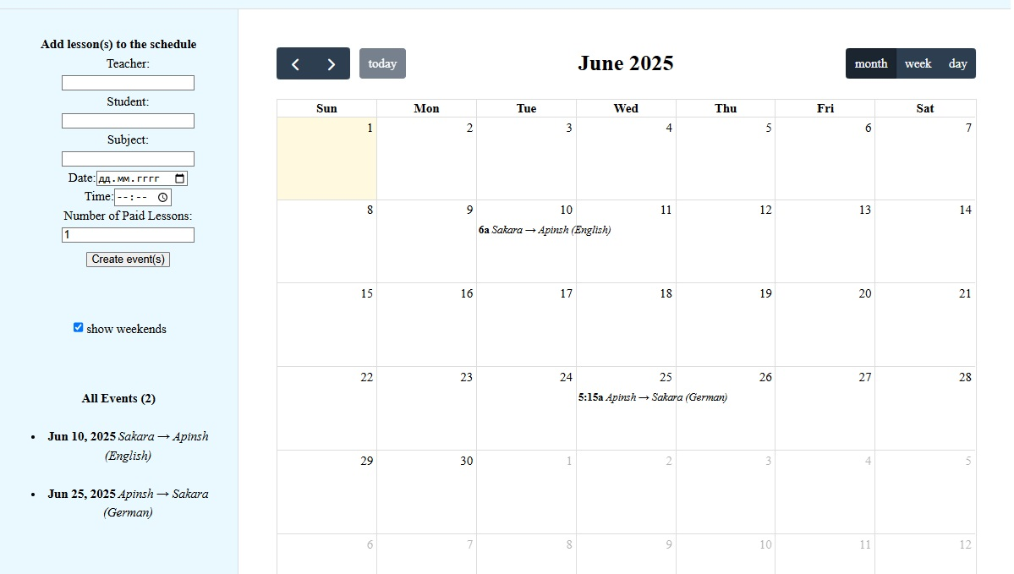
What i used
HTML
CSS
JavaScript
moduls
Local storage
DOM and Events
JSON
GitHub
(except ChatGPT)

Slide 8
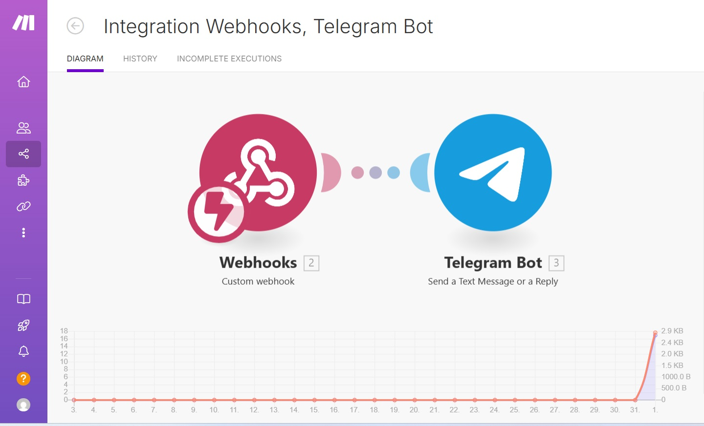
What i used
HTML
CSS
JavaScript
moduls
Local storage
DOM and Events
JSON
GitHub
(except ChatGPT)

Slide 9
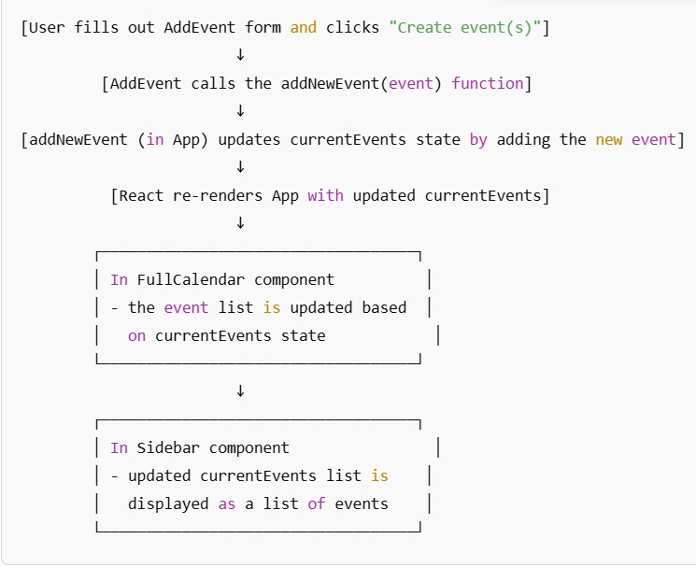
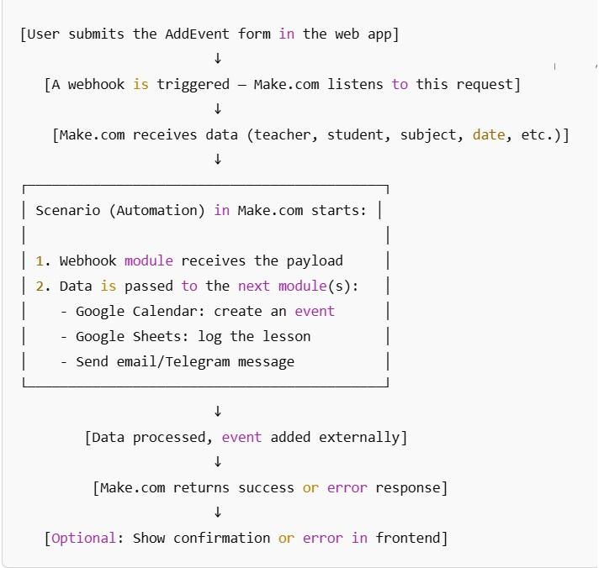
How it works
Event Adding Flowchart
Event Automation Flow via Make.com

Slide 10



Difficulties
1
many ideas, little skills and time
2
there was no architect. I'm not sure that I chose the optimal layout of parts/modules
3
CORS

Slide 11

Future steps
Add photos of teachers
Add analytics: notify that a teacher search is required, ets…
Add personal account for teachers, students and staff
Propose the website to a real online school in Ukraine

Slide 12
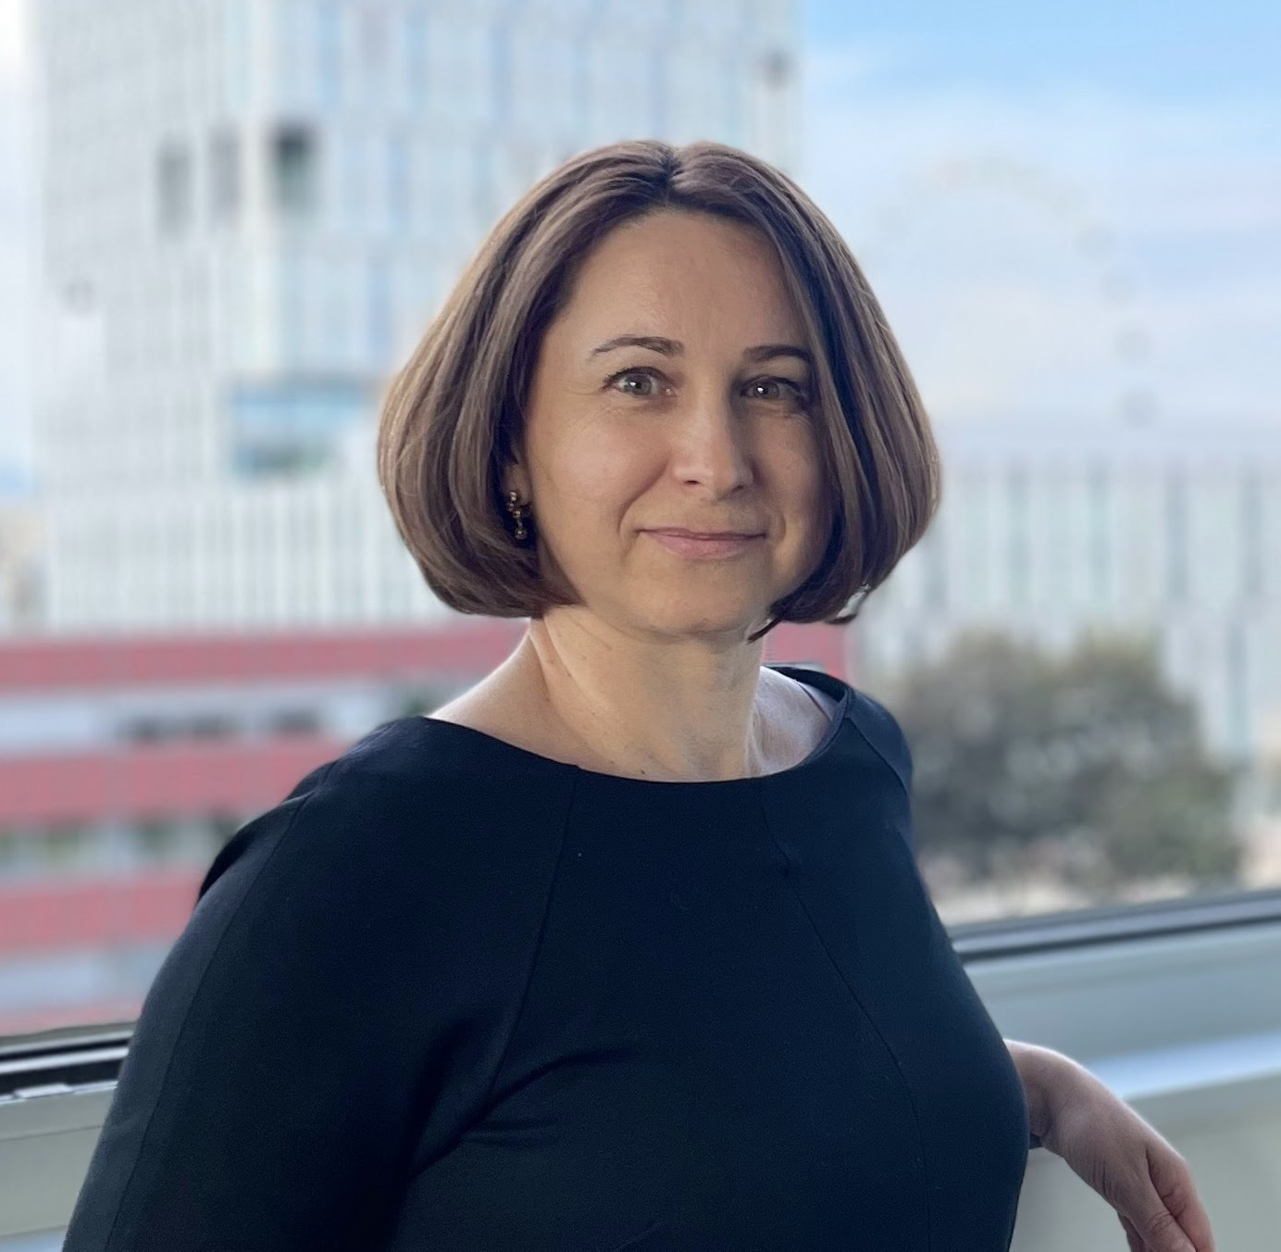
Thanks a lot, it was an interesting journey!
Contact
Olga Sakara
osakara@ukr.net

