Slide 1


SVG Airspan
IXIA – Guidelines for SVG Tomer Nahmady
tnahmady@Airspan.com
www.airspan.com

Slide 2
IXIA Agenda
What is the purpose
IXIA location at SVG LAB
Some TCP guidelines
How to configure IXIA
Some troubleshooting.

Slide 3
What is IXIA
Ixia, a company that provides testing tools for network equipment vendors.

Slide 4
IXIA at SVG Lab
SVG LAB HAS 2 IXIA Chassis:
VERSION 5.10 BIG Chassis and Version 6.60 is for the smaller chassis but with newer version, which mostly used for automation.
Pls install IXIA : VERSION 5.10 BIG Chassis.
Link to installer - W:\SVG\3rd Party Elements\Traffic Generators\Ixia Big Chassis
IP of chassis – 172.20.61.234
Guides:
T:\SVG\Training\IxLOAD\L4-L7 TESTING

Slide 5
A little bit about TCP
TCP (Transmission Control Protocol) is a connection oriented protocol which means that we keep track of how much data has been transmitted. The sender will transmit some data and the receiver has to acknowledge it. When we don’t receive the acknowledgment in time then the sender will re-transmit the data.
3 steps Handshake …
Windows – next slide

Slide 6
TCP Windows
The throughput of a communication is limited by two windows:
congestion window.
receive window.
The congestion window tries not to exceed the capacity of the network (congestion control);
The receive window tries not to exceed the capacity of the receiver to process data (flow control).

Slide 7
Scaling window
Typically the TCP connection will start with a small window size and every time when there is a successful acknowledgement, the window size will increase.
TCP Slow start …

Slide 8
Dropped Packet
With TCP slow start, the window size will initially grow exponentially (window size doubles) but once a packet is dropped, the window size will be reduced to one segment. It will then grow exponentially again until the window size is half of what it was when the congestion occurred. At that moment, the window size will grow linearly instead of exponentially.
TCP Saw tooth…

Slide 9
IXIA Configuration
IXIA Configuration is according to the following slides.

Slide 10
Set up Preparations
You can take an existing file and make adaptations to your setup.
Use Set up allocated Vlans and IP addresses.
Verify you have an excellent radio link between the UE and the enodeB (to achieve MAX Throughput).
Test your Setup with STC ( using UDP traffic) before. Normally TCP rate achieves around 95% of UDP.

Slide 11
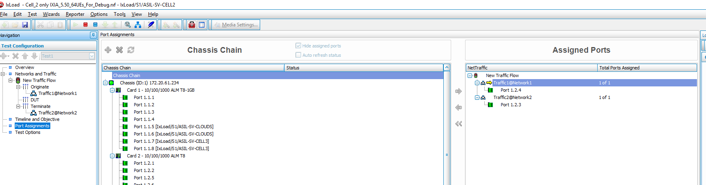
IXIA Configuration
Port assignment: 1.2.4 network 1 Client ; 1.2.3 network 2 Server

Slide 12
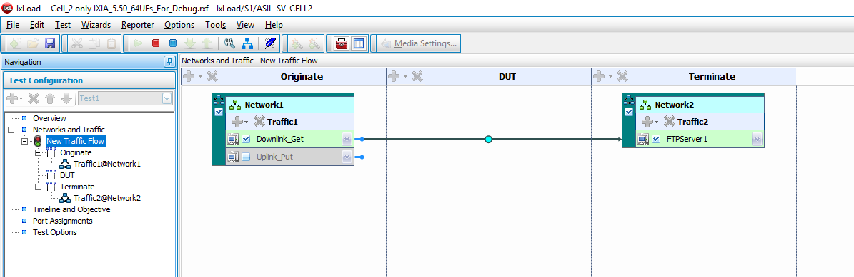
IXIA Configuration
Client and Server:

Slide 13
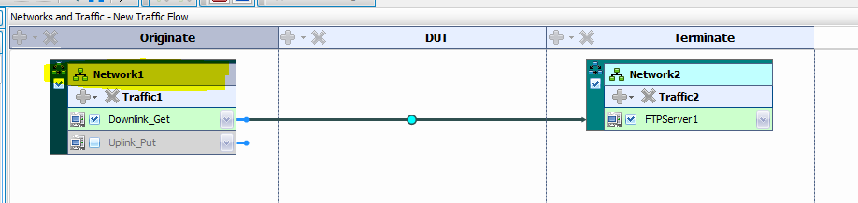
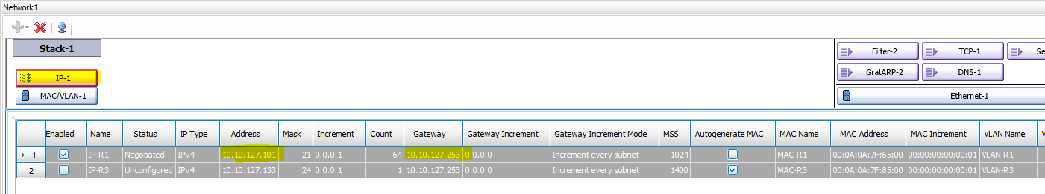
IXIA Configuration
Client Network configuration:

Slide 14
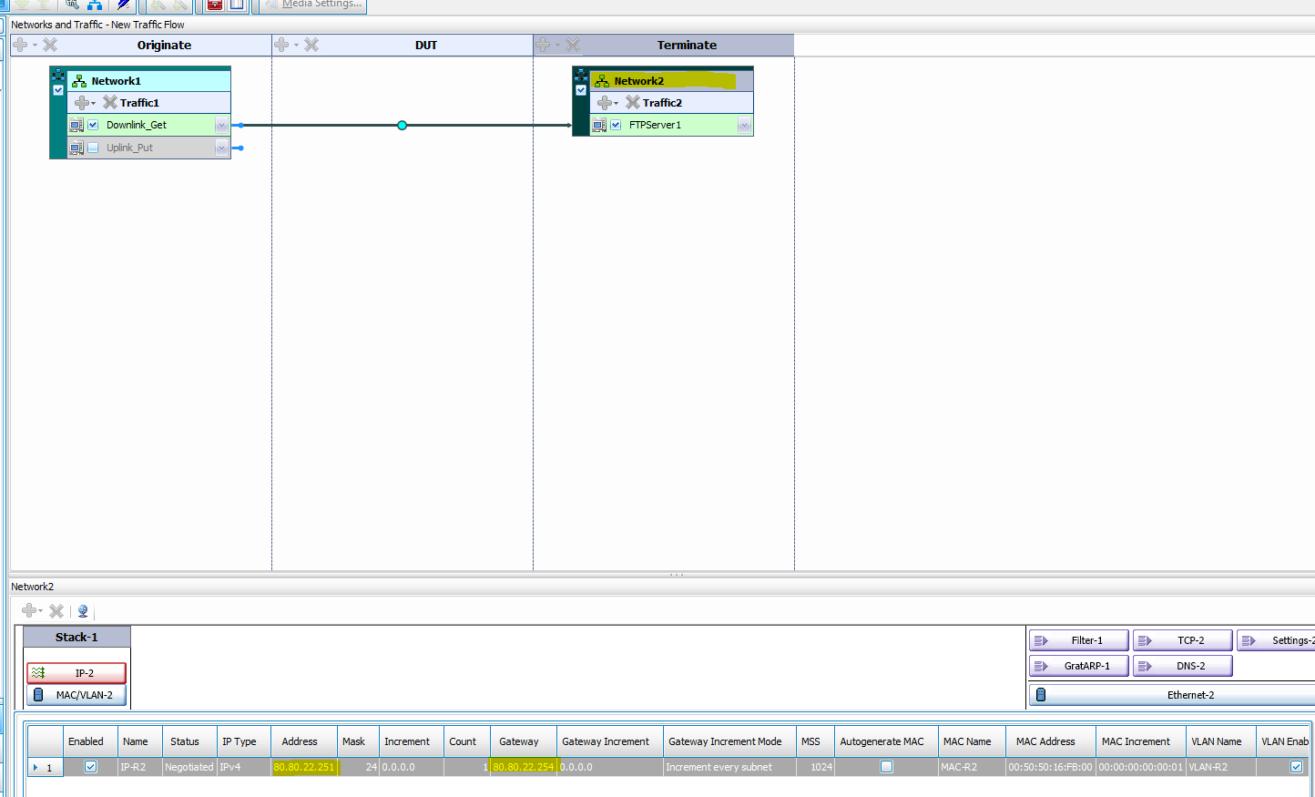
IXIA Configuration
Server Network configuration :

Slide 15
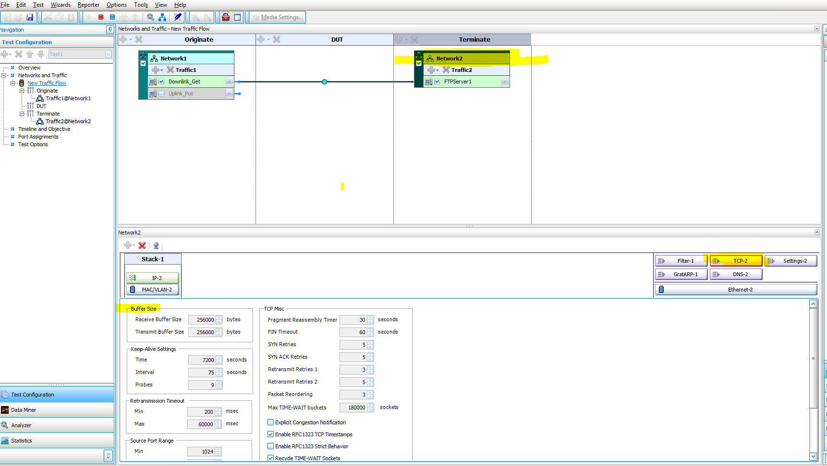
IXIA Configuration
TCP Parameters configuration Defaults:

Slide 16
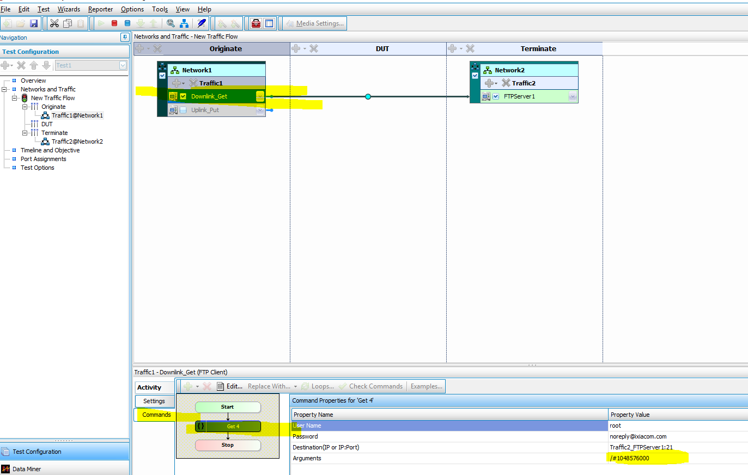
IXIA Configuration
Configuration of Download (Get) and Files size:

Slide 17
IXIA Configuration
Configuration of Download (Get) and Files size:

Slide 18
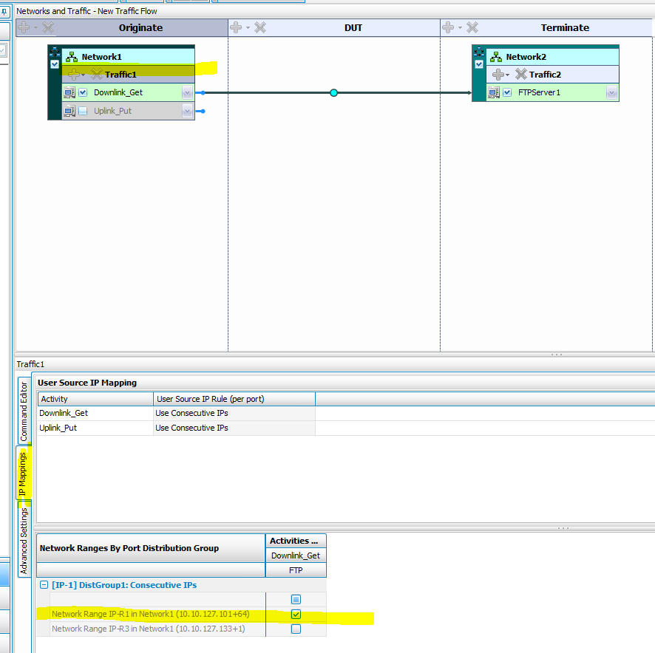
IXIA Configuration
Client – which networks that will be used:

Slide 19
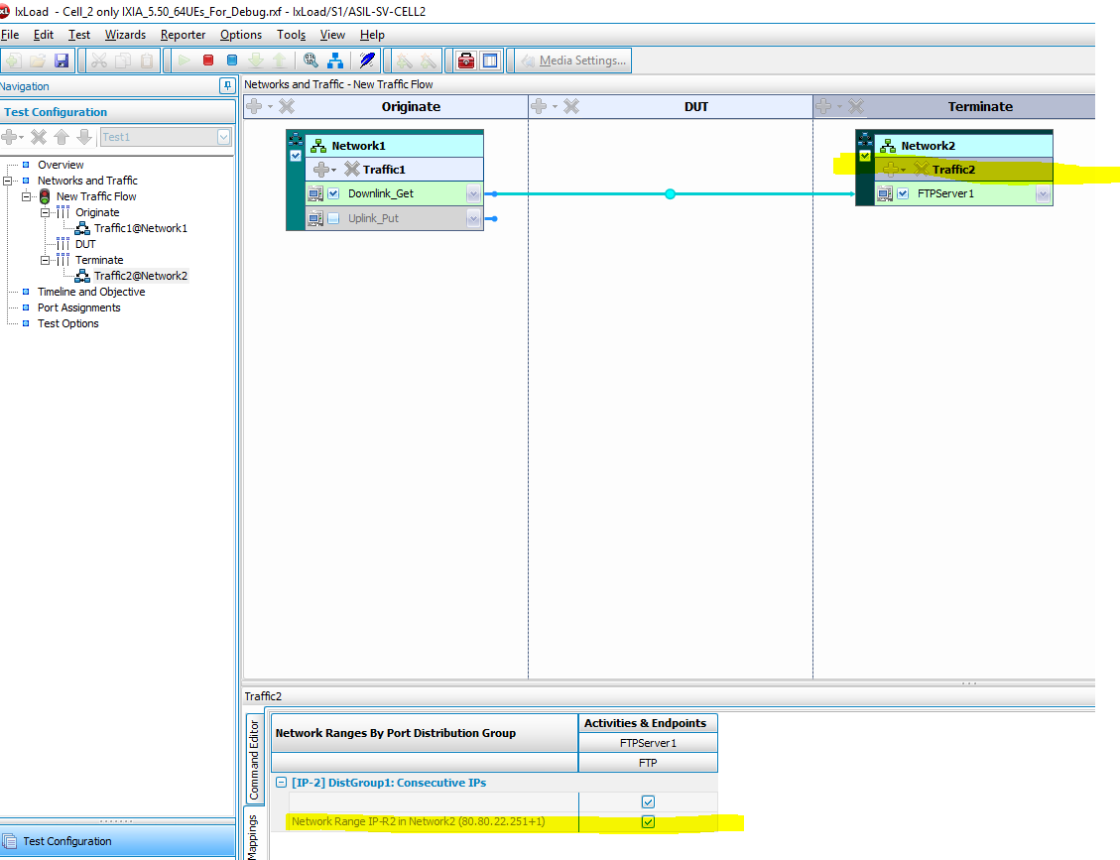
IXIA Configuration
Server – which networks that will be used:

Slide 20
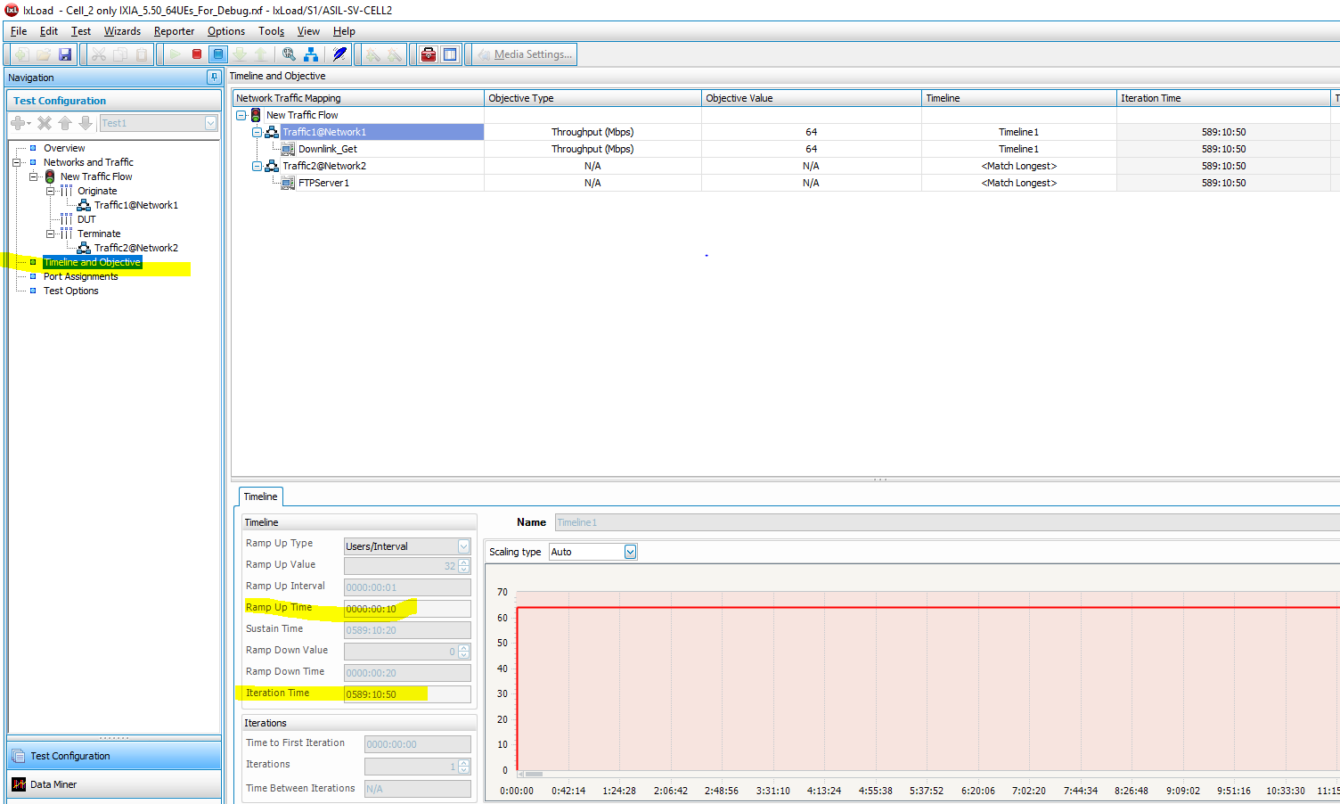
IXIA Configuration
Timeline and Objective:

Slide 21
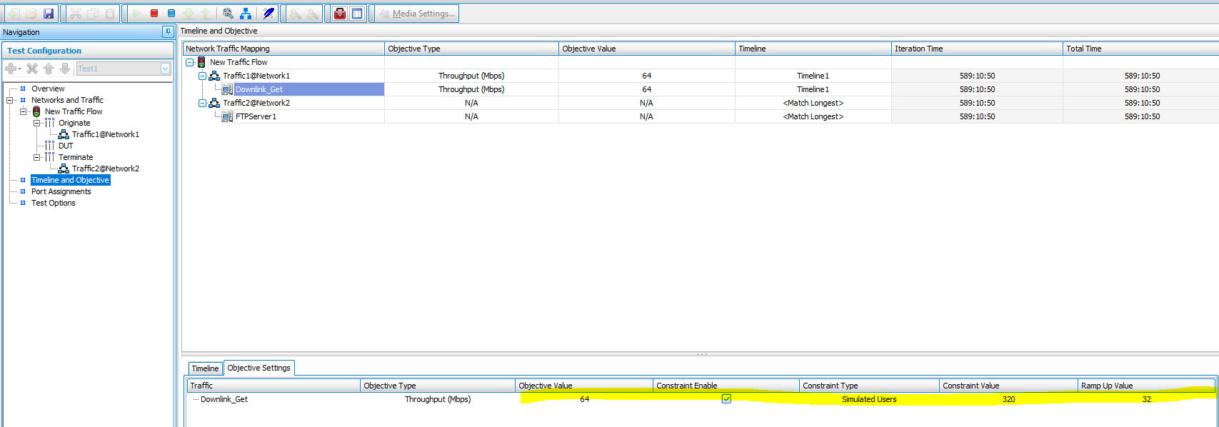
IXIA Configuration
Simulated users: each “UE” will used X sessions simultaneously
Example:

Slide 22
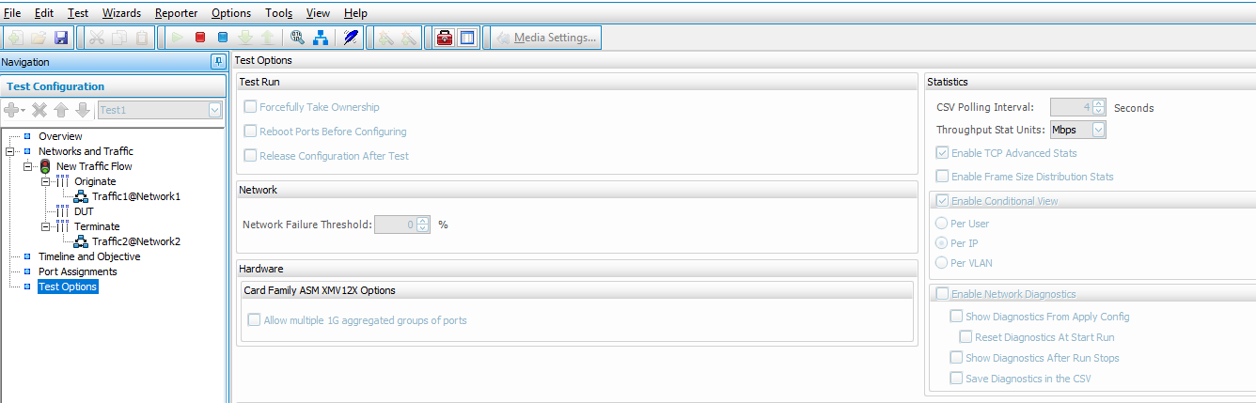
IXIA Configuration
Test options:

Slide 23
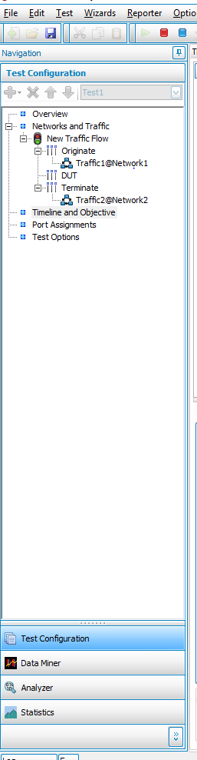
IXIA Configuration
Move between configuration and Statistics:

Slide 24
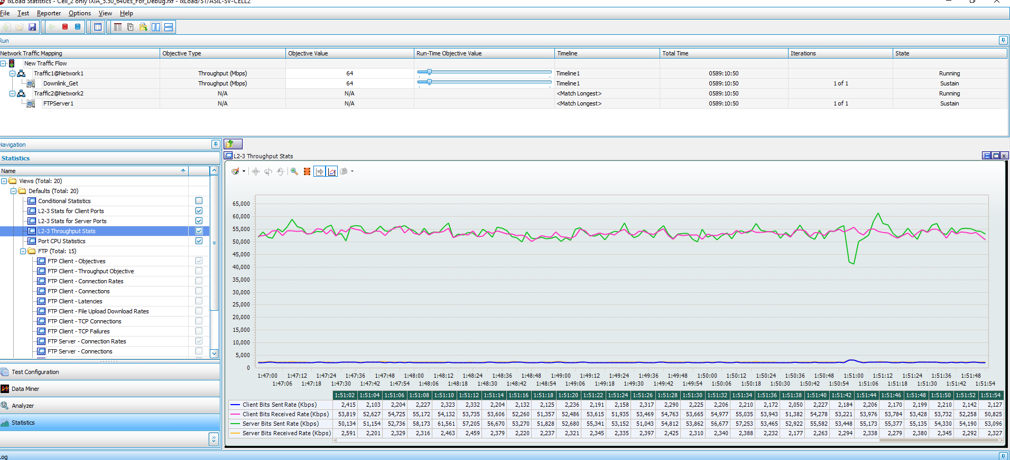
IXIA Statistics
L2-3 throughput stats:

Slide 25
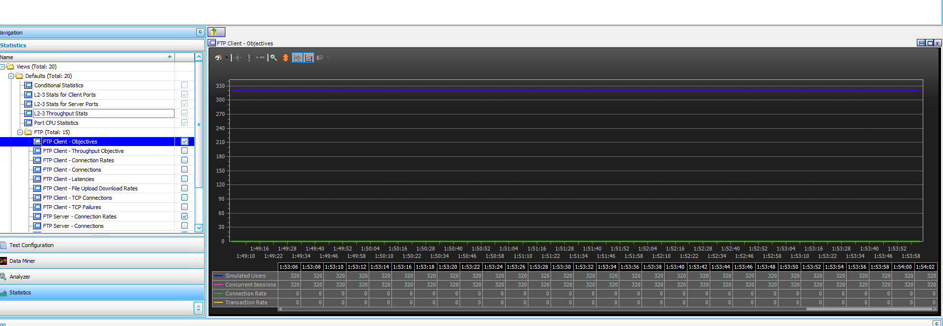
IXIA Statistics
Objectives – “simulated users”

Slide 26
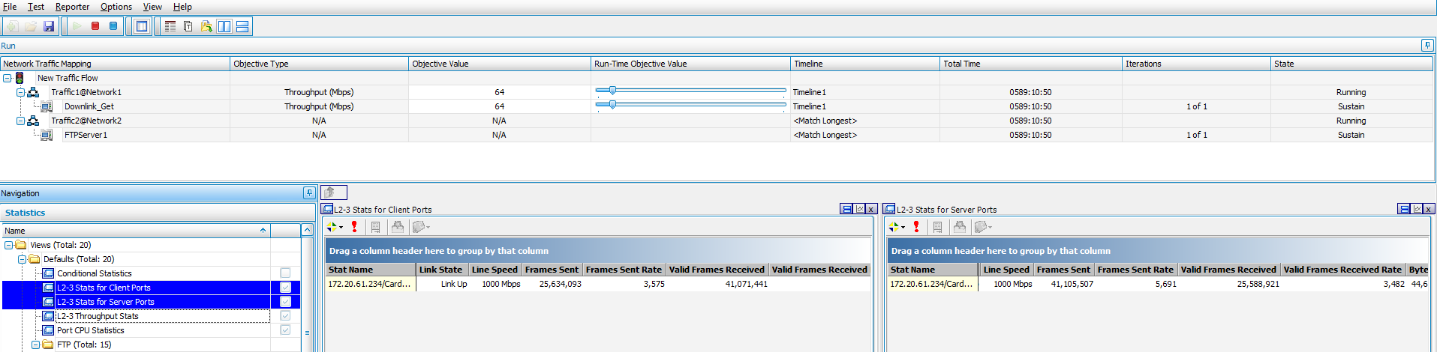
IXIA Statistics
Port statistics:

Slide 27
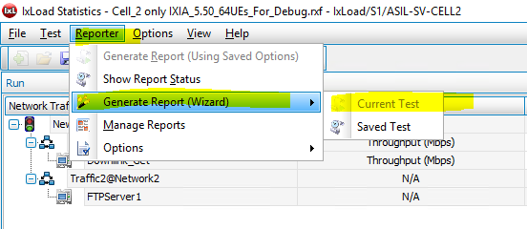
IXIA Generate report

Slide 28
Troubleshooting
Verify you have an excellent radio link between the UE and the enodeB.
Use more than one UE. ( UE problem /TCP behavior…).
Test your Setup with STC ( using UDP traffic) before. Normally TCP rate achieves around 95% of UDP.
Ping to default gateway – according to the next slide
IXIA Test log which may indicate on a configuration error.
Be aware that we are testing a system so the problem may with the UE, the network, the EPC and/or configuration error.
Run some performance commands on the enodeB for debugging of R&D ( were sent separately).

Slide 29
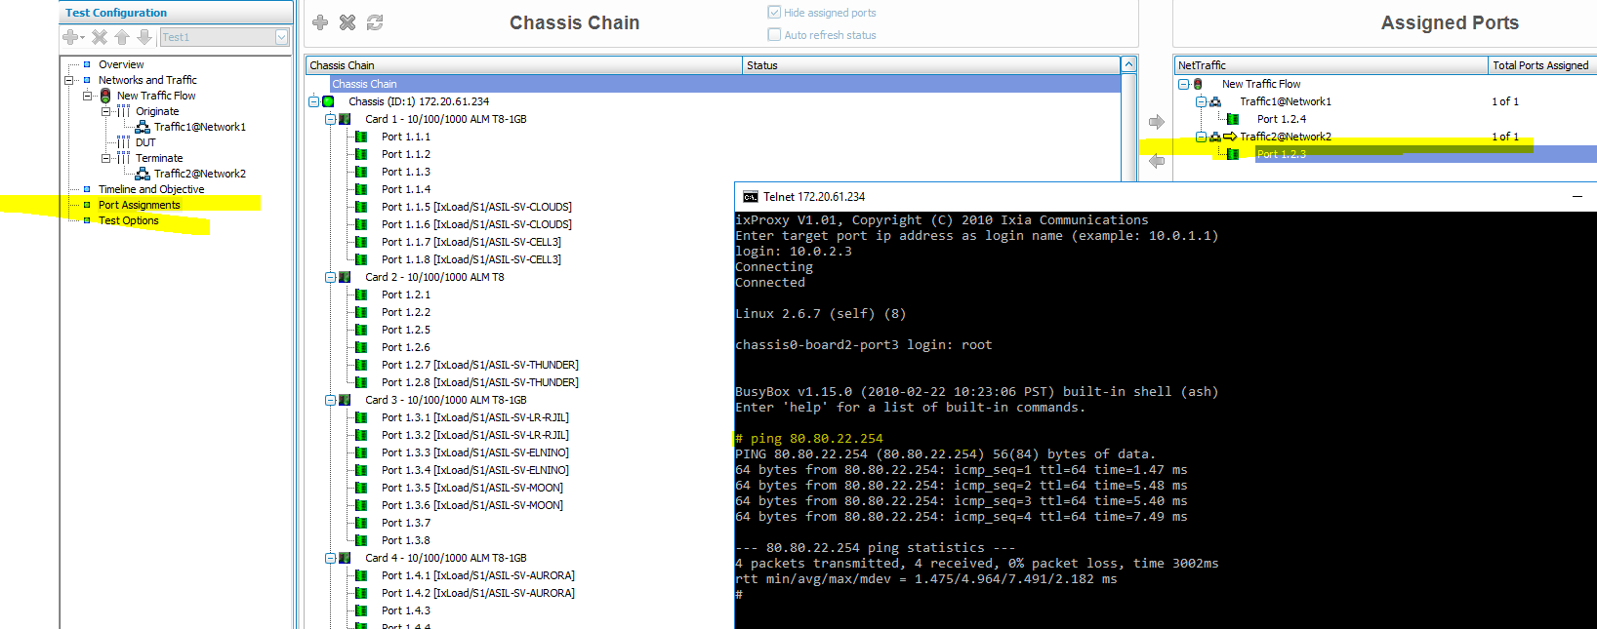
Ping the default gateway from IXIA

Slide 30
Additional info
IXIA and STC are connected to UL/DL switches. Following slides explain how to reach them to verify correct configuration.
MSS and MTU: Explanation and differences.
Example how one parameter can influence the THPT results.

Slide 31
DMZ
UE configuration example:
UE MNG IP 100.39.1.254 DMZ 100.39.1.100
WAN 10.10.39.1 Gateway 10.10.39.254
DMZ is a default address which the UE will send traffic arrive from server and the NAT does not know the destination address. In more details:
When no UL data , the downlink traffic which comes to the UE on WAN address ( LTE) 10.10.39.1
The NAT on the UE does not know where to send the traffic.
so it sends it to the DMZ 100.39.1.100 which is the IPv4 address of the STC/IXIA UL UE configuration.
When the traffic is bi-dir the NAT knows where to send the traffic ( learnt by NAT).

Slide 32
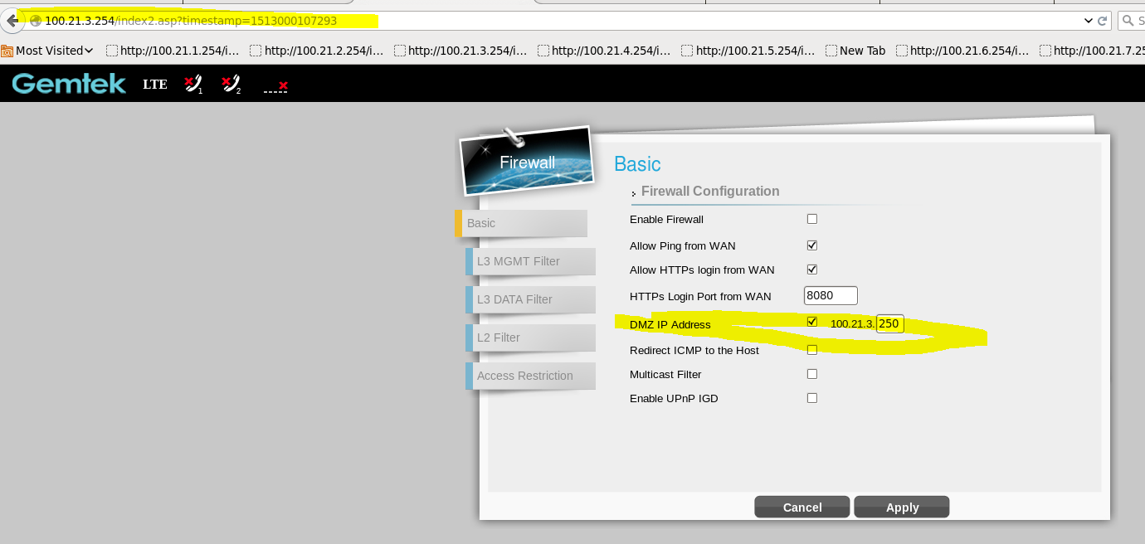
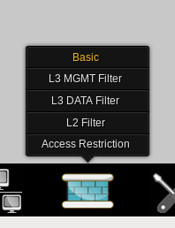
DMZ

Slide 33
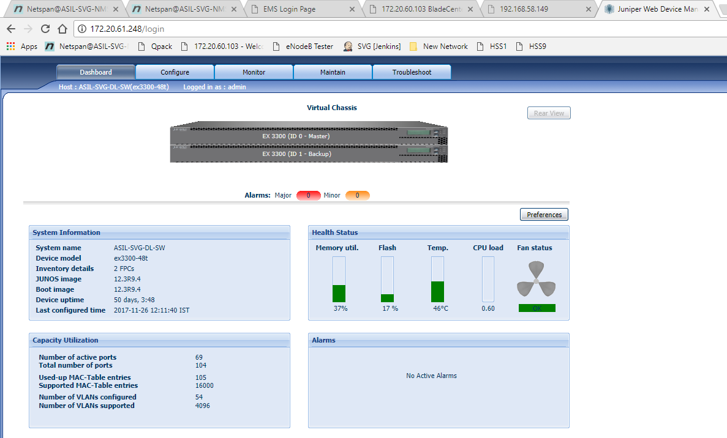
172.20.61.248 DL Switch STC(0) IXIA(1)

Slide 34
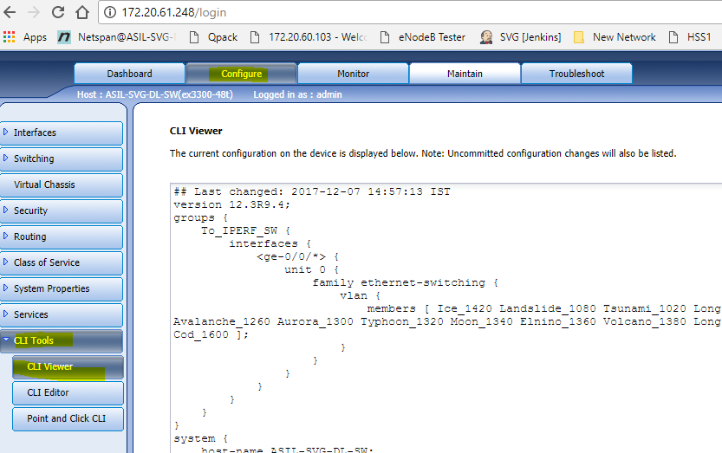
DL Switch View configuration

Slide 35
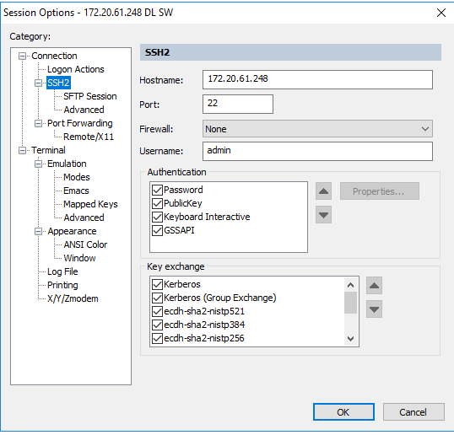
DL SW via SSH

Slide 36
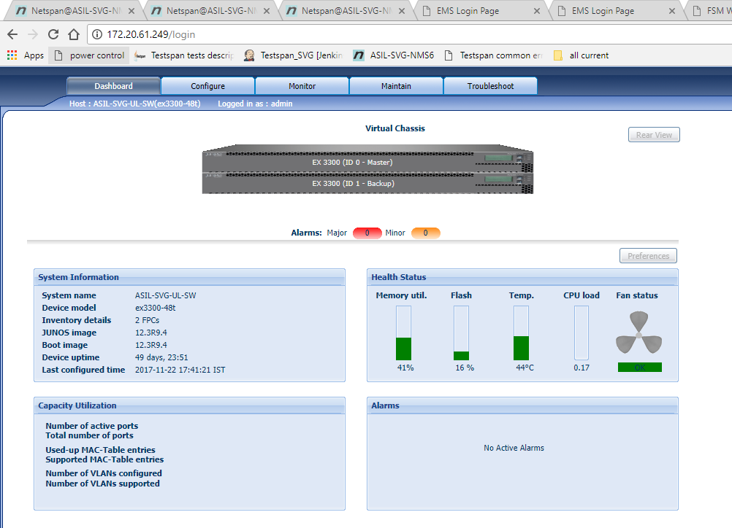
172.20.61.249 UL Switch STC(0) IXIA(1)

Slide 37
MTU and MSS
A maximum transmission unit (MTU) is the largest packet or frame size, specified in octets (eight-bit bytes) that can be sent in a packet- or frame-based network such as the internet.
The internet’s transmission control protocol (TCP) uses the MTU to determine the maximum size of each packet in any transmission.
TCP MSS is the payload its self…
IP MTU / ETH MTU is the payload with TCP header (20 bytes and IP header 20bytes)
In other words: MTU= MSS + 40 bytes.

Slide 38
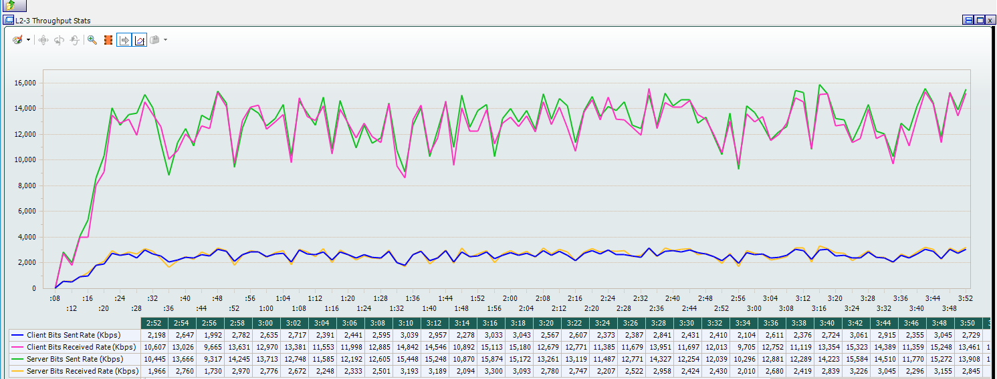
Example THPT when 64 UEs MSS=128
For example:
If client MSS=128 => the server will not sent packets which
are greater than 128.

Slide 39
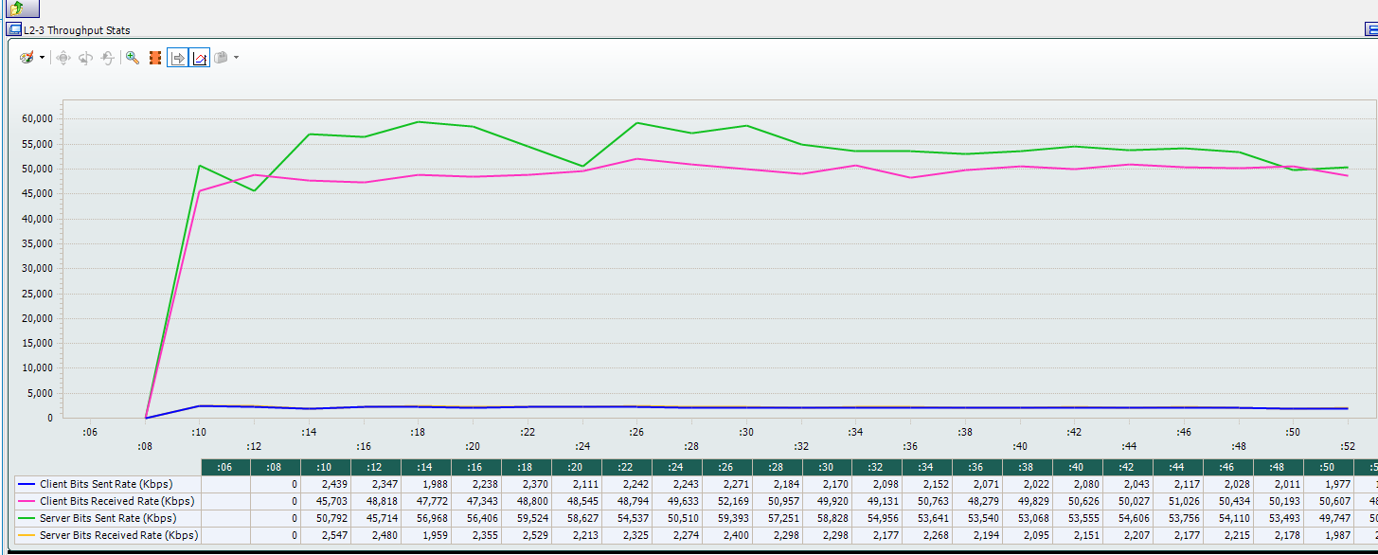
Example THPT when 64 UEs MSS=1024
Below THPT when client MSS=1024 :

Slide 40
END
Thanks for your attention.
Additional info:
Guides: T:\SVG\Training\IxLOAD\L4-L7 TESTING
IXIA Manuals.
For any question: tnahmady@Airspan.com

