Slide 1
Company Strategy
Integrated pack
Current date

Slide 2
A title conveying something
Column header
Column header
Column header
Column header
Column header
Valued contrib
Valued contrib
Valued contrib
Valued contrib
Another category
Another category
Another category
Another category
Another category
Valued contrib
Valued contrib
Valued contrib
Valued contrib
Another category
Another category
Another category
Another category
Another category
Valued contrib
Valued contrib
Valued contrib
Valued contrib

Slide 3
Table of contents
Section A – Very important
Section B – Slightly more slightly less you choose
Section C – Most important

Slide 4
Executive summary
Ay, marry, is't: But to my mind, though I am native here And to the manner born, it is a custom More honour'd in the breach than the observance.
This heavy-headed revel east and west Makes us traduced and tax'd of other nations:
They clepe us drunkards, and with swinish phrase
Soil our addition; and indeed it takes From our achievements, though perform'd at height,
The pith and marrow of our attribute. So, oft it chances in particular men, That for some vicious mole of nature in them,
Ay, marry, is't: But to my mind, though I am native here And to the manner born, it is a custom More honour'd in the breach than the observance.
This heavy-headed revel east and west Makes us traduced and tax'd of other nations:
They clepe us drunkards, and with swinish phrase
Soil our addition; and indeed it takes From our achievements, though perform'd at height,
The pith and marrow of our attribute. So, oft it chances in particular men, That for some vicious mole of nature in them,

Slide 5
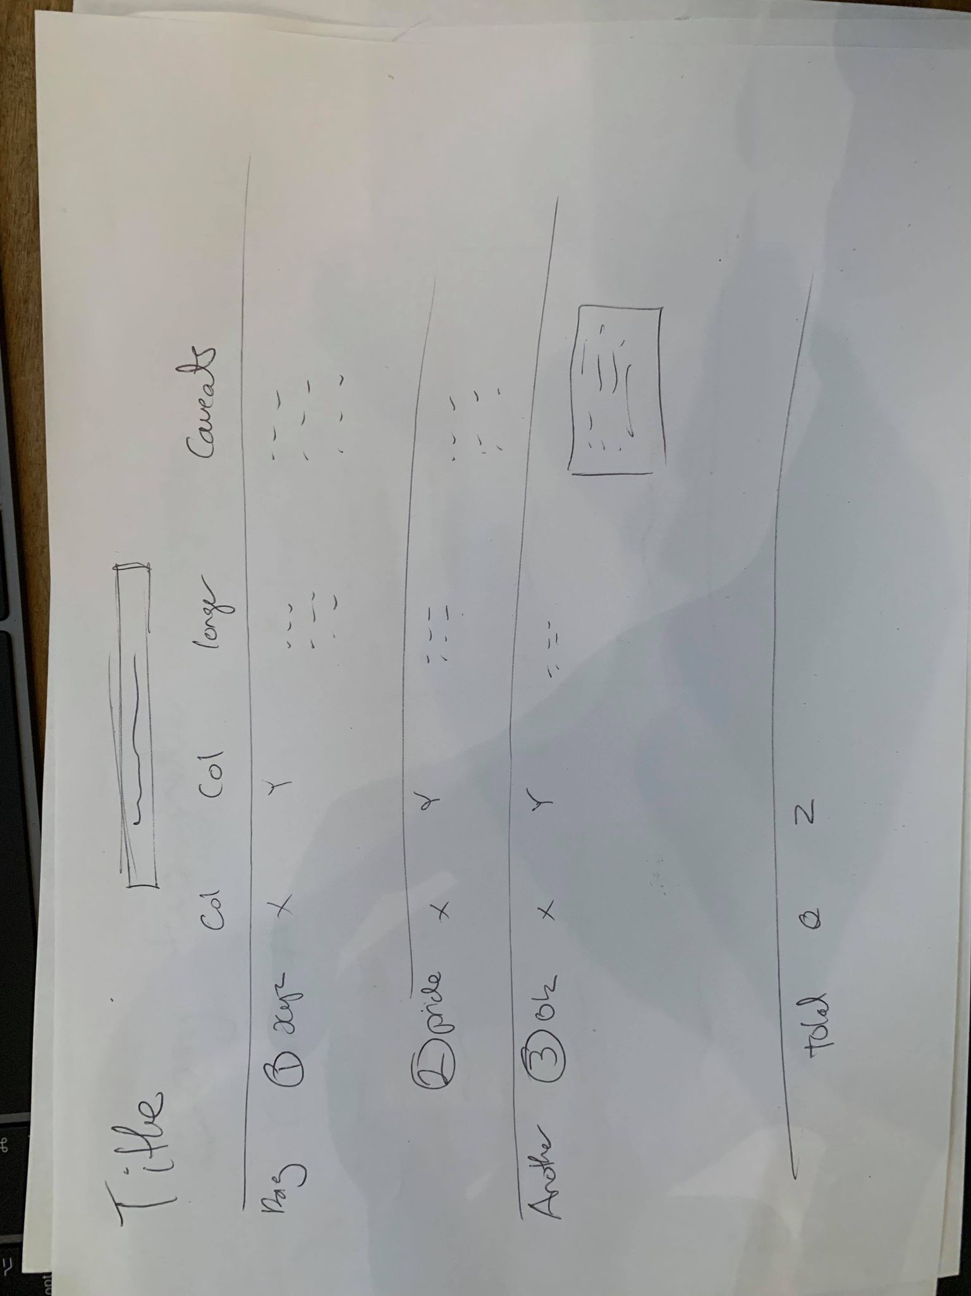
Data slide
Strong Caveat
Deep Dive
Col1
Col2
Notes
Caveats
SuperCat
1
Subcat 1
X
X
Ay, marry, is't: But to my mind, though I am native here And to the manner born, it is a custom
Ay, marry, is't: But to my mind, though I am native here And to the manner born, it is a custom
2
Subcat 2
Revisit'st thus the glimpses of the moon, Making night hideous; and we fools of nature
So horridly to shake our disposition With thoughts beyond the reaches of our souls?
Z
X
SuperCat2
3
Subcat 3
X
X
Revisit'st thus the glimpses of the moon, Making night hideous; and we fools of nature
So horridly to shake our disposition With thoughts beyond the reaches of our souls?
Total
Q
Y

Slide 6
Data slide
Strong Caveat
Deep Dive
Col1
Col2
Notes
Caveats
SuperCat
1
Subcat 1
X
X
Ay, marry, is't: But to my mind, though I am native here And to the manner born, it is a custom
Ay, marry, is't: But to my mind, though I am native here And to the manner born, it is a custom
2
Subcat 2
Revisit'st thus the glimpses of the moon, Making night hideous; and we fools of nature
So horridly to shake our disposition With thoughts beyond the reaches of our souls?
Z
X
SuperCat2
3
Subcat 3
X
X
Revisit'st thus the glimpses of the moon, Making night hideous; and we fools of nature
So horridly to shake our disposition With thoughts beyond the reaches of our souls?
Total
Q
Y

Slide 7
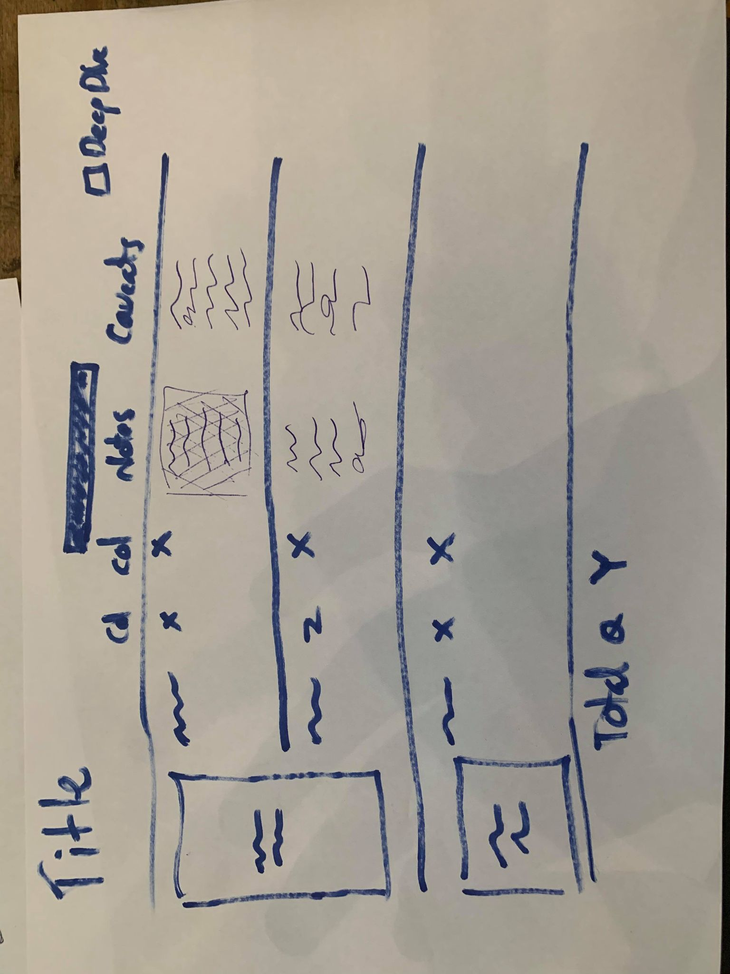
Data slide
Strong Caveat
Deep Dive
Col1
Col2
Notes
Caveats
Category Uno
Subcat 1
X
X
Ay, marry, is't: But to my mind, though I am native here And to the manner born, it is a custom
Ay, marry, is't: But to my mind, though I am native here And to the manner born, it is a custom
Subcat 2
Revisit'st thus the glimpses of the moon, Making night hideous; and we fools of nature
So horridly to shake our disposition With thoughts beyond the reaches of our souls?
Z
X
Category Duo
Subcat 3
X
X
Revisit'st thus the glimpses of the moon, Making night hideous; and we fools of nature
So horridly to shake our disposition With thoughts beyond the reaches of our souls?
Total
Q
Y

Slide 8
Data slide
Strong Caveat
Deep Dive
Col1
Col2
Notes
Caveats
Category Uno
Subcat 1
X
X
Ay, marry, is't: But to my mind, though I am native here And to the manner born, it is a custom
Ay, marry, is't: But to my mind, though I am native here And to the manner born, it is a custom
Subcat 2
Revisit'st thus the glimpses of the moon, Making night hideous; and we fools of nature
So horridly to shake our disposition With thoughts beyond the reaches of our souls?
Z
X
Category Duo
Subcat 3
X
X
Revisit'st thus the glimpses of the moon, Making night hideous; and we fools of nature
So horridly to shake our disposition With thoughts beyond the reaches of our souls?
Total
Q
Y

Slide 9
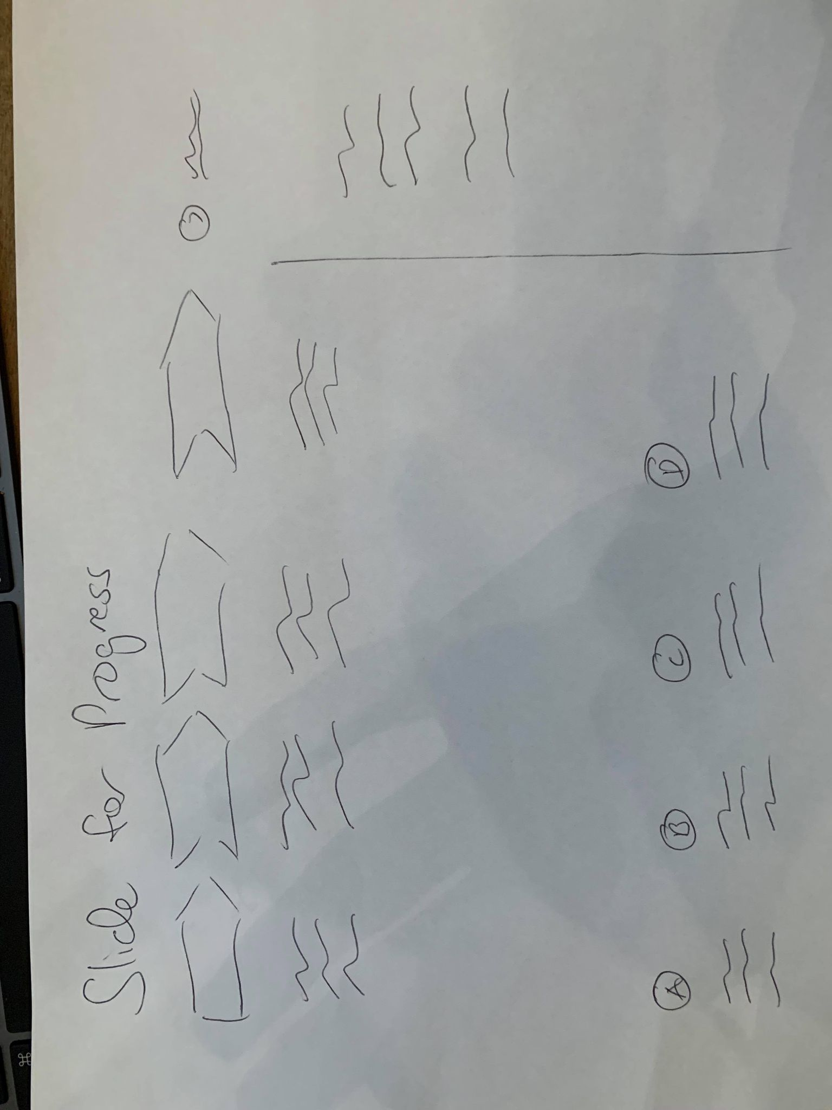
Progressing to the future
Stage 1
Stage 2
Stage 2
Stage 3
>
Implications of impact
The very place puts toys of desperation, Without more motive, into every brain That looks so many fathoms to the sea And hears it roar beneath.
Revisit'st thus the glimpses of the moon, Making night hideous; and we fools of nature
The very place puts toys of desperation, Without more motive, into every brain That looks so many fathoms to the sea And hears it roar beneath.
Revisit'st thus the glimpses of the moon, Making night hideous; and we fools of nature
Still am I call'd. Unhand me, gentlemen. By heaven, I'll make a ghost of him that lets me! I say, away! Go on; I'll follow thee.
A
B
C
D
Revisit'st thus the glimpses of the moon, Making night hideous; and we fools of nature
Revisit'st thus the glimpses of the moon, Making night hideous; and we fools of nature
Revisit'st thus the glimpses of the moon, Making night hideous; and we fools of nature
Revisit'st thus the glimpses of the moon, Making night hideous; and we fools of nature

Slide 10
Progressing to the future
Stage 1
Stage 2
Stage 2
Stage 3
>
Implications of impact
The very place puts toys of desperation, Without more motive, into every brain That looks so many fathoms to the sea And hears it roar beneath.
Revisit'st thus the glimpses of the moon, Making night hideous; and we fools of nature
The very place puts toys of desperation, Without more motive, into every brain That looks so many fathoms to the sea And hears it roar beneath.
Revisit'st thus the glimpses of the moon, Making night hideous; and we fools of nature
Still am I call'd. Unhand me, gentlemen. By heaven, I'll make a ghost of him that lets me! I say, away! Go on; I'll follow thee.
A
B
C
D
Revisit'st thus the glimpses of the moon, Making night hideous; and we fools of nature
Revisit'st thus the glimpses of the moon, Making night hideous; and we fools of nature
Revisit'st thus the glimpses of the moon, Making night hideous; and we fools of nature
Revisit'st thus the glimpses of the moon, Making night hideous; and we fools of nature

Slide 11
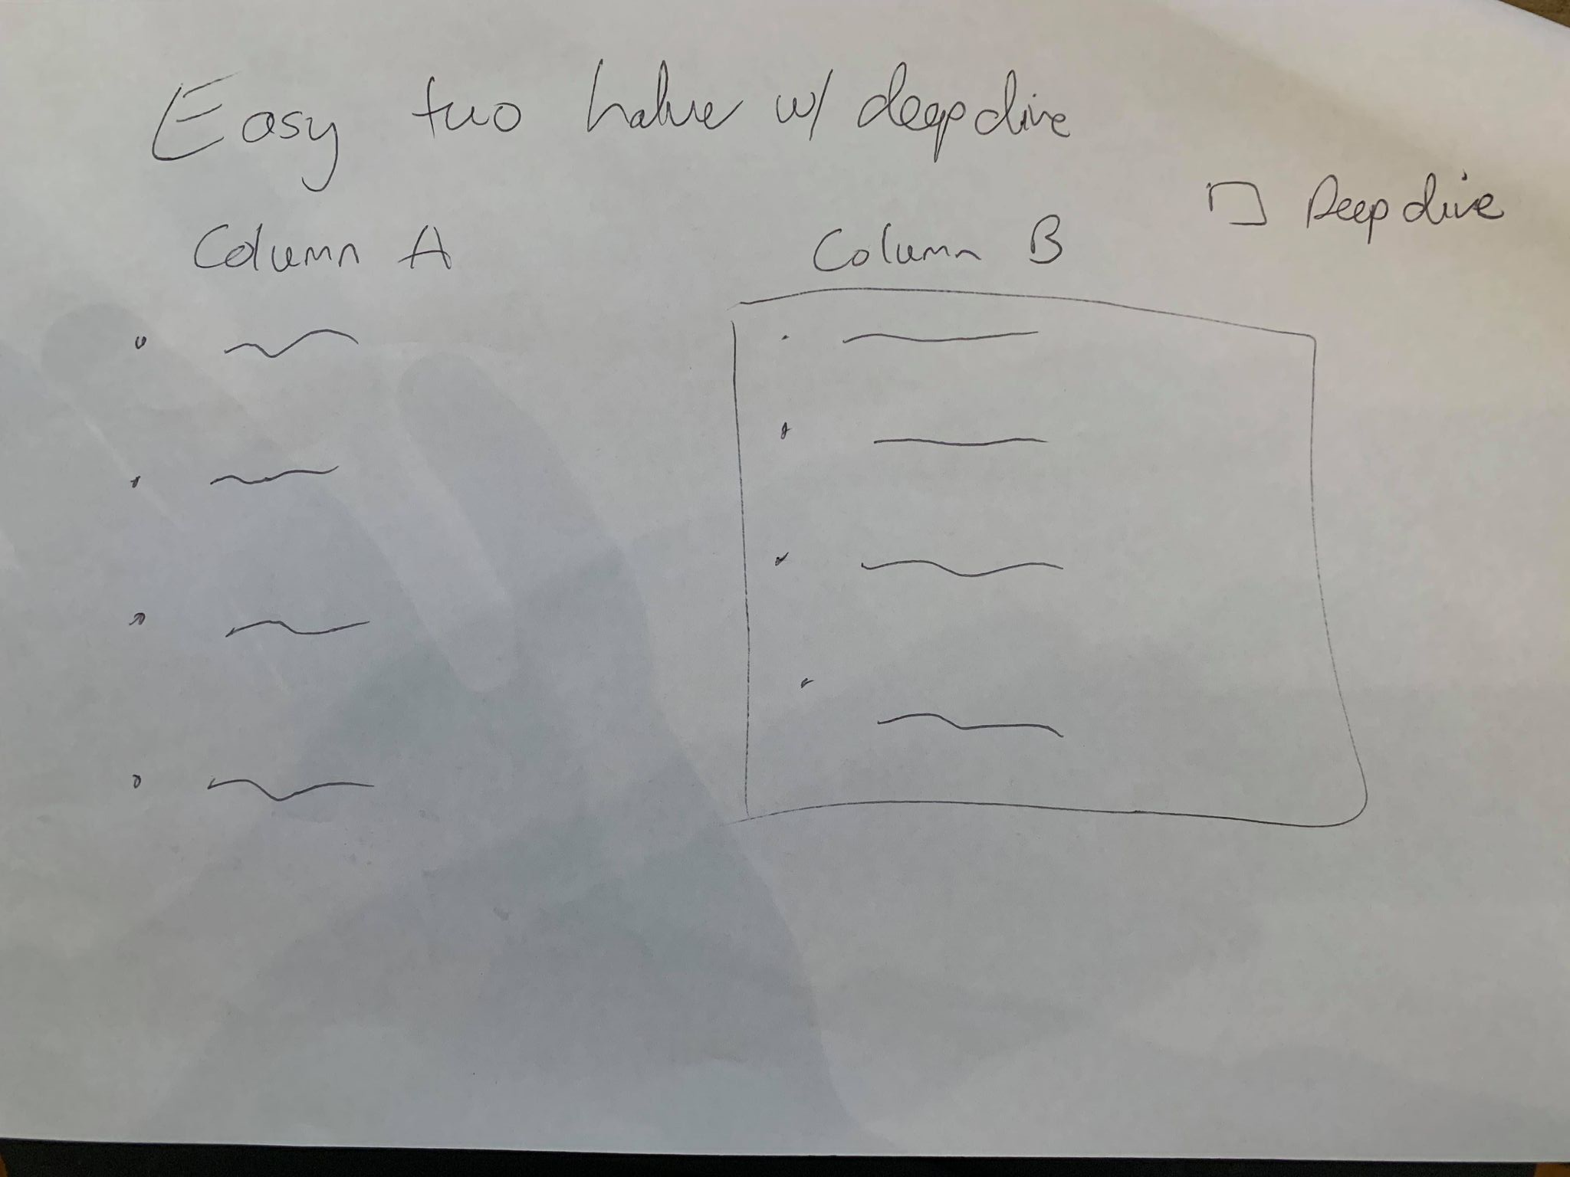
Easy two halver with deep dive
To the depths
Lil bit of column A
Lil bit of column B
Ay, marry, is't: But to my mind, though I am native here And to the manner born, it is a custom More honour'd in the breach than the observance.
This heavy-headed revel east and west Makes us traduced and tax'd of other nations:
They clepe us drunkards, and with swinish phrase
Soil our addition; and indeed it takes From our achievements, though perform'd at height
Ay, marry, is't: But to my mind, though I am native here And to the manner born, it is a custom More honour'd in the breach than the observance.
This heavy-headed revel east and west Makes us traduced and tax'd of other nations:
They clepe us drunkards, and with swinish phrase
Soil our addition; and indeed it takes From our achievements, though perform'd at height,

Slide 12
Easy two halver with deep dive
To the depths
Lil bit of column A
Lil bit of column B
Ay, marry, is't: But to my mind, though I am native here And to the manner born, it is a custom More honour'd in the breach than the observance.
This heavy-headed revel east and west Makes us traduced and tax'd of other nations:
They clepe us drunkards, and with swinish phrase
Soil our addition; and indeed it takes From our achievements, though perform'd at height
Ay, marry, is't: But to my mind, though I am native here And to the manner born, it is a custom More honour'd in the breach than the observance.
This heavy-headed revel east and west Makes us traduced and tax'd of other nations:
They clepe us drunkards, and with swinish phrase
Soil our addition; and indeed it takes From our achievements, though perform'd at height,

Slide 13
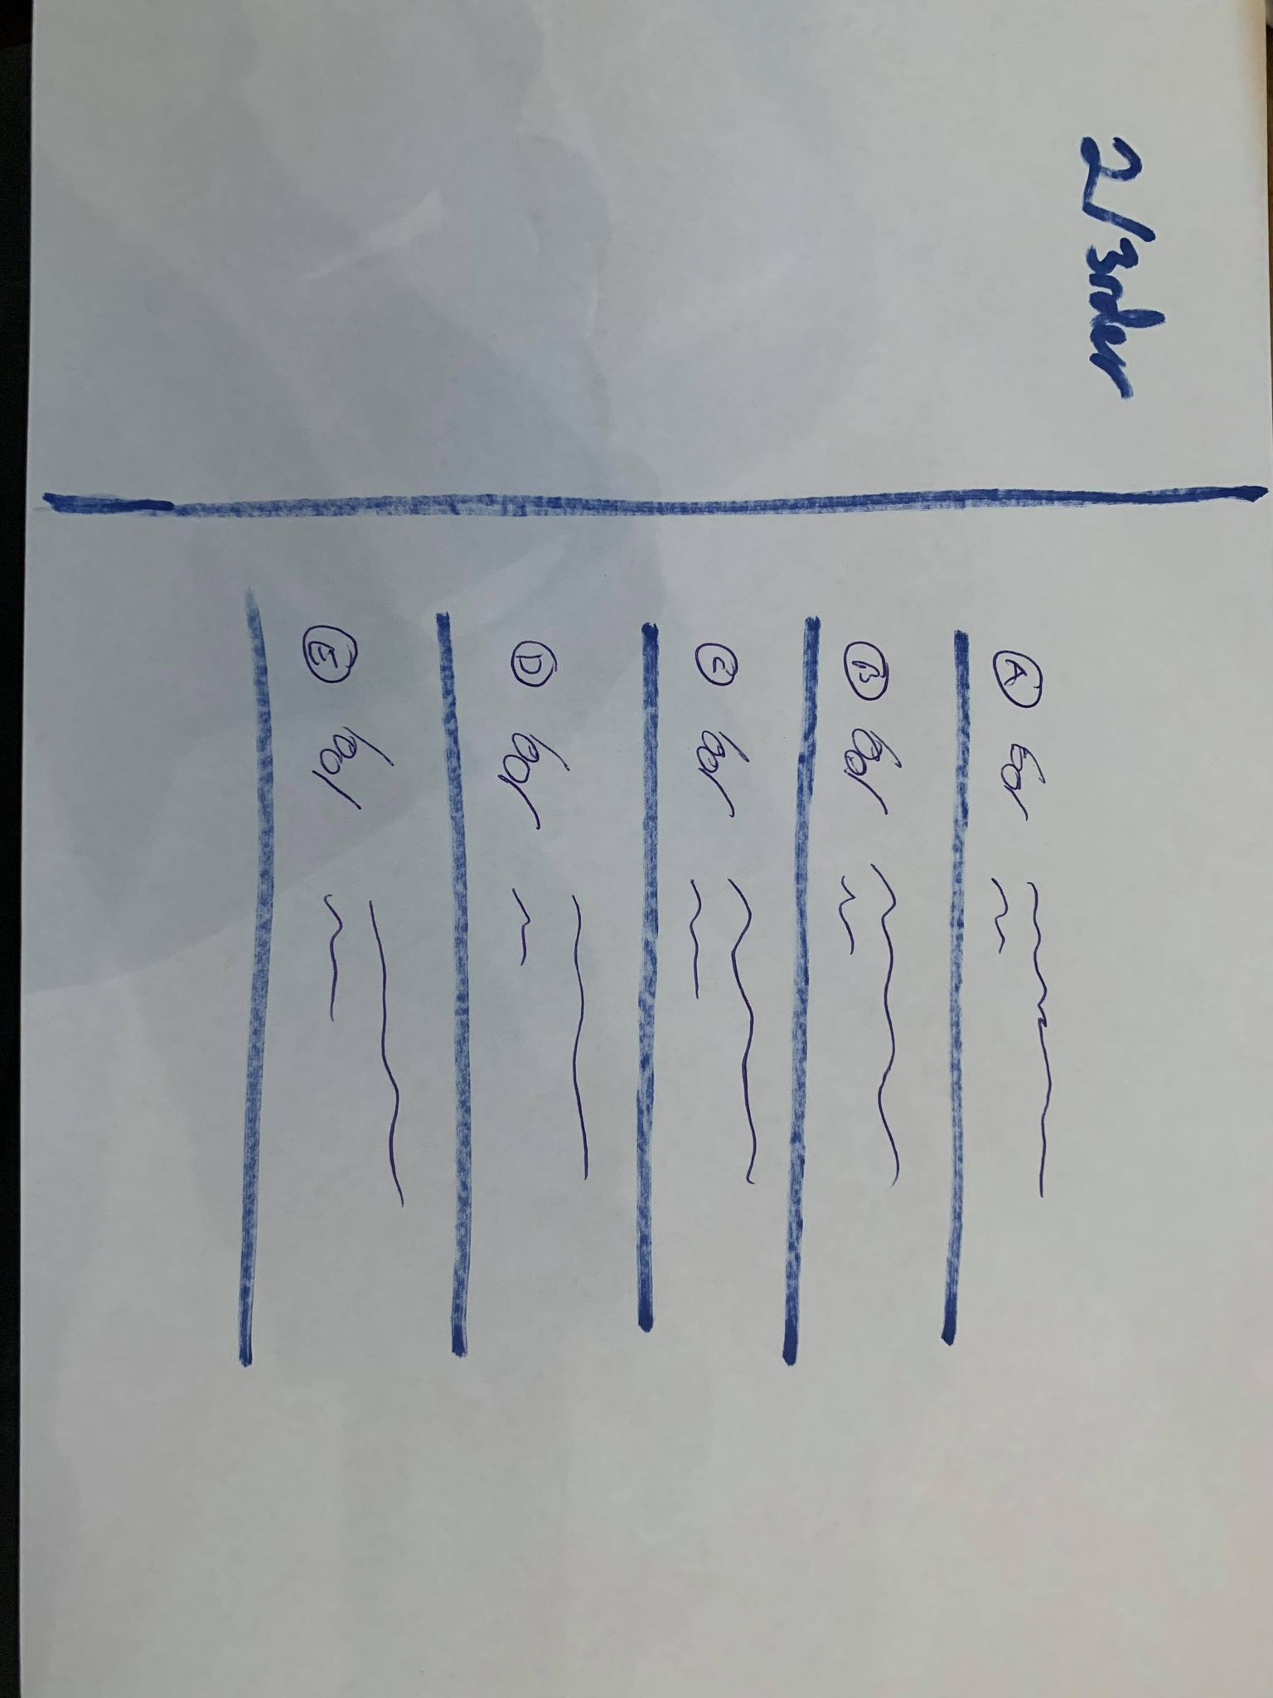

2/3rder with principles
A
Ay, marry, is’t: But to my mind, though I am native here And to the
B
Out of his lunacies. : Hazard so dangerous as doth hourly grow
C
That spirit upon whose weal depend and rest : But to my mind, though I am native here And to the
D
Ay, marry, is’t: But to my mind, though I am native here And to the
E
The lives of many. The cease of majesty Dies not alone; but, like a gulf, doth draw

Slide 14
2/3rder with principles
A
Ay, marry, is’t: But to my mind, though I am native here And to the
B
Out of his lunacies. : Hazard so dangerous as doth hourly grow
C
That spirit upon whose weal depend and rest : But to my mind, though I am native here And to the
D
Ay, marry, is’t: But to my mind, though I am native here And to the
E
The lives of many. The cease of majesty Dies not alone; but, like a gulf, doth draw

Slide 15
Data slide
Preliminary
Reccomended
Option A
Option B
Timeline
Ay, marry, is't: But to my mind, though I
Ay, marry, is't: But to my mind, though I
Description
The terms of our estate may not endure Hazard so dangerous as doth hourly grow Out of his lunacies.
I your commission will forthwith dispatch, And he to England shall along with you:
Each small annexment, petty consequence, Attends the boisterous ruin. Never alone Did the king sigh, but with a general groan.
What ya need to believe
Ay, marry, is't: But to my mind, though I
Ay, marry, is't: But to my mind, though I

Slide 16
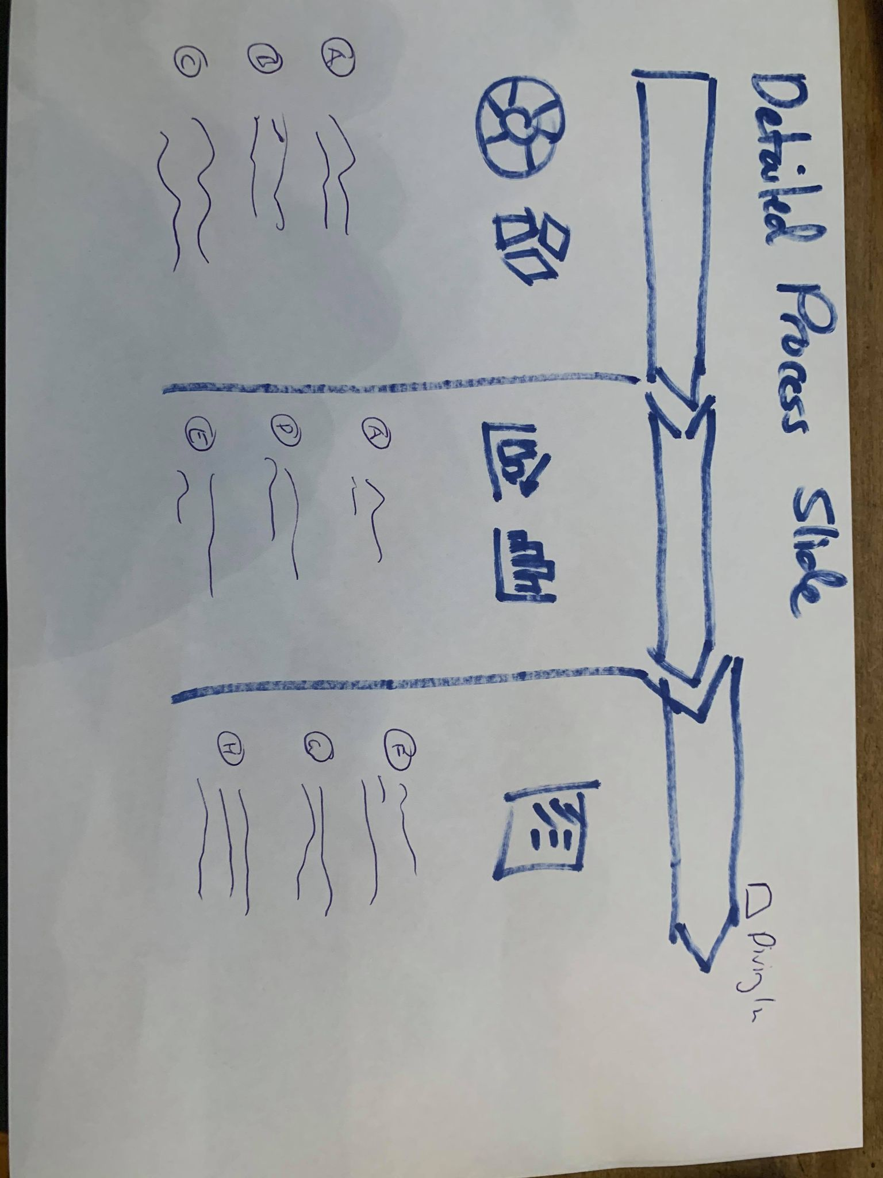





Detailed process slide
Diving in
Stage 1
Stage 2
Stage 2
A
The very place puts toys of desperation,
Without more motive, into every brain
That looks so many fathoms to the sea And hears it roar beneath.
A
The very place puts toys of desperation,
Without more motive, into every brain
That looks so many fathoms to the sea And hears it roar beneath.
The very place puts toys of desperation,
Without more motive, into every brain
That looks so many fathoms to the sea And hears it roar beneath.
F
B
D
G
C
E
H

Slide 17
Detailed process slide
Diving in
Stage 1
Stage 2
Stage 2
A
The very place puts toys of desperation,
Without more motive, into every brain
That looks so many fathoms to the sea And hears it roar beneath.
A
The very place puts toys of desperation,
Without more motive, into every brain
That looks so many fathoms to the sea And hears it roar beneath.
The very place puts toys of desperation,
Without more motive, into every brain
That looks so many fathoms to the sea And hears it roar beneath.
F
B
D
G
C
E
H

Slide 18
Dense details slide
Preliminary
Notes
Notes
Notes
I your commission will forthwith dispatch, And he to England shall along with you:
>
>
Description
Ay, marry, is't: But to my mind, though I am native here And to the manner born, it is a custom
Ay, marry, is't: But to my mind, though I am native here And to the manner born, it is a custom
Ay, marry, is't: But to my mind, though I am native here And to the manner born, it is a custom
Revisit'st thus the glimpses of the moon, Making night hideous; and we fools of nature
Revisit'st thus the glimpses of the moon, Making night hideous; and we fools of nature
Revisit'st thus the glimpses of the moon, Making night hideous; and we fools of nature
What ya need to believe
Revisit'st thus the glimpses of the moon, Making night hideous; and we fools of nature
Revisit'st thus the glimpses of the moon, Making night hideous; and we fools of nature
Revisit'st thus the glimpses of the moon, Making night hideous; and we fools of nature

Slide 19
Dense details slide
Preliminary
Notes
Notes
Notes
>
>
Description
Ay, marry, is't: But to my mind, though I am native here And to the manner born, it is a custom
Ay, marry, is't: But to my mind, though I am native here And to the manner born, it is a custom
Ay, marry, is't: But to my mind, though I am native here And to the manner born, it is a custom
I your commission will forthwith dispatch, And he to England shall along with you:
Revisit'st thus the glimpses of the moon, Making night hideous; and we fools of nature
Revisit'st thus the glimpses of the moon, Making night hideous; and we fools of nature
Revisit'st thus the glimpses of the moon, Making night hideous; and we fools of nature
What ya need to believe
Revisit'st thus the glimpses of the moon, Making night hideous; and we fools of nature
Revisit'st thus the glimpses of the moon, Making night hideous; and we fools of nature
Revisit'st thus the glimpses of the moon, Making night hideous; and we fools of nature

Slide 20
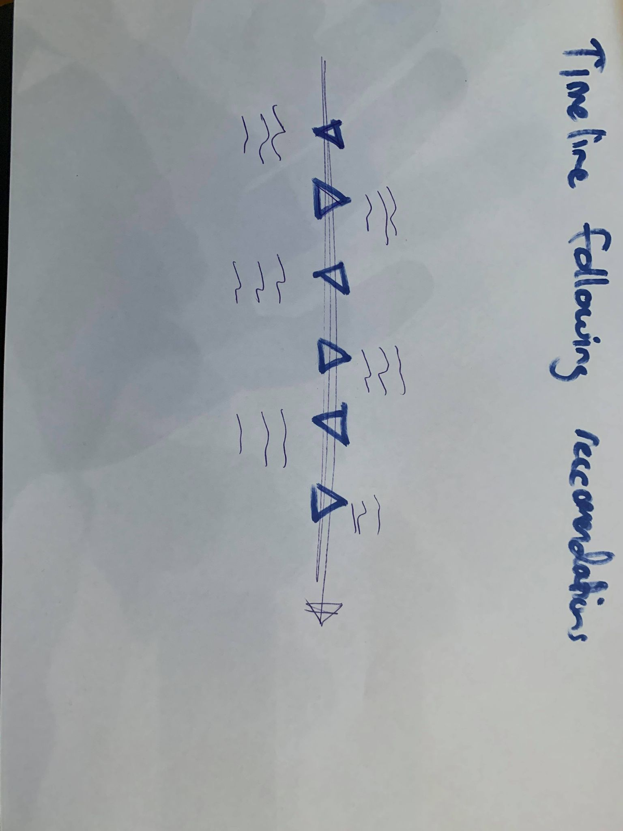
Timeline following recommendations
The very place puts toys of desperation,
The very place puts toys of desperation,
The very place puts toys of desperation,
The very place puts toys of desperation,
The very place puts toys of desperation,
The very place puts toys of desperation,

Slide 21
Timeline following recommendations
The very place puts toys of desperation,
The very place puts toys of desperation,
The very place puts toys of desperation,
The very place puts toys of desperation,
The very place puts toys of desperation,
The very place puts toys of desperation,

Slide 22
Timeline following recommendations
The very place puts toys of desperation,
The very place puts toys of desperation,
The very place puts toys of desperation,
The very place puts toys of desperation,
The very place puts toys of desperation,
The very place puts toys of desperation,

Slide 23
Timeline following recommendations
The very place puts toys of desperation,
The very place puts toys of desperation,
The very place puts toys of desperation,
The very place puts toys of desperation,
The very place puts toys of desperation,
The very place puts toys of desperation,

Slide 24
Action items by sector
Category
Steps
Responsibility
By When
Subsec1
With all his crimes broad blown, as flush as May; And how his audit stands who knows save heaven?
Ay, marry, is't: But to my mind
Ay, marry, is't: But to my mind
Subsec2
With all his crimes broad blown, as flush as May; And how his audit stands who knows save heaven?
Ay, marry, is't: But to my mind
Ay, marry, is't: But to my mind
Subsec1
With all his crimes broad blown, as flush as May; And how his audit stands who knows save heaven?
Ay, marry, is't: But to my mind
Ay, marry, is't: But to my mind
Subsec2
With all his crimes broad blown, as flush as May; And how his audit stands who knows save heaven?
Ay, marry, is't: But to my mind
Ay, marry, is't: But to my mind
Wouldn’t change these for the world

Slide 25
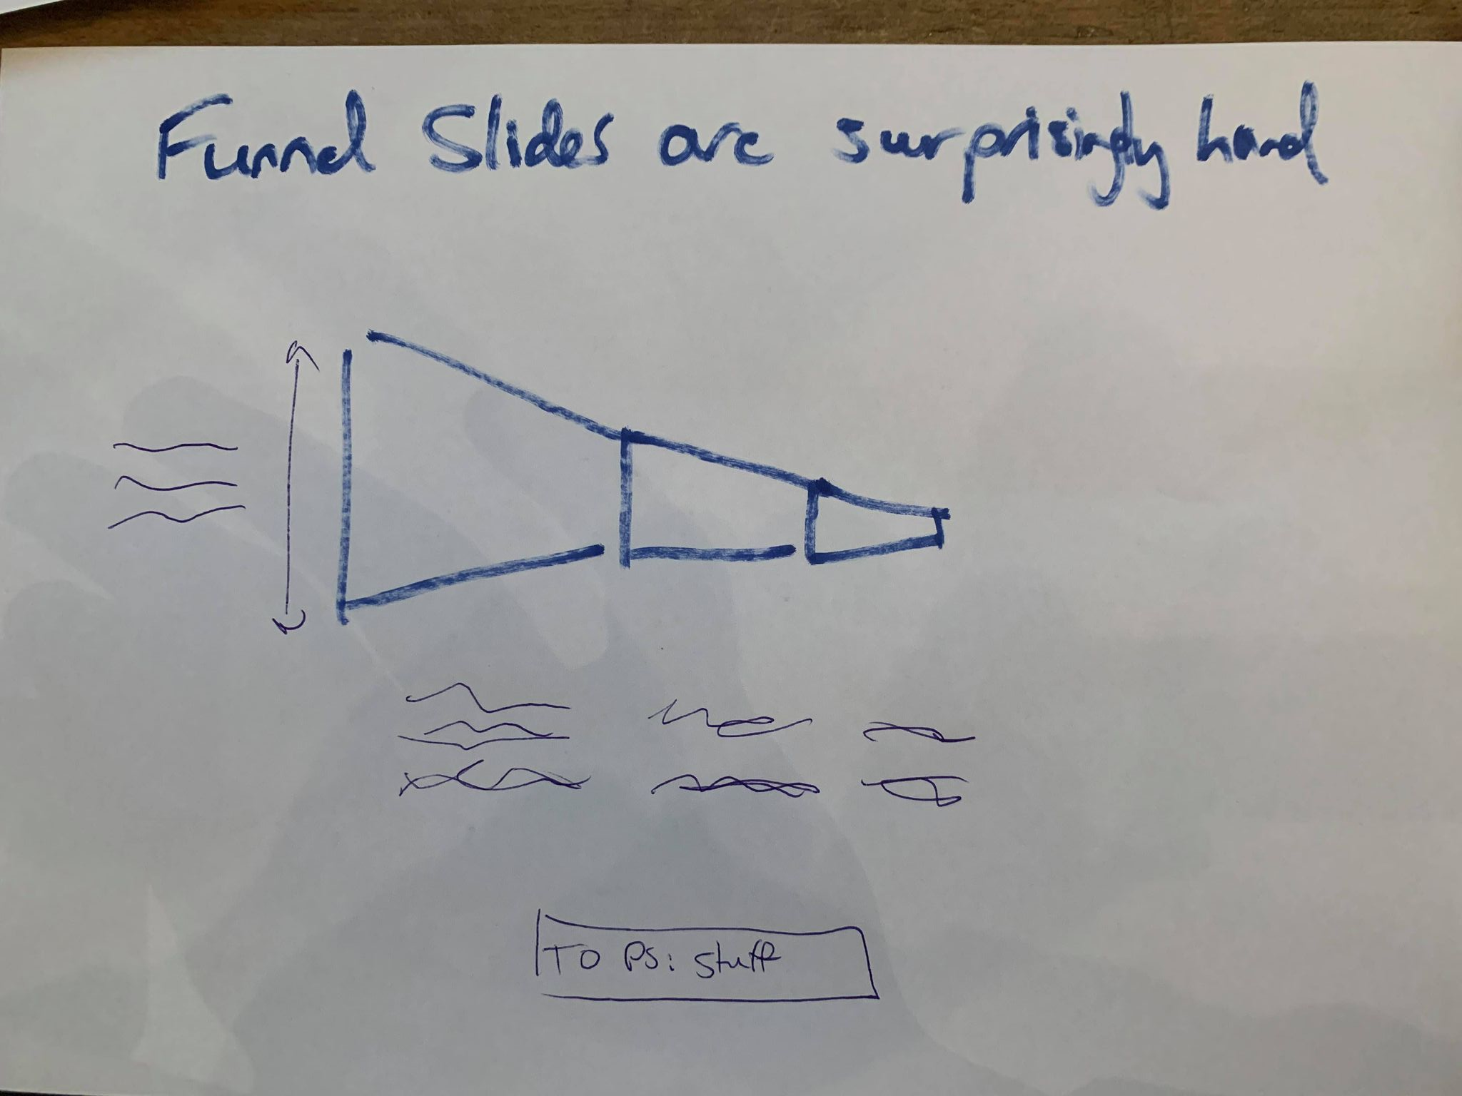
Funnel slides are really hard I didn’t realise
Revisit'st thus the glimpses of the moon, Making night hideous; and we fools of nature
Revisit'st thus the glimpses of the moon, Making night hideous; and we fools of nature
Revisit'st thus the glimpses of the moon, Making night hideous; and we fools of nature
Revisit'st thus the glimpses of the moon, Making night hideous; and we fools of nature
To PS: Stuff

Slide 26
Funnel slides are really hard I didn’t realise
Revisit'st thus the glimpses of the moon, Making night hideous; and we fools of nature
Revisit'st thus the glimpses of the moon, Making night hideous; and we fools of nature
Revisit'st thus the glimpses of the moon, Making night hideous; and we fools of nature
Revisit'st thus the glimpses of the moon, Making night hideous; and we fools of nature
To PS: Stuff

Slide 27
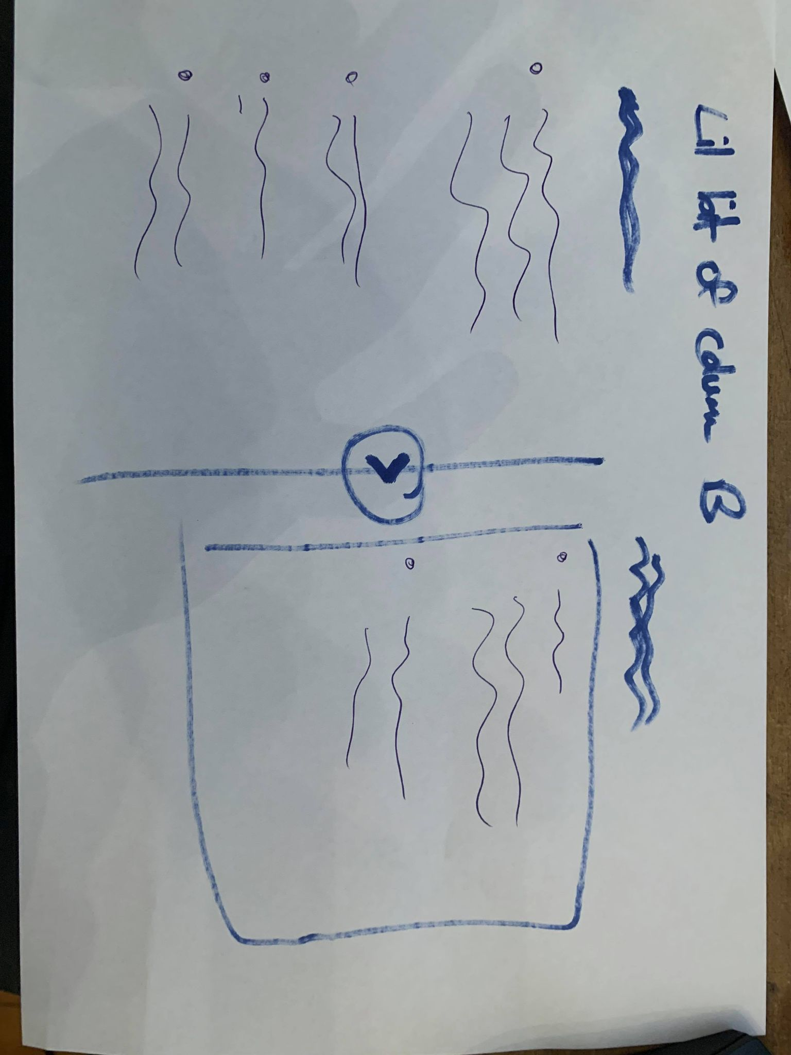
Easy two halver with deep dive
To the depths
Lil bit of column A
Lil bit of column B
Ay, marry, is't: But to my mind, though I am native here And to the manner born, it is a custom More honour'd in the breach than the observance.
This heavy-headed revel east and west Makes us traduced and tax'd of other nations:
They clepe us drunkards, and with swinish phrase
Soil our addition; and indeed it takes From our achievements, though perform'd at height
Ay, marry, is't: But to my mind, though I am native here And to the manner born, it is a custom More honour'd in the breach than the observance.
This heavy-headed revel east and west Makes us traduced and tax'd of other nations:
>

Slide 28
Easy two halver with deep dive
To the depths
Lil bit of column A
Lil bit of column B
Ay, marry, is't: But to my mind, though I am native here And to the manner born, it is a custom More honour'd in the breach than the observance.
This heavy-headed revel east and west Makes us traduced and tax'd of other nations:
They clepe us drunkards, and with swinish phrase
Soil our addition; and indeed it takes From our achievements, though perform'd at height
Ay, marry, is't: But to my mind, though I am native here And to the manner born, it is a custom More honour'd in the breach than the observance.
This heavy-headed revel east and west Makes us traduced and tax'd of other nations:
>

Slide 29
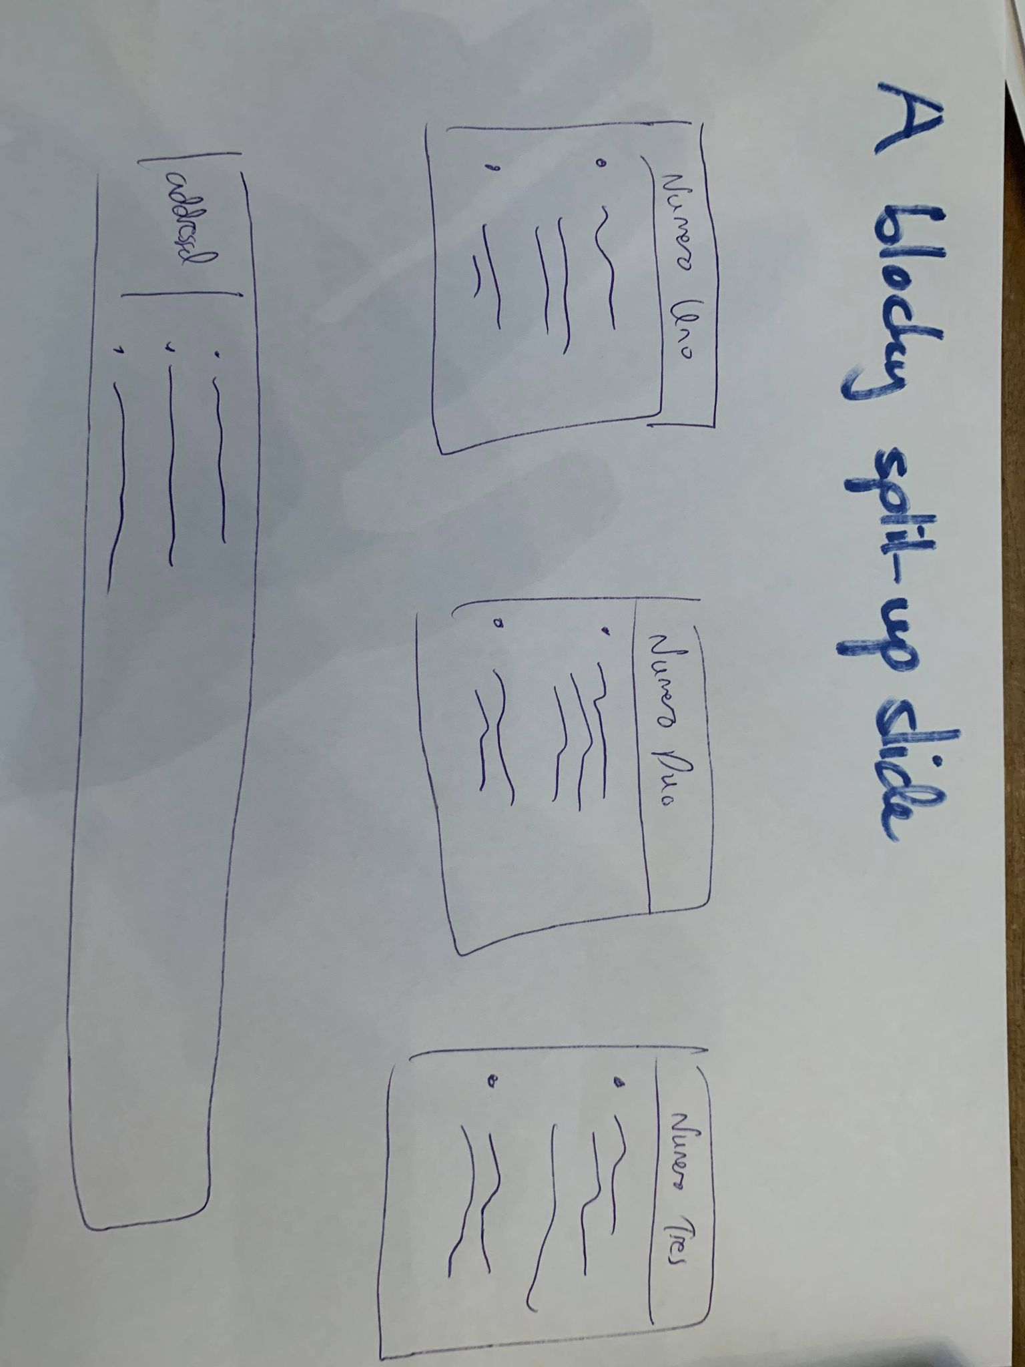
A blocky split up slide
Numero Uno
Numero Duo
Numero Tres
Ay, marry, is't: But to my mind, though I am native here And to the manner born, it is a custom More honour'd in the breach than the observance.
This heavy-headed revel east and west Makes us traduced and tax'd of other nations:
Ay, marry, is't: But to my mind, though I am native here And to the manner born, it is a custom More honour'd in the breach than the observance.
This heavy-headed revel east and west Makes us traduced and tax'd of other nations:
Ay, marry, is't: But to my mind, though I am native here And to the manner born, it is a custom More honour'd in the breach than the observance.
This heavy-headed revel east and west Makes us traduced and tax'd of other nations:
addressed
Ay, marry, is't:But to my mind, though I am native hereAnd
to the manner born, it is a customMore honour'd in the breach than the observance.
This heavy-headed revel east and westMakes us traduced and tax'd of other nations:

Slide 30
A blocky split up slide
Numero Uno
Numero Duo
Numero Tres
Ay, marry, is't: But to my mind, though I am native here And to the manner born, it is a custom More honour'd in the breach than the observance.
This heavy-headed revel east and west Makes us traduced and tax'd of other nations:
Ay, marry, is't: But to my mind, though I am native here And to the manner born, it is a custom More honour'd in the breach than the observance.
This heavy-headed revel east and west Makes us traduced and tax'd of other nations:
Ay, marry, is't: But to my mind, though I am native here And to the manner born, it is a custom More honour'd in the breach than the observance.
This heavy-headed revel east and west Makes us traduced and tax'd of other nations:
addressed
Ay, marry, is't:But to my mind, though I am native hereAnd
to the manner born, it is a customMore honour'd in the breach than the observance.
This heavy-headed revel east and westMakes us traduced and tax'd of other nations:

Slide 31
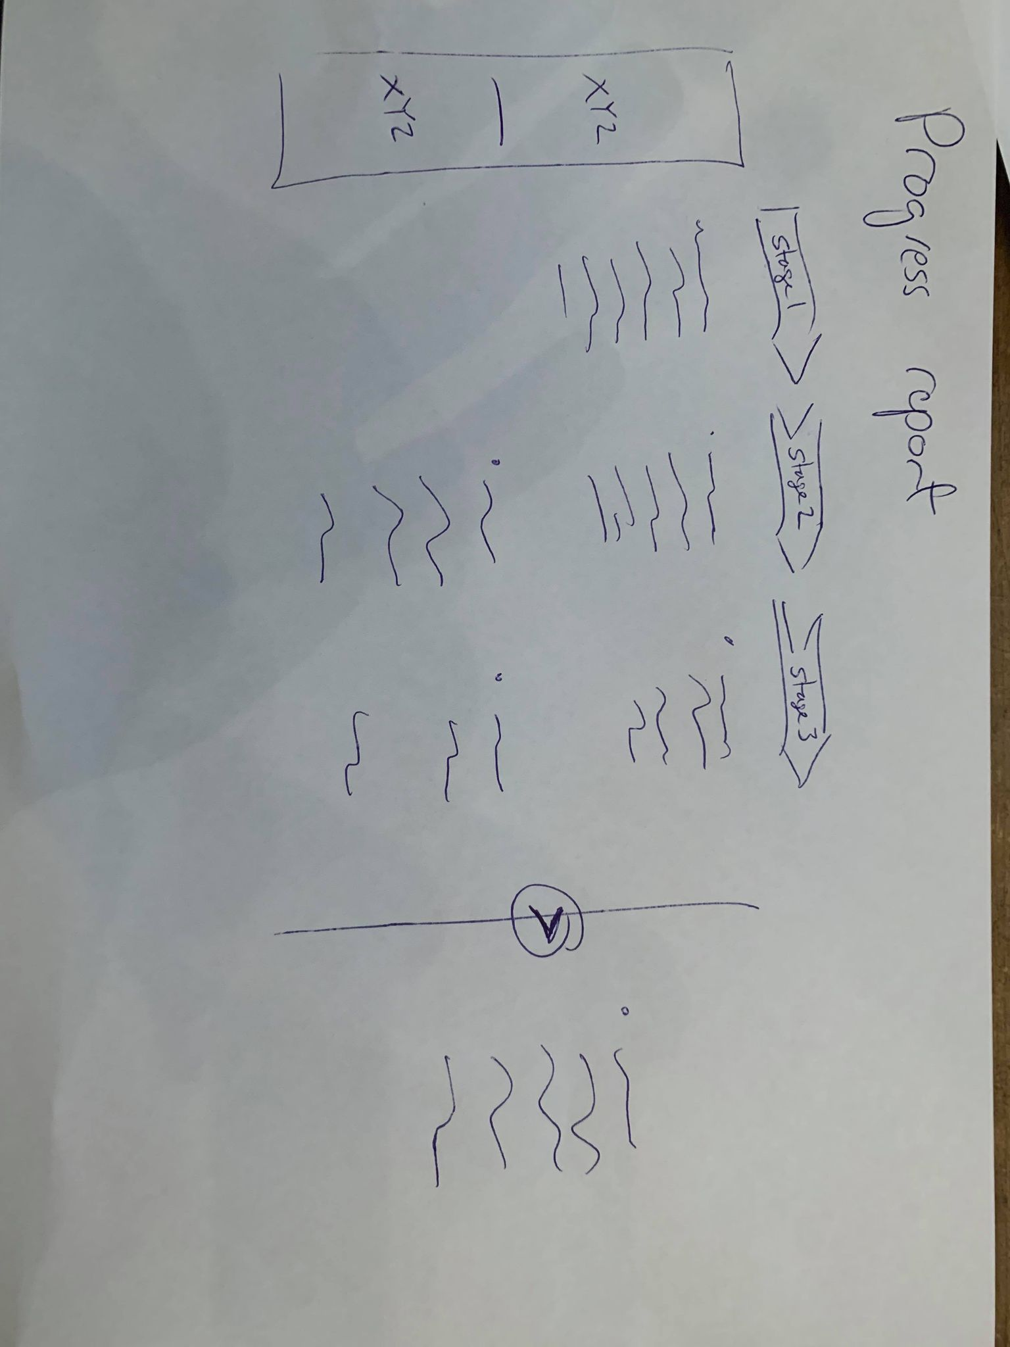
Progress report
Stage 1
Stage 2
Stage 2
Ay, marry, is't: But to my mind, though I am native here And to the manner born, it is a custom More honour'd in
Ay, marry, is't: But to my mind, though I am native here And to the manner born, it is a custom More honour'd in
Ay, marry, is't: But to my mind, though I am native here And to the manner born, it is a custom More honour'd in
XYZ
Ay, marry, is't: But to my mind, though I am native here And to the manner born, it is a custom More honour'd in
>
Ay, marry, is't: But to my mind, though I am native here And to the manner born, it is a custom More honour'd in
Ay, marry, is't: But to my mind, though I am native here And to the manner born, it is a custom More honour'd in
XYZ

Slide 32
Progress report
Stage 1
Stage 2
Stage 2
Ay, marry, is't: But to my mind, though I am native here And to the manner born, it is a custom More honour'd in
Ay, marry, is't: But to my mind, though I am native here And to the manner born, it is a custom More honour'd in
Ay, marry, is't: But to my mind, though I am native here And to the manner born, it is a custom More honour'd in
XYZ
Ay, marry, is't: But to my mind, though I am native here And to the manner born, it is a custom More honour'd in
>
Ay, marry, is't: But to my mind, though I am native here And to the manner born, it is a custom More honour'd in
Ay, marry, is't: But to my mind, though I am native here And to the manner born, it is a custom More honour'd in
XYZ

Slide 33
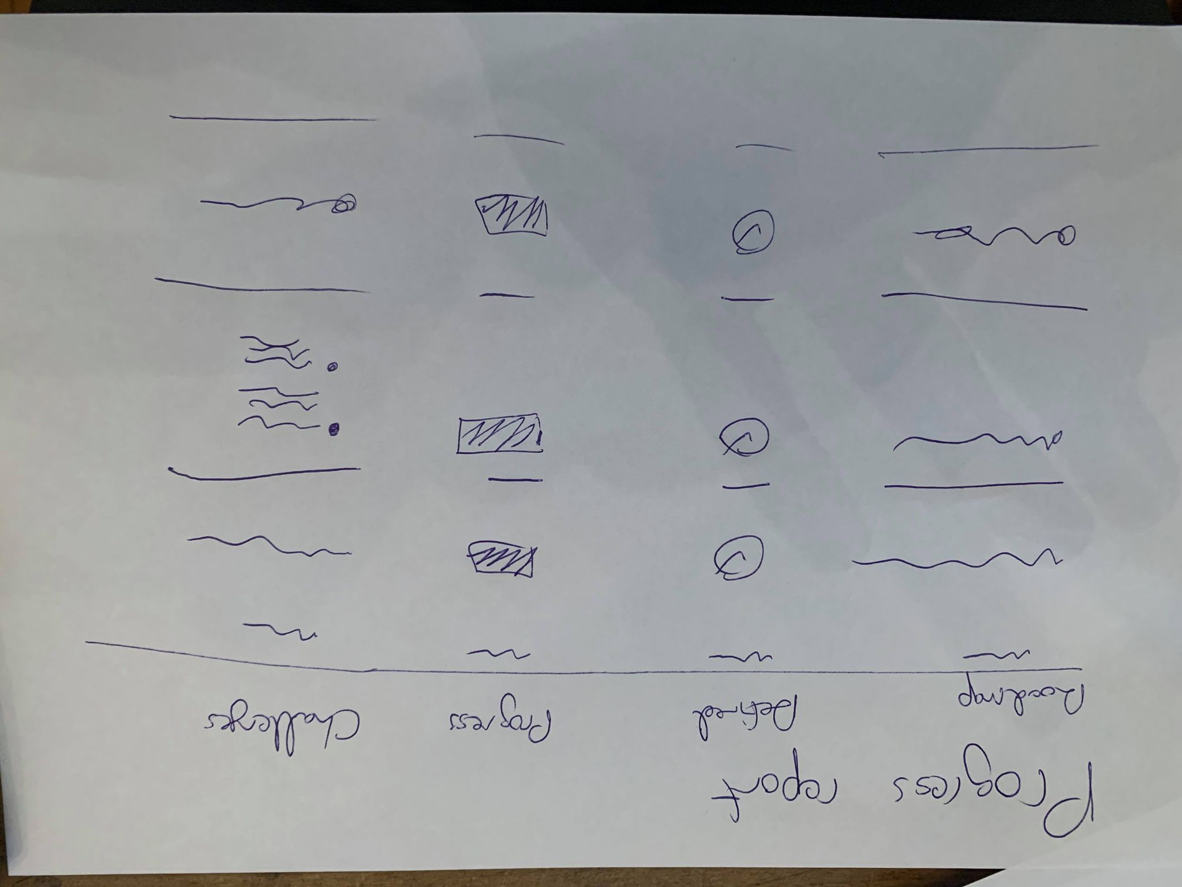

Progress report
Roadmap
Defined
Progress
Challenges
Itsy bitsy
Itsy bitsy
Itsy bitsy
Itsy bitsy
xxxxxxxxxaaaaaaaabbb
xxxxxxxxxaaaaaaaabbb
xxxxxxxxxaaaaaaaabbb
They clepe us drunkards, and with swinish phrase
Soil our addition;
xxxxxxxxxaaaaaaaabbb
xxxxxxxxxaaaaaaaabbb

Slide 34
Progress report
Roadmap
Defined
Progress
Challenges
Itsy bitsy
Itsy bitsy
Itsy bitsy
Itsy bitsy
xxxxxxxxxaaaaaaaabbb
xxxxxxxxxaaaaaaaabbb
xxxxxxxxxaaaaaaaabbb
They clepe us drunkards, and with swinish phrase
Soil our addition;
xxxxxxxxxaaaaaaaabbb
xxxxxxxxxaaaaaaaabbb

Slide 35
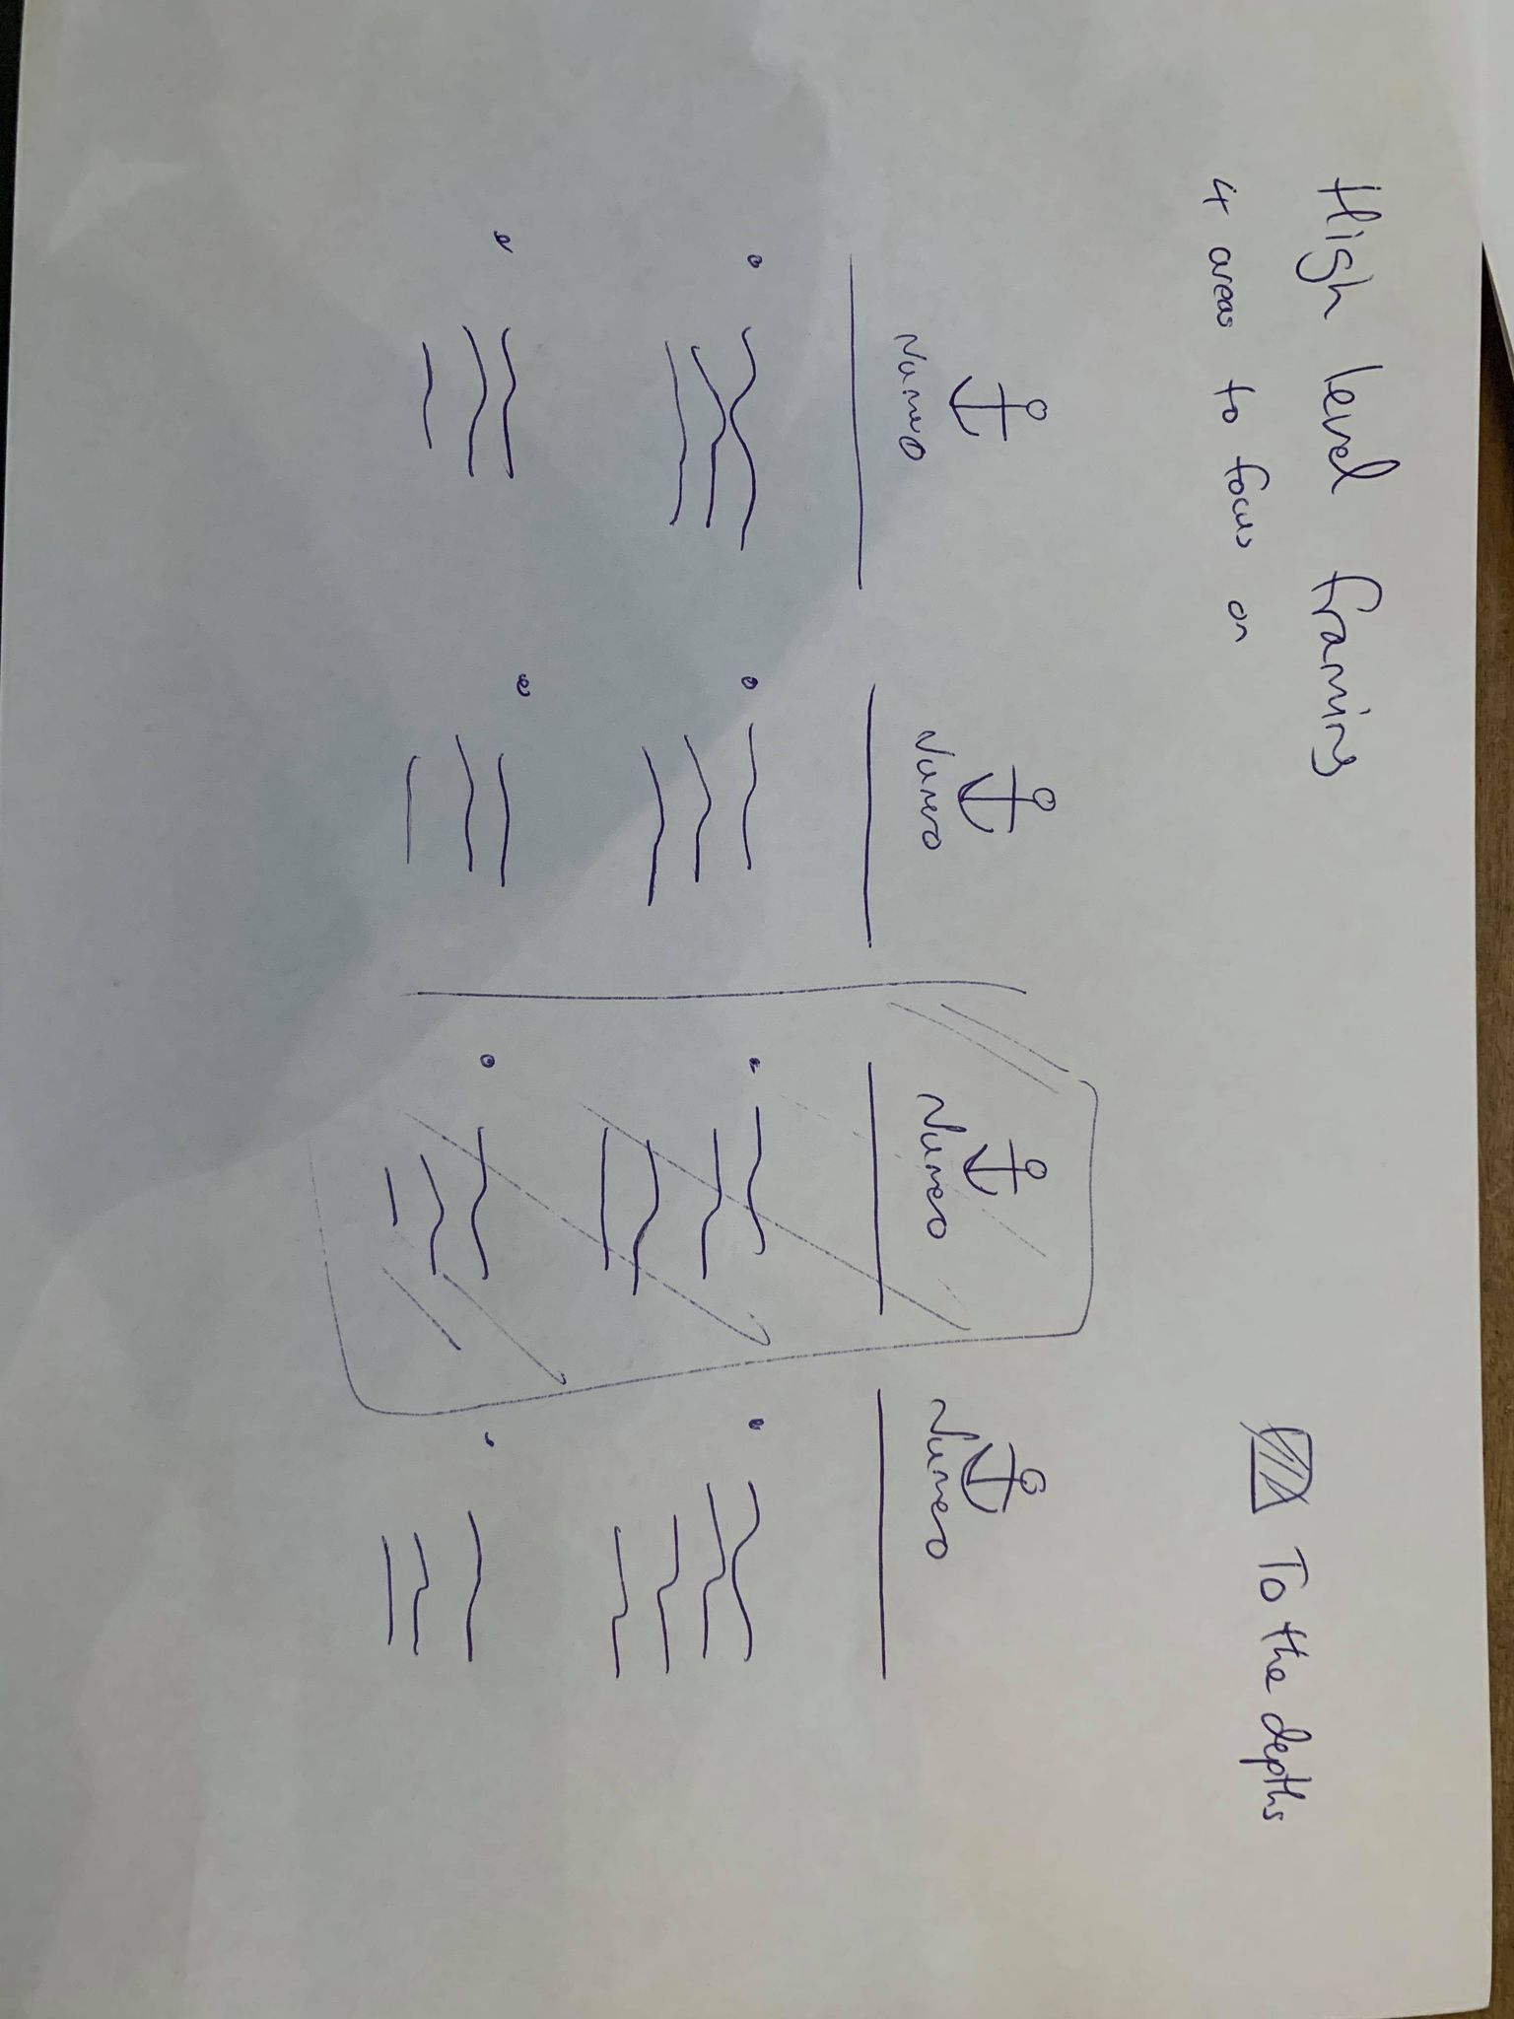

High level framing
To the depths
4 areas to focus on
Numero
Numero
Numero
Numero
But to my mind, though I am native here And to the manner born, it is a custom More honour'd in the breach than the observance.
This heavy-headed revel east and west Makes us traduced
But to my mind, though I am native here And to the manner born, it is a custom More honour'd in the breach than the observance.
This heavy-headed revel east and west Makes us traduced
But to my mind, though I am native here And to the manner born, it is a custom More honour'd in the breach than the observance.
This heavy-headed revel east and west Makes us traduced
But to my mind, though I am native here And to the manner born, it is a custom More honour'd in the breach than the observance.
This heavy-headed revel east and west Makes us traduced

Slide 36
High level framing
To the depths
4 areas to focus on
Numero
Numero
Numero
Numero
But to my mind, though I am native here And to the manner born, it is a custom More honour'd in the breach than the observance.
This heavy-headed revel east and west Makes us traduced
But to my mind, though I am native here And to the manner born, it is a custom More honour'd in the breach than the observance.
This heavy-headed revel east and west Makes us traduced
But to my mind, though I am native here And to the manner born, it is a custom More honour'd in the breach than the observance.
This heavy-headed revel east and west Makes us traduced
But to my mind, though I am native here And to the manner born, it is a custom More honour'd in the breach than the observance.
This heavy-headed revel east and west Makes us traduced

Slide 37
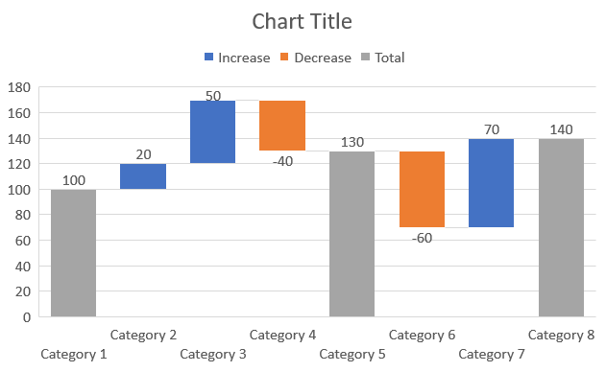
Bold data, backed up by chart
But to my mind, though I am native here And to the manner born, it is a custom More honour'd in the breach than the observance.
This heavy-headed revel east and west Makes us traduced

Slide 38
Emphasising some points
But to my mind, though I am native here And to the manner born, it is a custom More honour'd in the breach than the observance.
This heavy-headed revel east and west Makes us traduced
Numero
But to my mind, though I am native here And to the manner born, it is a custom More honour'd in the breach than the observance.
This heavy-headed revel east and west Makes us traduced
Numero
But to my mind, though I am native here And to the manner born, it is a custom More honour'd in the breach than the observance.
This heavy-headed revel east and west Makes us traduced
Numero
But to my mind, though I am native here And to the manner born, it is a custom More honour'd in the breach than the observance.
This heavy-headed revel east and west Makes us traduced
Numero

Slide 39
Intricate table
Longer category more writing
Subcat 1
Subcat 1
Subcat 1
Subcat 1
Colcat
Ay, marry, is't:
Ay, marry:
Ay, marry:
Ay, marry:
Ay, marry:
Colcat
Ay, marry, is't:
Ay, marry:
Ay, marry:
Ay, marry:
Ay, marry:
Colcat
Ay, marry, is't:
Ay, marry:
Ay, marry:
Ay, marry:
Ay, marry:
Colcat
AyBut to my mind, though I am native here And to the manner born, it is a custom More honour'd in the breach than the observance., marry, is't:
custom More honour'd in the breach than the observance
custom More honour'd in the breach than the
custom More honour'd in the breach, is't
custom More honour'd in the is't
Total impact
Ay, marry, is't:
Ay, marry:
Ay, marry:
Ay, marry:
Ay, marry:

Slide 40
More techy analysis
Subtitre
This graph details two variables against each other
Units
Ay, marry, is't: But to my mind, though I am native here And to the manner born, it is a custom More honour'd in
>

Slide 41
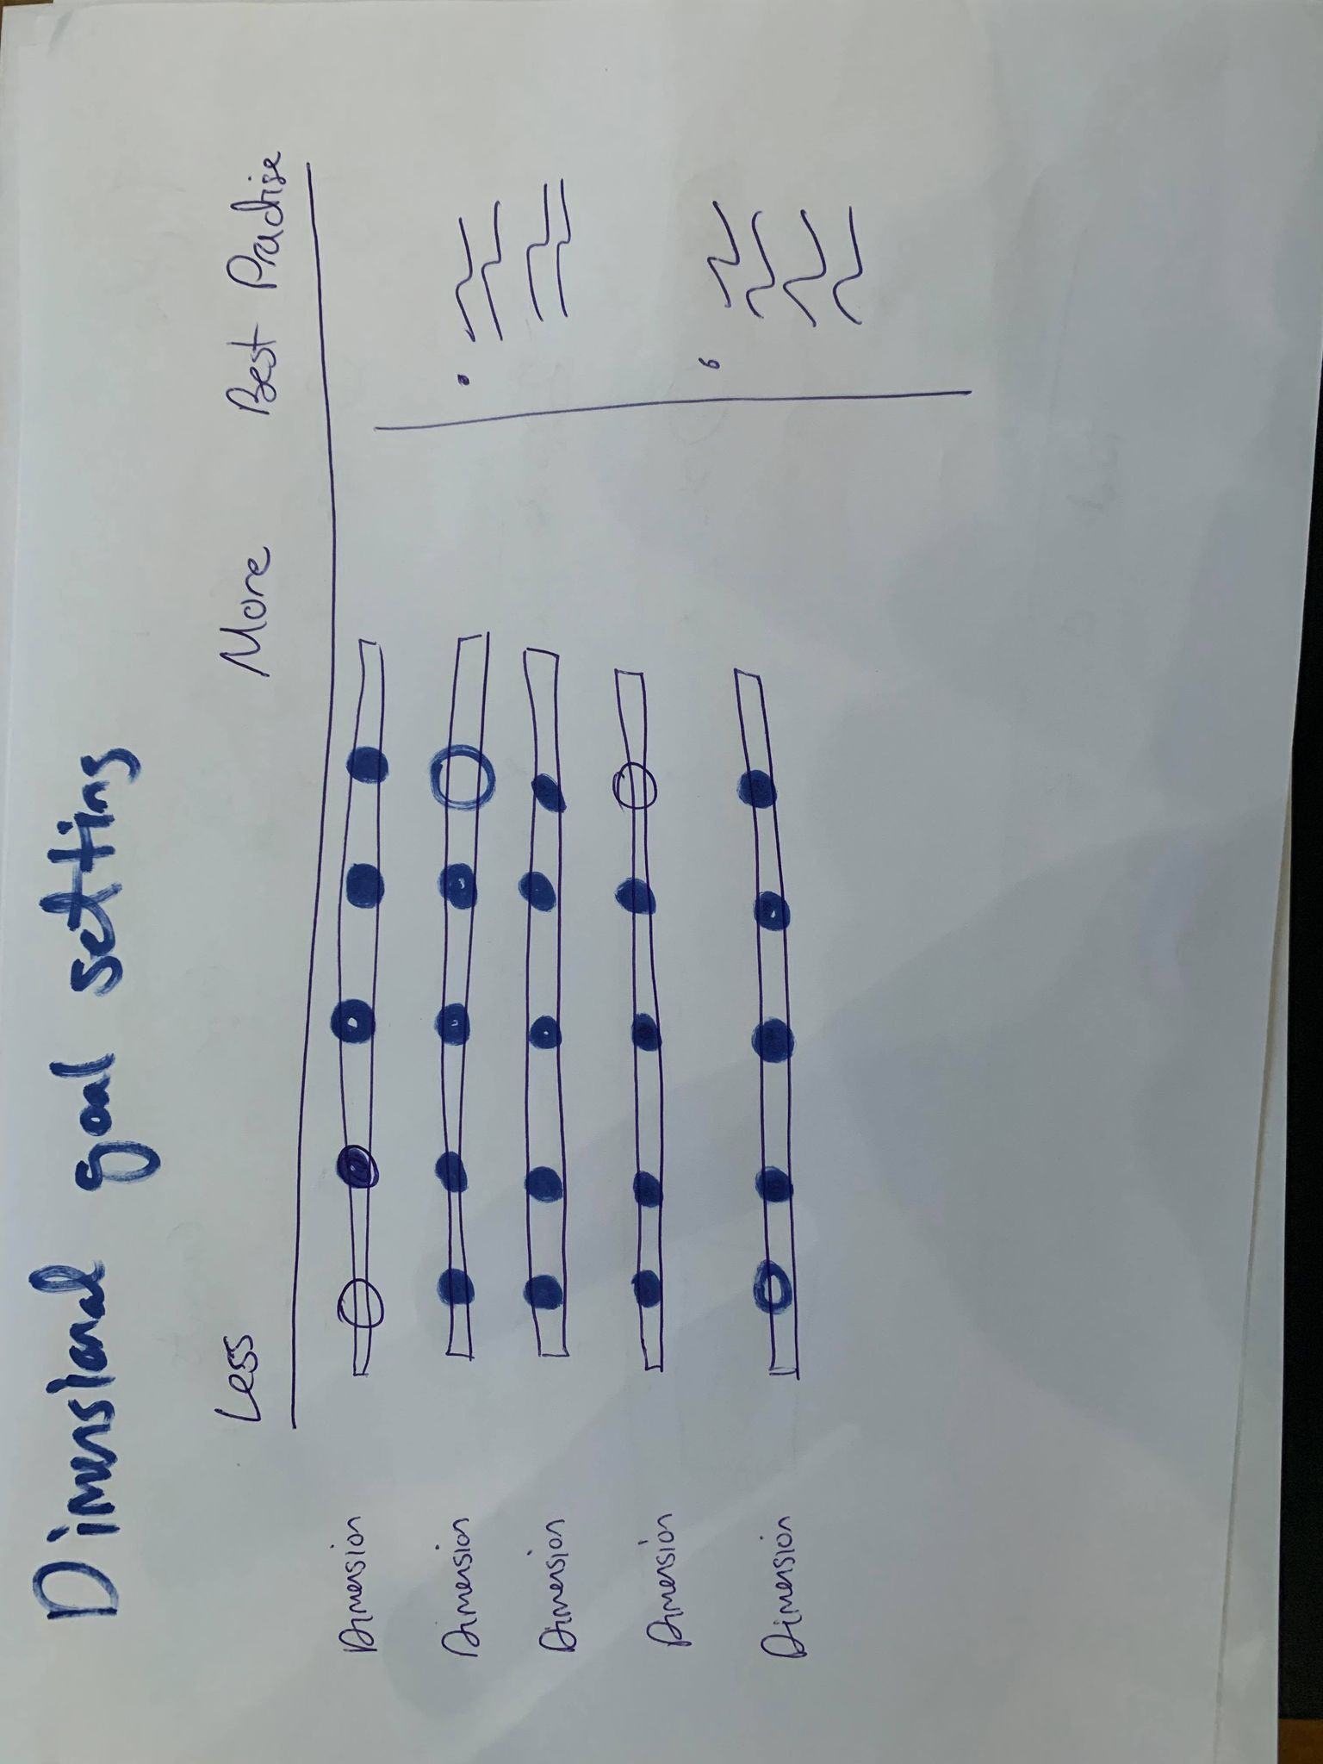
Dimensional goal setting page
Less
More
Best practise
Dimenzione
Ay, marry, is't: But to my mind, though I am native here And to the manner born, it is a custom More honour'd in
Dimenzione
Dimenzione
Ay, marry, is't: But to my mind, though I am native here And to the manner born, it is a custom More honour'd in
Dimenzione
Dimenzione

Slide 42
Dimensional goal setting page
Less
More
Best practise
Dimenzione
Ay, marry, is't: But to my mind, though I am native here And to the manner born, it is a custom More honour'd in
Dimenzione
Dimenzione
Ay, marry, is't: But to my mind, though I am native here And to the manner born, it is a custom More honour'd in
Dimenzione
Dimenzione

Slide 43
This is the timeline of stuff to target
1. Stuff
1. Stuff
1. Stuff
1. Stuff
1. Stuff
They clepe us drunkards, and with swinish phrase
Soil our addition; and indeed it
From our achievements, though perform'd at height
They clepe us drunkards, and with swinish phrase
Soil our addition; and indeed it takes From our achievements, though perform'd at height
They clepe us drunkards, and with swinish
; and indeed it takes From our achievements, though perform'd at height
They clepe us drunkards, and with swinish phrase
Soil our addition; and indeed it takes From our achievements, though perform'd at height
They clepe us drunkards, and with swinish phrase
Soil our addition; and indeed it takes From our achievements, though perform'd at height
achievements, though perform'd at height
achievements, though perform'd at height

Slide 44
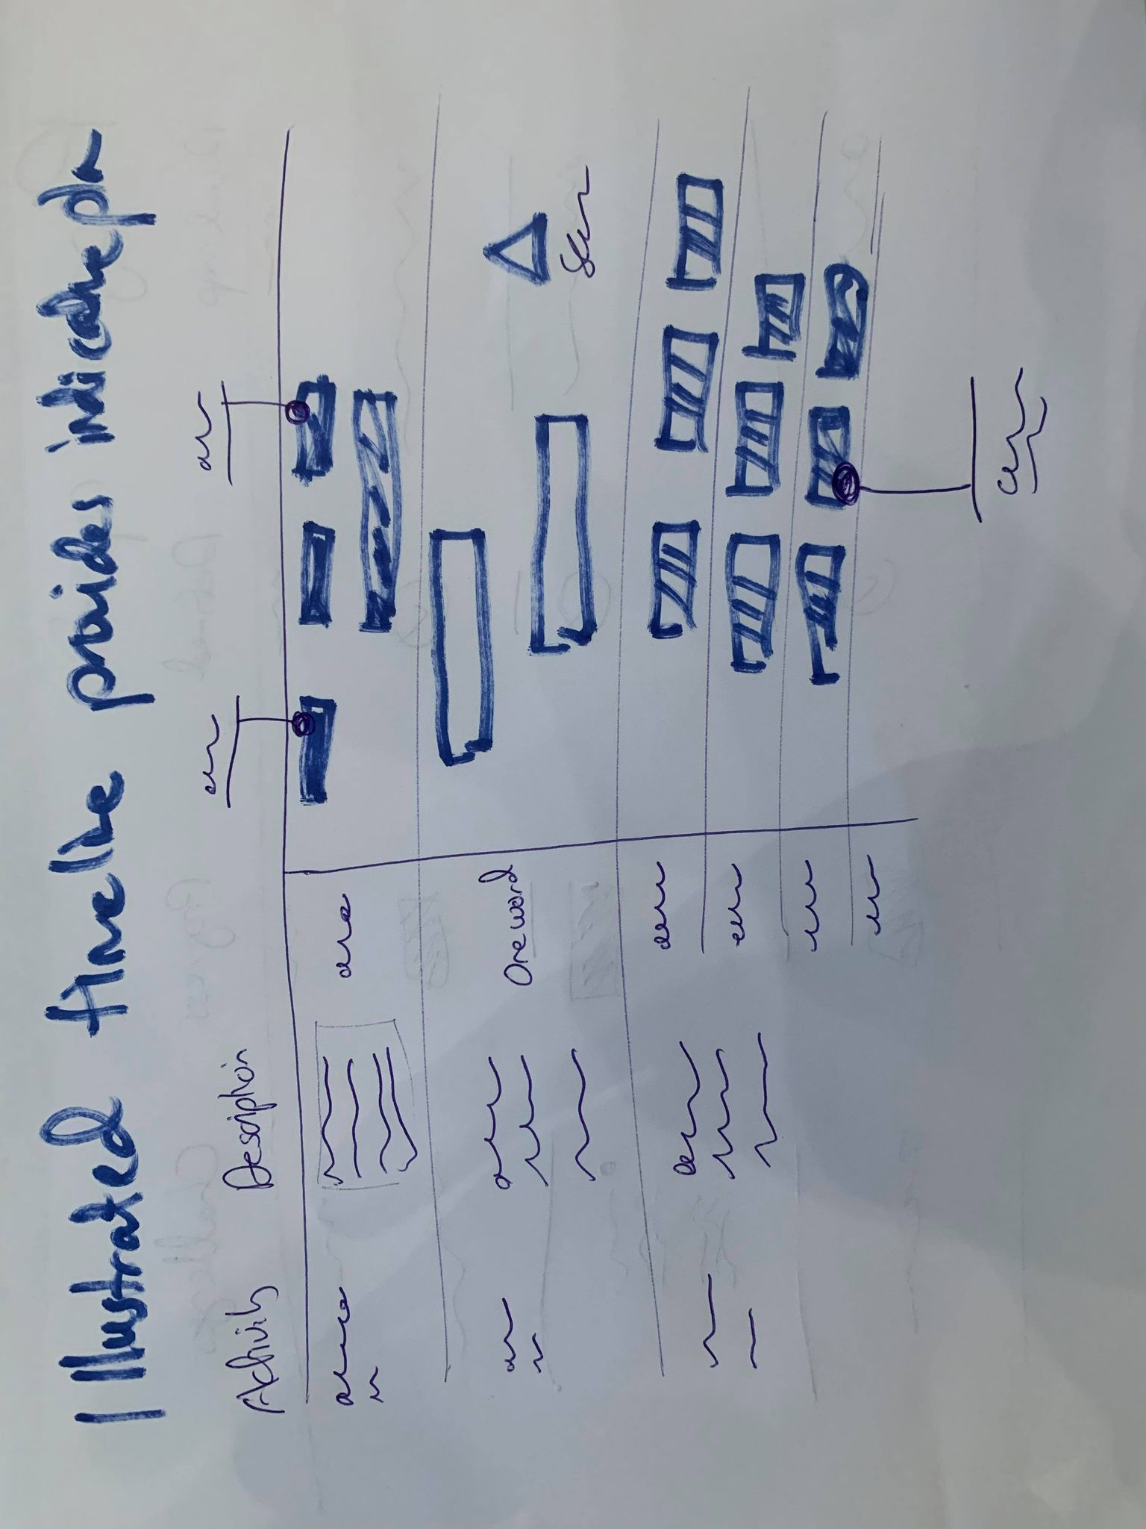
Illustrated timeline provides indicative plan
Commentary
Commentary
Activity
Description
Ay, marry, is't:
Ay, marry, is't: But to my mind, though I am native here
One word
Ay, marry, is't:
Ay, marry, is't: But to my mind, though I am native here
One word
Steerco
Ay, marry, is't:
Ay, marry, is't: But to my mind, though I am native here
One word
One word
One word
One word
Commentary

Slide 45
Illustrated timeline provides indicative plan
Commentary
Commentary
Activity
Description
Ay, marry, is't:
Ay, marry, is't: But to my mind, though I am native here
One word
Ay, marry, is't:
Ay, marry, is't: But to my mind, though I am native here
One word
Steerco
Ay, marry, is't:
Ay, marry, is't: But to my mind, though I am native here
One word
One word
One word
One word
Commentary

Slide 46
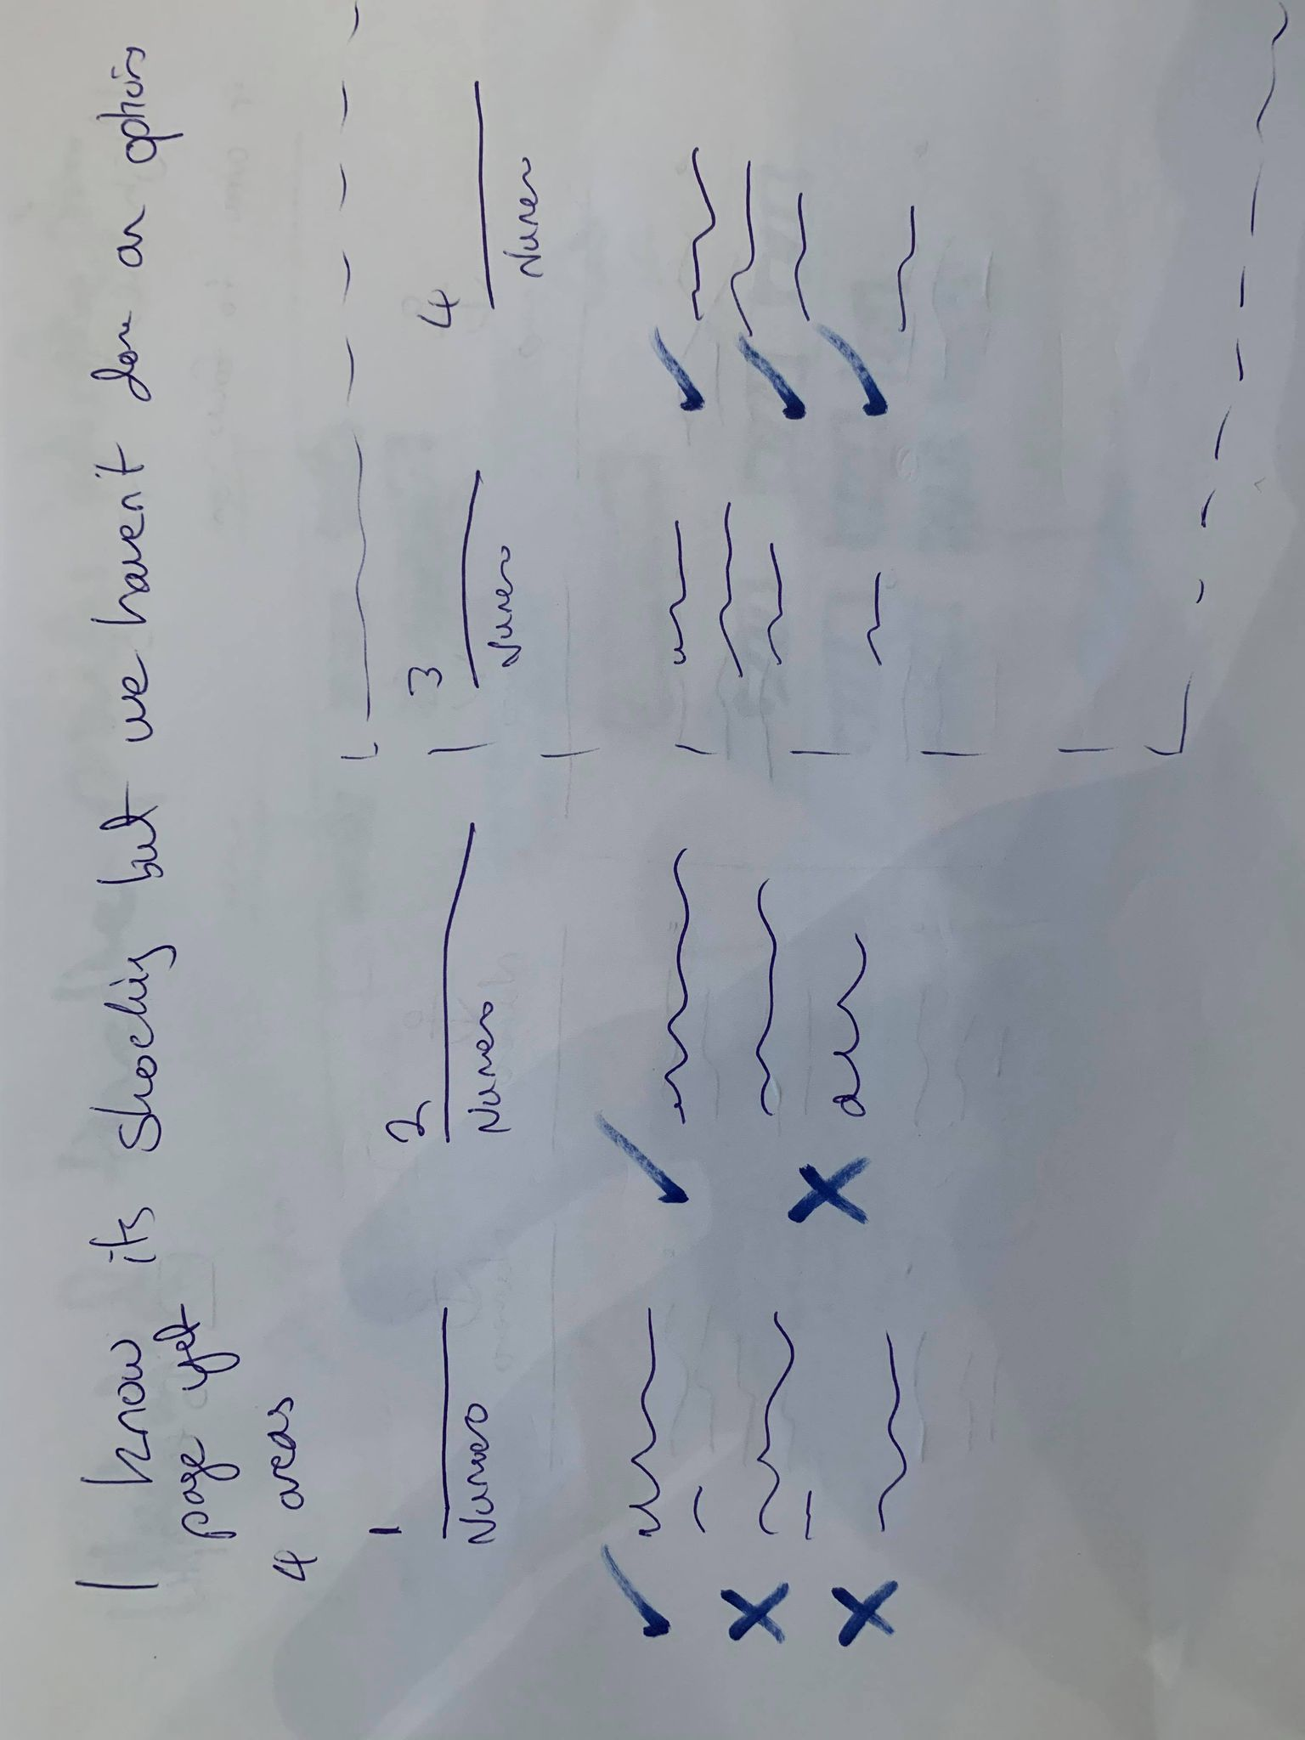


I know its shocking but we haven’t done an options page yet
4 areas to focus on
Recommended
1
2
3
4
Numero
Numero
Numero
Numero
But to my mind, though I am native here More honour'd in the breach than the observance.
Makes us traduced
But to my mind, though I am native here More honour'd in the breach than the observance.
Makes us traduced
But to my mind, though I am native here More honour'd in the breach than the observance.
Makes us traduced
But to my mind, though I am native here More honour'd in the breach than the observance.
Makes us traduced

Slide 47
I know its shocking but we haven’t done an options page yet
4 areas to focus on
Recommended
1
2
3
4
Numero
Numero
Numero
Numero
But to my mind, though I am native here More honour'd in the breach than the observance.
Makes us traduced
But to my mind, though I am native here More honour'd in the breach than the observance.
Makes us traduced
But to my mind, though I am native here More honour'd in the breach than the observance.
Makes us traduced
But to my mind, though I am native here More honour'd in the breach than the observance.
Makes us traduced

