Slide 1

Medallion-Architecture Data Pipeline for the Uber NYC Rides Dataset
SIC 8
BD Track
G 7
Notes:
Note:

Slide 2
Agenda
Team
Introduction
Problem Statement
Methodology
Key Tasks
Results and Insights
Conclusion
Q&A
Notes:
Note:

Slide 3
Team
Shahesta Mohamed Salama
Yusuf Ahmed Shoman
Amr Yousri Badr
Ibrahim Reda Mohamed
Notes:
Note:

Slide 4
Agenda
Team
Introduction
Problem Statement
Methodology
Key Tasks
Results and Insights
Conclusion
Q&A
Notes:
Note:

Slide 5
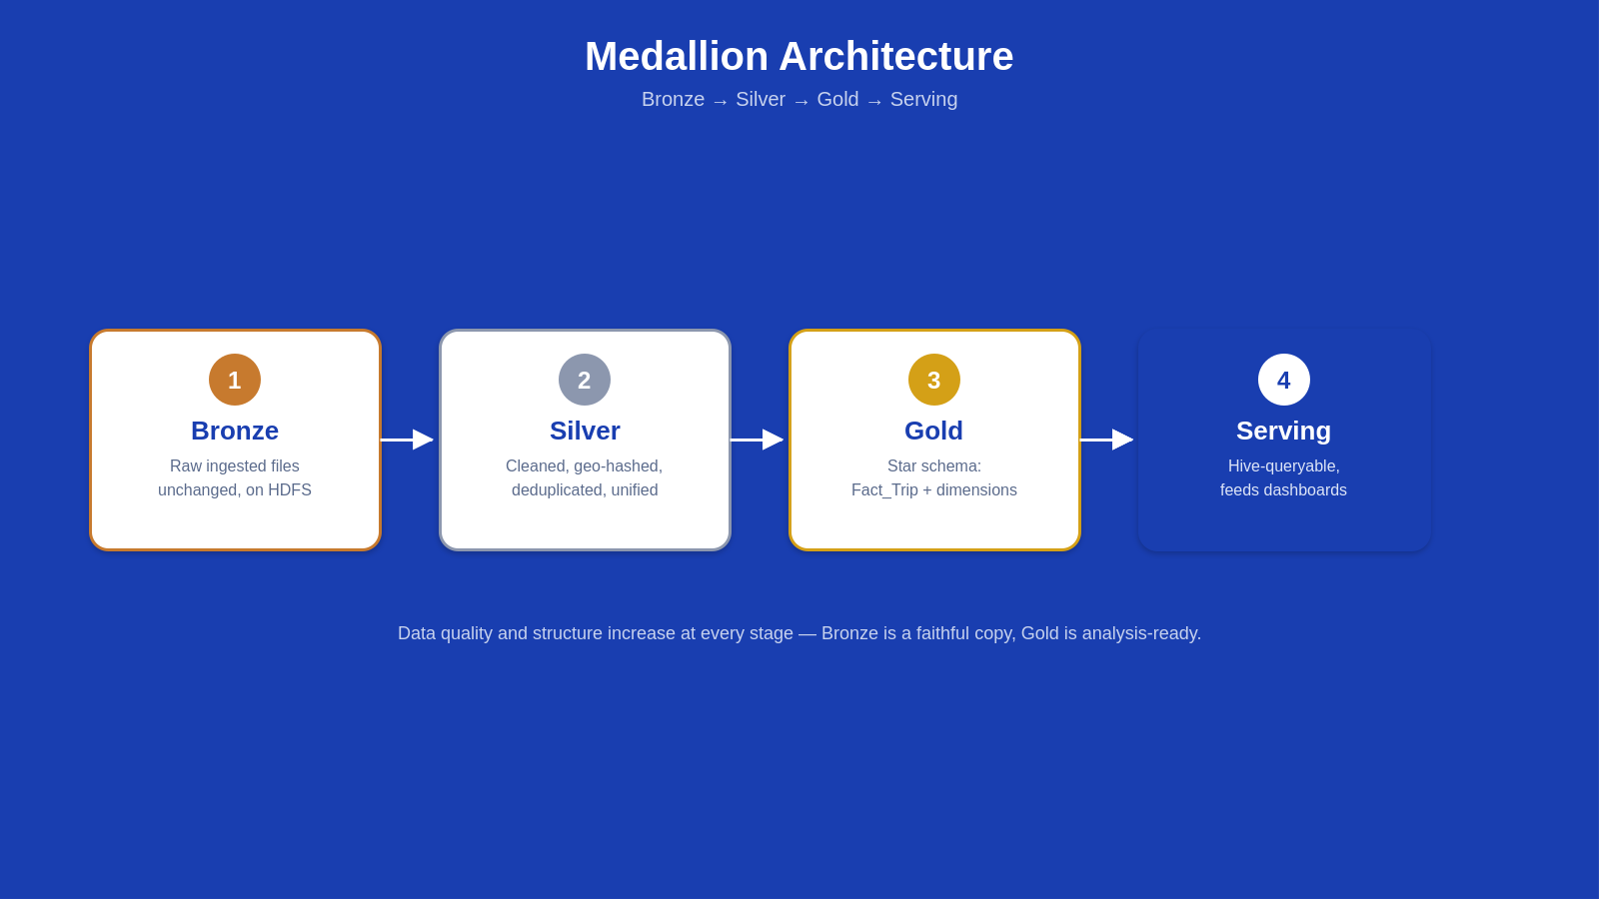
Introduction
The Dataset Utilizing the 2014 Uber NYC Pickups dataset (Jan - Dec 2014), combining historical batch records and continuous live streams.
Medallion Architecture Implementing a structured Bronze -> Silver -> Gold -> Serving flow, covering ingestion, geospatial processing, transformation, and serving layers.
Dual Ingestion Paths Historical monthly files (Jan-Nov) flow through Batch ETL, while the final month (Dec 2014) simulates a Live Stream.
Notes:
Note:

Slide 6
Agenda
Team
Introduction
Problem Statement
Key Tasks
Methodology
Results and Insights
Conclusion
Q&A
Notes:
Note:

Slide 7
Problem Statement
Indefinite Stream Looping
Raw ride data arrives as static historical files and continuously generated live events, which must be unified into a single, consistent view.
Watermark Limitations
Raw coordinates aren't directly useful for spatial analysis; they must be converted into H3 geo-hash keys to enable region-based aggregation and route analysis.
Schema Alignment
Data quality issues (invalid timestamps, missing coordinates, duplicate records) must be handled reliably, especially since streamed source data may be replayed.
Notes:
Note:

Slide 8
Agenda
Team
Introduction
Problem Statement
Methodology
Key Tasks
Results and Insights
Conclusion
Q&A
Notes:
Note:

Slide 9
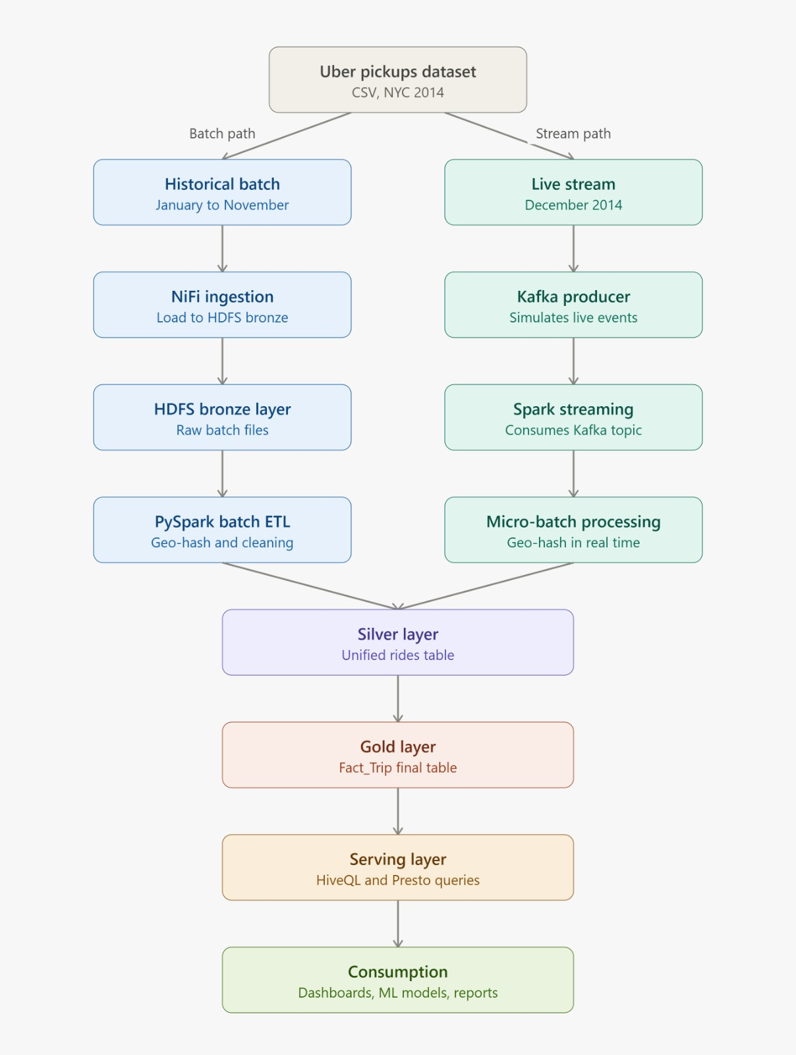
The Complete Journey of a Trip
Notes:
Note:

Slide 10
Methodology
Batch Path: Ingests historical data (Jan-Nov) via Apache NiFi to Bronze HDFS, followed by PySpark batch ETL for geo-hashing and cleaning.
Stream Path: Simulates live events (Dec) using a Kafka producer. Spark Structured Streaming
Convergence: Both paths land in a unified Silver rides table, then transform into a Gold layer dimensional model for Hive/Presto querying.
Notes:
Note:

Slide 11
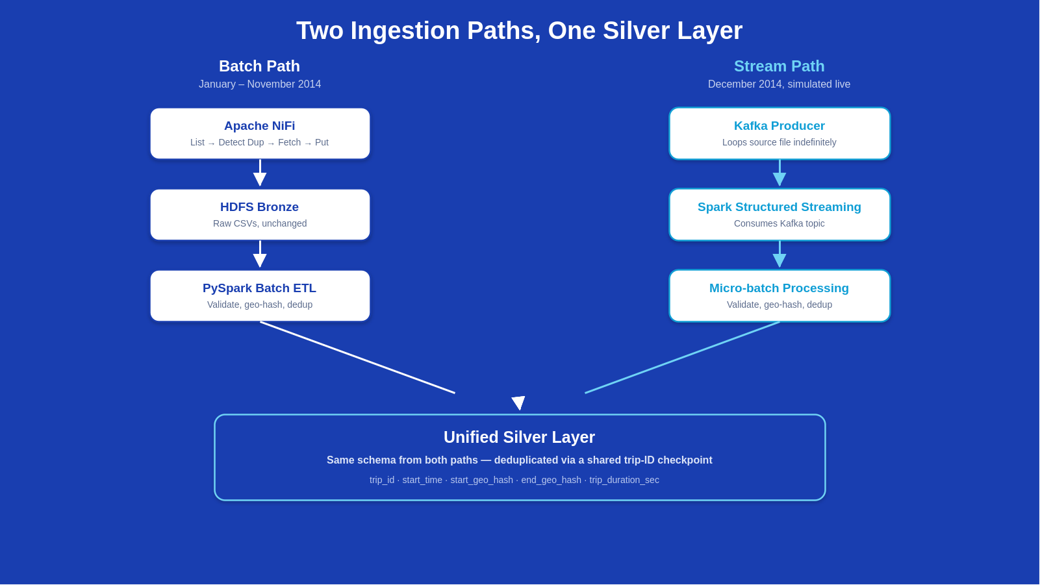
Methodology — Two Ingestion Paths, One Silver Layer
Samsung Innovation Campus

Slide 12




Methodology
Why Batch Processing?
Ideal for historical backfills (Jan–Nov 2014 datasets).
High-throughput processing of massive archived CSV files.
Scheduled, predictable ETL jobs for bulk data integration.
Notes:
Note:

Slide 13

Methodology
Batch Ingestion with Apache NiFi
NiFi Flow Components
ListFile: Detects and lists source CSV files.
Reliability & Governance
DetectDuplicate: Prevents duplicate file ingestion.
NiFi provides visual data routing, backpressure management, and robust error handling.
FetchFile: Retrieves file payload.
Failed file transfers are automatically routed to a DLQ for inspection, guaranteeing fault-tolerant ingestion.
PutHDFS: Lands raw files into HDFS Bronze.
Error Handling: RetryFlowFile & Dead-Letter Queue (DLQ).
Notes:
Note:

Slide 14
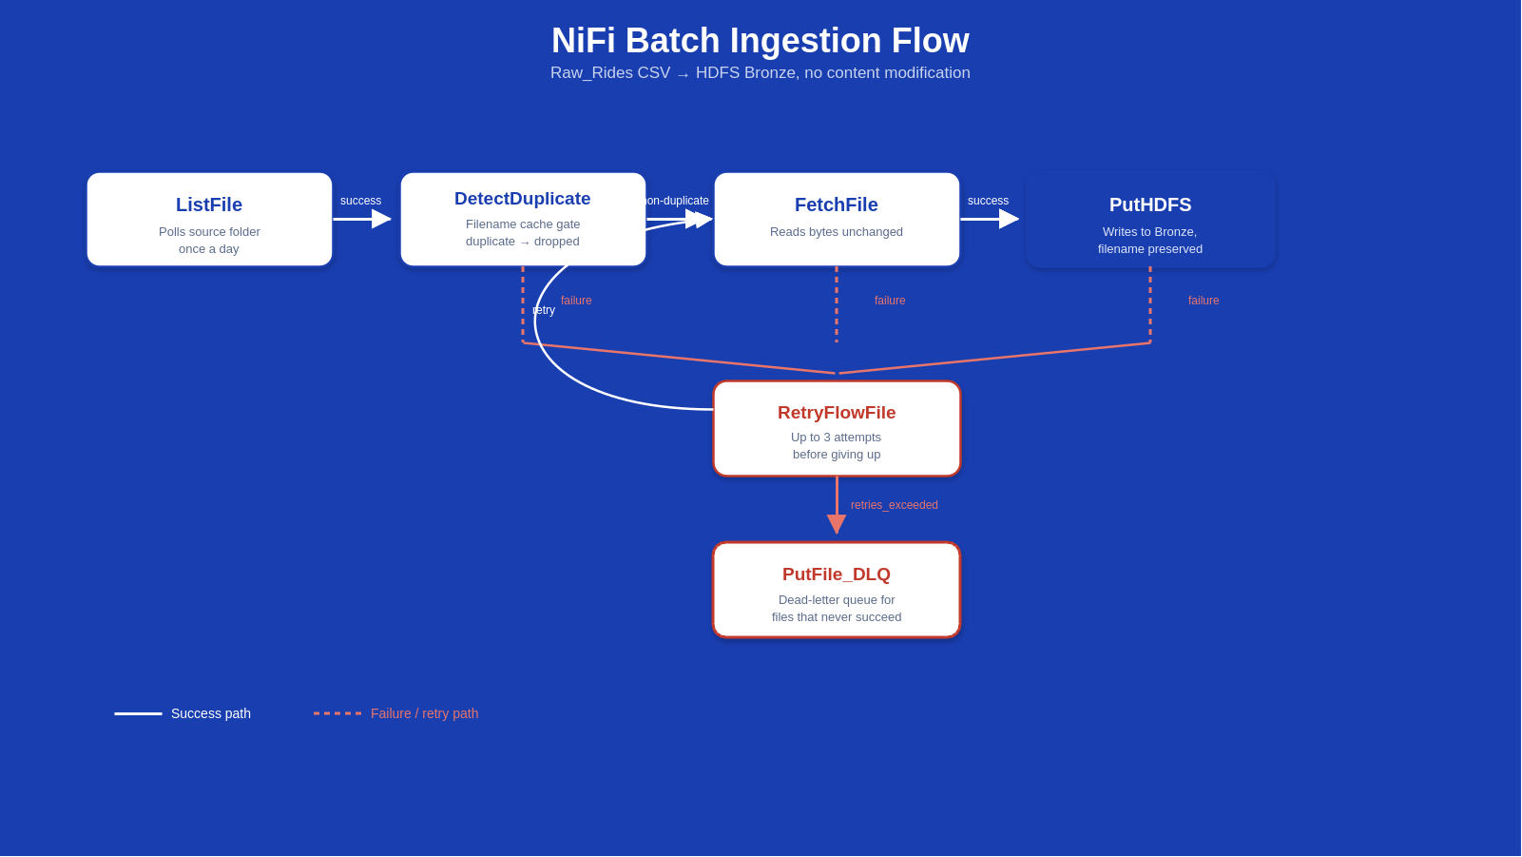
Methodology
Notes:
Note:

Slide 15
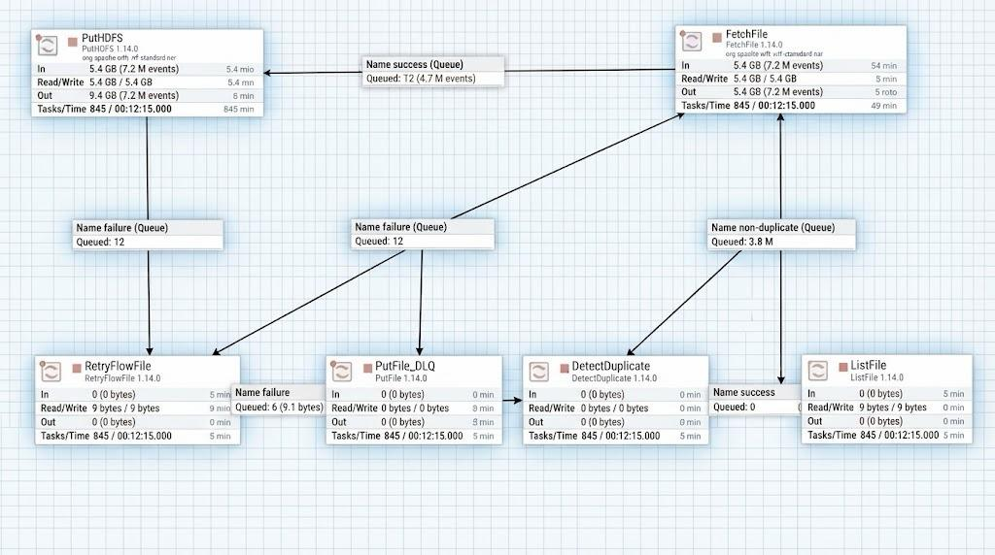
Methodology
Batch Ingestion Flow — Live NiFi Canvas

Slide 16






Methodology
Batch Transformation with PySpark
→
→
→
→
The batch output schema is intentionally shaped to match the streaming output schema. Schema consistency is critical because both ingestion paths are ultimately UNIONED into a single Silver layer.

Slide 17




Methodology
Real-Time Streaming Pipeline
Simulating Live Operations
The final month of the dataset (December 2014) is replayed through a Python producer to simulate real-time incoming rider events.
Controlled pacing (e.g., 1.5 seconds per trip record).
Kafka acts as the decoupled distributed message broker.
Spark Structured Streaming processes events in micro-batches.

Slide 18



Methodology
Streaming Ingestion with Apache Kafka
Python Producer
Kafka Topic
Bronze Archival
Reads `stream_source.csv` row by row and publishes JSON records to Kafka topic `uber_stream_dec` at set intervals.
Acts as a durable, fault-tolerant event buffer decoupling trip generation from downstream consumers.
Consumer script reads messages and lands them directly into HDFS Bronze for audit and replayability.

Slide 19

Methodology
Real-Time Processing with Spark Structured Streaming
Continuous Micro-Batch Processing
Reads data streams directly from the Kafka topic (uber_stream_dec) in real time using micro-batches.
Streaming Mechanics
Built on Spark's DataFrame API, providing fault-tolerant, exactly-once processing semantics.
Applies on-the-fly cleaning, timestamp parsing, and GeoHash generation.
Enables low-latency transformation of incoming live trip events into trusted Silver-grade data.
Executes stateful deduplication before writing to the Silver layer.

Slide 20


Methodology
Reliable Deduplication Strategy
The Looping Source Challenge
Because the Kafka producer loops the source CSV file indefinitely (approx. every 8 hours), standard time-based watermarks are insufficient for removing duplicate trip IDs across long periods.
Persistent Seen Trip IDs on HDFS
Deduplication is implemented using a persistent tracker file of previously seen trip IDs stored on HDFS, evaluated within Spark's foreachBatch mechanism.
Result: Idempotent + Persistent + Duplicate-Free Silver Output

Slide 21



Methodology
Unifying Batch and Streaming Data
Batch Pipeline Output
Jan–Nov historical cleaned records
UNION OPERATION
Identical schemas, business logic, and data types allow a direct SQL UNION.
Streaming Pipeline Output
→ Unified Silver Layer (Single Source of Truth)
December cleaned & deduped records

Slide 22



Methodology
Silver Layer — Unified & Clean Data
Standardized Data
GeoHash & Duration
Batch + Stream Merge
Nulls handled, timestamps parsed, coordinates validated, and invalid records filtered out.
Spatial hashing applied for regional aggregation, alongside trip duration calculations.
Combines historical months and live stream records into one reliable dataset on HDFS.

Slide 23

Methodology
Gold Layer — Dimensional Data Warehouse
Star Schema Architecture
The Gold layer organizes the unified Silver data into an optimized dimensional star schema for high-performance analytical queries.
Incremental Gold ETL
Built via `gold_etl.py` using the same seen-identifier tracking pattern, allowing incremental updates without duplication.
Central Fact Table: FACT_TRIP
Dimension Tables for Date, Time, Geography, and Duration.

Slide 24
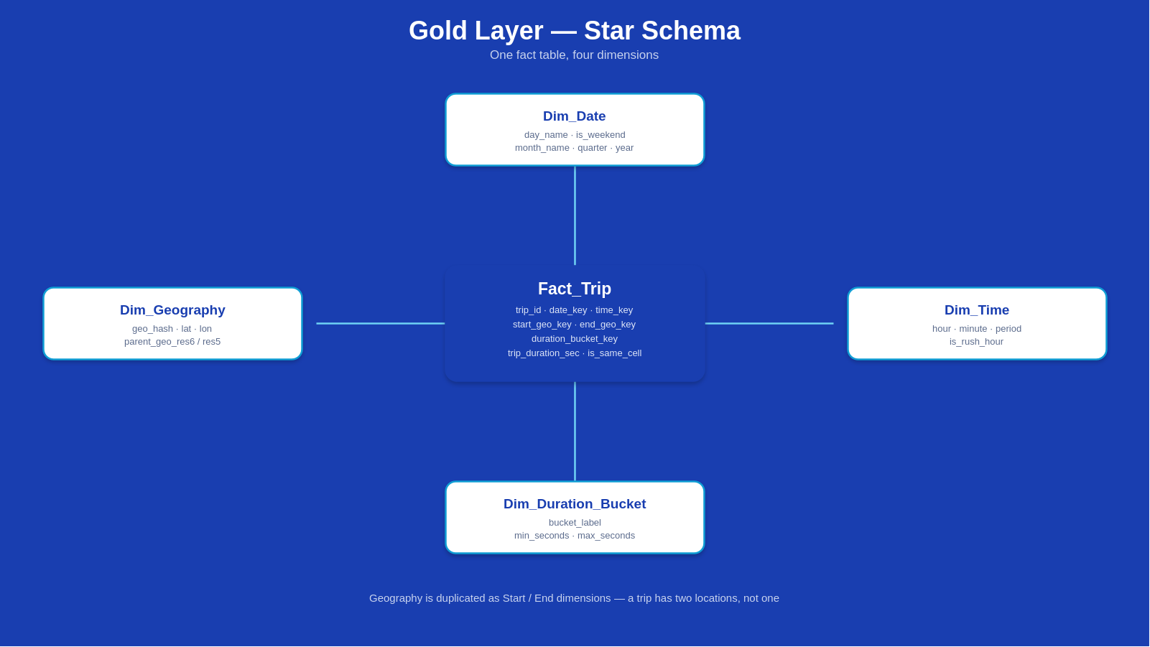
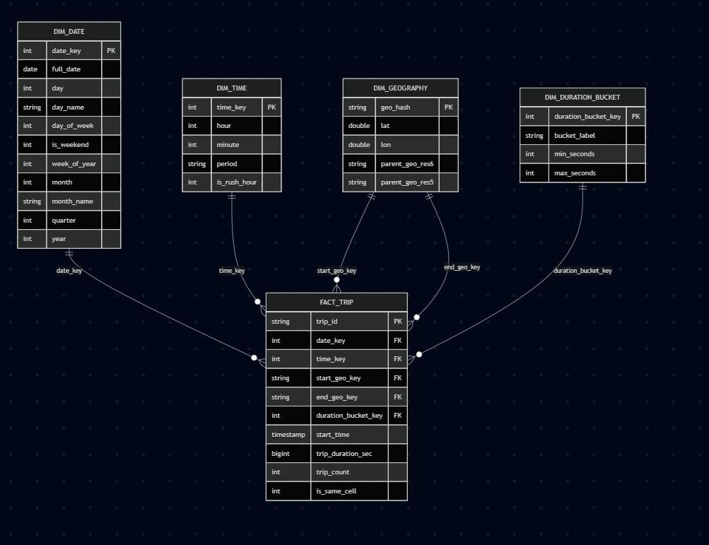
Methodology
Data Warehouse Design
Fact_Trip: trip_id, date_key, time_key, start/end_geo_key, duration_bucket_key, trip_duration_sec, is_same_cell
Dim_Date, Dim_Time, Dim_Geography (Start/End), Dim_Duration_Bucket -- built incrementally via gold_etl.py with checkpoint files
Actual Power BI Data Model View
Notes:
Note:

Slide 25
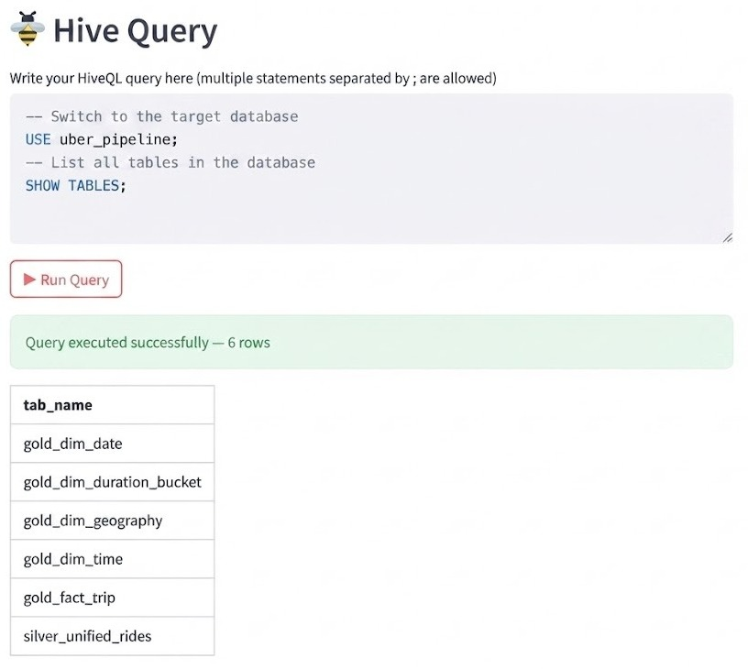







Methodology
Hive — SQL Access to the Data Warehouse
→
→
→
Why Hive?
External Tables
Provides a standard SQL interface over distributed HDFS files without requiring data relocation.
Metadata abstraction allows querying warehouse layers securely while keeping underlying storage intact.

Slide 26
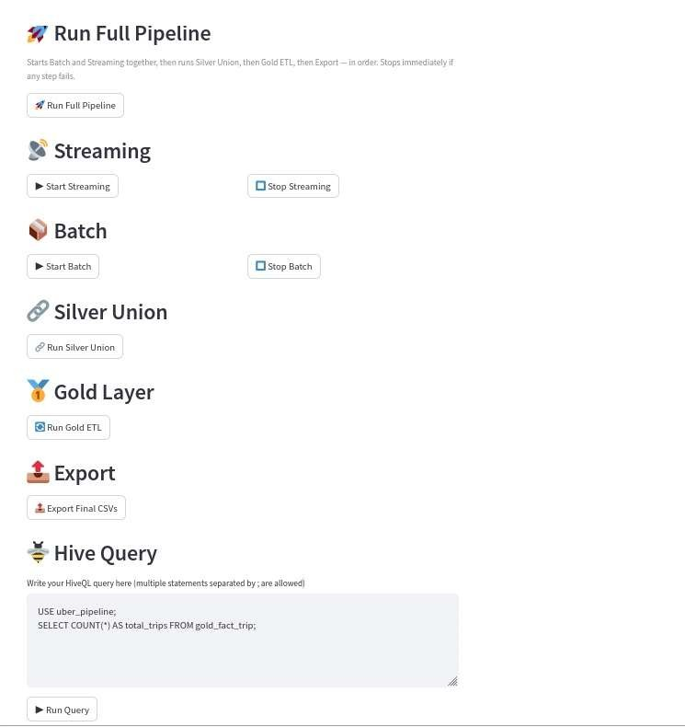
Methodology
This screenshot shows the operational interface used to run and monitor the Uber pipeline. At the top, a single "Run Full Pipeline" button starts the entire process end-to-end — running Batch and Streaming together, then Silver Union, then Gold ETL, then Export — and stops immediately if any step fails, so no partial or inconsistent data reaches the later stages.
Below that, each stage of the pipeline is also exposed individually, giving finer control for testing and debugging:
Streaming — Start/Stop buttons to control the Kafka-based live ingestion path independently.
Batch — Start/Stop buttons to control the historical NiFi/HDFS ingestion path independently.
Silver Union — a single trigger to merge the batch-origin and stream-origin data into the unified Silver layer.
Gold Layer — a single trigger to run the Gold ETL script that builds the dimensional star schema (Fact_Trip + dimensions).
Export — a single trigger to export the final Gold-layer tables as coalesced CSV files for sharing.
At the bottom, a Hive Query box lets the user write and execute HiveQL statements directly (multiple statements separated by semicolons), which is useful for quickly inspecting table schemas, row counts, or testing queries without leaving the control panel.
Notes:
Note:

Slide 27







Technology Stack
Ingestion
Processing
Storage & Warehouse
Apache NiFi
Apache Spark
HDFS
Apache Kafka
PySpark / Structured Streaming
Apache Hive
Power BI
Samsung Innovation Campus

Slide 28
Agenda
Team
Introduction
Problem Statement
Methodology
Key Tasks
Results and Insights
Conclusion
Q&A
Notes:
Note:

Slide 29
Key Tasks
1. Ingestion Engineering
Designed the NiFi batch flow into HDFS Bronze, and built the Kafka producer/consumer pair simulating live ride events.
2. Cleaning, Geo-Hashing & Dedup
Developed batch and streaming PySpark ETL for geo-hashing and validation, plus the persistent-ID deduplication mechanism for the streaming path.
3. Data Warehouse Design
Designed the star-schema Gold layer (Fact_Trip + 4 dimensions) and built the incremental Gold ETL script with checkpoint-based loading.
4. Orchestration & Delivery
Built the pipeline control panel, the HiveQL query interface, and the Overview / Time & Geography / Duration Analysis dashboards.
Notes:
Note:

Slide 30
Agenda
Team
Introduction
Problem Statement
Methodology
Key Tasks
Results and Insights
Conclusion
Q&A
Notes:
Note:

Slide 31

Results and Insights
End-to-End Volume Successfully processed ~172K valid trips end-to-end, from raw ingestion through the Gold layer.
Overview Average trip duration of 34.88 minutes; only 0.96% of trips start and end in the same region; demand shows clear morning and evening peaks by hour.
Time & Geography Trip demand is nearly evenly split between rush-hour (49.81%) and off-peak (50.19%) periods, with identifiable top pickup/drop-off regions and common routes.
Duration Analysis The majority of trips (30.3%) fall in the 30-60 minute range, followed by 15-30 minutes (27.1%); average duration increases consistently across buckets, up to ~86 minutes for 60+ min trips.
Reliability The pipeline correctly detects and skips duplicate records across repeated runs, confirming the deduplication design works as intended.
1. Overview
2. Time & Geography
3. Duration Analysis
Total Trips (172K), Avg Duration (34.8 mins), Weekday vs Weekend splits, and hourly demand peaks.
Spatial trip distribution, top start/end regions, route breakdowns, and rush-hour vs off-peak analysis (~50/50 split).
Trip distribution across duration buckets (e.g., 30-60 min peak at 30.3%) and average duration validation.
Samsung Innovation Campus

Slide 32
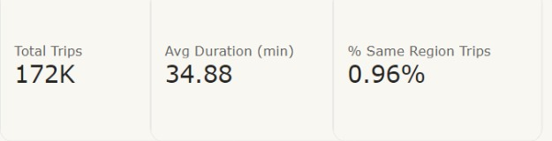
Overview — Key Metrics
The three headline numbers on the dashboard's first page
• Total Trips: 171,707 rides processed end-to-end (batch Jan-Nov + stream Dec)
• Avg Duration: 34.88 minutes across all trips
• % Same Region Trips: 0.96% — almost every ride covers real distance
Samsung Innovation Campus

Slide 33
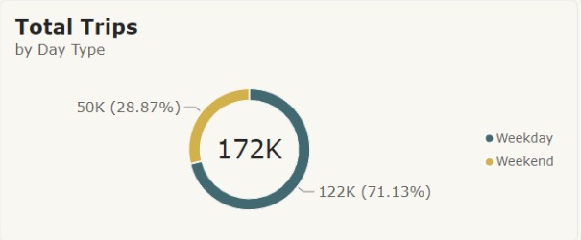
Overview — Weekday vs. Weekend
Total Trips by Day Type
• 71.13% of trips happen on weekdays vs. 28.87% on weekends
• Consistent with commute-driven demand rather than leisure travel
• Measure: Legend = Day Type, derived from Dim_Date.is_weekend
Samsung Innovation Campus

Slide 34
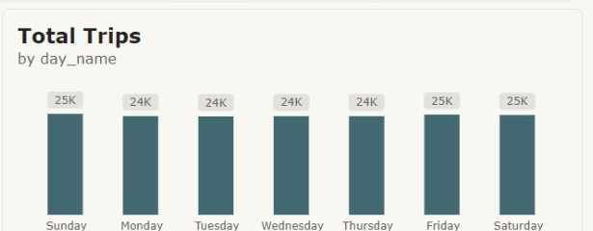
Overview — Trips by Day of Week
Total Trips by day_name
• Volume is nearly flat across the week, ~24-25K trips per day
• Unlike the hourly pattern, demand doesn't swing much by day
• Axis sorted by day_of_week (Sun -> Sat), not alphabetically
Samsung Innovation Campus

Slide 35
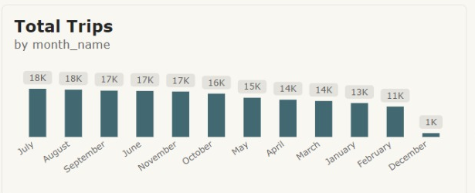
Overview — Trips by Month
Total Trips by month_name
• Volume climbs through summer, peaking in July (~18K trips)
• December drops sharply (~1K) because it is the stream-only slice, not a full batch month
• Axis sorted by calendar month via a Sort-by-Column relationship
Samsung Innovation Campus

Slide 36
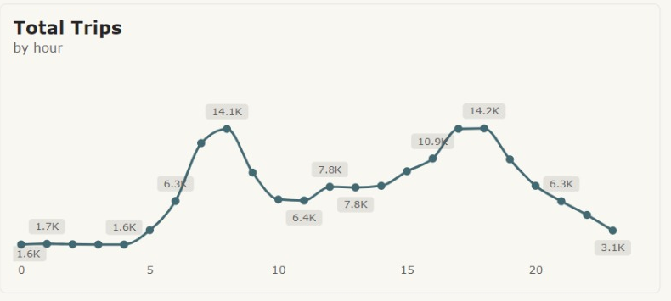
Overview — Trips by Hour
Total Trips by hour
• Two clear peaks: ~7-8 AM and ~5-6 PM (morning and evening commute)
• Mid-day lull, very low volume overnight (12-4 AM)
• Confirms demand is commute-driven, not evenly spread
Samsung Innovation Campus

Slide 37
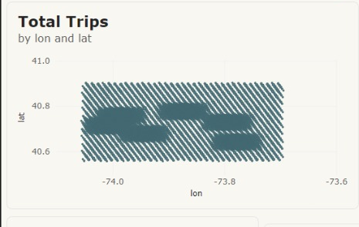
Geography — Pickup Density
Total Trips by lon and lat
• Raw coordinate scatter plot standing in for a live basemap
• Power BI's Azure Maps visual was blocked by the org's tenant policy
• The point cloud still traces the shape of the serviced NYC area
Samsung Innovation Campus

Slide 38
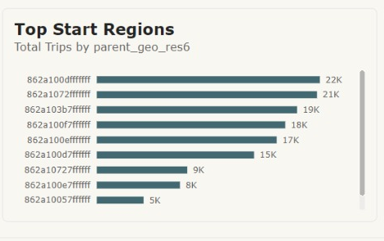
Geography — Top Start Regions
Total Trips by parent_geo_res6
• The single busiest region alone accounts for ~12.5% of all pickups
• The top 5 regions together cover more than half of all rides
• Grouped to a coarser H3 region (~36 km2/cell) so the chart stays readable
Samsung Innovation Campus

Slide 39
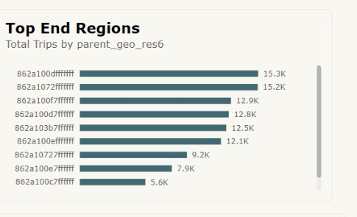
Geography — Top End Regions
Total Trips by parent_geo_res6 (drop-off)
• Ranking closely mirrors the start regions
• Trips are largely local rather than one-way flows into a few hub districts
• Same coarser H3 grouping, keyed on end_geo_key
Samsung Innovation Campus

Slide 40
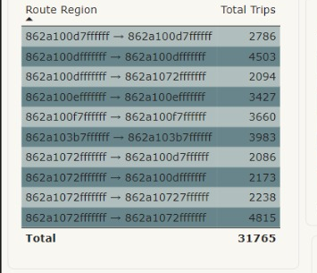
Geography — Most Common Routes
Route Region: start region -> end region
• Busiest "routes" actually start and end within the same broad region
• Short, local trips dominate even though exact same-cell trips are rare
• Built via a RELATED() calculated column joining both geography dimensions
Samsung Innovation Campus

Slide 41
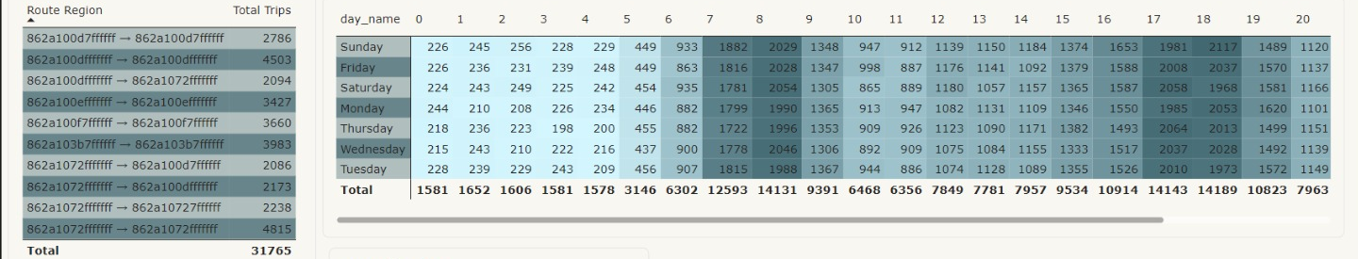
Geography — Day x Hour Heatmap
Trip volume by day_name and hour
• Confirms the commute pattern seen in the hourly chart
• Darker cells around 7-9 AM and 5-7 PM on weekdays
• Background color scale applied via Cell elements formatting
Samsung Innovation Campus

Slide 42
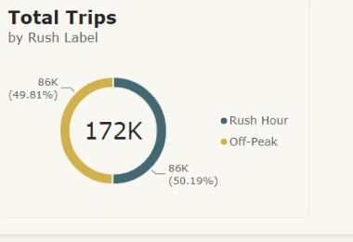
Geography — Rush Hour Split
Total Trips by Rush Label
• Almost exactly even: 49.81% rush hour vs. 50.19% off-peak
• Demand is spread fairly evenly, not narrowly concentrated in commute windows
• Derived from Dim_Time.is_rush_hour
Samsung Innovation Campus

Slide 43
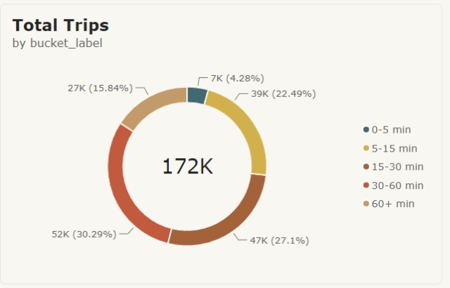
Duration — Trip Length Distribution
Total Trips by bucket_label
• Most trips (30.3%) fall in the 30-60 minute range
• Followed by 15-30 minutes (27.1%); only 4.3% are under 5 minutes
• Buckets sorted by min_seconds so they read in logical order
Samsung Innovation Campus

Slide 44
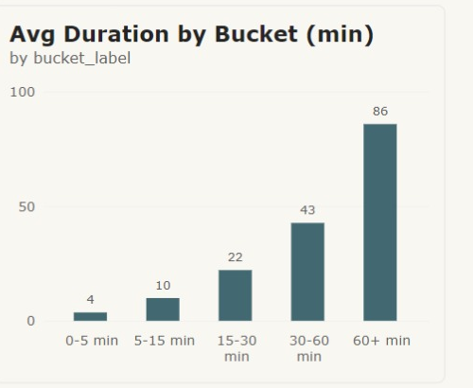
Duration — Avg Duration by Bucket
Avg Duration by Bucket (min)
• Sanity-check: average duration rises consistently across buckets
• The 60+ min bucket averages ~86 minutes, confirming the boundaries are meaningful
• Validates the bucketing logic isn't just an arbitrary label
Samsung Innovation Campus

Slide 45
Agenda
Team
Introduction
Problem Statement
Methodology
Key Tasks
Results and Insights
Conclusion
Q&A
Notes:
Note:

Slide 46
Conclusion
Successful Integration : The project successfully bridged disparate batch and streaming data into a single, unified Silver layer.
Robust Deduplication : By implementing persistent HDFS ID-checking, we bypassed standard limitations, guaranteeing zero duplicates from an indefinite stream.
Actionable Analytics : The resulting dimensional Gold layer easily supports advanced Hive/Presto querying and feeds comprehensive, visual dashboards.
Future Improvements: real-time dashboard refresh, additional dimensions (weather, traffic), and automated orchestration scheduling.
Notes:
Note:

Slide 47
Questions & Discussion
Uber NYC End-to-End Data Pipeline Presentation
Repository: https://github.com/shoman042/Uber_End_to_End_Data_Pipeline

