Slide 1


Analysing Convolutional Neural Networks for Music Genre Classification
By:
Shadi Bazazordeh
Moustafa Shomer
Tutorial TA: Rishabh lalla
Project TA: Alex Hernandez Garcia
Pod Name: Lurking Butterflies
Group Name: Music Stars
Notes:
hello everyone welcome to our presentation,in our project we analyse convolutional neural networks for music genre classification.
under the supervision of Rishabh lalla and Alex hernandez

Slide 2

Outline
Data pipeline
The model architecture
What we did:
Exploring the audio features
Training the model
Analysing the model
Analysing Convolutional Neural Networks for music genre classification
Music Stars
Notes:
we used GTZAn dataset. which consist of 10 musisc genres and each one have 100 music file.
and then we Explore the audio features Training the model Analysing the model

Slide 3
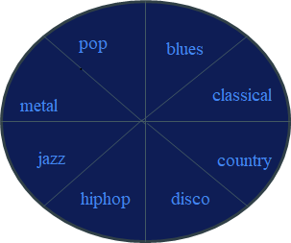

Data pipeline
Mel spectrogram
chroma
spectral rolloff
spectral centroid
Feature Extractor
Classifier
Music File
Analysing Convolutional Neural Networks for music genre classification
Music Stars
Notes:
.we aimed to conduct a comprehensive study on music audio files ,extract features like ( chroma frequencies, spectral centroid and spectral roll-off and mel spectogram) and classify them using a convolutional neural networks approach.

Slide 4
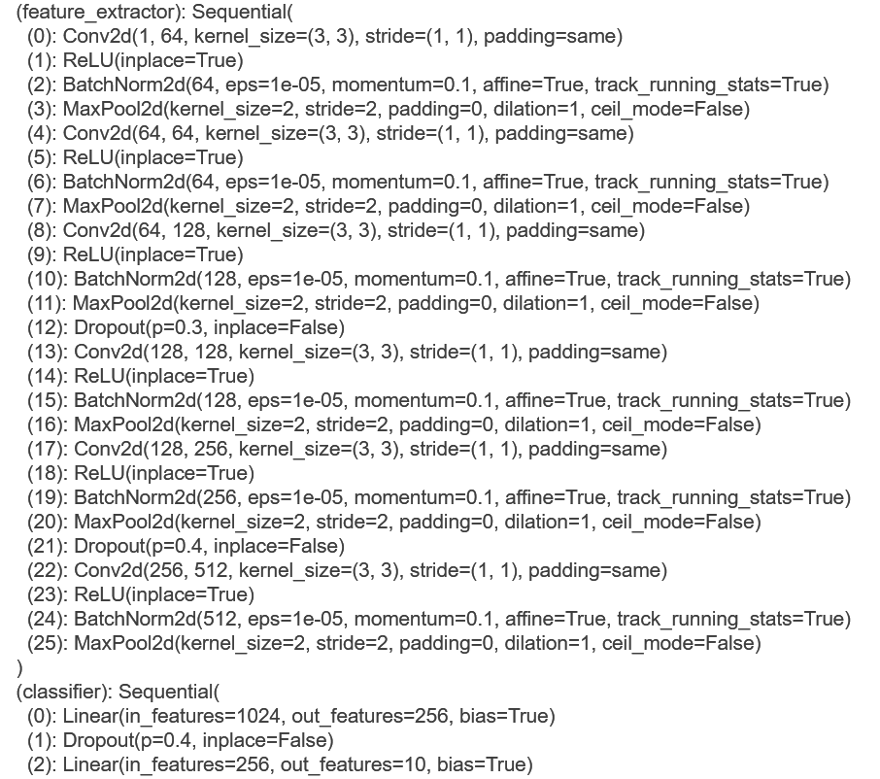
Why using Conv Nets?
Analysing Convolutional Neural Networks for music genre classification
Music Stars
Notes:
why CNN?
Audio data is becoming an important part of machine learning. We are using audio to interact with modern technology.
A spectrogram is a visual representation of audio frequency through time dimension.
here spectograms contains time of the freq and value of the features so we can combine both of these values into 2d matrix and we can use it as an image.
CNN makes sense since spectograms of a song are kind of like an image, each with their own distinct patterns.
thiis is why we use this method instead of using raw audio files because raw audio files are expensive to train model on it

Slide 5
Exploring the Audio Features
Analysing Convolutional Neural Networks for music genre classification
Music Stars
Notes:
we will now explore audio features

Slide 6

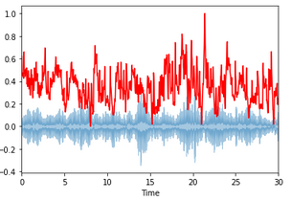
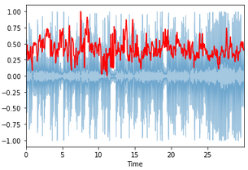
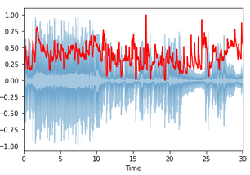
Spectral Centroid
Indicates at which frequency, the energy of spectrum is centered
classic pop rock
Analysing Convolutional Neural Networks for music genre classification
Music Stars
Notes:
.it indicates at which fre,the energy of spectrum is centered.. .
here for example It shows that the spectral centorid of pop/rock music samples seems higher than that of classical music samples.

Slide 7

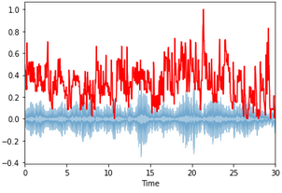
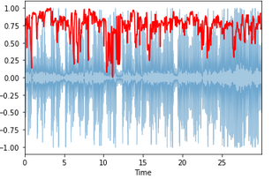
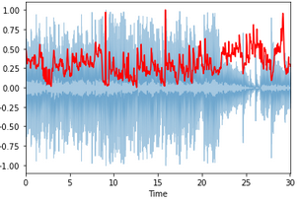
Spectral Rolloff
Spectral rolloff is the frequency below which a specified percentage of the total spectral energy, e.g. 85%, lies.
classic pop rock
Analysing Convolutional Neural Networks for music genre classification
Music Stars
Notes:
Spectral Rolloff :It is a measure of the shape of the signal. It represents the frequency below which some amount of energy (typically 85%) is located

Slide 8
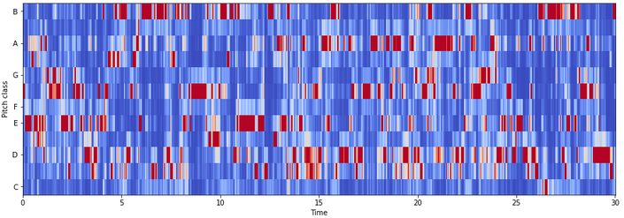
Chroma
Chroma features indicate the energy of a discrete set of pitches (C, C#, D, D# …)
classic
Analysing Convolutional Neural Networks for music genre classification
Music Stars
Notes:
The chroma feature i, which represents the tonal content of a musical audio signal in a condensed form. it can be considered as important for high-level semantic analysis, like chord recognition or harmonic similarity estimation.

Slide 9
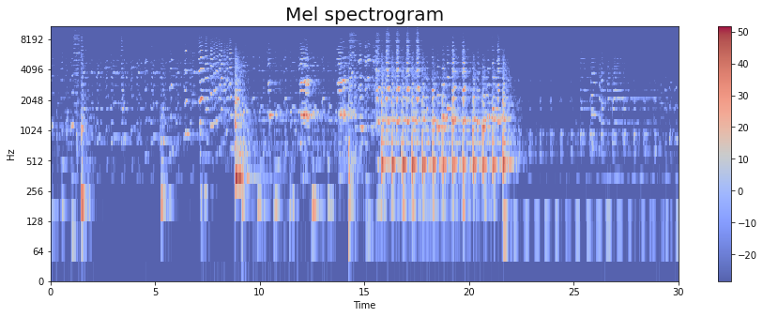
Mel spectrogram is a representation of the short-term power spectrum of a sound
Mel Spectrogram
Analysing Convolutional Neural Networks for music genre classification
Music Stars
Notes:
the mel-frequency cepstrum (MFC) is a representation of the short-term power spectrum of a sound, based on a linear cosine transform of a log power spectrum on a nonlinear mel scale of frequency

Slide 10
Training The Model
Analysing the different features effect on the model performance
Analysing Convolutional Neural Networks for music genre classification
Music Stars
Notes:
As my friend said we used a simple architecture of 6 conv nets with batch norm and dropouts to increase the generalization of the model
and we took a data centric approach, so we fixed the model and started tweeking the data, taking different processing approaches like using the whole 30sec audio file, or dividing each file into 3 files, each one is 10sec long. we also used different features to train the model

Slide 11
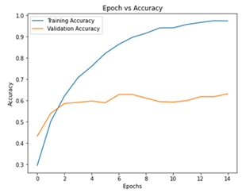
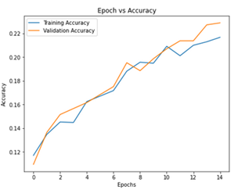
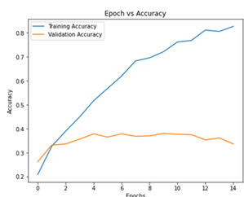
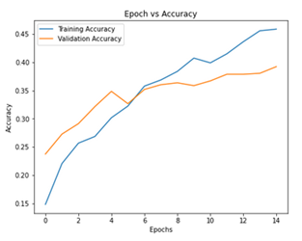
Train a CNN model with each feature
Mel Spectrogram Spectral Centroid
Spectral Rolloff Chroma
Analysing Convolutional Neural Networks for music genre classification
Music Stars
Notes:
as we can see here in the process of finding the best representative features, we trained our model on each of them one at a time
and we observed the performance of the model, surely the model was over fitting as it’s the case with small amount of data

Slide 12
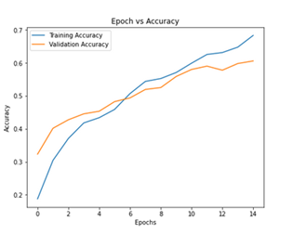
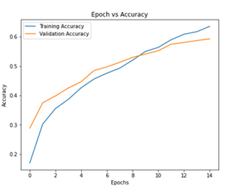
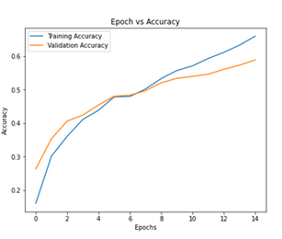
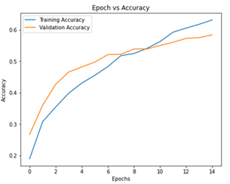
Train a CNN model with concatenate features
Mel Spectrogram & Spectral Centroid Mel Spectrogram & Chroma
Spectral Centroid & Spectral RollOff Spectral Centroid & Chroma
Analysing Convolutional Neural Networks for music genre classification
Music Stars
Notes:
then we tried every possible combination of the features and observed how the model was improving,so we tried combining 2 features 3 features and using all of them at once

Slide 13
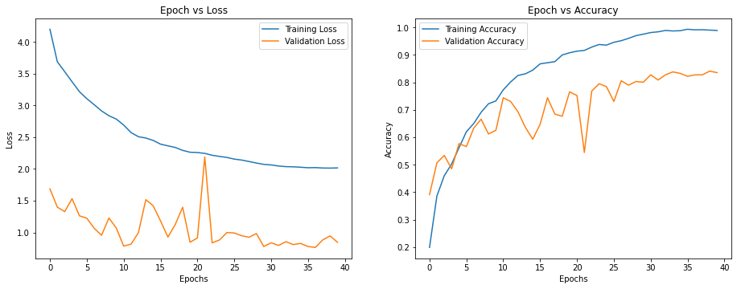
Training with the best combination of features and
L2 regularization
Mel spectrogram & Chroma
Analysing Convolutional Neural Networks for music genre classification
Music Stars
Notes:
then we found out that the most informative features were mel spectrogram and chroma freq.
after that we trained the model with and without regularization
and finally with regularization we get over 84% val accuracy

Slide 14
Model Analysis
Analysing the representations learned by the best model
Analysing Convolutional Neural Networks for music genre classification
Music Stars
Notes:
after reaching the best performing model we conducted different analysis methods, like PCA and (representational similarity analysis)
RSM on the features of the last conv layer and we will refer to it as the representations

Slide 15
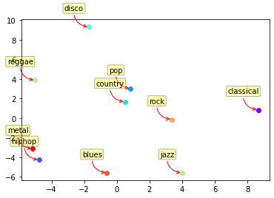
PCA visualization with 2 components
Analysing Convolutional Neural Networks for music genre classification
Music Stars
Notes:
we can see that doing pca with 2 components on all the outputs of that layer we get clusters for each genre

Slide 16
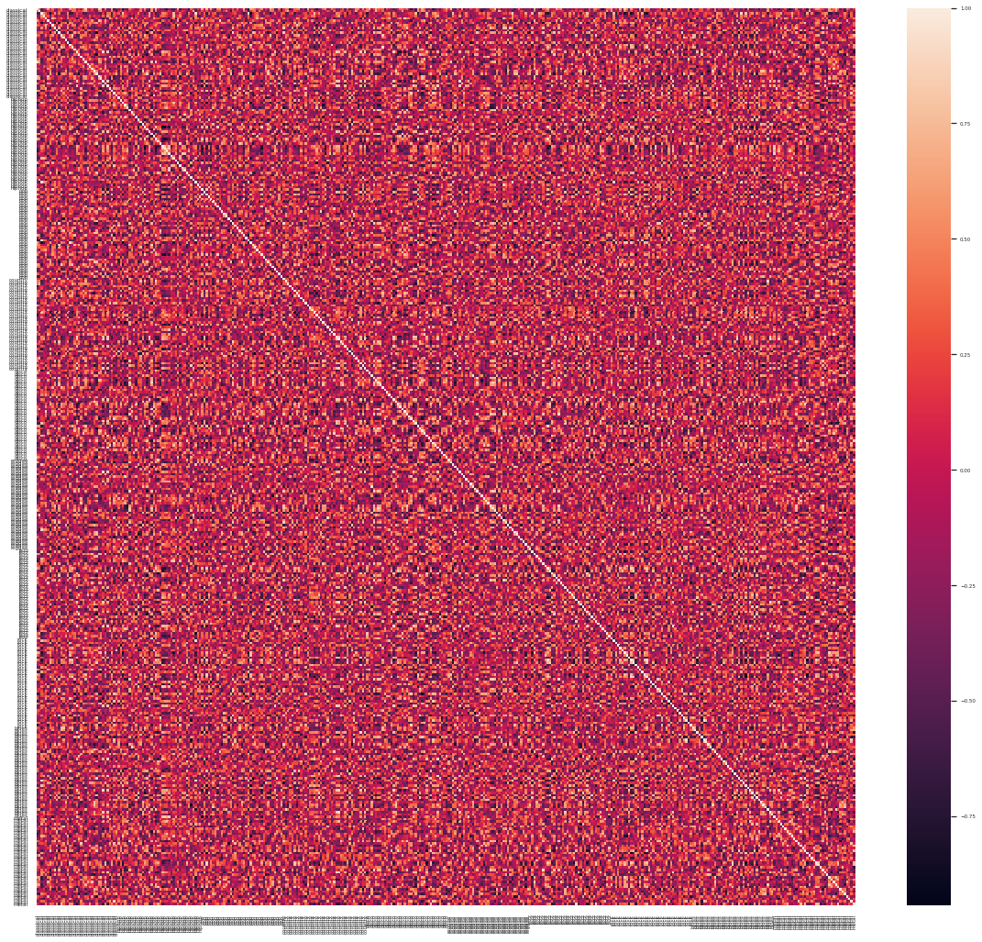
PCA heatmap with 10 components
Analysing Convolutional Neural Networks for music genre classification
Music Stars
Notes:
but as with pca it’s not clear as to what it represents so you can see that it’s just noize

Slide 17
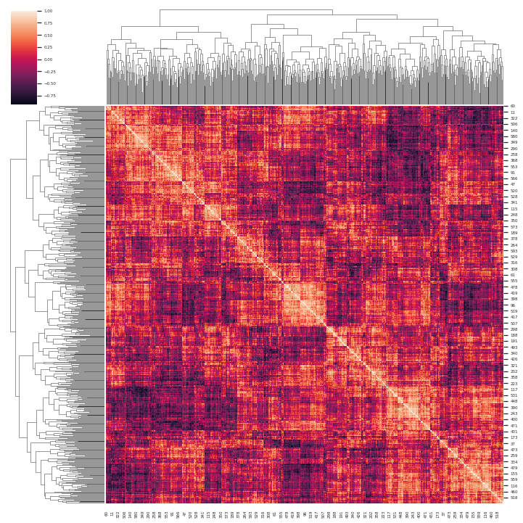
PCA visualization using cluster maps
Analysing Convolutional Neural Networks for music genre classification
Music Stars
Notes:
and when applying cluster maps which finds the patterns in the components and cluster them together, we can clearly see some similarities between the components

Slide 18
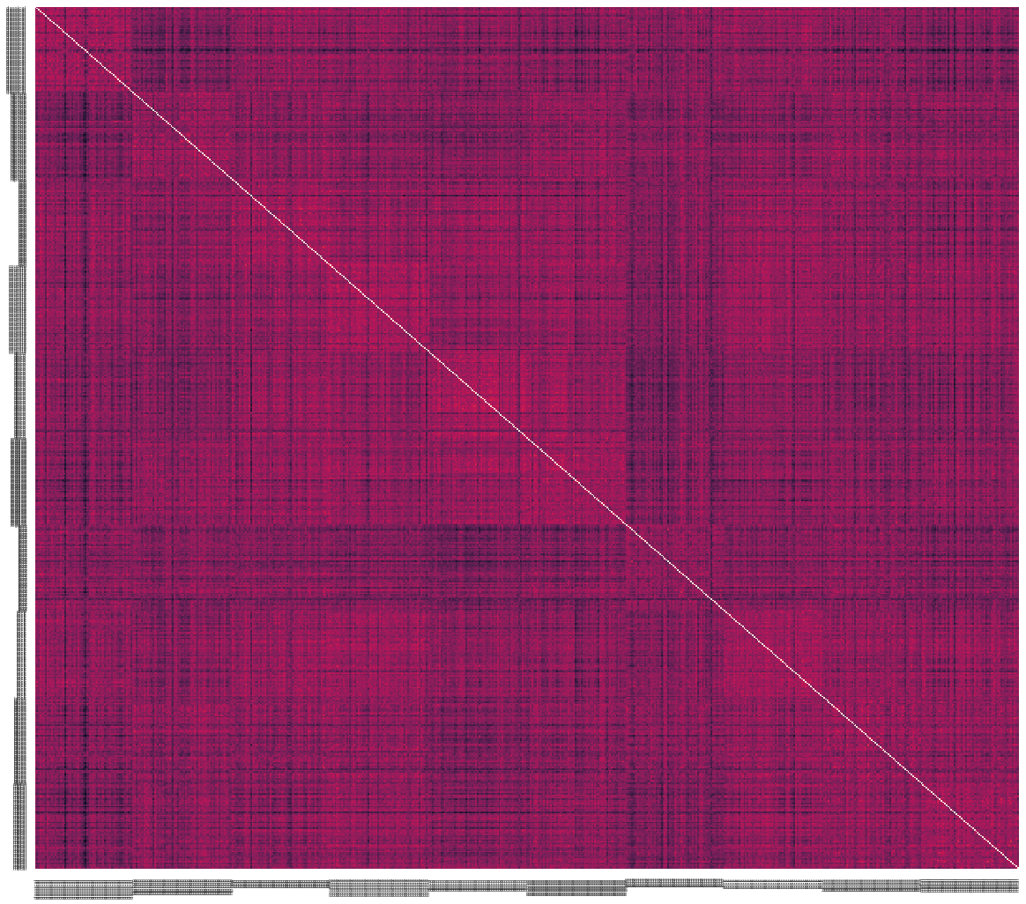
Representational similarity analysis
Analysing Convolutional Neural Networks for music genre classification
Music Stars
Notes:
Finally, conducting RSM on the representations, we can see similarities between certain genres where as it’s not that great for others
and that’s because the model’s performance isn’t that high, and with more data hopefully we would get much better results.

Slide 19

Thank You for Listening
shomerthesec@gmail.com
shadi.bazazordeh94@gmail.com
Notes:
and in the end we would like to than alex and rishab, without your support we wouldn’t be able to advance this far in the project, and also thank you all for listening, and we would love to answer your questions if you have any

