Slide 1

Recipe Integration Tests Framework Kickoff
Shay Barazovsky
June 2020

Slide 2



Problem Domain – Manual Regression
Regression testing is one of the key activities of the QA
Today, a great part of the regression is performed manually
Tool testing is one reason, but it is not the only one
An important part of this activity is the execution of various recipes against expected results, an activity we can perform more easily with an Offline
If it is broken on the Offline, it is broken on the Tool too

Slide 3

Problem Domain – Manual Regression
Due to its cost and extent, regression only takes place at the end of the development, once per version
Manual regression does not provide any feedback for developers during the development phase
Manual regression is error prone and is affected by the tester knowledge, experience and understanding
Regression activities shift critical QA resources from the development teams when they are needed the most to complete the testing of newly developed features

Slide 4
Any degree of automation should ease these pains
Anything that can be tested on an Offline before it is tested on Tool, should be tested

Slide 5



The Framework
A DevOps framework that allows any developer or tester (or PL) to create a test scenario that includes:
A recipe
A set of expected results
A context environment (CCI configurations and licenses setup)
The scenario is recoded by a GUI tool available at the development \ test environment
The creator of the test scenario does not need any special knowledge or skills
Just to be able to create a recipe in the system

Slide 6
OK, it is easy to compose a new test scenario.
But if we have a mass of these, how can we automate them all in a reasonable amount of time?

Slide 7
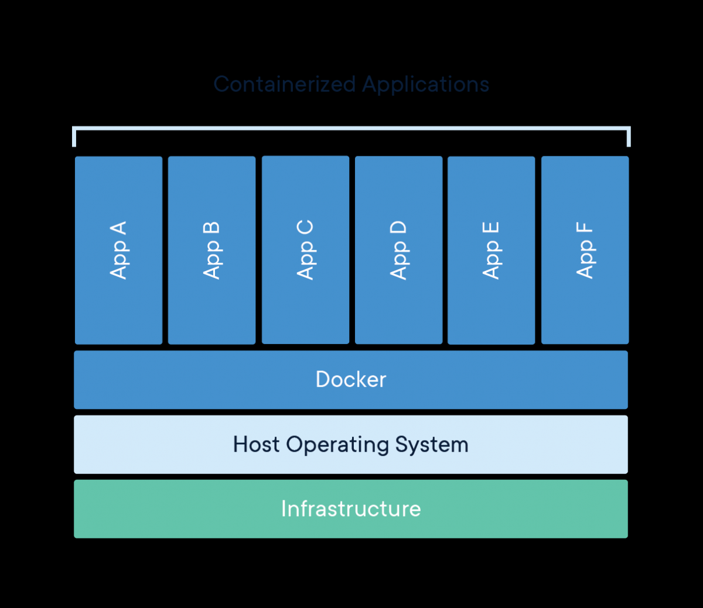
Using Containers – Dockers Technology
“A container is a standard unit of software that packages up code and all its dependencies so the application runs quickly and reliably from one computing environment to another.”
“A Docker container image is a lightweight, standalone, executable package of software that includes everything needed to run an application: code, runtime, system tools, system libraries and settings.”

Slide 8
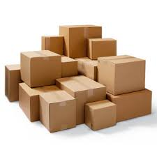
Test Automation over Dockers
A Verity image is created after each CI build
An image can be executed inside a container
Using a specialized host machine(s)
We can run several containers of Verity inside the host
Containers are isolated from each other
Each container executes a single test scenario at a time
The more containers we execute in parallel, the faster we complete the test scenarios
Need to benchmark how many Verity instances can execute in parallel over the same host without significant cross-effects

Slide 9
Framework Development Overview
Development takes 2 parallel routes
MC
DevOps
MC work is done within the development teams
DevOps work is done by a specialized expert contractor
Major milestones
Autonomous Recipe Testing
Verity in Docker
Recipe Test in Docker
Support Verity Environment
Recipe Recorder
Optimizations
Autonomous Recipe Testing
Support Verity Environment
Verity in Docker
Recipe Test in Docker
Recipe Recorder for Offline
Optimizations
MC Lane
DevOps Lane
Sync

Slide 10

Package 1 - Autonomous Recipe Testing
Explore the ability to execute recipes E2E over an Offline using a minimal set of processes
With the Simulator, Recipe and IP processes
Without the client (GUI)
Execute recipes on this system configuration directly from MSTest (our UT engine)
A single generic test that can fit all recipes
Automatic self validation
Compare recipe actual results to expected results

Slide 11
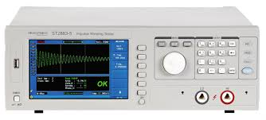
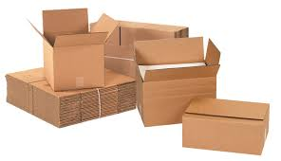
Package 2 – Verity in Docker
Define and setup a host machine for hosting Windows Dockers in the cooperate environment
Write a simple benchmark application that simulates tool behavior
Benchmark how many Dockers we can execute in parallel without significant cross impact
Build an image containing a specific Verity version
Build an image containing a fresh Verity version as part of the CI process

Slide 12
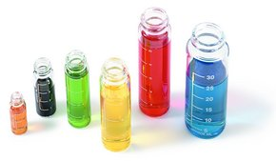
Package 3 – Recipe Test in Docker
Integrate previous packages
Add the recipe test code to the Docker image
Define the structure of a test scenario and add some to GIT
From Jenkins, activate the Docker with a specific test scenario
Collect the test results and integrate them into the current CI process

Slide 13

Package 4 – Support Verity Environment
Extend the test code to support a realistic test environment
CCI
Licenses
Simulator configuration

Slide 14
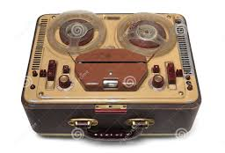
Package 5 – Recipe Recorder for Offline
A new GUI tool that can be started from QL
Allows creating a test scenario automatically by recording an existing Offline working with the Simulator
One-click recording
Pick which results should be validated in the test
Tag the test scenario
When the package is ready, it can be pushed via a Pull Request

Slide 15

Package 6 - Optimizations
Optimize all flows that are overheads for the AT
Fast CCI import
Fast recipe import
Fast system bootstrapping
Docker related optimizations

Slide 16
Timeline

Slide 17
TODO

Slide 18
Aftermath

Slide 19
Shift of Focus
This framework should change the focus of our current E2E AT
GUI AT should focus in E2E scenarios with high user interaction
Recipe editing
Complex configurations
“Monkey Testing”
Backend scenarios that can be fully automated should gradually shift to the Integration world
Recipes
Calibrations
FIFA scenarios
IP Test Wizard

Slide 20
What’s Next?
Consider using the recipe recorder for Tools (at least in PDC)
In the future, extend Verity automation capabilities by exposing relevant API’s
Recipe Read API
Recipe Engineering API
Next maturity level may well be Tool based regression AT
Should be a strategic goal as this should significantly reduce regression time
Docker over Tool my be a tread stone for exciting new possibilities
Super fast deployments
Better use of fleet computing power

