Slide 1
Distributed Systems
(4th edition, version 01)
Module-III
Naming

Slide 2
Naming
Naming Names, identifiers, and addresses
Essence
Names are used to denote entities in a distributed system. To operate on an entity, we need to access it at an access point. Access points are entities that are named by means of an address.
Note
A location-independent name for an entity E , is independent of the addresses of the access points offered by E .

Slide 3
Identifiers
Naming Names, identifiers, and addresses
Pure name
A name that has no meaning at all; it is just a random string. Pure names can be used for comparison only.
Identifier: A name having some specific properties
An identifier refers to at most one entity.
Each entity is referred to by at most one identifier.
An identifier always refers to the same entity (i.e., it is never reused).
Observation
An identifier need not necessarily be a pure name, i.e., it may have content.

Slide 4
Naming
Flat naming
Broadcasting
Broadcast the ID, requesting the entity to return its current address
Can never scale beyond local-area networks
Requires all processes to listen to incoming location requests
Address Resolution Protocol (ARP)
To find out which MAC address is associated with an IP address, broadcast the query “who has this IP address”?
Simple solutions

Slide 5
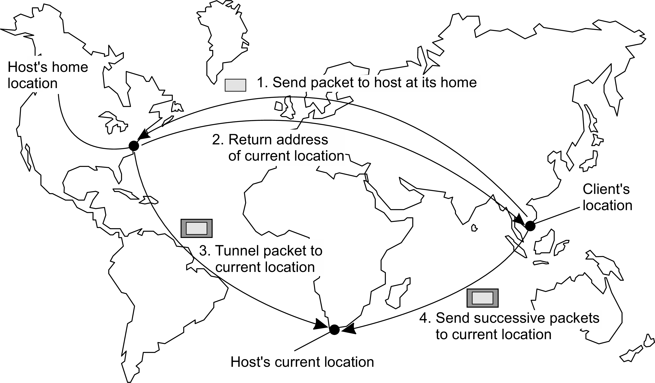
Naming
Flat naming
The principle of mobile IP
Home-based approaches

Slide 6
Naming
Flat naming
Illustrative: Chord
Consider the organization of many nodes into a logical ring
Each node is assigned a random m-bit identifier.
Every entity is assigned a unique m-bit key.
Entity with key k falls under jurisdiction of node with smallest id ≥ k
(called its successor succ(k )).
Nonsolution
Let each node keep track of its neighbor and start linear search along the ring.
Notation
We will speak of node p as the node have identifier p
Distributed hash tables

Slide 7
Naming
Flat naming
Chord finger tables
Principle
Each node p maintains a finger table FT_{p} [] with at most m entries:
FT_{p} [i ] = succ(p + 2^{i−1})
Note: the i -th entry points to the first node succeeding p by at least 2^{i−1}.
To look up a key k , node p forwards the request to node with index j
satisfying
q = FT_{p} [j ] ≤ k < FT_{p} [j + 1]
If p < k < FT_{p} [1], the request is also forwarded to FT_{p} [1]
Distributed hash tables

Slide 8
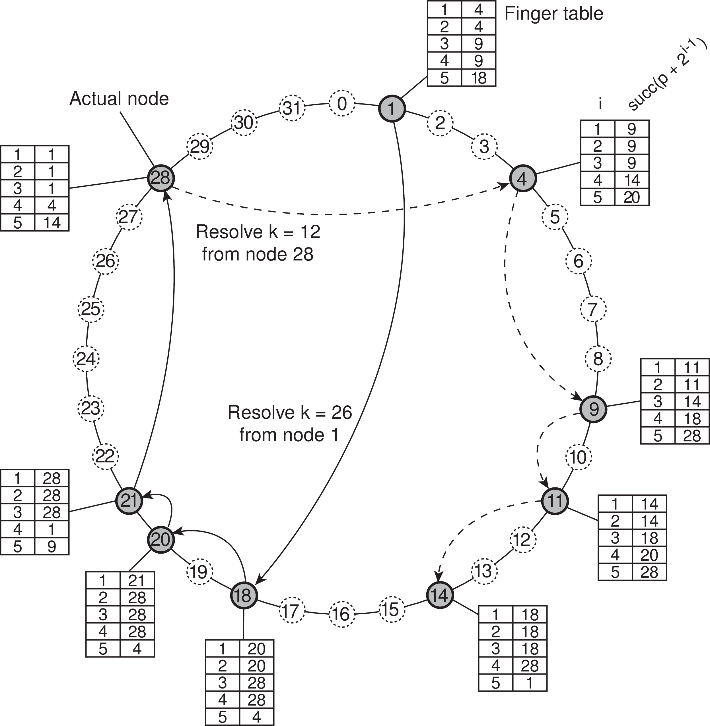
Naming
Flat naming
Chord lookup example
Resolving key 26 from node 1 and key 12 from node 28
Distributed hash tables

Slide 9
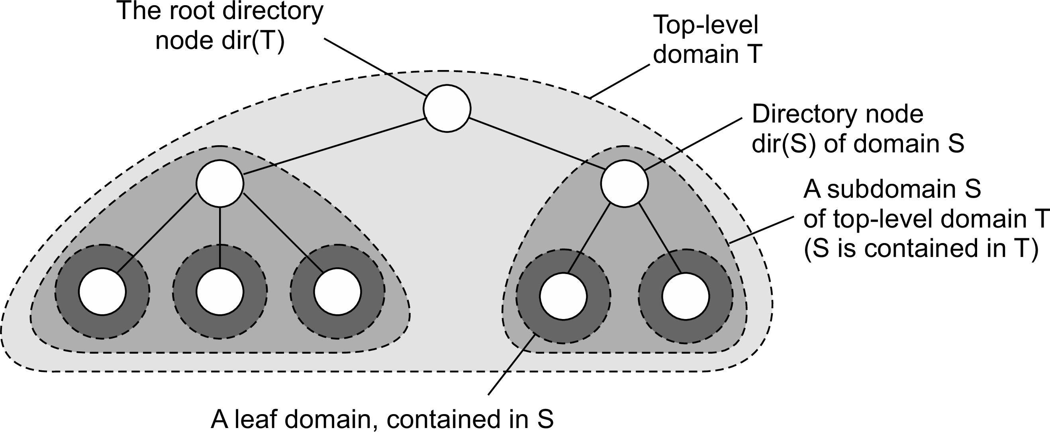
Naming
Flat naming
Hierarchical Location Services (HLS)
Basic idea
Build a large-scale search tree for which the underlying network is divided into hierarchical domains. Each domain is represented by a separate directory node.
Principle
Hierarchical approaches

Slide 10
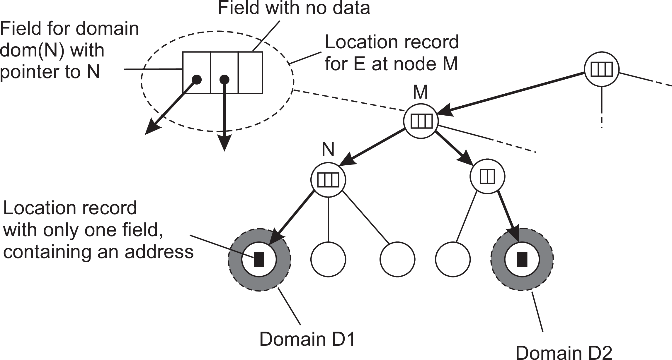
Naming
Flat naming
HLS: Tree organization
Invariants
Address of entity E is stored in a leaf or intermediate node
Intermediate nodes contain a pointer to a child if and only if the subtree rooted at the child stores an address of the entity
The root knows about all entities
Storing information of an entity having two addresses in different leaf domains
Hierarchical approaches

Slide 11
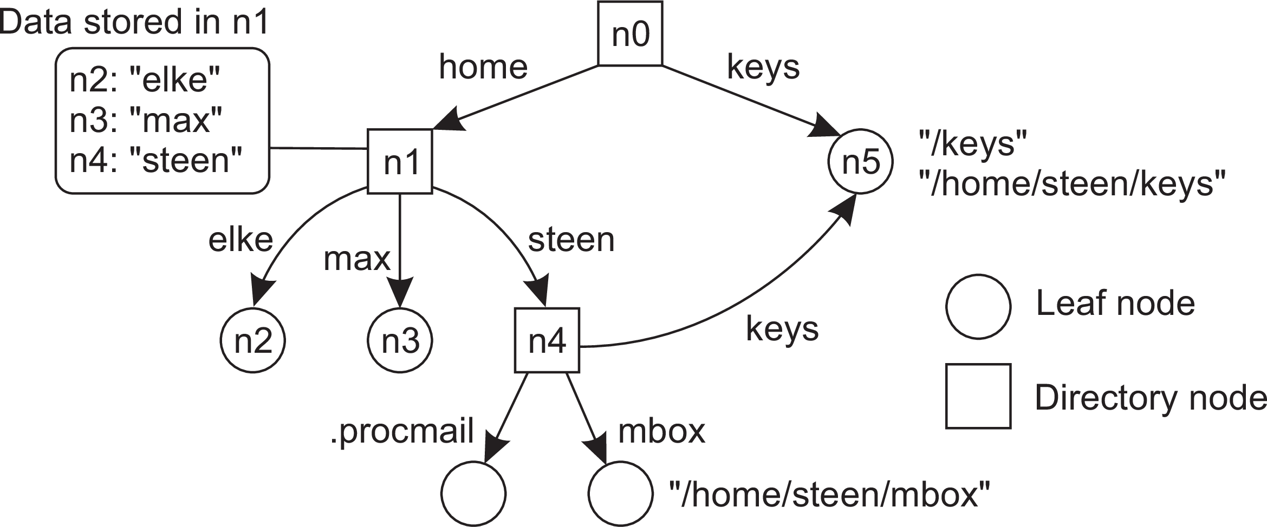
Name space
Naming Structured naming
Naming graph
A graph in which a leaf node represents a (named) entity. A directory node is an entity that refers to other nodes.
A general naming graph with a single root node
Note
A directory node contains a table of (node identifier, edge label) pairs.
Name spaces

Slide 12
Mounting
Naming Structured naming
Issue
Name resolution can also be used to merge different name spaces transparently through mounting: associating a node identifier of another name space with a node in a current name space.
Terminology
Foreign name space: the name space that needs to be accessed
Mount point: the node in the current name space containing the node identifier of the foreign name space
Mounting point: the node in the foreign name space where to continue name resolution
Mounting across a network
The name of an access protocol.
The name of the server.
The name of the mounting point in the foreign name space.
Name resolution

Slide 13
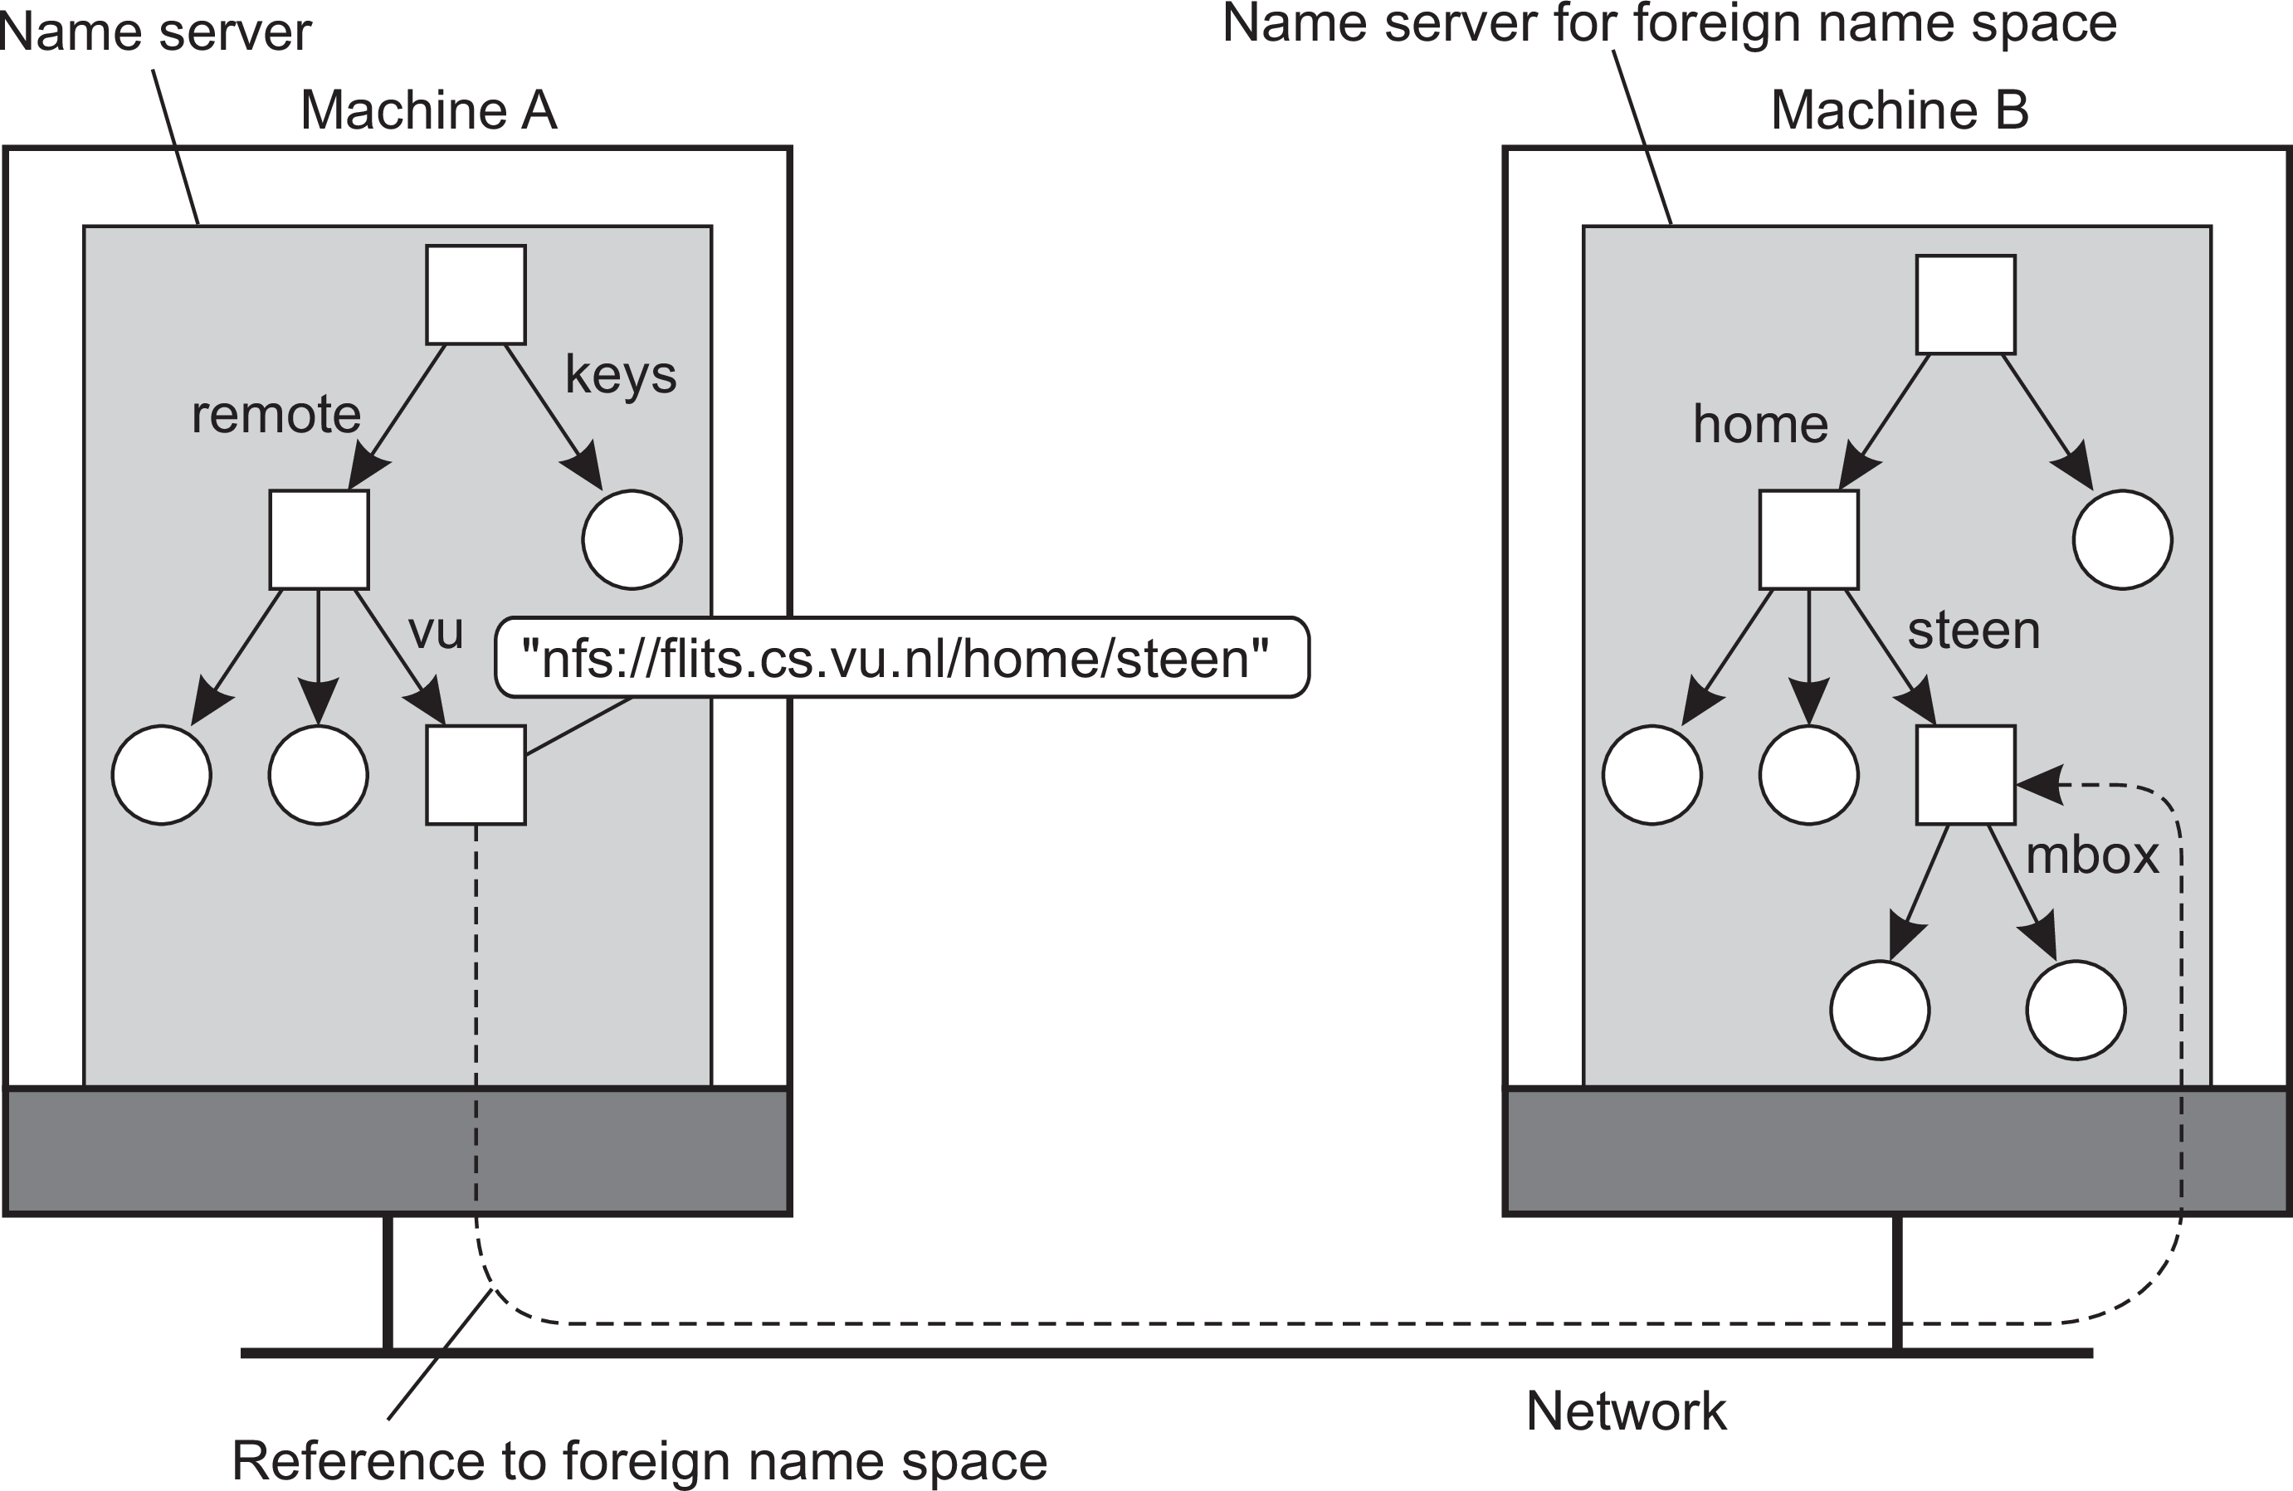
Naming
Structured naming
Mounting in distributed systems
Mounting remote name spaces through a specific access protocol
Name resolution

Slide 14
Name-space implementation
Naming Structured naming
Basic issue
Distribute the name resolution process as well as name space management across multiple machines, by distributing nodes of the naming graph.
Distinguish three levels
Global level: Consists of the high-level directory nodes. Main aspect is that these directory nodes have to be jointly managed by different administrations
Administrational level: Contains mid-level directory nodes that can be grouped in such a way that each group can be assigned to a separate administration.
Managerial level: Consists of low-level directory nodes within a single administration. Main issue is effectively mapping directory nodes to local name servers.
The implementation of a name space

Slide 15
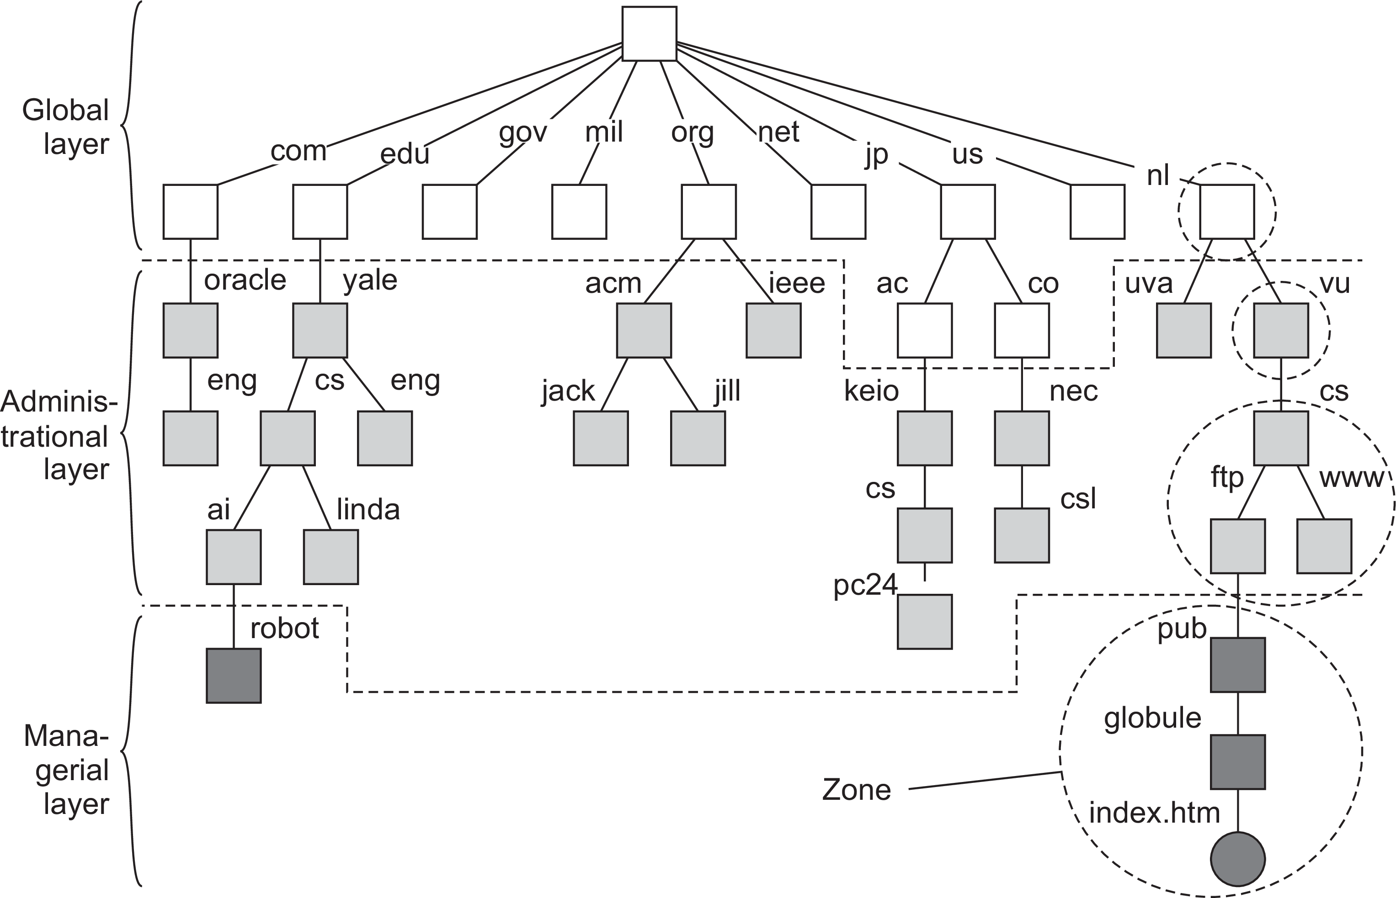
Name-space implementation
Naming Structured naming
An example partitioning of the DNS name space, including network files
The implementation of a name space

Slide 16
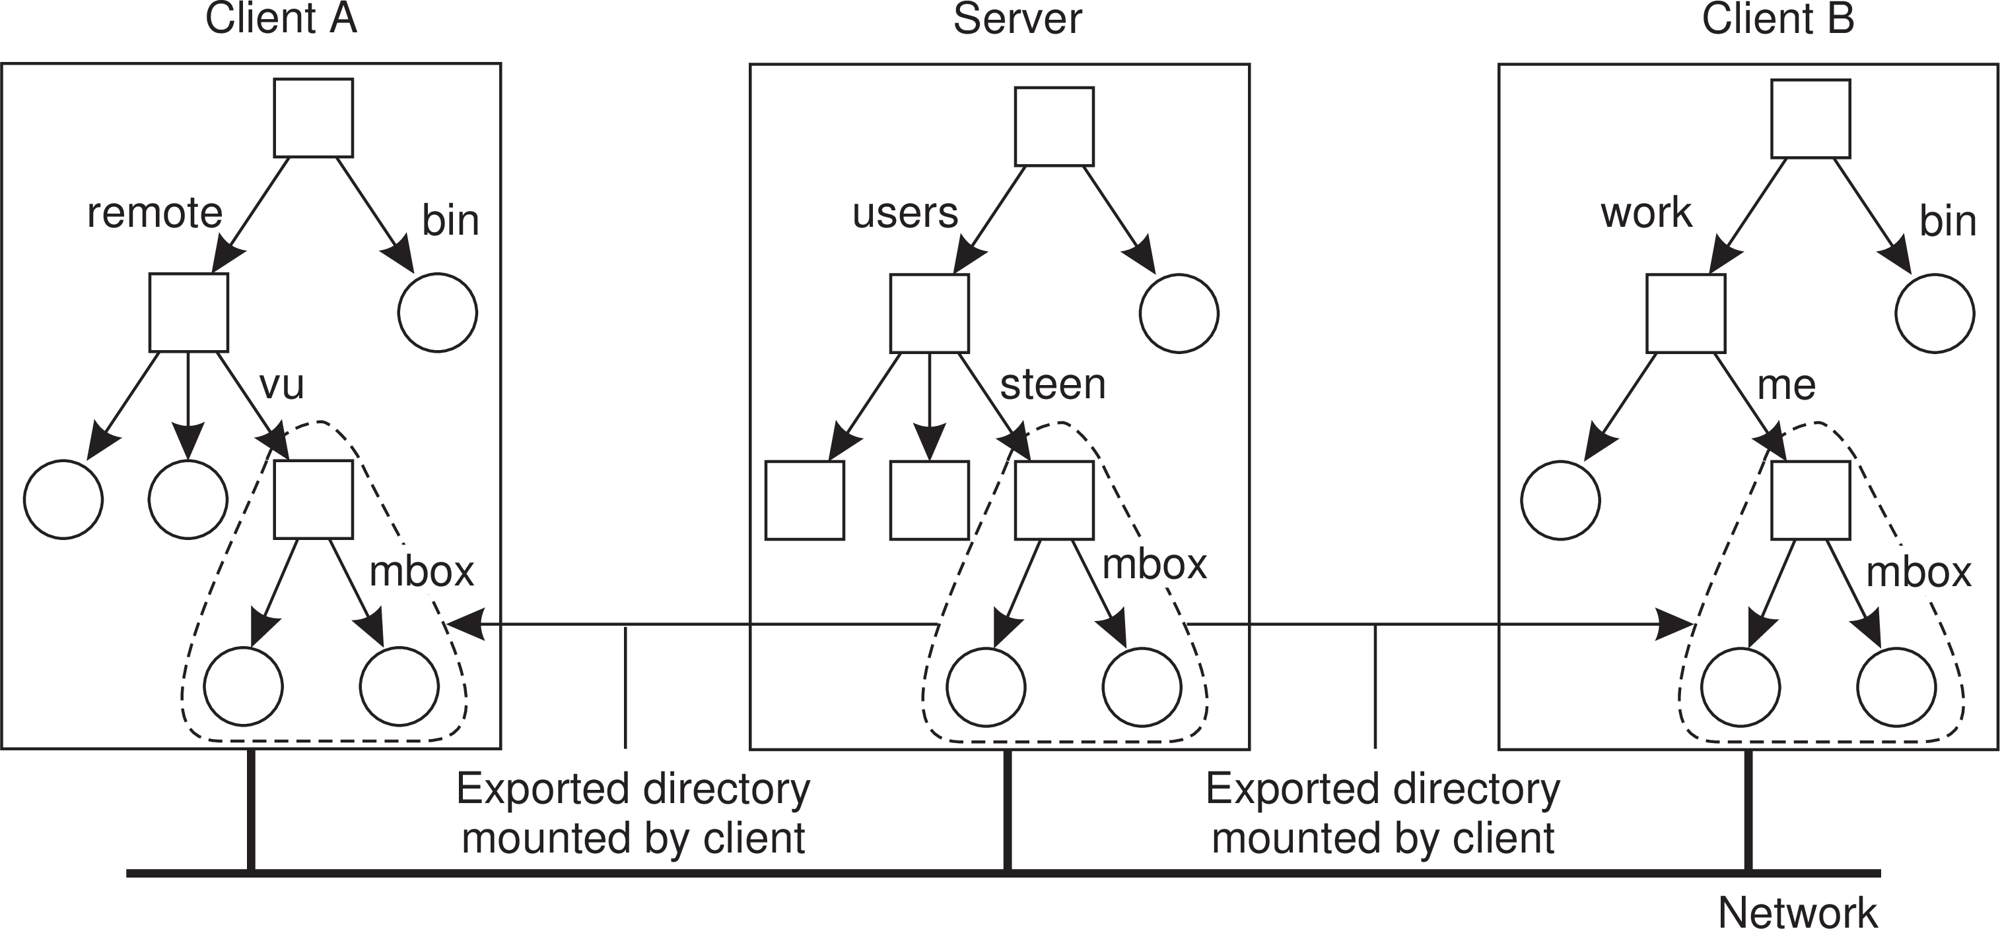
Naming
Structured naming
Naming in NFS
Observation
A server may export (a part of) its filesystem, which can then be imported by different clients by mounting. Note that different clients will have different (nonsharable) namespaces!
Example: The Network File System

Slide 17
Distributed Systems
(4th edition, version 01)
Consistency and Replication

Slide 18
Consistency and replication
Introduction
Replication
Why replicate
Assume a simple model in which we make a copy of a specific part of a system (meaning code and data).
Increase reliability: if one copy does not live up to specifications, switch over to the other copy while repairing the failing one.
Performance: simply spread requests between different replicated parts to keep load balanced, or to ensure quick responses by taking proximity into account.
The problem
Having multiple copies, means that when any copy changes, that change should be made at all copies: replicas need to be kept the same, that is, be kept consistent.
Reasons for replication

Slide 19
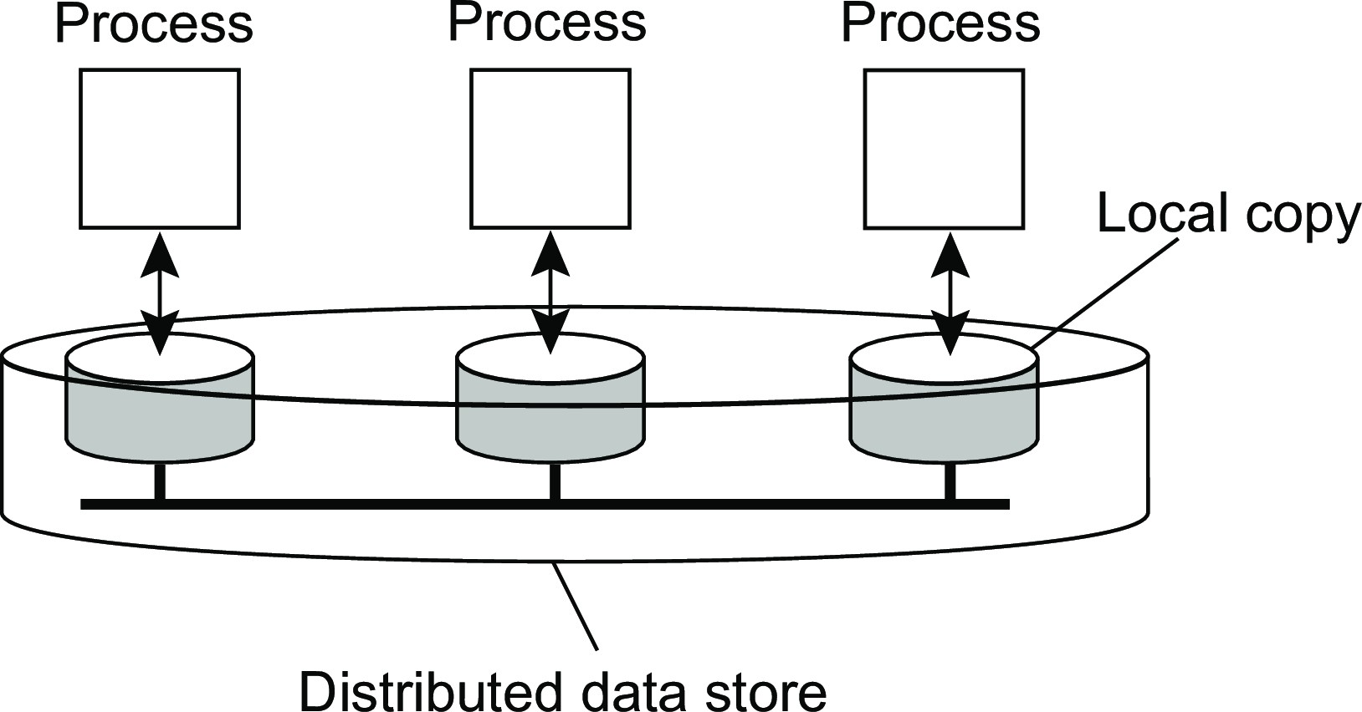
Data-centric consistency models
Consistency and replication Data-centric consistency models
Consistency model
A contract between a (distributed) data store and processes, in which the data store specifies precisely what the results of read and write operations are in the presence of concurrency.
Essential
A data store is a distributed collection of storages:

Slide 20
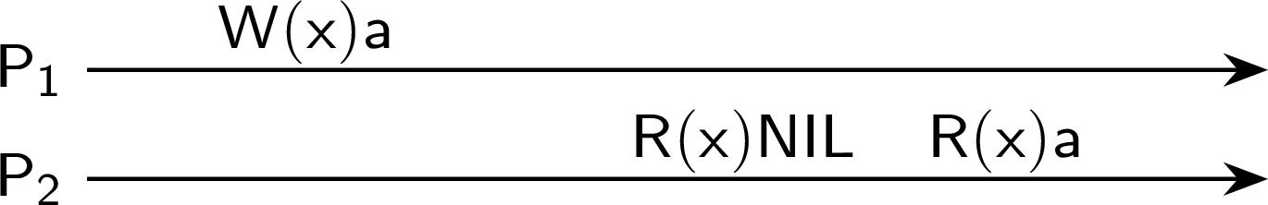
Consistency and replication
Data-centric consistency models
Some notations
Read and write operations
W_{i} (x )a: Process P_{i} writes value a to x
R_{i} (x )b: Process P_{i} reads value b from x
All data items initially have value NIL
Possible behavior
We omit the index when possible and draw according to time (x-axis):
Consistent ordering of operations

Slide 21
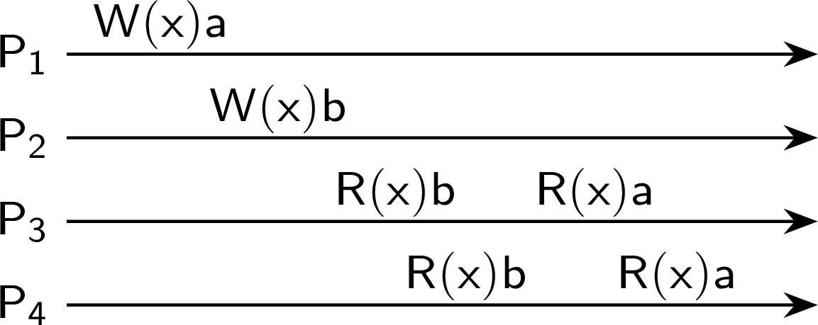

Sequential consistency
Consistency and replication Data-centric consistency models
Definition
The result of any execution is the same as if the operations of all processes were executed in some sequential order, and the operations of each individual process appear in this sequence in the order specified by its program.
A sequentially consistent data store
A data store that is not sequentially consistent
Consistent ordering of operations

Slide 22
Consistency and replication
Data-centric consistency models
Example
Three concurrent processes (initial values: 0)
Process P₁ | Process P₂ | Process P₃
x ← 1; | y ← 1; | z ← 1;
print(y,z); | print(x,z); | print(x,y);
Consistent ordering of operations

Slide 23
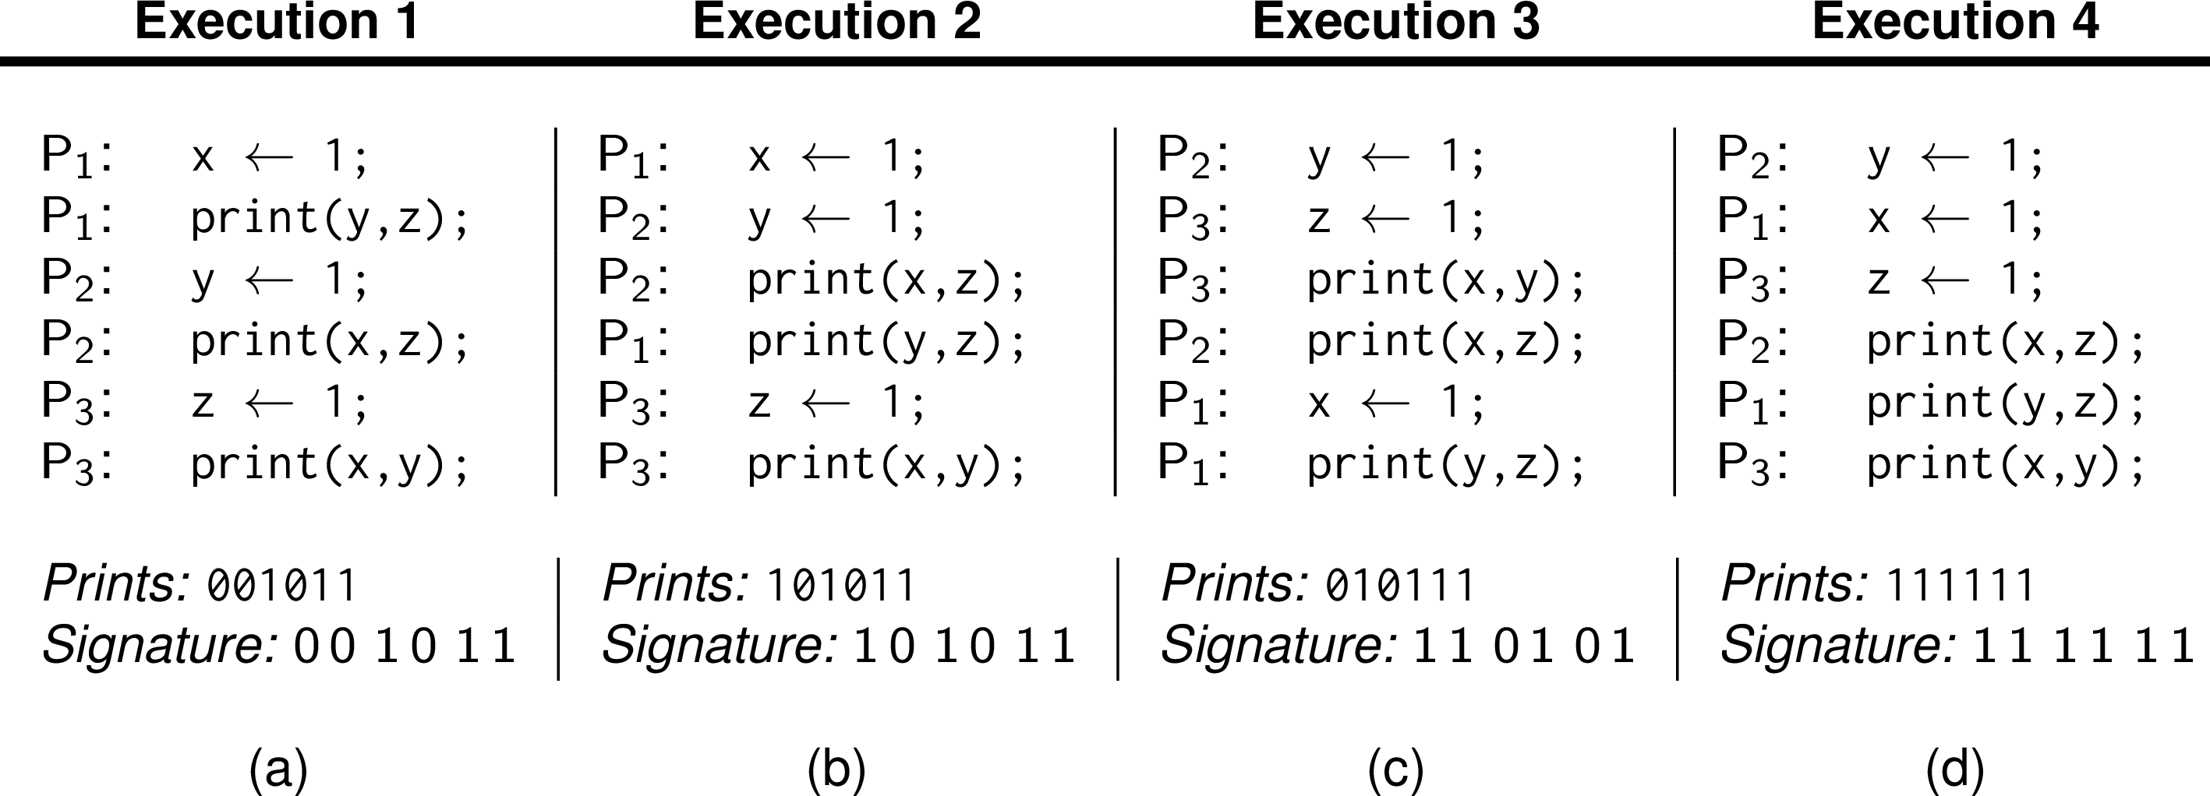
Consistency and replication
Data-centric consistency models
Example
Three concurrent processes (initial values: 0)
Process P₁ | Process P₂ | Process P₃
x ← 1; | y ← 1; | z ← 1;
print(y,z); | print(x,z); | print(x,y);
Example execution sequences
Consistent ordering of operations

Slide 24
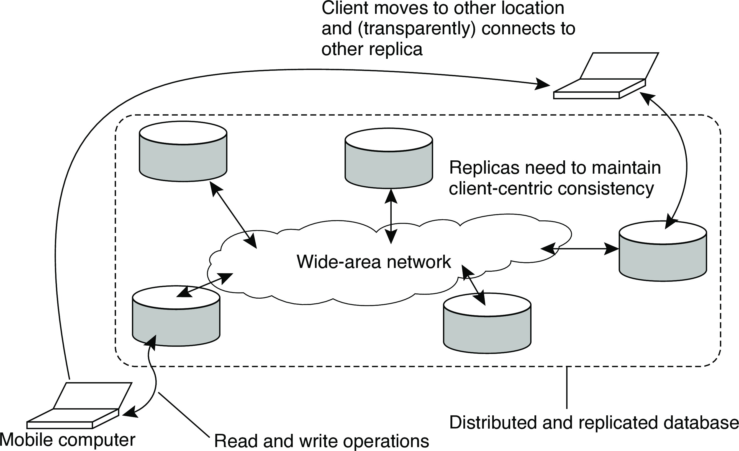
Basic architecture
Consistency and replication Client-centric consistency models
The principle of a mobile user accessing different replicas of a distributed database

Slide 25
Client-centric consistency: notation
Consistency and replication Client-centric consistency models
Notations
W₁(x₂ ) is the write operation by process P₁ that leads to version x₂ of x
W₁(x_{i} ; x_{j} ) indicates P₁ produces version x_{j} based on a previous version
x_{i} .
W₁(x_{i} |x_{j} ) indicates P₁ produces version x_{j} concurrently to version x_{i} .
Monotonic reads

Slide 26
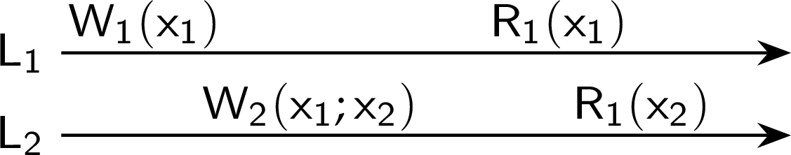
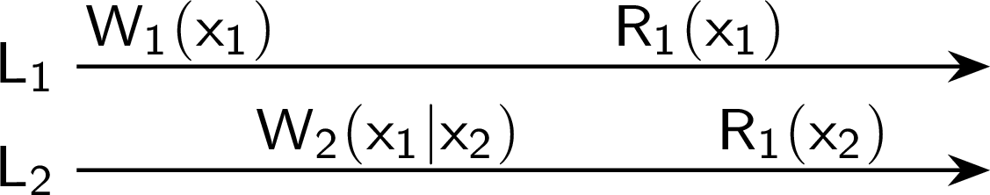
Monotonic reads
Consistency and replication Client-centric consistency models
Definition
If a process reads the value of a data item x , any successive read operation on
x by that process will always return that same or a more recent value.
A monotonic-read consistent data store
A data store that does not provide monotonic reads
Monotonic reads

Slide 27
Monotonic writes
Consistency and replication Client-centric consistency models
Example
Updating a program at server S₂ , and ensuring that all components on which compilation and linking depends, are also placed at S₂ .
Example
Maintaining versions of replicated files in the correct order everywhere (propagate the previous version to the server where the newest version is installed).
Monotonic writes

Slide 28
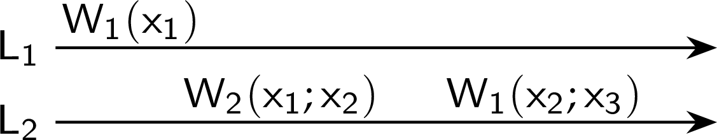
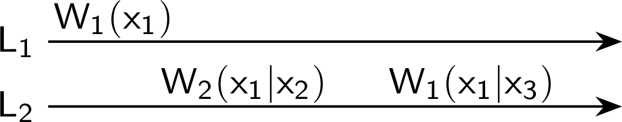


Monotonic writes
Consistency and replication Client-centric consistency models
Definition
A write operation by a process on a data item x is completed before any successive write operation on x by the same process.
OK
Not OK
Not OK
OK
Monotonic writes

Slide 29
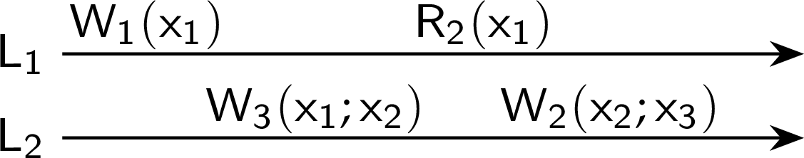

Writes follow reads
Consistency and replication Client-centric consistency models
Definition
A write operation by a process on a data item x following a previous read operation on x by the same process, is guaranteed to take place on the same or a more recent value of x that was read.
OK
Not OK
Example
See reactions to posted articles only if you have the original posting (a read “pulls in” the corresponding write operation).
Writes follow reads

Slide 30
Replica placement
Consistency and replication Replica management
Essence
Figure out what the best K places are out of N possible locations.
Select best location out of N −K for which the average distance to clients is minimal. Then choose the next best server. (Note: The first chosen location minimizes the average distance to all clients.) Computationally expensive.
Select the K -th largest autonomous system and place a server at the best-connected host. Computationally expensive.
Finding the best server location

Slide 31
Content replication
Consistency and replication Replica management
Distinguish different processes
A process is capable of hosting a replica of an object or data:
Permanent replicas: Process/machine always having a replica
Server-initiated replica: Process that can dynamically host a replica on request of another server in the data store
Client-initiated replica: Process that can dynamically host a replica on request of a client (client cache)
Content replication and placement

Slide 32
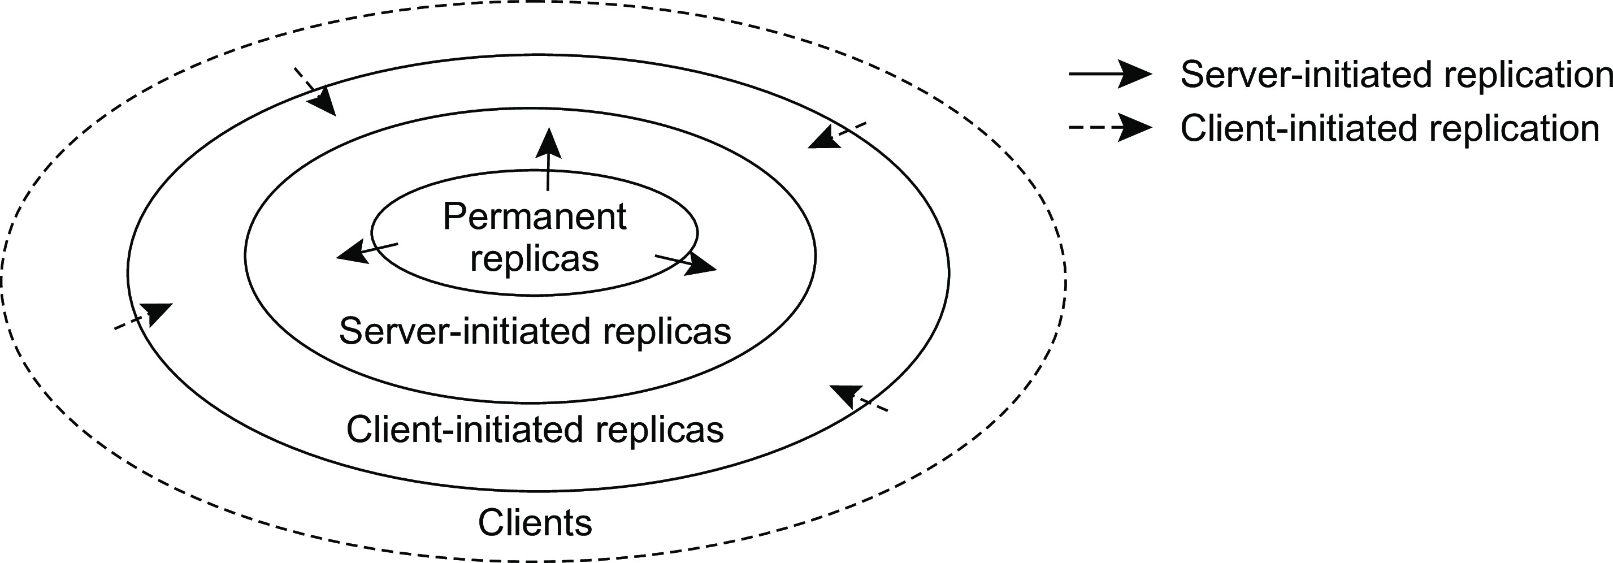
Content replication
Consistency and replication Replica management
The logical organization of different kinds of copies of a data store into three concentric rings
Content replication and placement

Slide 33
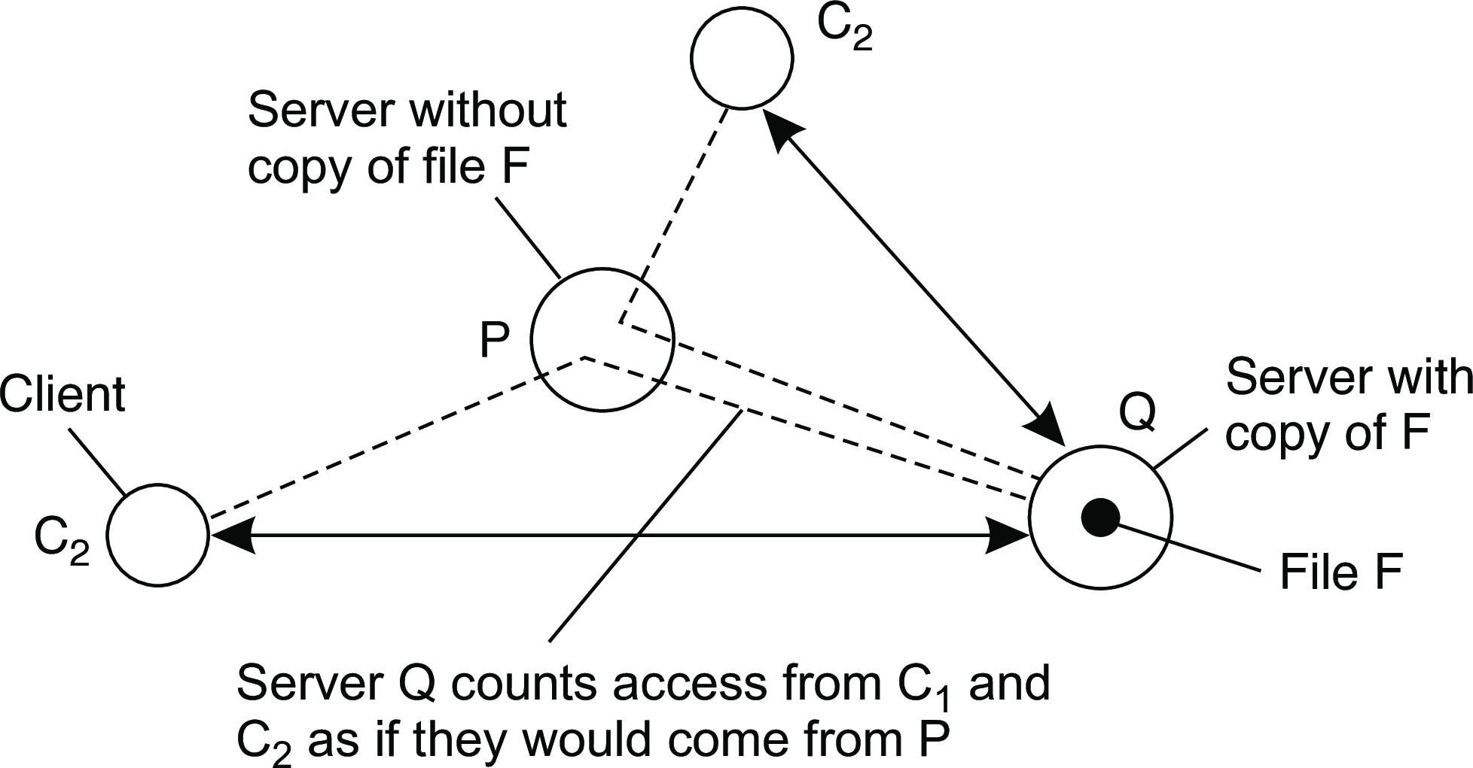
Consistency and replication
Replica management
Server-initiated replicas
Counting access requests from different clients
Keep track of access counts per file, aggregated by considering server closest to requesting clients
Number of accesses drops below threshold D ⇒ drop file
Number of accesses exceeds threshold R ⇒ replicate file
Number of access between D and R ⇒ migrate file
Content replication and placement

Slide 34
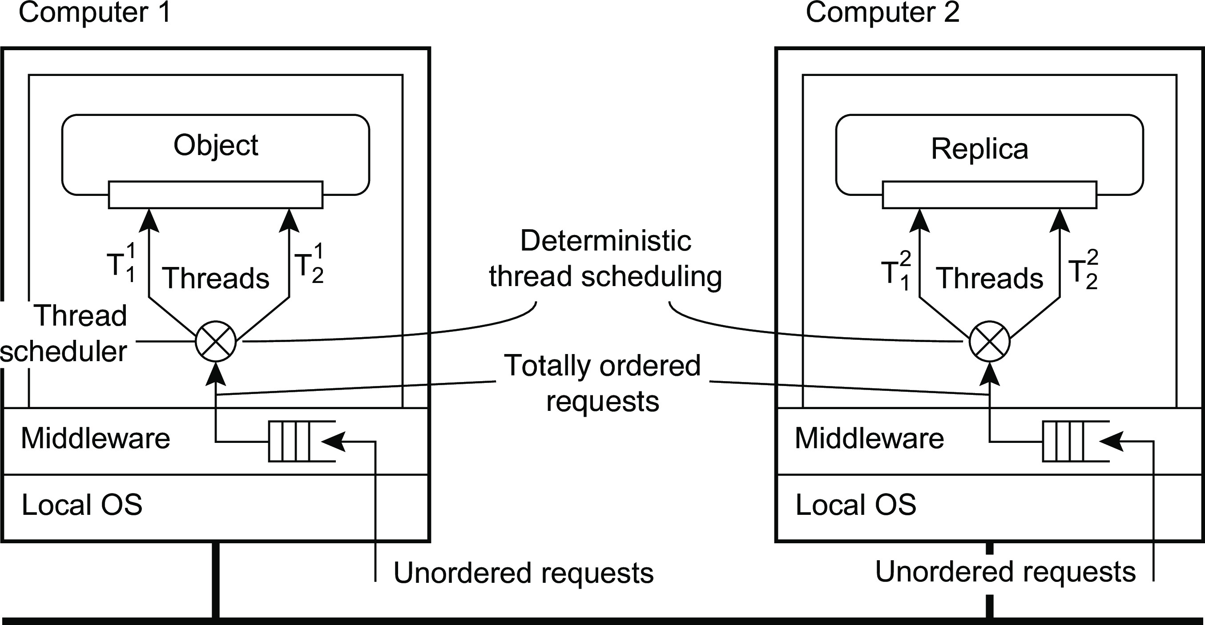
Managing replicated objects
Consistency and replication Replica management
Prevent concurrent execution of multiple invocations on the same object: access to the internal data of an object has to be serialized. Using local locking mechanisms are sufficient.
Ensure that all changes to the replicated state of the object are the same: no two independent method invocations take place on different replicas at the same time: we need deterministic thread scheduling.
Managing replicated objects

Slide 35
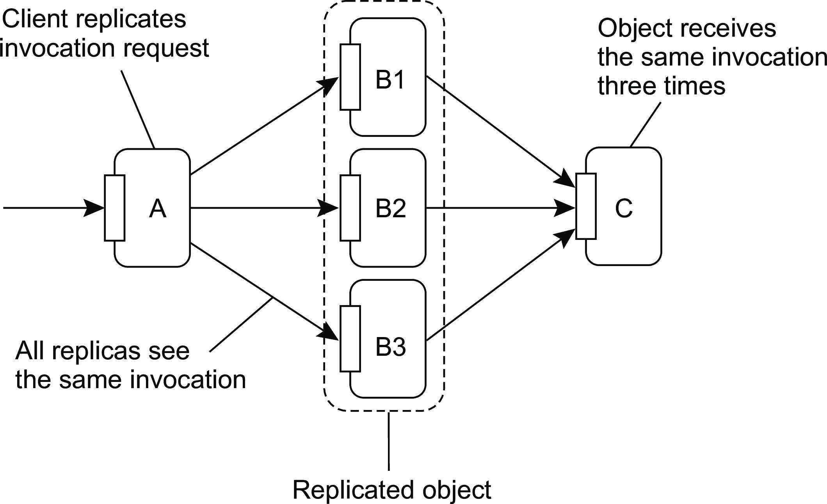
Consistency and replication
Replica management
Replicated-object invocations
Problem when invocating a replicated object
Managing replicated objects

Slide 36
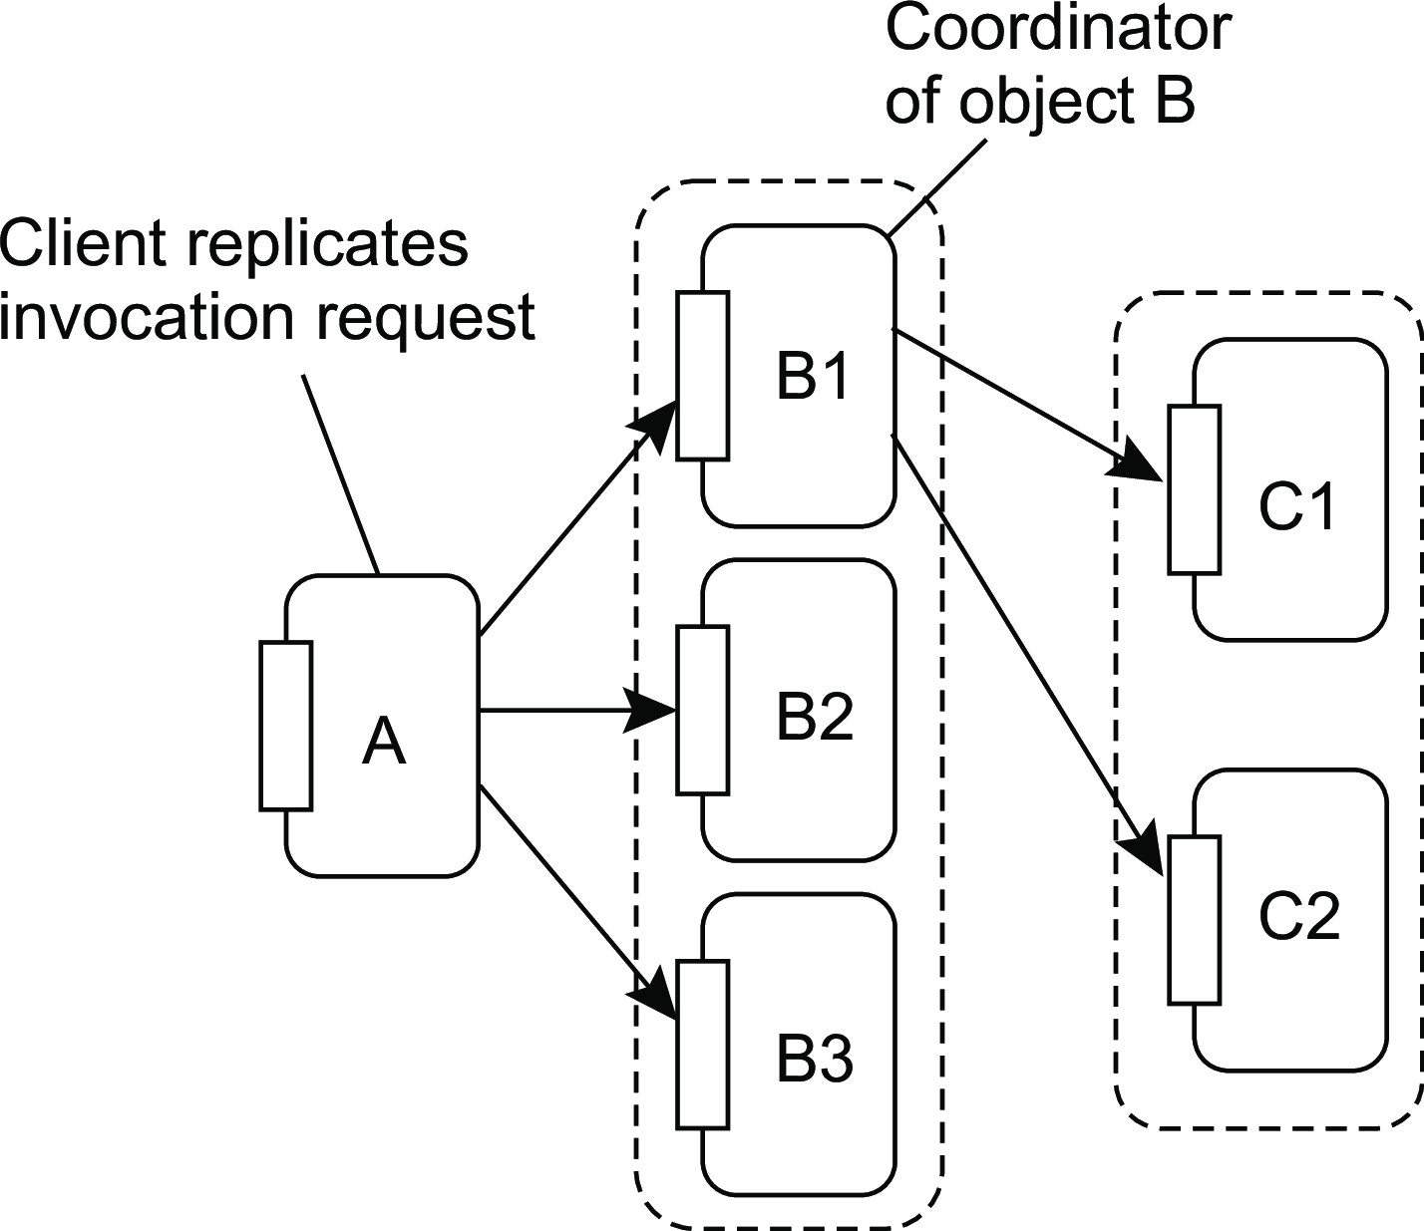
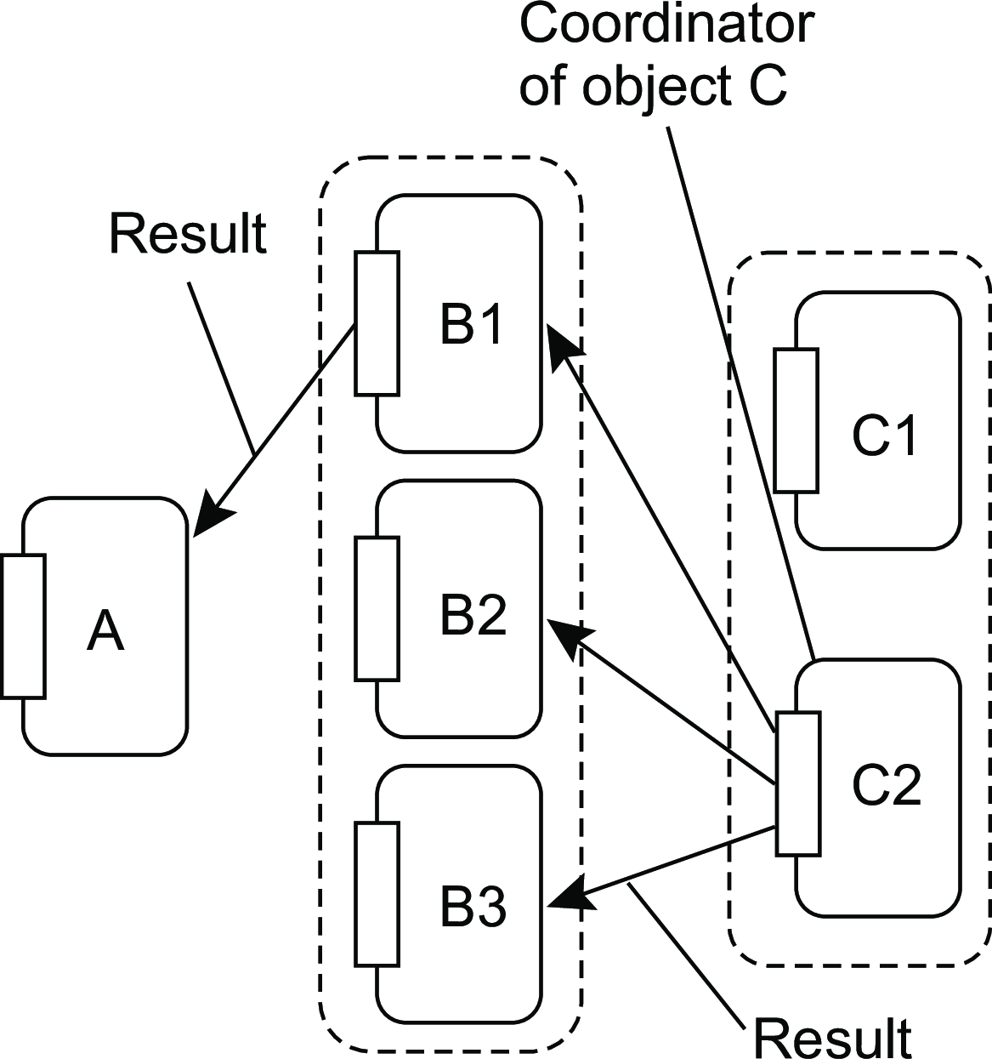
Consistency and replication
Replica management
Replicated-object invocations
Forwarding a request
Returning the reply
Managing replicated objects

