Slide 1
Distributed Systems
Module - I

Slide 2
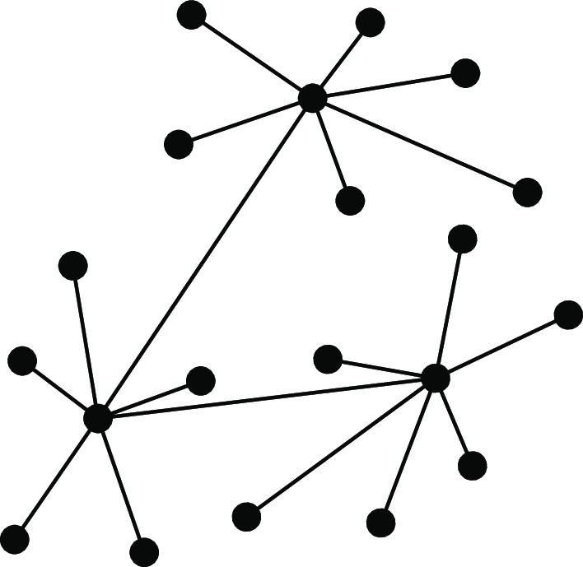
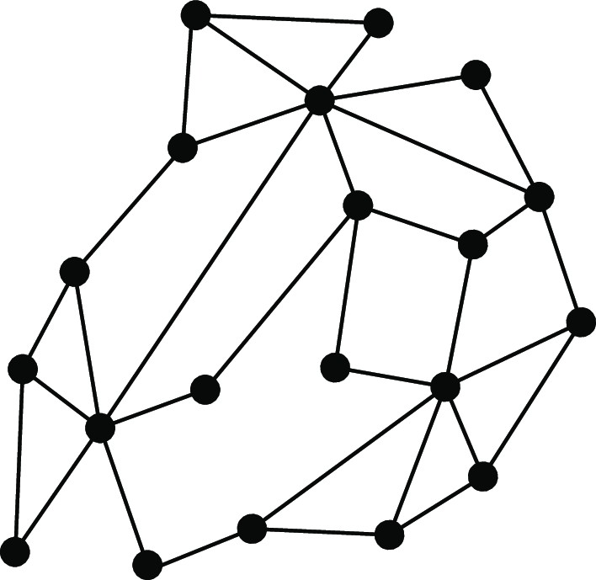
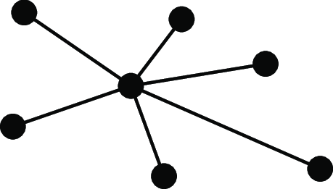
Introduction
From networked systems to distributed systems
Distributed versus Decentralized
What many people state
Centralized Decentralized Distributed
When does a decentralized system become distributed?
Adding 1 link between two nodes in a decentralized system?
Adding 2 links between two other nodes?
In general: adding k > 0 links....?
Distributed versus decentralized systems

Slide 3
Alternative approach
Introduction From networked systems to distributed systems
Two views on realizing distributed systems
Integrative view: connecting existing networked computer systems into a larger a system.
Expansive view: an existing networked computer systems is extended with additional computers
Distributed versus decentralized systems

Slide 4
Alternative approach
Introduction From networked systems to distributed systems
Two views on realizing distributed systems
Integrative view: connecting existing networked computer systems into a larger a system.
Expansive view: an existing networked computer systems is extended with additional computers
Two definitions
A decentralized system is a networked computer system in which processes and resources are necessarily spread across multiple computers.
A distributed system is a networked computer system in which processes and resources are sufficiently spread across multiple computers.
Distributed versus decentralized systems

Slide 5
Perspectives on distributed systems
Introduction From networked systems to distributed systems
Distributed systems are complex: take persepctives
Architecture: common organizations
Process: what kind of processes, and their relationships
Communication: facilities for exchanging data
Coordination: application-independent algorithms
Naming: how do you identify resources?
Consistency and replication: performance requires of data, which need to be the same
Fault tolerance: keep running in the presence of partial failures
Security: ensure authorized access to resources
Studying distributed systems

Slide 6
Introduction
Design goals
What do we want to achieve?
Overall design goals
Support sharing of resources
Distribution transparency
Openness
Scalability

Slide 7
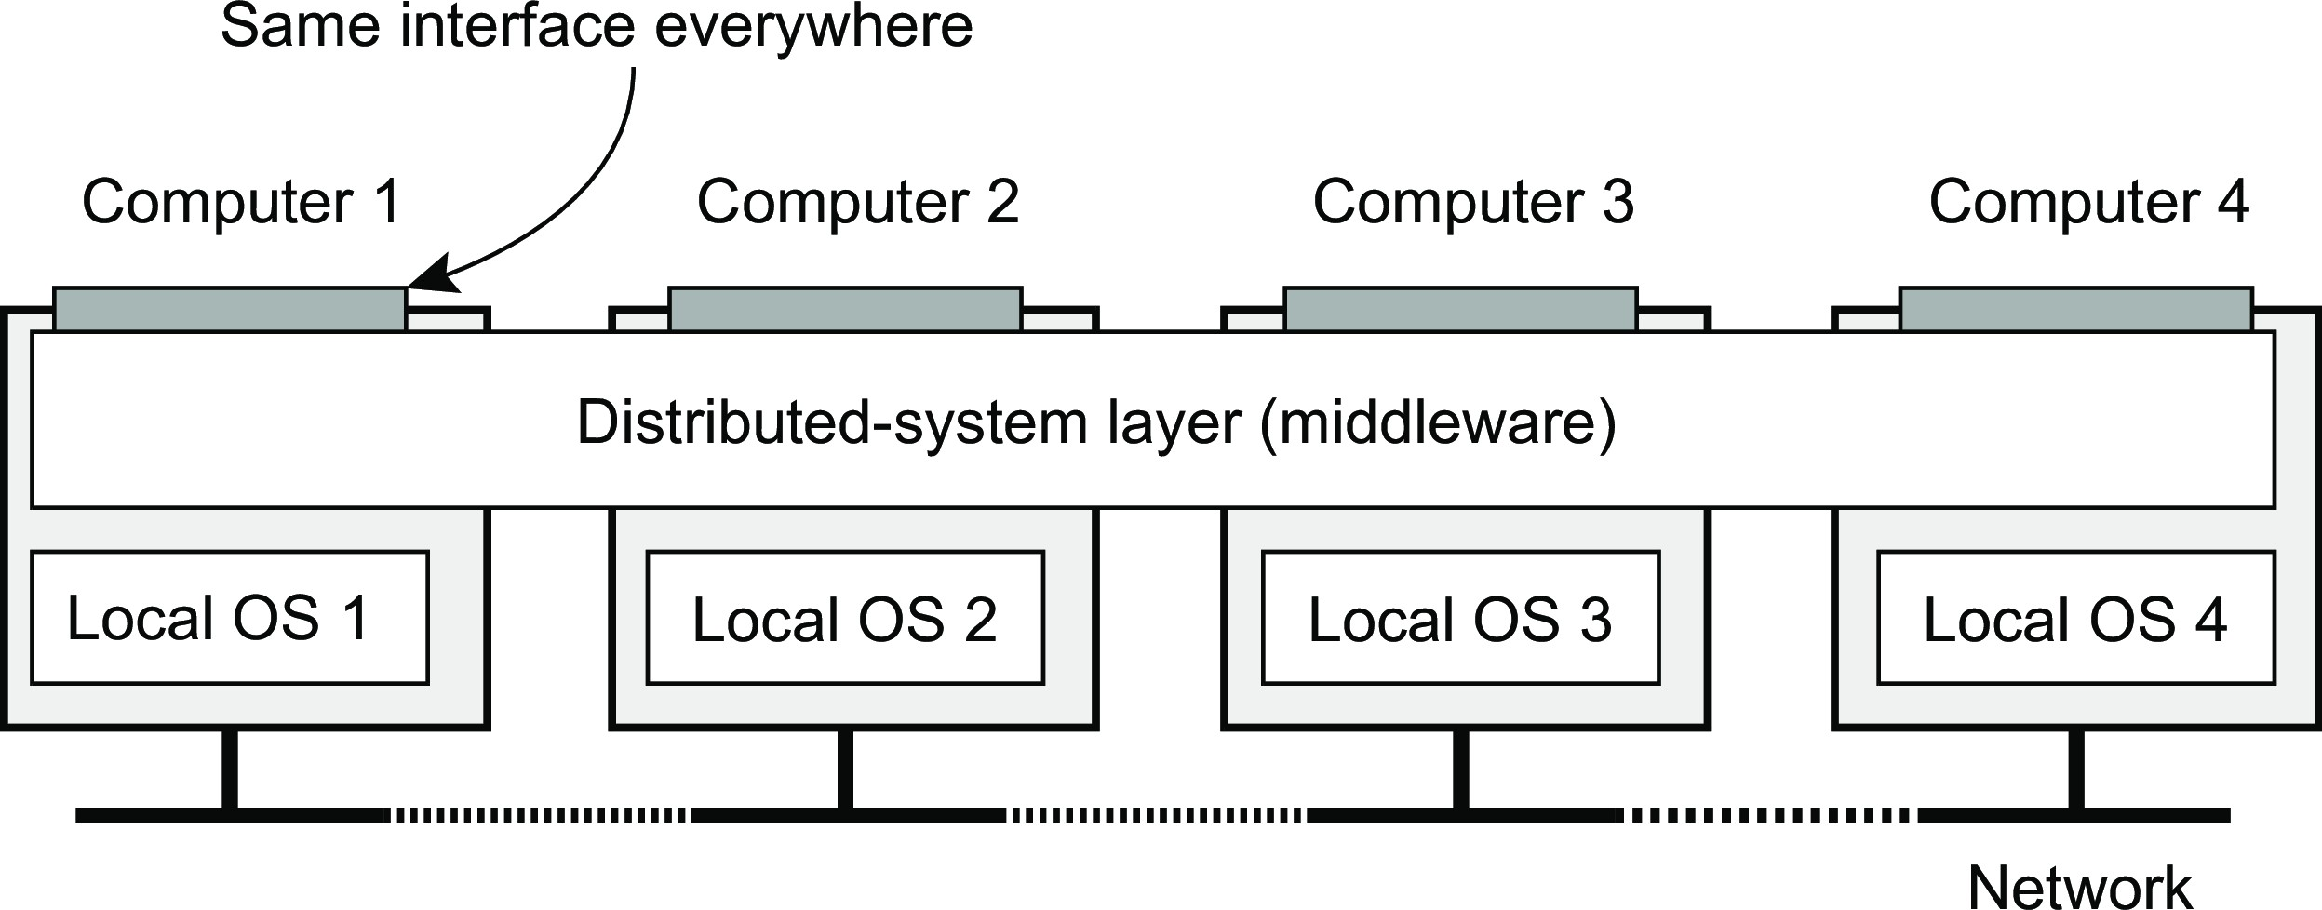
Introduction
Design goals
Distribution transparency
What is transparency?
The phenomenon by which a distributed system attempts to hide the fact that its processes and resources are physically distributed across multiple computers, possibly separated by large distances.
Observation
Distribution transparancy is handled through many different techniques in a layer between applications and operating systems: a middleware layer
Distribution transparency

Slide 8
Introduction
Design goals
Distribution transparency
Types
Transparency | Description
Access | Hide differences in data representation and how an object is accessed
Location | Hide where an object is located
Relocation | Hide that an object may be moved to another location while in use
Migration | Hide that an object may move to another location
Replication | Hide that an object is replicated
Concurrency | Hide that an object may be shared by several independent users
Failure | Hide the failure and recovery of an object
Distribution transparency

Slide 9
Openness of distributed systems
Introduction Design goals
Open distributed system
A system that offers components that can easily be used by, or integrated into other systems. An open distributed system itself will often consist of components that originate from elsewhere.
What are we talking about?
Be able to interact with services from other open systems, irrespective of the underlying environment:
Systems should conform to well-defined interfaces
Systems should easily interoperate
Systems should support portability of applications
Systems should be easily extensible
Openness

Slide 10
Introduction
Design goals
Dependability
Requirements related to dependability
Requirement | Description
Availability | Readiness for usage
Reliability | Continuity of service delivery
Safety | Very low probability of catastrophes
Maintainability | How easy can a failed system be repaired
Dependability

Slide 11
Reliability versus availability
Introduction Design goals
Reliability R(t ) of component C
Conditional probability that C has been functioning correctly during [0, t ) given
C was functioning correctly at the time T = 0.
Traditional metrics
Mean Time To Failure (MTTF): The average time until a component fails.
Mean Time To Repair (MTTR): The average time needed to repair a component.
Mean Time Between Failures (MTBF): Simply MTTF + MTTR.
Dependability

Slide 12
Introduction
Design goals
Terminology
Failure, error, fault
Term | Description | Example
Failure | A component is not living up to its specifications | Crashed program
Error | Part of a component that can lead to a failure | Programming bug
Fault | Cause of an error | Sloppy programmer
Dependability

Slide 13
Introduction
Design goals
Terminology
Handling faults
Term | Description | Example
Fault prevention | Prevent the occurrence of a fault | Don’t hire sloppy programmers
Fault tolerance | Build a component and make it mask the occurrence of a fault | Build each component by two independent programmers
Fault removal | Reduce the presence, number, or seriousness of a fault | Get rid of sloppy programmers
Fault forecasting | Estimate current presence, future incidence, and consequences of faults | Estimate how a recruiter is doing when it comes to hiring sloppy programmers
Dependability

Slide 14
Introduction
Design goals
Scale in distributed systems
Observation
Many developers of modern distributed systems easily use the adjective “scalable” without making clear why their system actually scales.
At least three components
Number of users or processes (size scalability)
Maximum distance between nodes (geographical scalability)
Number of administrative domains (administrative scalability)
Observation
Most systems account only, to a certain extent, for size scalability. Often a solution: multiple powerful servers operating independently in parallel. Today, the challenge still lies in geographical and administrative scalability.
Scalability

Slide 15
Size scalability
Introduction Design goals
Root causes for scalability problems with centralized solutions
The computational capacity, limited by the CPUs
The storage capacity, including the transfer rate between CPUs and disks
The network between the user and the centralized service
Scalability

Slide 16
Introduction
Design goals
Techniques for scaling
Hide communication latencies
Make use of asynchronous communication
Have separate handler for incoming response
Problem: not every application fits this model
Scalability

Slide 17
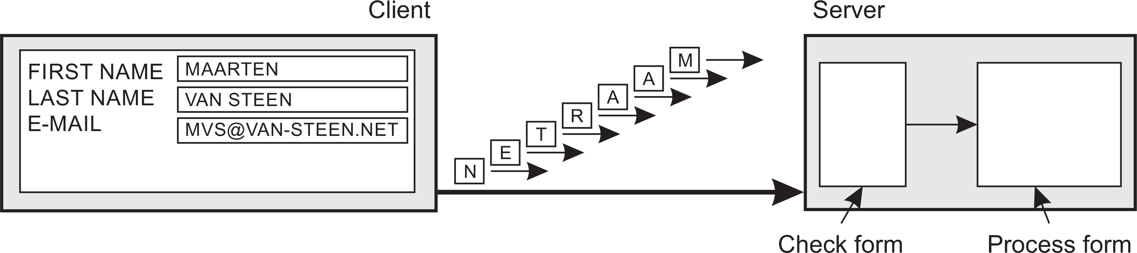
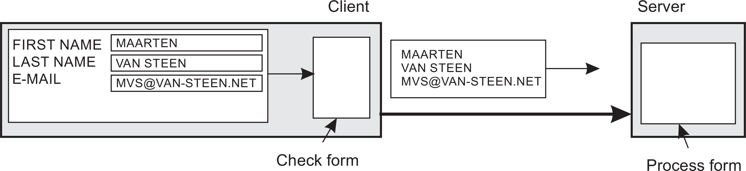
Introduction
Design goals
Techniques for scaling
Facilitate solution by moving computations to client
Scalability

Slide 18
Introduction
Design goals
Techniques for scaling
Partition data and computations across multiple machines
Move computations to clients (Java applets and scripts)
Decentralized naming services (DNS)
Decentralized information systems (WWW)
Scalability

Slide 19
Introduction
Design goals
Techniques for scaling
Replication and caching: Make copies of data available at different machines
Replicated file servers and databases
Mirrored Websites
Web caches (in browsers and proxies)
File caching (at server and client)
Scalability

Slide 20
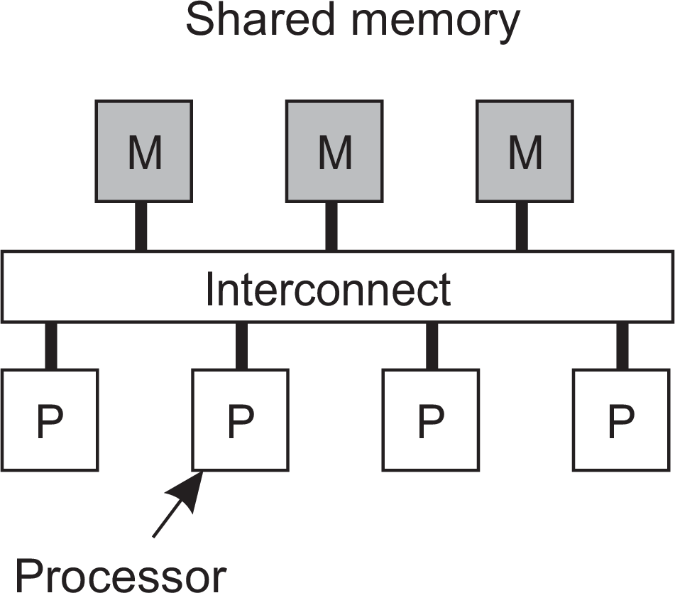
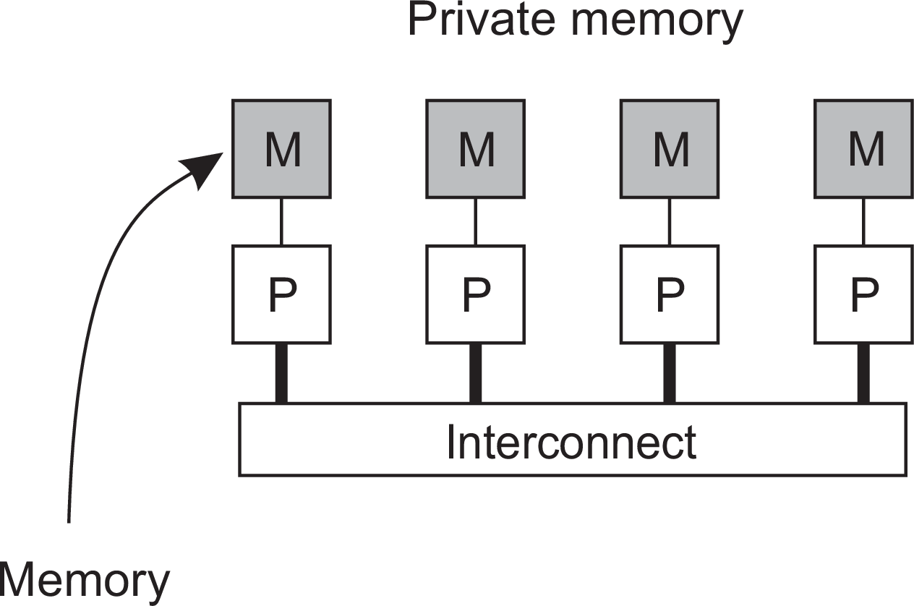
Parallel computing
Introduction A simple classification of distributed systems
Observation
High-performance distributed computing started with parallel computing
Multiprocessor and multicore versus multicomputer
High-performance distributed computing

Slide 21
Distributed shared memory systems
Introduction A simple classification of distributed systems
Observation
Multiprocessors are relatively easy to program in comparison to multicomputers, yet have problems when increasing the number of processors (or cores). Solution: Try to implement a shared-memory model on top of a multicomputer.
Example through virtual-memory techniques
Map all main-memory pages (from different processors) into one single virtual address space. If a process at processor A addresses a page P located at processor B, the OS at A traps and fetches P from B, just as it would if P had been located on local disk.
Problem
Performance of distributed shared memory could never compete with that of multiprocessors, and failed to meet the expectations of programmers. It has been widely abandoned by now.
High-performance distributed computing

Slide 22
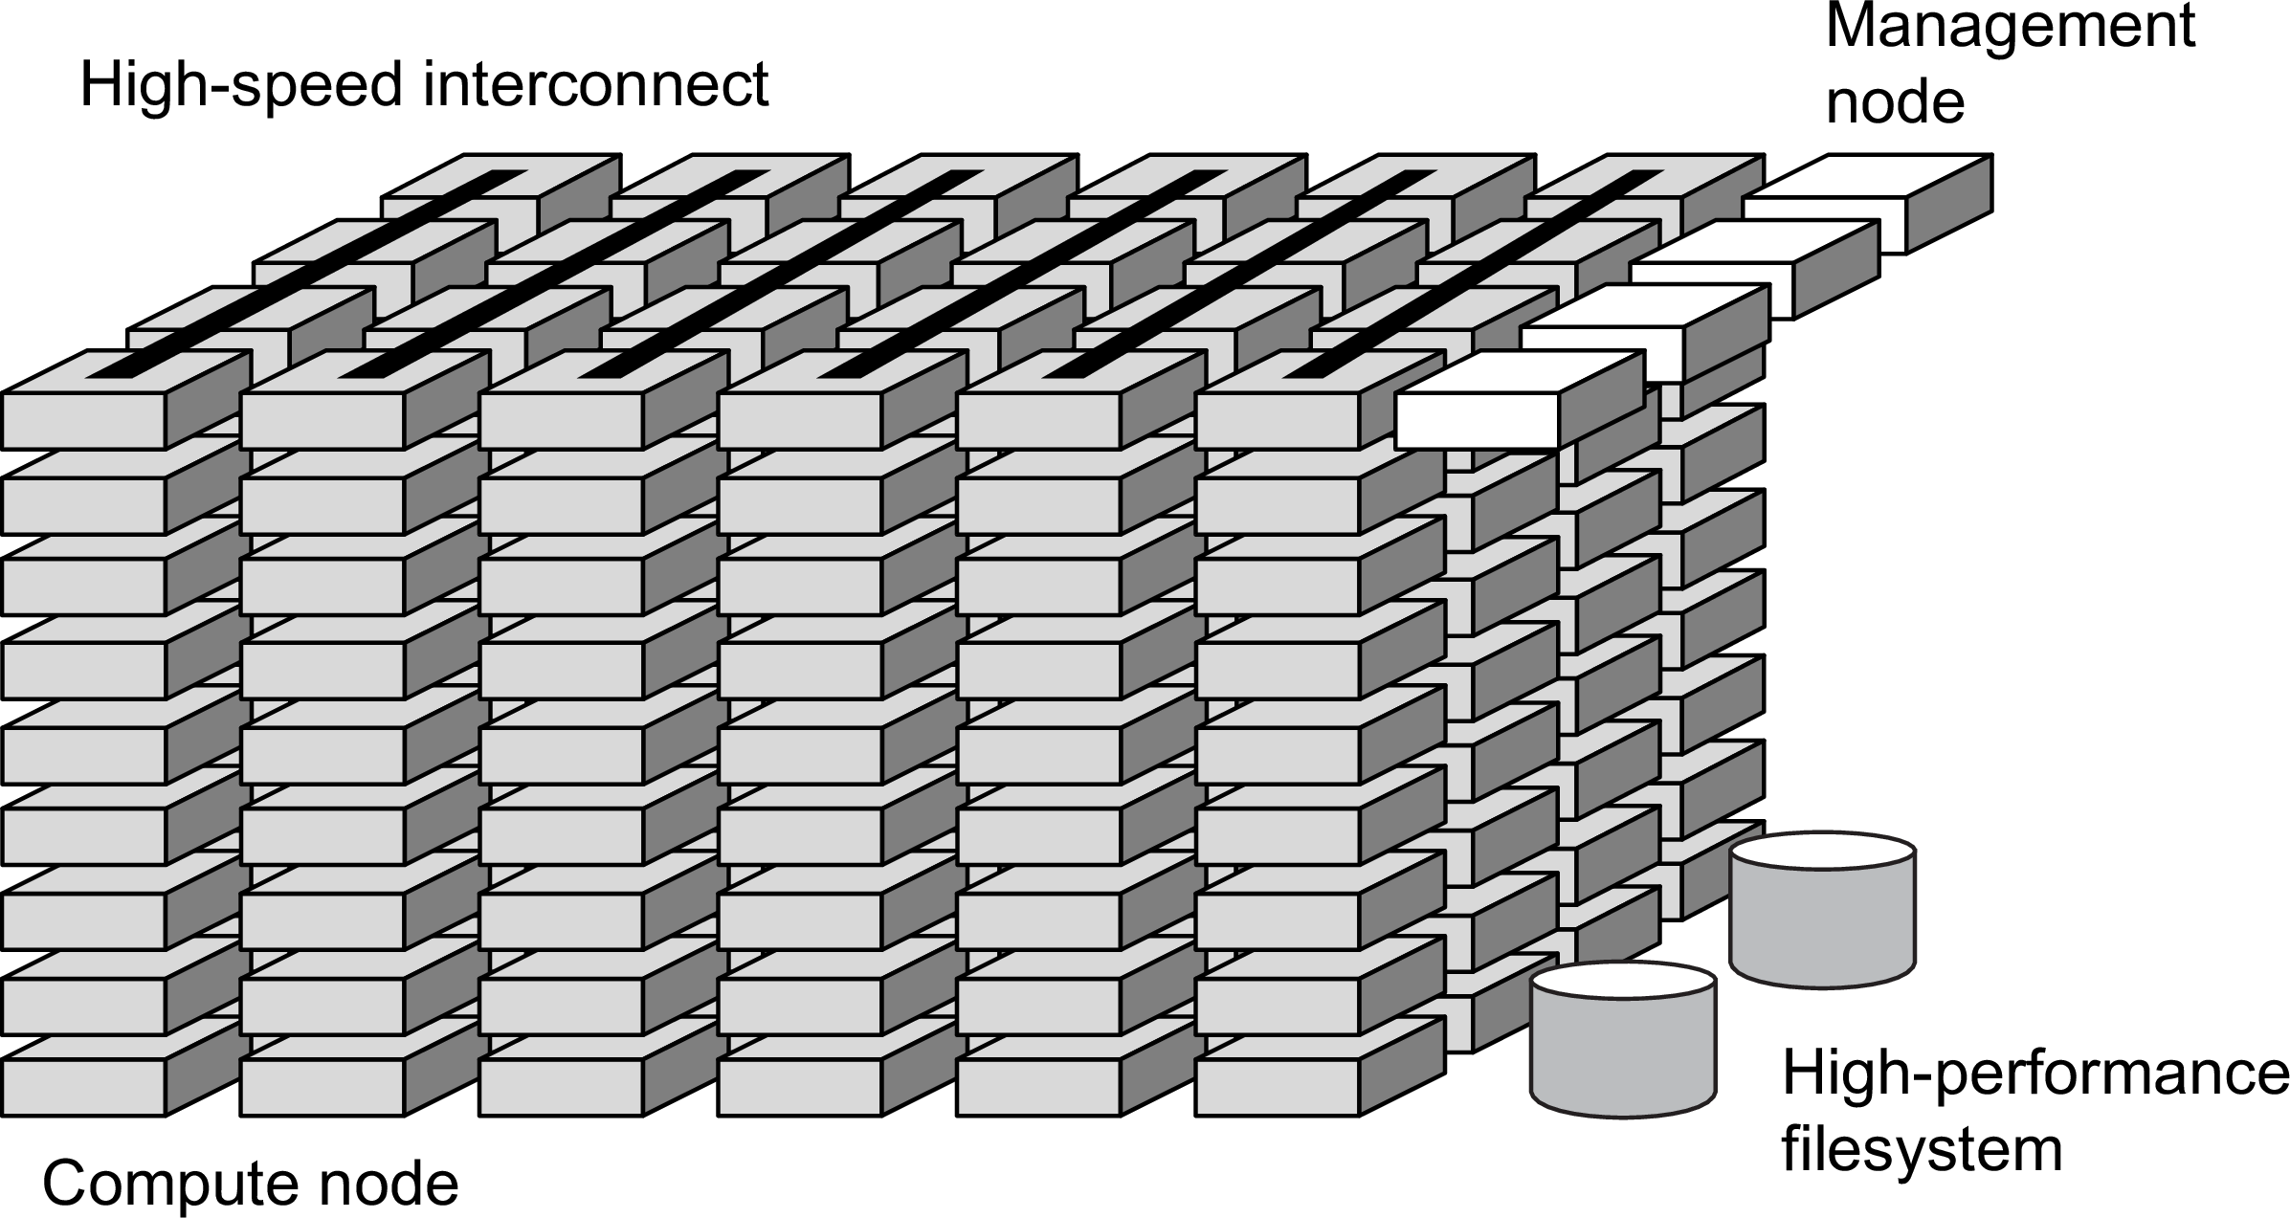
Cluster computing
Introduction A simple classification of distributed systems
Essentially a group of high-end systems connected through a LAN
Homogeneous: same OS, near-identical hardware
Single, or tightly coupled managing node(s)
High-performance distributed computing

Slide 23
Introduction
A simple classification of distributed systems
Grid computing
The next step: plenty of nodes from everywhere
Heterogeneous
Dispersed across several organizations
Can easily span a wide-area network
Note
To allow for collaborations, grids generally use virtual organizations. In essence, this is a grouping of users (or better: their IDs) that allows for authorization on resource allocation.
High-performance distributed computing

Slide 24
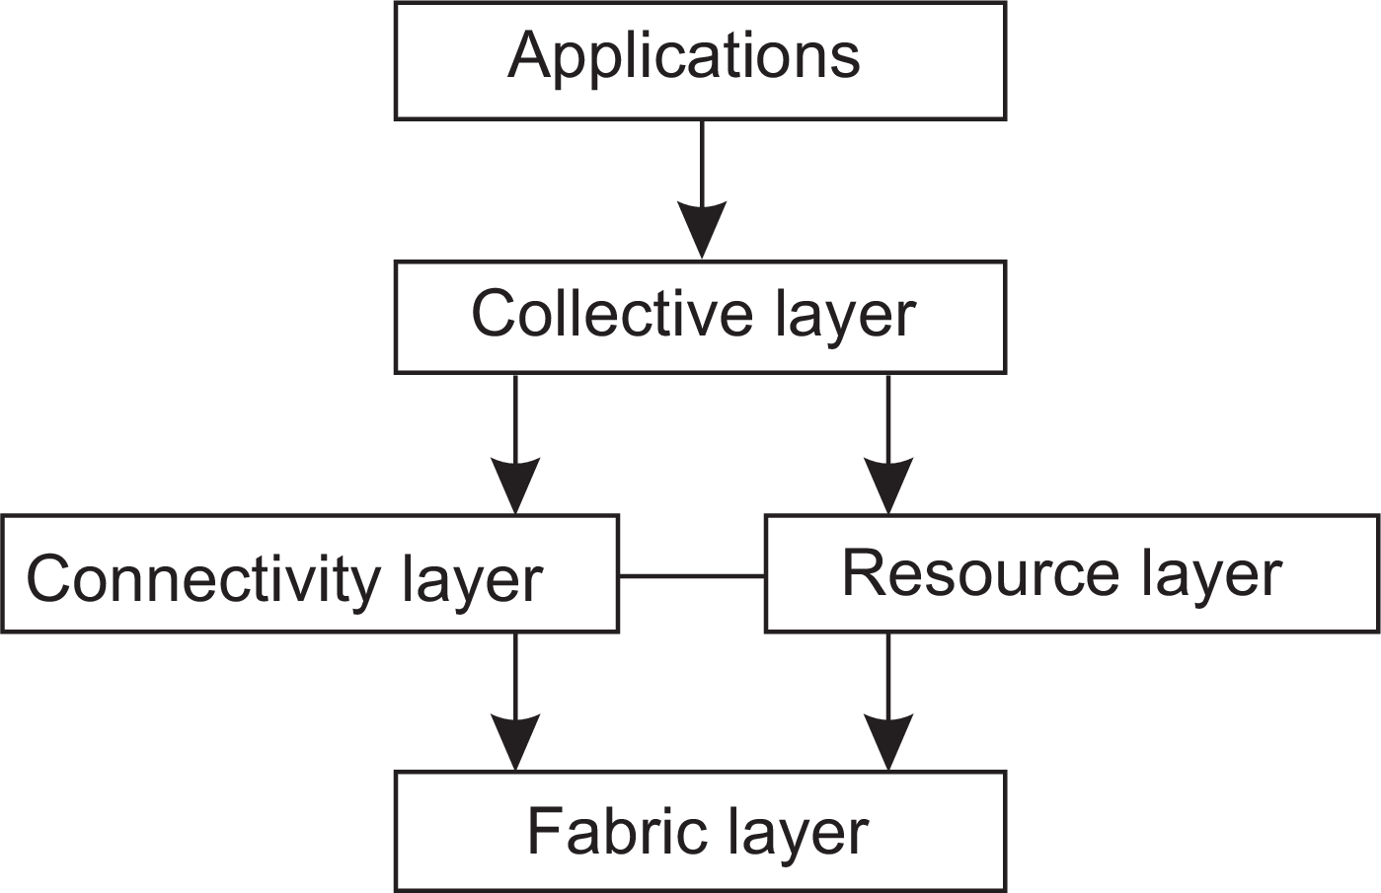
Architecture for grid computing
Introduction A simple classification of distributed systems
The layers
Fabric: Provides interfaces to local resources (for querying state and capabilities, locking, etc.)
Connectivity: Communication/transaction protocols, e.g., for moving data between resources. Also various authentication protocols.
Resource: Manages a single resource, such as creating processes or reading data.
Collective: Handles access to multiple resources: discovery, scheduling, replication.
Application: Contains actual grid applications in a single organization.
High-performance distributed computing

Slide 25
Integrating applications
Introduction A simple classification of distributed systems
Situation
Organizations confronted with many networked applications, but achieving interoperability was painful.
Basic approach
A networked application is one that runs on a server making its services available to remote clients. Simple integration: clients combine requests for (different) applications; send that off; collect responses, and present a coherent result to the user.
Next step
Allow direct application-to-application communication, leading to Enterprise Application Integration.
Distributed information systems

Slide 26
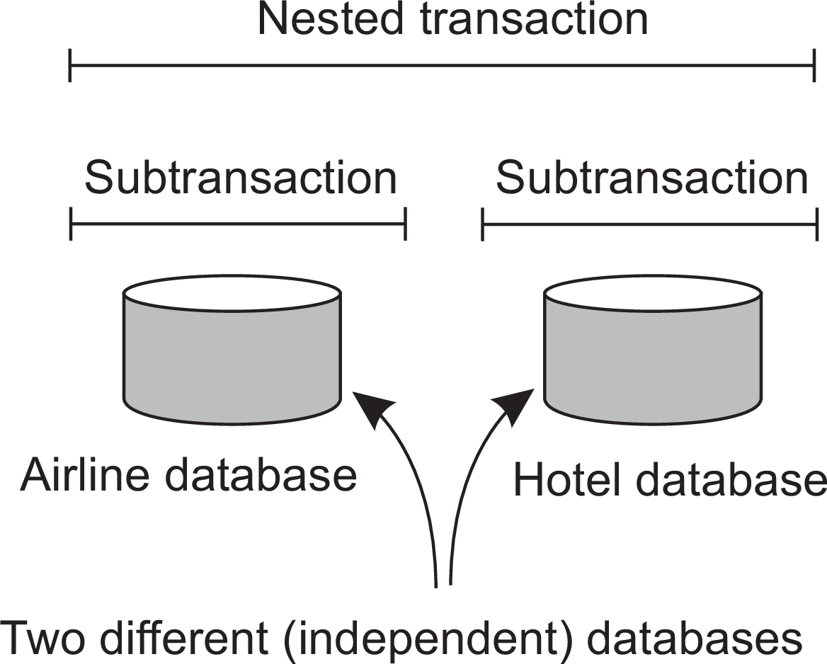
Introduction
A simple classification of distributed systems
Example EAI: (nested) transactions
Transaction
Primitive | Description
BEGIN TRANSACTION | Mark the start of a transaction
END TRANSACTION | Terminate the transaction and try to commit
ABORT TRANSACTION | Kill the transaction and restore the old values
READ | Read data from a file, a table, or otherwise
WRITE | Write data to a file, a table, or otherwise
Issue: all-or-nothing
Atomic: happens indivisibly (seemingly)
Consistent: does not violate system invariants
Isolated: not mutual interference
Durable: commit means changes are permanent
Distributed information systems

Slide 27
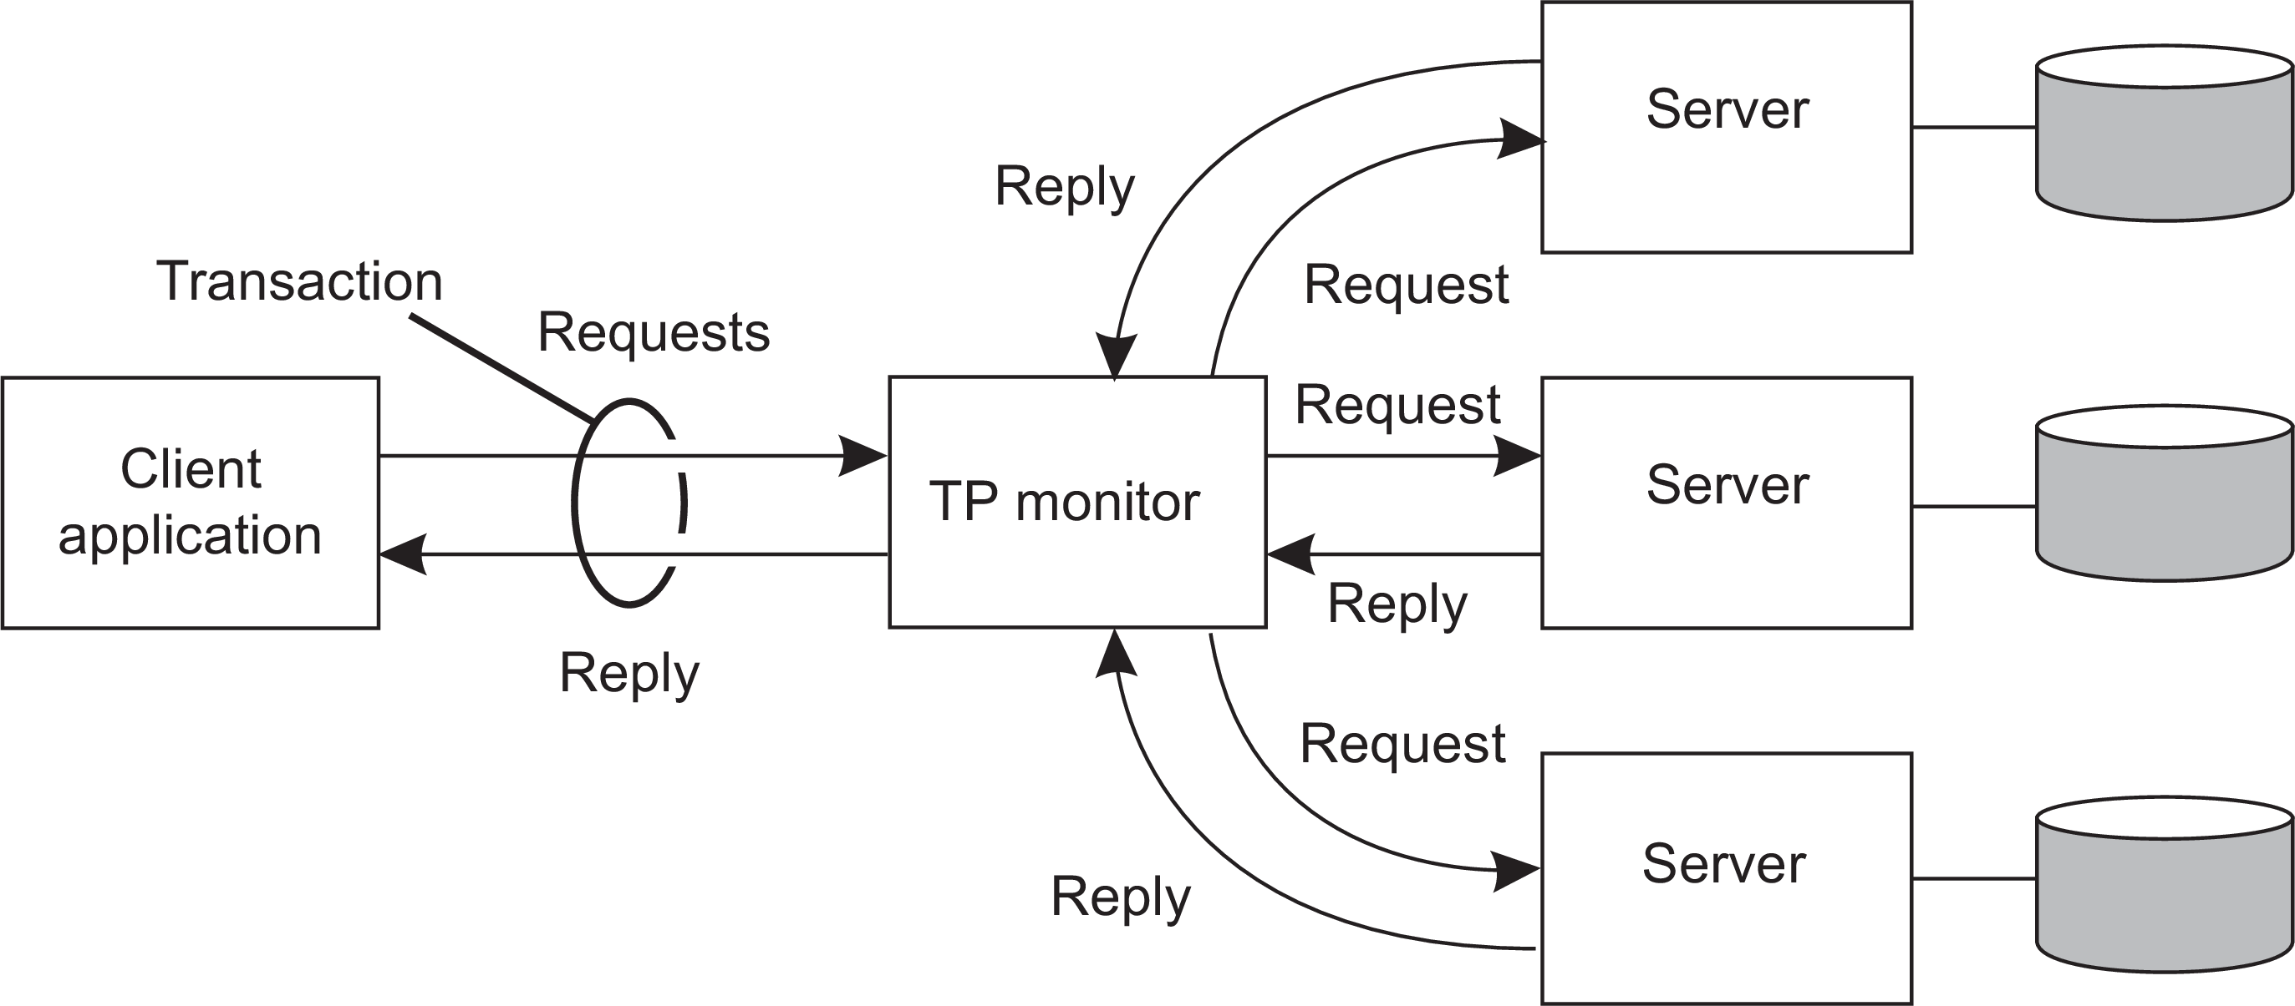
Introduction
A simple classification of distributed systems
TPM: Transaction Processing Monitor
Observation
Often, the data involved in a transaction is distributed across several servers. A TP Monitor is responsible for coordinating the execution of a transaction.
Distributed information systems

Slide 28
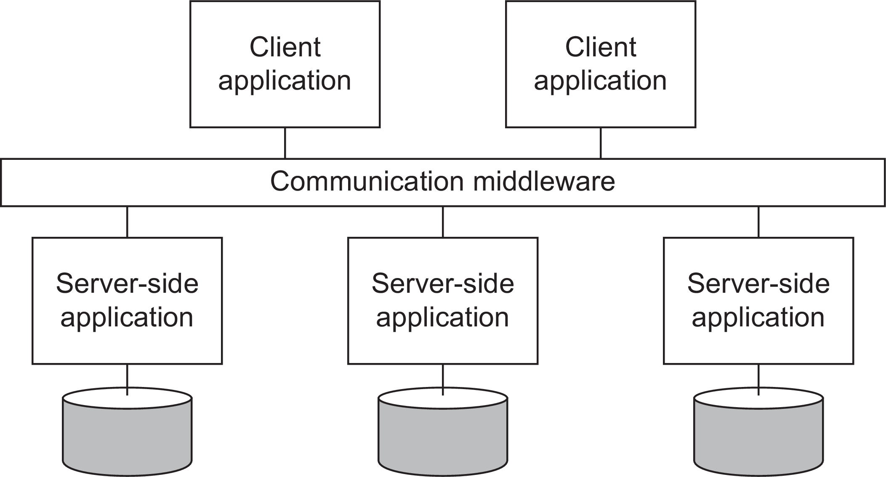
Introduction
A simple classification of distributed systems
Middleware and EAI
Middleware offers communication facilities for integration
Remote Procedure Call (RPC): Requests are sent through local procedure call, packaged as message, processed, responded through message, and result returned as return from call.
Message Oriented Middleware (MOM): Messages are sent to logical contact point (published), and forwarded to subscribed applications.
Distributed information systems

Slide 29
Ubiquitous systems
Introduction A simple classification of distributed systems
Core elements
(Distribution) Devices are networked, distributed, and accessible transparently
(Interaction) Interaction between users and devices is highly unobtrusive
(Context awareness) The system is aware of a user’s context to optimize interaction
(Autonomy) Devices operate autonomously without human intervention, and are thus highly self-managed
(Intelligence) The system as a whole can handle a wide range of dynamic actions and interactions
Pervasive systems

Slide 30
Mobile computing
Introduction A simple classification of distributed systems
Distinctive features
A myriad of different mobile devices (smartphones, tablets, GPS devices, remote controls, active badges).
Mobile implies that a device’s location is expected to change over time ⇒
change of local services, reachability, etc. Keyword: discovery.
Maintaining stable communication can introduce serious problems.
For a long time, research has focused on directly sharing resources between mobile devices. It never became popular and is by now considered to be a fruitless path for research.
Pervasive systems

Slide 31
Mobile computing
Introduction A simple classification of distributed systems
Distinctive features
A myriad of different mobile devices (smartphones, tablets, GPS devices, remote controls, active badges).
Mobile implies that a device’s location is expected to change over time ⇒
change of local services, reachability, etc. Keyword: discovery.
Maintaining stable communication can introduce serious problems.
For a long time, research has focused on directly sharing resources between mobile devices. It never became popular and is by now considered to be a fruitless path for research.
Bottomline
Mobile devices set up connections to stationary servers, essentially bringing mobile computing in the position of clients of cloud-based services.
Pervasive systems

Slide 32
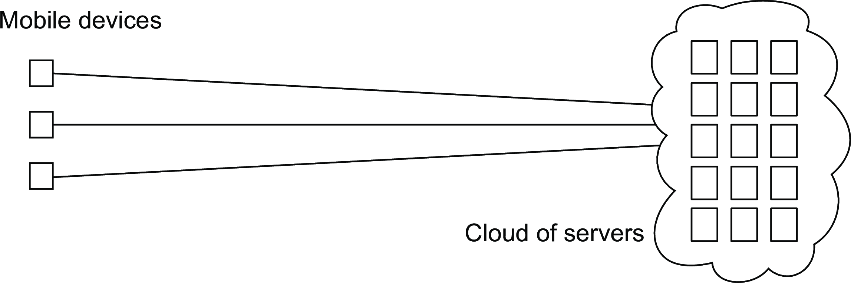
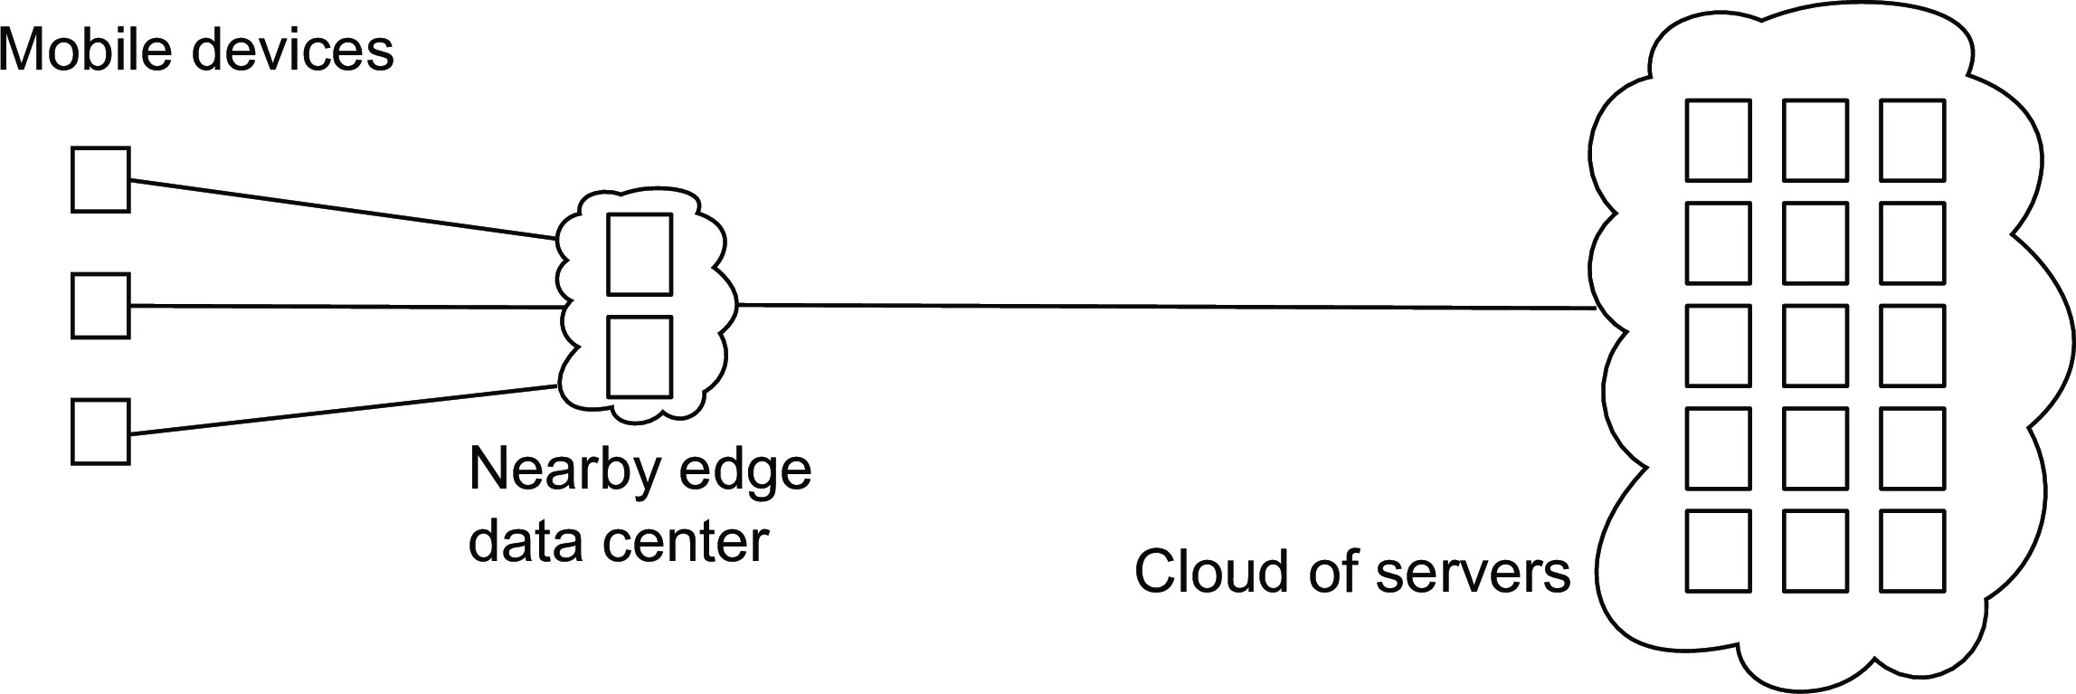
Introduction
A simple classification of distributed systems
Mobile computing
Mobile cloud computing
Mobile edge computing
Pervasive systems

Slide 33
Sensor networks
Introduction A simple classification of distributed systems
Characteristics
The nodes to which sensors are attached are:
Many (10s-1000s)
Simple (small memory/compute/communication capacity)
Often battery-powered (or even battery-less)
Pervasive systems

Slide 34
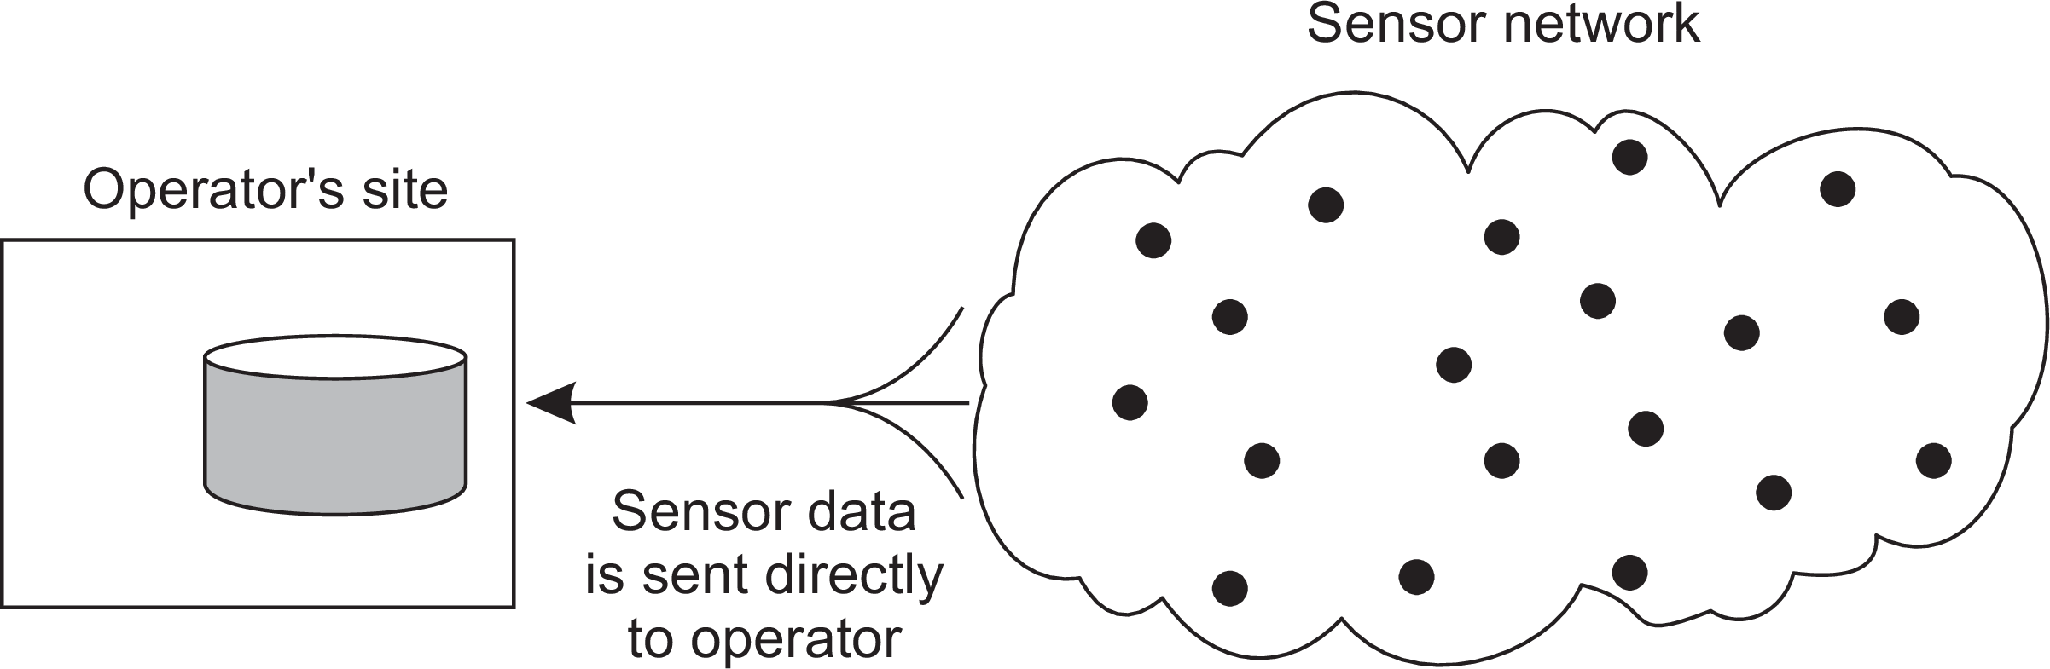
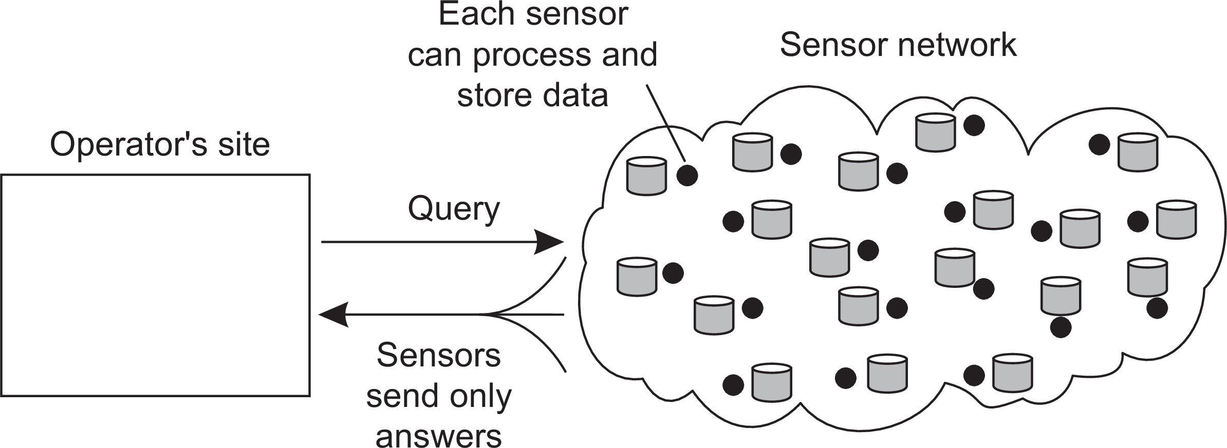
Introduction
A simple classification of distributed systems
Sensor networks as distributed databases
Two extremes
Pervasive systems

Slide 35
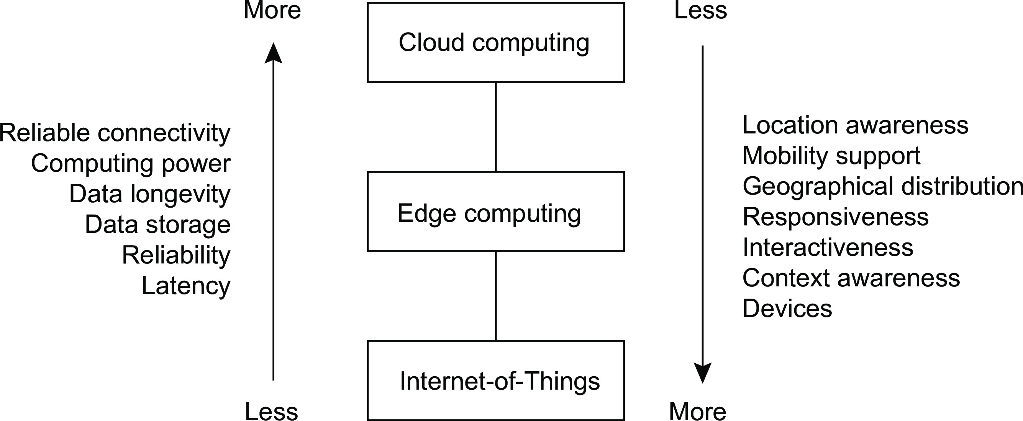
Introduction
A simple classification of distributed systems
The cloud-edge continuum
Pervasive systems

Slide 36
Architectures
Architectural styles
Architectural styles
Basic idea
A style is formulated in terms of
(replaceable) components with well-defined interfaces
the way that components are connected to each other
the data exchanged between components
how these components and connectors are jointly configured into a system.
Connector
A mechanism that mediates communication, coordination, or cooperation among components. Example: facilities for (remote) procedure call, messaging, or streaming.

Slide 37
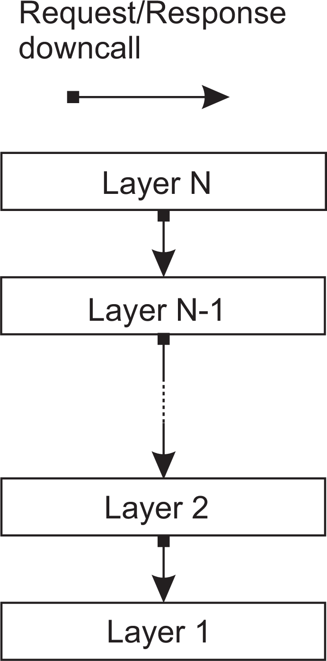
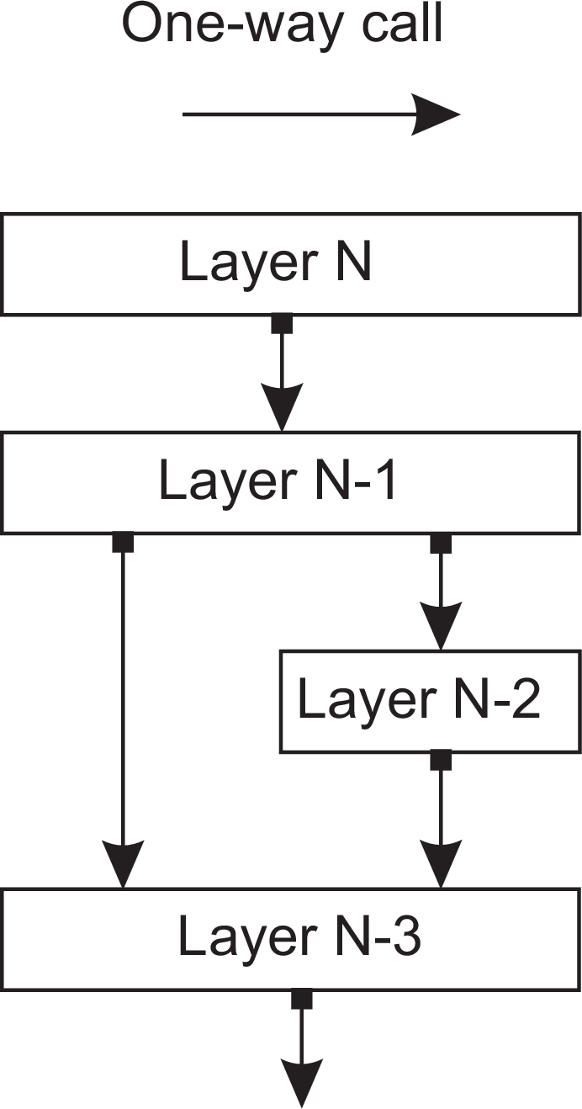
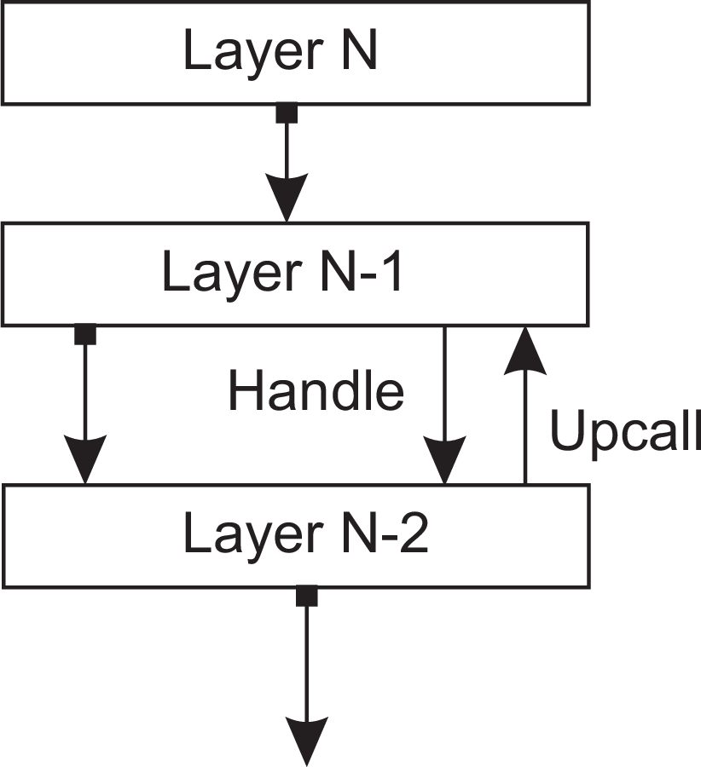
Architectures
Architectural styles
Layered architecture
Different layered organizations
(a)
(b)
(c)
Layered architectures

Slide 38
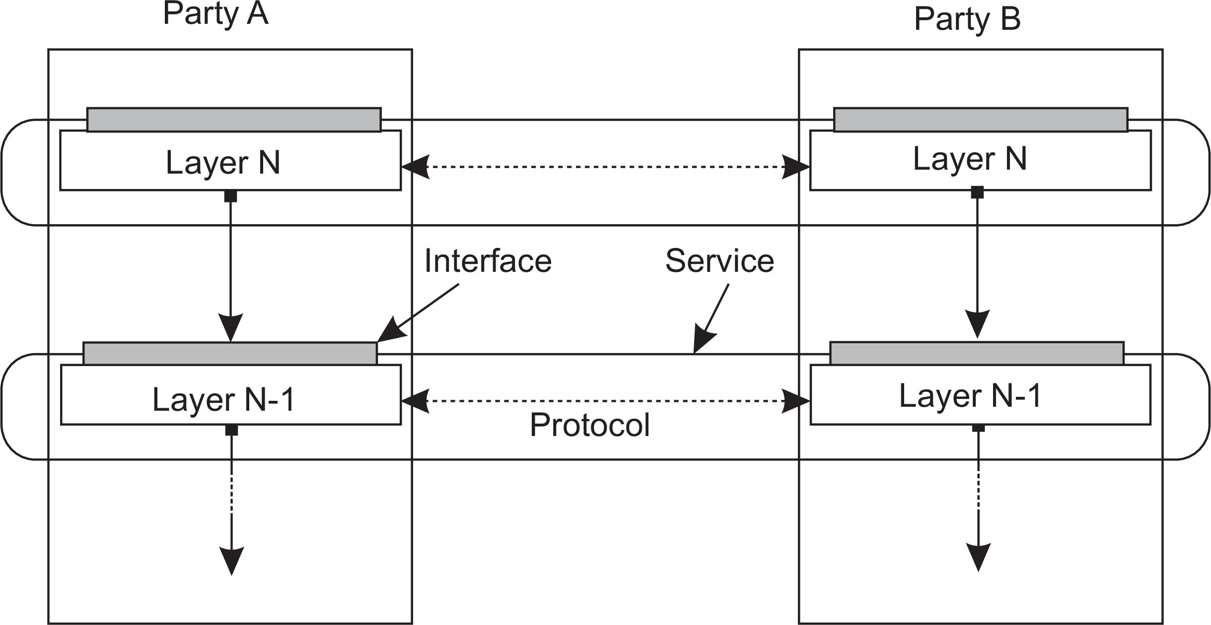
Architectures
Architectural styles
Example: communication protocols
Protocol, service, interface
Layered architectures

Slide 39
Architectures
Architectural styles
Two-party communication
Server
1 from socket import *
2
3 s = socket(AF_INET, SOCK_STREAM)
4 (conn, addr) = s.accept() # returns new socket and addr. client
5 while True: # forever
6
7
8
9
data = conn.recv(1024) # receive data from client
if not data: break # stop if client stopped
msg = data.decode()+"*" # process the incoming data into a response
conn.send(msg.encode()) # return the response
10 conn.close() # close the connection
Client
1 from socket import *
2
3 s = socket(AF_INET, SOCK_STREAM)
4 s.connect((HOST, PORT)) # connect to server (block until accepted)
5 msg = "Hello World" # compose a message
6 s.send(msg.encode()) # send the message
7 data = s.recv(1024) # receive the response
8 print(data.decode()) # print the result
9 s.close() # close the connection
Layered architectures

Slide 40
Application Layering
Architectures Architectural styles
Traditional three-layered view
Application-interface layer contains units for interfacing to users or external applications
Processing layer contains the functions of an application, i.e., without specific data
Data layer contains the data that a client wants to manipulate through the application components
Layered architectures

Slide 41
Application Layering
Architectures Architectural styles
Traditional three-layered view
Application-interface layer contains units for interfacing to users or external applications
Processing layer contains the functions of an application, i.e., without specific data
Data layer contains the data that a client wants to manipulate through the application components
Observation
This layering is found in many distributed information systems, using traditional database technology and accompanying applications.
Layered architectures

Slide 42
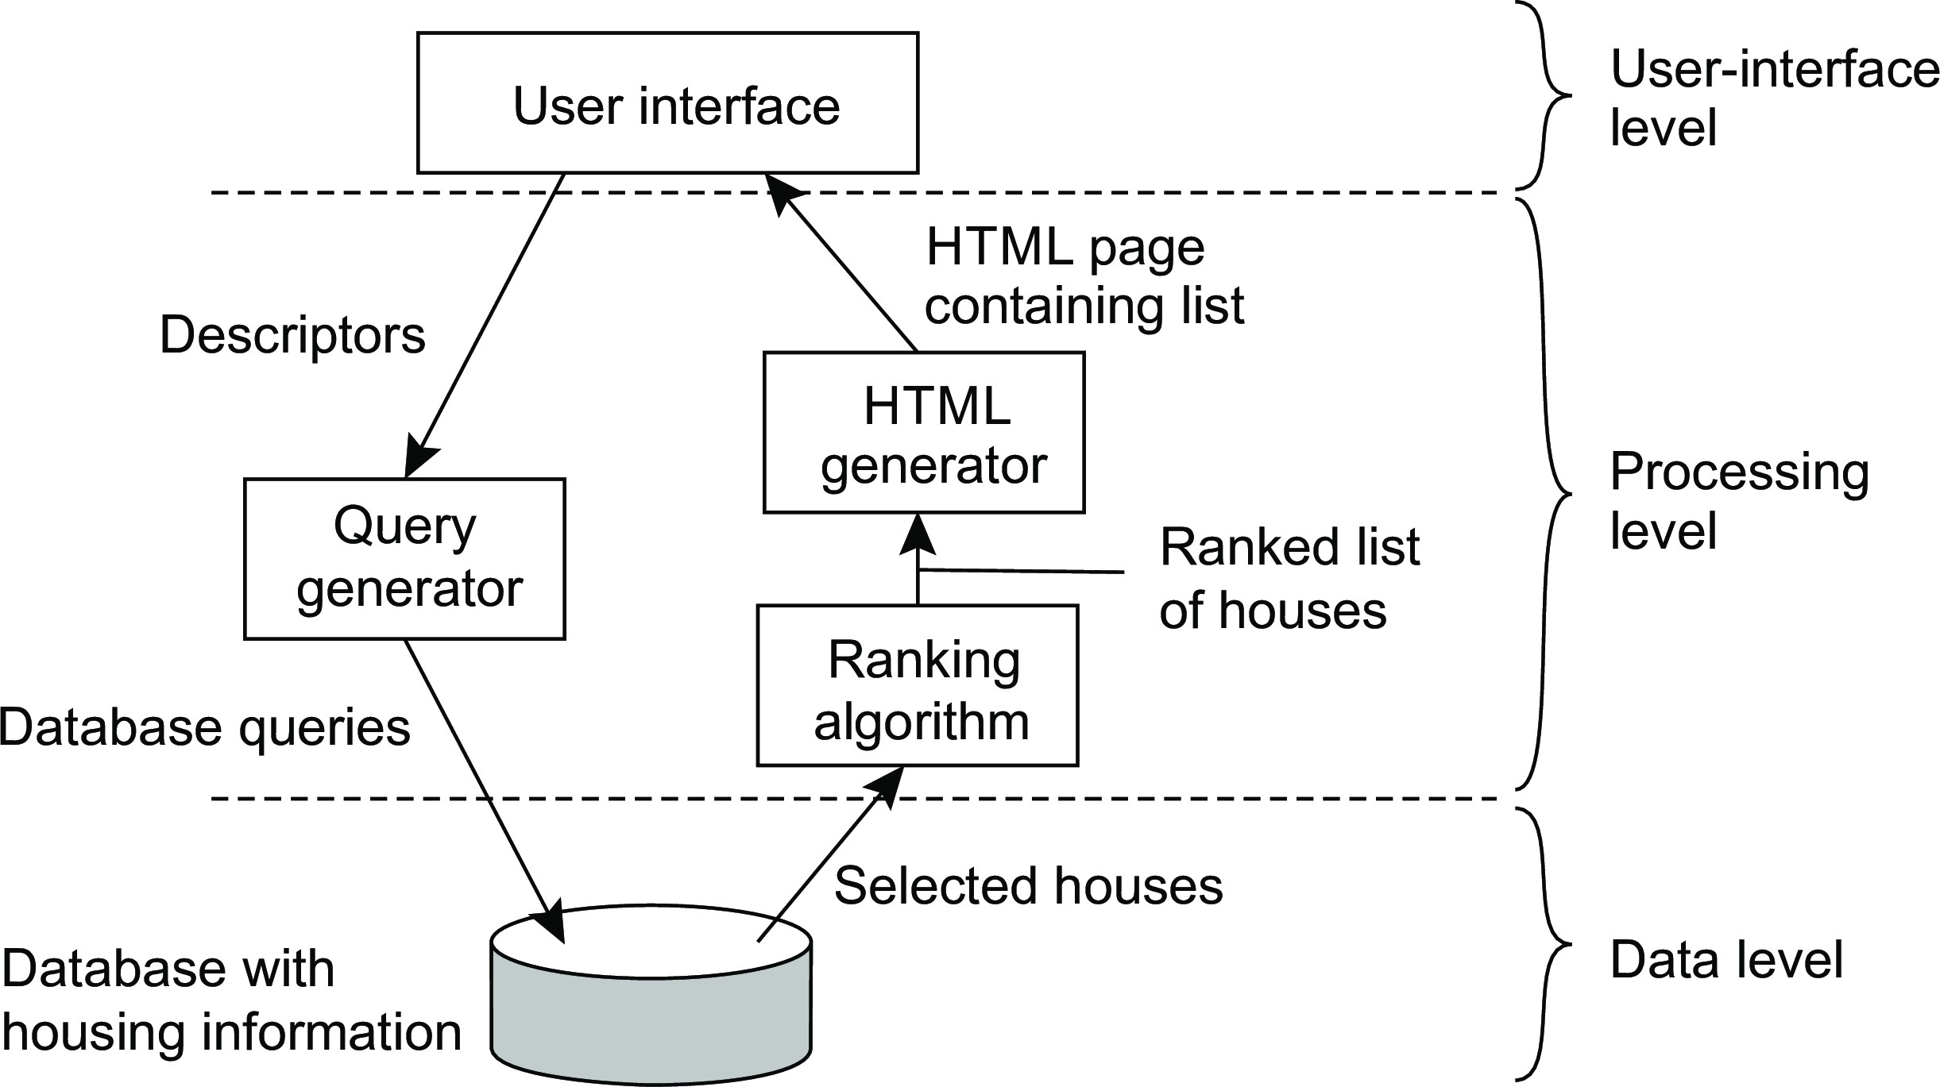
Architectures
Architectural styles
Application Layering
Example: a simple search engine
Layered architectures

Slide 43
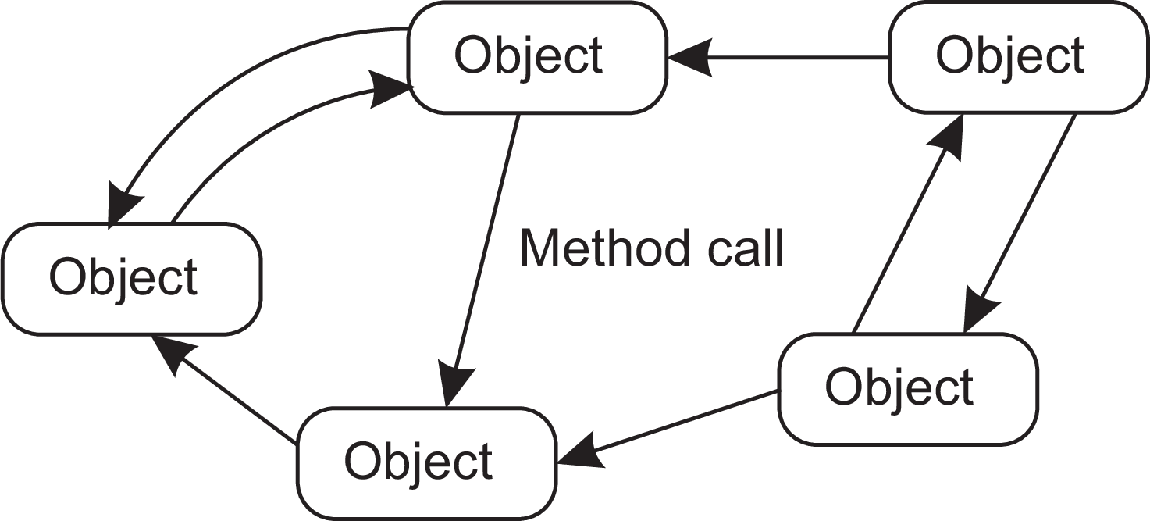
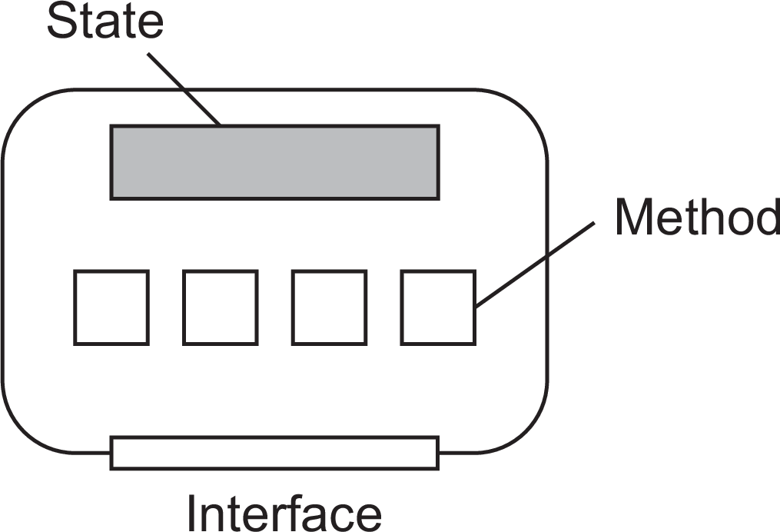
Object-based style
Architectures Architectural styles
Essence
Components are objects, connected to each other through procedure calls. Objects may be placed on different machines; calls can thus execute across a network.
Encapsulation
Objects are said to encapsulate data and offer methods on that data without revealing the internal implementation.
Service-oriented architectures

Slide 44
RESTful architectures
Architectures Architectural styles
Essence
View a distributed system as a collection of resources, individually managed by components. Resources may be added, removed, retrieved, and modified by (remote) applications.
Resources are identified through a single naming scheme
All services offer the same interface
Messages sent to or from a service are fully self-described
After executing an operation at a service, that component forgets everything about the caller
Basic operations
Operation | Description
PUT | Create a new resource
GET | Retrieve the state of a resource in some representation
DELETE | Delete a resource
POST | Modify a resource by transferring a new state
Service-oriented architectures

Slide 45
Example: Amazon’s Simple Storage Service
Architectures Architectural styles
Essence
Objects (i.e., files) are placed into buckets (i.e., directories). Buckets cannot be placed into buckets. Operations on ObjectName in bucket BucketName require the following identifier:
http://BucketName.s3.amazonaws.com/ObjectName
Typical operations
All operations are carried out by sending HTTP requests:
Create a bucket/object: PUT, along with the URI
Listing objects: GET on a bucket name
Reading an object: GET on a full URI
Service-oriented architectures

Slide 46
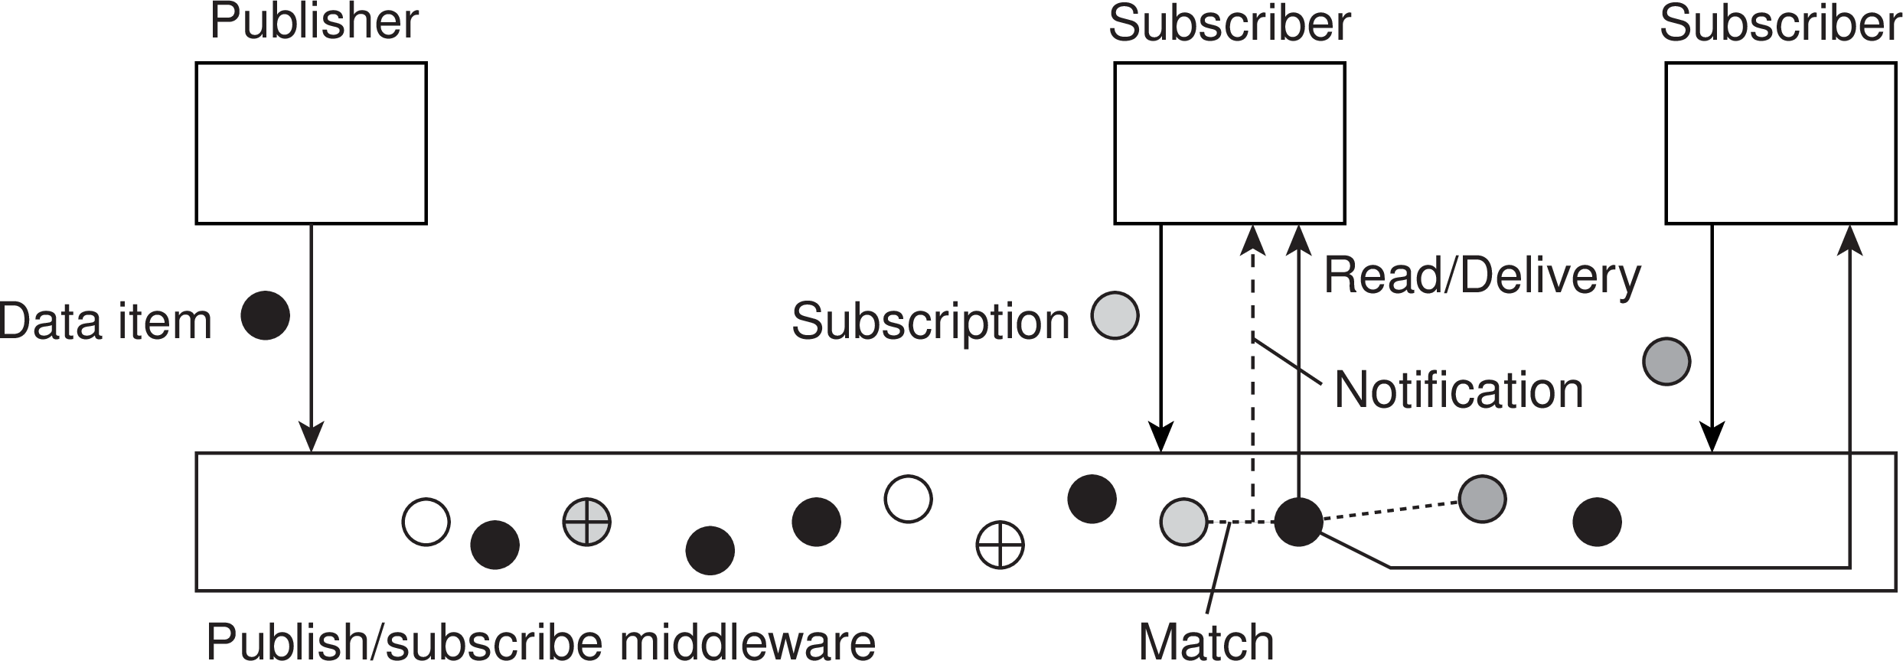
Architectures
Architectural styles
Publish and subscribe
Issue: how to match events?
Assume events are described by (attribute,value) pairs
topic-based subscription: specify a “attribute = value” series
content-based subscription: specify a “attribute ∈ range” series
Observation
Content-based subscriptions may easily have serious scalability problems (why?)
Publish-subscribe architectures

Slide 47
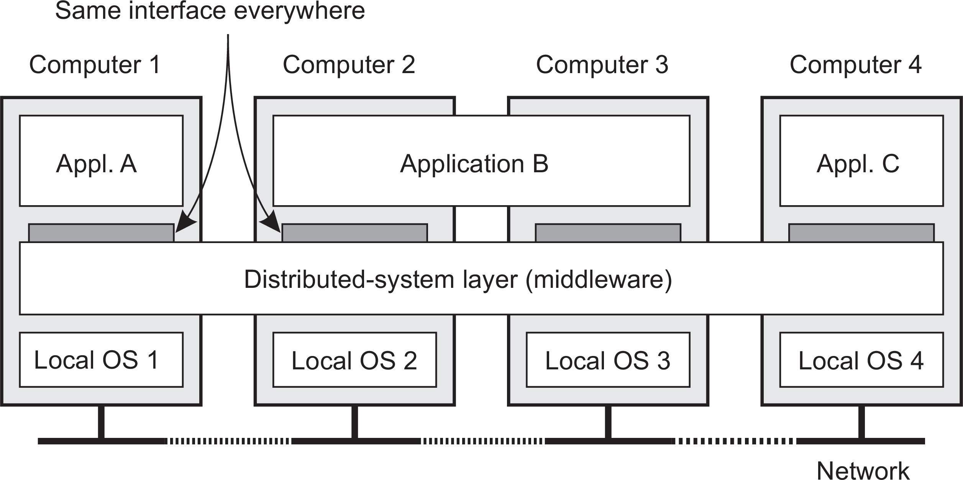
Architectures
Middleware and distributed systems
Middleware: the OS of distributed systems
What does it contain?
Commonly used components and functions that need not be implemented by applications separately.

Slide 48
Developing adaptable middleware
Architectures Middleware and distributed systems
Problem
Middleware contains solutions that are good for most applications ⇒ you may want to adapt its behavior for specific applications.
Middleware organization

Slide 49
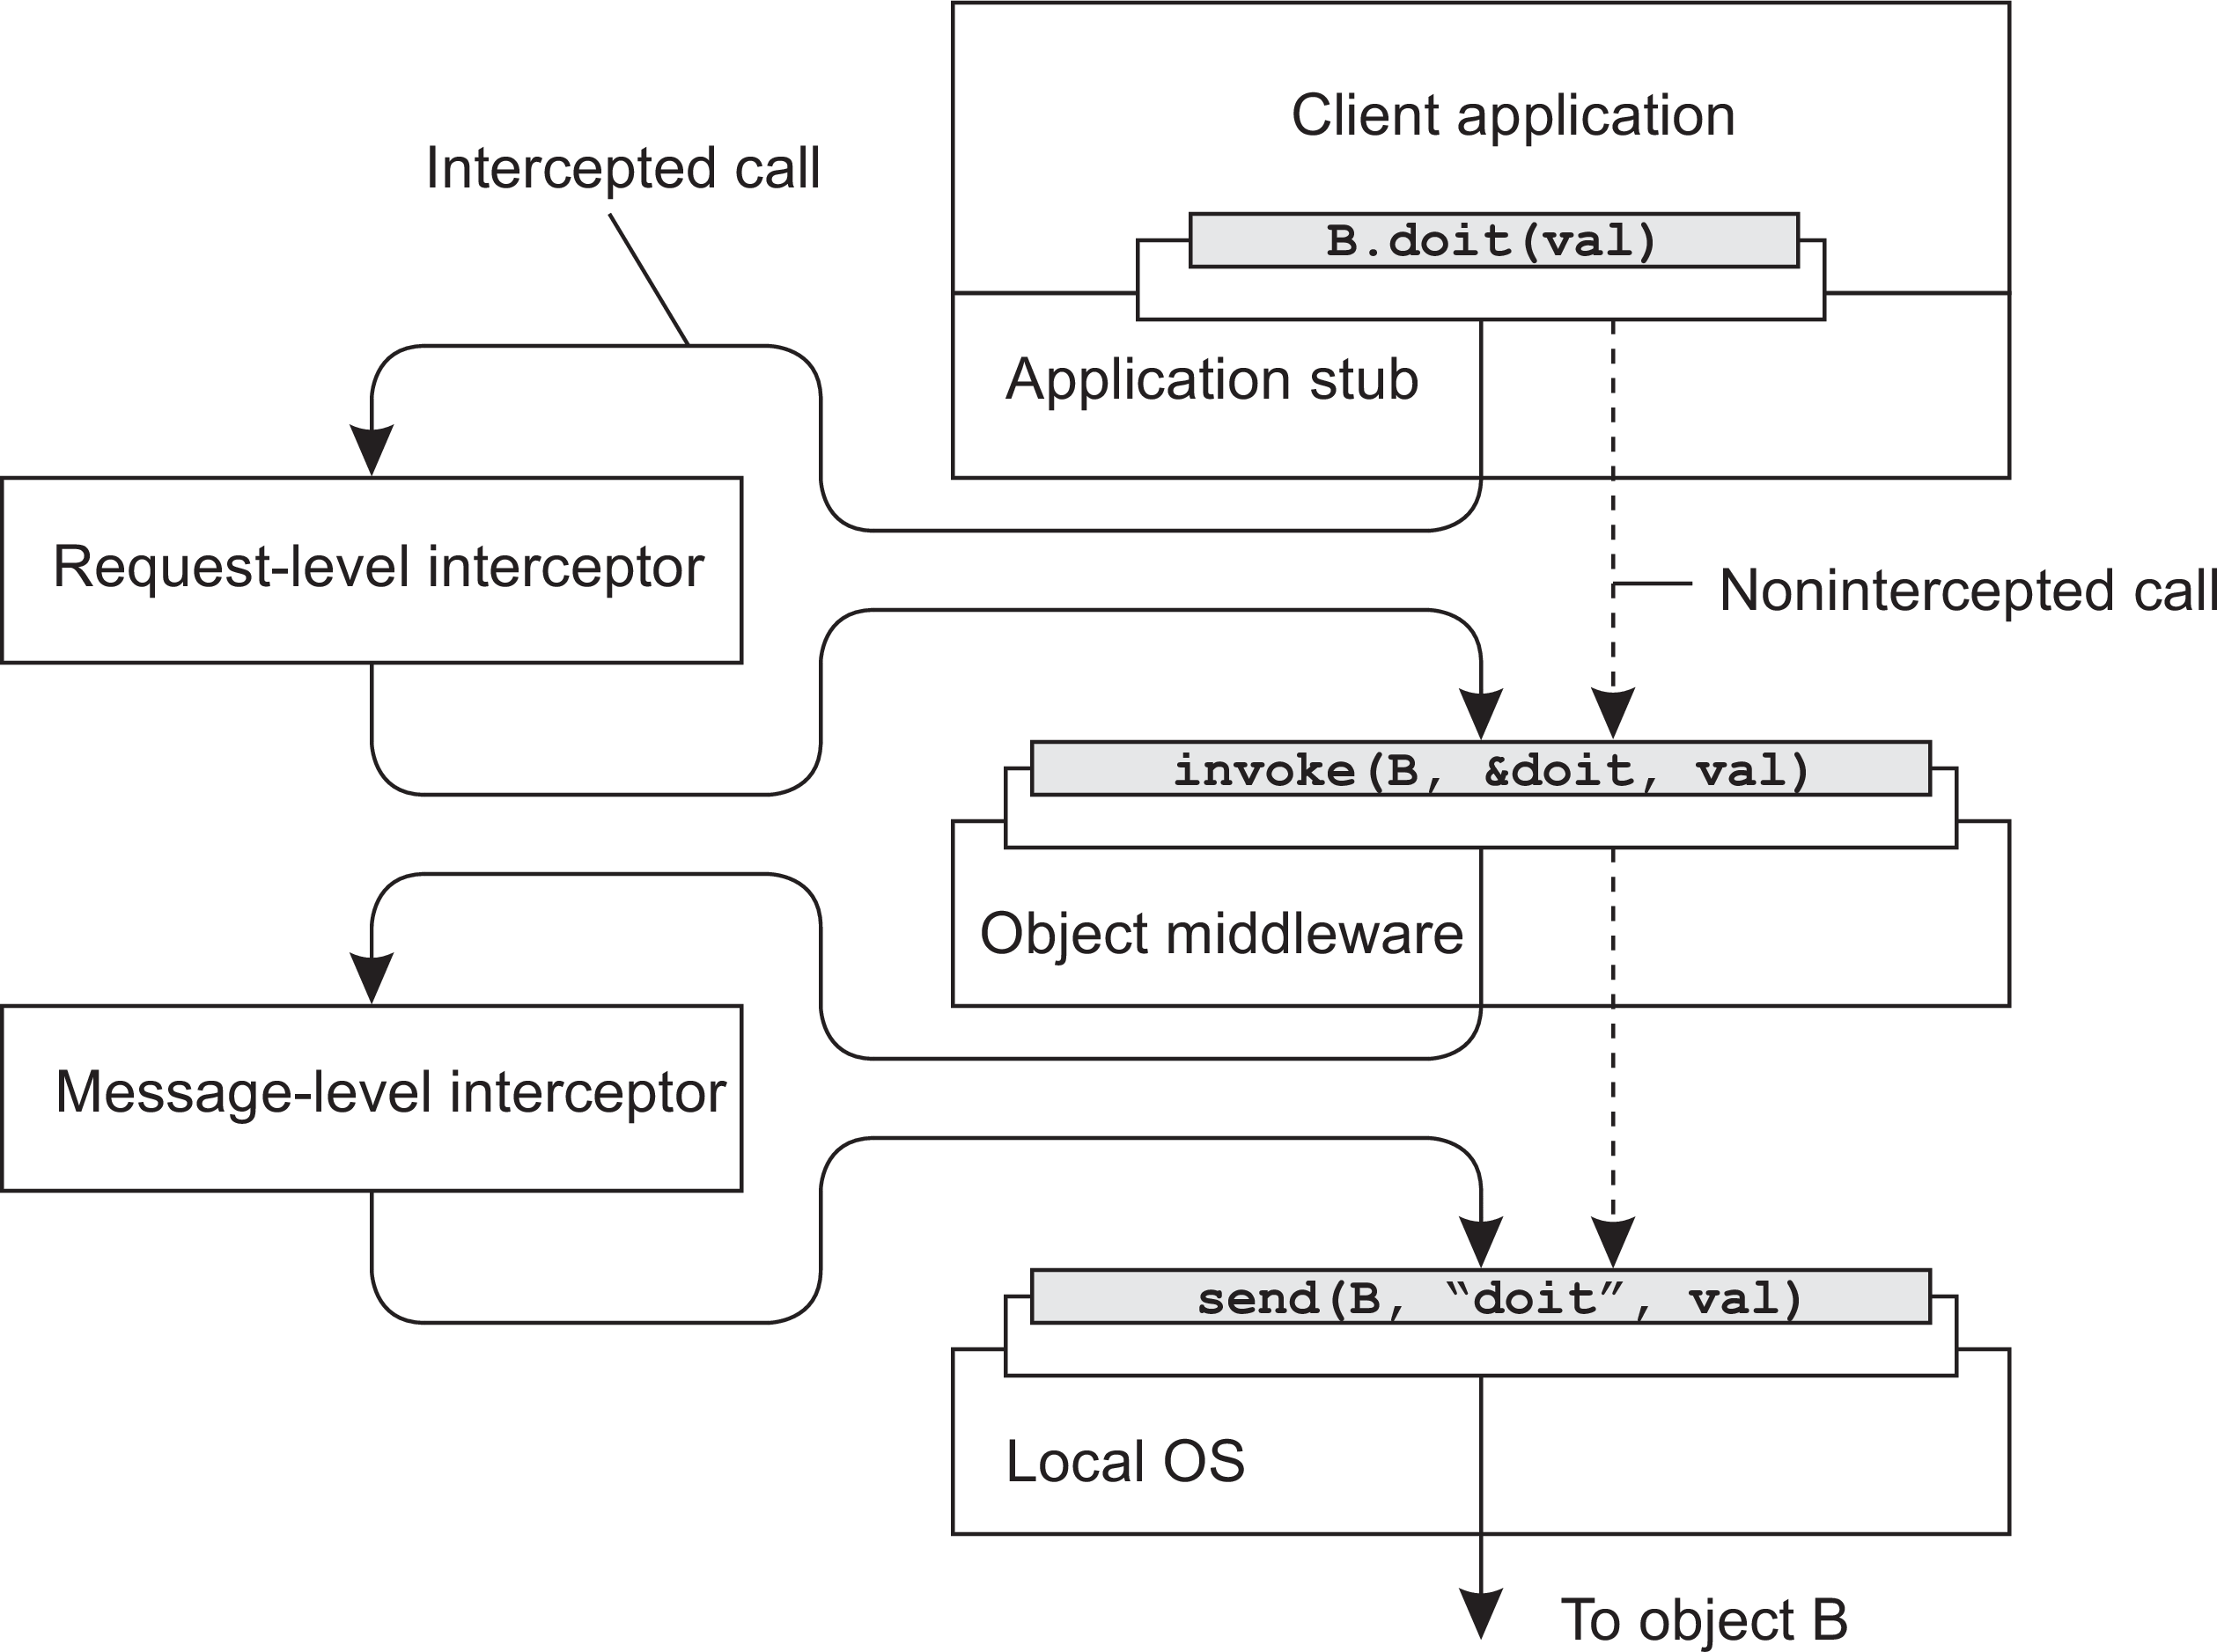
Architectures
Middleware and distributed systems
Intercept the usual flow of control
Middleware organization

Slide 50
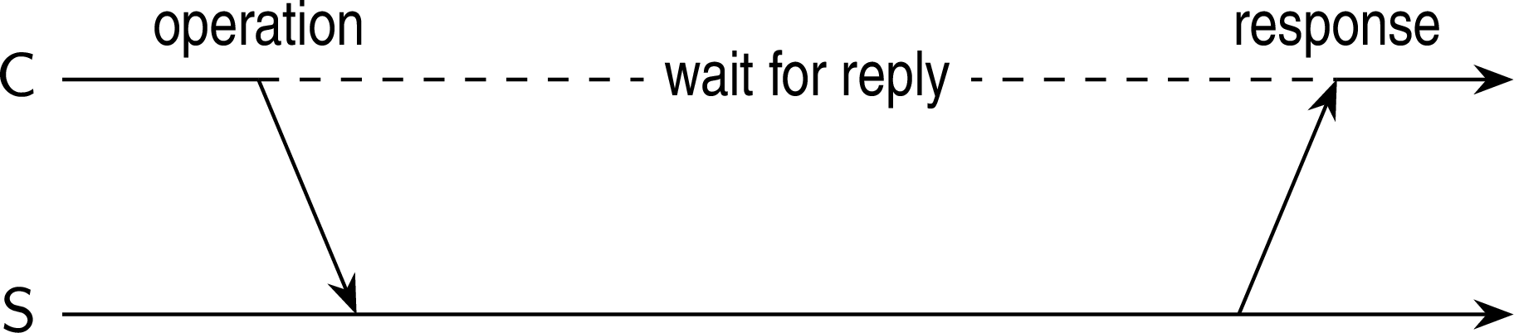
Architectures
Layered-system architectures
Centralized system architectures
Basic Client–Server Model
Characteristics:
There are processes offering services (servers)
There are processes that use services (clients)
Clients and servers can be on different machines
Clients follow request/reply model regarding using services
Simple client-server architecture

Slide 51
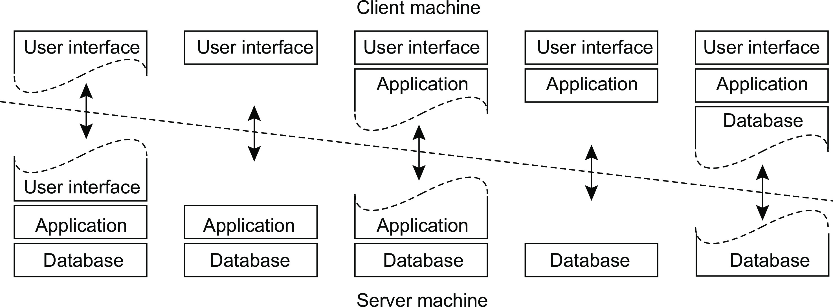
Architectures
Layered-system architectures
Multi-tiered centralized system architectures
Some traditional organizations
Single-tiered: dumb terminal/mainframe configuration
Two-tiered: client/single server configuration
Three-tiered: each layer on separate machine
Traditional two-tiered configurations
(a)
(b)
(c)
(d)
(e)
Multitiered Architectures

Slide 52
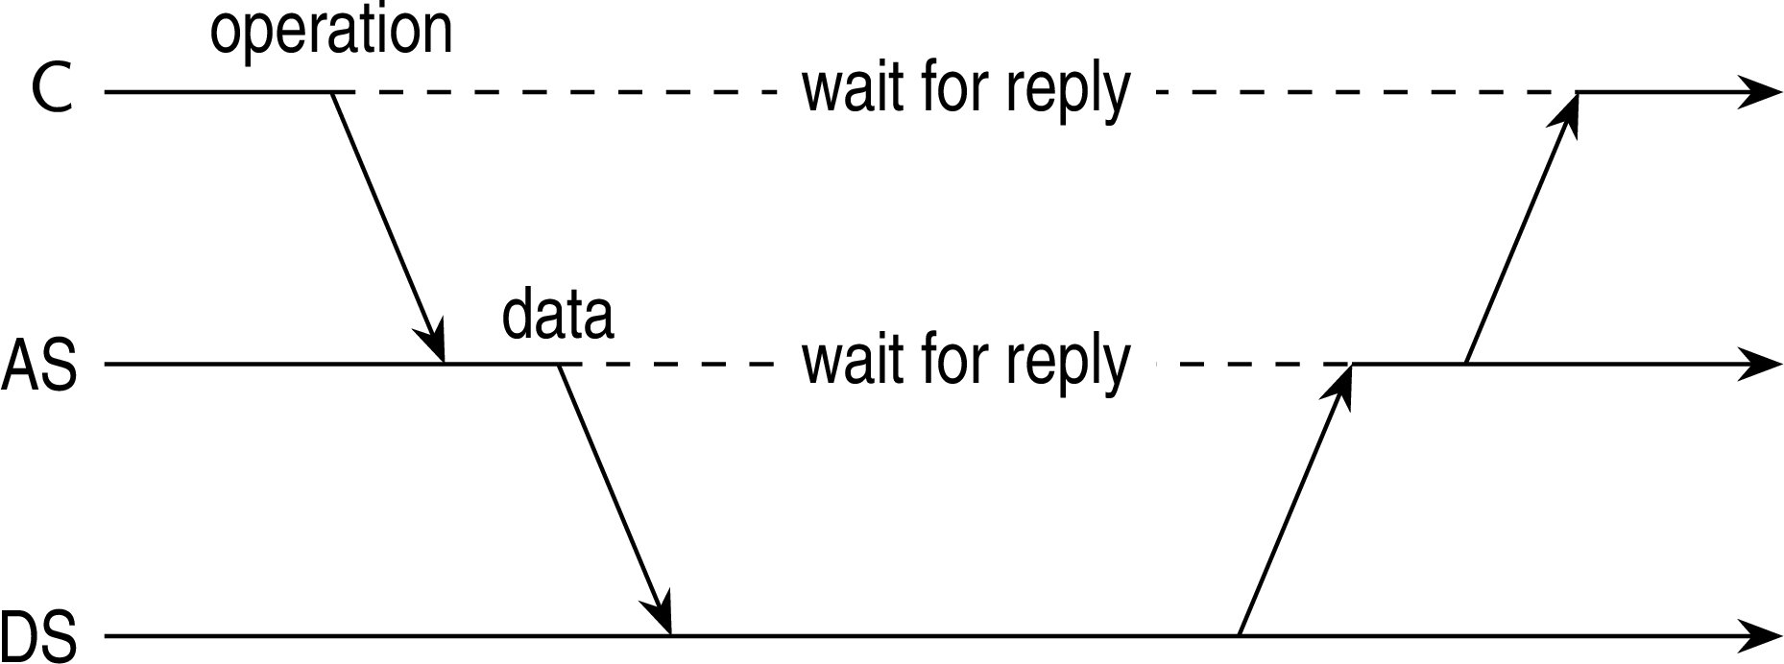
Architectures
Layered-system architectures
Being client and server at the same time
Three-tiered architecture
Multitiered Architectures

Slide 53
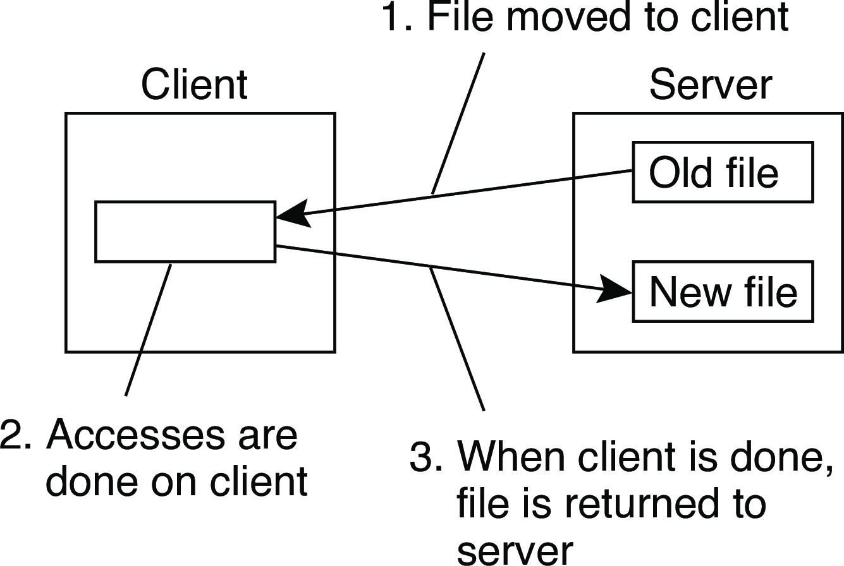
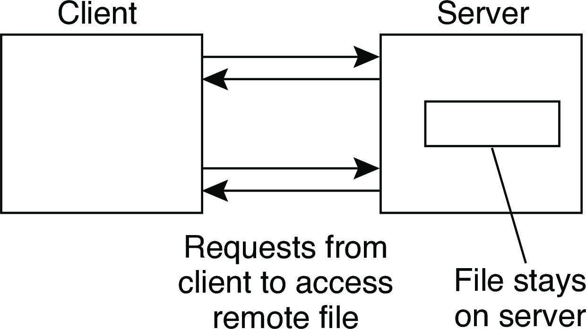
Example: The Network File System
Architectures Layered-system architectures
Foundations
Each NFS server provides a standardized view of its local file system: each server supports the same model, regardless the implementation of the file system.
The NFS remote access model
Remote access Upload/download
Note
FTP is a typical upload/download model. The same can be said for systems like Dropbox.
Example: The Network File System

Slide 54
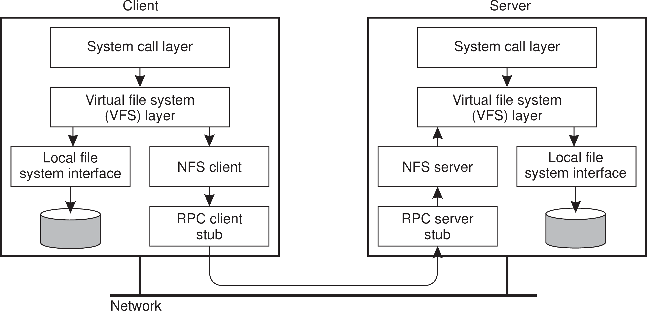
Architectures
Layered-system architectures
NFS architecture
Example: The Network File System

Slide 55
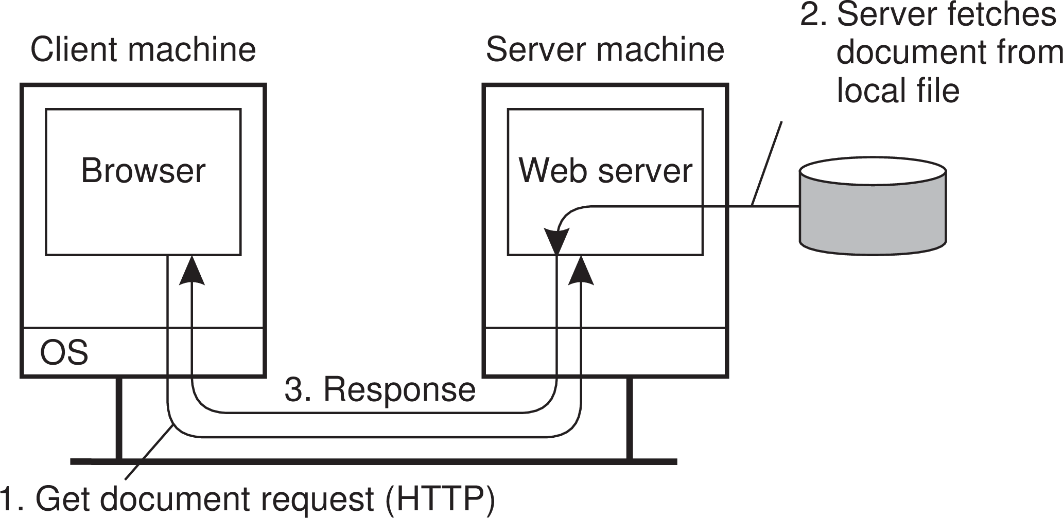
Architectures
Layered-system architectures
Example: Simple Web servers
Back in the old days...
...life was simple:
A website consisted as a collection of HTML files
HTML files could be referred to each other by a hyperlink
A Web server essentially needed only a hyperlink to fetch a file
•
A browser took care of properly rendering the content of a file
Example: The Web

