Slide 1
CPU Scheduling
Overview of CPU Scheduling Concepts and Algorithms

Slide 2
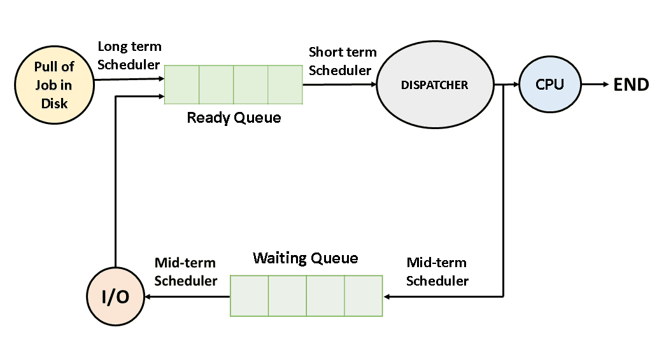
Introduction to CPU Scheduling
CPU Scheduling is the method used by operating systems to allocate CPU time to processes. It ensures efficient CPU utilization and improves system performance.

Slide 3
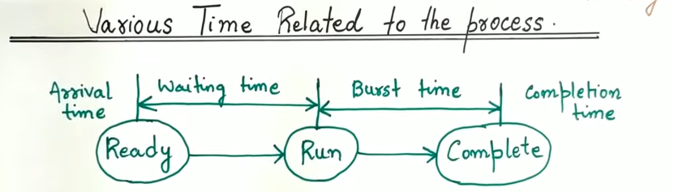

Slide 4
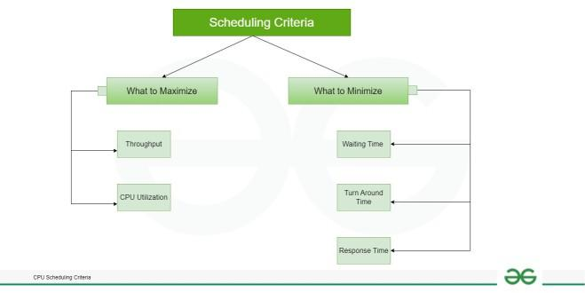

Slide 5
Criteria of CPU Scheduling
CPU scheduling criteria, such as turnaround time, waiting time, and throughput, are essential metrics used to evaluate the efficiency of scheduling algorithms.
Now let’s discuss CPU Scheduling has several criteria. Some of them are mentioned below.
1. CPU utilization
The main objective of any CPU scheduling algorithm is to keep the CPU as busy as possible. Theoretically, CPU utilization can range from 0 to 100 but in a real-time system, it varies from 40 to 90 percent depending on the load upon the system.
2. Throughput
A measure of the work done by the CPU is the number of processes being executed and completed per unit of time. This is called throughput. The throughput may vary depending on the length or duration of the processes.

Slide 6
3. Turnaround Time
For a particular process, an important criterion is how long it takes to execute that process. The time elapsed from the time of submission of a process to the time of completion is known as the turnaround time. Turn-around time is the sum of times spent waiting to get into memory, waiting in the ready queue, executing in CPU, and waiting for I/O.
Turn Around Time = Completion Time – Arrival Time

Slide 7
4. Waiting Time
A scheduling algorithm does not affect the time required to complete the process once it starts execution. It only affects the waiting time of a process i.e. time spent by a process waiting in the ready queue.
Waiting Time = Turnaround Time – Burst Time

Slide 8
Scheduling Criteria
Response Time
Amount of time it takes from when a request was submitted until the first response is produced. Remember, it is the time till the first response and not the completion of process execution(final response).
In general CPU utilization and Throughput are maximized and other factors are reduced for proper optimization.
Response Time = CPU Allocation Time(when the CPU was allocated for the first) – Arrival Time

Slide 9
Completion Time
The completion time is the time when the process stops executing, which means that the process has completed its burst time and is completely executed.

Slide 10
Scheduling Criteria
1. CPU Utilization: Percentage of CPU usage.
2. Throughput: Number of completed tasks per time unit.
3. Turnaround Time: Total time taken for process completion.
4. Waiting Time: Time spent in the ready queue.
5. Response Time: Time taken to start execution after request.

Slide 11
Types of CPU Scheduling
1. Non-Preemptive Scheduling: Process keeps CPU until completion.
2. Preemptive Scheduling: Process can be interrupted based on priority.

Slide 12
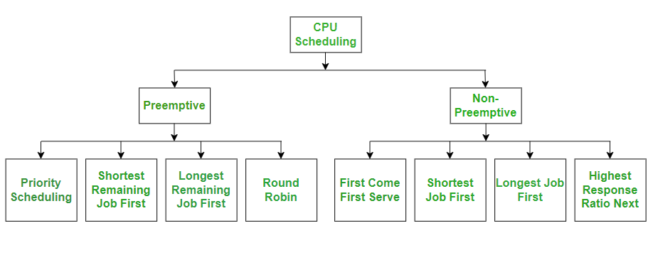
CPU Scheduling Algorithms

Slide 13
Scheduling Algorithms
1. First Come First Serve (FCFS)
2. Shortest Job First (SJF)
3. Priority Scheduling
4. Round Robin Scheduling
5. Shortest Remaining Time Next (SRTN)

Slide 14
First Come First Serve Scheduling
The process which arrives first, gets executed first, or we can say that the process which requests the CPU first, gets the CPU allocated first.
First Come First Serve, is just like FIFO(First in First out) Queue data structure,
This is used in Batch Systems.
It's easy to understand and implement programmatically, using a Queue data structure, where a new process enters through the tail of the queue, and the scheduler selects process from the head of the queue.
A perfect real life example of FCFS scheduling is buying tickets at ticket counter.

Slide 15
First Come First Serve (FCFS)
Processes are scheduled in the order they arrive. Implemented using FIFO queue.
Turnaround Time = Completion Time - Arrival Time
Waiting Time = Turnaround Time - Burst Time

Slide 16

Example 1
S. No | Process ID | Arrival Time | Burst Time
1 | P 1 | 0 | 9
2 | P 2 | 1 | 3
3 | P 3 | 1 | 2
4 | P 4 | 1 | 4
5 | P 5 | 2 | 3
6 | P 6 | 3 | 2
Gantt chart for the above Example 1 is:

Slide 17
S. No | Process ID | Arrival Time | Burst Time | Completion Time | Turn Around Time | Waiting Time
1 | P 1 | 0 | 9
2 | P 2 | 1 | 3
3 | P 3 | 1 | 2
4 | P 4 | 1 | 4
5 | P 5 | 2 | 3
6 | P 6 | 3 | 2

Slide 18
S. No | Process ID | Arrival Time | Burst Time | Completion Time | Turn Around Time | Waiting Time
1 | P 1 | 0 | 9 | 9 | 9 | 0
2 | P 2 | 1 | 3 | 12 | 11 | 8
3 | P 3 | 1 | 2 | 14 | 13 | 11
4 | P 4 | 1 | 4 | 18 | 17 | 13
5 | P 5 | 2 | 3 | 21 | 19 | 16
6 | P 6 | 3 | 2 | 23 | 20 | 18

Slide 19
The Average Completion Time is:
Average CT = ( 9 + 12 + 14 + 18 + 21 + 23 ) / 6
Average CT = 97 / 6
Average CT = 16.16667
The Average Waiting Time is:
Average WT = ( 0 + 8 + 11 + 13 + 16 + 18 ) /6
Average WT = 66 / 6
Average WT = 11

Slide 20
Shortest Job First (SJF)
Characteristics of SJF Scheduling:
Shortest Job first has the advantage of having a minimum average waiting time among all scheduling algorithms.
It is a Greedy Algorithm.
This is the best approach to minimize waiting time.
This is used in Batch Systems.

Slide 21
Algorithm:
Sort all the processes according to the arrival time.
Then select that process that has minimum arrival time and minimum Burst time.
After completion of the process make a pool of processes that arrives afterward till the completion of the previous process and select that process among the pool which is having minimum Burst time.

Slide 22
Shortest Job First (SJF)
It may cause starvation if shorter processes keep coming. This problem can be solved using the concept of ageing.
It is practically infeasible as Operating System may not know burst times and therefore may not sort them. While it is not possible to predict execution time, several methods can be used to estimate the execution time for a job, such as a weighted average of previous execution times.
SJF can be used in specialized environments where accurate estimates of running time are available.

Slide 23
Shortest Job First (SJF)
Example
In the following example, there are five jobs named as P1, P2, P3, P4 and P5. Their arrival time and burst time are given in the table below.
PID | Arrival Time | Burst Time
1 | 1 | 7
2 | 3 | 3
3 | 6 | 2
4 | 7 | 10
5 | 9 | 8
So that's how the procedure will go on in shortest job first (SJF) scheduling algorithm.

Slide 24
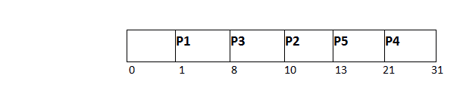
Since, No Process arrives at time 0 hence; there will be an empty slot in the Gantt chart from time 0 to 1 (the time at which the first process arrives).
According to the algorithm, the OS schedules the process which is having the lowest burst time among the available processes in the ready queue.
Till now, we have only one process in the ready queue hence the scheduler will schedule this to the processor no matter what is its burst time.
At Arrival Time | Queue Status
0 | Empty
1 | P1
8 | P2,P3,P4
10 | P2,P4,P5

Slide 25
This will be executed till 8 units of time. Till then we have three more processes arrived in the ready queue hence the scheduler will choose the process with the lowest burst time.
Among the processes given in the table, P3 will be executed next since it is having the lowest burst time among all the available processes.
So that's how the procedure will go on in shortest job first (SJF) scheduling algorithm.
Avg Waiting Time = 27/5=5.4
AVG TAT=11.4

Slide 26
PID | Arrival Time | Burst Time | Completion Time | Turn Around Time | Waiting Time
1 | 1 | 7 | 8 | 7 | 0
2 | 3 | 3 | 13 | 10 | 7
3 | 6 | 2 | 10 | 4 | 2
4 | 7 | 10 | 31 | 24 | 14
5 | 9 | 8 | 21 | 12 | 4

Slide 27
Example-2: Consider the following table of arrival time and burst time for five processes P1, P2, P3, P4 and P5.
Process | Burst Time | Arrival Time
P1 | 6 ms | 2 ms
P2 | 2 ms | 5 ms
P3 | 8 ms | 1 ms
P4 | 3 ms | 0 ms
P5 | 4 ms | 4 ms

Slide 28

P4 = 0 – 0 = 0
P1 = 3 – 2 = 1
P2 = 9 – 5 = 4
P5 = 11 – 4 = 7
P3 = 15 – 1 = 14
Average Waiting Time = 0 + 1 + 4 + 7 + 14/5 = 26/5 = 5.2

Slide 29
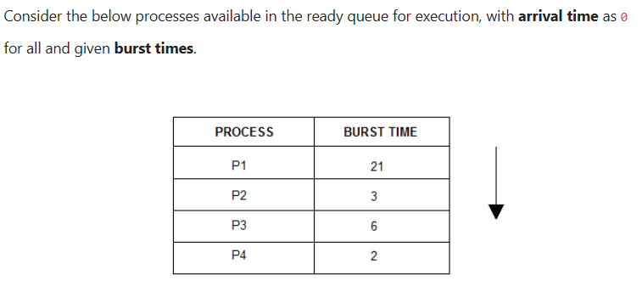

Slide 30
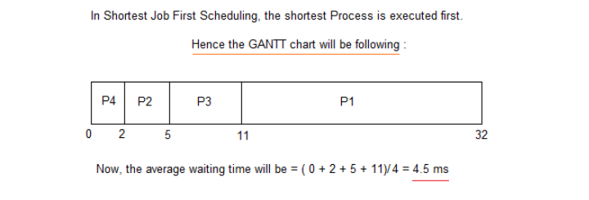

Slide 31
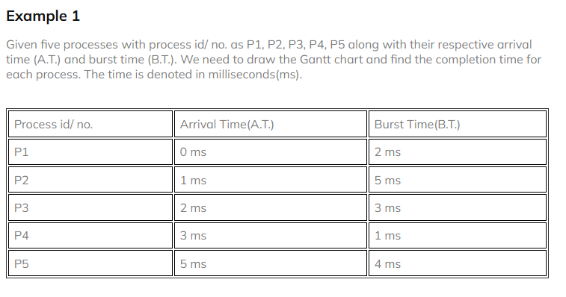

Slide 32

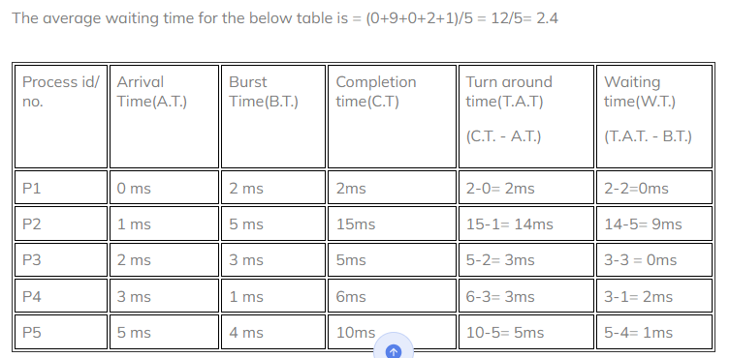

Slide 33
Priority Scheduling
Each process is assigned a priority. Higher priority processes are executed first.
Can be preemptive or non-preemptive.
Example: Priority-based execution order with average turnaround and waiting times.

Slide 34
Round Robin Scheduling
Processes are assigned fixed time slices (time quantum) in a cyclic order.
Time-sharing approach improves response time.
Example: Avg Turnaround Time = 42.16 ms, Avg Waiting Time = 31.16 ms

Slide 35
Shortest Remaining Time Next (SRTN)
Preemptive version of SJF. Process with shortest remaining time is executed next.
Example: Avg Turnaround Time = 10 ms, Avg Waiting Time = 4.5 ms

Slide 36
Conclusion
CPU Scheduling plays a vital role in OS performance. Different algorithms are used based on system requirements and workload characteristics.

Slide 37
Example: First Come First Serve (FCFS)
Processes:
P1: Arrival Time = 0, Burst Time = 9
P2: Arrival Time = 1, Burst Time = 3
P3: Arrival Time = 1, Burst Time = 2
Gantt Chart: | P1 | P2 | P3 |
Avg Turnaround Time = 16.16 ms
Avg Waiting Time = 11 ms

Slide 38
Example: Shortest Job First (SJF)
Processes:
P1: Arrival Time = 1, Burst Time = 7
P2: Arrival Time = 3, Burst Time = 3
P3: Arrival Time = 6, Burst Time = 2
Gantt Chart: | P3 | P2 | P1 |
Avg Turnaround Time = 11.4 ms
Avg Waiting Time = 5.4 ms

Slide 39
Example: Priority Scheduling
Processes:
P1: Arrival Time = 0, Burst Time = 5, Priority = 10
P2: Arrival Time = 1, Burst Time = 4, Priority = 20
P3: Arrival Time = 2, Burst Time = 2, Priority = 30
Gantt Chart: | P3 | P2 | P1 |
Avg Turnaround Time = 5.5 ms
Avg Waiting Time = 2.5 ms

Slide 40
Example: Round Robin Scheduling
Processes:
P1: Arrival Time = 0, Burst Time = 7
P2: Arrival Time = 1, Burst Time = 4
P3: Arrival Time = 2, Burst Time = 15
Time Quantum = 5
Gantt Chart: | P1 | P2 | P3 | P1 | P3 |
Avg Turnaround Time = 42.16 ms
Avg Waiting Time = 31.16 ms

Slide 41
Example: Shortest Remaining Time Next (SRTN)
Processes:
P1: Arrival Time = 0, Burst Time = 10
P2: Arrival Time = 1, Burst Time = 6
P3: Arrival Time = 3, Burst Time = 2
Gantt Chart: | P3 | P2 | P1 |
Avg Turnaround Time = 10 ms
Avg Waiting Time = 4.5 ms

