Slide 1
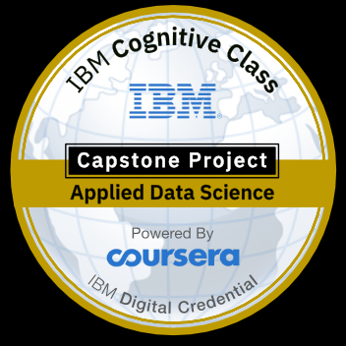
Coursera Capstone IBM Applied Data Science Capstone “Opening A New Shopping Mall In Kuala Lumpur, Malaysia”
BY:- SANIKA BIRLA

Slide 2
INTRODUCTION
For many shoppers, visiting shopping malls is a great way to relax and enjoy themselves during weekends and holidays. They can do grocery shopping, dine at restaurants, shop at the various fashion outlets, watch movies and perform many more activities.
Shopping malls are like a one-stop destination for all types of shoppers.
Particularly, the location of the shopping mall is one of the most important decisions that will determine whether the mall will be a success or a failure.

Slide 3
Business Problem
The objective of this capstone project is to analyse and select the best locations in the city of Kuala Lumpur, Malaysia to open a new shopping mall.

Slide 4
Data Required
List of neighbourhoods in Kuala Lumpur .
Latitude and longitude coordinates of those neighbourhoods. This is required in order to plot the map and also to get the venue data.
Venue data, particularly data related to shopping malls. We will use this data to perform clustering on the neighbourhoods.

Slide 5
FOURSQUARE API
After that, we will use Foursquare API to get the venue data for those neighbourhoods. Foursquare has one of the largest database of 105+ million places and is used by over 125,000 developers. Foursquare API will provide many categories of the venue data, we are particularly interested in the Shopping Mall category in order to help us to solve the business problem put forward.

Slide 6
Methodology
Web scraaping Wikipedia page for neighbourhoods list.
Get latitude and longitude coordinates using GEOCODER.
Use FOURSQUARE API

Slide 7
Results
The results from the k-means clustering show that we can categorize the neighbourhoods into 3 clusters based on the frequency of occurrence for “Shopping Mall”:
Cluster 0: Neighbourhoods with moderate number of shopping malls
Cluster 1: Neighbourhoods with low number to no existence of shopping malls
Cluster 2: Neighbourhoods with high concentration of shopping malls

Slide 8
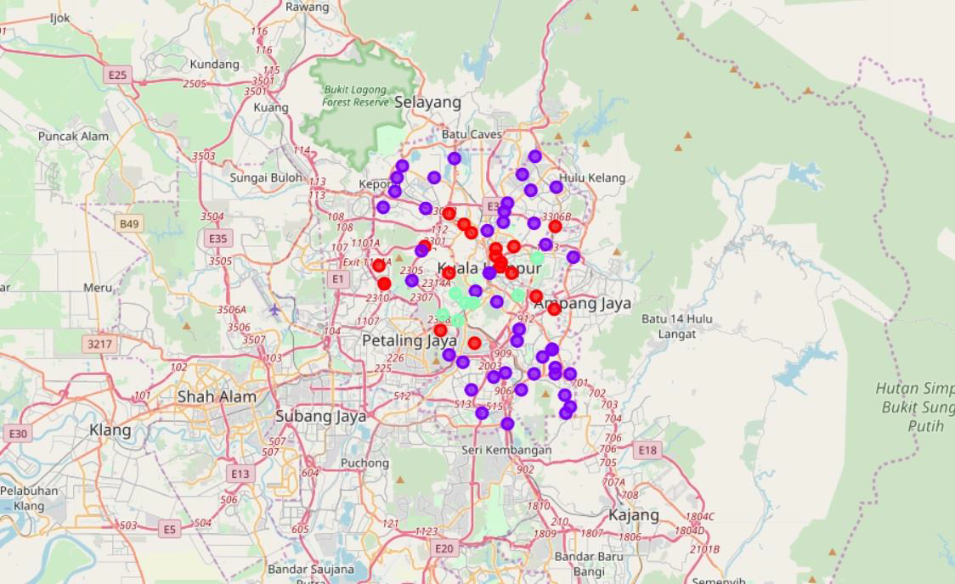

Slide 9
DISCUSSION
As observations noted from the map in the Results section, most of the shopping malls are concentrated in the central area of Kuala Lumpur city, with the highest number in cluster 2 and moderate number in cluster 0. On the other hand, cluster 1 has very low number to no shopping mall in the neighbourhoods.
This represents a great opportunity and high potential areas to open new shopping malls as there is very little to no competition from existing malls

Slide 10
Conclusion
In this project, we have gone through the process of identifying the business problem, specifying the data required, extracting and preparing the data, performing machine learning by clustering the data into 3 clusters based on their similarities
To answer the business question that was raised in the introduction section, the answer proposed by this project is: The neighbourhoods in “cluster1 “are the most preferred locations to open a new shopping mall.

Slide 11
THANK-YOU

