Slide 1
The OpenStreetMap API
An overview of the OpenStreetMap API, its advantages over other map APIs and how to get authorization for using the API data.
- Team 9

Slide 2

Introduction
- OpenStreetMap is a collaborative project to create a free, editable map of the world.
- The OpenStreetMap API provides programmatic access to OSM's map data.
Photo by Pexels

Slide 3

Advantages of the OSM API
- Free to use and available under an open license.
- Highly customizable and flexible.
- Collaborative, with a large and active community of contributors.
Photo by Pexels

Slide 4

Comparison with Other Map APIs
- Google Maps API and Bing Maps API are more expensive and may not be suitable for all use cases due to their licensing restrictions.
- OpenLayers API is more complex and may require more technical expertise to use.
Photo by Pexels

Slide 5

How to Get Authorization for Using the API Data
- OpenStreetMap (OSM) is a free and open-source map of the world
- The OpenStreetMap API is a web service that provides read and write access to the OSM data.
- Overpass API is a read-only API that allows users to query OSM data in a more flexible and efficient way than the OSM API.
- Overpass API provides a way to extract a custom selection of data from OSM based on different criteria like geographical region, tags, date/time, and much more.
- Overpass API supports multiple output formats, including XML, JSON, and GeoJSON.
Photo by Pexels

Slide 6
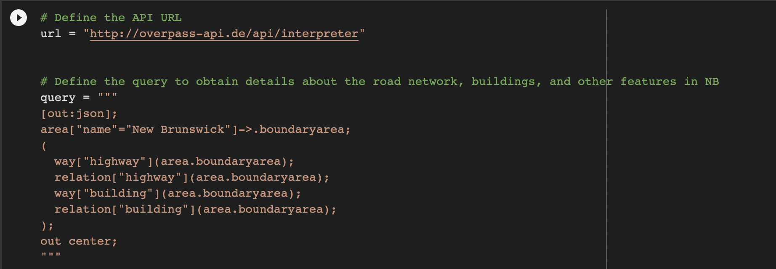
Invoking API

Slide 7
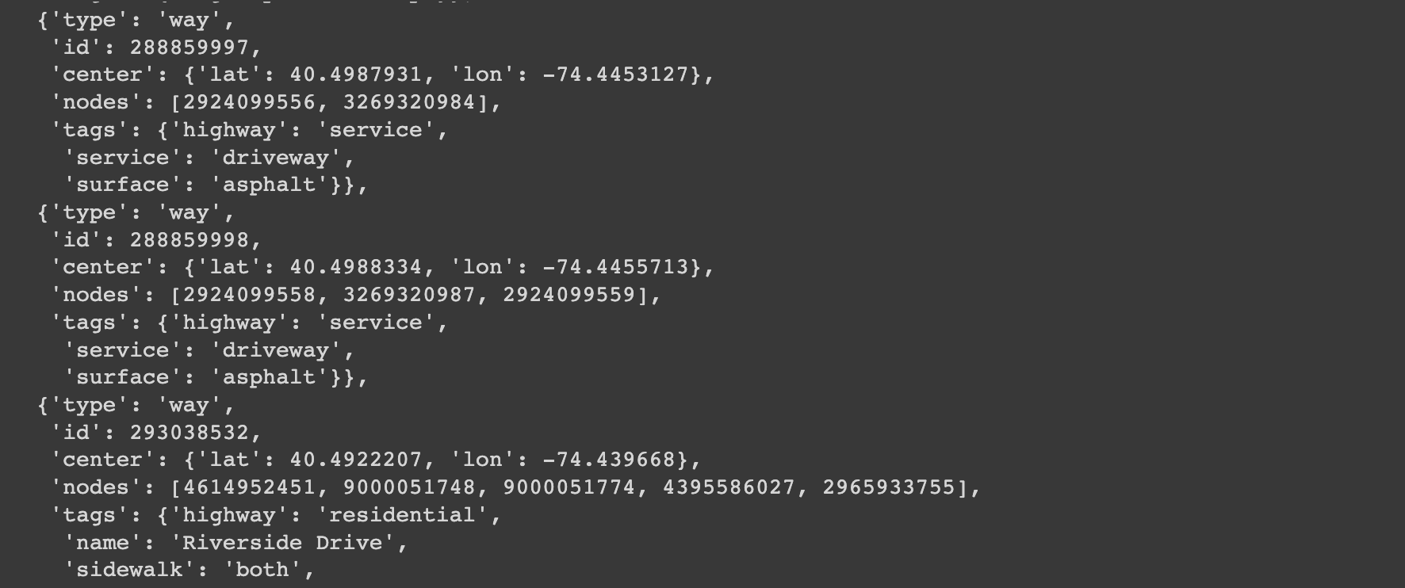
Invoking API- Output

Slide 8
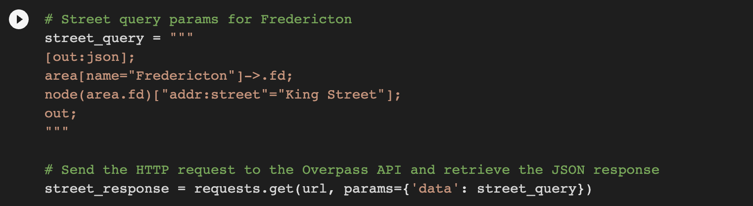
Retrieving data through API

Slide 9
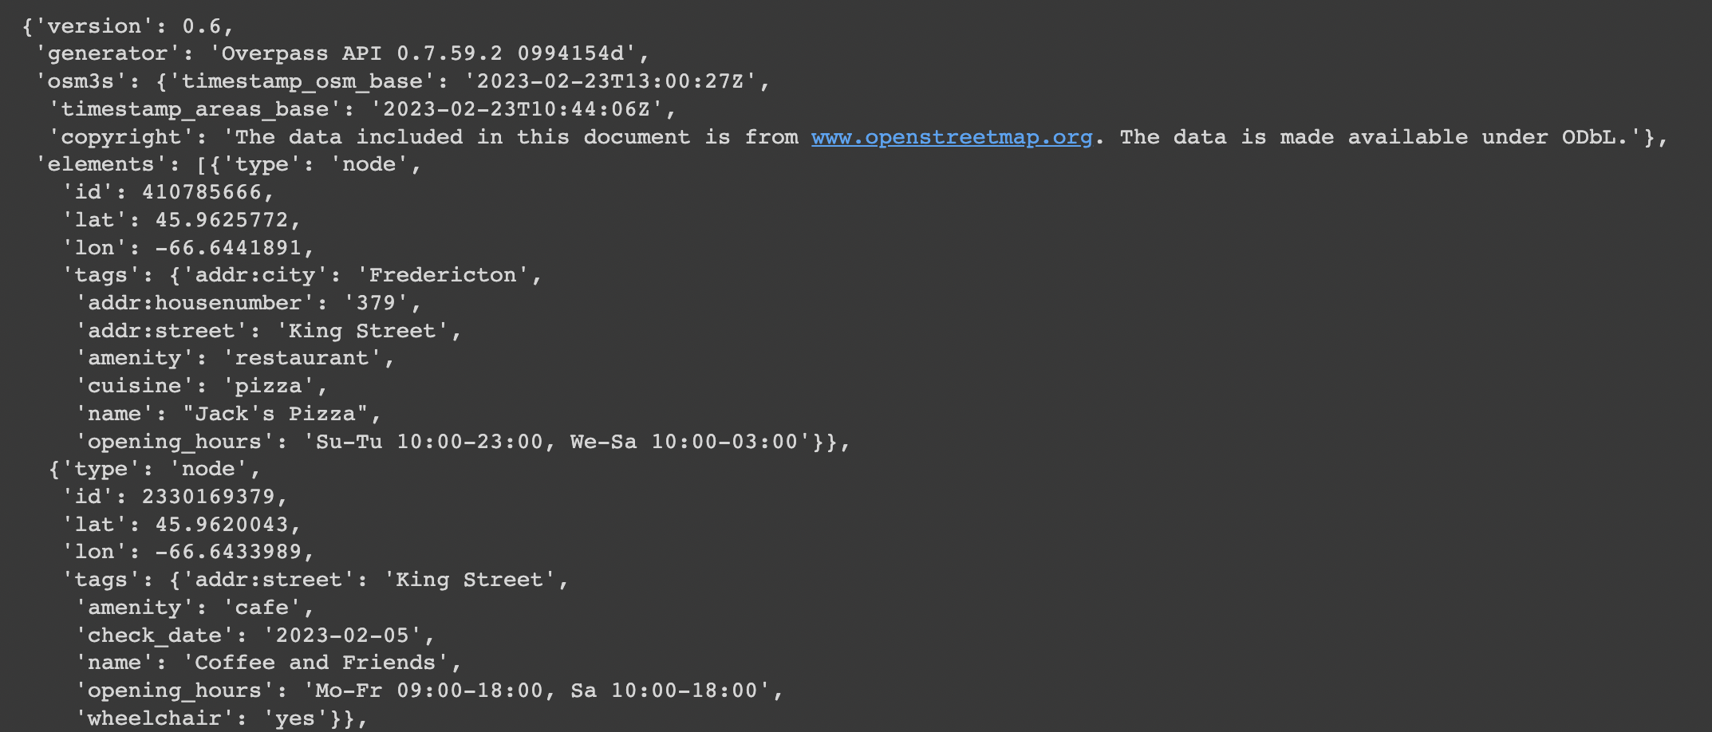
Retrieved data- Output

Slide 10

Conclusion
-The OpenStreetMap API is the best choice for developers who need programmatic access to map data.
-It offers a wide range of features, is highly customizable and flexible, and is free to use.
-To get authorization for using the API data, developers must agree to the ODbL and generate an API key.
-By complying with the terms of the ODbL, developers can use OSM's map data in their applications without restrictions and contribute to a collaborative effort to create a free, editable map of the world.

Slide 11
References
1.Overpass API; Overpass API - OpenStreetMap Wiki. Available at: https://wiki.openstreetmap.org/wiki/Overpass_API (Accessed: February 23, 2023).
2.Main page; OpenStreetMap Wiki. Available at: https://wiki.openstreetmap.org/wiki/Main_Page (Accessed: February 23, 2023).
3.Overpass API user's Manual. Available at: https://dev.overpass-api.de/overpass-doc/en/index.html (Accessed: February 23, 2023).

Slide 12
Our Team- Team 9
Iaswer Karthikeyan Sonal Joshi Kishankumar Hasmukhbhai Sachani
Student id:3736196 Student id:3719369 Student id:3740388
Thank you for your time and attention 🙂

