Slide 1
CSci 3081W: Program Design and Development
Lecture 02 – Version Control and Git

Slide 2
zyBooks issues?

Slide 3
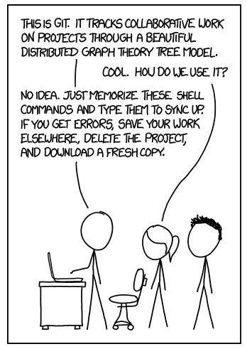
What is Version Control?
Version control is the practice of managing and tracking changes to code over time.
Why is it important for development?

Slide 4
What is Version Control?
Version control is the practice of managing and tracking changes to code over time.
Key Features
Maintain a history of changes
Collaborate seamlessly with a team
Revert to previous versions if needed
Why It Matters
Prevents data loss
Enhances collaboration and productivity

Slide 5
Real-Life Analogy of Version Control
Example: Writing a collaborative essay.
Each contributor makes changes to their own copy
Editors merge changes into the final draft
How do you ensure no changes are lost?
How do you resolve conflicting edits?

Slide 6
Introduction to Git
Git is a distributed version control system widely used for software development.
Track changes locally and remotely
Supports non-linear development with branches
Fast and lightweight
Free and open source
Robust community support
Used by industry leaders

Slide 7
Git Workflow
Stages:
Working Directory: Local copy of files
Staging Area: Files marked for the next commit
Repository: Permanent storage of commits
Basic Commands:
git clone: Copy an existing repository
git add: Stage changes
git commit: Save changes to the repository
git push: Upload changes to a remote repository

Slide 8
Git Branching and Merging
Branches allow for parallel development
ex. branch names: main, feature-branch, bugfix-branch
Merging combines branches into one. Resolve conflicts if changes overlap.
Key Commands:
git branch: List branches
git checkout: Switch branches
git merge: Merge changes

Slide 9
Collaborative Development
Using remote repositories:
Platforms: GitHub, GitLab, Bitbucket
Pull requests enable code review
Conflict Resolution:
Occurs when multiple changes overlap
Use git status and git diff to inspect
Edit conflicting files and commit

Slide 10
Best Practices
Commit Often:
Small, descriptive commits
Easier to debug
Write meaningful commit messages:
Example: “Fix bug in SimulationModel.cc”
Use branches:
Isolate features of fixes
Review Code:
Collaborate effectively through pull requests

Slide 11
Git and CI/CD Integration
Continuous Integration/Continuous Deployment
Automate testing and deployment
Tools: GitHub Actions, Jenkins
Example Workflow:
Commit triggers automated testing
Tests pass, triggering deployment
Benefits:
Faster feedback loop
Fewer integration issues

Slide 12
Common Git Pitfalls
Forgot to stage changes
Use git add consistently
Merge Conflicts
Accidental Commits to the main branch
Use branches to isolate work

Slide 13
Resources for Learning Git
Documentation:
Git Official Documentation
Pro Git Book
Interactive Tutorial:
Learn Git Branching

Slide 14
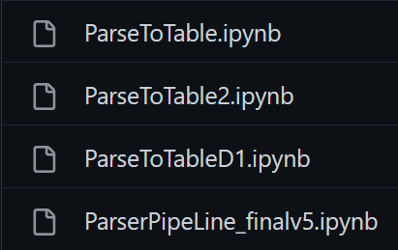
What if we don’t use version control?
Don’t know which developer made which change
Don’t know if we created any integration failures
Leads to reworks and refactors

Slide 15
Version control is mandatory for all group work
Version control is also helpful for solo projects
You’ll do some version control work for lab 1

Slide 16
Git Demo

Slide 17
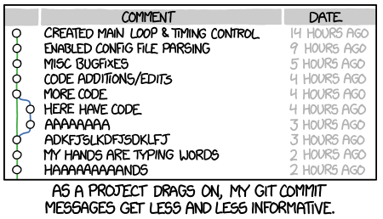
Git

