Slide 1
CSci 3081W: Program Design and Development
Introduction to SDLC, Requirements, and Documentation (Doxygen)

Slide 2
Homework 2
Released/releases sometime today - Tuesday, Feb 18th
Due Friday, March 7th

Slide 3
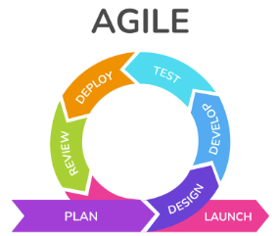
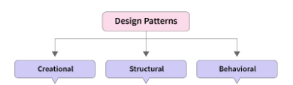
Program Design and Development

Slide 4
Requirements
What is a "requirement"?
A requirement in software engineering is a feature of new software that someone either wants, needs or commands.
It describes what a software does as well as its limitations.

Slide 5
Requirements
What’s the goal when making a requirement?
What do we want the system to do?
What are the needs of the users?
What does the system need to do in order to achieve those needs?

Slide 6
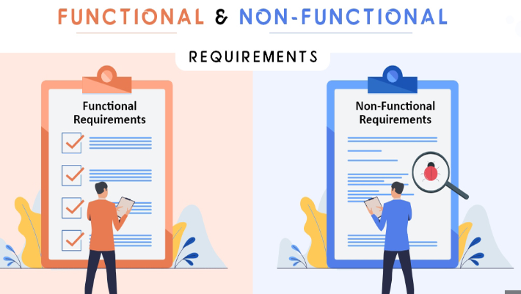
Requirements
Requirements can be split into two categories: functional and nonfunctional requirements

Slide 7
Functional Requirement
Functional requirement: describes what the software does
Express in terms of: data storage, any process that transforms data, and any outputs that it produces

Slide 8
Non-functional Requirement
Non-functional requirement: defines limitations that the software has
Express in terms of: performance, security and access, technical constraint, project constraint, organizational constraint, usability and reliability issues

Slide 9
Requirement Analysis / Engineering
Requirements engineering (RE) is the process of defining, documenting, and maintaining requirements in the engineering design process. It is a common role in systems engineering and software engineering.
Wikipedia

Slide 10
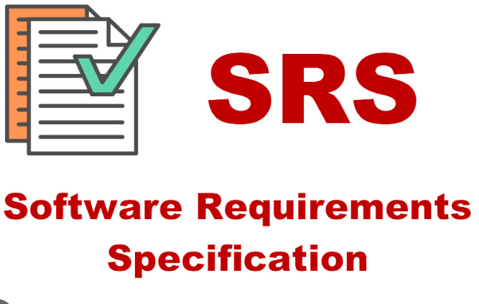
Requirement Analysis / Engineering
What’s the output of requirements analysis?
Create a document that describes the software to be built.
Software Requirements Specification Document (SRS)

Slide 11
Requirements Specification Document
Contains: overview of what the system will do, description of all the requirements, and a list of the functional requirements
Doesn’t contain: any info about the algorithms or logic, UI discussion, details about data entities or types, technical specifications

Slide 12
Requirements
Poor requirements engineering is one of the reasons why a software engineering project can fail or produce a highly defective piece of software.
Many reasons for failure: miscommunication between management and developers, poor testing, poor user experience, unwillingness to pivot, complex to use

Slide 13
Requirements
Poor requirements engineering is one of the reasons why a software engineering project can fail or produce a highly defective piece of software.
Benefits to good requirements engineering: lower cost of development, fewer defects, faster delivery, reusability, traceability, requirements get tied to test cases, global config management

Slide 14
EARS (Easy Approach to Requirements Syntax)
2009 17th IEEE International Requirements Engineering Conference
Alistair Mavin, Philip Wilkinson, Adrian Harwood, Mark Novak
Rolls-Royce PLC
Derby, UK

Slide 15
Challenges in Requirements Elicitation
Requirements are often expressed in unconstrained natural language
leads to ambiguity
Problems in initial requirements spread to other parts of the system
volatility and risk impact program cost
Some solutions have been put forward but they come with their own issues
refactors of existing requirements
training overhead

Slide 16
Requirements with Structural Rules
Developed a few basic rules to solve common issues
ambiguity, complexity, vagueness
All requirements can be written in 1 of 5 ways
Tested this method while writing requirements for airplane engine controls
Using these rules increased the amount of requirements as well as the quality of the requirements

Slide 17
Common Problems with Natural Language
Ambiguity
Vagueness
Complexity
Omission
Duplication
Wordiness
Inappropriate Implementation
Untestable

Slide 18
The five syntax templates (in EARS)
Ubiquitous
Event-driven
Unwanted behaviors
State-driven
Optional features
We can also combine these to make complex requirements

Slide 19
Generic Requirements Syntax
<optional preconditions> <optional trigger> the <system name> shall <system response>
Specialized into the five types of requirements

Slide 20
Ubiquitous Requirements
No preconditions or trigger
Not invoked by an event detected at the system boundary or in response to a defined system state (always active)
The <system name> shall <system response>
Example: The control system shall prevent engine overspeed.

Slide 21
Event-Driven Requirements
Initiated only when a triggering event is detected at the system boundary
WHEN <optional preconditions> <trigger> the <system name> shall <system response>
Example: When continuous ignition is commanded by the aircraft, the control system shall switch on continuous ignition.

Slide 22
Unwanted Behaviors
Unwanted behaviors are undesired situations
failures, disturbances, deviations from desired user behavior
unexpected behavior of interacting systems
IF <optional preconditions> <trigger>, THEN the <system name> shall <system response>
Example: If the computed airspeed fault flag is
set, then the control system shall use modelled airspeed.

Slide 23
State-Driven Requirements
Active while the system is in a defined state.
WHILE <in a specific state> the <system name> shall <system response>
Example: While the aircraft is in-flight, the control system shall maintain engine fuel flow above XX lbs/sec.

Slide 24
Optional Features
Applicable only in systems that include a particular feature
WHERE <feature is included> the <system name> shall <system response>
Example: Where the control system includes an overspeed protection function, the control system shall test the availability of the overspeed protection function prior to aircraft dispatch.

Slide 25
Complex Requirement Syntax
Requirements can have complex conditional clauses using combinations of WHEN, WHERE, and WHILE.
We can mix and match these keywords to build complex expressions to specify richer system behaviors.
Example: While the aircraft is on-ground, when
reverse thrust is commanded, the control system shall enable deployment of the thrust reverser.
Example: While the aircraft is in-flight, if reverse thrust is commanded, then the control system shall inhibit thrust reverser deployment.
Example: When selecting idle setting, if aircraft data is unavailable, then the control system shall select Approach Idle.

Slide 26

Documentation in this course
We will not be making a requirements specification document in this course
Instead, we will document our project after the fact. After we finish coding and commenting, we will use a software called Doxygen.

Slide 27
Doxygen
Doxygen is the de facto standard tool for generating documentation from annotated C++ sources.
Generates an online documentation browser in HTML (or .tex) from documented source files
Can also visualize relations between entities via diagrams which are automatically generated

