Slide 1
CSci 3081W: Program Design and Development
Lecture 8 – Creational Design Patterns
Factory Method

Slide 2
Creational Design Patterns
Various object creation mechanisms
Why? To increase flexibility and reuse of existing code

Slide 3
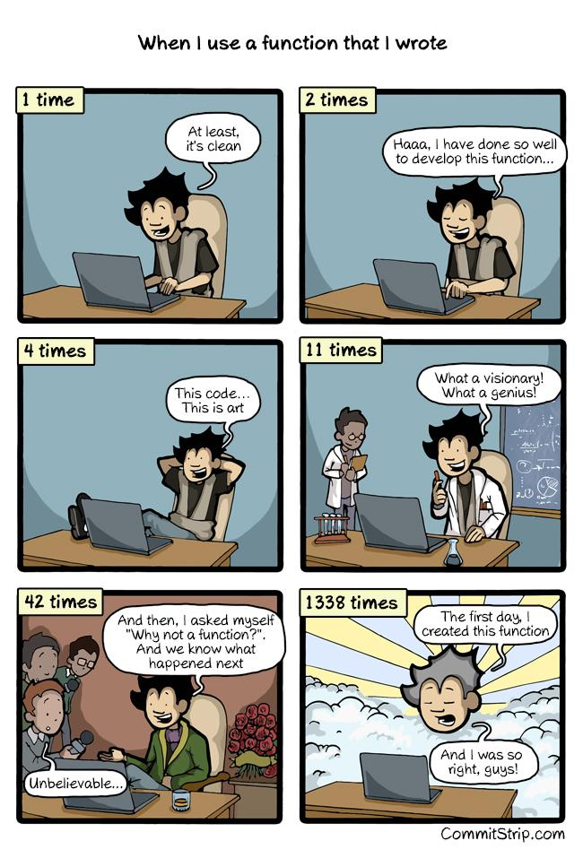
Code Reuse

Slide 4
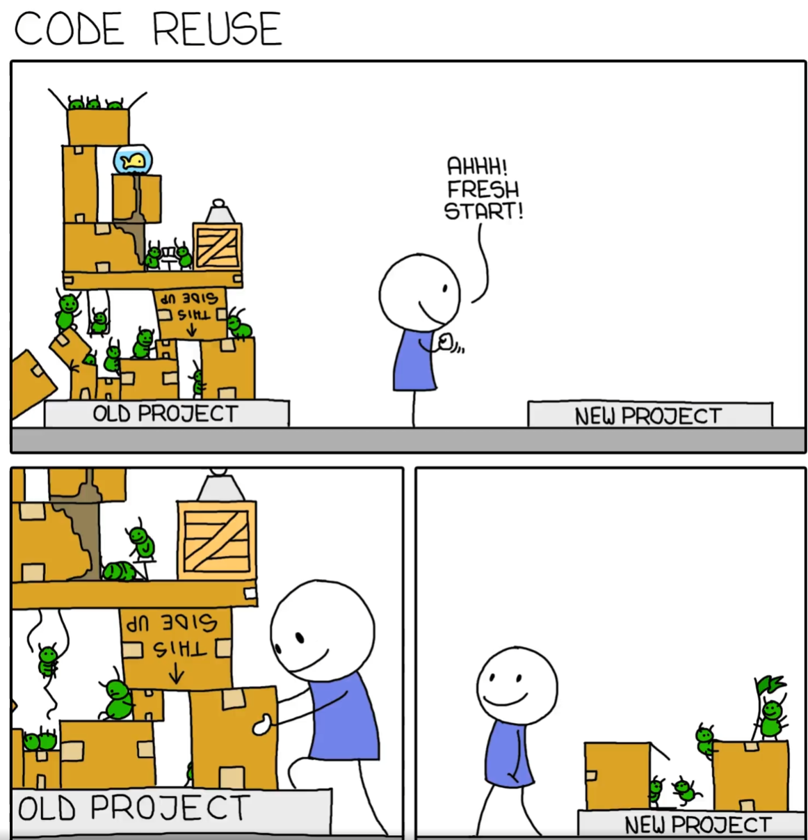
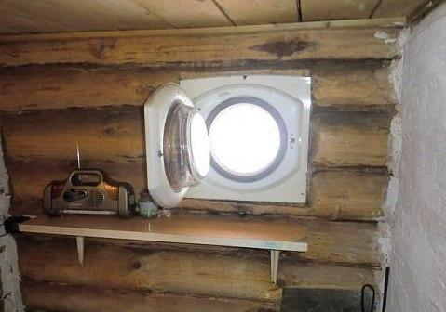
Code Reuse

Slide 5
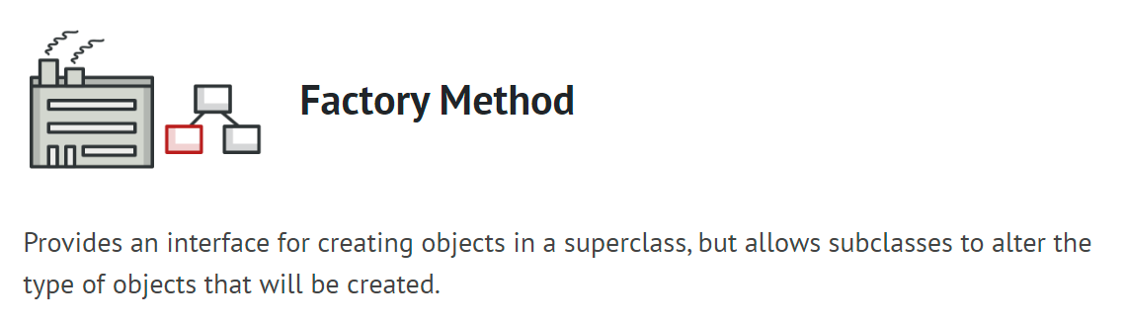
Creational Design Patterns

Slide 6
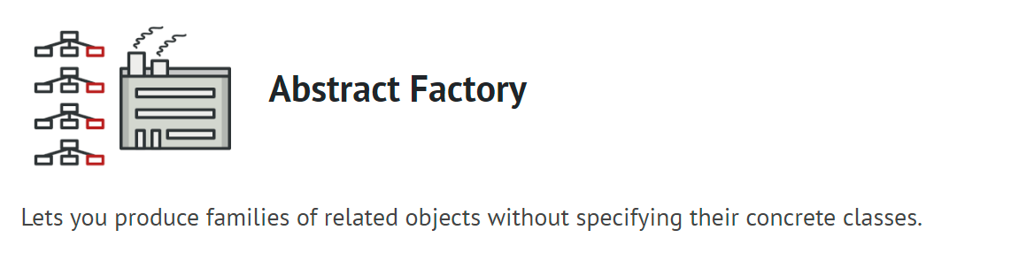
Creational Design Patterns

Slide 7
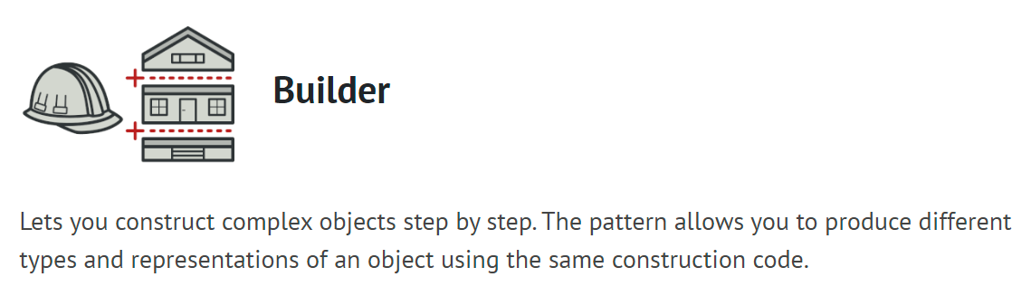
Creational Design Patterns
*We are not doing this one*

Slide 8
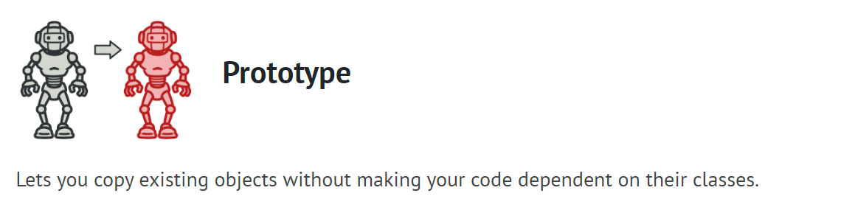
Creational Design Patterns
*We are not doing this one*

Slide 9
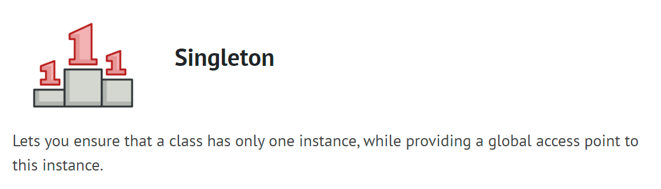
Creational Design Patterns

Slide 10
Factory Method aka Virtual Constructor
Definition:
Provides an interface for creating objects in a superclass but allows subclasses to alter the type of objects that will be created

Slide 11
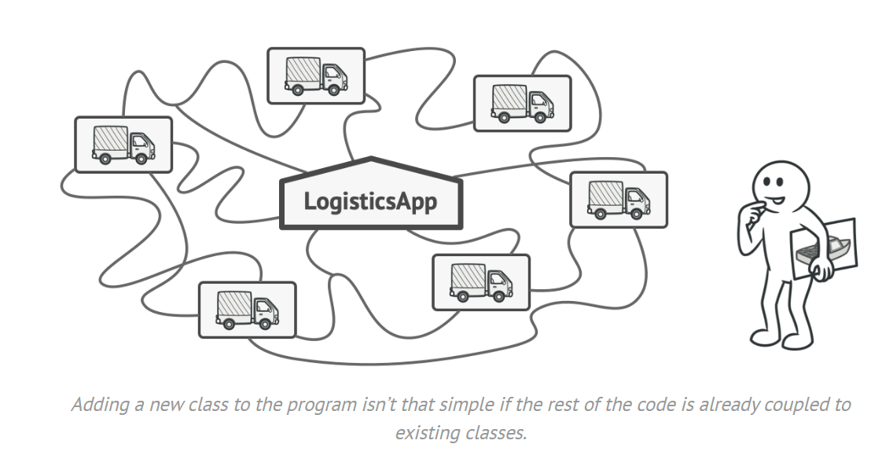
Problem

Slide 12
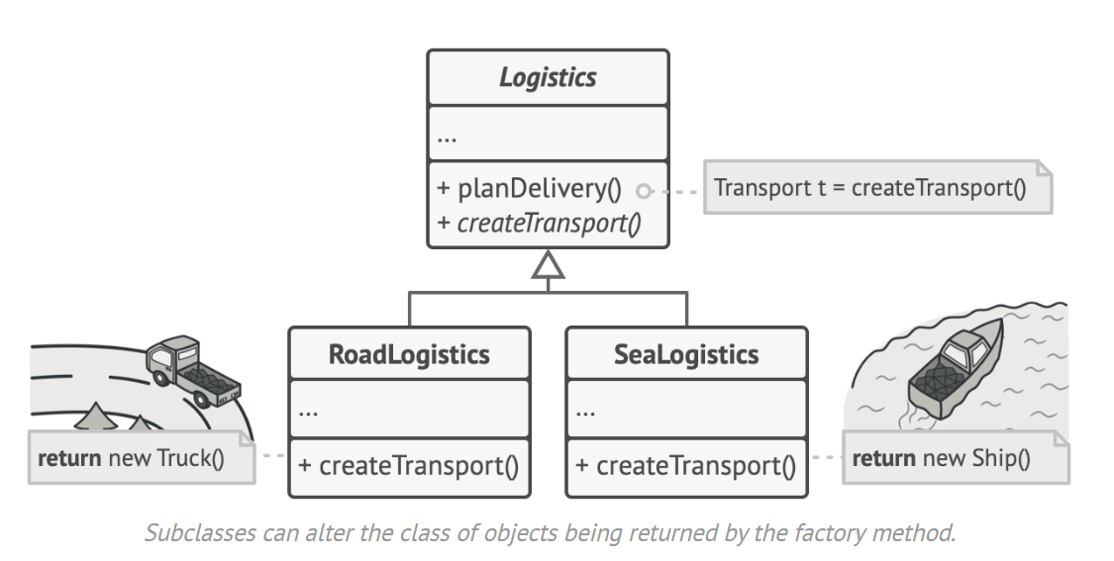
Solution

Slide 13
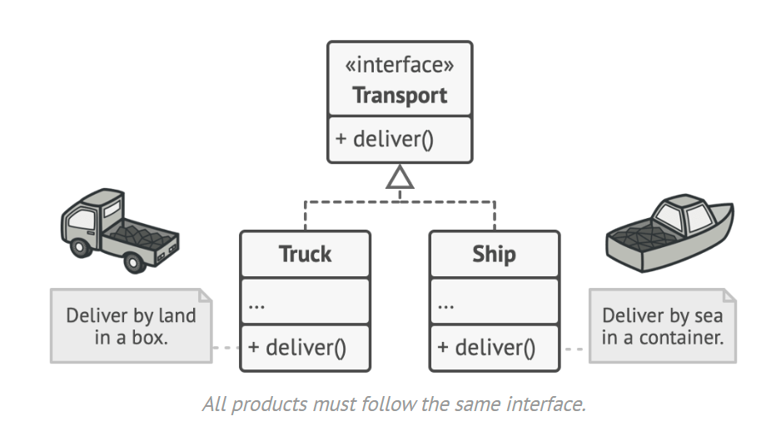
Solution

Slide 14
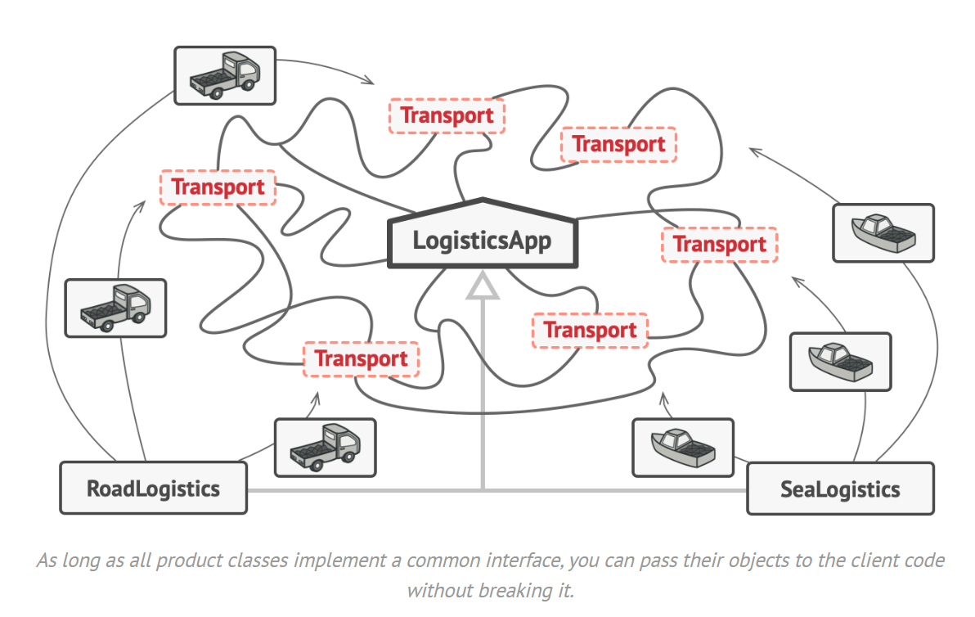
Solution

Slide 15
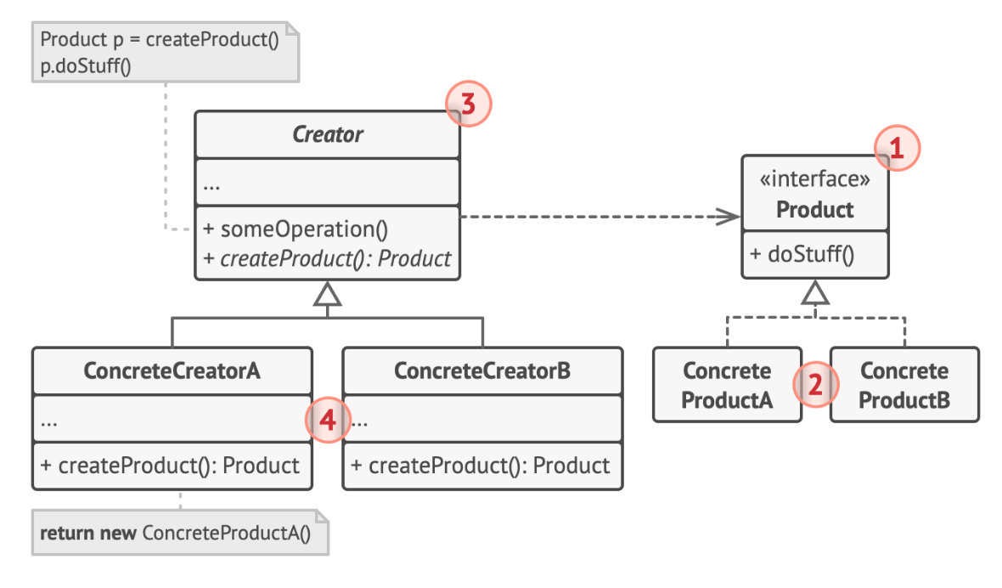
UML Class Diagram Structure
1. The Product declares the interface, which is common to all objects that can be produced by the creator and its subclasses.

Slide 16
UML Class Diagram Structure
2. Concrete Products are different implementations of the product interface.

Slide 17
UML Class Diagram Structure
3. The Creator class declares the factory method that returns new product objects. It’s important that the return type of this method matches the product interface.

Slide 18
UML Class Diagram Structure
4. Concrete Creators override the base factory method, so it returns a different type of product.

Slide 19
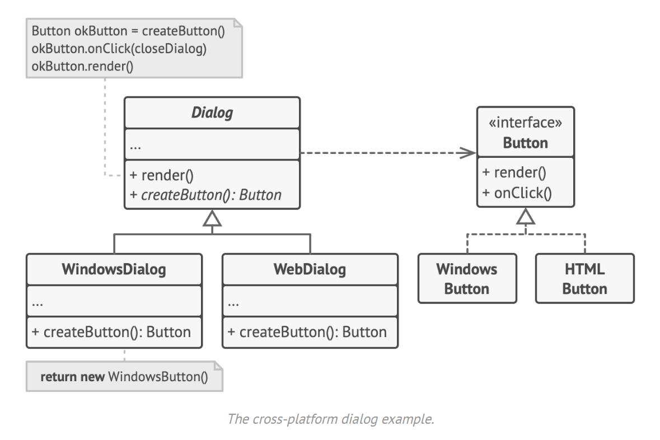

Slide 20
Factory Method - Applicability
When you don’t know beforehand the exact types and dependencies of the objects your code should work with.
When you want to provide users of your library or framework with a way to extend its internal components.
When you want to save system resources by reusing existing objects instead of rebuilding them each time.

Slide 21
The big pros
Avoid tight coupling between the creator and the concrete products
S from SOLID
O from SOLID

Slide 22
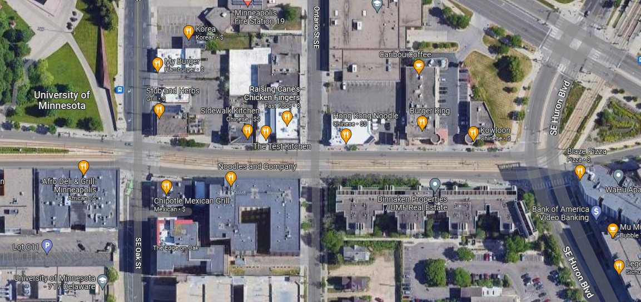
Demo and Walkthrough of Factory Method

Slide 23
Singleton Pattern
Definition:
Let's you ensure that a class has only one instance, while providing a global access point to this instance

Slide 24
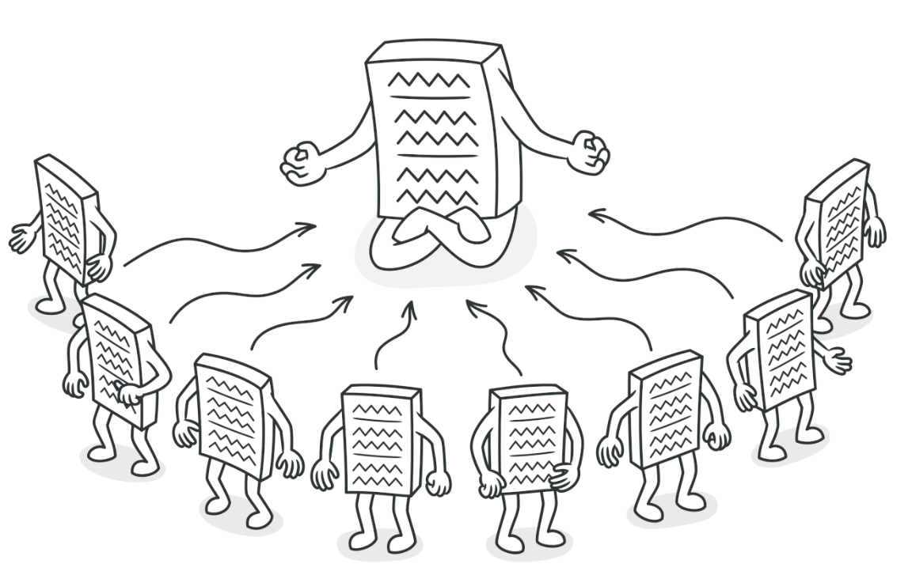
Singleton Pattern

Slide 25
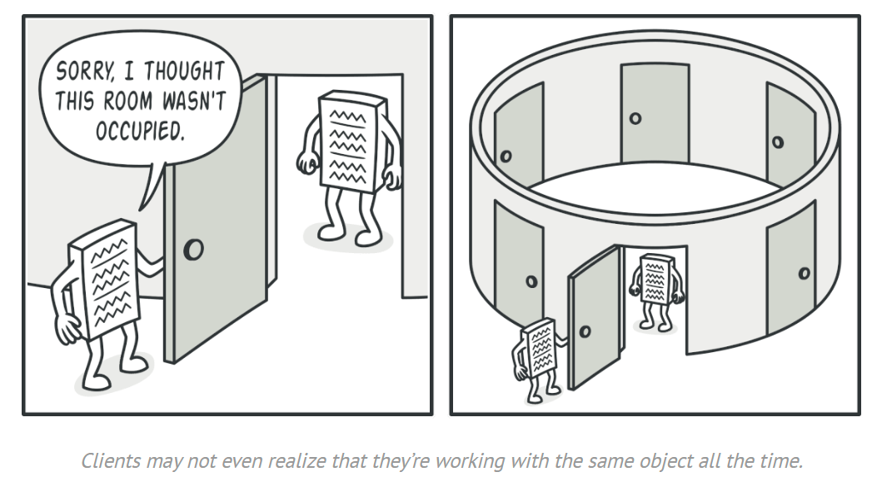
Singleton Pattern
This pattern breaks the S of SOLID
Does 2 things:
Ensures that a class has just a single instance
Provides a global access point to that instance

Slide 26
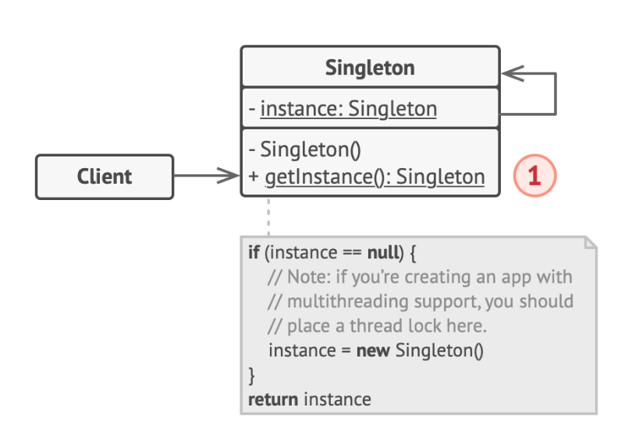
UML Class Diagram Structure
1. The Singleton class declares the static method getInstance that returns the same instance of its own class.
The Singleton’s constructor should be hidden from the client code. Calling the getInstance method should be the only way of getting the Singleton object.

Slide 27
Singleton Applicability
When you need strict control over global variables
When your program should have exactly one instance available to all clients/users

Slide 28
The big pros
The class only has one instance
Global access point to that instance
Only initialized once – the first time

Slide 29
Singleton – no code example
Singleton was one of the most used extensions for the project in this course
Data Collection Class

