Slide 1
CSci 3081W: Program Design and Development
Lecture 10 – Behavioral Design Patterns
Strategy Pattern

Slide 2
Behavioral Design Patterns
Behavioral design patterns are concerned with algorithms and the assignment of responsibilities between objects.

Slide 3
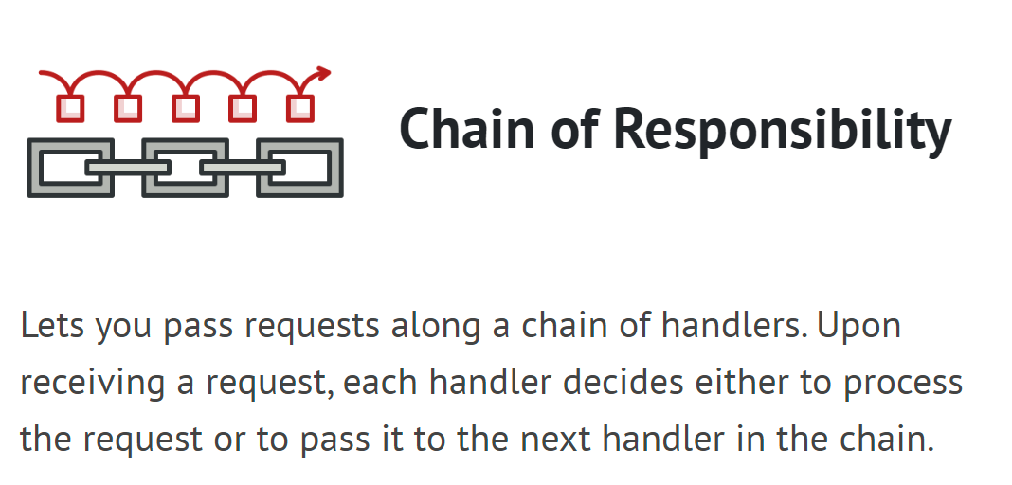
Behavioral Design Patterns
**We are not going over this one**

Slide 4
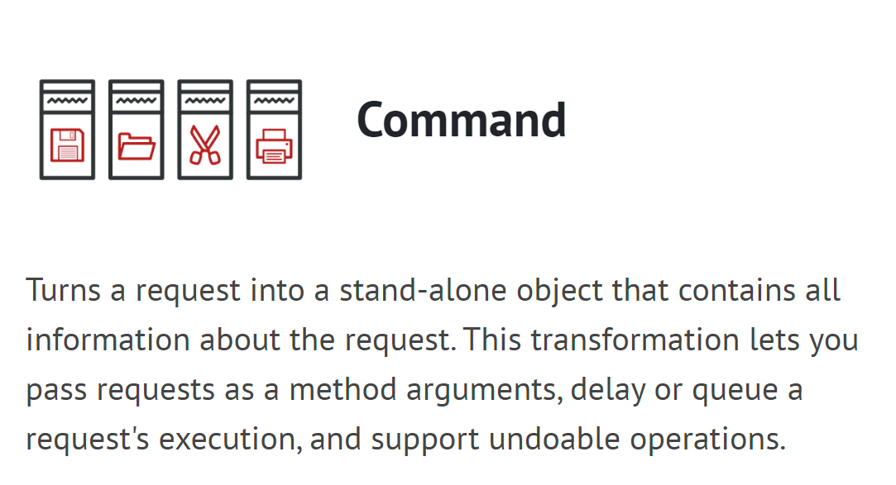
Behavioral Design Patterns
**We are not going over this one**

Slide 5
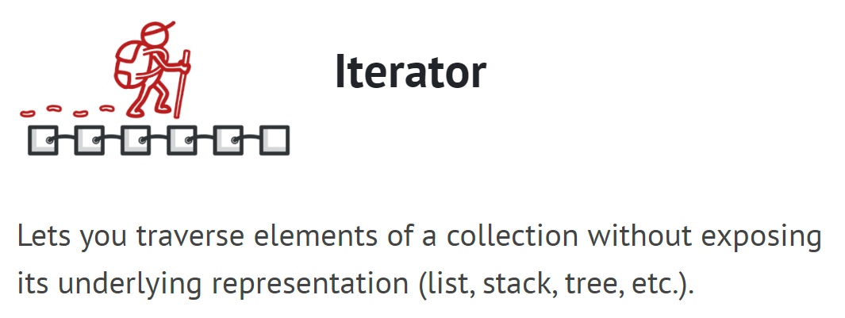
Behavioral Design Patterns
**We are not going over this one**

Slide 6
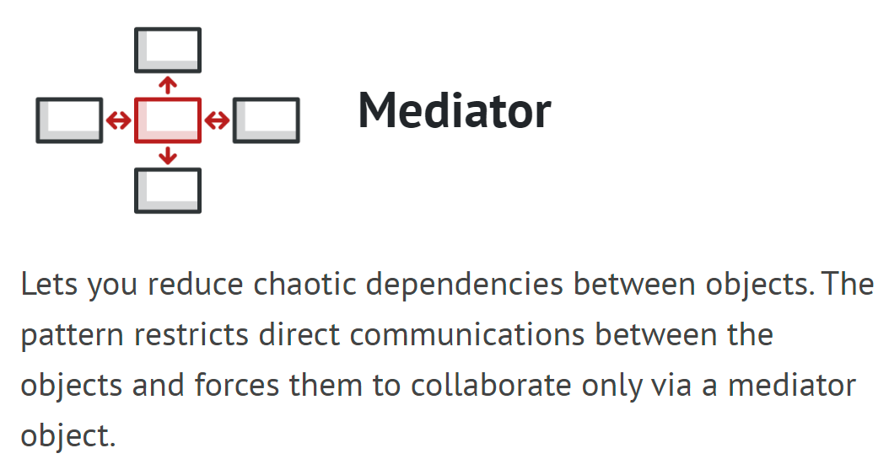
Behavioral Design Patterns
**We are not going over this one**

Slide 7
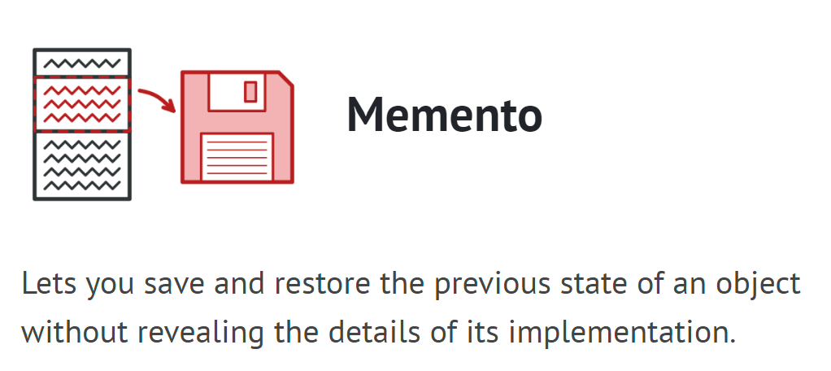
Behavioral Design Patterns
**We are not going over this one**

Slide 8
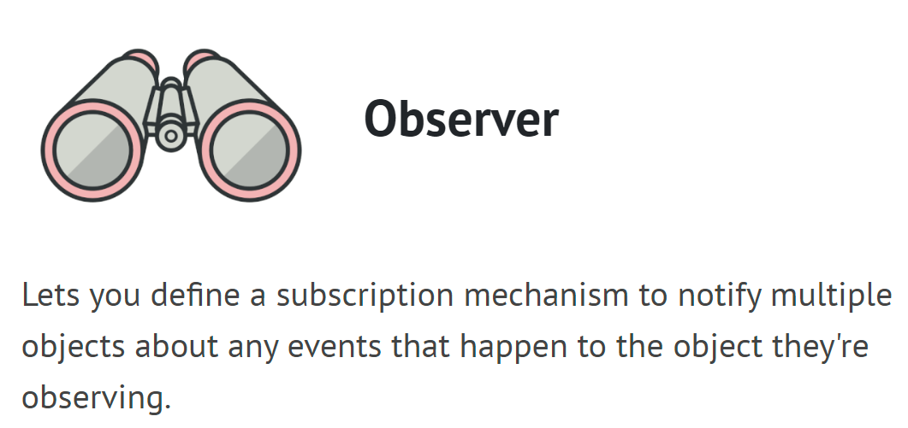
Behavioral Design Patterns

Slide 9
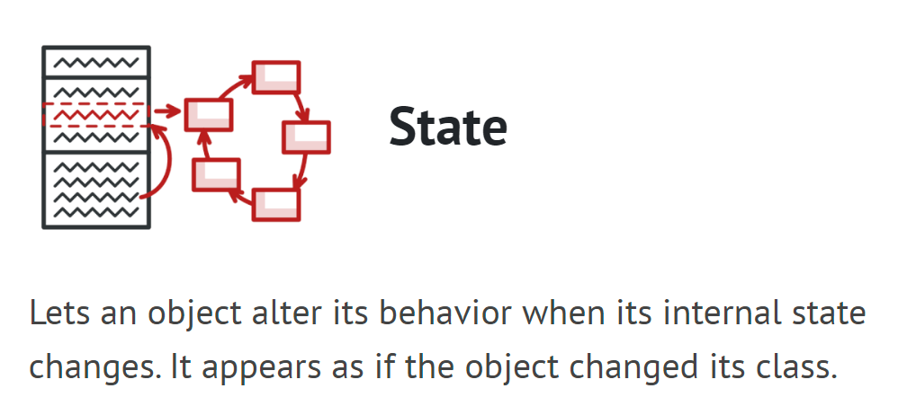
Behavioral Design Patterns
**We are not going over this one**

Slide 10
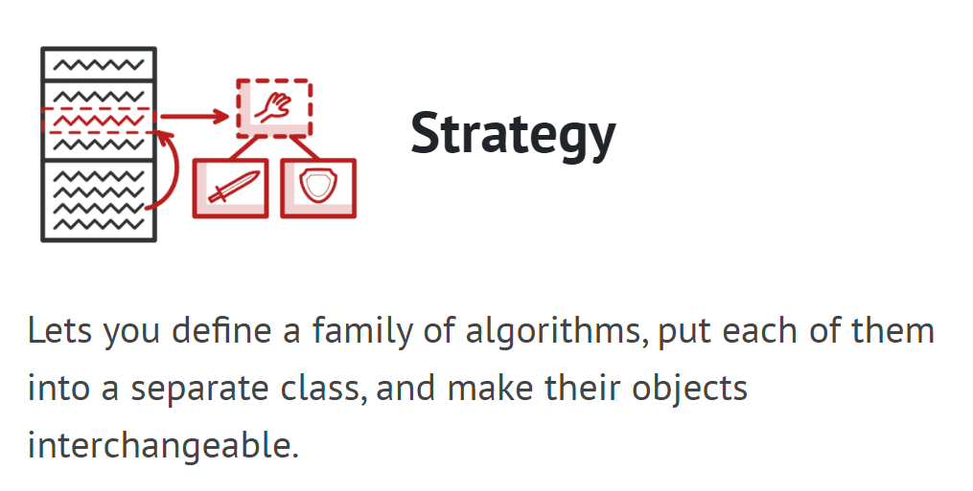
Behavioral Design Patterns

Slide 11
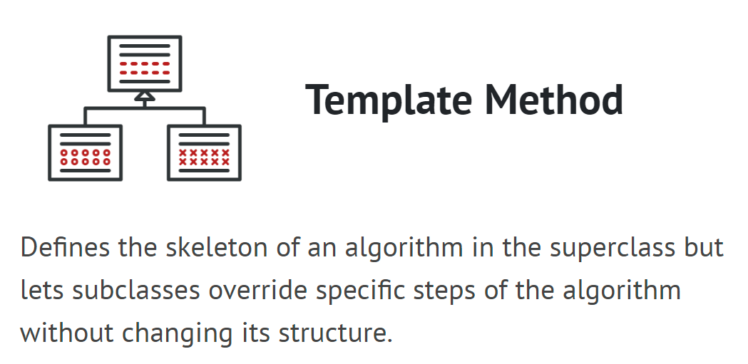
Behavioral Design Patterns
**We are not going over this one**

Slide 12
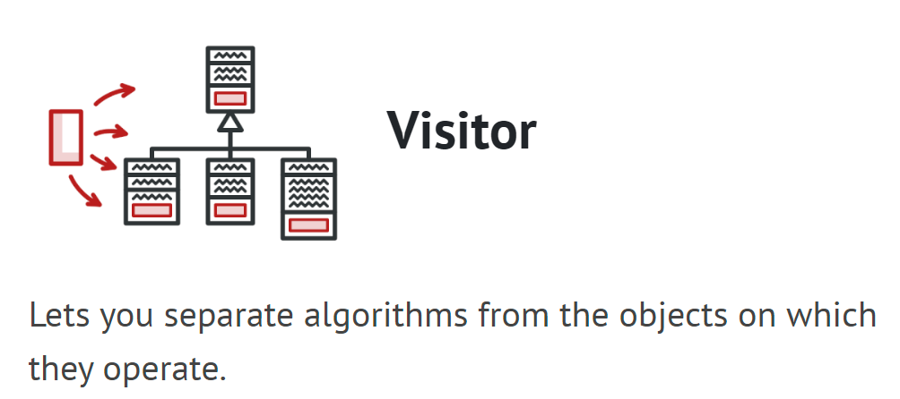
Behavioral Design Patterns
**We are not going over this one**

Slide 13
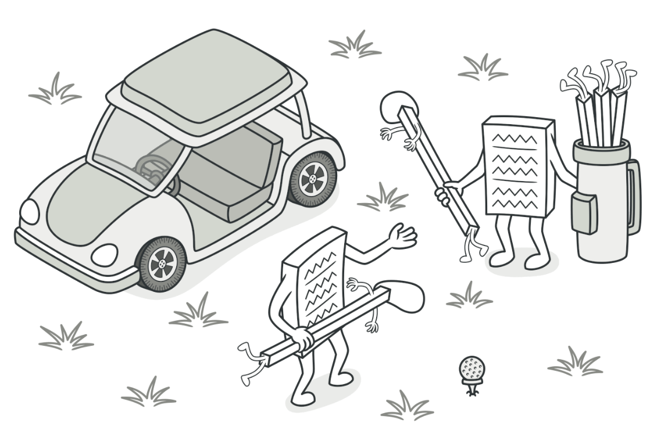
Strategy Pattern
Strategy is a behavioral design pattern that lets you define a family of algorithms, put each of them into a separate class, and make their objects interchangeable.

Slide 14

Problem
First Iteration –
Shortest Path Algorithm
Beeline
**This is just an example, only tangentially related to your project**

Slide 15
Problem
Second
Iteration –
Wind is too strong for Beeline
A* on the roads
**This is just an example, only tangentially related to your project**

Slide 16
Problem
Third
Iteration –
A* is too expensive
Some other algorithm
**This is just an example, only tangentially related to your project**

Slide 17
Problem
Nth
Iteration –
Who knows
Algorithm N
**This is just an example, only tangentially related to your project**

Slide 18
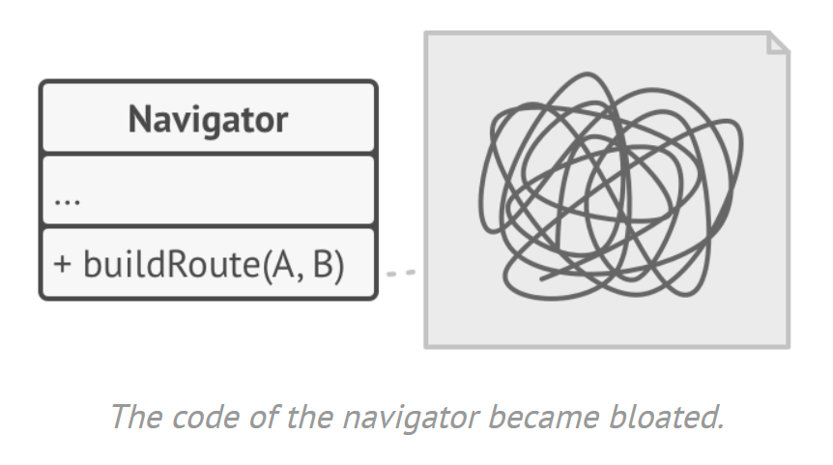
Problem

Slide 19
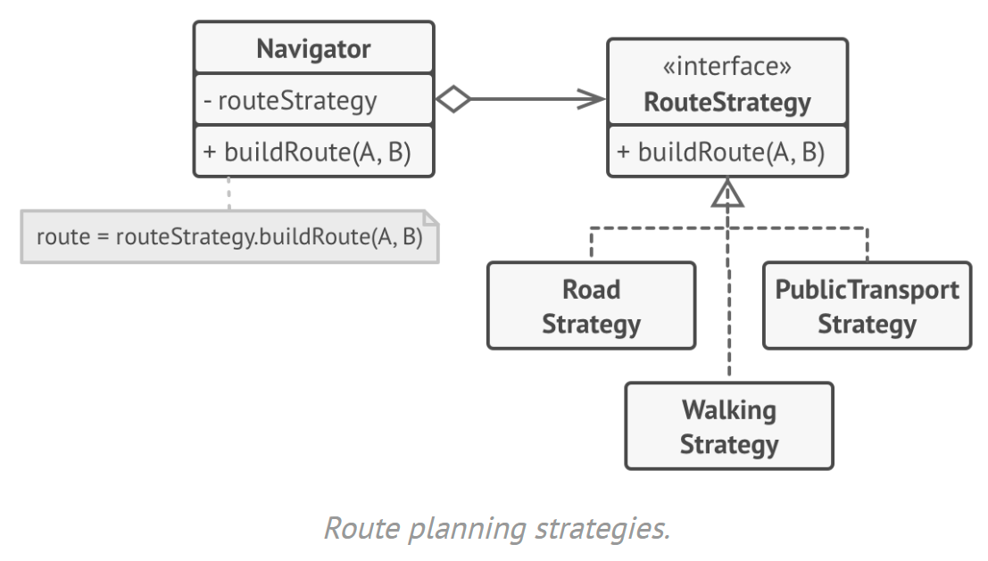
Solution

Slide 20
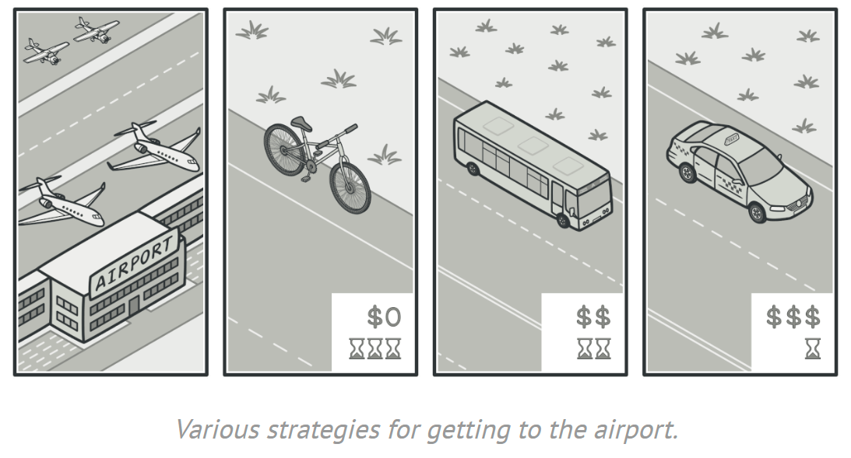
Another Example

Slide 21
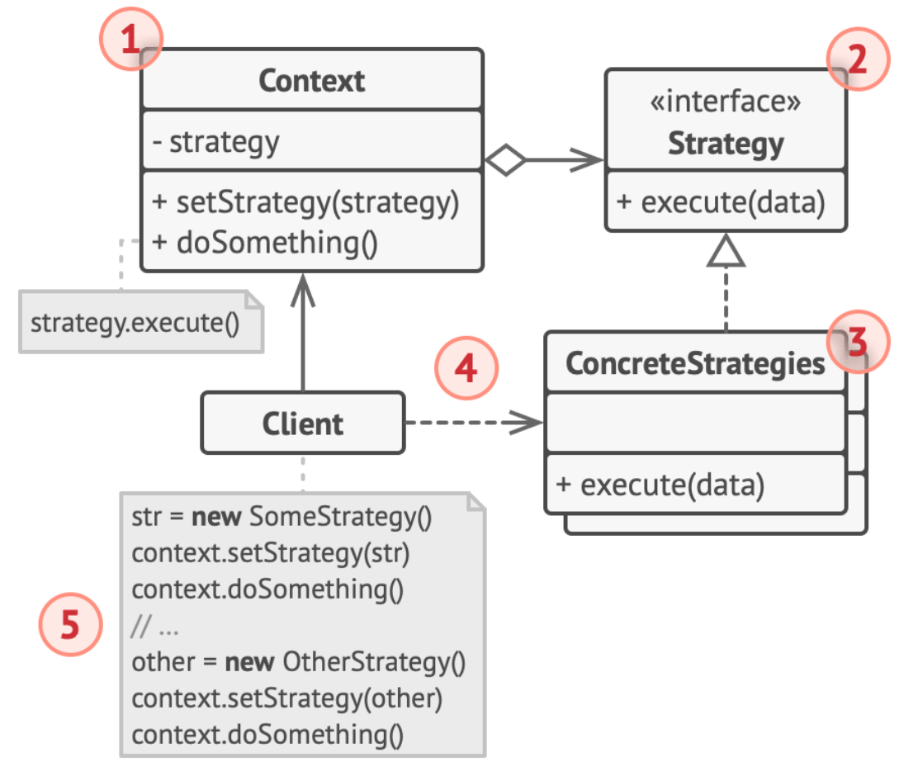
UML Class Diagram
1. The Context maintains a reference to one of the concrete strategies and communicates with this object only via the strategy interface.

Slide 22
UML Class Diagram
2. The Strategy interface is common to all concrete strategies. It declares a method the context uses to execute a strategy.

Slide 23
UML Class Diagram
3. Concrete Strategies implement different variations of an algorithm the context uses.

Slide 24
UML Class Diagram
4. The context calls the execution method on the linked strategy object each time it needs to run the algorithm. The context doesn’t know what type of strategy it works with or how the algorithm is executed.

Slide 25
UML Class Diagram
5. The Client creates a specific strategy object and passes it to the context. The context exposes a setter which lets clients replace the strategy associated with the context at runtime.

Slide 26
Applicability
When you want to use different variants of an algorithm within an object and be able to switch from one algorithm to another
When you have a lot of similar classes that only differ in the way they execute some behavior
To isolate the business logic of a class from the implementation details of algorithms
when your class has a massive conditional statement for switching between variants of the same algorithm

Slide 27
The big pros
Swap algorithms used inside an object
Isolate implementation of an algorithm from the code that uses it
Replace inheritance with composition
O from SOLID

Slide 28
Triathlete code example

