Slide 1
CSci 3081W: Program Design and Development
Lecture 12 – Decorator Pattern
Docker

Slide 2
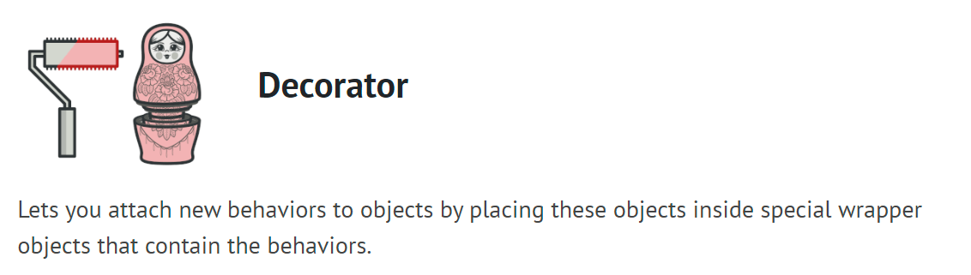
Structural Design Patterns

Slide 3
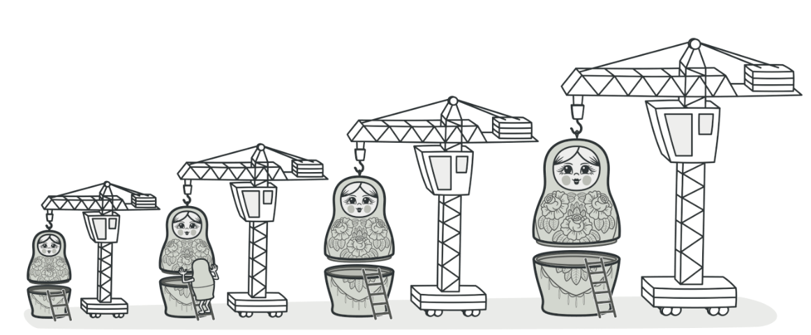
Decorator Pattern
Decorator is a structural design pattern that lets you attach new behaviors to objects by placing these objects inside special wrapper objects that contain the behaviors.

Slide 4
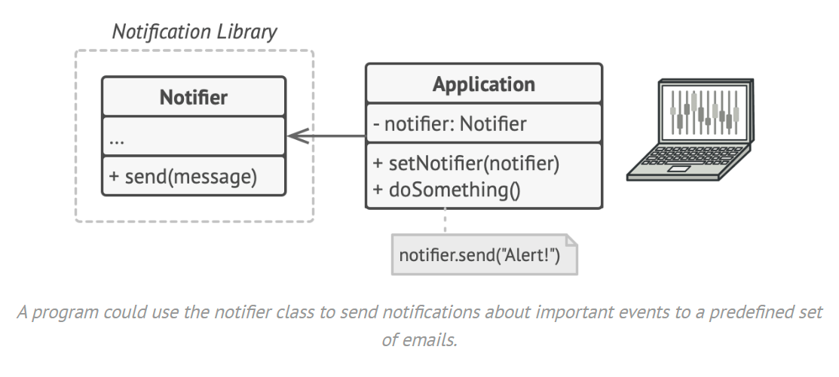
Problem

Slide 5
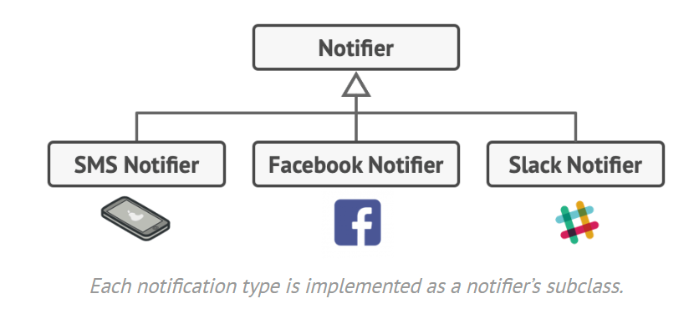
Problem

Slide 6
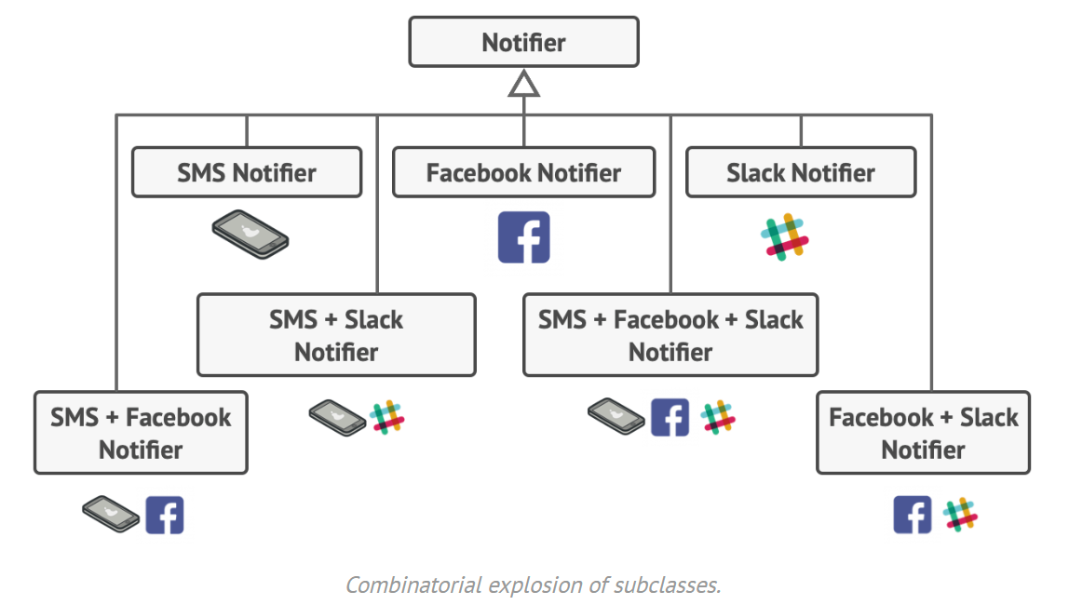
Problem

Slide 7
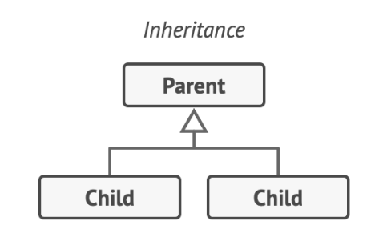
Potential Solution
Use inheritance (naïve)

Slide 8
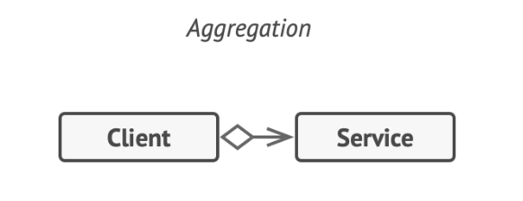
Better Solution
Use aggregation

Slide 9
Why aggregation over inheritance?
Inheritance is static.
You won’t be able to change behavior at runtime, only replace the whole object with a different subclass.
Also, in some languages, you can only inherit from one parent.

Slide 10
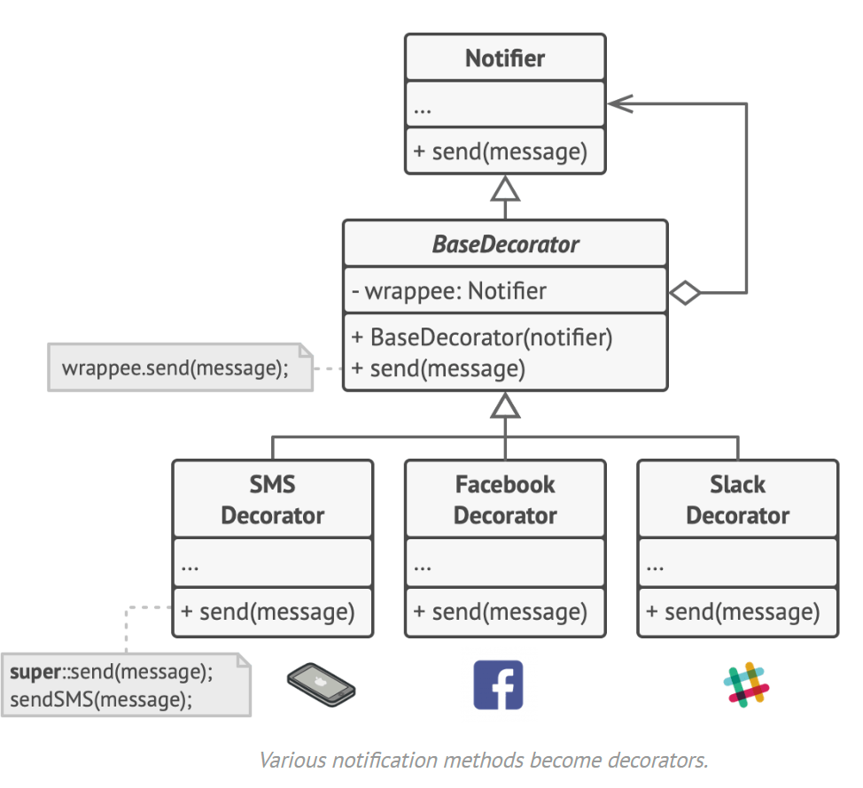
Solution

Slide 11
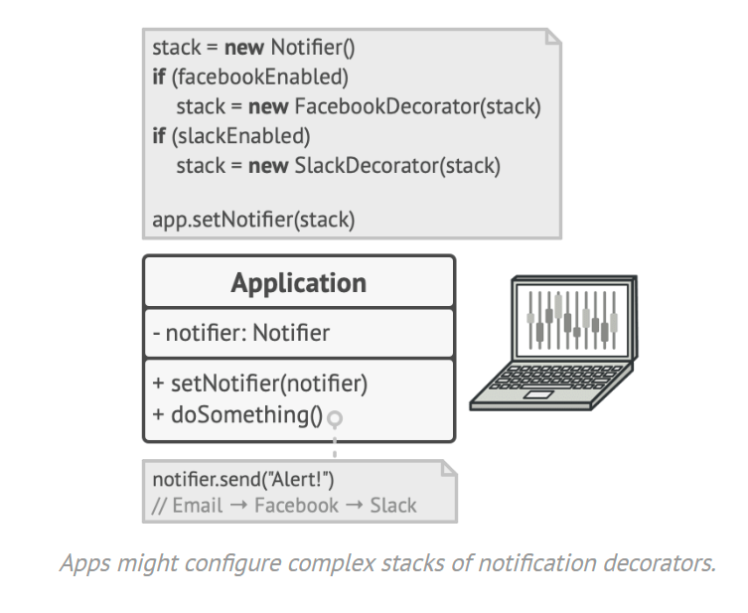
Solution

Slide 12
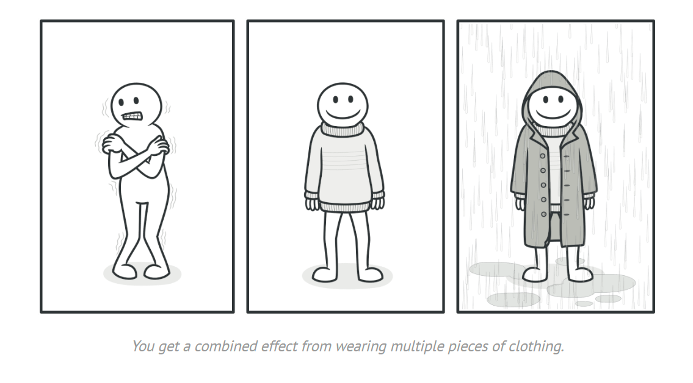
Solution

Slide 13
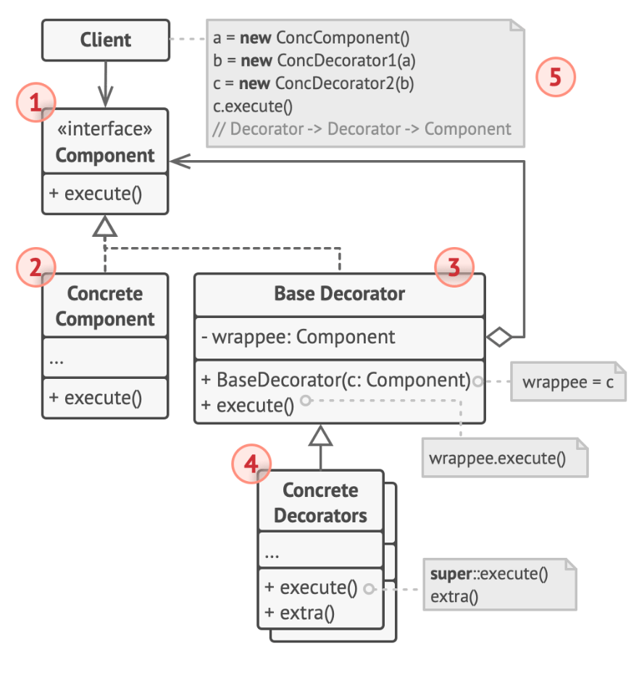
UML Class Diagram
1. The Component declares the common interface for both wrappers and wrapped objects.

Slide 14
UML Class Diagram
2. Concrete Component is a class of objects being wrapped. It defines the basic behavior, which can be altered by decorators.

Slide 15
UML Class Diagram
3. The Base Decorator class has a field for referencing a wrapped object. The field’s type is the component interface so it can contain both concrete components and decorators. The base decorator delegates all operations to the wrapped object.

Slide 16
UML Class Diagram
4. Concrete Decorators define extra behaviors that can be added to components dynamically. Concrete decorators override methods of the base decorator and execute their behavior either before or after calling the parent method.

Slide 17
UML Class Diagram
5. The Client can wrap components in multiple layers of decorators, if it works with all objects via the component interface.

Slide 18
Applicability
When you want to give extra behaviors to objects at runtime without breaking any existing code
When it’s not possible to extend an object’s behavior via inheritance

Slide 19
The big pros
S from SOLID
Extend behavior without making a subclass
Can add and remove functionality from an object at runtime
Can combine several behaviors all into one object (using multiple decorators)

Slide 20
Relationships to other patterns
Composite and Decorator both use recursive composition
A Decorator is like a Composite but only has one child component.
Decorator adds additional responsibilities to the wrapped object, while Composite just “sums up” its children’s results.
Strategy changes the behaviors of a class on the inside and the decorator(s) change the behavior on the outside

Slide 21
Code Examples

Slide 22

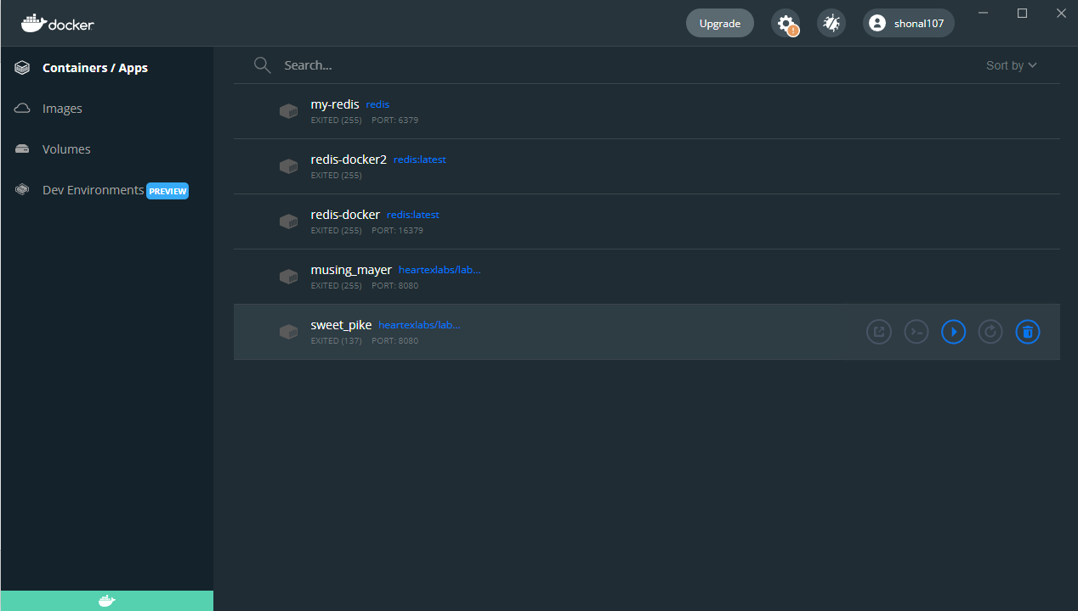
Docker

Slide 23

Docker

Slide 24

Docker
**this is a joke**

Slide 25

Docker

Slide 26
Docker
Software that lets you work with containers.
Build, deploy, run, update, and manage containers.
What’s a container? Executable component that combines source code with OS libraries and dependencies required to run the source code.
If you like cloud-native development and hybrid multicloud environments, go read and learn about Docker.

Slide 27
Docker
Better than a VM (virtual machine)
lightweight: don’t have an entire OS instance, just the OS processes necessary to execute the source code
Increased productivity – better for Agile and DevOps because they’re ideal for CI/CD because they’re faster and easier to deploy than VMs
Greater resource efficiency – save money on your cloud spending

Slide 28
Docker Pros
Improved and seamless container portability
Lightweight and granular updates
Automated container creation
Container versioning
Container reuse
Shared container libraries

Slide 29
Docker Terms
DockerFile – list of instructions for Docker to run in order to build the image
Docker Images – executable source code, tools, libraries, and dependencies that runs to make the container. When you run an image, it becomes one instance of the container
Docker containers - Docker containers are the live, running instances of Docker images meaning users can interact with them
Docker Hub – GitHub for Docker
Docker Desktop – the app that I use for Docker stuff, also links to Docker Hub

