Slide 1
CSci 3081W: Program Design and Development
Lecture 13 – Development Processes

Slide 2
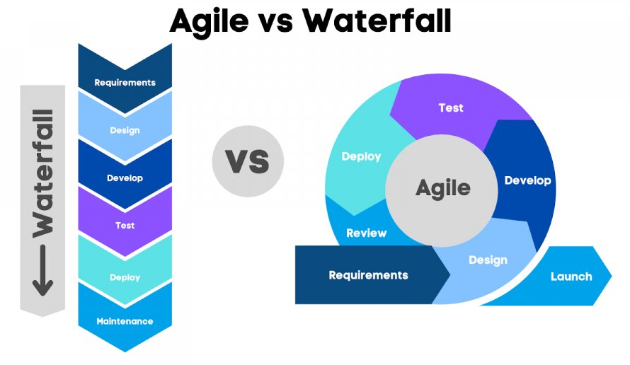
Introduction to Software Development Life Cycle
What is the SDLC?
A framework for structuring the process of developing software
Ensures quality, predictability, repeatability
Different projects need different models

Slide 3
Introduction to Software Development Life Cycle
Why are there so many SDLC models?
Project size
Complexity
Stakeholder engagement
Rate of requirement change

Slide 4
Development Model Classifications
Predictive vs. Adaptive
Predictive: plan-driven, follows a structured path (e.g. Waterfall)
Adaptive: change-driven, responsive to new information (e.g. Agile)

Slide 5
Predictive vs. Adaptive

Slide 6
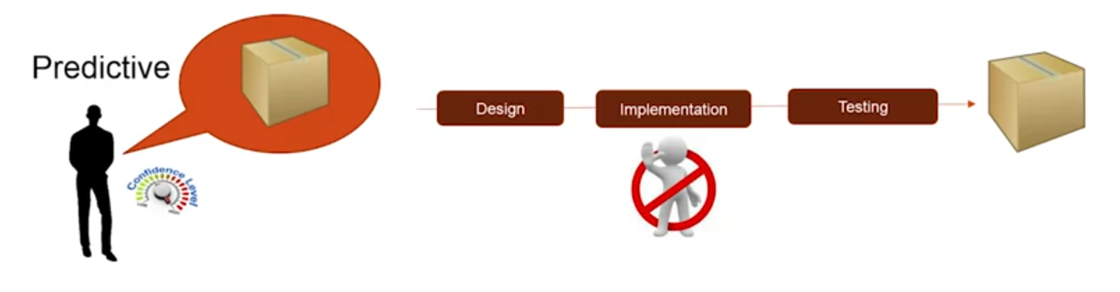
Predictive vs. Adaptive

Slide 7
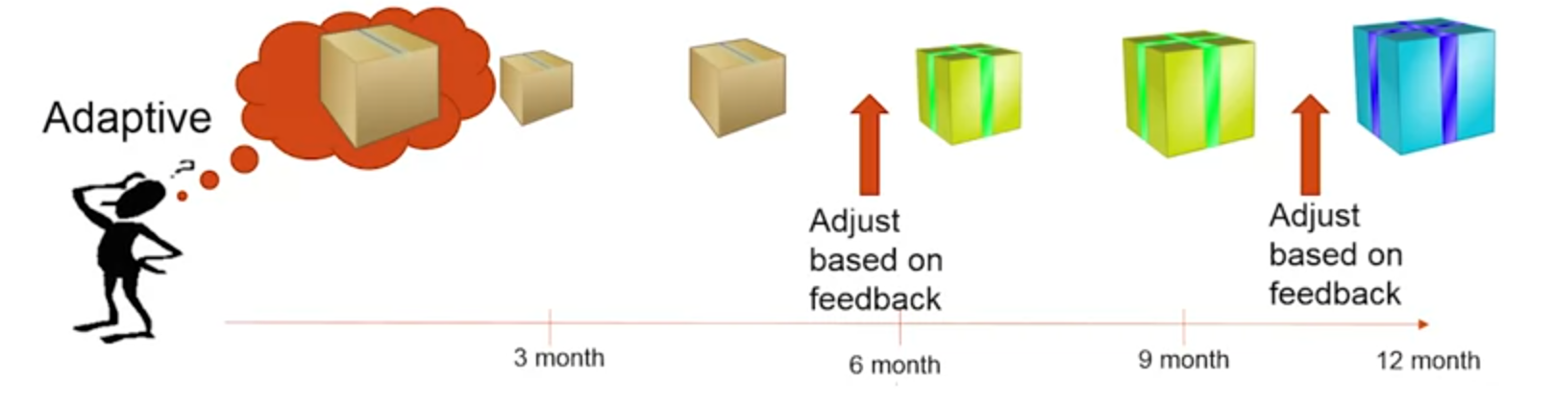
Predictive vs. Adaptive

Slide 8
Development Model Classifications
Incremental vs. Iterative vs. Both vs. Neither
Incremental: add new functionality each step
Iterative: refine or rework existing parts
Both: agile and real-world dev often do both
Neither: Pure waterfall

Slide 9

Incremental vs. Iterative
Incremental
Notes:
Good idea of what to build, build in increments

Slide 10

Incremental vs. Iterative
Iterative
Notes:
Not super clear idea but somewhat of a difference

Slide 11
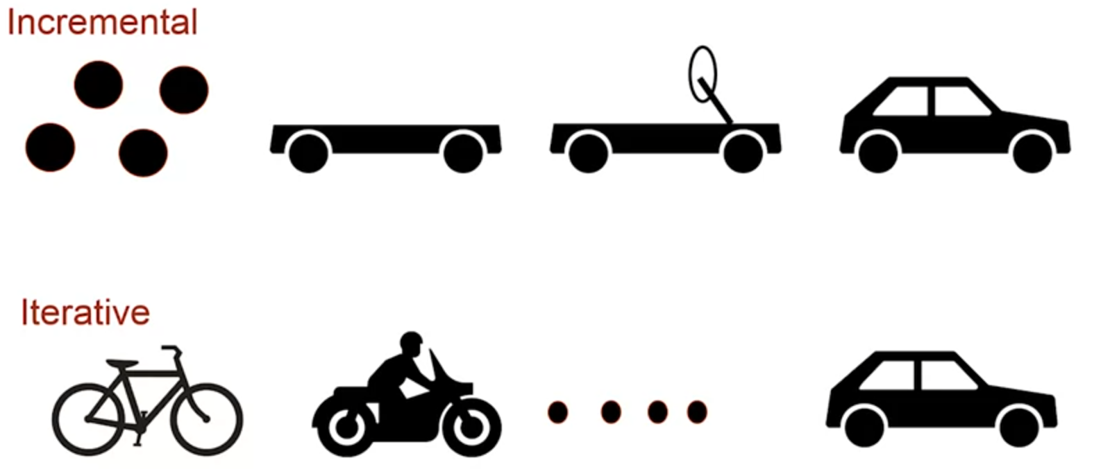
Incremental vs. Iterative vs. Both vs. None
Notes:
Agile is both
Predictive model is none

Slide 12
Incremental vs. Iterative
Incremental
Build and deliver in chunks
Use when parts of the system are well understood
Iterative
Refine same product through cycles
Use when requirements are unclear

Slide 13
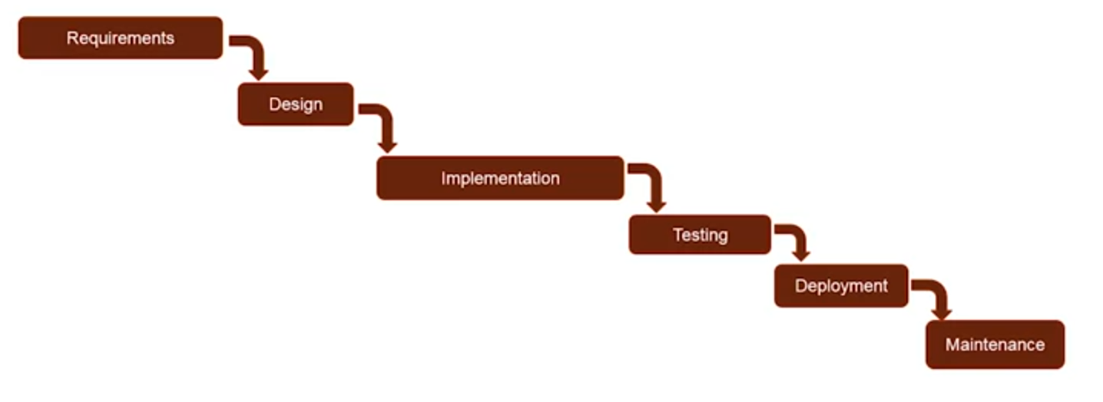
Waterfall

Slide 14
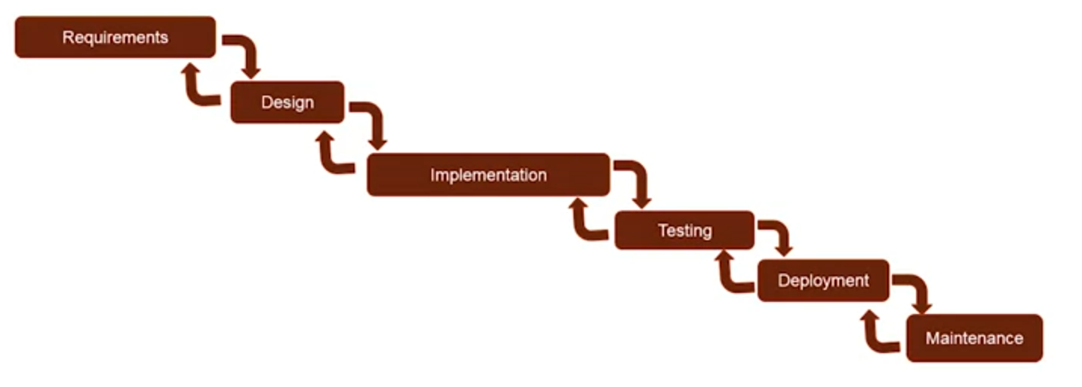
Waterfall

Slide 15
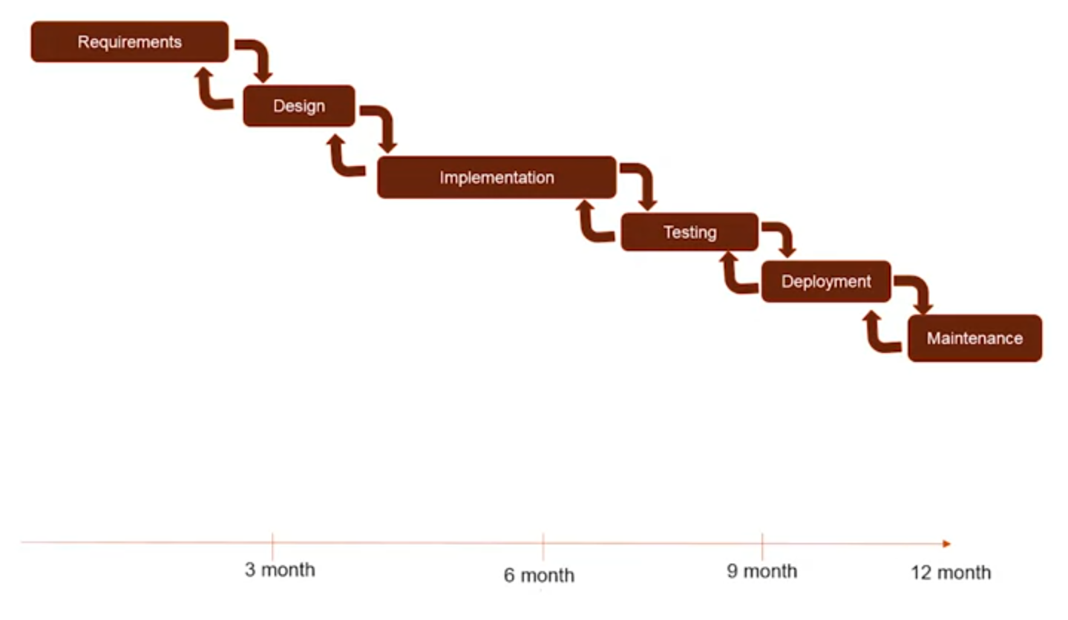
Waterfall
Cost of change
As time elapses, cost of change increases

Slide 16
Waterfall
Assumptions
We fully understand the requirements, we were given the requirements with no mistakes in them, the requirements won’t change
Team has experience building similar software
The whole process from requirements all the way until the release will be perfect
When to use
Predictable, repeatable work

Slide 17
Waterfall
Predictive/Adaptive Scale
Completely predictive
Pros
Simple, easy for everyone to understand
Predictable
Efficient
Cons
Not flexible for change
First release happens at the end of the process

Slide 18
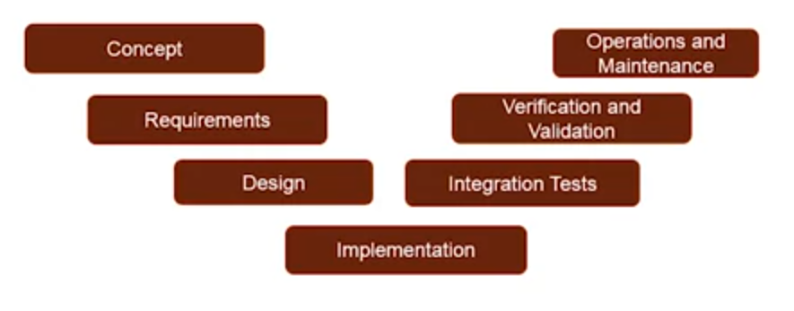
V-Model

Slide 19
Validation and Verification
V&V are two procedures which check requirements and specifications
Validation checks requirements - am I building the right thing? Verification checks specifications - am I building the thing correctly?

Slide 20
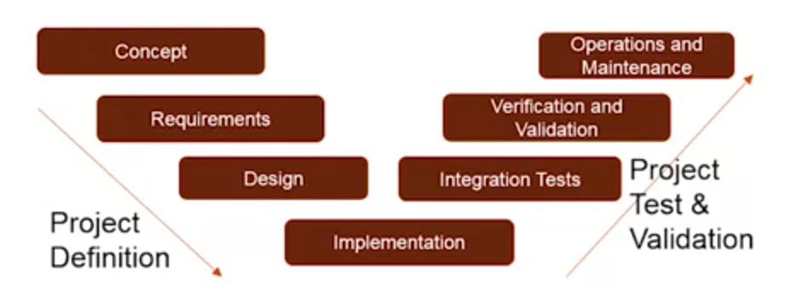
V-Model

Slide 21
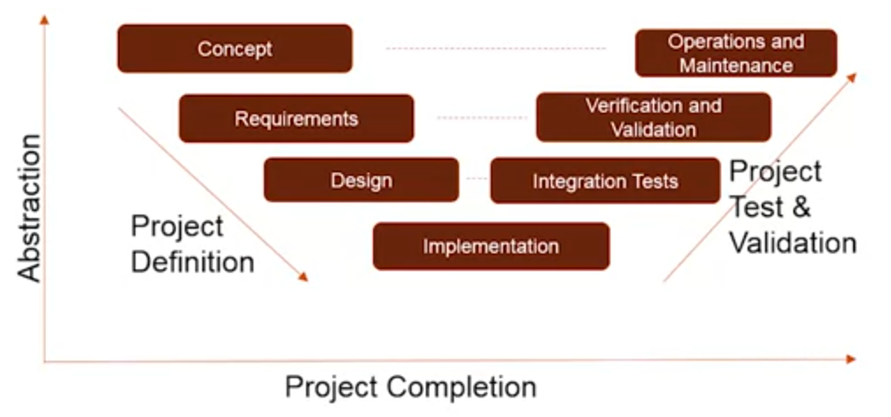
V-Model

Slide 22
V-Model
Mechanism – emphasis on validation earlier in the process
Predictive/Adaptive Scale
Predictive – no feedback/changes
When to use?
Ambiguity in the requirements
Mission critical or regulated industries

Slide 23
V-Model
Pros
Earlier detection of potential issues
Cons
More upfront work

Slide 24
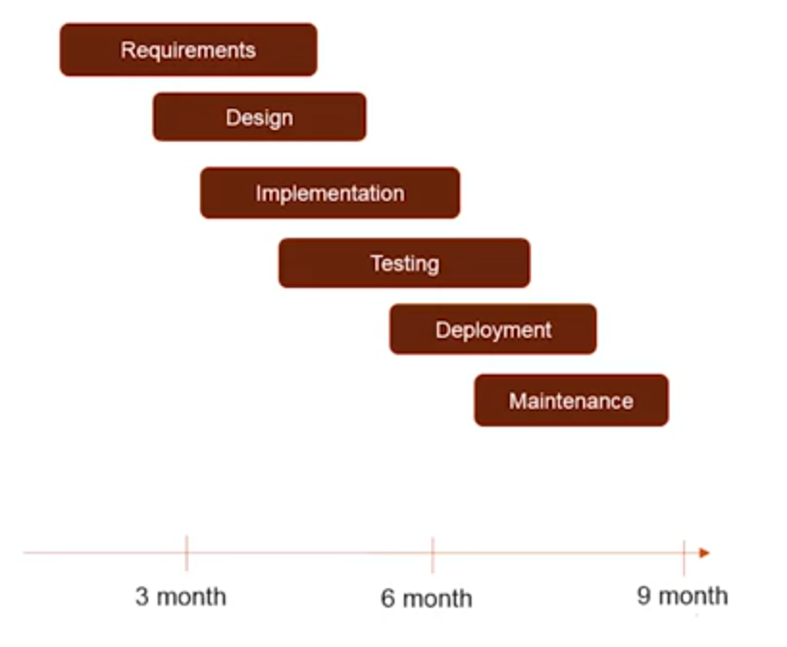
Sashimi

Slide 25
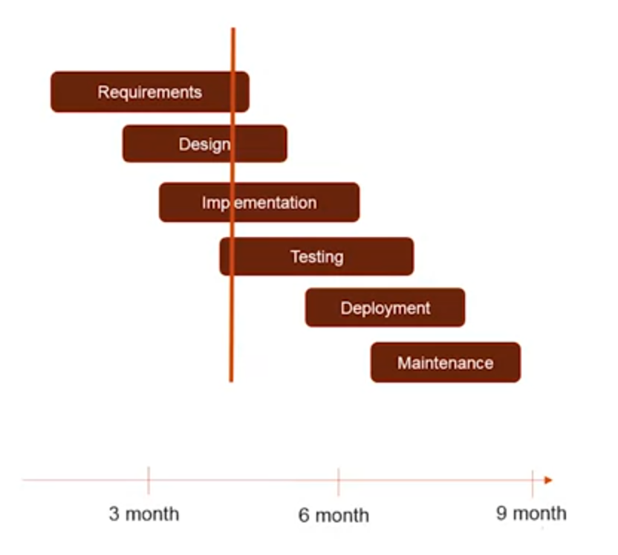
Sashimi

Slide 26
Sashimi
Mechanism – a phase can start before the previous phase ends
Predictive/Adaptive Scale
Almost completely predictive but maybe a little bit adaptive
When to use?
To shorten the time scale
Resource utilization

Slide 27
Sashimi
Pros
Shorten development time
People can start working without waiting for the previous phase to finish
Can learn more easily
Cons
Reworks

Slide 28
Comparing and Selecting Models
Model | Predictive? | Incremental? | Iterative? | Pros | Cons | Best for
Waterfall | Yes | No | No | Simple | Inflexible | Stable requirements
V-Model | Yes | No | No | Early Validation | High upfront effort | Mission-critical
Sashimi | Yes* | No | No | Faster Start | Risk of rework | Shorter timelines
Agile | No | Yes | Yes | Responsive | Hard to plan upfront | Changing requirements

Slide 29
Customizing the SDLC
Phases can be reordered, omitted, or merged
Example: agile omits “formal” design phases
SDLC is a guideline, you can always tweak the model to better fit your needs

Slide 30
How to choose a model?
How stable are the requirements?
How experienced is the team?
What are the project constraints?
How important is early delivery?
Know your project, pick what fits

Slide 31
SDLC in the wild
Waterfall
Government contracts, safety-critical
V-model
Medical software, automative
Sashimi
Projects with time crunch and some known elements
Agile
Startups and evolving products

Slide 32
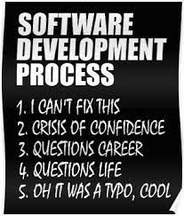
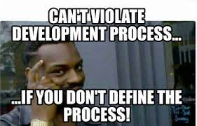

Slide 33
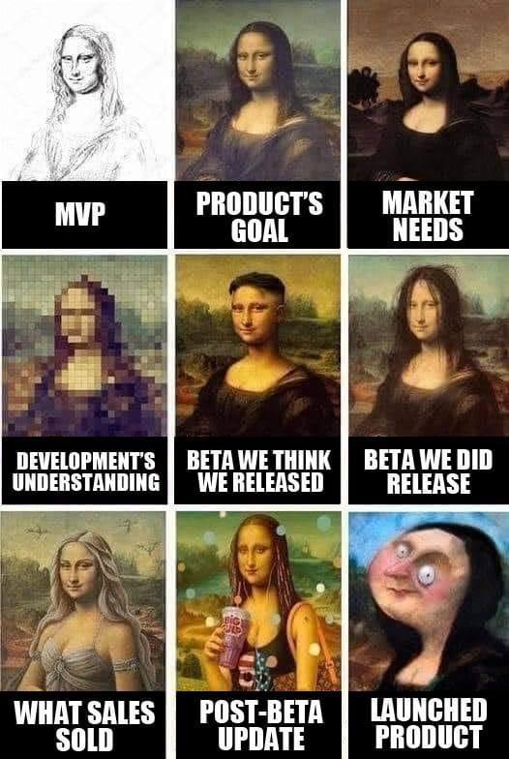
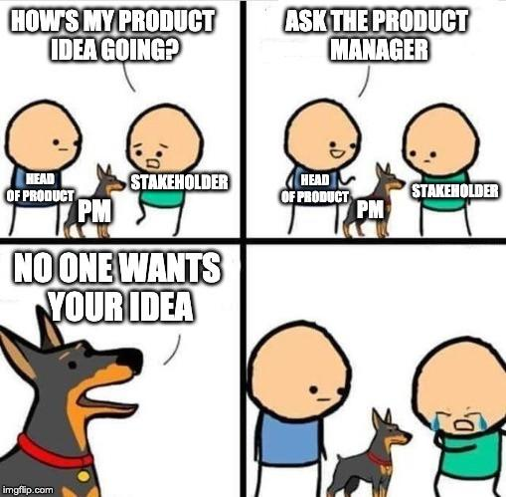

Slide 34
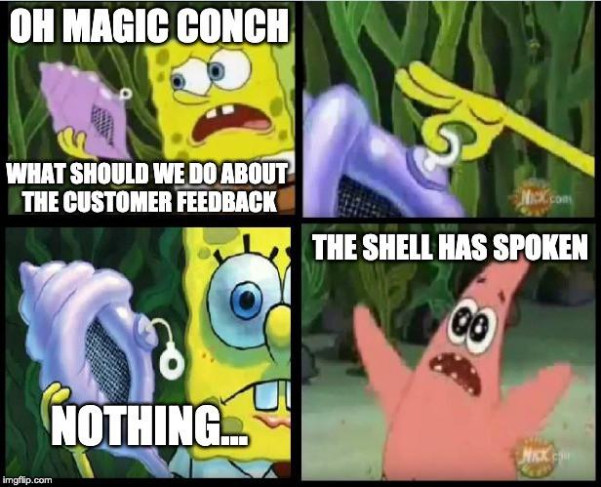
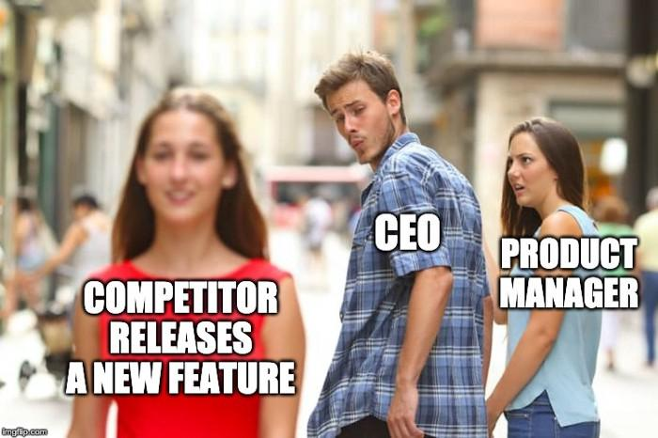

Slide 35
