Slide 1
CSci 3081W: Program Design and Development
Lecture 16 – Deployment

Slide 2
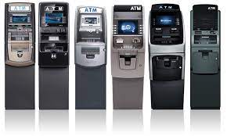


History
Black box (ex. physical ATM)
Cartridges, cassettes, floppy disks, CD/DVD, flash drives

Slide 3


History
Internet – enabled users to be able to download software without a hard copy (as well as installation, updates, etc)

Slide 4

Deployment
General process that can be modified
Activities within the deployment process
Can be handled by producer, consumer, or both

Slide 5
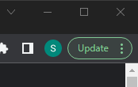
Deployment
Who deploys the software?
Depends!
Examples:
The user clicks update
DevOps: deployment/release coordinator(s)

Slide 6
Deployment Environment
Also known as tiers
A system or set of subsystems where a program or software is deployed and executed
In simple cases, you could have just a single environment
In industrial use/complex cases, the development environment and production environment are separated

Slide 7
Deployment Environment
In industrial use/complex cases, the development environment and production environment are separated
development environment - where the changes are made originally
production environment - what the clients or users end up using
*usually stages in between
This allows phased deployment (aka rollout), testing, and rollback in case of bugs or issues.

Slide 8
Deployment Environments
Environment Name | Description
Local | Developer's desktop/workstation
Development | Development server acting as a sandbox where unit testing may be performed by the developer
Testing | The environment where interface testing is performed
Staging/Pre-production/External-Client Acceptance | Mirror of production environment
Production | Serves end-users/Client

Slide 9
Deployment Environments
Local Environment
The place where developers code the features assigned to them for the sprint.
Your computer
Local
Development
Testing
Staging
Production

Slide 10
Deployment Environments
Development Environment
‘dev’
‘sandbox’ environment - code deployed to test servers
Local
Development
Testing
Staging
Production
Notes:
For example: if there’s 10 features being developed simultaneously, then there should ideally be 10 different dev environments such that we can see how each feature behaves individually.

Slide 11
Deployment Environments
Testing Environment
The environment where different types of testing can be performed
Combine features into one ‘release’
Local
Development
Testing
Staging
Production
Notes:
For eg: the 10 different features developed in the last sprint are all merged together in Github and their combination is now deployed to a testing environment where the QA team makes sure that none of the existing features are impacted by the changes made as well as none of the changes interfere with other changes made during the same sprint.

Slide 12
Deployment Environments
Staging Environment
Mimics the production environment
Client feedback (Agile!)
Used to check release before deployment
Local
Development
Testing
Staging
Production
Notes:
Eg: The features developed over the last sprint are now shown to the client where they can green flag/red flag changes based on their liking. If a change gets red flagged we go back to the local environment to develop a new solution. Else, we move to the production environment.

Slide 13
Deployment Environments
Production Environment
Environment that the users/clients use
Outages/mistakes often impact revenue, hence the previous environments in this process.
Local
Development
Testing
Staging
Production
Notes:
Eg: In our day to day lives we only interact with production environments. www.youtube.com, www.gmail.com, etc. are all production environments.

Slide 14
Deployment Environments
The process of running changes on all environments can happen as soon as one week!
This is after the developer has already coded the changes/features.
Local
Development
Testing
Staging
Production
Notes:
Eg: In our day to day lives we only interact with production environments. www.youtube.com, www.gmail.com, etc. are all production environments.

Slide 15
Hotfixes
Problem:
Imagine that you’re in production and there’s an important bug that needs to be fixed immediately
Solution:
local
testing
production

Slide 16
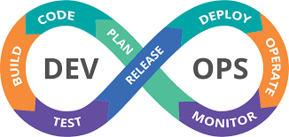
Intro to DevOps
Partnership between Development and Operations teams (dev and ops)
Enables code deployment and production to be more rapid and automated
Before DevOps, these teams worked independently from one another
Principles: flow, feedback, and continuous learning

Slide 17
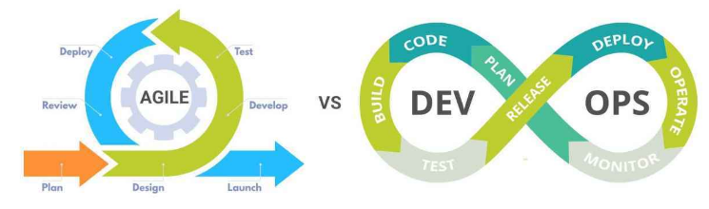
DevOps and Agile
Not mutually exclusive

Slide 18
DevOps and Agile
 | DevOps | Agile
Philosophy and Focus | - Rooted in stability, consistency, and planning - Seeks to identify new ways to improve and streamline processes - Focuses on maximizing efficiency, identifying programmable processes, and increasing automation | - Centers around adaptability and keeping pace with customer needs and expectations - Features are described as user stories, placing the focus on the individual user, what they need, and why
Scope | - Represents the intersections of development, operations, and quality assurance - Cross-disciplinary teams unite and collaborate in the development and delivery of software | -Specific to the development team, its productivity, and its progress toward completing the project at hand -Development is completed in incremental sprints, and software delivery, deployment, or ongoing maintenance of each release is managed by different teams
Manifestations | - Continuous integration - Continuous delivery - Continuous deployment | - Scrum - Kanban - Extreme programming - and others (crystal, lean, DSDM, etc.)

Slide 19
Additional Reading
DevOps:
https://itrevolution.com/product/the-devops-handbook-second-edition/
https://learn.microsoft.com/en-us/azure/devops/?view=azure-devops

Slide 20
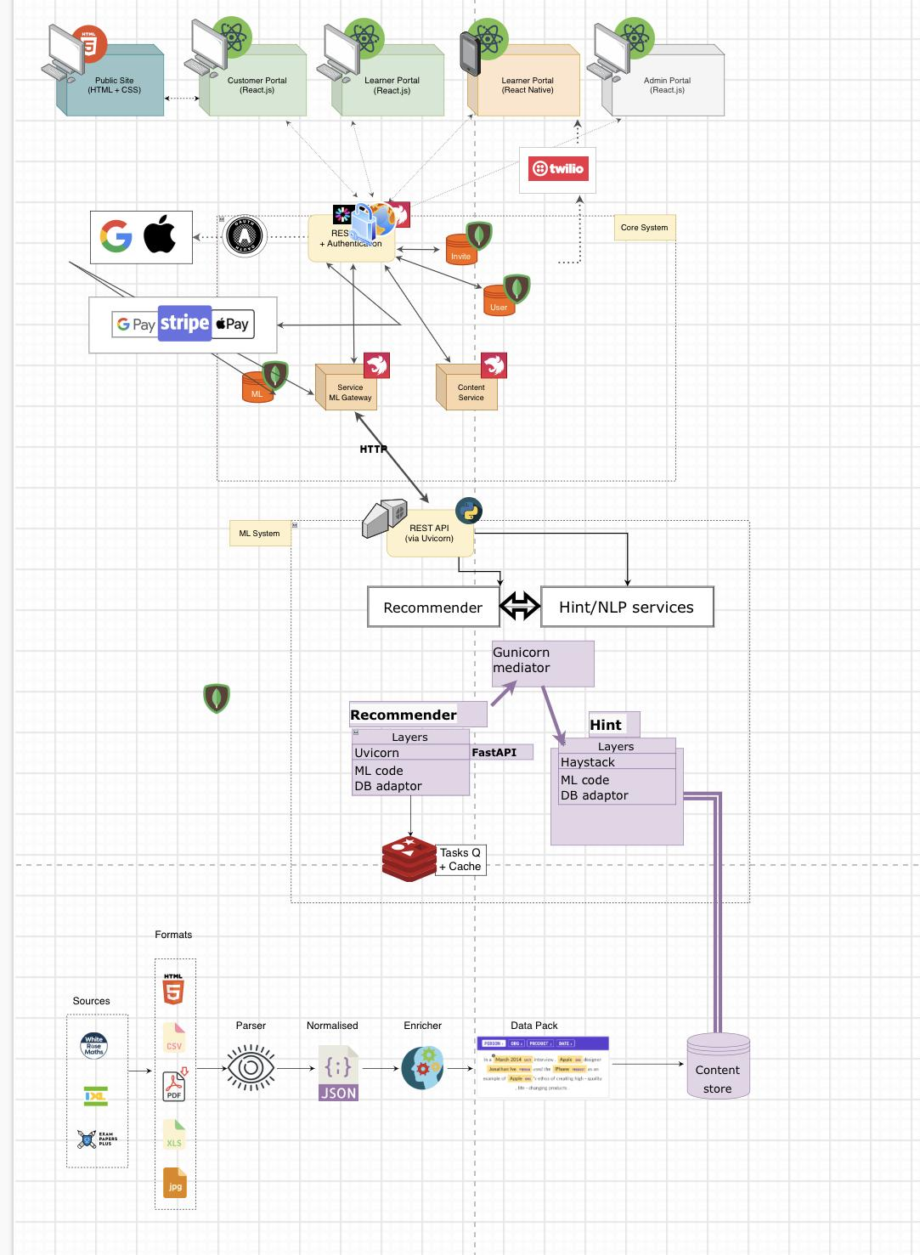
Machine learning deployment
Deploying ML models is usually quite different than other kinds of software
Unsure how ML models will behave in production
Rollout ML models in multiple deployment methods

Slide 21
Recreate
Shut down Version A
Deploy Version B while A is off
Implies downtime
Pros: easy to setup, state is entirely renewed
Cons: downtime

Slide 22
Ramped
Roll out one instance at a time with replacement of old instances
Pros: easy to setup, version is slowly released across instances, convenient for stateful applications that can handle the rebalancing of data
Cons: rollout (and potential rollback(s)) can take time, supporting multiple APIs is difficult, no control over traffic

Slide 23
Blue/Green
Version B is deployed with Version A with the same number of instances. After some testing, Version A is switched to Version B
Pros: instant rollout (or rollback), no versioning issues
Cons: expensive (double the cost), requires proper testing of an entire platform, handling stateful applications is difficult

Slide 24
Canary
Weighted split between Version A and Version B. For example, 10% to B, 90% to A.
Pros: release for a subset of users, fast rollback, good for collecting error rates and performance monitoring
Cons: slow rollout

Slide 25
A/B
Routes a subset of users to Version B depending on some specific condition. Usually used for making business decisions based on statistics
Sample conditions: geolocalization, language, browser version, OS, cookie data, etc.
Pros: can run several versions in parallel, full control over traffic distribution
Cons: need a smart load balancer, hard to troubleshoot unless you have distributed tracing

Slide 26
Shadow
Version A and Version B are both released. Version A’s incoming requests are forked and sent to Version B.
Pros: performance testing, no impact on user, no rollout until stability and performance meet requirements
Cons: expensive (double the cost), potentially complex to setup

Slide 27
ML Deployment Conclusion
Multiple ways to deploy a new version of an application – dependent on needs and money
Development/Staging environment 🡪 recreate or ramped
Production environment 🡪 ramped or blue/green
Blue/green and shadow are expensive
If there’s little confidence 🡪 shadow, canary, A/B

Slide 28
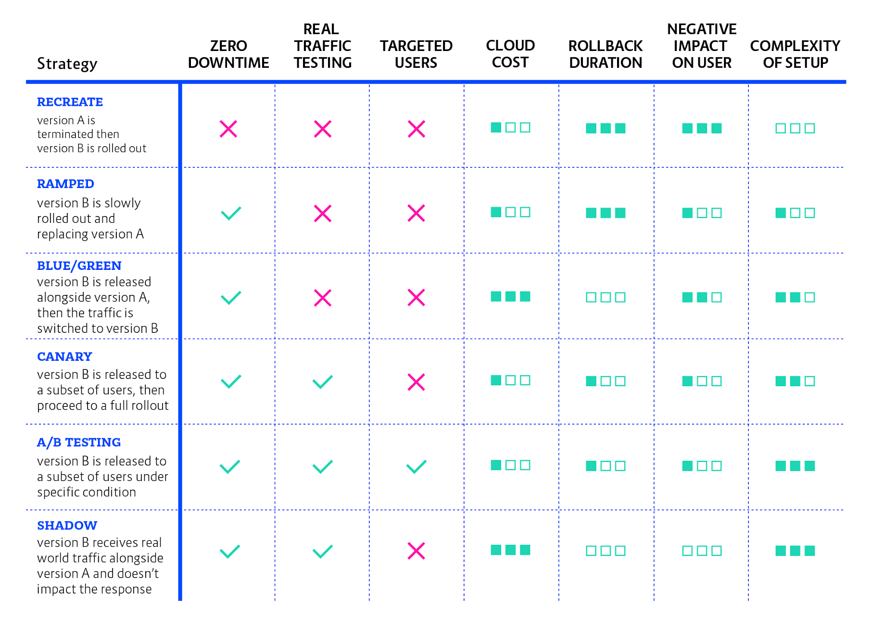
ML Deployment Strategies

Slide 29
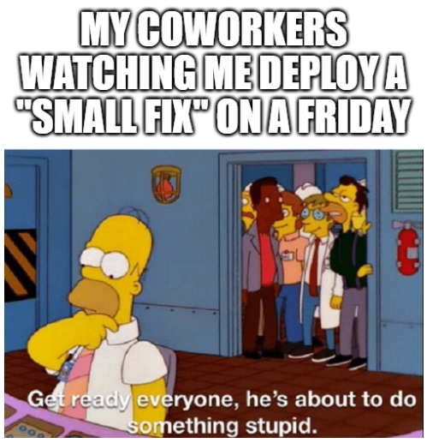
Deployment

Slide 30
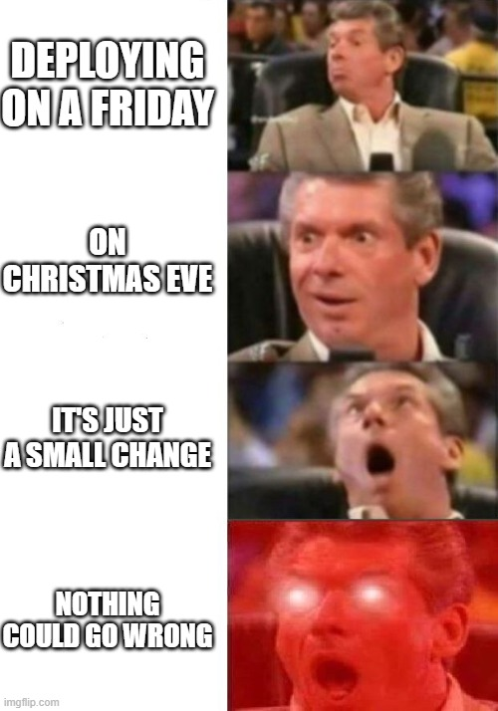
Deployment

Slide 31
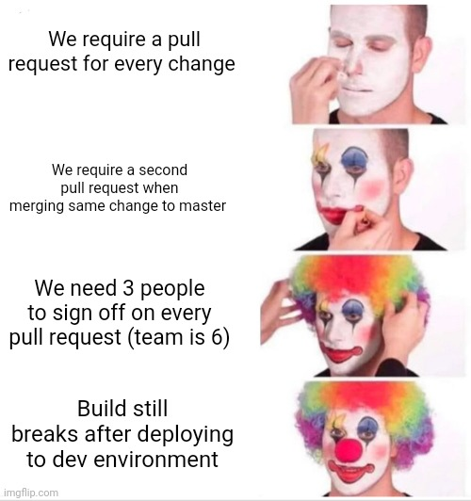
Deployment

Slide 32
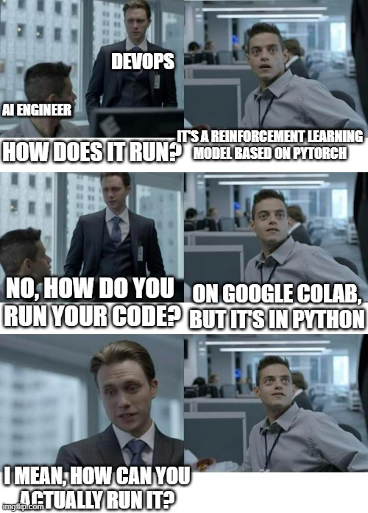
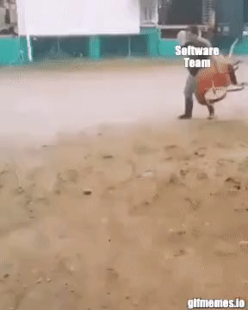
DevOps

