Slide 1

AI Sudarshan Chakra

Slide 2
Executive Summary
CHALLENGE
SOLUTION
OUTCOME
AI risks, prompt injection, compliance
Multi-agent governance layer
Trusted AI at Scale

Slide 3
Enterprise AI Risk Landscape
1
2
3
4
Security
Privacy
Compliance
Hallucinations
Enterprise Risk
Enterprise Risk
Enterprise Risk
Enterprise Risk

Slide 4
The Governance Gap
Dimension | Traditional | Agentic Reality
Approach | Manual | Autonomous
Response | Reactive | Dynamic
Rules | Static | Real-Time

Slide 5
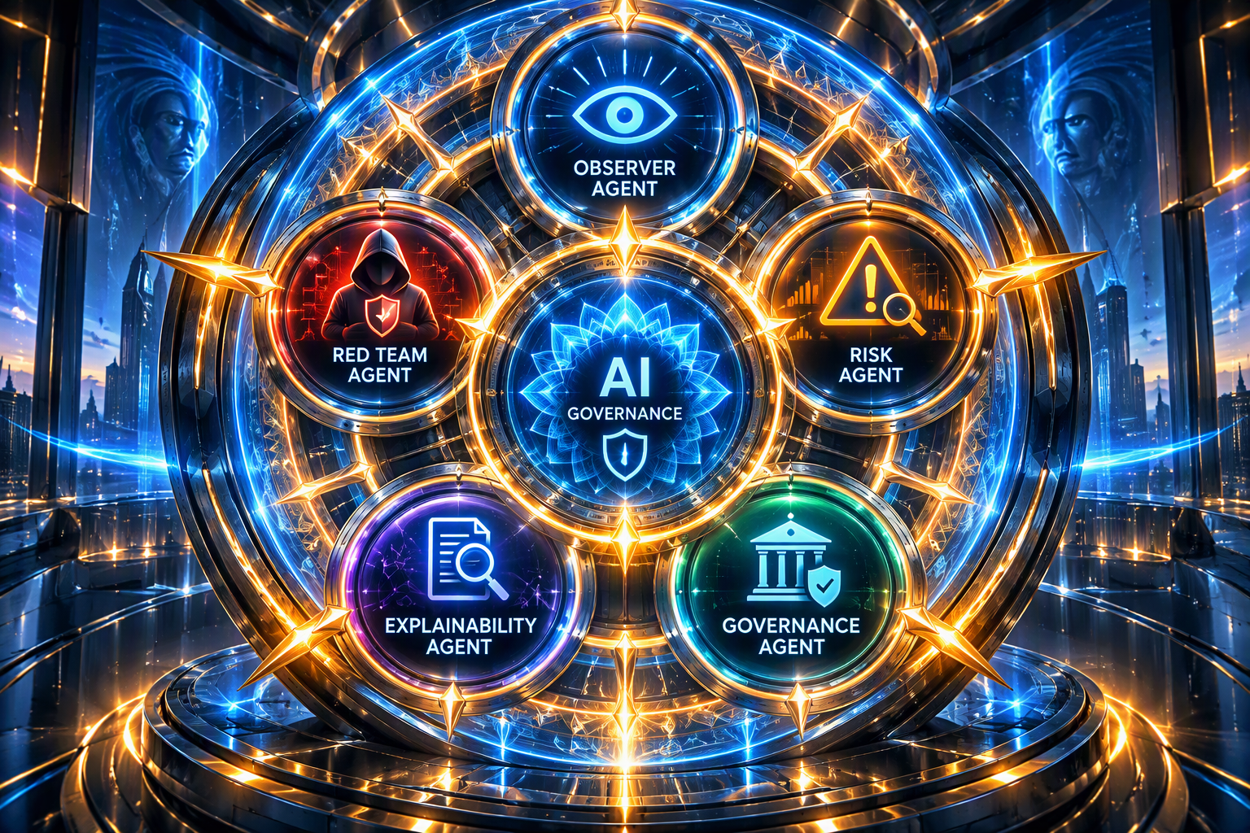
Framework

Slide 6
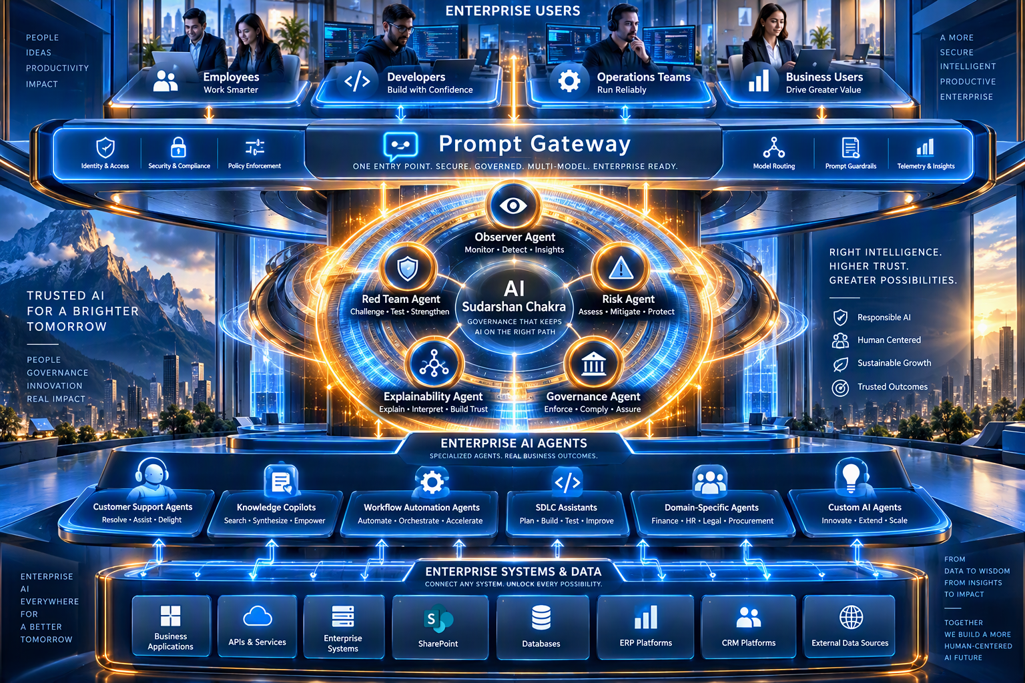
Architecture

Slide 7
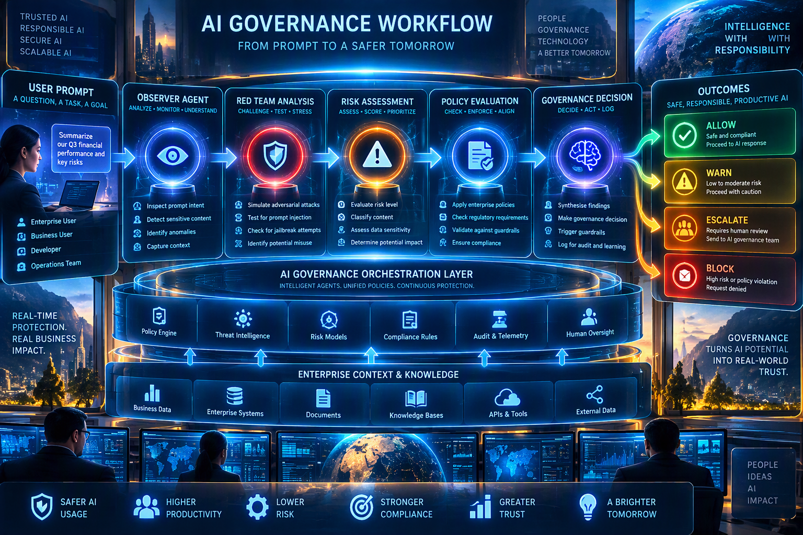
Workflow

Slide 8
Attack Simulation Demo
01
02
03
04
05
Malicious Prompt
Observer
Red Team
Risk 96/100
BLOCKED
Input
Inspect
Challenge
Assess
Decision
FINAL DECISION • BLOCKED • RISK SCORE: 96/100

Slide 9
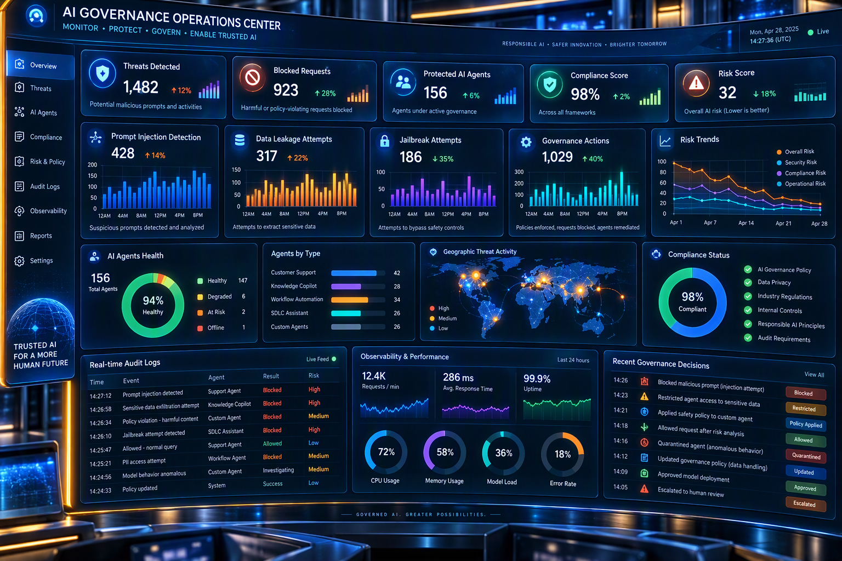
Governance Operations Center

Slide 10
Evaluation Metrics
95%
97%
<5%
<2s
Detection
PII
False +
Decision

Slide 11
Risk & Control Framework
Risk | Control
Injection | Red team
Leakage | PII detection
Compliance | Policy engine

Slide 12
Cost & Scalability
MVP COST
SCALE
$250/month
100
1000
10000
→
→
Agents
Agents
Agents

Slide 13
Business Impact
Banking
Healthcare
Insurance
Retail
Government

Slide 14
Vision & Roadmap
PHASE 1
PHASE 2
PHASE 3
PHASE 4
Assistants
Teams
Control Tower
AI Immune System
1
2
3
4

