Slide 1

Analysis of protein expression in mice
Notes:
Greetings everyone,
My name is Shonil Dabreo.
This presentation is about the Analysis of protein expression in mice.

Slide 2
Table of contents
Introduction
Goal
Data Preparation
Hypothesis
Data Modelling
Results
Discussion
Conclusion
References

Slide 3
Introduction
The mice protein expression dataset was created to study the effect of learning between normal and trisomic mice with Down Syndrome (DS).
Down Syndrome (DS) is a chromosomal disorder cause by the presence of an additional chromosome 21 referred as trisomy, which alters the normal pathways and normal responses to stimulation, causing learning and memory deficits.
Expression levels of 77 proteins were measured in the cerebral cortex of 8 classes of control and Down syndrome mice which were exposed to context fear conditioning, a task used to assess associative learning. The measurements were taken with and without the injection of drug Memantine.
Notes:
I’d like to explain you all about the mice dataset.
A mice dataset was created to understand the effect of learning between control and trisomic mice with down Syndrome.
DS is a chromosomal disorder with an extra copy of chromosome referred as trisomy, causing learning and memory deficits
77 Expressions level proteins were examined after exposing the mice to context fear conditioning.

Slide 4
Goal
The aim is to understand which trisomy protein classes contribute to the success and the failure of mice learning.
Analysis was conducted by creating a model which predicts the 8 classes of mice based on their protein expression levels.
We can then decide which proteins were significant in the predictions i.e. support a hypothesis where we could say that a particular protein might affect learning in trisomic mice.
Notes:
The goal is to understand which trisomy protein classes contribute to the success and the failure of mice learning.
A model was created to predict 8 classes of mice based on their protein expression levels.
The results were then interpreted to determine significance of the proteins.

Slide 5
Data Preparation
Data preparation steps are:-
Replace null values
Feature selection
Replacing null values is the only step of Data Preparation which was needed to be performed for this analysis.
After importing the dataset, there were total 1396 missing values in mice data. The missing values of each column were replaced by the corresponding mean values for that column.
Notes:
Replace null values and Feature selection are the steps of Data Preparation.
After importing the dataset, there were total 1396 missing values in mice data
The missing values of each column were replaced by the corresponding mean values for that column. For columns (proteins) with more number of null values, mean values were used as replacing the null values with mean value could have most of the protein measurements with similar values, where there was variance in the measurements of the proteins.

Slide 6
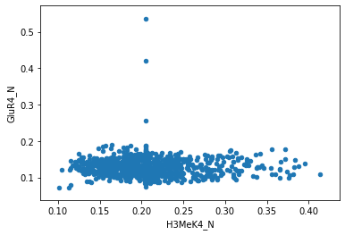
Hypothesis
The hypothesis is that, as the signal value of H3MeK4_N protein increases the GluR4_N
protein signal value decreases.
Notes:
The hypothesis is that, as the signal value of one protein increases the protein signal value of another protein decreases.
We can see the fig for the relationship between these two proteins.

Slide 7
Hypothesis
In the above Fig, it is observed that as the signal value of H3MeK4_N protein increases the GluR4_N protein value remains stable i.e. between 0.1 to 0.2.
Hence, there wasn’t sufficient evidence to support the hypothesis.
This hypothesis wasn’t statistically significant.
Notes:
It was observed that as the signal value of one protein increases the another protein value remains stable i.e. between 0.1 to 0.2.
This hypothesis wasn’t statistically significant as there wasn’t sufficient statistical evidence to support the hypothesis.

Slide 8
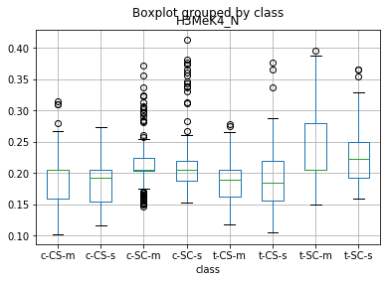
Hypothesis
The hypothesis is that the trisomy mice with Shock-Context behavior with the treatment
given by memantine drug injection (i.e. t-SC-m) will have higher effect of H3MeK4_N
protein as compare to other classes.
Notes:
The hypothesis is that the trisomy mice with Shock-Context behavior with the treatment
given by memantine drug injection (i.e. t-SC-m) will have higher effect of H3MeK4_N
protein as compare to other classes.

Slide 9
Hypothesis
As we can see, the box plot of t-SC-m for H3MeK4_N protein has more than 0.25 signal values which are higher than box plots of other classes.
The H3MeK4_N protein is statistically significant for t-SC-m class category.
Notes:
As we can see, the box plot of t-SC-m for H3MeK4_N protein has more than 0.25 signal values which are higher than box plots of other classes.
The H3MeK4_N protein is statistically significant for t-SC-m class category;
hence, we can say that H3MeK4_N protein was effective for recovering the ability to learn in trisomy mice

Slide 10
Data Modelling
Feature selection:
As we need to select a label data, therefore we would be using the Class column from the mice dataset as a predictor and the rest of the columns which includes 77 protein expression levels and Genotype, Behavior and Treatment would be taken based on which class would be predicted.
Model selection :
Two classification models; K-Nearest Neighbor and Decision Tree were used to build a model and predict the mice class and determine which proteins were critical for each class.
The dataset is divided into 70% train data and 30% test data to get a better indication of the model’s performance on unseen data.
A small k results in predictions with high variance and K=1 could result in 100% accuracy or overfitting. So, k=5 was the value selected for K-Nearest Neighbors.
Notes:
For Feature selection, class column was selected as a target variable and based on the rest of the data columns, the model could predict the class.
For Model selection, K-Nearest Neighbor and Decision Tree were used to build a model and predict the mice class and determine which proteins were critical for each class. The dataset was divided into 70% train data and 30% test data to get a better indication of the models performance on unseen data.
A small k results in predictions with high variance and K=1 could result in overfitting, k =5 was selected as K neighbors value

Slide 11
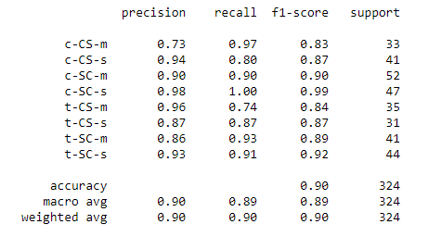
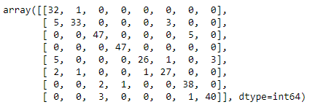
K-Nearest Neighbor
Classification report
Confusion matrix
Notes:
These are the classification report and confusion matrix for K-Nearest Neighbor model.

Slide 12
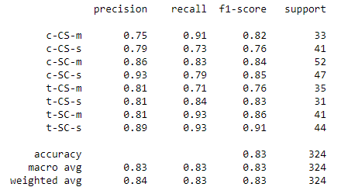
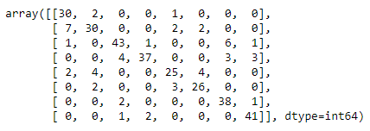
Decision Tree
Classification report
Confusion matrix
Notes:
These are the classification report and confusion matrix for Decision Tree model.

Slide 13
Results
We can see the classification report and confusion matrix of both the models.
For KNN model, we got 90% accuracy score. There are total 34 mislabeled errors for the KNN model. The highest precision i.e. correctly predicted class was c-SC-s.
For Decision Tree, the accuracy score was 83%. After tuning the parameters, it was observed that parameters with default value give the best accuracy score. The confusion matrix had a total of 47 mislabeled errors. The highest precision score was of the t-SC-s class.
Notes:
For KNN model, we got 90% accuracy score. There were total 34 mislabeled errors for the KNN model.
For Decision Tree, the accuracy score was 83%. After tuning the parameters, it was observed that parameters with default value give the best accuracy score. The confusion matrix had a total of 47 mislabeled errors. Although, the precision of class was different for these two models.

Slide 14
Discussion
Two classifiers; K-Nearest Neighbor and Decision Tree were used for analyzing. We can see the accuracy and the confusion matrix from the above given figures.
It can be seen clearly that KNN model worked efficiently better with an accuracy of 90% compared to the 83% accuracy of Decision Tree model. Therefore, we should implement KNN for this kind of dataset where features are numeric as KNN is a distance metric algorithm.
Notes:
We know that KNN model worked efficiently better with an accuracy of 90% compared to the 83% accuracy of Decision Tree model. Therefore, we should implement KNN for this kind of dataset where features are numeric.

Slide 15
Conclusion
To sum up, KNN model could predict the unlabelled data but couldn’t classify which protein contributes to success or failed learning.
The KNN algorithm doesn’t have a feature importance method to classify the data. Although, Decision Tree had feature importance method but didn’t had a high accuracy score.
We should implement KNN model when the features are numeric to find the similar examples. Whereas, Decision Tree model should be implemented when we need to classify a particular class variable where the features contains binary data.
Notes:
In conclusion, KNN model could predict the unlabelled data but couldn’t classify which protein contributes to success or failed learning.
On the other hand, Decision Tree had feature importance method but didn’t had a high accuracy score.
Based on the analysis, We should implement KNN model when the features are numeric and Decision Tree model where the features contains binary data

Slide 16
Thank You!
Notes:
Thank You!!

