Slide 1

Summary for HTFN Worldwide Meeting
1
Sunday 21st May 2017

Slide 2

The History of HTFN APAC Meetings
First meeting in Bangkok in 2010.
This was now our 5th Meeting, in 7 years.
Previous hosts after EWL/BKK were
ANC/Vietnam, Sailors/Bangladesh
& Thomas Intl / Cambodia
1
Our objective is very simple.
“To discuss opportunities within the APAC Region, exchange general ideas about the logistics industry, and share ideas, which help improve our success within the HTFN network”.

Slide 3

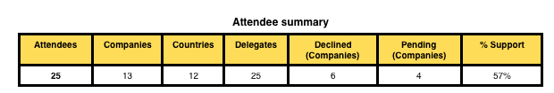
Meeting Structure and format
The APAC meeting was represented by 13 companies, 25 delegates, from 12 different counties (excluding host).
The schedule structure is 1 1/2 days of discussions, based on agenda topics proposed members in the region.
1/2 a day at the end of the meetings, is left open, to let delegates enjoy the host country.
James Forwarding as host arranged a tour of their office facilities, followed by a City Tour & Sightseeing.
1

Slide 4

Topics discussed
After the opening speeches, by Angela Flynn (Chairman), Evelin (APAC Chair) and our host, we discussed 4 main agenda topics : -
Admin & Membership.
Finance and agency agreements.
Sales & Marketing .
IT and HTFN Resources.
1
The specific topics are based on the contribution given by the APAC members.

Slide 5
Wrap Up
Hosts for our next APAC Meetings.
2018 Hosts - Dragon Logistics / Shenzhen.
2019 Hosts - Taiwan Express / Taipei
APAC members in attendance.
Confirmed upwards growth / development within HTFN.
Agreed unanimously with our APAC meetings, helps build their network in a positive manner.
1
Meeting minutes of all topics discuss, can be found within the members section of the HTFN website.

Slide 6

Angela Flynn, who graciously opens each of our APAC meetings.
Evelin Lim, for putting so much time and energy to bring our region together.
Brandon Cheong and the James Forwarding Team. They were truly amazing hosts, that thought about every individual delegate. Helping make our meeting one of the most successful to date.
1

Slide 7
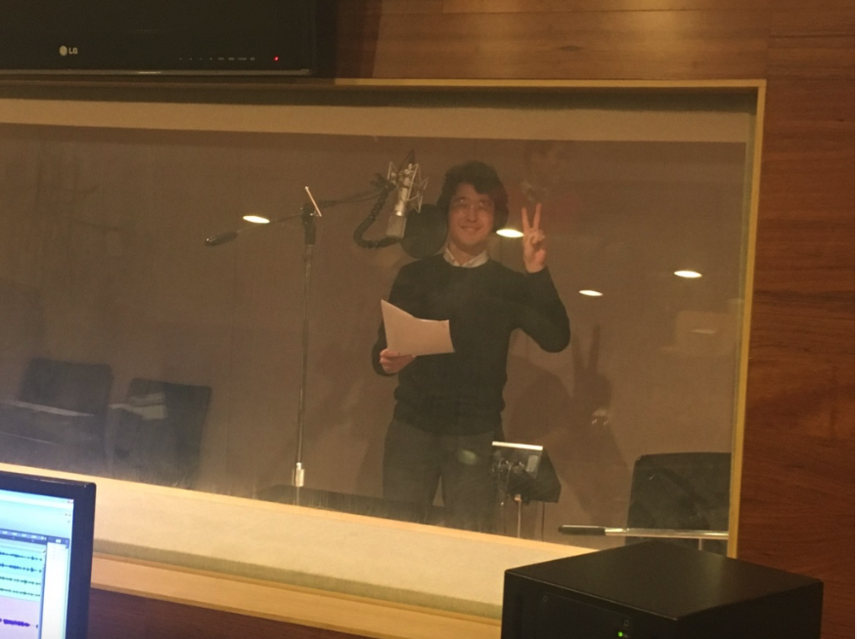
Going the Extra yard…
We asked Brandon (Jokingly) if we could have Korean pop star to open the APAC meeting. Brandon done better than this, he rounded up his team to the recording studio, to record a song, dedicated to HTFN.
Sit back and enjoy their song, together with some photos from our APAC meeting.
1

