Slide 1



“Connecting Your Freight Business to the World and the World to Your Freight Business”
Building Bridges and Making Connections

Slide 2


Introduction to Aidan Conaty
From Dublin, Ireland
2004 founded Chinese company called QTCI
2008 founded a QC Inspection company
2012 Received Funding to Research Freight Industry
2015 launched Goodada Platform to Freight Forwarders

Slide 3
Freight Research Findings – Main Issues for Freight Forwarders
Customers are Demanding More.
Getting harder to Make Money.
Getting harder to Grow Sales.

Slide 4
Freight Research Findings – Growth Strategies for Freight Forwarders
Focus on Excellent Customer Service.
One point of contact for a Customer.
Point of contact must be able to resolve all the Customers Issues.
Be Actively Growing Sales.
All staff members should be selling – use relationships to grow sales.
Consider the new generation of Freight Customers.
Be able to generate revenues across the Supply Chain – “Supermarket Approach”.
Develop “Sticky” Relationships with Customers.
Be a “One-Stop-Shop Provider/ Everything Under the One Roof” to the Customer.
Use IT Capabilities to grow sales & keep customers.
Develop Specialist Routes and Industries.

Slide 5
4 Main Stages of the Supply Chain
1
Products
Customer Priority
2
Pre Freight Stage
3
Freight Stage
4
Post Freight Stage
Notes:
How do you know if your customer doesn’t want a new supplier or has problems with current supplier. Have you asked? Allow customers to find products and freight will grow there sales….

Slide 6
Freight Forwarders currently target & sell to customers at Stage 3
1
Products
Customer Priority
2
Pre Freight Stage
3
Freight Stage
4
Services Offered:
Sea, Land, Air & combination
Ex Works, FOB, CIF & others
Customs Clearance (Departure)
Transport tracking
Post Freight Stage
Notes:
How do you know if your customer doesn’t want a new supplier or has problems with current supplier. Have you asked? Allow customers to find products and freight will grow there sales….

Slide 7
Freight Forwarders also offer “Post Freight” Stage 4 Services
1
Products
Customer Priority
2
Pre Freight Stage
3
Freight Stage
4
Services Offered:
Sea, Land, Air & combination
Ex Works, FOB, CIF & others
Customs Clearance (Departure)
Transport tracking
Post Freight Stage
Services Offered:
Customs Clearance (Arrival)
Port Delivery
Warehousing
Pick & Pack
Order Delivery
Notes:
How do you know if your customer doesn’t want a new supplier or has problems with current supplier. Have you asked? Allow customers to find products and freight will grow there sales….

Slide 8
Freight Forwarders should sell “Pre Freight” Stage 2 Services
1
Products
Customer Priority
2
Pre Freight Stage
3
Grow Sales:
Insurance
Quality Control Inspections
International Payments
Freight Stage
4
Services Offered:
Sea, Land, Air & combination
Ex Works, FOB, CIF & others
Customs Clearance (Departure)
Transport tracking
Post Freight Stage
Services Offered:
Customs Clearance (Arrival)
Port Delivery
Warehousing
Pick & Pack
Order Delivery
Notes:
How do you know if your customer doesn’t want a new supplier or has problems with current supplier. Have you asked? Allow customers to find products and freight will grow there sales….

Slide 9
“Freight is about moving Products ”

Slide 10
Engage Customers at the Stage 1
1
Products
2
Grow Customers
Source Products
Source Sellers
Source Buyers
Pre Freight Stage
3
Grow Sales
Insurance
Quality Control Inspections
International Payments
Freight Stage
4
Services Offered:
Sea, Land, Air & combination
Ex Works, FOB, CIF & others
Customs Clearance (Departure)
Transport tracking
Post Freight Stage
Services Offered:
Customs Clearance (Arrival)
Port Delivery
Warehousing
Pick & Pack
Order Delivery
Notes:
How do you know if your customer doesn’t want a new supplier or has problems with current supplier. Have you asked? Allow customers to find products and freight will grow there sales….

Slide 11
Allows your Freight Company to promote & sell “Pre Freight Services”
1
Products
2
Grow Customers
Source Products
Source Sellers
Source Buyers
Pre Freight Stage
3
Grow Sales
Insurance
Quality Control Inspections
International Payments
Freight Stage
4
Services Offered:
Sea, Land, Air & combination
Ex Works, FOB, CIF & others
Customs Clearance (Departure)
Transport tracking
Post Freight Stage
Services Offered:
Customs Clearance (Arrival)
Port Delivery
Warehousing
Pick & Pack
Order Delivery
Notes:
How do you know if your customer doesn’t want a new supplier or has problems with current supplier. Have you asked? Allow customers to find products and freight will grow there sales….

Slide 12
It then becomes more easier to promote & sell main Freight Services
1
Products
2
Grow Customers
Source Products
Source Sellers
Source Buyers
Pre Freight Stage
3
Grow Sales
Insurance
Quality Control Inspections
International Payments
Freight Stage
4
Services Offered:
Sea, Land, Air & combination
Ex Works, FOB, CIF & others
Customs Clearance (Departure)
Transport tracking
Post Freight Stage
Services Offered:
Customs Clearance (Arrival)
Port Delivery
Warehousing
Pick & Pack
Order Delivery
Notes:
How do you know if your customer doesn’t want a new supplier or has problems with current supplier. Have you asked? Allow customers to find products and freight will grow there sales….

Slide 13
Additional “Post Freight” Services are then more easily promoted and sold to customers
1
Products
2
Grow Customers
Source Products
Source Sellers
Source Buyers
Pre Freight Stage
3
Grow Sales
Insurance
Quality Control Inspections
International Payments
Freight Stage
4
Services Offered:
Sea, Land, Air & combination
Ex Works, FOB, CIF & others
Customs Clearance (Departure)
Transport tracking
Post Freight Stage
Services Offered:
Customs Clearance (Arrival)
Port Delivery
Warehousing
Pick & Pack
Order Delivery
Notes:
How do you know if your customer doesn’t want a new supplier or has problems with current supplier. Have you asked? Allow customers to find products and freight will grow there sales….

Slide 14

Solutions

Slide 15
Your Freight Company receives its own branded Supply Chain Platform
Goodada provides a branded platform which:
Make money by selling services online.
Allows you to develop & grow Sales Leads
Importers can use to find Products & Sellers.(+450,000)
Exporters can promote their Products through your site.
Allows your customers to chat with Online Customer support.
Allows you to develop business into China.

Slide 16
Grow Sales selling “Pre Freight” Services
1
Source Sellers/ Buyers of Products
2
Pre Freight Stage
3
Grow Sales
Insurance
Quality Control Inspections
International Payments
Freight Stage
4
Post Freight Stage
Notes:
How do you know if your customer doesn’t want a new supplier or has problems with current supplier. Have you asked? Allow customers to find products and freight will grow there sales….

Slide 17
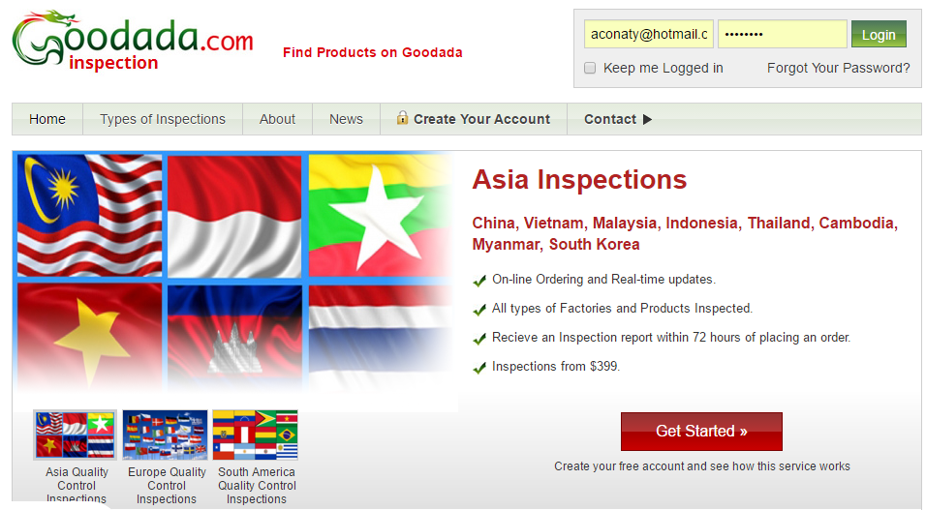
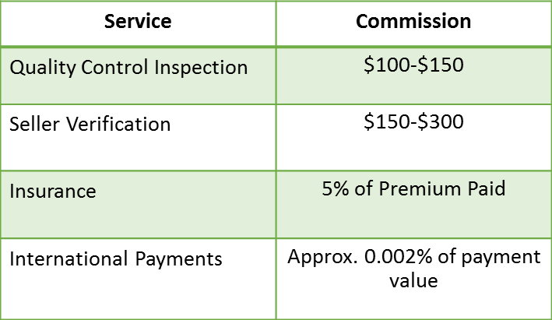
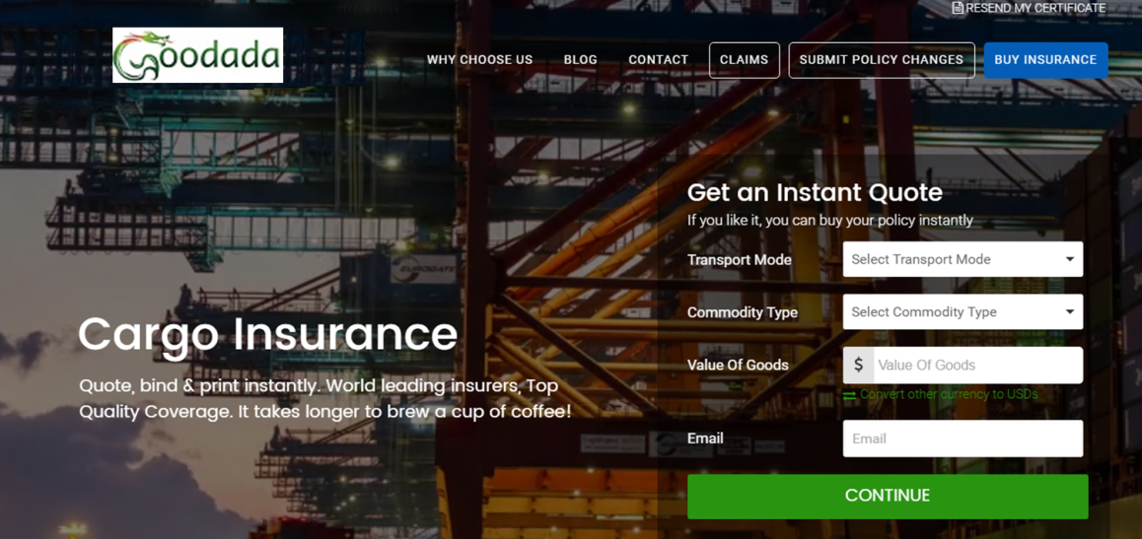

Increase Your Sales with “Pre Freight” Services
Seller Verifications & QC Inspections
Insurance Services
International Payments

Slide 18
Engage Customers at the Stage 1
1
Products
2
Grow Customers
Find Sellers
Find Buyers
Pre Freight Stage
3
Grow Sales
Insurance
Quality Control Inspections
Duties & Taxes Information
International Payments
Freight Stage
4
Services Offered:
Sea, Land, Air & combination
Ex Works, FOB, CIF & others
Customs Clearance (Departure)
Transport tracking
Post Freight Stage
Services Offered:
Customs Clearance (Arrival)
Port Delivery
Warehousing
Pick & Pack
Order Delivery
Notes:
How do you know if your customer doesn’t want a new supplier or has problems with current supplier. Have you asked? Allow customers to find products and freight will grow there sales….

Slide 19
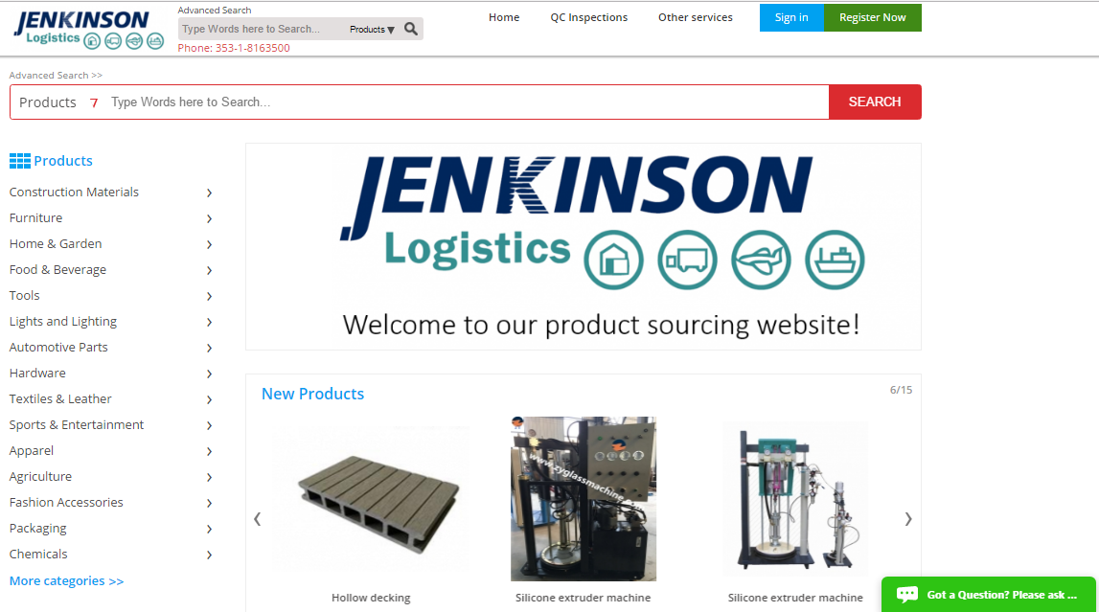
Jenkinson Website facilitates in Making a Market & Building Bridges

Slide 20
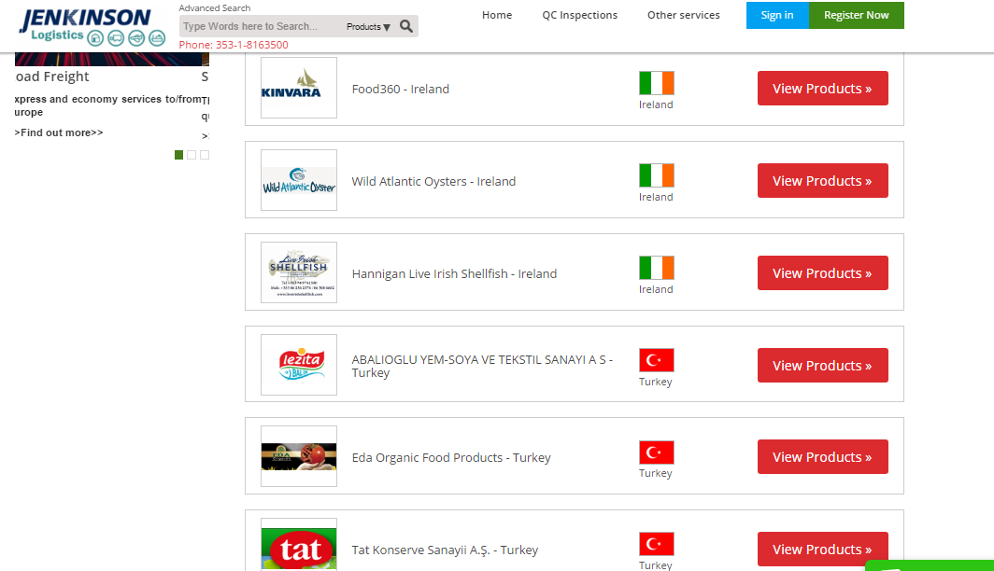
Importers use Jenkinson website to find Products,
- Exporters Use Jenkinson website to promote their Products

Slide 21
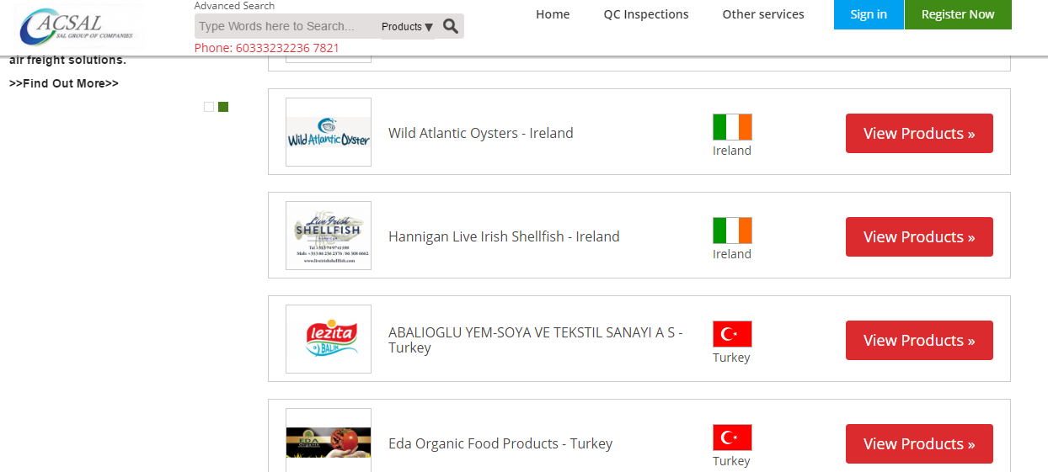
Jenkinson’s Exporters Products are Promoted Through the network

Slide 22
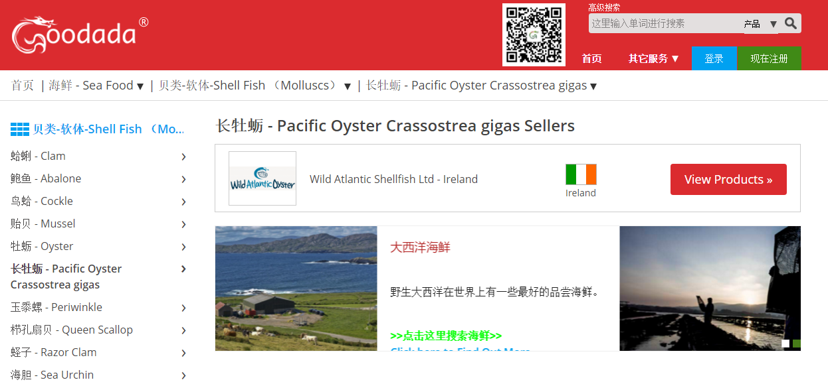
Exporters Products are Promoted in China

Slide 23

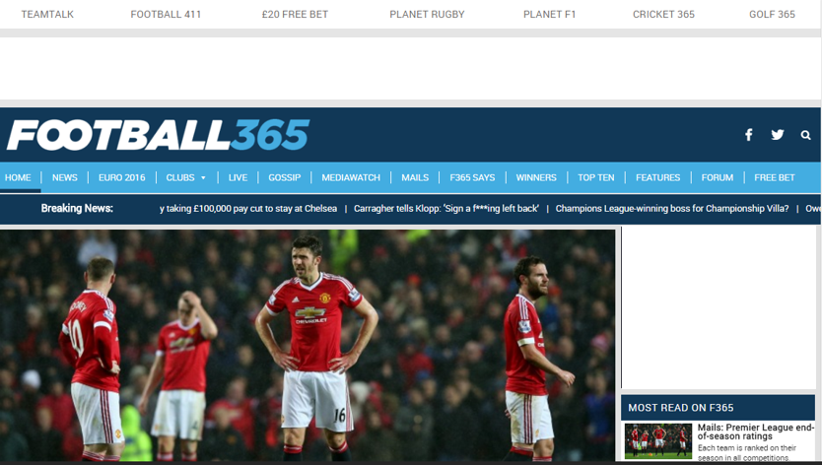



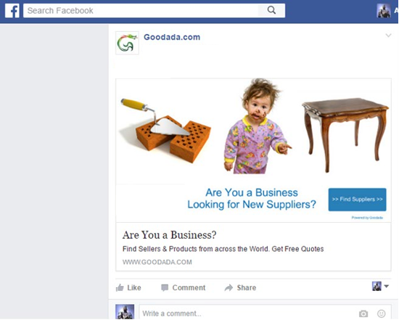
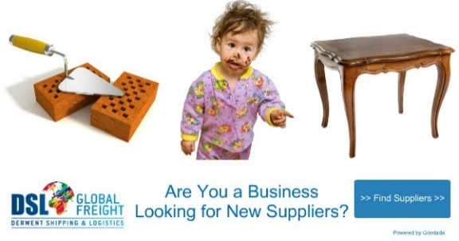
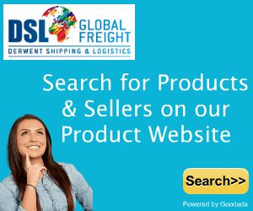



Freight Forwarders are Marketed online after the visit to the Platform
Internet Re-Targeting
Facebook Re-Targeting

Slide 24
So why should your Freight Company use Goodada?

Slide 25
Summary - Why use my Company?
It allows all HTFN members to Grow Sales by connecting their importers and exporters.
It allows All staff to become “Sales Makers” – all they have to do is direct any potential client to the website. This saves costs on hiring many expensive sales staff.
It turns your website from a passive into an active sales which caters for the “Next Generation” of Freight Clients
On-line chat provides any visitor to the your website with Excellent Customer Service.
It allows you company to Generate Revenues across the supply chain through offering:
QC Inspection Services.
International Promotion Services.
International Payments facilities.
Insurance
You will Save Money on marketing costs as we provide:
Online Marketing through retargeting banner ads to any visitor
Marketing email flyers which are provided to you so that they can be issued out your customers.

Slide 26
Call to Action
Please complete the form
Return to me before this session closes
Tomorrow I can demonstrate to you using your very own branded platform
There is no obligation

Slide 27
Thank You

