Slide 1

Time line build-up
Present perfect progressive for long or repeated actions with a current outcome and future plan

Slide 2
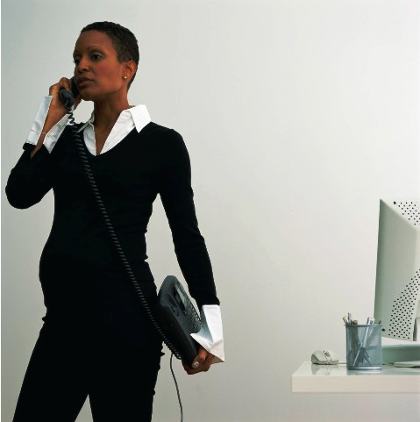

Sentence 1
I have been trying two or three times a week to speak to her on the phone with no luck so I’m going to visit her.

Slide 3
Sentence 1
I have been trying two or three times a week to speak to her on the phone with no luck so I’m going to visit her.
The past
Now
The future

Slide 4
Sentence 1
I have been trying two or three times a week to speak to her on the phone with no luck so I’m going to visit her.
The past
Now
The future

Slide 5
Sentence 1
I have been trying two or three times a week to speak to her on the phone with no luck so I’m going to visit her.
The past
Now
The future




I have been trying 2 or three times …

Slide 6
Sentence 1
I have been trying two or three times a week to speak to her on the phone with no luck so I’m going to visit her.
The past
Now
The future




Decide:
I’m going to visit her

Slide 7
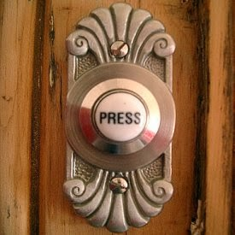
Sentence 1
I have been trying two or three times a week to speak to her on the phone with no luck so I’m going to visit her.
The past
Now
The future




Decide:
I’m going to visit her
Visiting her

Slide 8
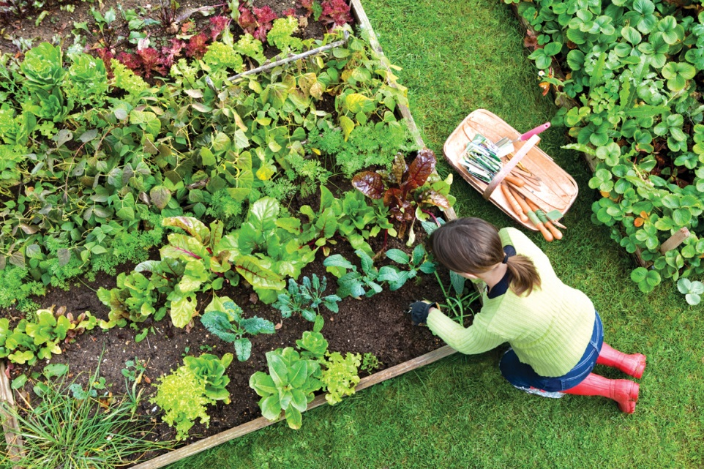
Sentence 2
I have been working in the garden all day and I’m exhausted so I’m going to lie down for a while.

Slide 9
Sentence 2
I have been working in the garden all day and I’m exhausted so I’m going to lie down for a while.
The past
Now
The future

Slide 10
Sentence 2
I have been working in the garden all day and I’m exhausted so I’m going to lie down for a while.
The past
Now
The future

Slide 11
Sentence 2
I have been working in the garden all day and I’m exhausted so I’m going to lie down for a while.
The past
Now
The future
I have been working …

Slide 12
Sentence 2
I have been working in the garden all day and I’m exhausted so I’m going to lie down for a while.
The past
Now
The future
I have been working …
Decide:
I’m going lie down

Slide 13
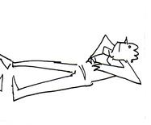
Sentence 2
I have been working in the garden all day and I’m exhausted so I’m going to lie down for a while.
The past
Now
The future
I have been working …
Decide:
I’m going lie down
Lying down

