Slide 1
DATA-INFORMED OPERATIONS
Food Demand
Analysis
From order data to actionable insights
FOOD DEMAND ANALYSIS PROJECT
A concise review of demand patterns, planning opportunities, and limits

Slide 2
01 / THE QUESTION
Better demand visibility can support better planning
The available records show what was ordered across observed weeks, meals, and fulfilment centers.
What should planners understand?
Why it matters for operations
When demand shifts
Planning stock and replenishment around observed demand can help teams focus attention where volumes and variability are greatest.
Identify weekly peaks and lows to inform review of planning assumptions.
Where demand concentrates
See which categories and meals account for most recorded orders.
This analysis describes patterns; it does not forecast demand or prove what caused it.
What varies
Compare observed patterns by meal, promotion flag, and center.
FOOD DEMAND ANALYSIS • OBSERVED ORDER RECORDS
02

Slide 3
02 / DATA & METHOD
A checked training dataset underpins the findings
Training records and two reference tables provide observed demand and meal/center context.
456,548
119.6M
145
DATA SOURCES
train.csv • meal_info.csv • fulfilment_center_info.csv
test.csv: schema check only
training rows
recorded orders
observed weeks
WORKFLOW
01
02
03
04
Inspect
›
Validate
›
Analyze
›
Communicate
columns, types, missingness, duplicates
keys and join row/order totals
weekly, category, center, meal, price & promotion
summaries and clear charts
Tools used: Python • Pandas • NumPy • SciPy • Matplotlib • Jupyter
FOOD DEMAND ANALYSIS • OBSERVED ORDER RECORDS
03

Slide 4
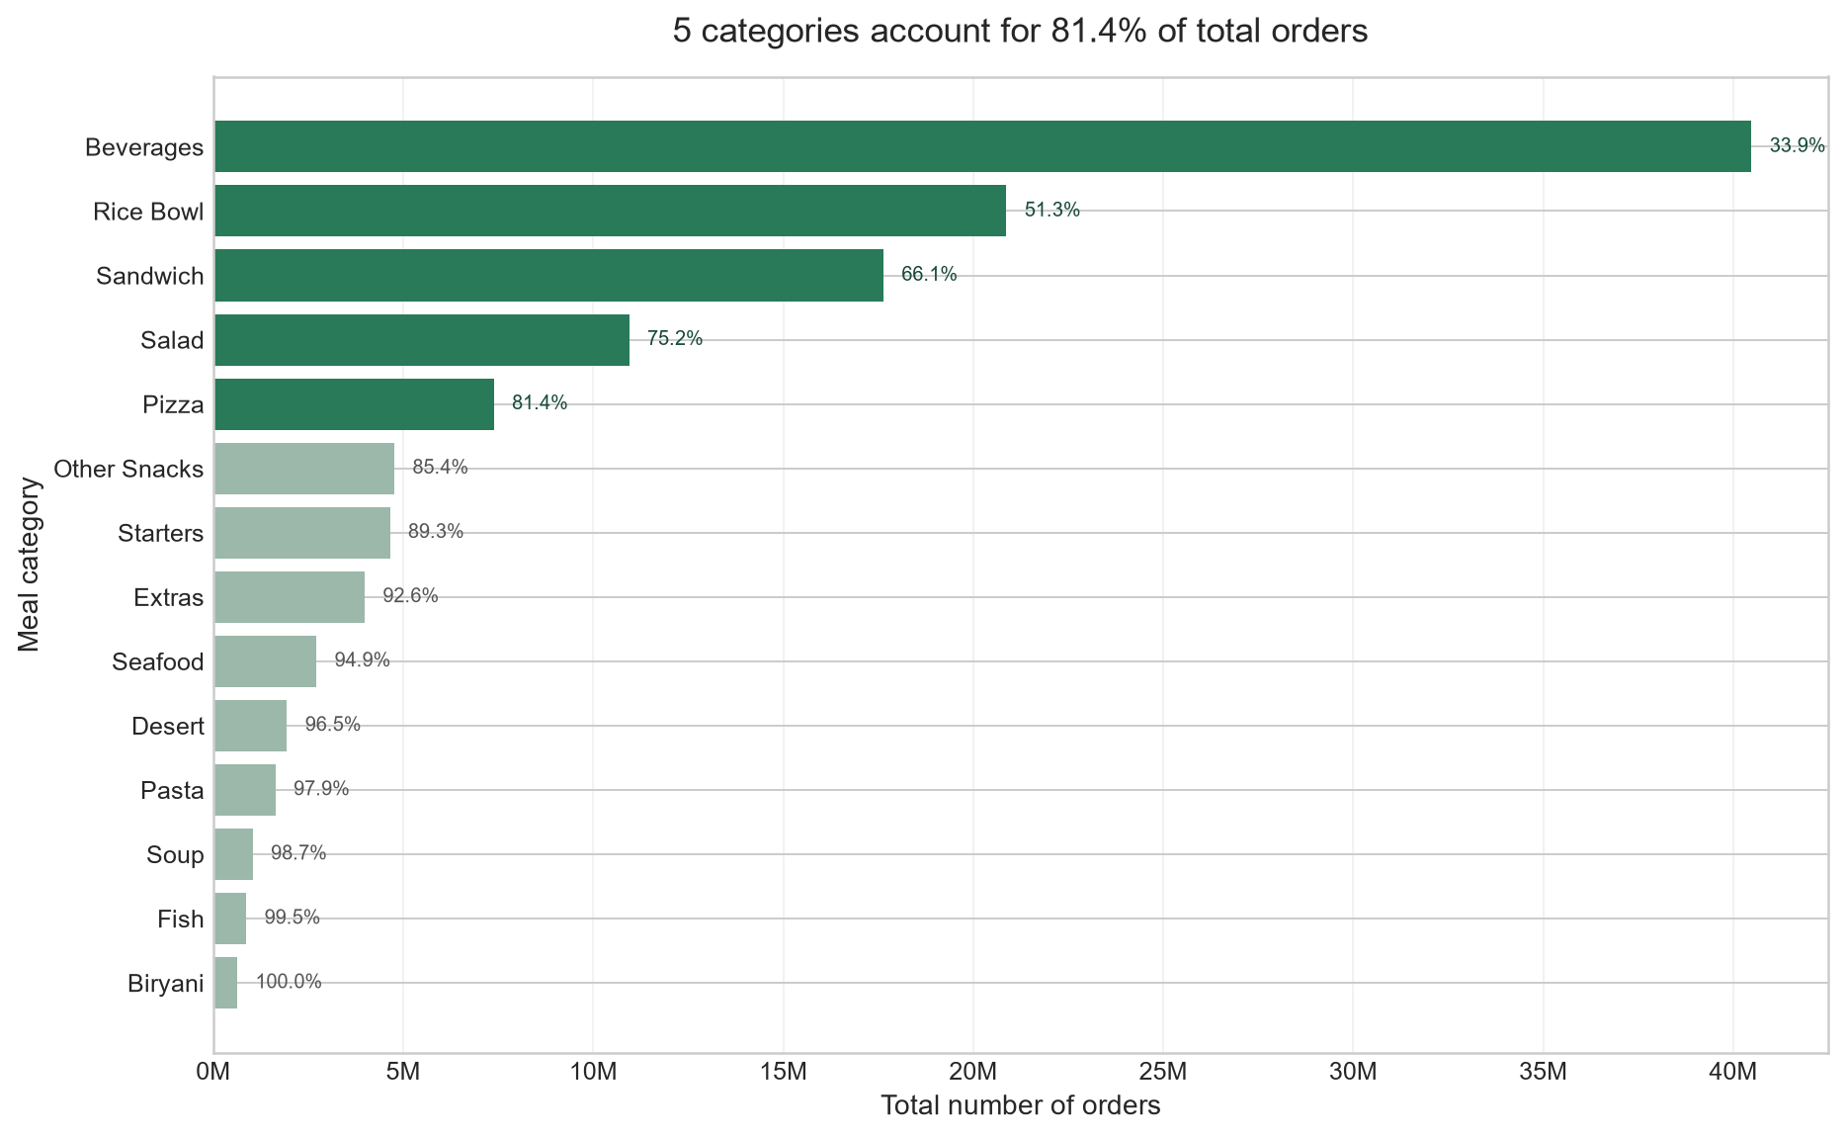
03 / KEY FINDING 1
Five categories account for 81.40% of all orders
A concentrated order mix offers a practical starting point for demand-planning review.
119,557,485
total orders
81.40%
from five categories
1,303,457
peak in Week 48
Top five: Beverages, Rice Bowl,
Sandwich, Salad, and Pizza
FOOD DEMAND ANALYSIS • OBSERVED ORDER RECORDS
04

Slide 5
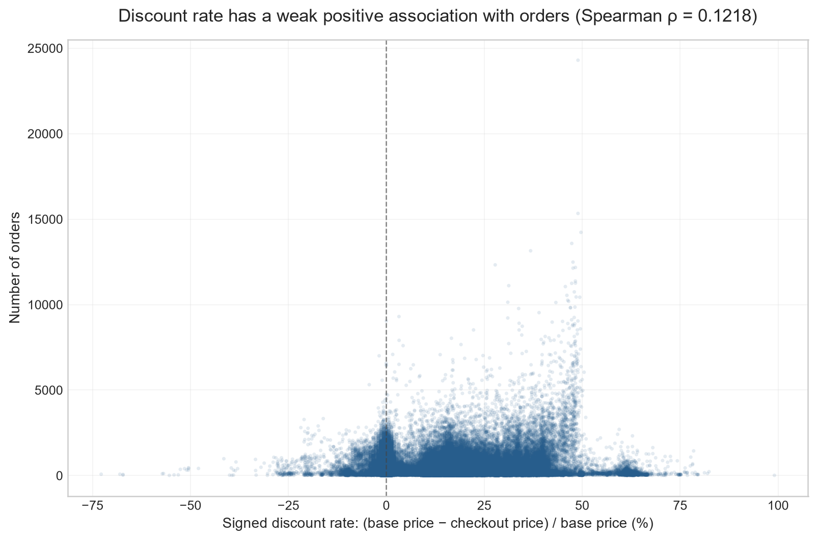
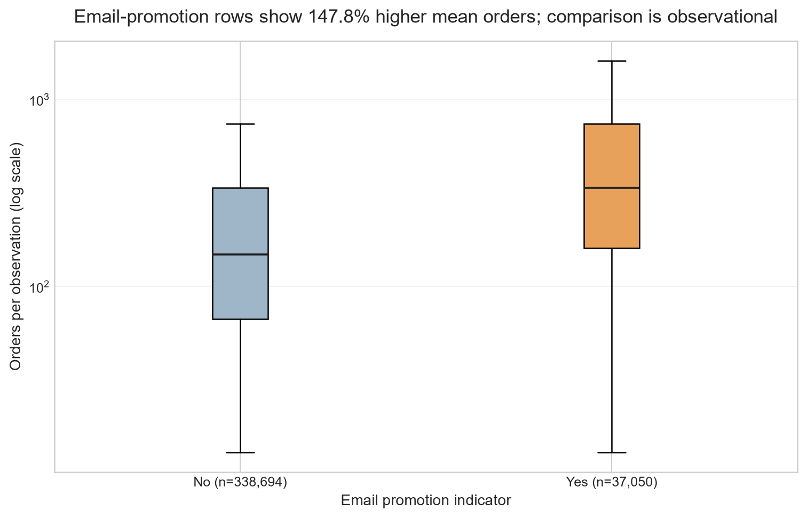
04 / KEY FINDING 2
Price and promotion patterns are associations—not causes
The observed discount relationship is weak; promotion rows differ, but the comparison is observational.
Spearman ρ = 0.1218
Weak positive association
Email-promo rows: +147.84% mean orders
Repeated observations; not causal evidence
FOOD DEMAND ANALYSIS • OBSERVED ORDER RECORDS
05

Slide 6
05 / RECOMMENDATIONS
Turn the findings into measurable planning tests
Establish a baseline first; evaluate changes over comparable future periods.
01
02
03
Prioritize high-share categories
Plan for volume and variability
Test before scaling promotions
EVIDENCE
EVIDENCE
EVIDENCE
Five categories represent 81.40% of orders.
Meal 2290: 9.77M orders; meal 2444: CV 1.205.
Email-promo rows show +147.84% mean orders; observational only.
TRACK
TRACK
TRACK
Weekly stockout and unfulfilled-order rates for those categories.
Meal-level forecast error and stockout rate, reported by demand/volatility group.
Incremental orders per eligible meal-center-week and margin per promotion cost in a controlled test.
FOOD DEMAND ANALYSIS • OBSERVED ORDER RECORDS
06

Slide 7
06 / LIMITATIONS
Use the findings with these boundaries in mind
The analysis describes recorded observations, not a complete picture of business operations.
No calendar dates
No causal proof
Week numbers are observed period labels; actual dates are not established.
Correlation and observational comparisons cannot show that a promotion or discount caused demand to change.
Repeated promotion rows
Revenue is estimated
Meal-center observations repeat over weeks, so ordinary Mann–Whitney p-values are exploratory, not confirmatory.
Checkout price × orders is a calculated estimate, not audited financial revenue.
Centers are not normalized
Missing meal-weeks
Comparisons are not adjusted for operating area or meal mix.
Unobserved meal-week combinations were not assumed to have zero demand or availability.
FOOD DEMAND ANALYSIS • OBSERVED ORDER RECORDS
07

Slide 8
07 / RESPONSIBLE USE & TAKEAWAY
Use analysis as a planning aid—not an autopilot
How AI assistance was used
THE TAKEAWAY
GitHub Copilot assisted with project organization, code drafting and review, debugging, and documenting the analysis and report.
Notebook outputs, summary tables, and chart files were checked against project data. AI assistance is not independent proof of correctness; outputs need human review.
Focus planning on where demand is concentrated, then measure whether inventory and promotion decisions improve.
Start with a baseline. Track outcomes. Learn before scaling.
FOOD DEMAND ANALYSIS PROJECT
08

