Slide 1
Evaluating Performance of Clustering Methods on Cancer Single-Cell RNA-seq Data

Slide 2
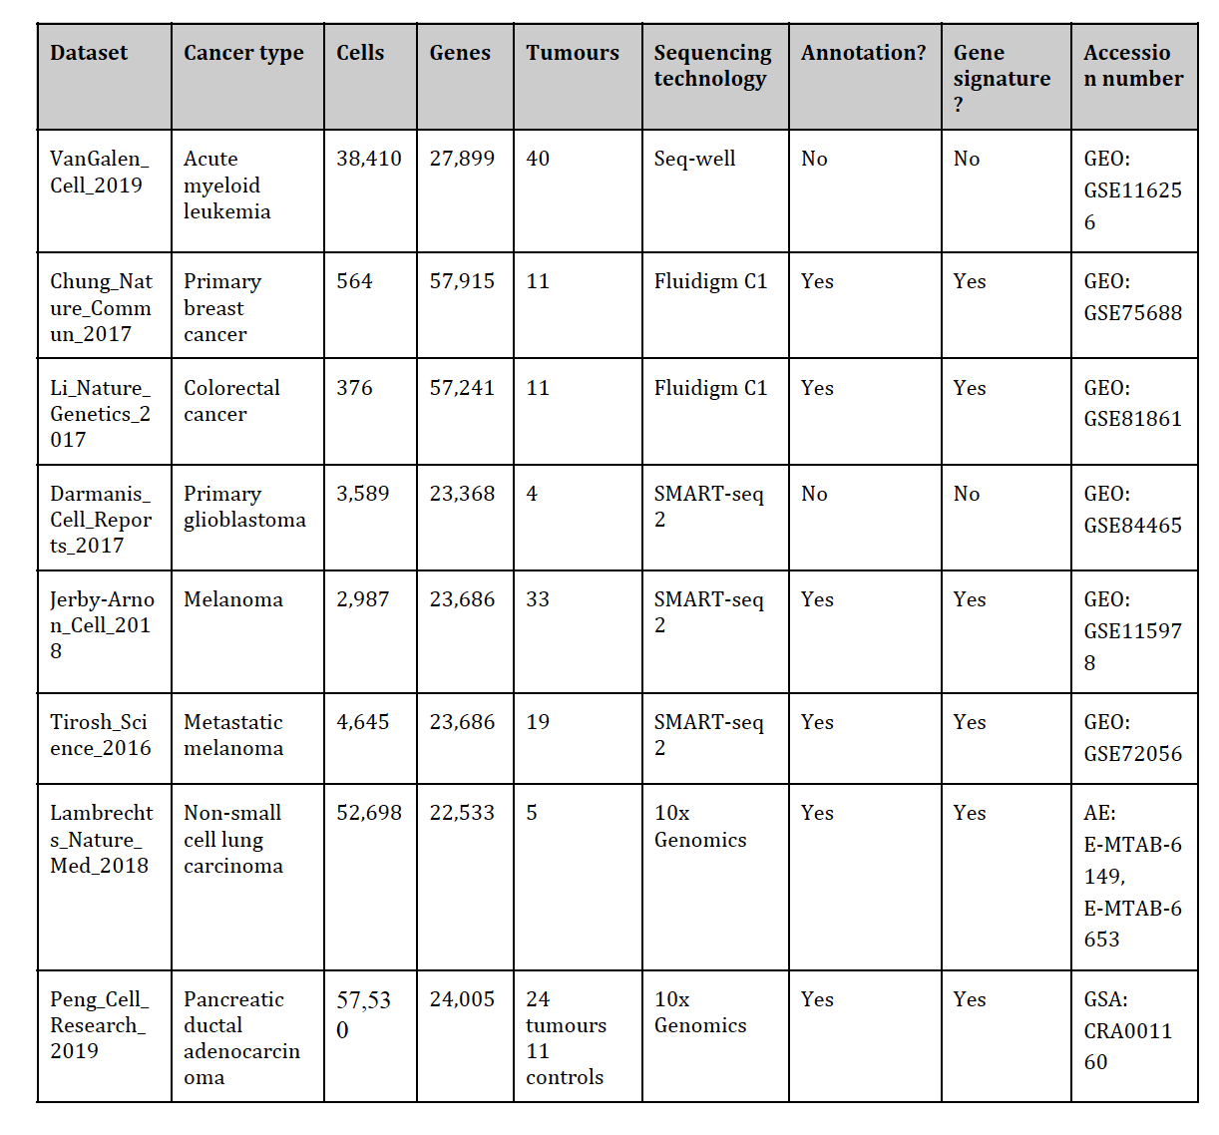
Datasets

Slide 4
Normalized difference in number of clusters
li_crc
JA_melanoma
tirosh_melanoma
darmanis_glioblastoma

