Slide 1
Our Great Meals
From fridge to fork — AI-powered recipe discovery
React Router v7
TypeScript
Express.js
PostgreSQL
Claude AI
Docker
Full-Stack Portfolio Project

Slide 2
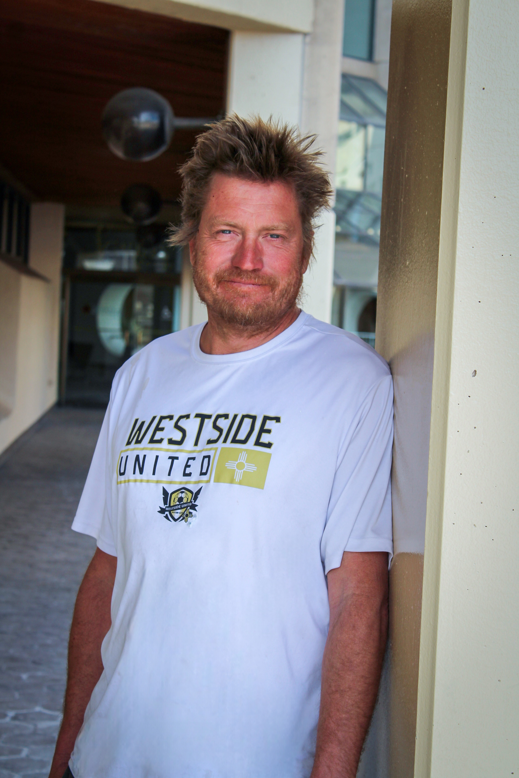
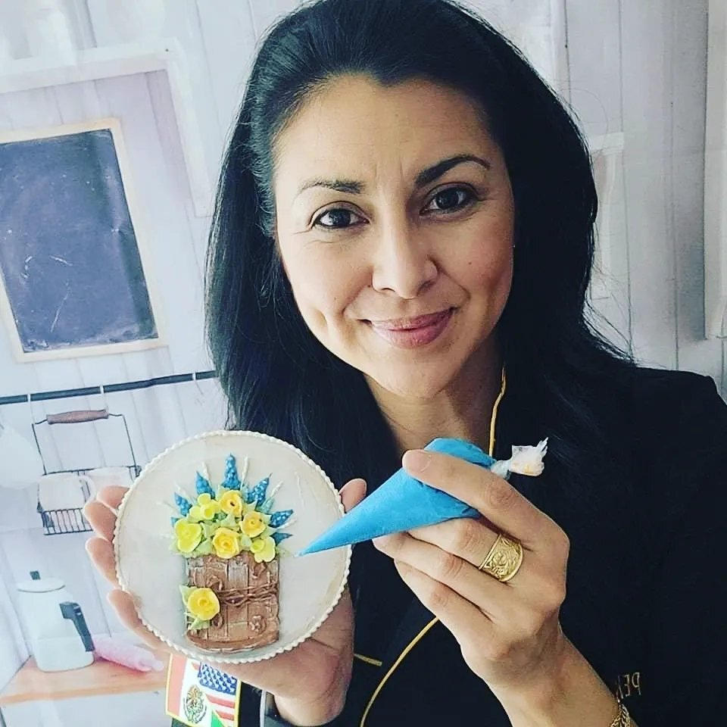
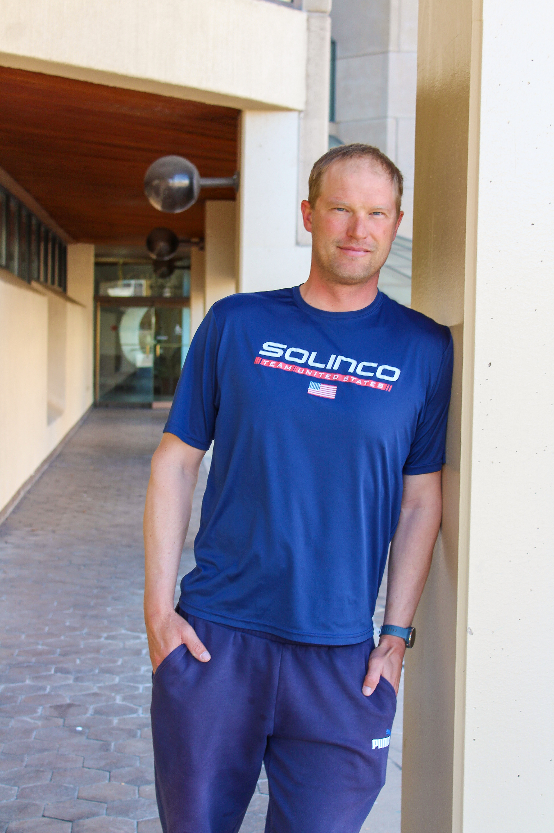
Introduction
Ben Njus
Perla Trujillo
Martin Poboril
https://bensburrito.com/
https://pekascookies.com/
https://martinpoboril.com/

Slide 3
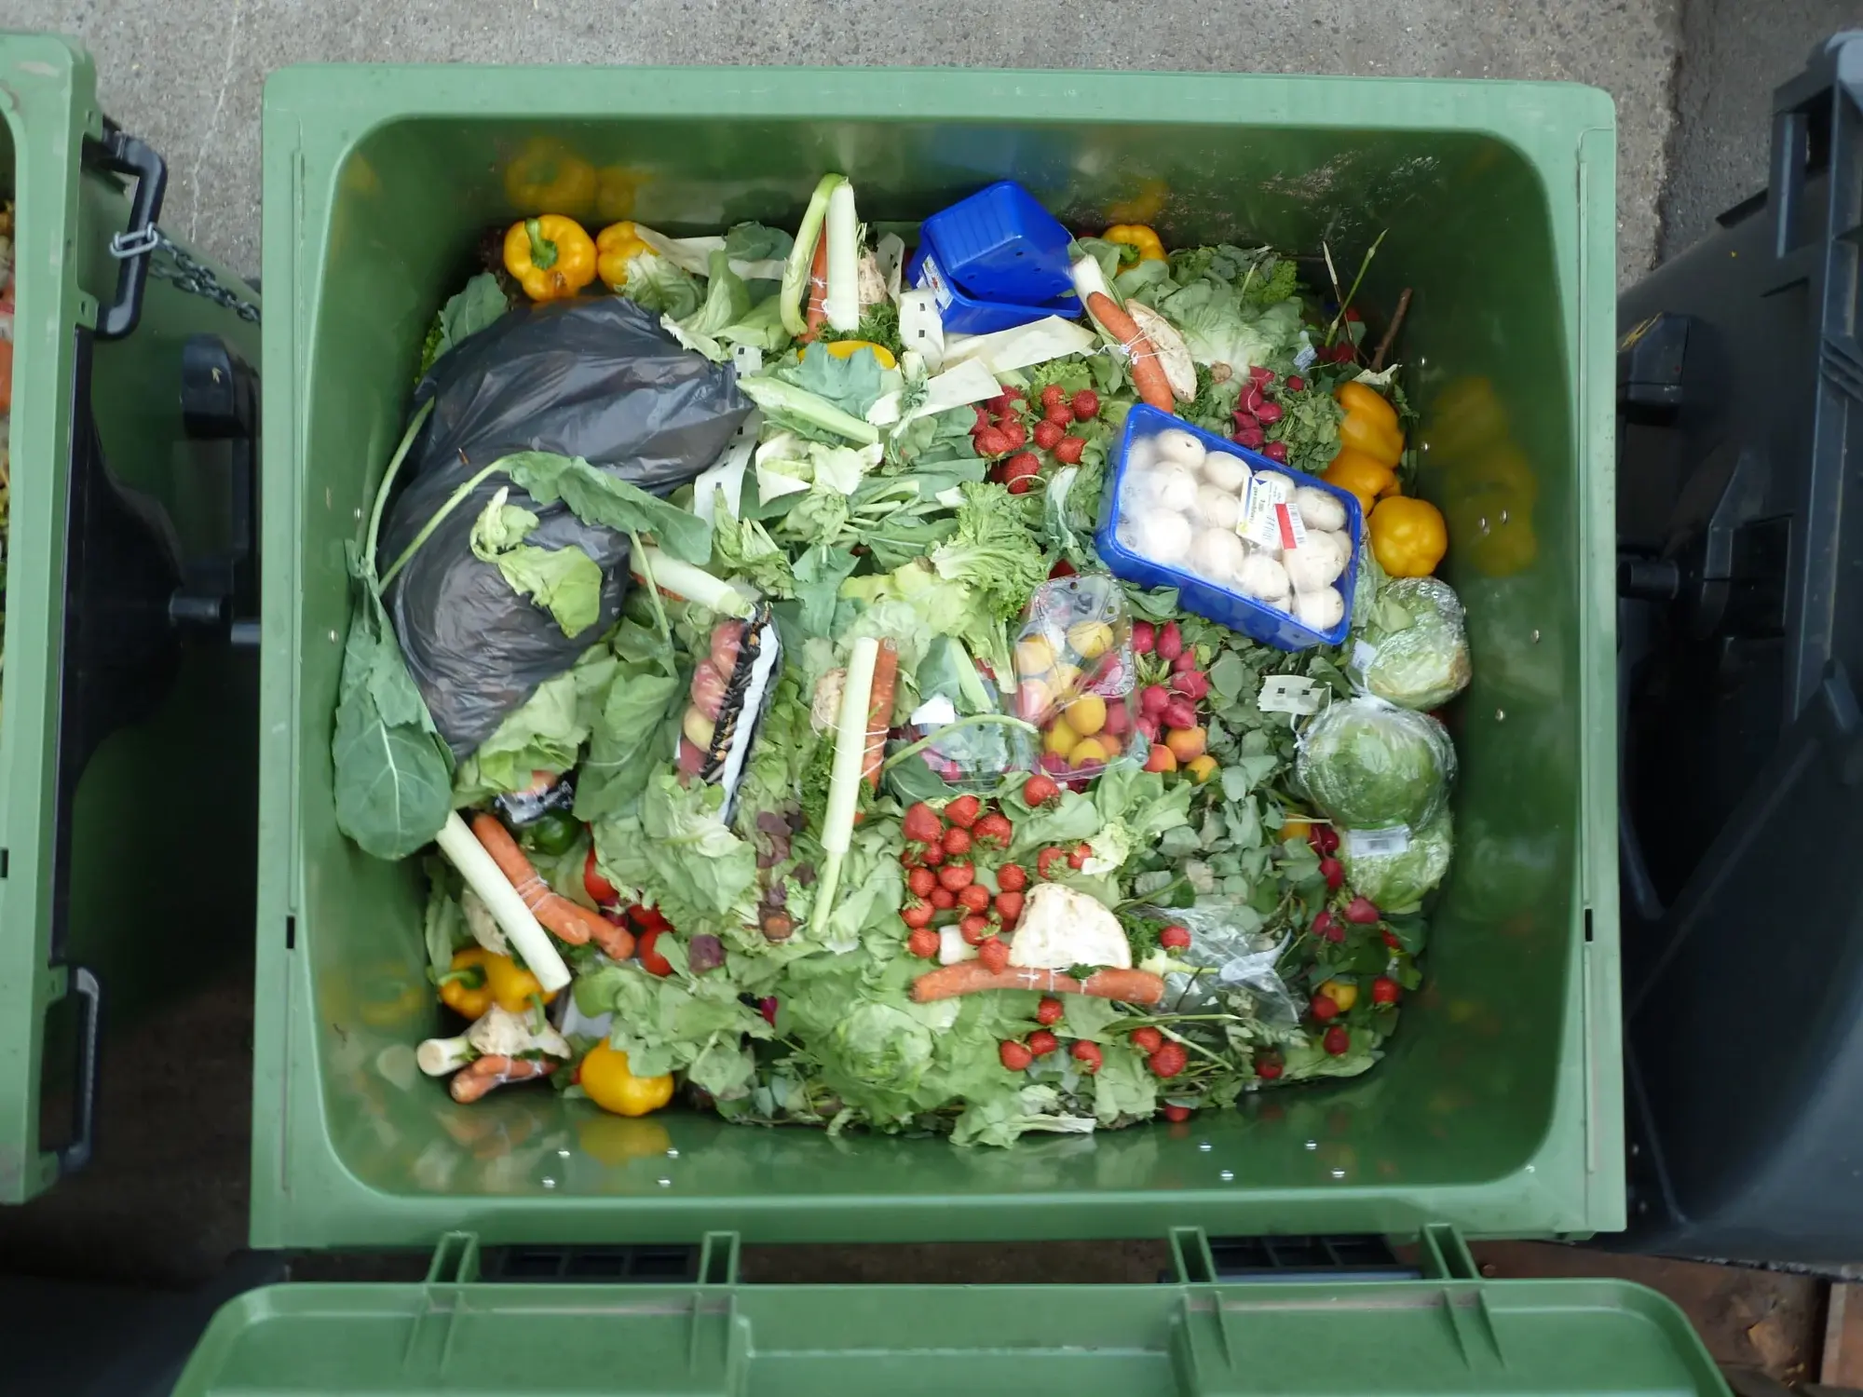
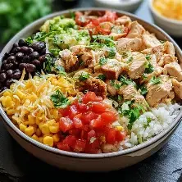
The Problem & The Solution
❌ The Problem
✅ The Solution

Slide 4
Upload & Scan Your Fridge
How it works
1.
User uploads a photo (JPEG/PNG/WebP, max 5 MB)
2.
File saved to server via Remix file-storage
[ Screenshot: Home page with drag-and-drop upload ]
3.
Image converted to Base64 in the SSR loader
4.
Sent to Claude Haiku Vision API with a JSON prompt
5.
Returns a JSON array of detected ingredients
Tech involved:
Claude Haiku Vision
Base64 encoding
SSR Loader

Slide 5
Demo · Step 2 of 4
Review & Edit Ingredients
How it works
1.
AI-detected ingredients shown as an editable list
2.
User can delete, rename or add ingredients manually
[ Screenshot: Ingredient list with edit / delete controls ]
3.
Form powered by React Hook Form + Zod schema
4.
User selects meal type and cuisine preference
5.
Submits to /recipe-generation via URL query params
Tech involved:
React Hook Form
Zod v4 validation
Remix Storage

Slide 6
Demo · Step 3 of 4
AI-Powered Recipe Suggestions
How it works
1.
Loader fires two requests in parallel via Promise.all
2.
Claude Haiku generates 3 tailored recipe suggestions
[ Screenshot: Recipe suggestions page showing 3 AI cards + DB results ]
3.
PostgreSQL returns matching recipes from the database
4.
Both results render side-by-side on the same page
5.
User picks a recipe to generate in full detail
Tech involved:
Promise.all
PostgreSQL
React Router v7

Slide 7
Demo · Step 4 of 4
Full Recipe Generation & Save
How it works
1.
Claude generates full recipe JSON (instructions, nutrition)
2.
Zod schema validates every field before DB insert
[ Screenshot: Full recipe page with ingredients, steps & nutrition facts ]
3.
Save requires login — JWT + Redis session checked
4.
Recipe stored in PostgreSQL via parameterised query
5.
Redirects to the saved recipe's permanent page
Tech involved:
Zod validation
JWT + Redis auth
PostgreSQL

Slide 8
Architecture
Tech Stack
Frontend
Backend & Infrastructure
React Router v7
Express.js
Full-stack SSR framework (loader / action pattern)
REST API with modular route / controller / model pattern
TypeScript
PostgreSQL
End-to-end type safety across routes and models
Relational DB — recipes, users, reviews, friends
Tailwind CSS v4
Redis
Utility-first styling, mobile-responsive
Session store for Express (express-session)
React Hook Form
Anthropic Claude
Form state with Zod resolver validation
Vision + text AI — Haiku model for speed & cost
Vite
Docker / Compose
Fast dev server and production bundler
Containerised deployment — all services in one stack

Slide 9
Thank You
Our Great Meals — AI-powered recipe discovery
GitHub: github.com/your-username/our-great-meals
Contact: your@email.com
Questions?

