Slide 1
OAuth1/2 & AWS
Karthik Sundaram

Slide 2
Agenda
Introduction to API
OAuth 1 vs OAuth2
AWS Introduction
AWS in Intuit
Q & A

Slide 3
Some Highlights of API
API (aka) Application Programming Interface ➔ set a subroutine definitions, Communication protocols used in building software for data transfer.
Early API’s were used in late 1968 and early 1970, but lacks many communication features as it is of today. They are limited within one system.
Early API’s most commonly has
Routines
Data Structures
Remote Procedure calls etc. (e.g.. Unix to Unix calls, LAN calls etc)
With the invention of TCIP, Ethernet by Xerox/PARC and NFS by Sun Microsystems (The network is the computer), the communication barrier across the computers was eliminated, and API has transformed to it’s new heights
Java RPC, RMI and OO were made simple, and API became the de-facto for transferring data across systems.
Initially all API’s were private (within company or partner)
With the evolution of Internet, API became public.

Slide 4
Some Highlights of API (cont..)
Big companies started to invest in API development and came with different types of API
SOAP ➔ Simple Object Access Protocol (used mainly for web)
RPC ➔ Remote Procedure Call (back end calls)
REST ➔ Representational State Transfer (web, mobile etc)
REST became more popular, because it uses HTTP protocol
As API has lot of pros in terms of transferring data, it also has cons. Hackers misused the API to steal data. Considering access/authorization as primary concerns, API framework started to adapt standard security/authorization framework such as OAuth, OAuth2 as they provide better authorization mechanism used via http protocol.
OAuth 1.x was originally developed by Flicker and Google and made it as Open Source. They became the de-facto for authorization. But due to some security limitations found at a later stage. OAuth2.x was introduced. (many companies such as Yahoo, Facebook, SFDC, Microsoft, Google, Mozilla, Intuit were chartered to form the new OAuth 2.x framework which fixes most of the issues found from OAuth 1.x)

Slide 5
Oauth1.x vs Oauth 2.x
OAuth 1.x | OAuth 2.x
We have 3 main players here. Customers (like all of us) Consumer (Security Agent designated by company) Service Provider (Company) | We have 4 main players here Resource Owner ➔ Customer or User Client ➔ equivalent to Consumer Authorization Server ➔ 2nd Part of Consumer Resource Server ➔ Service Provider
Customer first register with the service provider for data access. The service provider gives a client id, a secret key and a consumer key. | Customer first register with the Resource Server for data access. Resource server gives Client ID, Client Secret, Authorization token, Refresh token, end point URI, Refresh Endpoint URI
Customer gets a Client id, Client secret key and a consumer key. | Using this, get Authorization token (normally valid for 100 days) Refresh token (normally valid for 24 hours Access Token (normally valid for 1 hour)

Slide 6





Oauth1.x (visualize that you get data from Twitter)
One time Registration
1) Client Key
2) Client Secret
3) Consumer Key
4) End Point URI
Register
User
Calls using
Client secret,
Consumer key
End Point
Validates
Consumer
One time token
Limited Access
Twitter DB
User
Pass to
Twitter DB

Slide 7
Oauth 2.x (visualize that you get data from Twitter)
One time Registration
1) Client Key
2) Client Secret
3) Authorization URI
Register
User
Calls using
Client secret,
Authorization URI
Step 1
Step 4
One hour
Access Token
User
Authorize Token
Refresh Token
Call Back URI
Or User Consent
Step 2
Client
Step 3
Limited Access
Twitter DB
Step 7
Step 5
Combine your Client Secret, Authorize token
Step 6
Use refresh token
User

Slide 8
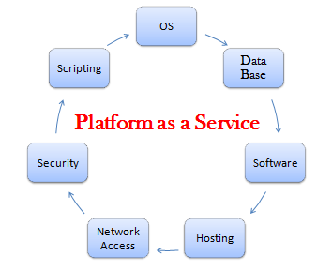
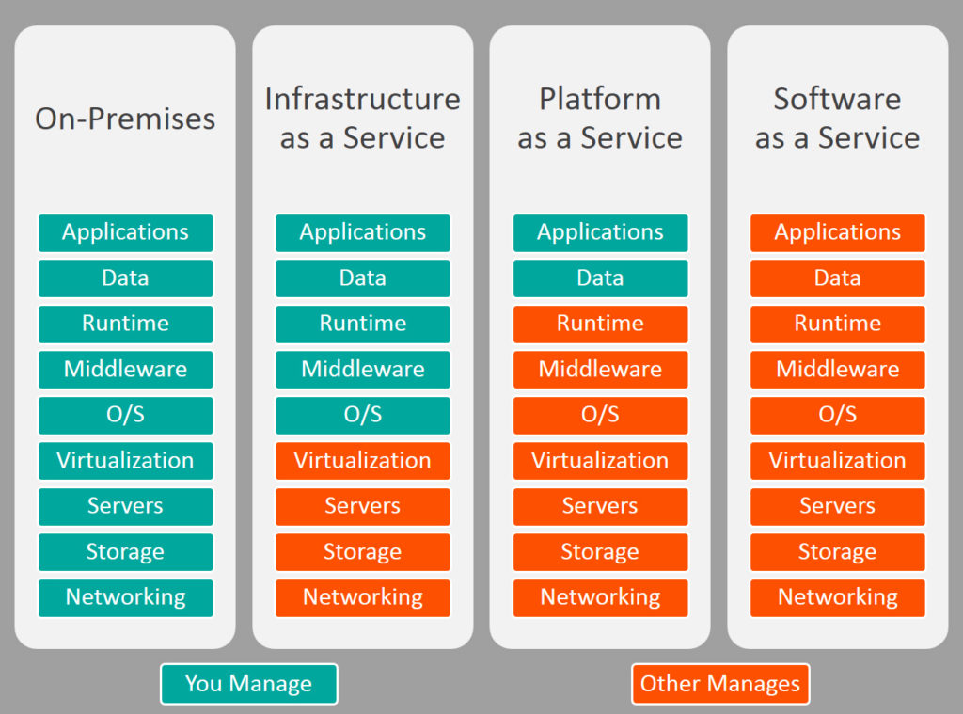
AWS (Amazon Web Service)
AWS is a Cloud Based Platform as a Service Model.
What is PaaS? What is PaaS?
A platform allowing customers to develop, run, and manage applications without the complexity of building and maintaining the infrastructure and comes with a fraction of cost.
The 3 buzz words that all people in the computer field should know.
PaaS, SaaS, IaaS

Slide 9
AWS at Intuit
Intuit currently owns two data center and many local data centers
This involves lot of maintenance and costs which includes, setting up servers, managing software licenses, contracts, storage, data center infrastructure, security, Govt rules etc and many more.
Migrating to AWS (a 3rd party provider, who takes care of all these services) helps Intuit to focus more on business and products rather than spending time, resource and money on maintaining infrastructure
In simple English, it’s like owning a home or fully furnished renting a home. You pay the rent, and the rental company will take care of all the maintenance, and you can vacate any day. But if you own a home, there are lot of things that you need to do in terms of maintenance, taxes, HOA’s etc.

