Slide 1

Newton Raphson method
Numerical Methods
Presented to,
Tanim Ahmed
Lecturer
Department of CSE, DIU
Presented by,
Rizwan Shariare Shopno
ID: 221-15-4788
Section: 61_H

Slide 2
What is Newton Raphson Method?
The Newton-Raphson method is an iterative numerical method used to find the roots of a
real-valued function.
This formula is named after Sir Isaac Newton and Joseph Raphson, as they independently
contributed to its development.
Newton Raphson Method or Newton’s Method is an algorithm to approximate the roots of zeros
of the real-valued functions, using guess for the first iteration (x₀) and then approximating the
next iteration (x₁) which is close to roots, using the following formula.

Slide 3
Formula
x_{n} = x_{n-1} – f(x_{n-1})/f'(x_{n-1})
Where,
x_{n-1} is the estimated (n-1)^{th} root of the function,
f(x_{n-1}) is the value of the equation at (n-1)^{th} estimated root, and
f'(x_{n-1}) is the value of the first order derivative of the equation or function at x_{n-1}.

Slide 4
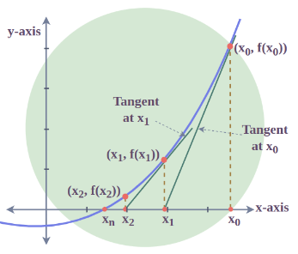
Calculation
Step 1: A tangent is drawn to f(x) at x₀. This is the initial value.
Step 2:This tangent will intersect the X- axis at some fixed
point (x₁,0) if the first derivative of f(x) is not zero i.e. f'(x₀) ≠ 0.
Step 3: As this method assumes iteration of roots, this x₁ is
considered to be the next approximation of the root.
Step 4: Now steps 2 to 4 are repeated until we reach the
actual root x*.

Slide 5
Example
Problem: For the initial value x₀ = 3, approximate the root of f(x)=x³+3x+1.
Solution:
Given, x₀ = 3 and f(x) = x³+3x+1
f'(x) = 3x²+3
f'(x₀) = 3(9) + 3 = 30
f(x₀) = f(3) = 27 + 3(3) + 1 = 37
Using Newton Raphson method:
x₁ = x₀ – f(x₀)/f'(x₀)
= 3 – 37/30
= 1.767

Slide 6
Conclusion
The Newton-Raphson Method is a valuable tool for finding approximate roots and has numerous real-world applications.
Convergence: The Newton-Raphson method typically converges rapidly if the initial guess is close to the actual root.
Applications:
Widely used in various fields, including engineering, physics, and computer science.
Used for solving nonlinear equations and optimization problems.

Slide 7
THANK YOU ☺

