Slide 1
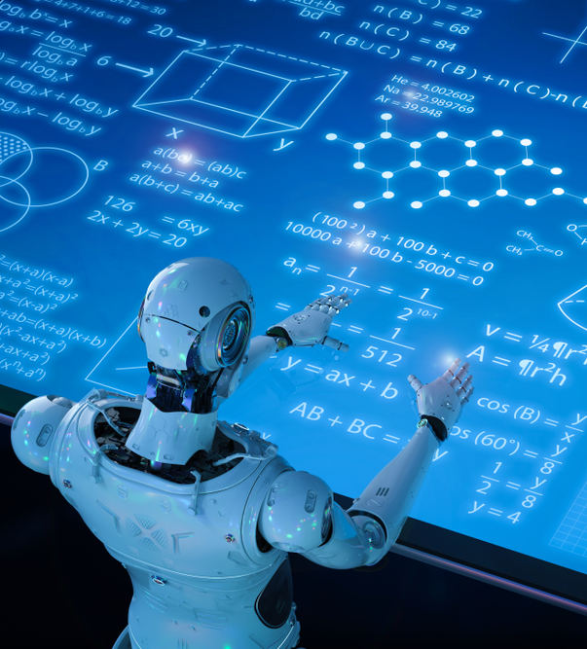

A BRIEF INTRODUCTION TO MACHINE LEARNING
PREPARED BY : VORTEX

Slide 2
PREPARED FOR
Rahmatul Kabir Rasel Sarker
Lecturer
Department of Computer Science and Engineering
Daffodil International University

Slide 3
GROUP MEMBERS
NAME | STUDENT ID
Most. Laboni Akter | 221-15-5770
Md. Rubayed Hossain | 221-15-5103
Minhazul Abedin | 221-15-4919
Rizwan Shariare Shopno | 221-15-4788

Slide 4

LET US BEGIN

Slide 5
POINTS TO BE DISCUSSED
Overview
Advantages and Disadvantages
Working Mechanism
Types
History
ML vs AI vs DL
Future of ML
QNA
Summary
Applications

Slide 6


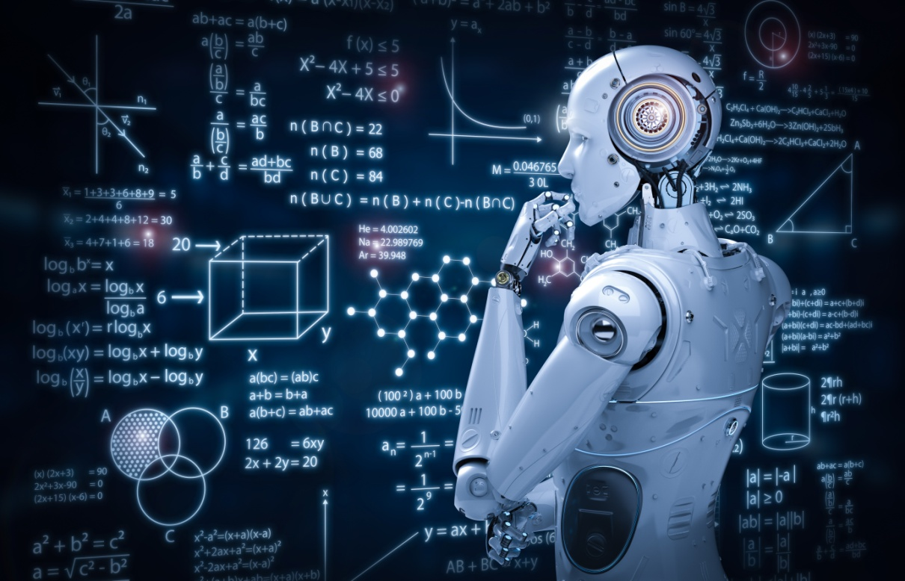
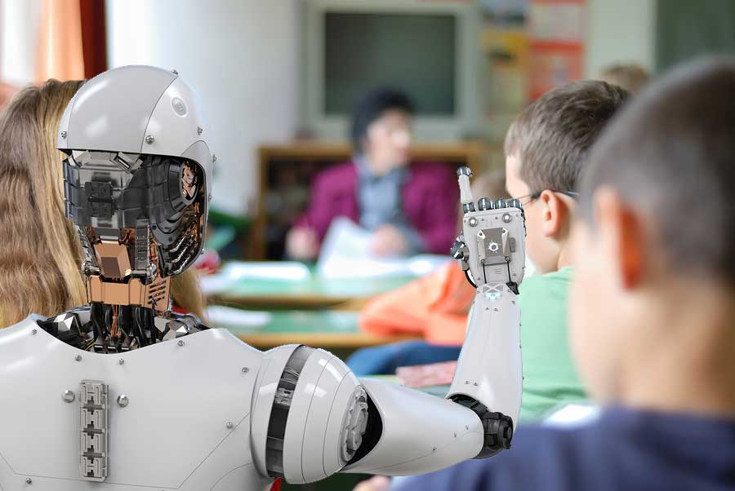
What is Machine Learning?
Machine learning is enabling computers to tackle tasks that have, until now, only been carried out by people.

Slide 7
What is Machine Learning? (Cont’d)
Machine learning is the study of computer algorithms that can improve automatically through experience and using data. It is seen as a part of artificial intelligence.
AUTOMATIC
DATA
ARTIFICIAL
INTELLIGENCE
COMPUTER
ALGORITHM

Slide 8
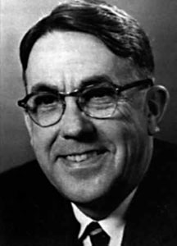

History of Machine Learning
1950s
The Term Machine Learning
1960s
Bayesian Methods introduced
1970s
AI Winner Caused
1980s
Rediscovery of backpropagation
1990s
From Knowledge driven to Data driven
Support-Vector Clustering
2000s
2010s
Deep Learning
Arthur L. Samuel
Tom M. Mitchell

Slide 9
How Machine Learning Works?
Traditional Programming
Data (Input)
Output
Program
Data (Input)
Machine Learning
Program
Output

Slide 10
Types of Machine Learning
Machine Learning
Unsupervised Learning
Clustering
Supervised Learning
Classification
Regression
Rainforcement Learning
Dimensionally Reduction
Game AI
Learning Tasks

Slide 11
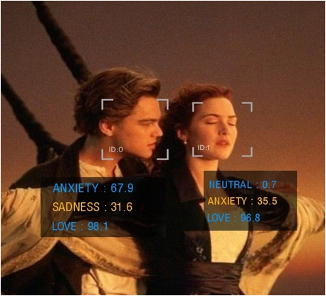
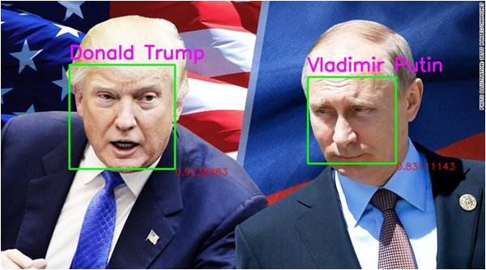
Applications of Machine Learning
Sentiment Analysis
Image Recognition

Slide 12


Applications of Machine Learning (Cont'd)
Product Recommendation
Google Translate

Slide 13

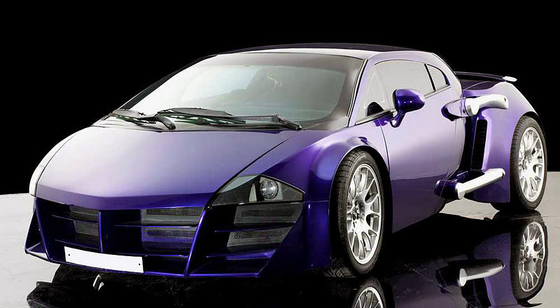
Applications of Machine Learning (Cont'd)
Virtual Personal Assistant
Self-Driven Car
Remember the movie named Tarzan?

Slide 14
Advantages and Disadvantages
No human intervention
Wide applications
Handling multi-variety data
Continuous improvement
Easily identify trends and patterns
Advantages

Slide 15
Advantages and Disadvantages (Cont'd)
High chances of error
Time and resource
Result interpretation
Data aquiring
Algorithm selection
Disadvantages

Slide 16

Machine Learning vs AI vs Deep Learning
Artificial Intelligence
Deep
Learning
Machine Learning
Machine Learning
Deep
Learning
Artificial
Intelligence

Slide 17
Machine Learning vs AI vs Deep Learning (Cont'd)
Artificial Intelligence
A science devoted to making machines think and act like humans.
Machine Learning
Focuses on enabling computers to perform tasks without explicit programming.
Deep Learning
A subset of machine learning based on artificial neural network and learn from vast amount of data.

Slide 18
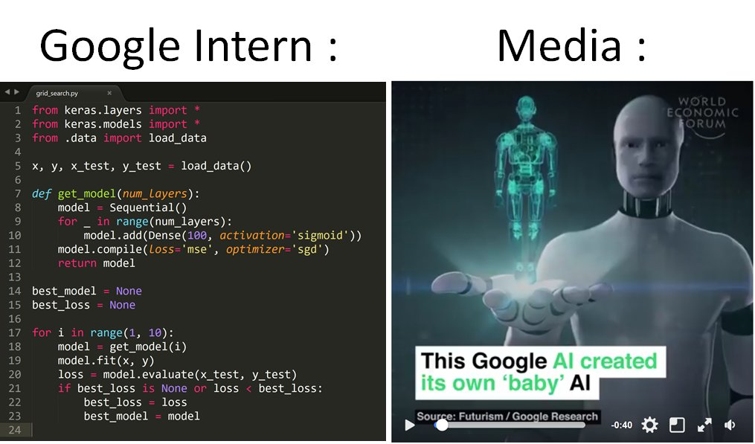
Future of Machine Learning
Will machine learning take over the world? or humans can keep their control over machine learning?

Slide 19
Future of Machine Learning (Cont'd)
“If you’re not concerned about AI and machine learning safety, you should be. Vastly more risk(y) than North Korea.”
- Elon Musk
VS
"I imagine a world in which AI and machine learning is going to make us work more productively, live longer, and have cleaner energy."
- Fei-Fei Li

Slide 20

QUESTIONS
& ANSWERS

