Slide 1
Superposition Theorem
Presented by:
Mohima Kabir (221-15-5855) Ashrufa Anne (221-15-5046)
Sumaiya Ritu (221-15-5173)
Rizwan Shariare Shopno (221-15-4788)
Presented to:
Md. Hasan Imam Bijoy Lecturer, Dept. of CSE
Daffodil International University

Slide 2
TABLE OF CONTENTS
01
Introduction to superposition theorem
02
Applications of superposition theorem
03
Working of superposition theorem
04
Requirements
05
Circuit Diagram

Slide 3
01
Introduction to superposition theorem
The Superposition Theorem for electrical circuits states that for a linear system the response (voltage or current) in any branch of a bilateral linear circuit having more than one independent source equals the algebraic sum of the responses caused by each independent source acting alone, where all the other independent sources are replaced by their internal impedances.

Slide 4
Applications of superposition theorem
02
The superposition theorem is very important in circuit analysis. It is used in converting any circuit into its Norton equivalent or Thevenin equivalent.
The Theorem is applicable to linear networks (time varying or time invariant) consisting of independent sources, linear dependent sources, linear passive elements (resistors, inductors, capacitors) and linear transformation.

Slide 5
Working of superposition theorem
03
To ascertain the contribution of each individual source, all of the other sources first must be “turned off’’ (set to zero) by:
Replacing all other independent voltage sources with a short circuit (thereby eliminating difference of potential i.e. V=0; internal impedance of ideal voltage source is zero (short circuit)
Replacing all other independent current sources with an open circuit (thereby eliminating current i.e. I=0; internal impedance of ideal current source is infinite (open circuit)).
This procedure is followed for each source in turn, then the resultant responses are added to determine the true operation of the circuit. The resultant circuit operation is the superposition of the various voltage and current sources.

Slide 6
Requirements
04
Current sources
Voltage sources
Resistors

Slide 7
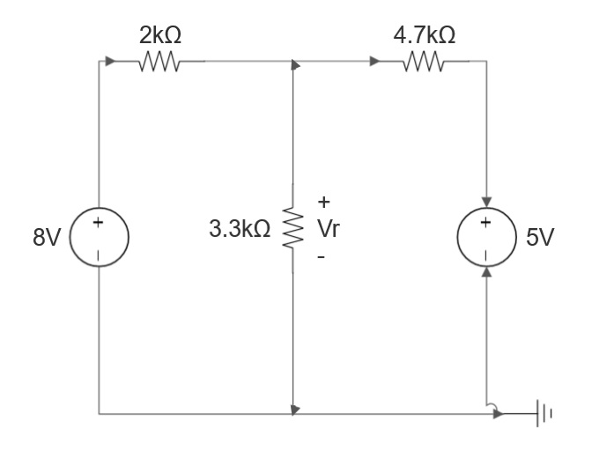
Circuit Diagram
05
Using the superposition theorem, determine the voltage drop and current across the resistor 3.3k as shown in the figure.

Slide 8
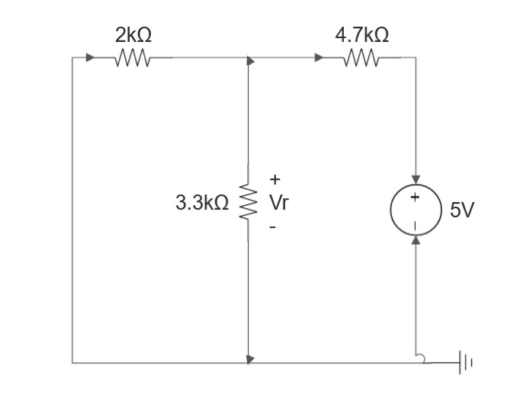
Step 1: Remove the 8V power supply from the original circuit, such that the new circuit becomes as the following then measure voltage across resistor.
Here 3.3k and 2k are in parallel, therefore resultant resistance will be 1.245k.
Using voltage divider rule voltage across 1.245k will be
V1= [1.245/(1.245+4.7)]*5 = 1.047V

Slide 9
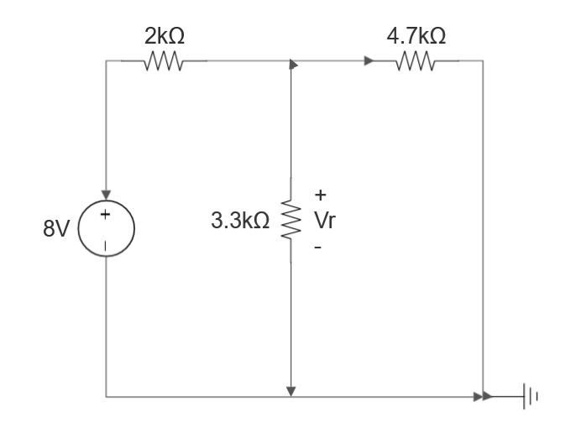
Step 2: Remove the 5V power supply from the original circuit, such that the new circuit becomes as the following then measure voltage across resistor.
Here 3.3k and 4.7k are in parallel, therefore resultant resistance will be 1.938k.
Using voltage divider rule voltage across 1.938k will be
V1= [1.938/(1.938+2)]*8 = 3.9377V
Therefore voltage drop across 3.3k resistor is V1+V2 = 1.047+3.9377 = 4.9847V

Slide 10
Thank You!

