Slide 1
Musify A Music Playlist Manager
___ ___ __ ___
| Y .--.--.---- | _.’ _ .--.--.
|. | | |_--- | | __|| | |
|. \_/ |___|___|__|__| |___|
|: | | |___|
|::.|:. |
`--- ---'
“ Simplifying Your Music Experience “
Submitted to:
Tania Khatun
Lecturer, Dept. of CSE Daffodil International University
Submitted by:
Rizwan Shariare Shopno (221-15-4788)
61_H, Dept. of CSE Daffodil International University

Slide 2
Introduction
Purpose: Creating an efficient and user-friendly music playlist management application.
Objectives: Designing a user-friendly interface, implementing core features, and enabling playlist saving/loading.

Slide 3
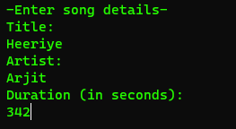
Data Collection
For effective playlist management, these data are Collected:
Song titles.
Artists.
Durations.

Slide 4
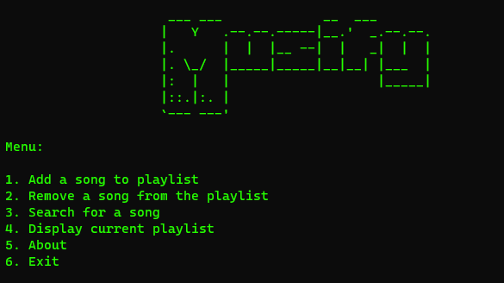
Outcomes of the Project
Objective Achievement:
Fully functional music
playlist manager.
User Experience:
Easy organization and
enjoyment of music
collections.

Slide 5
Future Scope
Limitations:
Platform-specific restrictions.
Limited features compared to commercial software.
Future Scope:
Support for various audio formats.
Advanced search capabilities.
Integration with online music services.

Slide 6
Conclusion
In conclusion, project MUSIFY is poised to revolutionize the way users manage and enjoy their music. With a focus on simplicity and efficiency, Musify can achieve all the positive usage worldwide.

Slide 7

Thank You
Scan for the source code

