Slide 1

Air Quality Analysis Bradford (Winter 2024/2025)
Period
1st November 2024 to 16th January 2025
Bradford Air Quality Team
Uk Air Quality Network (PM10,PM2.5)
Monitoring Station
Keighley, Tong Street, Treadwell Mills
Monitoring Station.
Urban Background, Roadside

Slide 2
Data Overview and Initial Challenge
97%
79.3%
PM10
35%
PM10
PM10
97.5%
77.8%
PM2.5
35%
PM2.5
PM2.5
Keighley
Tong Street
Treadwell Mills
PM10 -ve
1.67%
PM10 -ve
2.8%
PM10 -ve
0%
PM2.5 -ve
4.5%
PM2.5 -ve
11.8%
PM2.5 -ve
0%
PM10 Missing
2.97%
PM10 Missing
20.67 %
PM10 Missing
64.93 %
PM2.5 Missing
2.4%
PM2.5 Missing
22.18 %
PM2.5 Missing
64.93 %

Slide 3
STEP 3
Understanding the Limitation
STEP 1
Negative Values
03
01
Addressing
Data Quality
02
STEP 2
Linear Interpolation

Slide 4
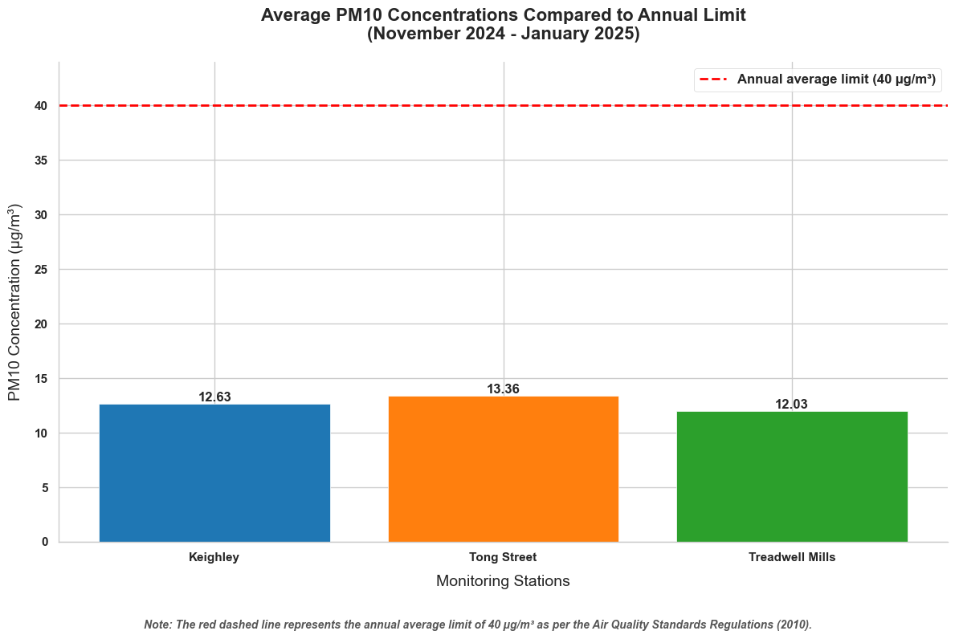

Slide 5
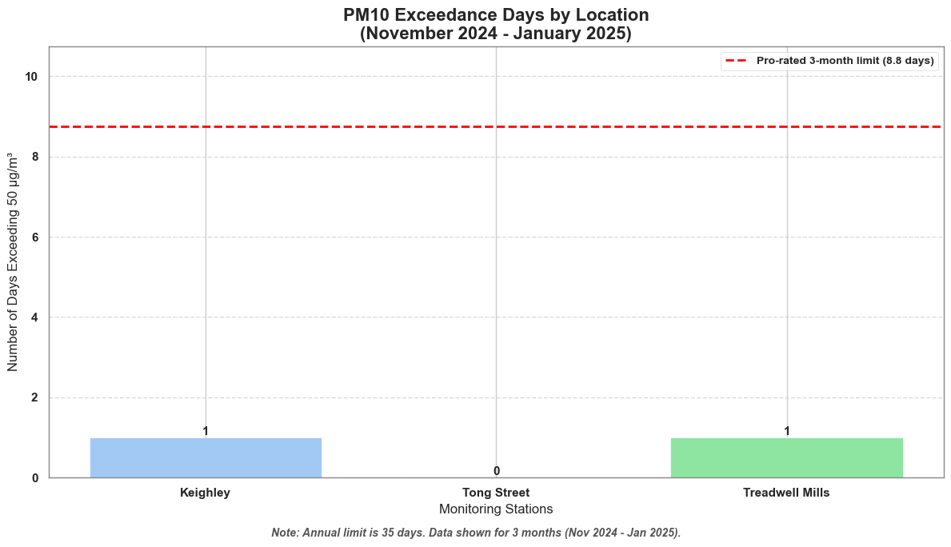

Slide 6
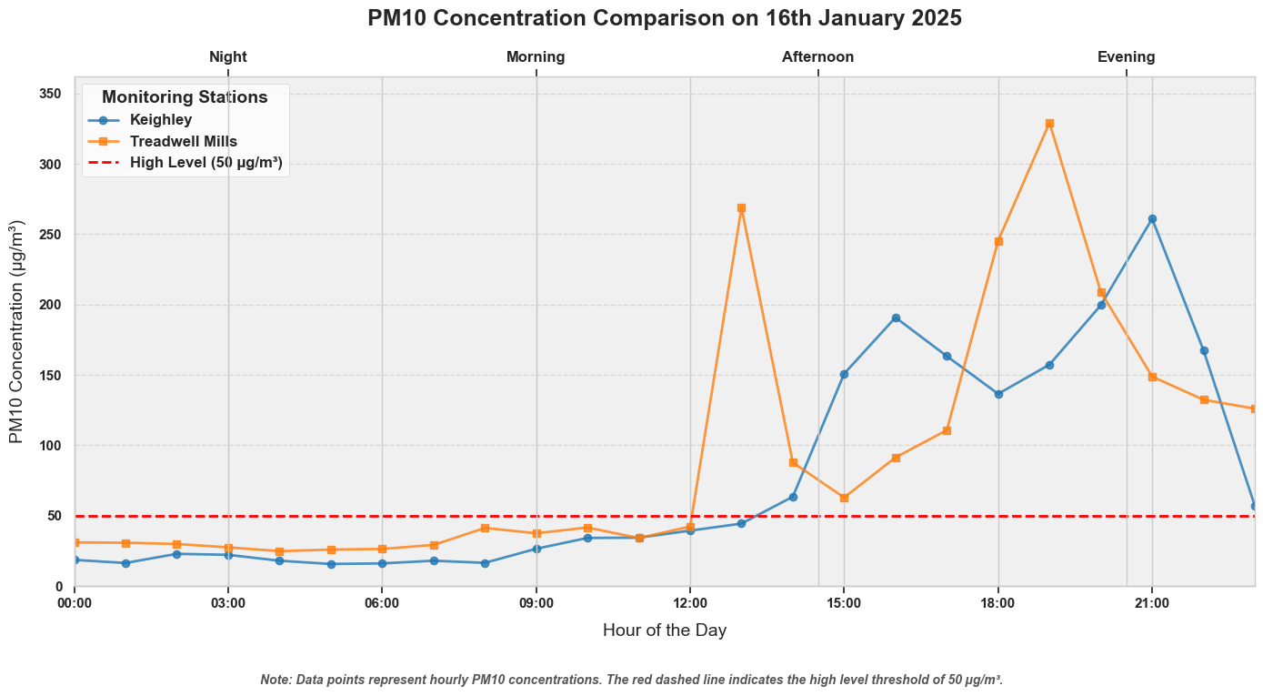

Slide 7
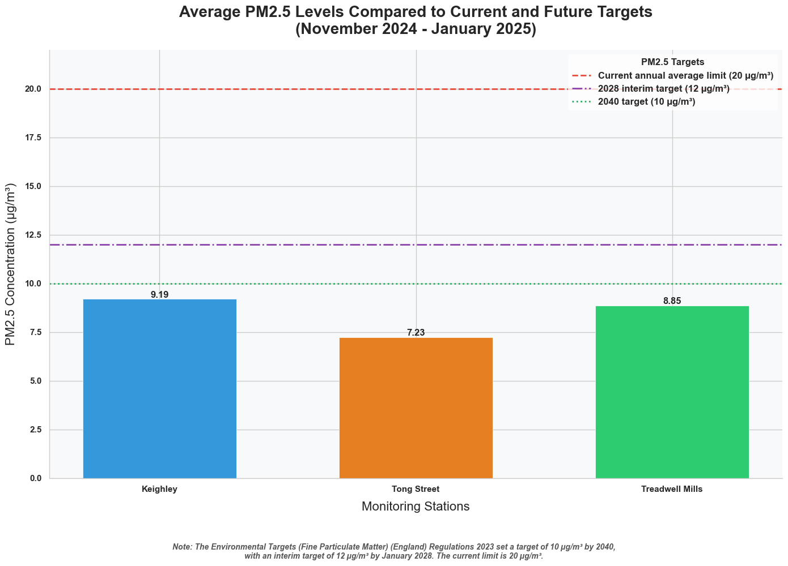

Slide 8
PM10 Exposure Analysis
98.50%
1.50%
3931 hours
60 hours
Note : Winter Air Quality Analysis from 1st of November to 16th of January

Slide 9
PM2.5 Exposure Analysis
96.66%
3.34%
3884 hours
134 hours
Note : Winter Air Quality Analysis from 1st of November to 16th of January

Slide 10
Hours of Exposure to PM10 and PM2.5
Treadwell PM2.5
0.46%
09
Keighley PM10
03
0.49%
High : 3 hours ( 0.46%)
Moderate : 22 hours (3.40%)
Low : 623 hours (96.14%)
High : 9 hours ( 0.49%)
Moderate : 27 hours (1.46%)
Low : 1812 hours (98.05%)
1.39%
10
Treadwell PM10
Keighley PM2.5
High : 9 hours ( 1.39%)
Moderate : 12 hours (1.85%)
Low : 627 hours (96.76%)
High : 10 hours ( 0.54%)
Moderate : 65 hours (3.25%)
Low : 1773 hours (95.94%)
09
0.54%
0.53%
06
Tong Street PM2.5
Tong Street PM10
High : 8 hours ( 0.53%)
Moderate : 26 hours (1.71%)
Low : 1488 hours (97.77%)
08
0.39%
High : 6 hours ( 0.39%)
Moderate : 24 hours (1.58%)
Low : 1492 hours (98.03%)
Notes:
© Copyright PresentationGO.com – The free PowerPoint and Google Slides template library

Slide 11






Key Findings
Data Quality Issues
Negative and Missing Values.
Regulatory Guidelines
January 16th.
HDRC
Members
Meeting the Set Targets
Meeting the Targets for 2028 and 2040.
Exposure Analysis
Predominantly Low Exposure Levels.

Slide 12






Warrants Further Research
Investigating of Extreme Air Quality Events
Further investigation is needed to understand the causes of extreme air quality events, such as the PM10 spike observed on January 16th. This should include analysis of meteorological conditions, traffic patterns, and potential local sources to inform targeted interventions.
Enhanced Data Quality Management
A comprehensive approach to data quality management is recommended. This involves root cause analysis of data errors, exploring advanced imputation techniques, and rigorously assessing the impact of data correction methods on analytical results.
Advanced Air Quality and Environment Modelling
Advanced statistical modeling is warranted to explore relationships between air quality and environmental factors. This includes time series analysis, correlation studies, and potentially spatial modeling to understand air quality dynamics.
Collaboration
Refined Public Health Exposure Assessment
A refined exposure assessment is necessary to better understand health implications. This should incorporate time-activity patterns, age-specific sensitivities, and potentially health impact modeling to assess population risk.
Benchmarking and Interactive Data Platform
Benchmarking against industry best practices and developing an interactive data platform would enhance data analysis and stakeholder communication. This platform would allow for user-driven exploration of air quality data and insights.

Slide 13
Thank You
Q & A
HDRC
Notes:
© Copyright PresentationGO.com – The free PowerPoint and Google Slides template library

