Slide 1








Child Poverty
Ethinicity
Population
47% Asian and British Asian
51% of Black and Black British
24% of white Families
333 Million – 15.4%
4.3 million – 30% UK population
Parental
Working Families
44% lone parent
60% of children in poverty comes from working families
Disability
Children in Families
34% children
46% of children in families with three or more children are in poverty.
London the Hotspot
Deep Poverty
32% London – 29%(Average)
Westminister Making it to the Top 3
2.3 Million Children are in deep Poverty
Notes:
© Copyright PresentationGO.com – Free Templates & Infographics for PowerPoint and Google Slides

Slide 2
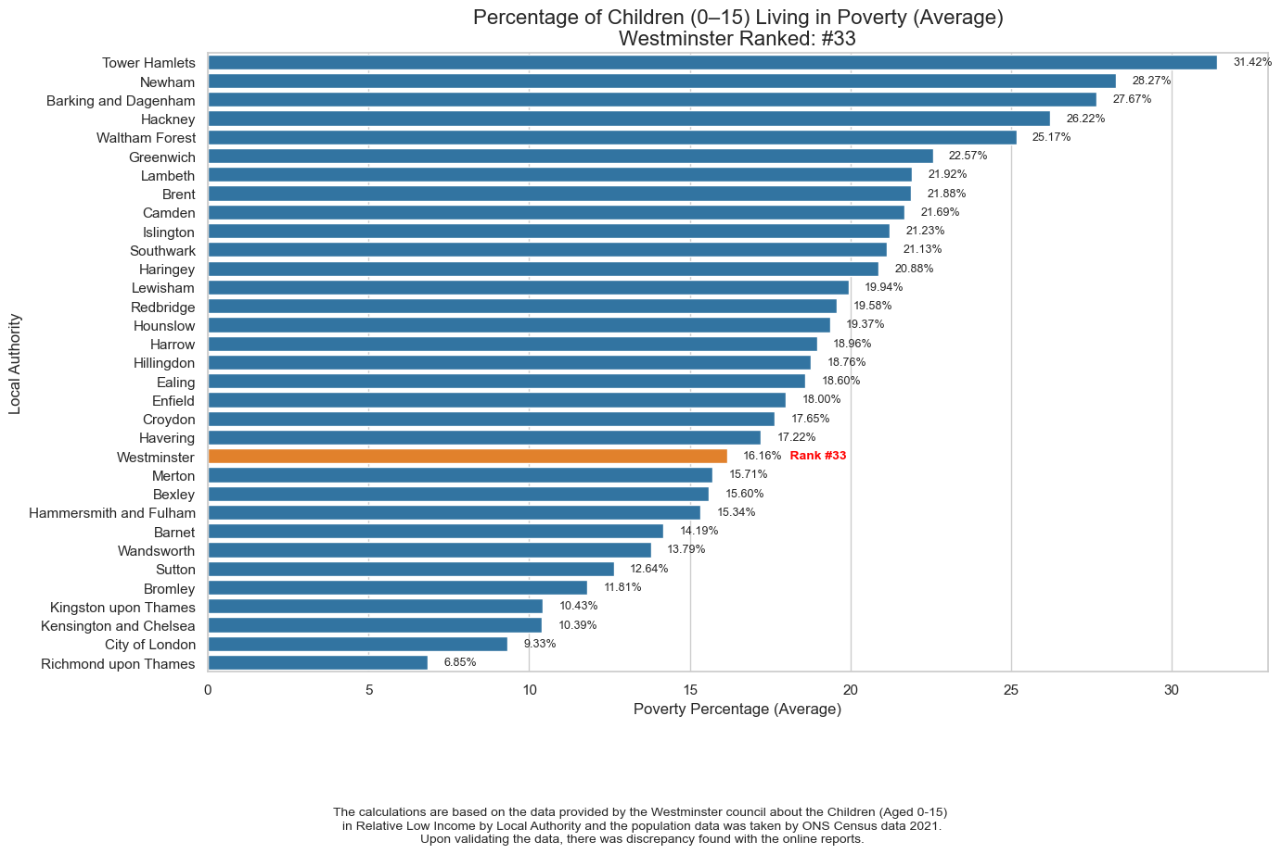

Slide 3
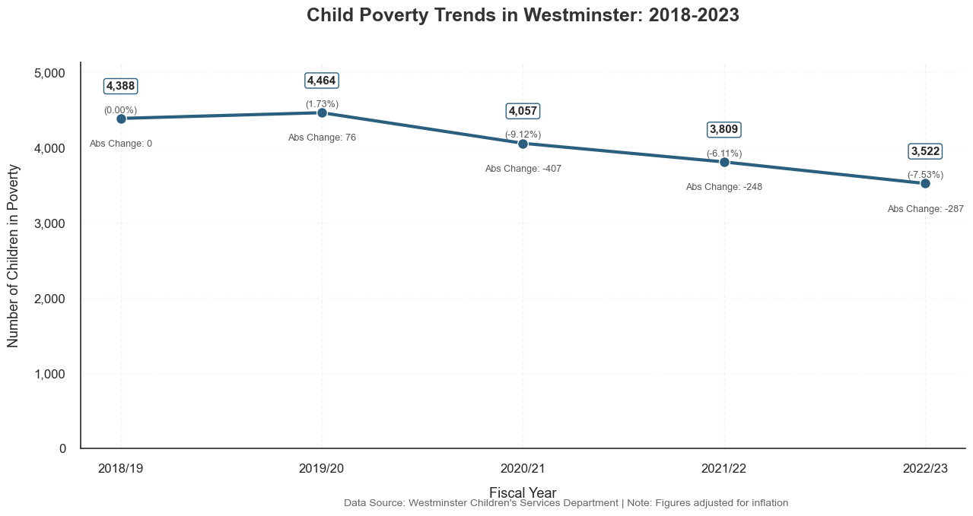

Slide 4
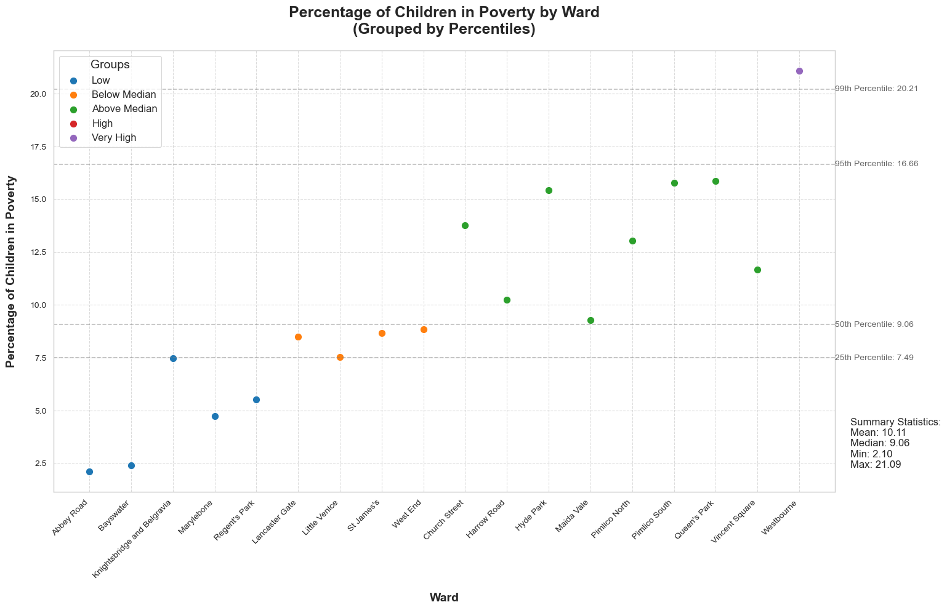

Slide 5
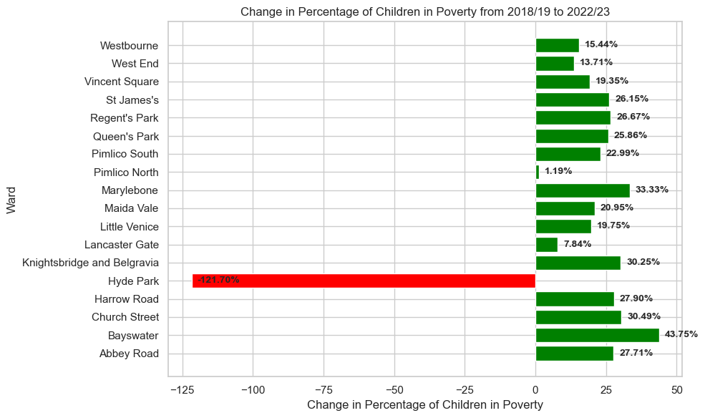

Slide 6






Impact
01 - Health
01
Infant Mortality – 4.1 per 1000
(London Average 3.3)
05 - Education
Lower GCSE attainement -76%
High Abseetism
High School Droup out Rates
05
02
02 - Qualification
04 – High Obesity Rates
No Qualification – 6%
(London Average 6.7%)
44% of Children when they leave primary School are obese
04
03
03 - Unemployment
Unemployment Rate 5.7%
(London Average 5.1)
Notes:
© Copyright PresentationGO.com – Free Templates & Infographics for PowerPoint and Google Slides

Slide 7


Key Trends
Refrom Changes
Child Poverty
Living Cost
30% AHC
UC
02nd
Notes:
© Copyright PresentationGO.com – Free Templates & Infographics for PowerPoint and Google Slides

Slide 8






Contributing Factors
06 – Changes in Policies
01 - Diverstiy
Universal Credit and Two child Rule
45% of the residents are from a global majority background.
01
02
05 - Unemployment
02 – Income Equality
06
03
5% (Similar to London Average)
23,390 (14% of household are below median income in London)
04 –Geo Spatial Disparities
05
04
03 – Housing Cost
Poverty is concentrated in specific areas of Westminster, often characterized by social housing and limited access to resources and opportunities.
2nd after Chelsea.
Notes:
© Copyright PresentationGO.com – Free Templates & Infographics for PowerPoint and Google Slides

Slide 9





Key Findings and Recommendation
Evaluate Existing Policies
33rd Rank
Targeted Support for high-risk wards
Downward Trend
Futher Investigation into Hyde Park
Key Findinds
High Risk Wards
Recommendation
Addressing the Root Cause of child Poverty
Impact
Key Trends
Data Science
Notes:
© Copyright PresentationGO.com – Free Templates & Infographics for PowerPoint and Google Slides

Slide 10
Thank You
Q & A
City of Westminister
Notes:
© Copyright PresentationGO.com – The free PowerPoint and Google Slides template library

