Slide 1







Al-Imam University
Computer Science Department
College of Computer and Information Sciences
Electronic training platform
Course Code / Title: CS 290
Assignment: Project
2nd Semester / Year: 2021
conclusion
pattren
Prototype
The charts
Sprints
content
Introduction
Supervisor: Jawza’a Almutairi

Slide 2
Contents
Introduction
Charts
Sprints
Pattern
Prototype
conclusion
pattren
Prototype
The charts
Sprints
content
Introduction

Slide 3
Introduction :
In this phase we discussed several aspects in terms of design, architecture, and implementation , And we drew several diagrams representing the tasks of all our users, also we put a pattern and choose a type for a specific reason , and at the end we put a prototype for our work and the processes that need interaction with the user.
conclusion
pattren
Prototype
Sprints
The charts
content
Introduction

Slide 4
x
Student Name | Role and Responsibilities
Areej Turky Alotaibi | Leader, Fill the Template, choosing pattern, Class, context , Sequence digram 5.
Raghad Adel Alshabana | Member, Flowchart digram, Sprints , Sequence digram 1,2 ,TimeLine
Slima Mohammed bnous | Customer of the team, Class diagram , sprints, and prototype
Shoroog Saad Alarifi | Member, Flowchart digram , Sprints , Sequence digram 4,TimeLine
HAJAR abdullaziz Aljassar | Member, pattern, Sequence and class digram 3.
conclusion
pattren
Sprints
Prototype
The charts
content
Introduction
Table 1: Team Contribution

Slide 5
Lifecycle Sprints
conclusion
pattren
Sprints
Prototype
The charts
content
Introduction

Slide 6
ToDo List
Story | Estimation (per day) | Priority
As a customer, I want Get app icon in home page, so users/visitors can download /transferred to the app. | Half a day | 4
As a customer, I want a trainer's overview in home page, so users/visitors can see the trainer's qualifications/information. | Half a day | 4
As a costumer, I want an announcements label in home page, so users/visitors can view if any news about courses announced. | Half a day | 4
As a costumer, I want a notification's icon in trainer/trainee home page, so trainer/trainee can notify about his/her currently courses. | 1 | 6
As a costumer, I want recently common courses appear in trainee’s home page, so trainee can see all recently common courses that related to his/her major. | 1 | 4
As a costumer, I want a search box in home page, so users can search for courses easily. | 1 | 4
As a costumer, I want a preferences icon in trainee’s home page, so trainee can mark the courses they prefer. | 1 | 5
As a costumer, I want a categories of courses list in home page, so users/visitors can see all courses categories. | Half a day | 4
As a costumer, I want a certifications icon in trainee’s home page, so trainee can see all certifications of course that he/she done. | 1 | 5
As a costumer, I want courses setting icon in trainer’s home page, so trainer can manage his/her course. | 1 | 6
As a costumer, I want statistic's reports icon in admin/administrator/trainer’s home page, so admin/administrator/trainer can see regularly statistics . | 3 | 7
As a costumer, I want Islamic design for ETP , so it can match with PoTHMs. | Half a day | 8
As a costumer, I want to use two main match colors for designing , so it can attract the users and to achieve the international standers in visual vision. | Half a day | 8
As an owner, I want to link my system with another systems, so I can improve the relations to the platform system. | 2 | 1
As an employee, I want to register in ETP, so I can access to training in the courses. | 2 | 2
As an owner, I want to connect ID of trainee with PoTHMs’s database, so they can join to the system easily with their information. | 1 | 1
As a trainee , I want to sing-up to the ETP , so I can access to courses . | Half a day | 3
As trainer , I want to sing-up to the ETP , so I can make a request to train on ETP. | Half a day | 3
As a trainee , I want to sing-in to the ETP , so I can enroll in courses. | Half a day | 3
As trainer , I want to sing-in to the ETP , so I can train on ETP. | Half a day | 3
Total | 19
conclusion
pattren
Sprints
Prototype
The charts
content
Introduction
Figure 1: product backlog

Slide 7
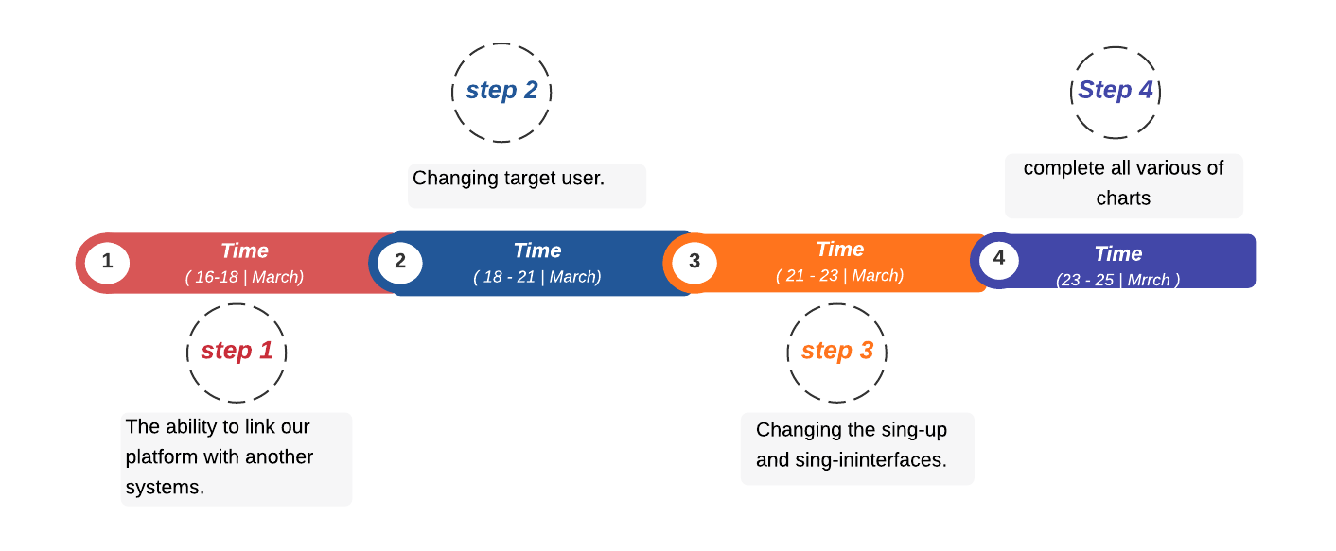
 | Task description | Duration | People (#workers)
Task 1 | The ability to link our platform with another systems. | 3 days | 3
Task 2 | Changing target user. | 2 days | 5
Task 3 | Changing the sing-up and sing-in interfaces. | 2 days | 2
Figure 2: sprint backlog
conclusion
pattren
Sprints
Prototype
The charts
content
Introduction
Figure 3: TimeLine

Slide 8
 | Task description | Duration | People (#workers)
Task 1 | Achieve design requirements of home page. | 4 days | 3
Task 2 | Achieve design requirements of trainee’s home page. | 2 days | 2
Task 3 | Achieve design requirements of trainer’s home page. | 2 days | 2
Task 4 | Achieve design requirements of admin’s home page. | 1 days | 2
Task 5 | Achieve design requirements of administrator’s home page. | 1 days | 2
Task 6 | Achieve design requirements of visual vision and theme for ETP. | 1 day | 3
Figure 4: sprint backlog
conclusion
pattren
Sprints
Prototype
The charts
content
Introduction
Figure 5: TimeLine

Slide 9
Diagrams
conclusion
pattren
Sprints
Prototype
The charts
content
Introduction

Slide 10
1.Context digram :
conclusion
pattren
Sprints
Prototype
The charts
content
Introduction

Slide 11
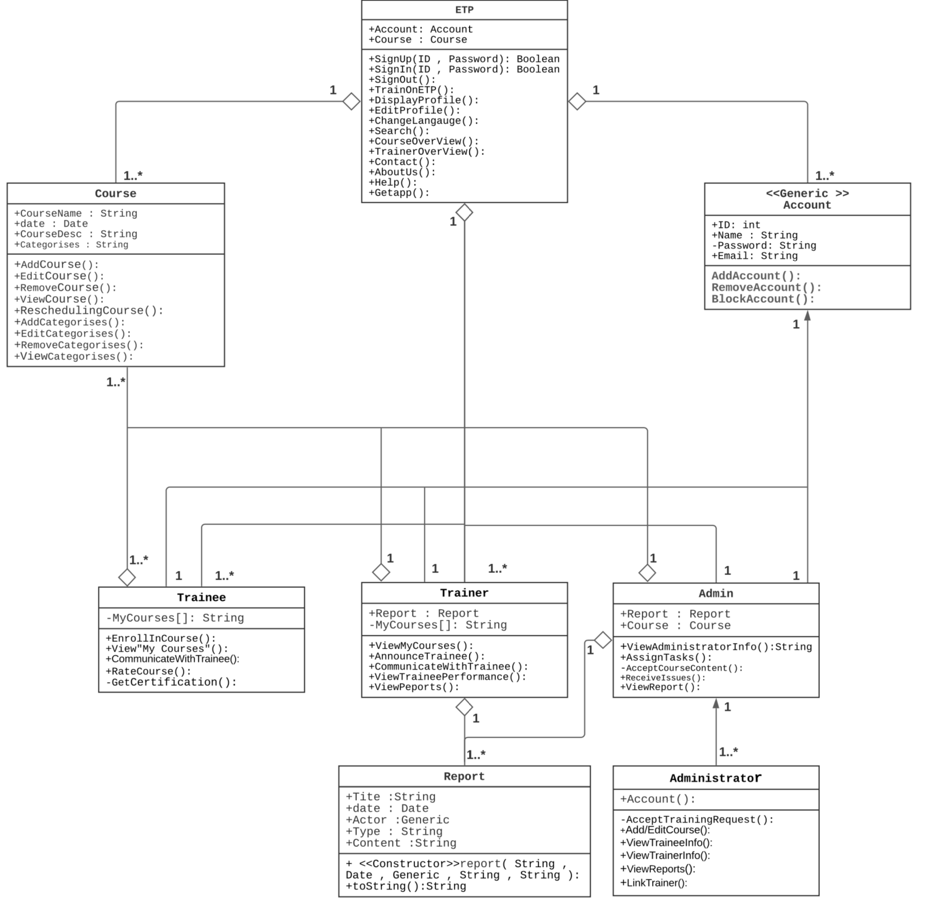
2.Class digram
conclusion
pattren
Sprints
Prototype
The charts
content
Introduction

Slide 12
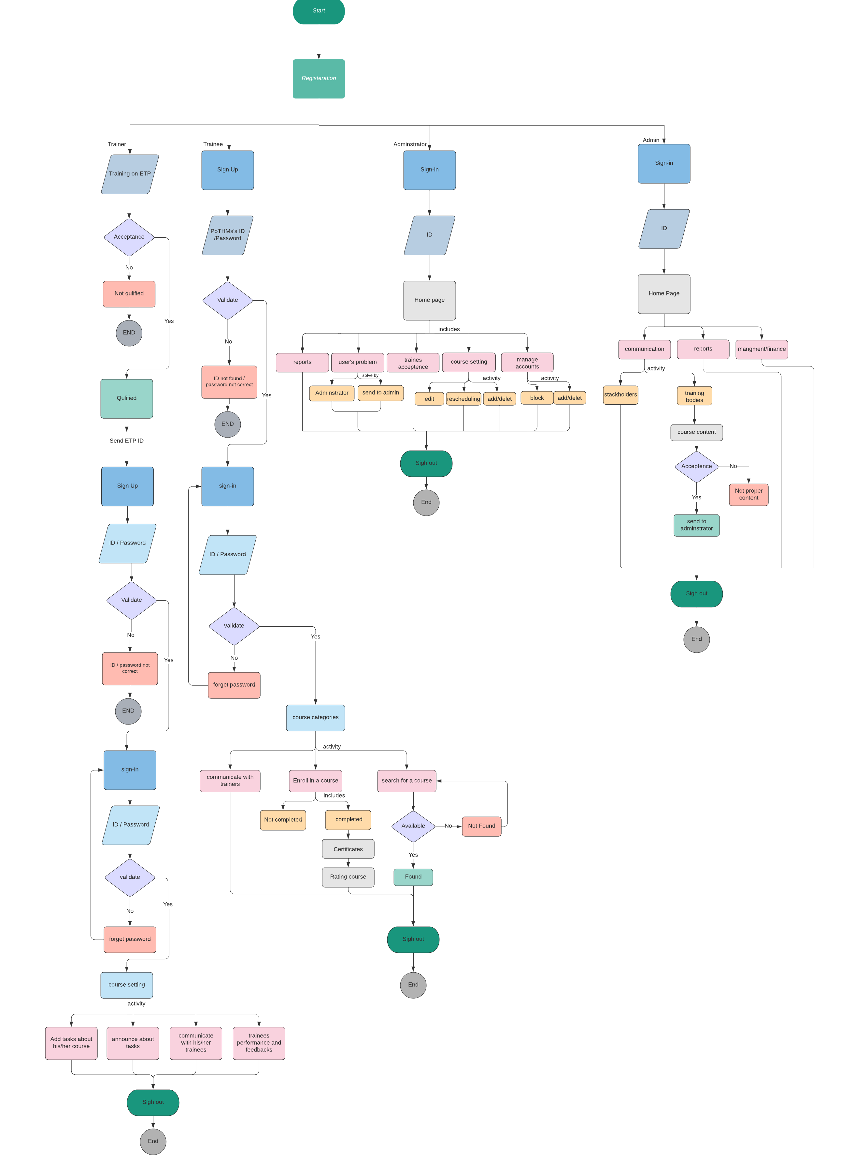
3.FlowChart
conclusion
pattren
Sprints
Prototype
The charts
content
Introduction

Slide 13
4.Sequence digrams
conclusion
pattren
Sprints
Prototype
The charts
content
Introduction

Slide 14
1. Sign-Up For Trainer/Treainee
conclusion
pattren
Sprints
Prototype
The charts
content
Introduction

Slide 15
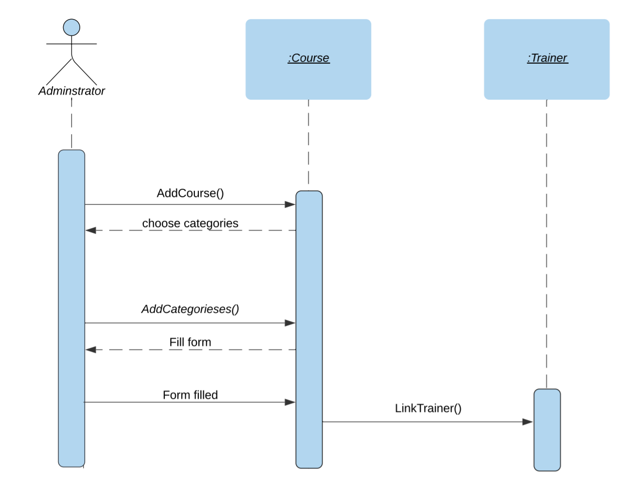
2. Add Course from adminstrator
conclusion
pattren
Sprints
Prototype
The charts
content
Introduction

Slide 16
3. Enroll For Trainee
conclusion
pattren
Sprints
Prototype
The charts
content
Introduction

Slide 17
Reason of choosing Pattern
conclusion
pattren
Sprints
Prototype
The charts
content
Introduction

Slide 18
MVC Pattern
conclusion
pattren
Sprints
Prototype
The charts
content
Introduction

Slide 19
Prototype
conclusion
pattren
Sprints
Prototype
The charts
content
Introduction

Slide 20
Sign-up
conclusion
pattren
Sprints
Prototype
The charts
content
Introduction

Slide 21
Change Language
conclusion
pattren
Sprints
Prototype
The charts
content
Introduction

Slide 22
Course Overview
conclusion
pattren
Sprints
Prototype
The charts
content
Introduction

Slide 23
Enroll Course
conclusion
pattren
Sprints
Prototype
The charts
content
Introduction

Slide 24
Request to training in ETP
conclusion
pattren
Sprints
Prototype
The charts
content
Introduction

Slide 25
In this report, we try to cover Software specification requirements from all aspects. In Future Work, we may try to complete the website and make new enhancement to ETP application .
conclusion
pattren
Sprints
Prototype
The charts
content
Introduction

Slide 26

In this report, we try to cover Software specification requirements from all aspects. In Future Work, we may try to complete the website and make new enhancement to ETP application .
Thank you for listening
conclusion
pattren
Sprints
Prototype
The charts
content
Introduction

