Slide 1







Al-Imam University
Computer Science Department
College of Computer and Information Sciences
Electronic training platform
Course Code / Title: CS 290
Assignment: Project
2nd Semester / Year: 2021
Team contribution
Objective
Product
Model
Scop
Introduction
Supervisor: Jawza’a Almutairi

Slide 2
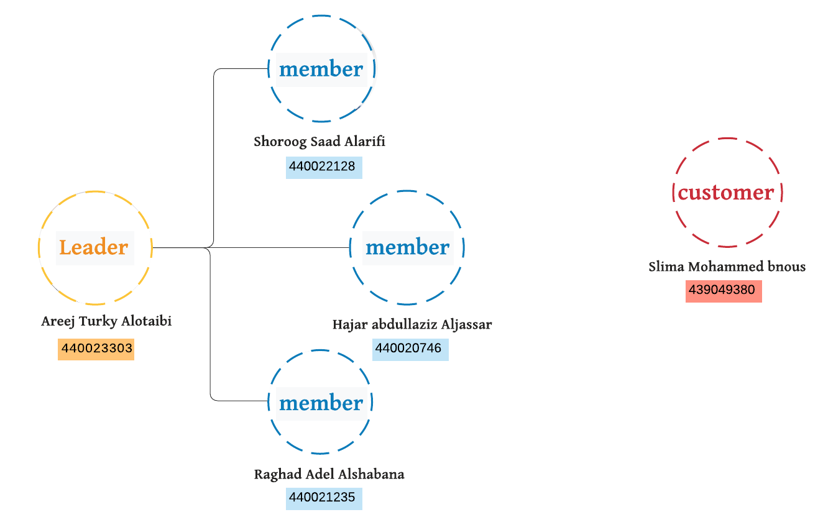
Team contribution
Objective
Product
Model
Scop
Product
Introduction

Slide 3
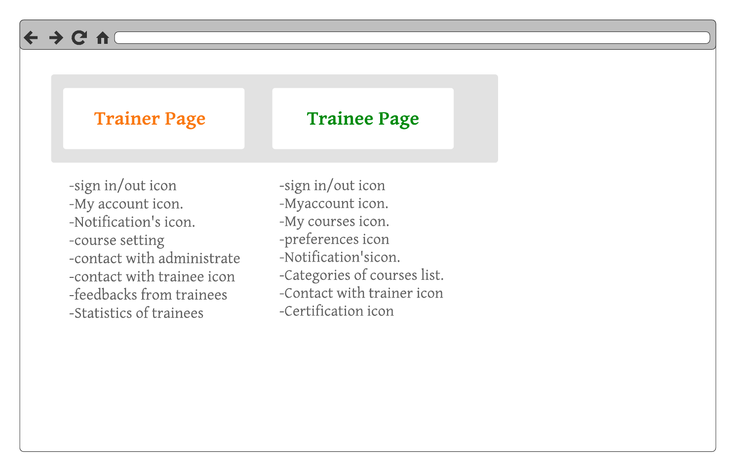
Contents :
1- Introduction
2- Charts
3-Pattern
4- prototype
User case
system
Model
Scop
Aim
Definition
Introduction
Content
Product vision

Slide 4
It’s an Electronic training platform system to help our target users to know more about what they do, the system offers different courses in various languages under different categories, in addition the system allow trainers to participate and post new courses, that will help them to find their course easier and in an efficient manner.
Team contribution
Product
Scop
Product
Model
Objective
Introduction
Notes:
salema

Slide 5
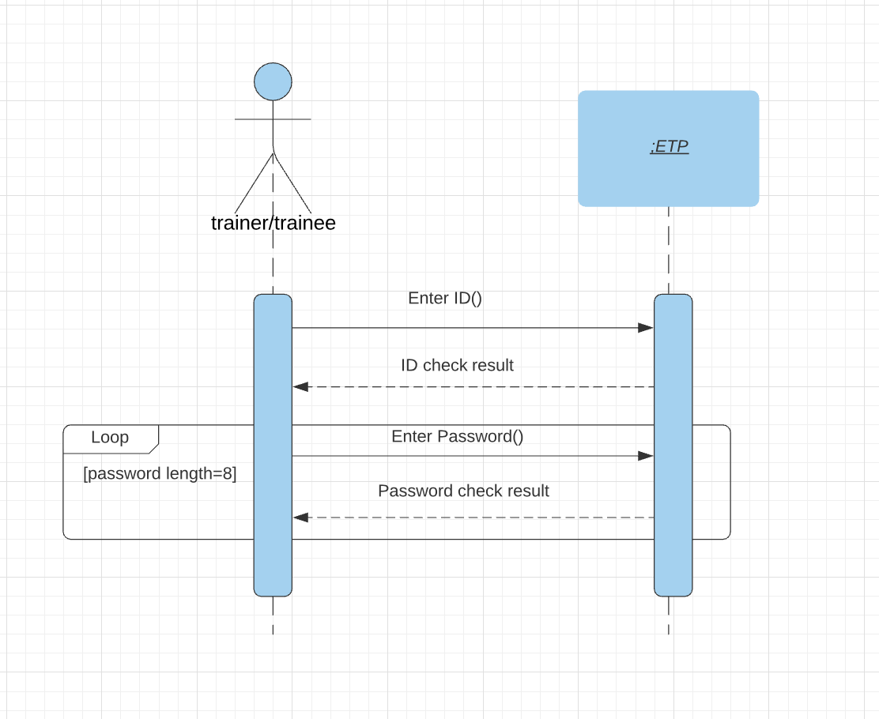
Sign-up for trainer/trainee :
Team contribution
Objective
Team contribution
Scop
Product
Model
Product
Introduction
Notes:
salema

Slide 6
-To make workers do their work in efficient manner
-To make workers of PoTHMs closer to their presidency without need to be in place
- To open the door for companies to provide courses through the platform
Team contribution
Objective
Product
Model
Scop
Product
Introduction
Notes:
salema

Slide 7
When we were choosing the model, two points were taken into consideration, which were mentioned in the RFP (Seventh part), and they are:
- The possibility of change and development in the next versions
- The importance of the developer's presence at every step with the presentation of developments
Also, some requirements were clearly not sufficient, so there was a team member who played the role of the client urging that he would be a key member in the meetings to delete / add and amend something from the requirements.
Therefore, the choice was made to be Agile, not a plan driven model, but XP or Scrum? Both models work on increasing and iterative work, but a member of the team had a specific responsibilities in the work of a certain part without the need for the work to become presented to everyone and everyone is responsible for all tasks.
Team contribution
Model
Scop
Product
Objective
Introduction
Notes:
Areej

Slide 8
The working group meetings were almost daily, with an estimated 10 meetings. The meeting is held to ask about three main points: the outputs of the previous meeting, the planning, and the outcomes of the next meeting.
there are questions we were asked in the first 3 meeting:
who? what? why? for example:
"As an admin, I want to access all the platform, so I can check the outcomes of the program".
The Iterative work were expressed in our work as one lightly task repeated in many times, for example: Description were progressed many times in the beginning, BRS and SRS and so on.
Also, in Effort Estimation, the team sought to fully take advantage of the number of main functionalities, number of group members and the remaining amount of effort. (Planning Poker)
The diagram below shows the progress of work from receiving the product until submitting our work.
Team contribution
Objective
Product
Model
Scop
Introduction
Notes:
Areej

Slide 9
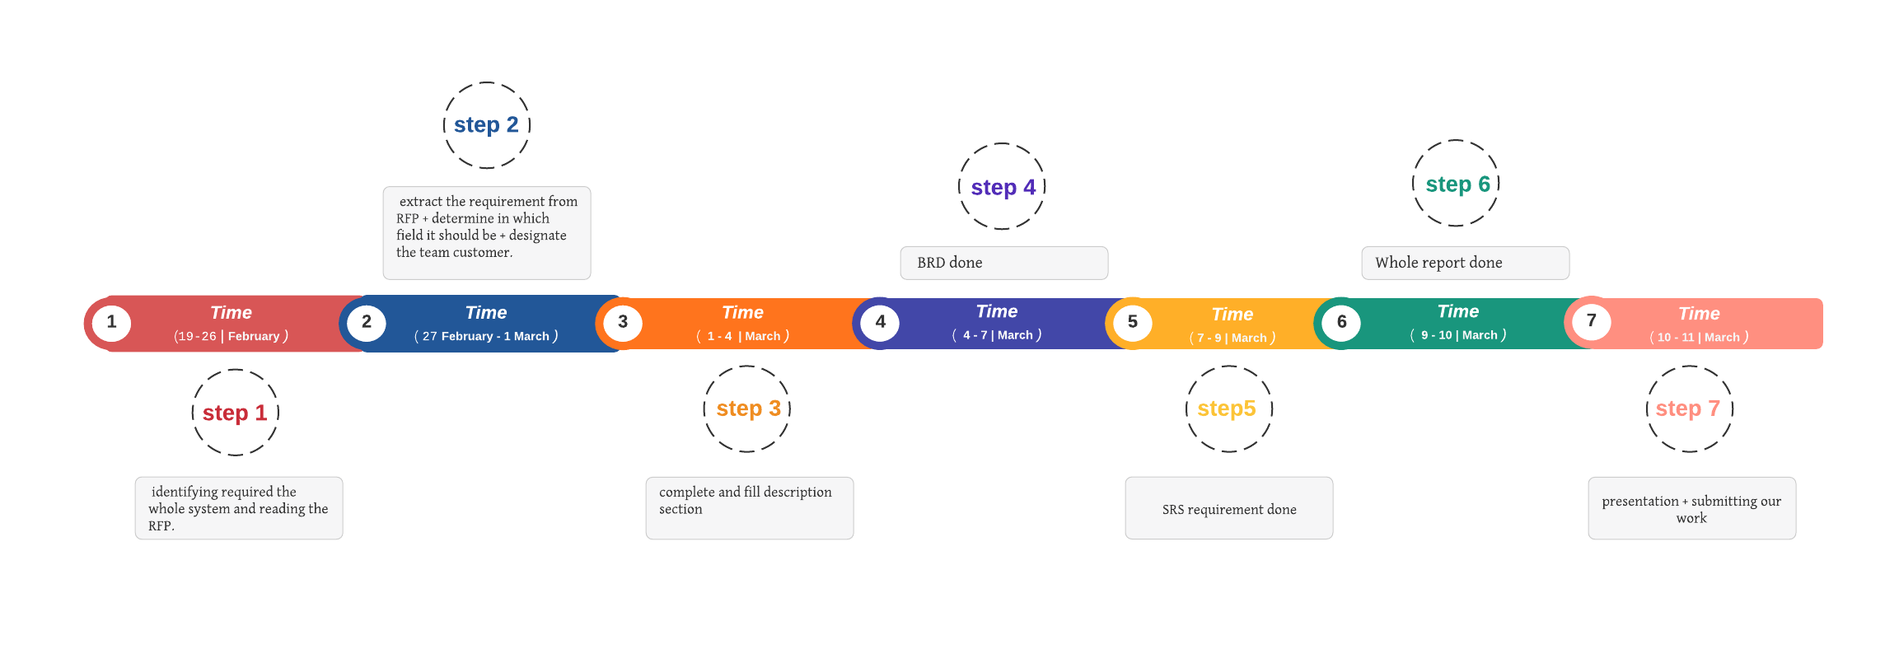
Team contribution
Objective
Product
Model
Scop
Introduction
Figure 1: Timeline
Notes:
Areej

Slide 10
ToDo List
Story | Estimation (per day) | Priority
As an Admin, I want to have the access to all aspect system, so I can rate my product. | 5 | 1
As an Administrator, I want to have the access to my section, and providing statistic, so I can provide Suggest for improvement. | 4 | 2
As an Administrator, I want to approve/disapprove trainers, so I can determine the workers of my section. | 3 | 1
As an Admin, I want to communicate with training bodies to provide courses. | 2 | 3
As an Admin, I want to have a unique ID to all my staff, so we can join to the system easily. | 3 | 5
As a trainer, I want to communicate with my trainee, so they can ask me, contact with me. | 1 | 3
As a trainee, I want to see all aspect courses, so I can choose any course. | 2 | 4
Total | 20
Team contribution
Objective
Product
Model
Scop
Introduction
Figure 2: product backlog
Notes:
Areej

Slide 11
 | Task description | Duration | People (#workers)
Task 1 | Identifying the system | 5 days | 5
Task 2 | Reading RFP and extract its requirement | 3 days | 5
Task 3 | Customer member Identify new requirement +preparing the template | 2 days | 2
Task 4 | Start filling the template + the rest record the requirement and analyze it | 2 days | 5
Task 5 | Determine BRS system | 4 days | 5
Task 6 | Determine SRS system + preparing the whole report | 3 days | 5
Task 7 | Whole report is done | 1 day | 5
Team contribution
Objective
Product
Model
Scop
Introduction
Figure 3: sprint backlog
Notes:
Areej

Slide 12
Student Name | Role and Responsibilities
Areej Turky Alotaibi | Leader, Fill the Template and Use case#6
Raghad Adel Alshabana | Member, Non-Functional Requirement and Use case#1,2,3
Slima Mohammed bnous | Customer of the team, Use case diagram and presentation
Shoroog Saad Alarifi | Member, Functional Requirement and Use case#5
HAJAR abdullaziz Aljassar | Member, Functional Requirement and Use case#4
Objective
Team contribution
Scop
Product
Model
Introduction
Table 1: Team Contribution
Notes:
Areej

Slide 13
Product Vision :
PoTHMs worker shall have a full knowledge to what they work for without needing to be nearly to PoTHMs.
Product Usability :
Can visitors find the information they need?
Can users easily find The products?
Objective
Model
Scop
Product
Introduction
Product component :
System Admin Control Panel
Administrator dashboard
A Cpanel for registrants on the site
Trainees + Trainer control panel
Website registration plate + login
Course review page and website services
The list of services used by them
Notes:
hajer

Slide 14
User Characteristics
Intended users are all PoTHMs workers, administrative and anyone who related to the presidency.
PoTHMs welcomes anyone who interested to the presidency.
Intended Technology
The platform compatible with tablets and mobile devices, and the application is compatible with Android system devices and Apple system devices.
Challenges
Lack of availability of information.
The team does not know each other, and thus causes slow workflow.
SOLUTIONs :
Every member chooses a specific task that she has a good background of it.
Daily meeting help us to understood each other clearly .
User case
system
Model
Scop
Aim
Definition
Introduction
Product vision
Notes:
hajer

Slide 15


Customer
Notes:
salema

Slide 16
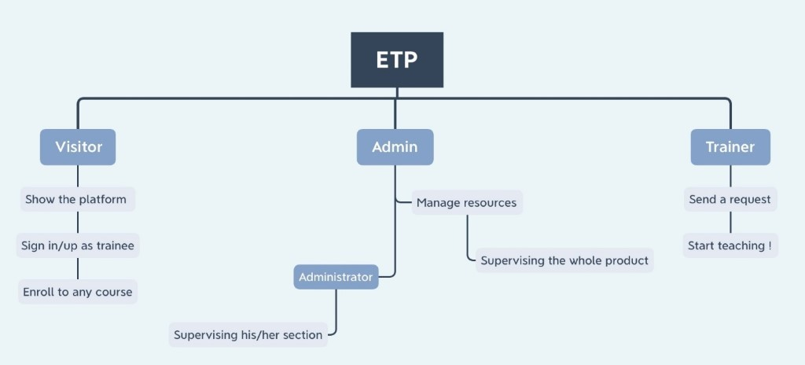
Activity diagram:
User case
system
Model
Scop
Aim
Definition
Introduction
Product vision
Notes:
shoroog

Slide 17
-The platform should be compatible with tablets and mobile devices, and the application is compatible with Android system devices and Apple system devices.
- Considering the ease of use in displaying the contents of the system.
-Considering the appropriate Islamic colors and design for the platform and site of the Presidency of the Two Holy Mosques with the development of the logo for the Presidency, and that the design is uniform for the website and application.
- Platform details can be viewed and browsed through the default home page without logging in as a visitor.
-Stages of order on the site: (New - under process – completed) in addition to sending Email alerts at each request stage.
User case
system
Main
Functionality
Model
Scop
Main
Functionality
Aim
Definition
Introduction
Product vision
Notes:
hajer

Slide 18
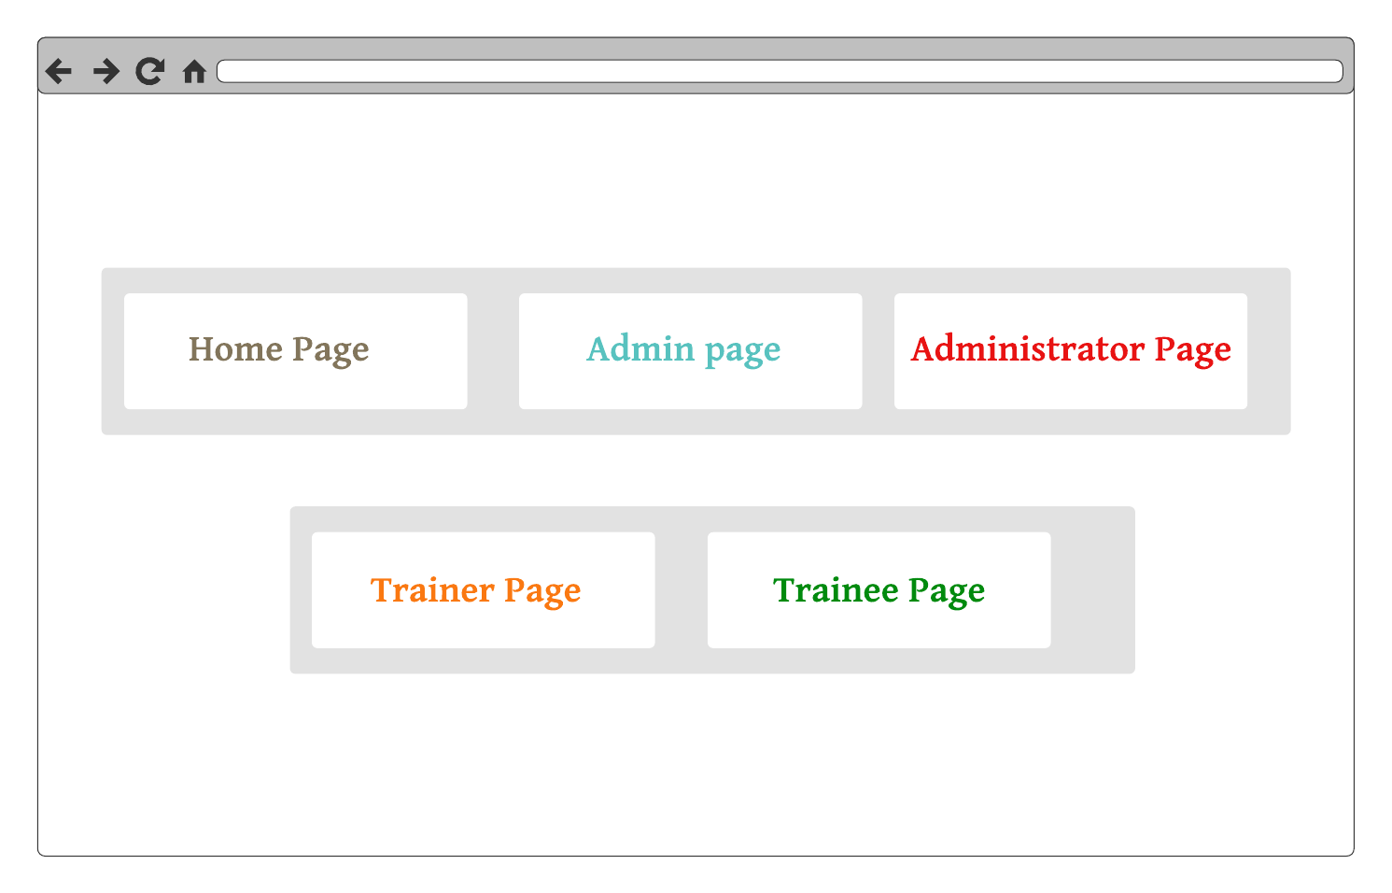
Functional Requirements
User case
system
Model
Scop
Specific
Requirements
Aim
Definition
Introduction
Product vision
Notes:
shoroog

Slide 19
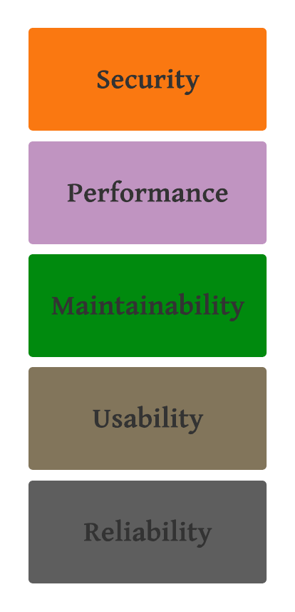
Non Functional Requirements
User case
system
Model
Scop
Specific
Requirements
Aim
Definition
Introduction
Product vision
Notes:
Raghed

Slide 20
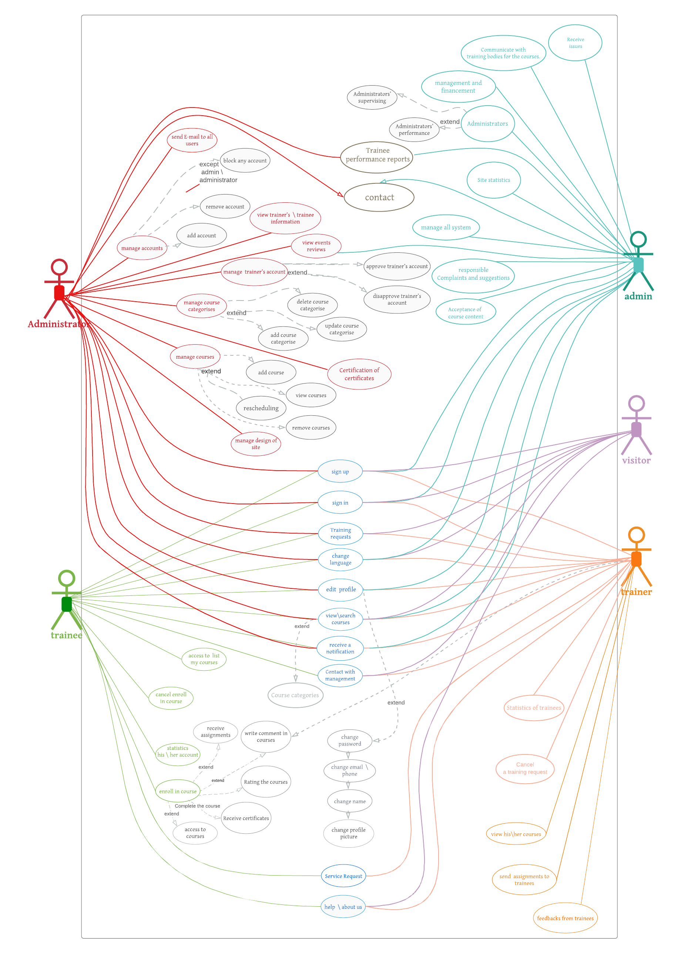
User case
system
Diagram
Model
Scop
Aim
Definition
Introduction
Use Case
Product vision
Notes:
salema

Slide 21
Use case: | Sign-up
Goal: | To sign up to the website
Actor: | Trainee/trainer
Trigger: | Trainee/trainer select the sign-up button from the home page
Scenario: | The use case starts when the Trainee/trainer select the sign-up button from the home page Trainee/trainer writes their first name and last name in names area Trainee/trainer writes their username in the username area Trainee/trainer writes their phone number or e-mail in contact area Trainee/trainer writes a specifies the correct choices to ensure that the user is not robot. Trainee/trainer writes their password that should contain 8 characters in form of letters, numbers, and symbol. Trainee/trainer select sign up button.
Extensions: | 3.A. The username is unavailable (used before). 2.A.1 Trainee/trainer tries with another username. 4.A. phone number or E-mail may be invalid 4.A.1. Trainee/trainer writes correct phone number or e-mail 4.A.2. Trainee/trainer tries with another phone number or e-mail 5.A The choices of user are incorrect. 5.A.1 . Trainee/trainer tries again. 6.A. The Trainee/trainer may not write 8 characters. 6.A.1. Trainee/trainer writes their password again
1
User case
system
Model
Scop
Aim
Definition
Introduction
Use Case
Product vision
Notes:
Raghed

Slide 22
Use case: | Sign-in as a trainee
Goal: | To sign-in to the website
Actor: | Trainee
Trigger: | trainee selects the sign in button from the home page
Scenario: | 1. The use case starts when the trainee selects the sign in button from the home page trainee writes the username in the username area . trainee writes the password . trainee selects sign in button.
Extensions: | 2.A. The username is ( incorrect ). 2.A.1 trainee tries again. 3.A. The password is ( incorrect ). 3.A.1. trainee writes password again. 3.A.2 trainee click on ( forget password) : 3.A.2.1 trainee write her/his e-mail. 3.A.2.2 trainee will receive on the e-mail new password suggested randomly by the system. 3.A.2.3 trainee should enter the new password for the first time. 3.A.2.4 trainee can change the password .
2
User case
system
Model
Scop
Aim
Definition
Introduction
Use Case
Product vision
Notes:
Raghed

Slide 23
Use case: | Add a new course.
Goal: | To add a new course to the system
Actor: | administrator
Trigger: | The administrator selects add course from course setting in his/her home page.
Scenario: | The use case starts when the administrator receives the course content from the admin. Administrator goes to the course setting icon. administrator selects add course option. Administrator selects the proper category to add this course to system displays add course form. Administrator fills the form about the course’s content according to course’ title, description, duration, target trainees, trainer name. Administrator links the corresponding trainer with the new course. administrator selects submit button.
Extensions: | 1.A reception process failed. 1.A.1 Administrator try to refresh the page. 1.A.2 Administrator informs the admin about the malfunctioning. 1.A.2.1 admin try to send it again. 1.A.2.1 admin contact with technical support 4.A Administrator does not select the category to add the course to 4.A.1The system keep asking until the Administrator selects one of the categories. 6.A Administrator made gaps to some of the required information about the new course. 6.A.1 The system keep notify the administrator and cannot submit until the Administrator fill them 6.A The course’ title is unavailable (used before). 6.A.1 Administrator tries with another available course’ title. 7.A Administrator link the course with wrong trainer. 7.A.1 Administrator delete the course from the wrong trainer and relink the course with the right trainer.
3
User case
system
Model
Scop
Aim
Definition
Introduction
Use Case
Product vision
Notes:
shoroog

Slide 24
Use case: | Submit a training request
Goal: | To Submit a training request for the opportunity to train trainees on the website
Actor: | user
Trigger: | user selects the training on ETP button from home page
Scenario: | 1. The use case starts when the user selects the training on ETP button from the home page 2. user uploads his/her CV in upload CV area. user selects submit button.
Extensions: | 2.A. The upload is failed . 2.A.1 user tries upload again. 2.A.2 user click on ( Help icon ). 2.A.2.1 user searches for the question related to his/her problem. 2.A.2.2 user will take the same steps as the mentioned solution. 2.A.3 user click on ( contact icon ). 2.A.3.1 user will contacts with administrator by phone number or by an e-mail.
4
User case
system
Model
Scop
Aim
Definition
Introduction
Use Case
Product vision
Notes:
hajer

Slide 25
Use case: | Enroll to courses
Goal: | Enroll to any courses in any time to achieve knowledge
Actor: | Trainee
Trigger: | trainee selects the “Enroll now” button in the course overview.
Scenario: | The system shows categories courses. Trainee select specific category. System show the trainee courses in this category. Trainee has to choose between courses 5. trainee enter the button of “Enroll now” button in the course overview. 6. System put the course in the my course section Trainee finds his/her course in my courses.
Extensions: | 2.A. The course is no longer available. 2.A.1. Trainee tries with another course 3.A. No courses in this category. 2.A.1. Trainee tries upload the page/close and open if it’s in the application. 2.A.2 Trainee tries with another category. 4.A Trainee doesn’t find his/her course in my courses. 4.A.1 Trainee shall contact to Complaints and suggestions then it will send to the IT team.
5
User case
system
Model
Scop
Aim
Definition
Introduction
Use Case
Product vision
Notes:
Areej

